Slide 1
SESAME’S Control System
Presented by: Ibrahim Saleh
Workshop: PLC Based Control Systems : SA1E
Date: 07.10.2017

Slide 2
What is SESAME?
SESAME (Synchrotron-light for Experimental Science and Applications in the Middle East)
Location: Allan, Jordan
A “third-generation” synchrotron light source that was officially opened on 16 May 2017
It is expected to become operational in late 2017. Storage ring is currently under commissioning.
It is the Middle East's first major international research centre
The current Members of SESAME are Cyprus, Egypt, Iran ,Israel, Jordan, Pakistan, Palestine and Turkey.

Slide 3
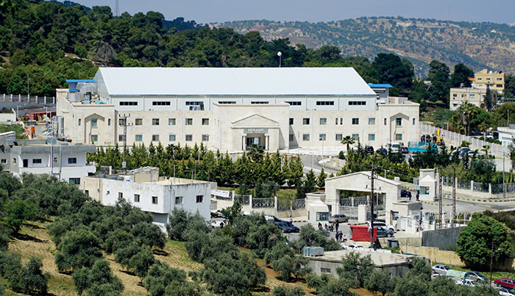
What is SESAME?

Slide 4
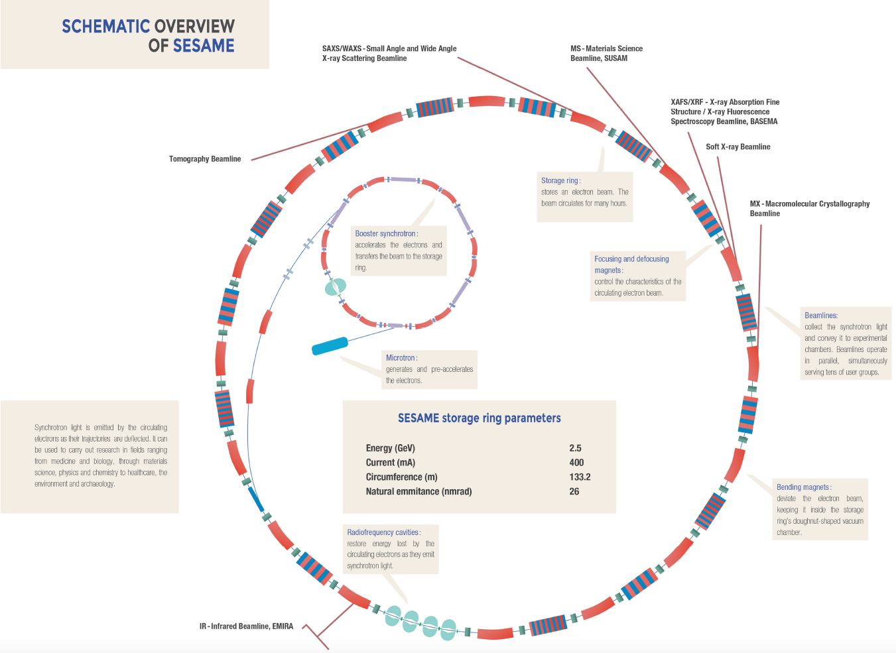
SESAME Information
Energy; 2.5 GeV
Circumference; 133m
Emittance; 26 nm-rad
Space for future full energy injector in the storage ring tunnel
Day One Beamlines:
XAFS/XRF
Infrared

Slide 5






Control System Overview
Control system implementation uses
(EPICS) base 3.14.12
Clients implementation uses Control System Studio (CSS) based on V.3.16
Development and administration
platforms use Scientific Linux 6.4
Git version Control System is used
to track development & documentation
Siemens S7-300 PLCs are used for the Machine Protection System (MPS)
Allen Bradley PLC is used for the
Personal Safety System (PSS).

Slide 6
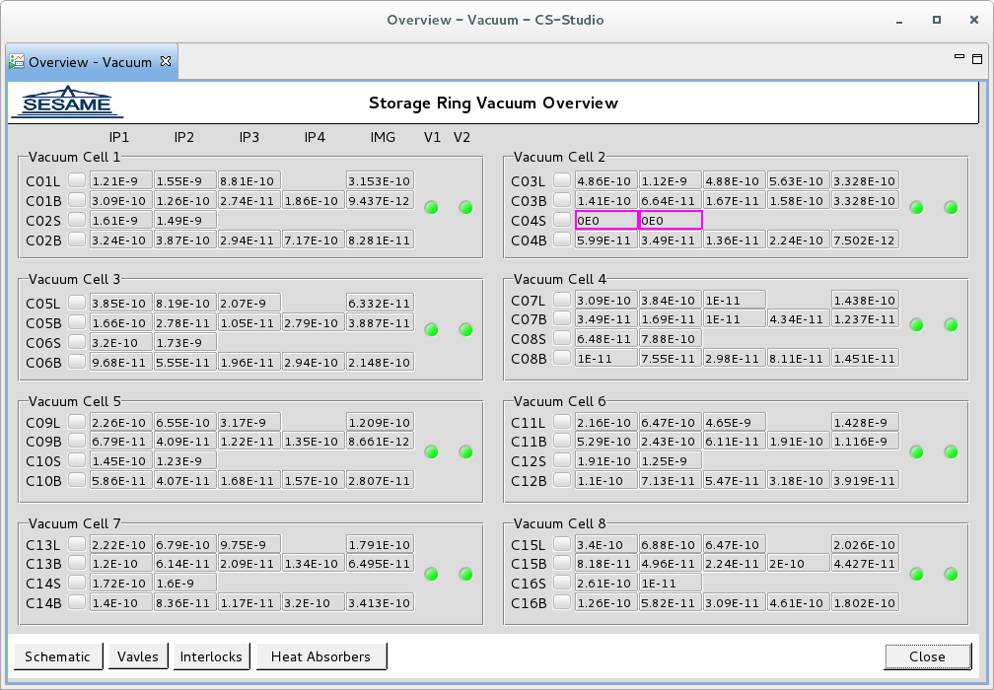


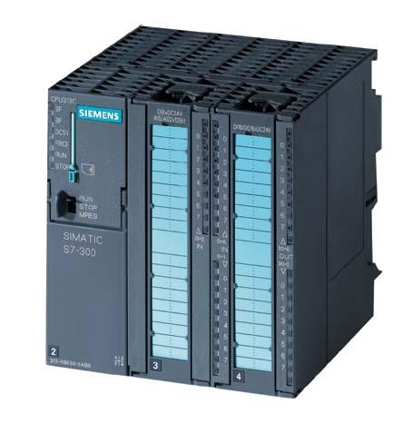
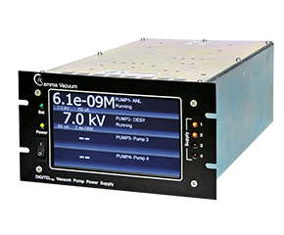

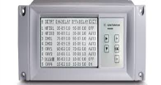
Vacuum Control System
Device | Brand | Control Interface
ION Pump Controller | Digital QPC (Gamma Vacuum) | Ethernet
Gauge Controller | XGS-600 (Agilent) | RS232, I/O
Gate Valve | VAT | I/O
CSS OPIs
Vacuum IOC
Network
MOXA
PLC
ION Pump Controller
Gate Valve
Gauge Controller

Slide 7
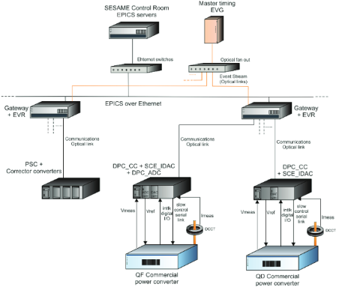
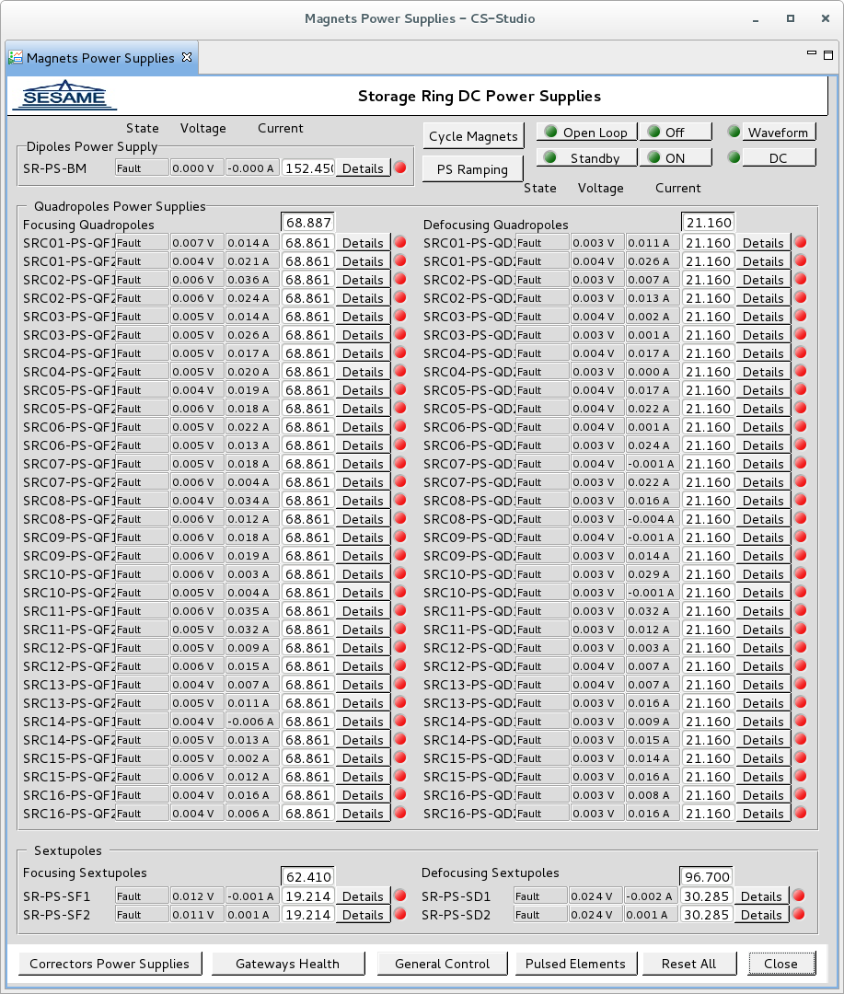
Power Supplies Control System

Slide 8
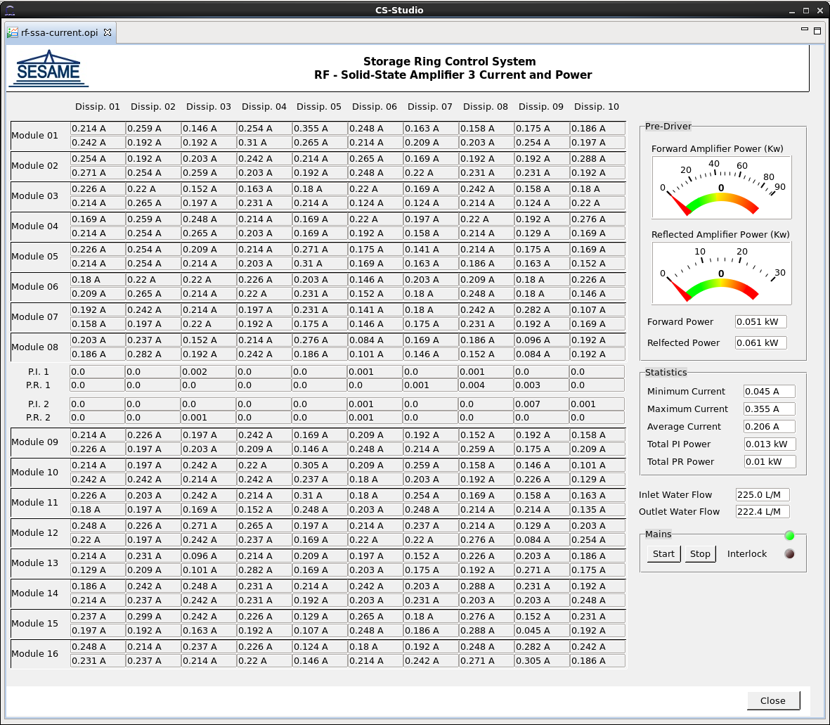

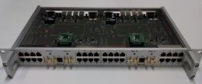


RF Control System
Device | Brand | Control Interface
LLE | Dimtel | Ethernet
Cavities | ELETTRA | I/O
Amplifiers | SEGMA-Phi | Ethernet (MUX Board)
Motion Controller | Galil | Ethernet
Signal Generator | Work Microwave | Ethernet
CSS OPIs
RF IOC
Signal Generator
Network
MUX
Motion Controller
PLC
Cavities Motors
LLE
Amplifiers
Cavities Cooling

Slide 9
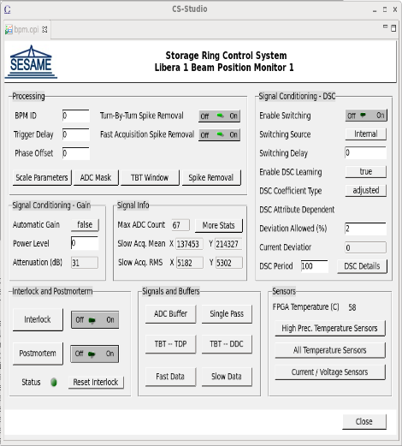
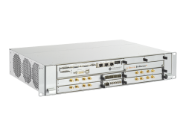
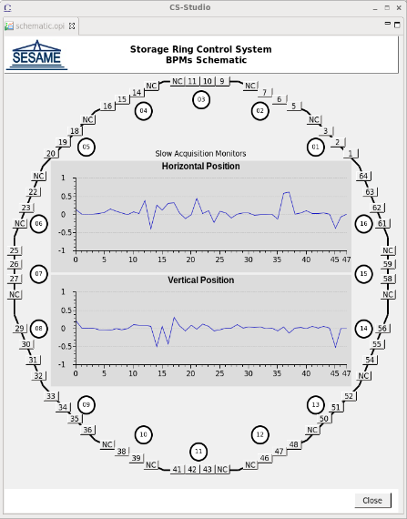

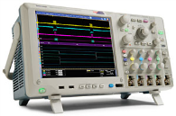
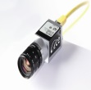

Diagnostics Control System
Device | Brand | Control Interface
Libera Brilliance+ | I-tech | Ethernet
Florescent Screens | VAb | I/O
Shaker | In-house | RS232, I /O
Function Generator | Tektronix | Ethernet
Oscilloscope | Tektronix | Ethernet
Motion Controller | Galil | Ethernet
Camera | Basler | Ethernet
Digital Voltmeter | Agilent | Ethernet
RF Switchers | NA | I/O
DI IOC
Libera Brilliance+
Network
Shaker
Motion Controller
Scope
PLC
Scraper, FS
DVM
GigE CAM
FS, Switchers

Slide 10
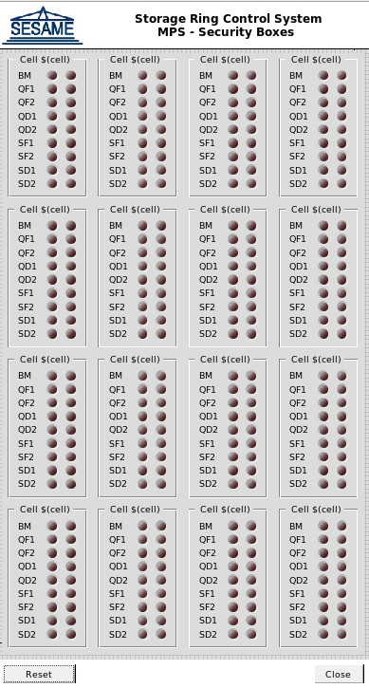
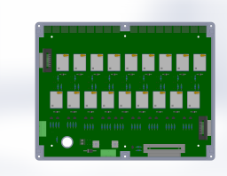
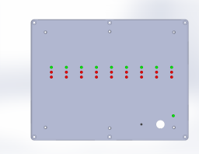
Cooling Control System
Device | Brand | Control Interface
Security Box | In-House | I/O
CSS OPIs
Cooling IOC
Network
PLC
Security Box
Flow Switches, Thermal Switches

Slide 11
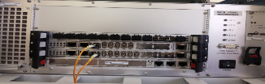

Timing System Control Status
CSS OPIs
Timing IOC
Device | Brand | Control Interface
Event Generator | MRF | Ethernet
Event Reciever | MRF | Ethernet
Network
EVG
Optical Fanout
Gateway 6 EVR
….
Gateway 1 EVR
Storage Ring EVR
Booster EVR
Power Supplies Triggers
Main Splitter
Devices Triggers
Splitter 4
…. Splitter 1
Devices Triggers
Liberas
Machine Clocks
Cameras
Scopes

Slide 12
PLC Systems at SESAME
Purpose: Machine protection for each sub-system
PLC: SIEMENS S7-300
Software: STEP7, TIA PORTAL
Programming Language: Ladder Logic
CPUs: CPU314, CPU315-2DP
I/O Modules: DI32, DO32, AI8, A08, TC8
Communication Modules: CP-343-1, CP342-5
Communication Protocols: PROFIBUS, PROFINET
Distributed I/O Modules: ET200M (IM153-4)

Slide 13
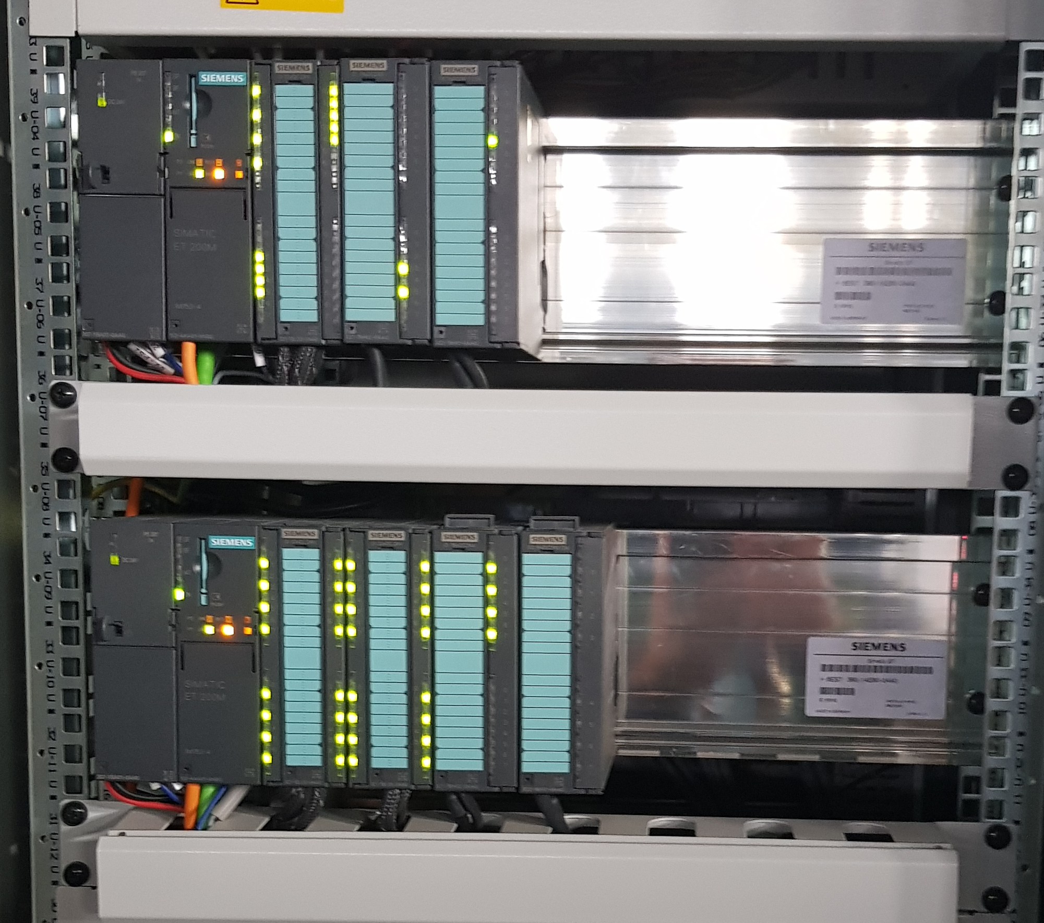
PLC Systems at SESAME
Nine CPUs and set of I/O modules are used for the following sub-systems:
Microtron (CPU315-2DP)
Transfer Line 1 (CPU315-2DP)
Booster Vacuum & Diagnostics (CPU315-2DP)
Booster Cooling & Power Supplies (CPU315-2DP)
Booster RF (CPU314)
Transfer Line 2 (CPU314)
Storage Ring Vacuum & Diagnostics (CPU314)
Storage Ring Cooling & Power Supplies (CPU314)
Storage Ring RF (CPU315-2DP)

Slide 14
PLC Programming - Strategy
Building the programming in an organized way
Make it easy to be modified
Make it easy for troubleshooting
Assign One Function Block (FB) for each device which will
have the main logic for that device.
Assign number of instance Data Blocks (DB) depends on
the number of devices for each sub-system.
Calling all FBs inside one Function (FC) or more
Calling all the Functions (FCs) inside the main Organization Block (OB)

Slide 15
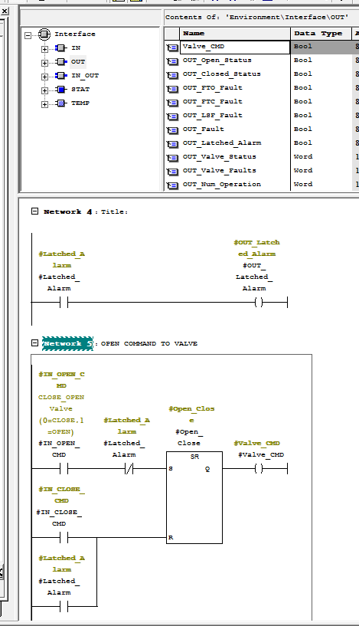
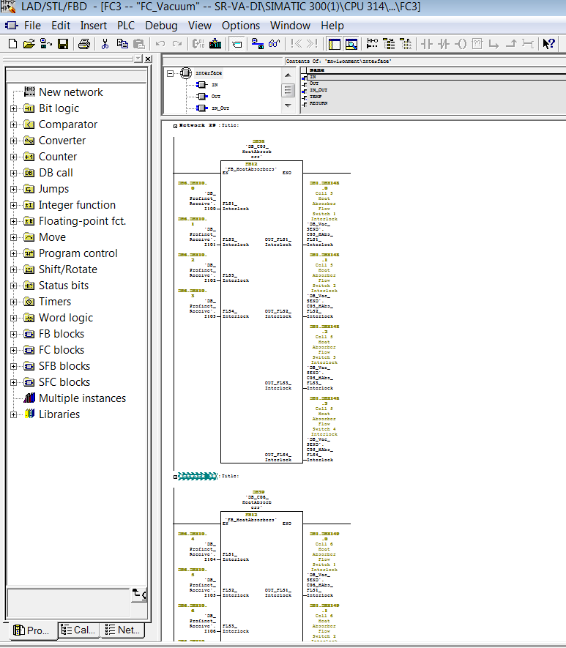
PLC Programming - Strategy
FB
FC

Slide 16
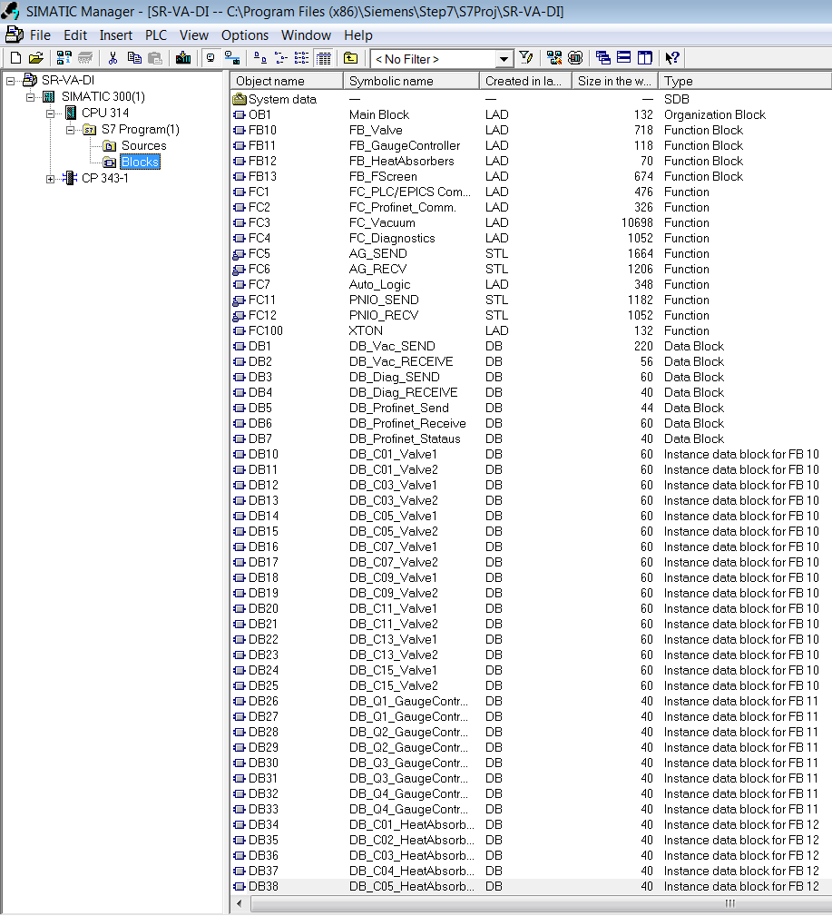
PLC Programming - Strategy
Main Blocks

Slide 17
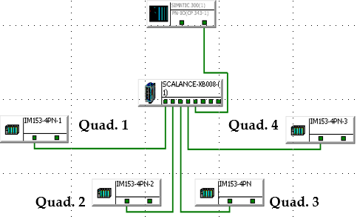
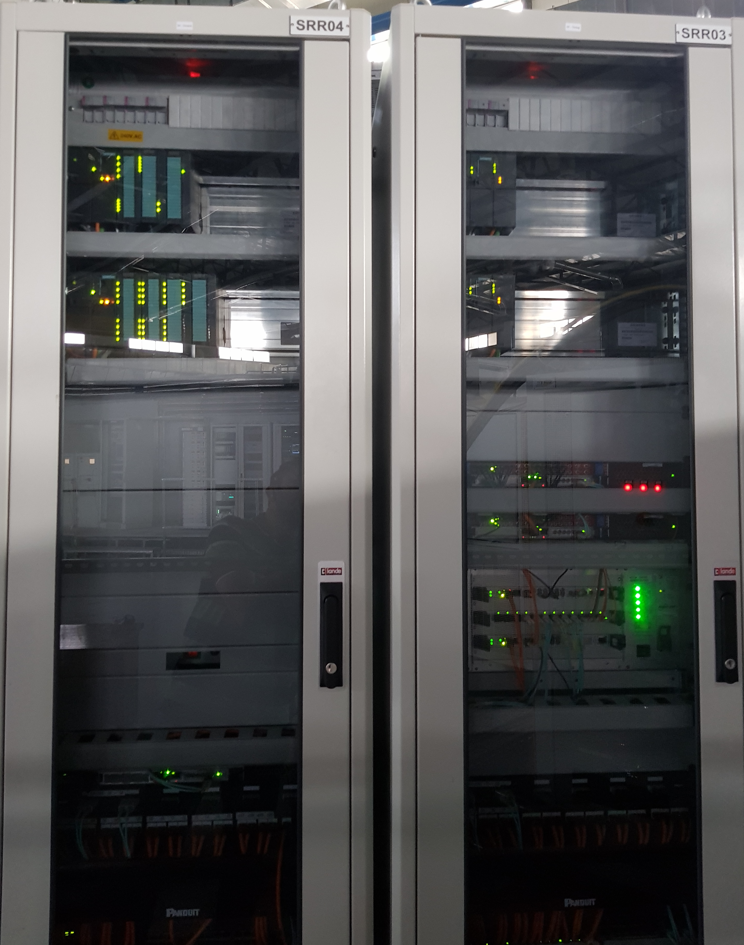
Distributed I/O modules
Storage Ring signals are distributed
into 16 cells and 4 quadrants.
Putting the PLC modules in one place will
not be possible because of cabling.
Using distributed I/O modules
ET200M (IM153-4) based on Profinet
communication was the solution.

Slide 18
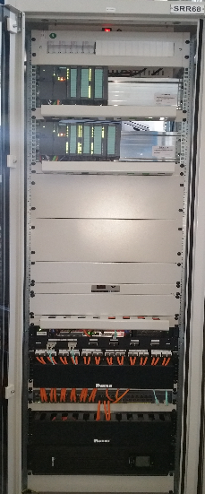
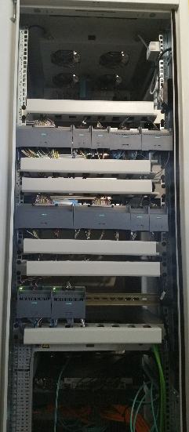
PLC Hardware and Cabling
Organize the PLC modules inside the racks
Organize cables inside the trunks
Installing Terminal Blocks
(Simatic Top Connect, ABB)
Labeling is important
Adding space for future use

Slide 19
Thank You

