Slide 1
FRIB PLC Testing & Verification Process
Kelly Davidson
Controls Department Deputy Manager

Slide 2
FRIB Controls Testing and Verification Process
Hardware for major procurements tested with Bench Test Acceptance Criterial List (ACL) Testing
Once PLC installation is complete, we perform several levels of testing
  Installation tests
  Interface tests
  Component/Connection including Interlock Tests
  Integration/Commissioning Tests include test with beam – Controls role is just support
  Test records are filed with a number and title in our Document Control Center (DCC)
Installation Test
  Testing the PLC installation using traveler procedure/checklist system
Interface Test
  Test our outputs and inputs at the point of interface to hardware devices
  Verify hardware devices have expected interface, i.e. Closed/open contact, 4-20 mA, etc
Component/Connection Test
  Connect to device hardware and verify I/O interface is working as expected, i.e. On/Off Control, readbacks, interlocks, limit status
  Verify channels in control screens work as expected
  Test Interlocks per Interlock and Alarm Document
Device Readiness Review (DRR) reviews that testing and documentation completed, as well as safety and operational concerns before final integrated testing is performed
Bench Test/ ACL
Installation/ Interface Test
Component/ Connection Test
DRR
Fully Integrated Testing

Slide 3
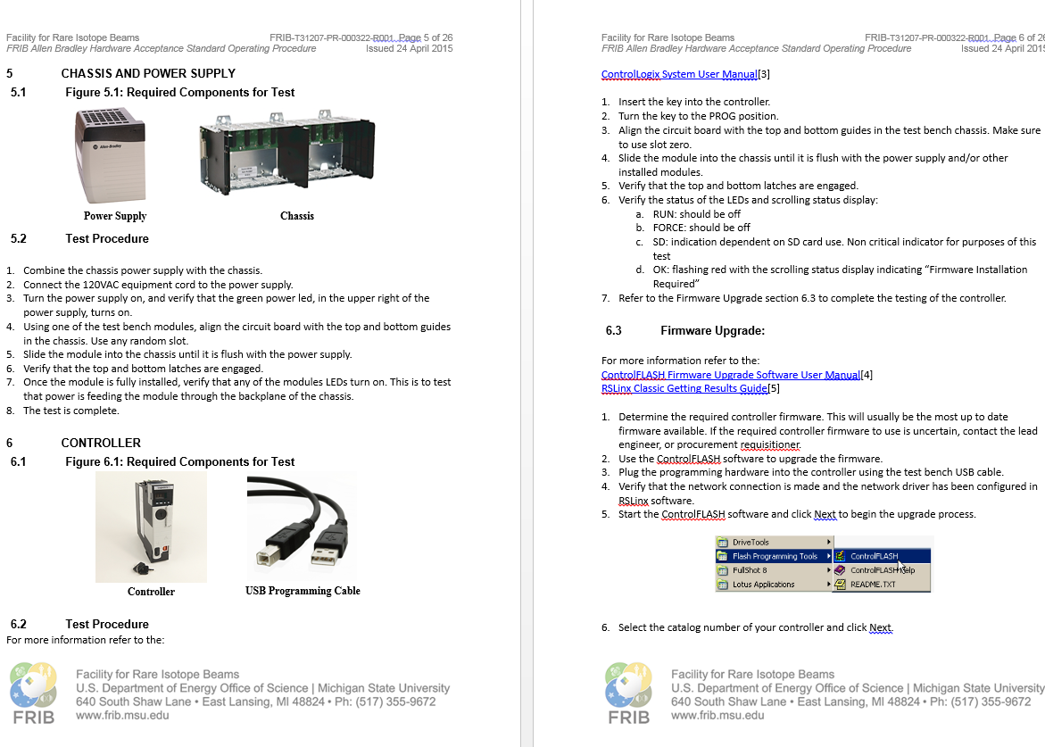
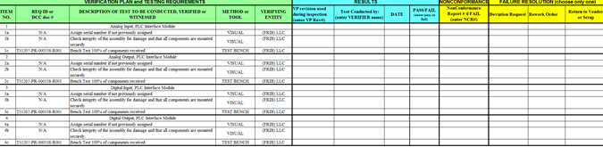
Acceptance Testing Plans Developed for PLC Hardware
New hardware tested against ACL verification plan
The Standard Operating Procedure is referenced by ACL plan and details how the ACL inspections are to be carried out
The results of the tests are recorded in a separate tab of the ACL verification report document
The results summary for the lot of modules is entered into the ACL Results section by the verifier and filed into our DCC system

Slide 4
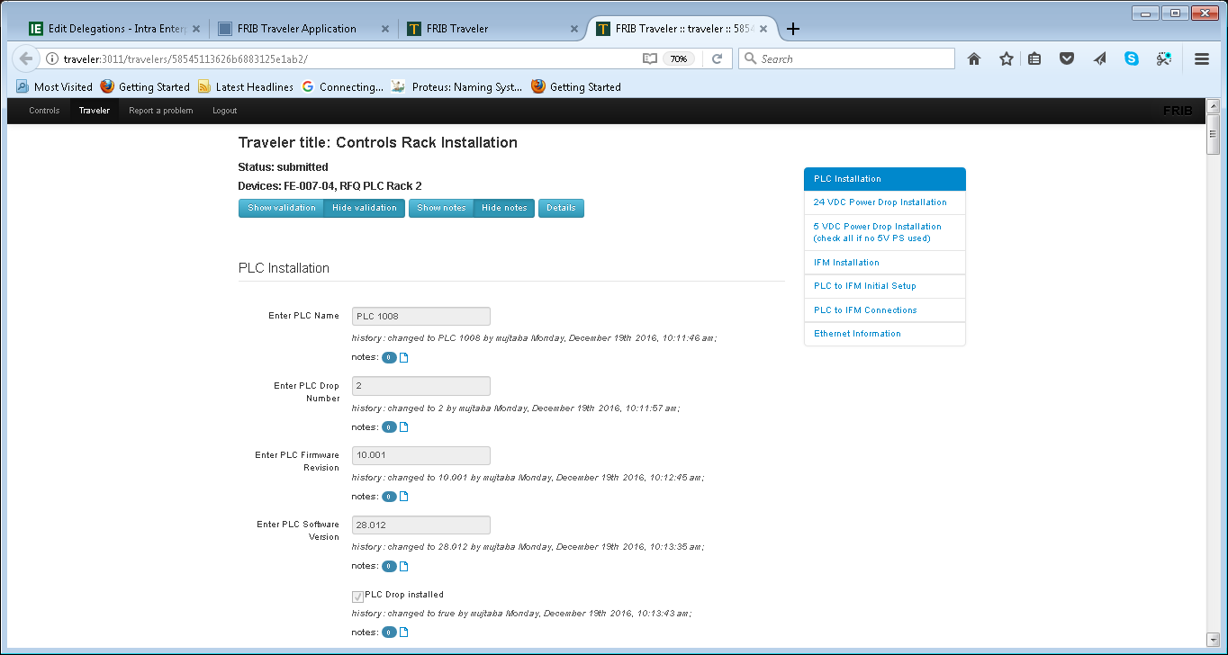
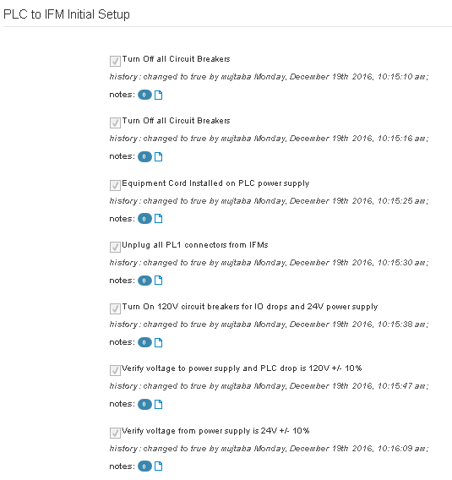
FRIB Controls Installation/Interface Tests
Installation testing uses online traveler system or spreadsheet
  Combination of procedure and checklist
  Tracks user & history

Slide 5
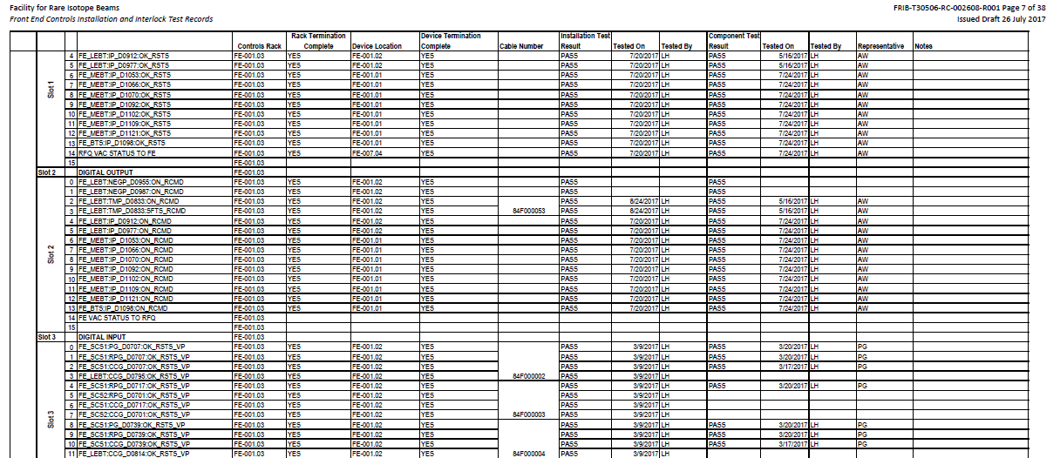
FRIB Controls Component/Connection Tests[1]
Component/Connection testing is tracked in spreadsheet and filed in DCC
  Testing verified installation/interface wiring and control connections through control screens
  Tracked by each hardwired I/O point and filed in Document Control Center

Slide 6
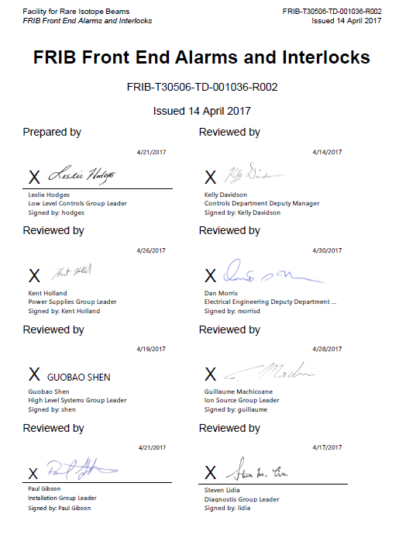
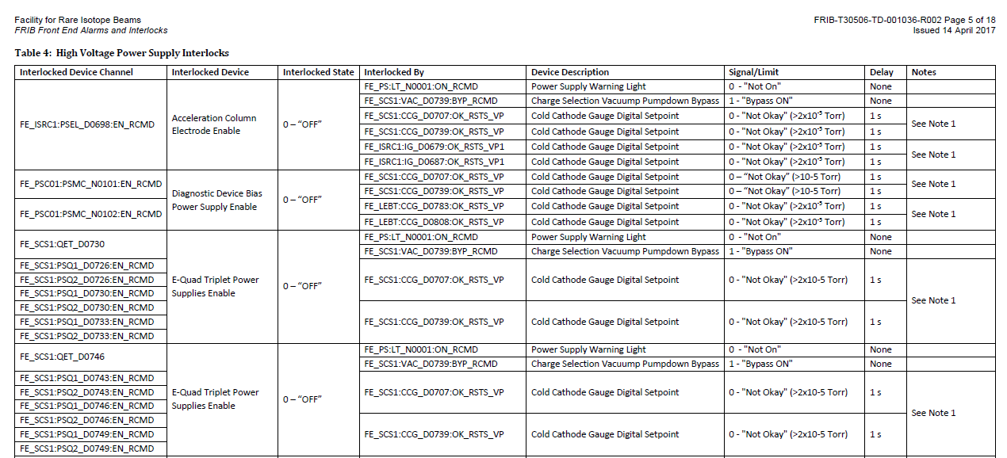
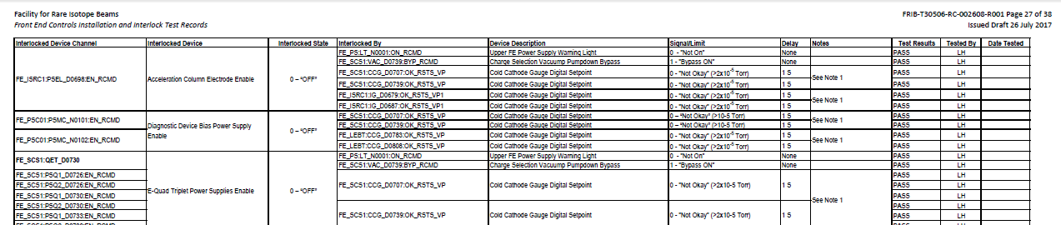
FRIB Controls Component/Connection Tests[2]
Checklists for component/connection test filed in DCC
  Alarms and Interlocks documented and signed off in DCC
  Interlocks tested per area’s Alarm and Interlocks document and results filed in Document Control Center

Slide 7
Summary
Testing completed at each level ensures quality installation and reduces engineers time troubleshooting at the final level
Beamline performs as intended on first commissioning/integration tests – reducing calls for support

Slide 8
Backup Slides

Slide 9
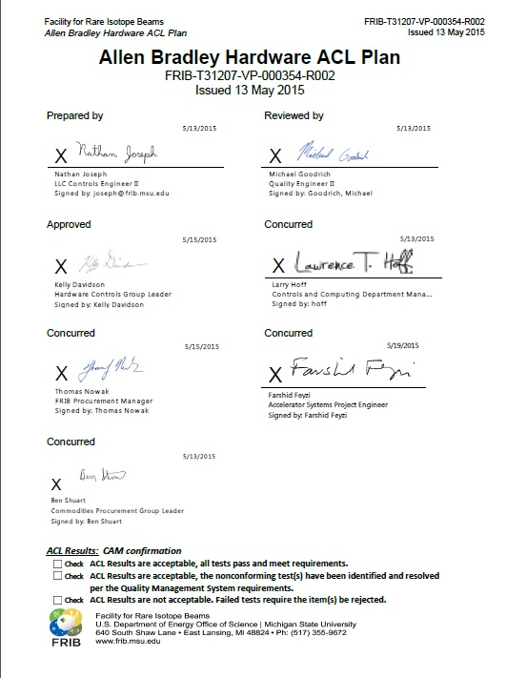
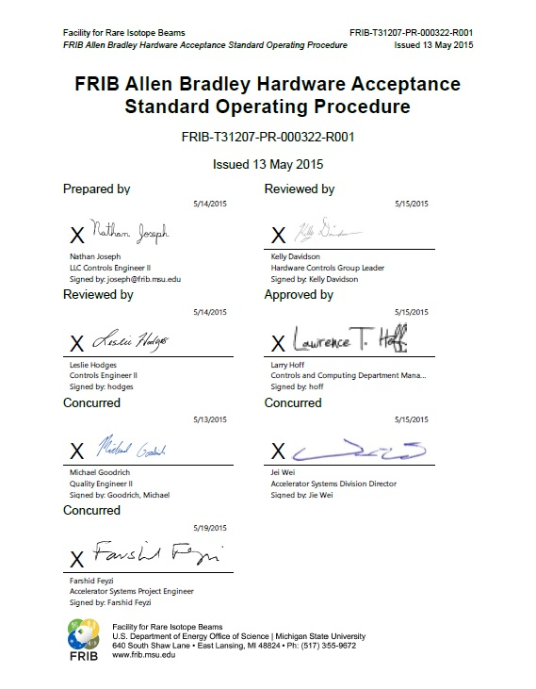
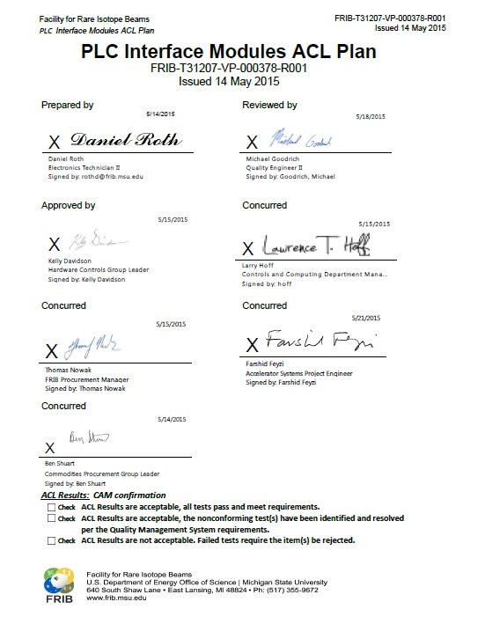
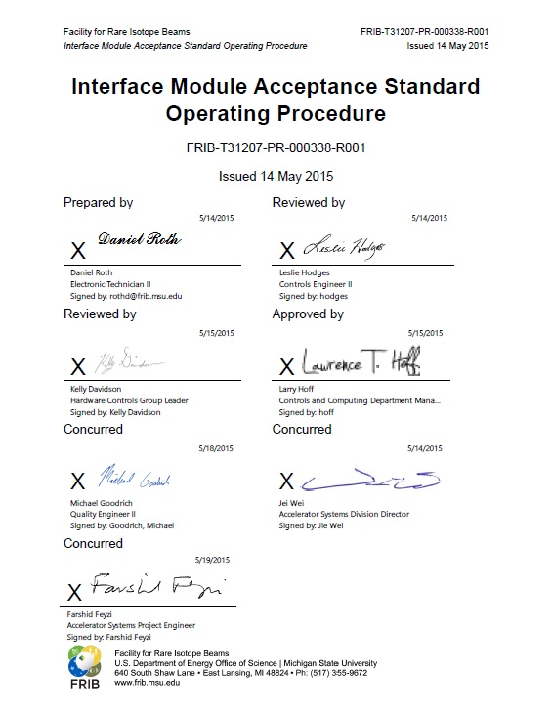
Quality Assurance - Acceptance Testing Plans Developed for PLC Hardware
Acceptance and SOP Test documents developed for PLC components and Interface Modules (IFMs),
  Allen Bradley Hardware ACL Plan (T31207-VP-000354)
  FRIB Allen Bradley Hardware Acceptance Standard Operating Procedure (T31207-PR-000322)
  Programmable Logic Controller (PLC) Interface Modules Acceptance Criteria Listing (ACL) Plan (T313207-VP-000378)
  Interface Module Acceptance Standard Operating Procedure (T3107-PR-000338)
Acceptance testing is performed once parts are received and documented in a verification report (VR)

