Slide 2
Improving the quality of PLC programs
PBCS workshop - ICALEPCS 2017
06/10/2017

Slide 3
Outline
Model checking
Static analysis
Conclusions

Slide 4
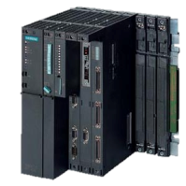
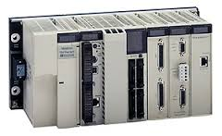
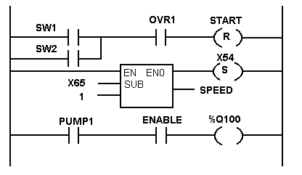

Context
BE-ICS group: Industrial Control and Safety.
PLC control systems:
  Standard and Safety Instrumented Systems.
How can we guarantee that the PLC code is compliant with the specifications?
Before: manual and automated testing
  Useful, but not efficient for every type of requirements.
  Difficult to test safety requirements:
  “if out1 is true, out2 should be false”
PLC program
Specifications
IEC 61131-3

Slide 5
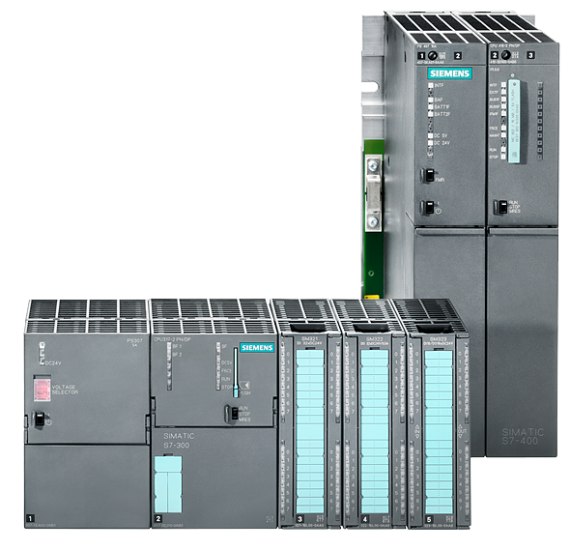
Testing vs. model checking
I0.0
PLC program
Q0.0
I0.1
IW2
IW3
Q0.1
…
Safety Requirement
If Q0.0 is TRUE, then Q0.1 is FALSE
It’s a “quite” complicated task for Testing.
Model checking will explore all input combinations and will verify the safety property

Slide 6
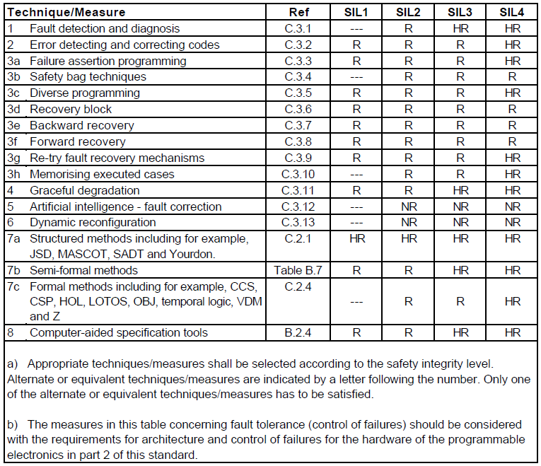
IEC 61508: Software design and dev. (table A.2)
Context
IEC 61511 gives guidelines for the “application software”
Even for SIL1 it is recommended to use [Semi]-formal methods

Slide 7
Background: Model checking
Verification
Formal
methods
Formal
verification
Testing
Formal
specification
(B, Z, Alloy, …)
Model
checking
Static analysis
Formalisms: Automata, Petri Nets, Temporal Logic
Verif. based on theorem proving

Slide 8
Idea – Problems – State of the art
Applying formal verification to PLC programs (new developments and existing systems independently of the purpose)
But…
  Why formal verification is not widely used in industry yet?
  How can we fill the gap between the automation and formal verification worlds?
Other industries using formal methods:
  NASA: Remote Agent spacecraft control system (Deep Space 1 mission).
  Aircraft industry: Airbus A340 flight control , etc.
  Train systems: Subway in Paris, Line 14.
  Communication protocols: IPv6 protocol.
  Etc.
What about formal verification in PLC based control systems?
  Industry: ESTEREL (SCADE), Siemens and ABB doing research.
  Academia: RWTH Aachen University, TU Dortmund, ENS Cachan, …

Slide 9
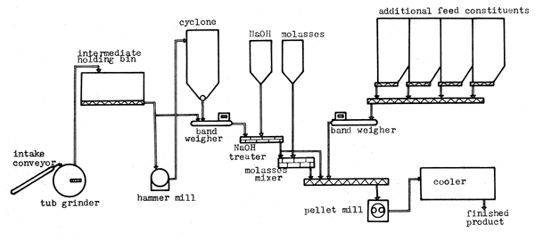
Why model checking is not widely used in automation?
Specifications
How to formalize requirements?
How to get models?
Real System
(hardware, software)
Formal
Model
Formal Requirement
Automated generation
Patterns
Which model checker should be used?
Model
checker
How to proceed with a counterexample?
satisfied
not satisfied
Multiple
(general meth.)
✓
Counter-example
Analysis & Demonstration
How to make
it efficient?
Reductions

Slide 10
Model checking vs. Testing
MC checks the specifications against a model instead of the real system.
Allows to check properties that are almost impossible to test (e.g. liveness properties).
Checks all possible combinations.
Gives a counterexample when a discrepancy is found.
Possible to automatize (can be used by non-formal method experts).
State space explosion.

Slide 11
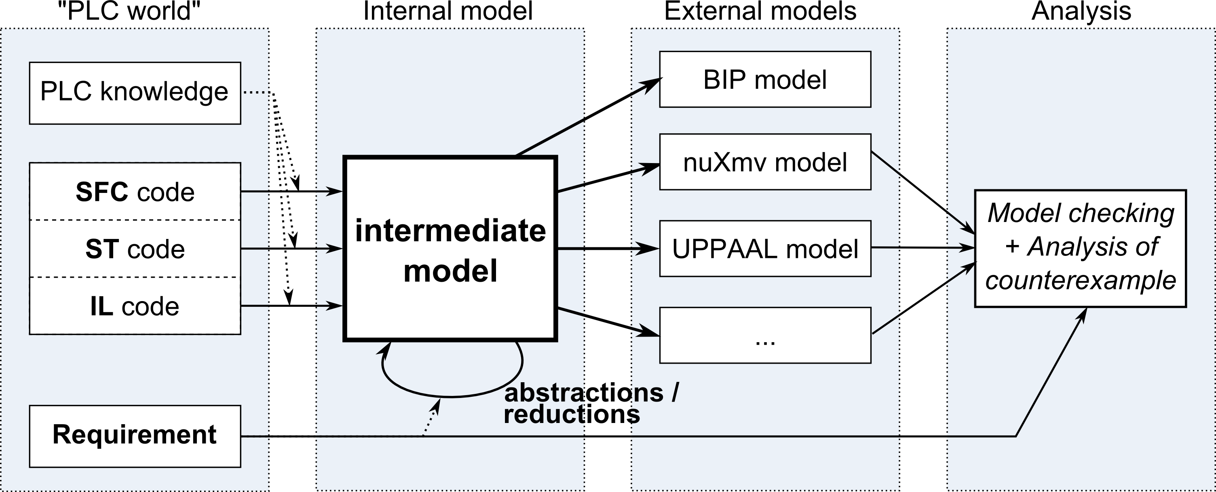
Our approach: methodology overview
General method for applying formal verification:
  Generate formal models automatically out of PLC code.
  Includes several input PLC languages
  (IEC 61131-3: SFC, ST, IL, Ladder, FBD).
  Easy integration of different formal verification tools.
2
4
Ladder
FBD
1
3
PLC formal verification at CERN: http://cern.ch/project-plc-formalmethods

Slide 12
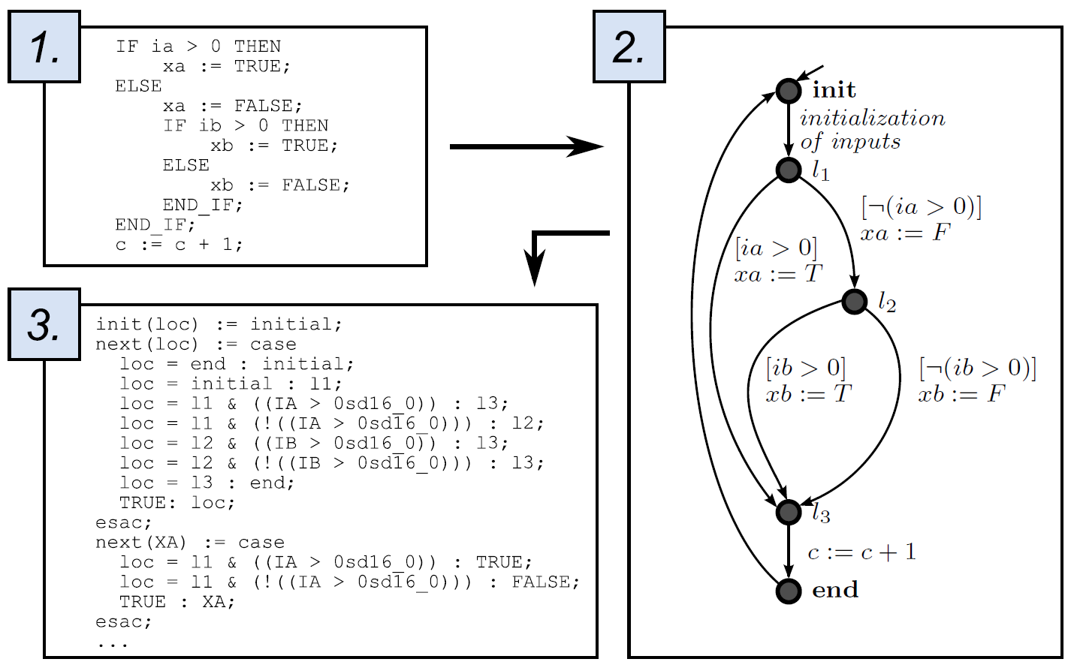
Model example

Slide 13
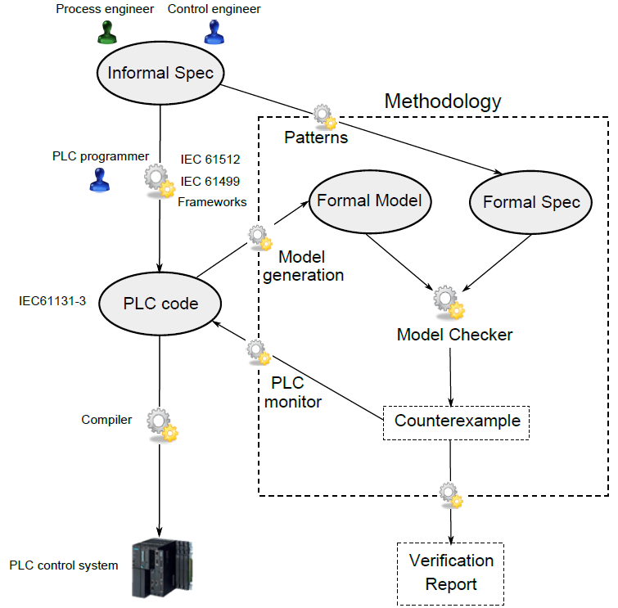
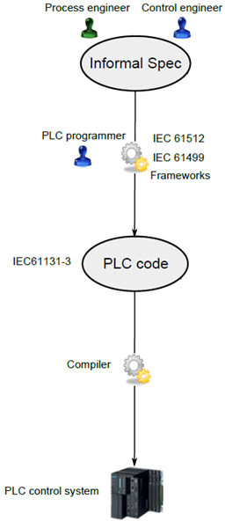
Our approach: methodology overview
Traditional PLC program development
1
How can we be sure that a bug found by this methodology is real?
2
3
We can use the counterexample in the real system and prove it
4

Slide 14
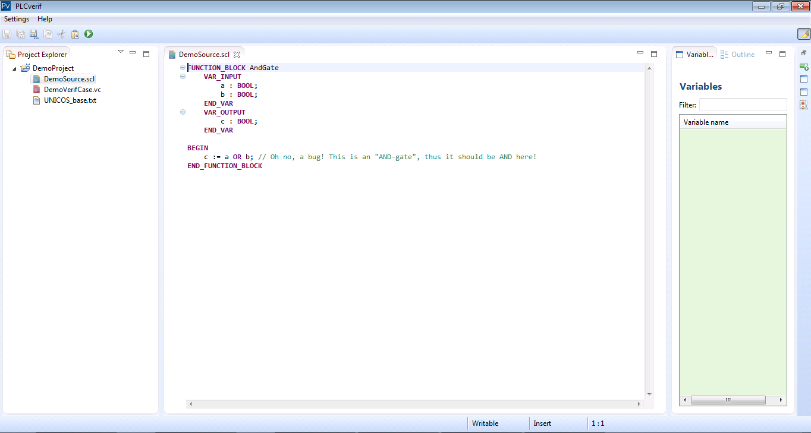
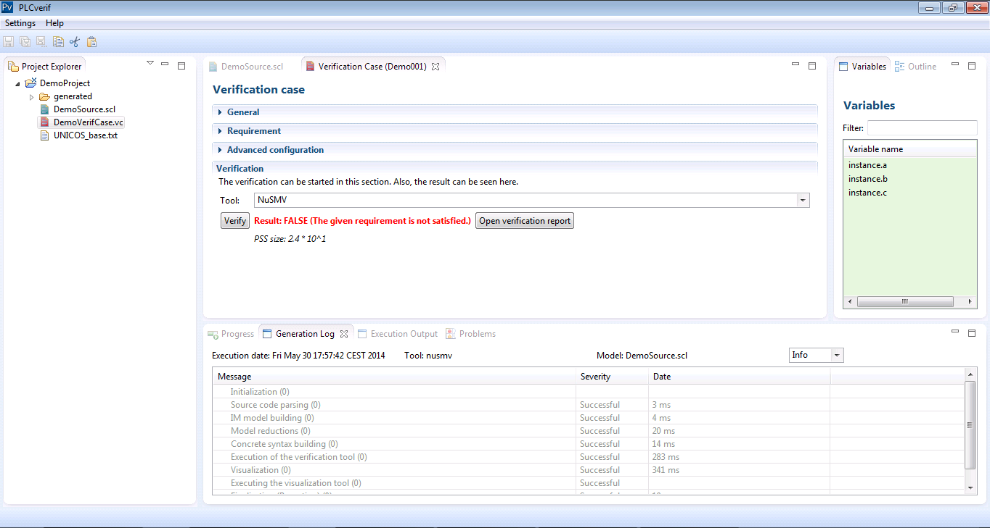
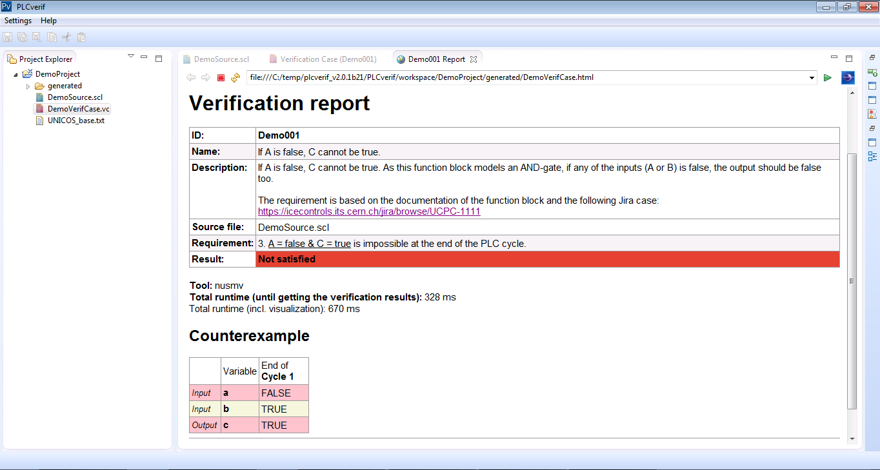
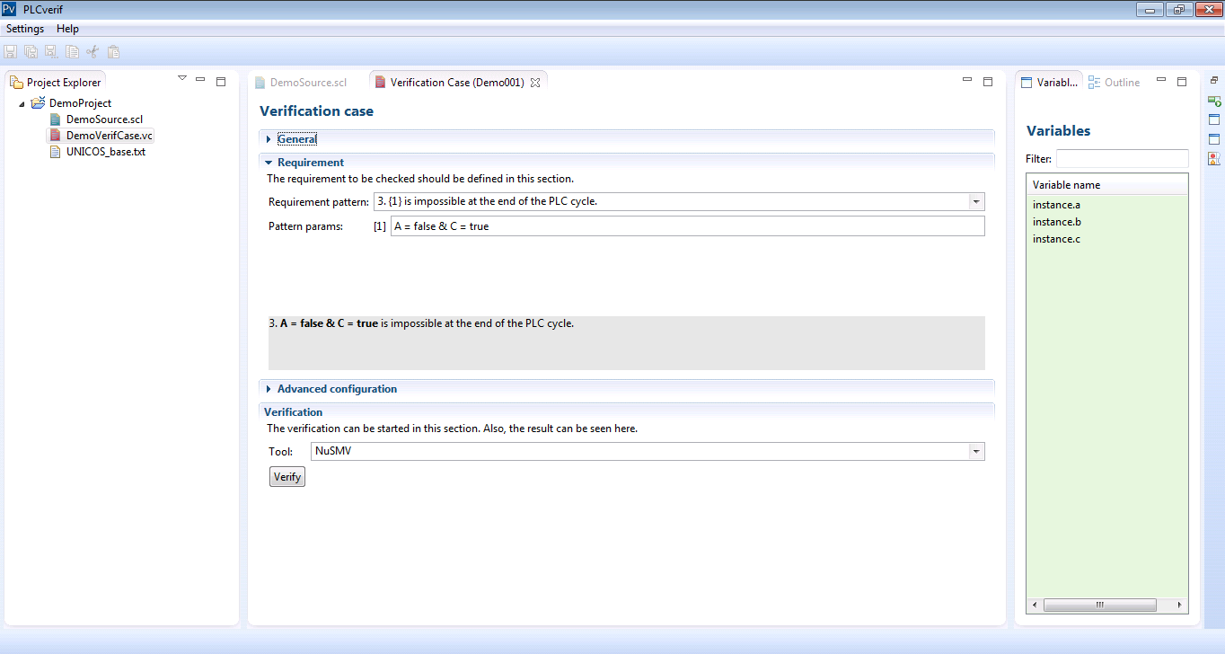
Project status: CASE tool prototype
PLC formal verification at CERN: http://cern.ch/project-plc-formalmethods

Slide 15
Project status & Results
The methodology has been applied to PLC programs at CERN:
  UNICOS library: Bugs/discrepancies have been found in previously tested PLC programs
  Full UNICOS applications: Cryogenic control system (QSDN)
  Safety PLC programs: SM18, FAIR, AWAKE (THCPA01 paper), ITER HIOC protocol (THPHA161 paper), etc.
Future development & research:
  Production-ready CASE tool
  More abstraction and reduction techniques
  Control system specifications
PLC formal verification at CERN: http://cern.ch/project-plc-formalmethods

Slide 16
Static Analysis
What is it?
  Technique that examines a program without executing it
  Similar to code review or code comprehension performed by automated tools
  Good complement to testing and formal verification
Which method?
  Rule-based AST (Abstract Syntax Tree) analysis, control-flow analysis, data-flow analysis, call graph analysis, etc.
What can we detect?
  Naming conventions violations, bad code smells (e.g. dead or duplicated code), overcomplicated expressions, multitasking problems, etc.

Slide 17
Static Analysis in PLC
UNICOS code guidelines?

Slide 18
Static Analysis for PLC programs
Lack of Static PLC Code Analysis tools comparing with general purpose programing languages
Several researchers and companies are working to bring static analysis to PLC programs but still far from being a common practice in this industry
UNICOS specific code guidelines implies specific static analysis rules for our programs

Slide 19
Static Analysis in PLC
Some relevant tools
Tool | PLC language | SA method | Violations
PLC Checker (Itris Automation) | Siemens Step7,PLCopen XML, CoDeSys, Scheinder-Electric Unity and Rockwell Automation RsLogix5000 etc. | AST and control flow analysis (?) | naming rules, commenting rules, writing rules, structure rules, information utilities and options
JKU (Johannes Kepler University & Hagenberg and the ENGEL Austria GmbH) | Kemro language developed by KEBA AG | AST analysis, control flow and data flow | code metrics, naming conventions, program complexity and possible performance problems, bad code smells, architectural issues, incompatible configuration settings, multitasking problems and dynamic statement dependencies
ARCADE.PLC (Aachen University) | IEC 61131 ST IEC 61131 IL Siemens S7 AWL(STL) | Abstract interpretation | loss of precision in expressions, assignments required on specific cast, unused variables and output variables that were assigned more than once in the source code

Slide 20
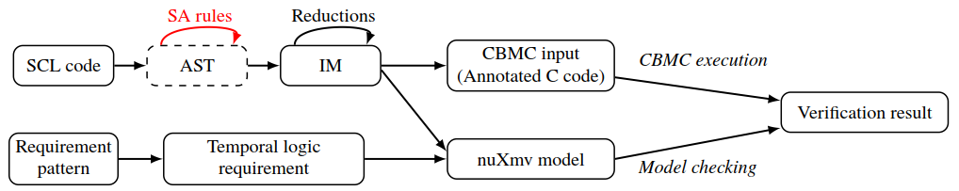
Our solution: Extending PLCverif
ICALEPCS 2017: THPHA160 paper
Modular architecture of PLCverif
Integration of AST rule-based analysis

Slide 21
Project status & Results
Static analysis integrated in PLCverif
Very early stage of the project
  AST-based analysis
  Naming convention and bad code smells rules (some of them UNICOS specific rules)
Future work
  More AST-based rules
  Extend to other methods (e.g. control flow graph, call graph analysis, etc.)

Slide 23
Conclusion and summary
Model checking can be applied to PLC programs
Contribution → Difficulty can be hidden:
  Automated model generation, requirement patterns, automatic reduction techniques and counterexample analysis
We have found discrepancies in our systems:
    Incomplete or incorrect specification
    Mistake in the implementation
Bugs can be proved in the real systems (counterexample info)
Models are built out of the PLC programs. No standards for PLC program specification

Slide 24
AST PLCverif

Slide 25
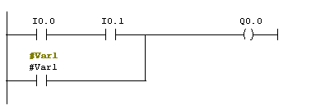
Testing vs. model checking
Q0.0 := (I0.0 AND I0.1) OR Var1
Requirement
If I0.0 is FALSE and I0.1 is FALSE , then Q0.0 is FALSE
(Incomplete) testing may answer that this property is correct.
Model checking will answer that this property is not correct and it will provide a counterexample: Var1 == 1

Slide 26
Testing vs. model checking
Model checking tools: algorithms to check that a global model (hardware, software, process, etc.) meets given requirements.
e.g. NuSMV, UPPAAL, Dfinder (BIP), SPIN, KRONOS, etc.
Testing
  Inputs are known,
  outputs are checked
Model checking
  Usually: The possibility of an output combination is checked.
  Can be used for other ways too.
3
?
?
5
+
+
?
- 3

Slide 27
Model checking
How to build the formal models?
Automata, Petri nets, Timed automata, …
How to build the formal requirement?
Temporal Logic
Temporal logic
Boolean logic
operators
AND, OR, NOT
predicates
input=TRUE, temp>100
+
Temporal operators
in the future …
once …
always …
until…

Slide 28
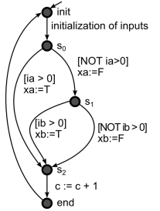
Intermediate model (IM)
Automata-based formalism
  Simple: but strong enough to represent any PLC feature.
  General and close to the modelling language used by the verification tools.

Slide 29
Results with the UNICOS library
CERN PLC programs developed with the UNICOS Framework:
  Library of objects (representing the logic of real equipment)
  Expressed in PLC code: ST language.
Metrics of the PLC program
Metric | OnOff PLC code
Lines of code | 600
Input variables | 60
Output variables | 62
Data types | Booleans, integers, floats, time, etc.
Timers | 3

Slide 30
Results with the UNICOS library
Metric | Non-reduced model | Reduced model | Specific Model *
Potential state space | ~10²¹⁸ | ~10³⁶ | ~10¹⁰
# Variables | 255 | 118 | 33
Generation | 0.3 s | 11.3 s | 12.6 s
NuSMV Verification (with cex.) | – | 160.8 s | 0.5 s
* Based on a real requirement about the mode manager of the
OnOff object
Cone of Influence algorithm
(property preserving reduction techniques)

Slide 31
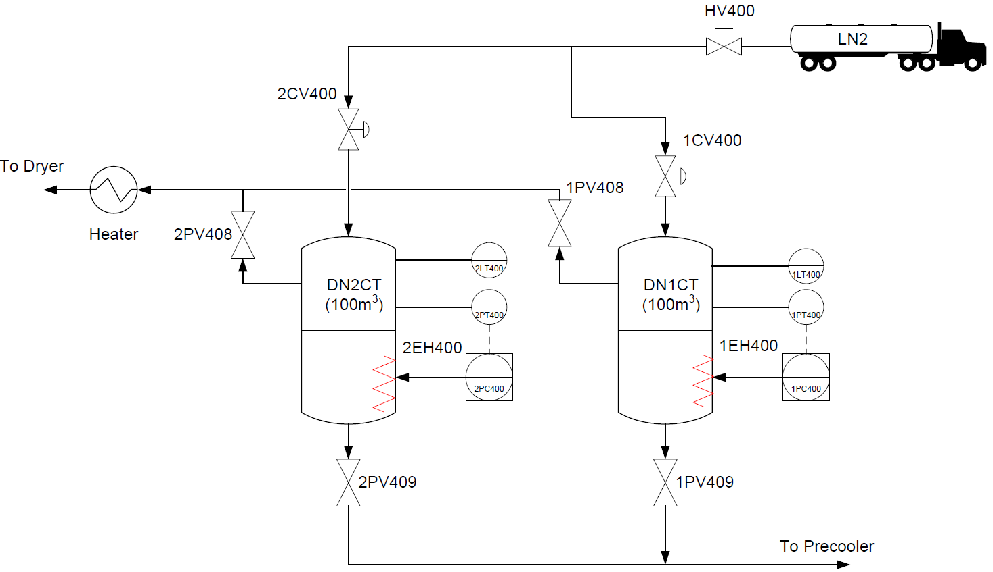
Results with an UNICOS control system
QSDN control system
PLC code
110 FBs and FCs
17,500 lines of code
Formal model
302 automata
PSS = ~10³¹⁹⁸⁵
Goal: Verify the specific logic of the application

Slide 32
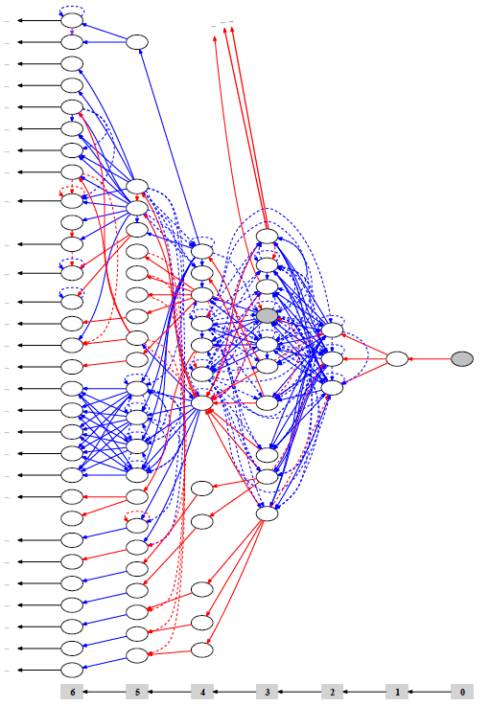
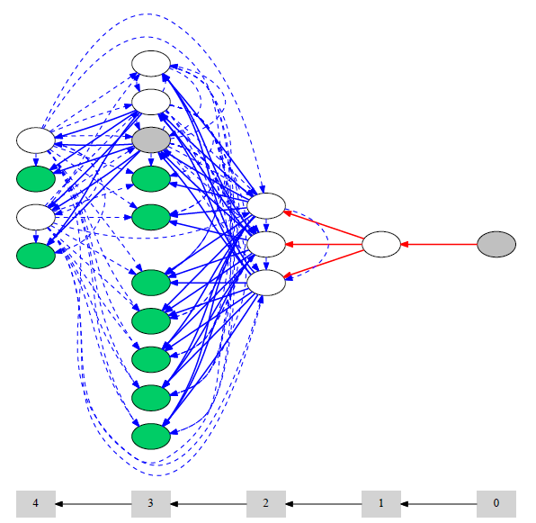
Results with an UNICOS control system
Example of a variable dependency graph
Reduced variable dependency graph
Safety req.
If Seq.Stop.x → Valve1.AuOffR
Metric | Non-reduced model | Reduced Model*
PSS | ~10³¹⁹⁸⁵ | ~10⁵⁰⁴⁸
# Variables | 31,402 | 3757
Generation | 4.2 s | 15.3 s
NuSMV Verification | – | –
Metric | Non-reduced model | Reduced Model* | Abstract Model **
PSS | ~10³¹⁹⁸⁵ | ~10⁵⁰⁴⁸ | ~10¹³
# Variables | 31,402 | 3757 | 20
Generation | 4.2 s | 15.3 s | 5.4 s
NuSMV Verification | – | – | 0.25 s
* Using property preserving reduction techniques
** Using non-property preserving reduction techniques

