Slide 1
1st PLC Based Control Systems
WORKSHOP
E. Blanco Viñuela
J. Ortolá Vidal, B. Fernandez Adiego
CERN

Slide 2
Goals
To create a COLLABORATIVE space where attendees will exchange:
  best practices
  methods and tools employed
  return of experience
  when engineering PLC based control systems.
Foster collaborations and/or identifying expertise among institutes
Workshop organizer/s- Workshop Title

Slide 3
Main workshop subject
Specifications
Development
Management
Testing
Engineering Lifecycle of a PLC based application

Slide 4
Challenges
PLC based applications life spans for more than 15 years in most of the cases. Development and maintenance of those applications is a complex task, as usually the applications do not follow any structure but the automation engineer own implementation. Is standardization a real need? Do the control frameworks give any help on this?
Testing industrial applications is a time consuming task and usually an imperfect exercise. Compromises must be found to the test coverage (e.g. difficult offline tests). Formal verification is emerging as a complementary approach. What is the best method to test an application?
Deploying applications must be tracked and the software components deployed must be easily traceable. In case of an issue in a delivered component in a project, a efficient identification of the affected PLCs should be straight forward. Are you in measure to identify this effectively?
Handling cents of applications becomes a difficult task. Online modifications are required along the life of control systems and the management of such changes must be addressed. How engineers handle the follow up of changes with respect to initial specifications? How a standby service could know the right application to download to a PLC without the expert assistance?

Slide 5
Tracks
Specifications
Requirement formalization
Best practices
Development
Standards and/or Frameworks
Language choice, code guidelines
Testing
Methodologies (FAT, SAT)
Advanced: Static Analysis, Formal verification
Management
Deployment
Versioning
Documentation
Novel approaches: Code generation, Ext. engineering, OO, DSLs
Simulation, virtual commissioning
Management of change

Slide 6
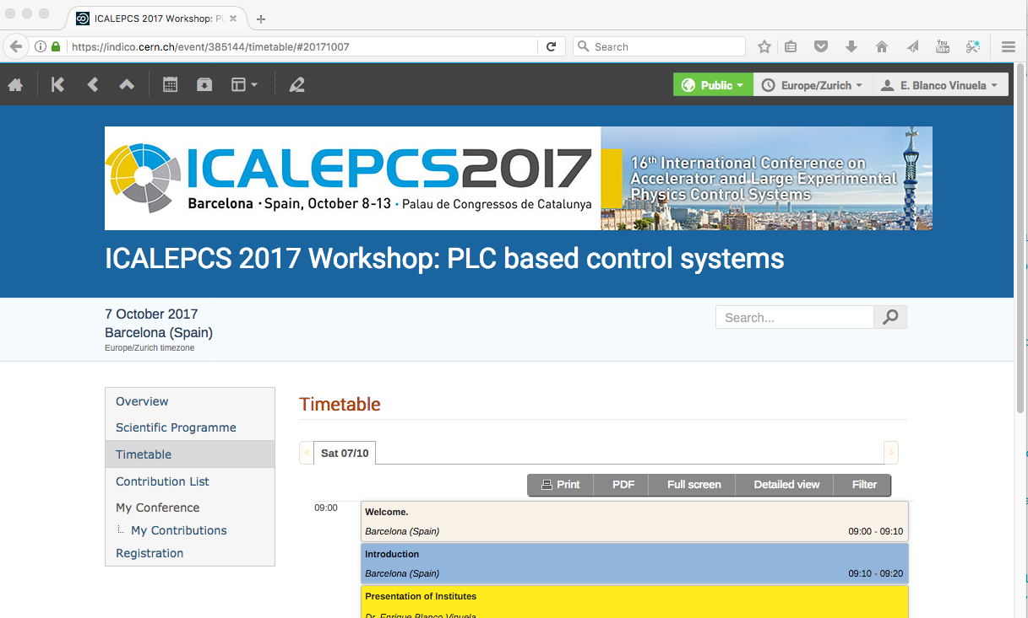
Agenda
Workshop agenda.

Slide 7

Support
Workshop webpage: https://indico.cern.ch/event/385144
  Scientific program
  Contributions
  Agenda

