Slide 2
Status of tune integer change in the PS
R. Wasef, S. Gilardoni, M. Juchno, D. Schoerling, F. Sperati
Acknowledgements: A. Huschauer, S. Machida
HSS Meeting, 15/04/15

Slide 3
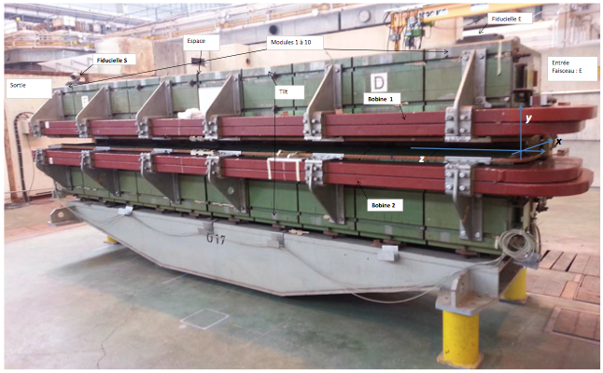
The PS
Started operation in 1959
100 m radius
100 combined function
magnets
Each magnet consists
of 10 blocks: 5 F and 5 D
(cell: FDODF)
Tunes are controlled with:
- LEQ at low energy (2 families, different symmetry than lattice)
- PFW at high energy (on main magnets, same machine periodicity)
Injection kinetic energy 1.4GeV (2 GeV after upgrade).
HSS Meeting, 15/04/15

Slide 4


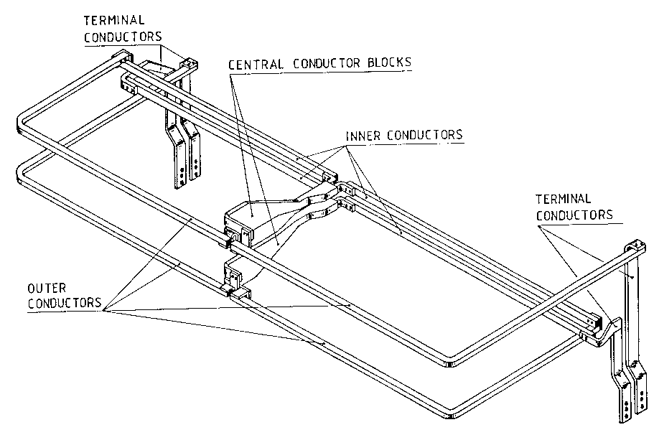
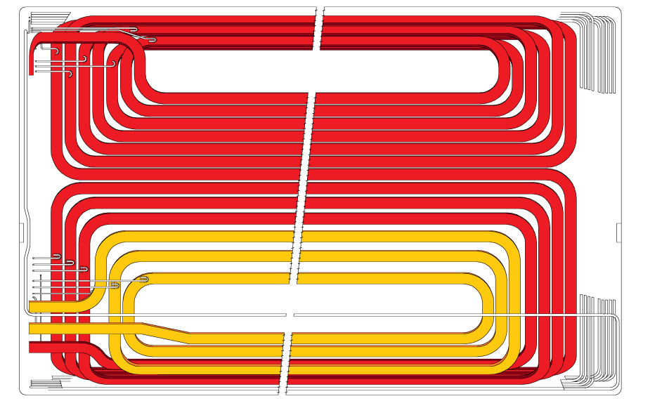
Coil system: main circuit and auxiliary coils
Thermographic inspection of PFW
Narrow circuit
B
I_{8L}
B
Wide circuit
HSS Meeting, 15/04/15

Slide 5
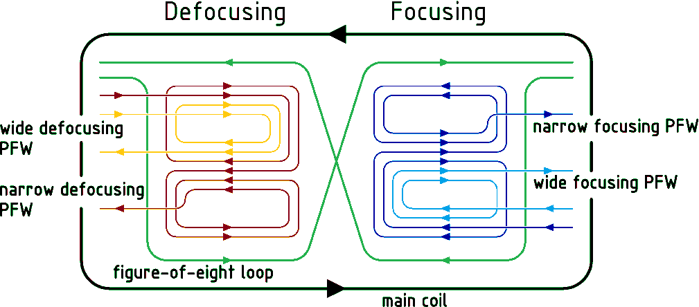
Coil system contributions
Main coil
  Hyperbolic pole shape
  Only dipolar and quadrupolar field at low field level
  Iron saturation
  Sextupolar and higher order components at high field level
Pole-face windings + and figure-of eight loop
  5-Current Mode
  Un-balanced N and W circuit current generate octupolar and higher components
  Non-linearities at high field
  (iron saturation)
  Field probably up to decapole
I_{8L}
I_{DW}
I_{FN}
I_{DN}
I_{FW}
HSS Meeting, 15/04/15

Slide 6
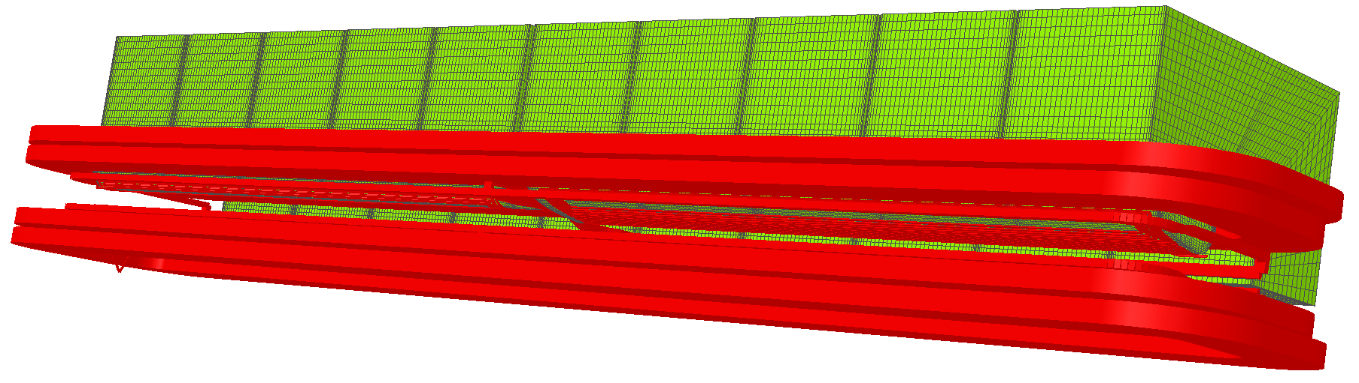
Magnetic Model (3D Opera)
Advanced 3D magnetic model available, so far only static solution performed.
Transient solutions are possible but will require long calculation times (several weeks per model).
All coils are implemented, auxiliary coils are approximated by linear pieces.
1
2
3
4
5
6
7
8
9
10
HSS Meeting, 15/04/15

Slide 7
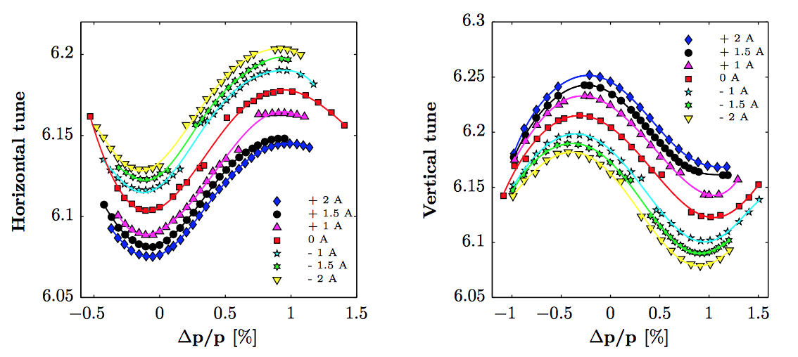
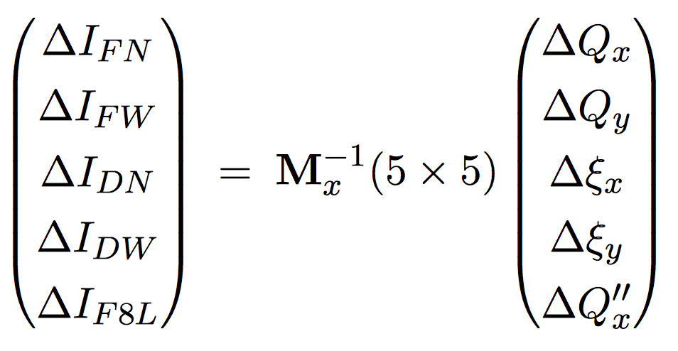
Working Point Control
In order to model the effect of the PFW, we measured the following matrices:
A similar matrix is measured using the magnetic model (calibrated to a reference point)
HSS Meeting, 15/04/15

Slide 8
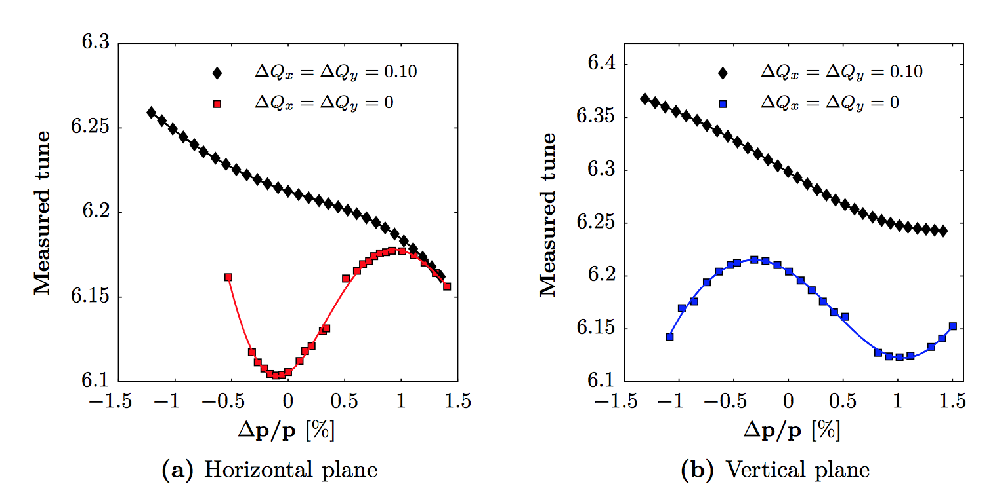
Limit of matrix
The matrix doesn’t agree with the measurement at all configurations
One has to be careful and specially for large changes.
HSS Meeting, 15/04/15

Slide 9
Current Situation
Halo particles
Core of the beam
The beam tune-spread is trapped between the Qv=6.25 and the integer resonances.
If one increases the vertical tune to avoid growth due to the integer, the losses increase because of the Qv=6.25 resonance
There are less losses with higher tune-spread because the proton population becomes smaller on the Qv=6.25 after compression.
The choice of the working point is a compromise between losses and emittance blow-up
HSS Meeting, 15/04/15

Slide 10
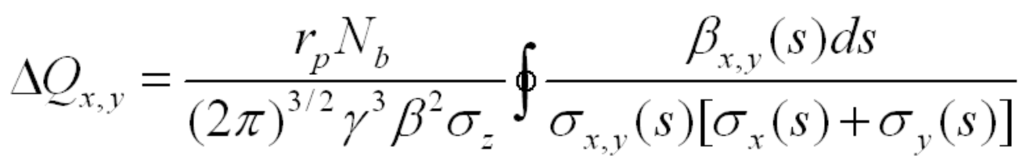
Qy=6.25 resonance
Horizontal tune fixed at 6.23
Vertical tune: 6.24->6.3->6.24
Maximum detuning due to space charge:
Beam 1 : (-.22 ; -.4)
Beam 2 : (-.18 ; -.37)
Beam 3 : (-.08 ; -.07)
Beam 4 : (-.01 ; -.01)
6.3
6.24
➔ Qy=6.25 resonance seems to be excited by space charge
HSS Meeting, 15/04/15

Slide 11
Hypothesis
Structure resonance driven by Space Charge.
Structure h=50 (lattice 50xFDODF).
Driven by space charge because doesn’t exist at low brightness (Tune-diagrams).
Mitigation strategies:
  A partial compensation with magnets seems extremely challenging because of the difference in magnetic center.
  Change of the integer, would avoid the harmonic 50.
HSS Meeting, 15/04/15

Slide 12
Mitigation of the problem
Optics (5,7)
Nominal Optics
Qv
Qp
time
➔ Significant improvement at the new integers
HSS Meeting, 15/04/15

Slide 13
8Qx=50
3Qx+Qy=25
3Qx-Qy=10
3Qx=20
-Qx+2Qy=10
2Qx+2Qy=25
3Qy=20
8Qy=50
Qx+2Qy=20
-Qx+3Qy=10
Qx+3Qy=25
2Qx=10
4Qx=20
2Qy=10
4Qy=20
2Qx+Qy=20
2Qx-Qy=10

Slide 14
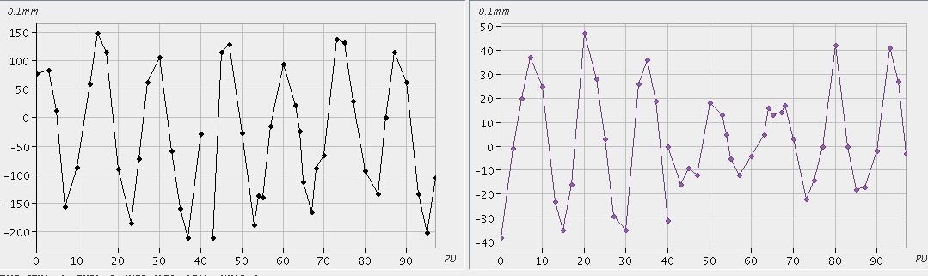
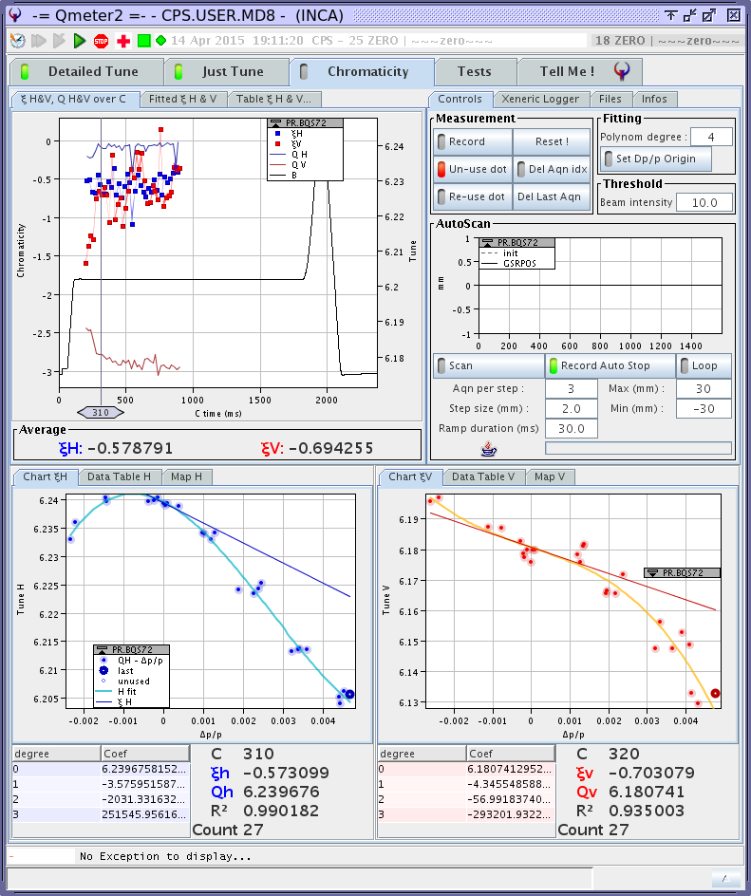
Change of integers to (7,7)
Horizontal Orbit
Vertical Orbit
0.1 mm

Slide 15
Change of integers to (7,7)
The beam is radially unstable due to the change of phase advance between the pickups of the radial loop.
The simulated matrix seems much closer. (The beam was not injected using the measured one!)
It is not possible to reach (7,7) without introducing octupolar component!➔ An resonance compensation might be necessary (using octupoles)
 | Measured Matrix | Simulated Matrix | Measurement
Q_{x} | 7.15 | 7.24 | 7.18
Q_{y} | 7.18 | 7.28 | 7.24
ξ_{x} | 8 | -0.83 | -0.5
ξ_{y} | 0.5 | -1.12 | -0.5 : -1
HSS Meeting, 15/04/15

Slide 16
Conclusions
The simulated matrix is a good cross-check/alternative to the measured one.
For large changes, a new matrix is needed.
Injection on (7,7) was only possible using the simulated matrix.
For the integers (7,7), the simulated matrix seems close to the measurement up to the 1st order chromaticity.
a new matrix is needed in order to make accurate changes (loss maps).
an octupolar compensation is needed .
HSS Meeting, 15/04/15

