Slide 1
Some theoretical aspects of Magnetars
Monika Sinha
Indian Institute of Technology Jodhpur

Slide 2
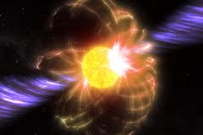
Introduction
Soft Gamma Repeaters (SGRs) and Anomalous X-ray Pulsars (AXPs) :
Very different from ordinary X-ray bursters and pulsars
L_{peak} ~ 10⁴⁵ ergs/s, L_{x} ~ 10³⁵ ergs/s.
Rotational period ~ 5 – 10 s, spin down rate ~ 10⁻¹¹ s/s
No evidence of binary companions: sometime association with supernova remnants:
Increasing number of common properties:
Close relationship between SGRs and AXPs

Slide 3
Introduction
Soft Gamma Repeaters (SGRs) and Anomalous X-ray Pulsars (AXPs) :
Very different from ordinary X-ray bursters and pulsars
No correlation between energy and time interval since the previous burst:
Trigger of the bursts is not accretion.
AXPs: Softer spectrum:
Neither accretion powered, nor rotation powered.
Current model: Magnetar – Neutron stars with strong surface magnetic field ~ 10¹⁴ - 10¹⁵ G.
The field in the interior of the NS may have higher value.

Slide 4
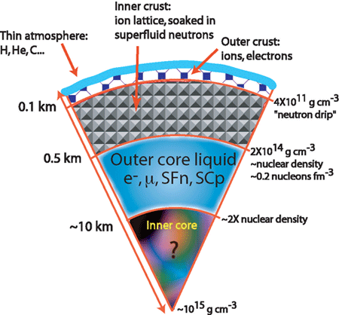
Structure of Neutron star
Outer crust: ions + electrons a few hundred meters
Inner crust: electrons + neutrons + neutron rich nuclei about one kilometer
Outer core: neutrons + protons + electrons + muons
Inner core: ? number of possibilities

Slide 5
Structure of Neutron star
Nuclear matter
Hyperon matter
Pion condensate
Kaon condendate
Quark matter
Neutrons in the core could also be in superfluid state.

Slide 6
General procedure to get a model of a star
Stable structure of a star:
Inward gravitational force = Outward force due to pressure gradient
This condition can be obtained from the Einstein’s equation
G^{μν} = 8πT^{μν}
Condition of hydrostatic equilibrium
From this condition one obtains
P(r) and m(r)
Provided P(ρ) is known.
The radius (R) of a star is where P(R) = 0
The mass of the star is then M = m(R)
G^{μν} = Einstein’s Tensor
T^{μν} = Energy momentum tensor
r = Distance from center of the star
m(r) = Mass enclosed within the distance r

Slide 7

Effect of magnetic field on matter
contribution from potential energy
In absence of magnetic field
In presence of magnetic field

Slide 8
Effect of magnetic field on matter
Energy momentum tensor of the system:
Matter energy density
Thermodynamic pressure
Magnetization tensor

Slide 9

Effect of magnetic field on matter
In the rest frame of matter, with the choice of magnetic field
Magnetic field
Magnetization

Slide 11
Superconductivity inside neutron stars
B_{s} = 10¹⁴ -10¹⁵ G
Interior field even greater
Superconductivity inside magnetar Quenched?

Slide 12

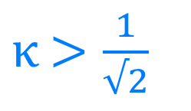

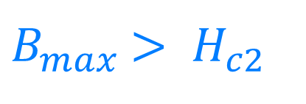
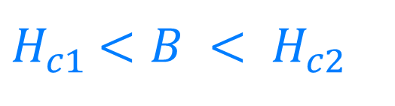

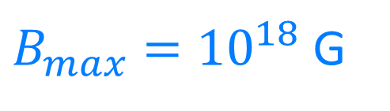
Superconductivity inside neutron stars
Type-II superconductivity
London’s penetration
depth
$κ$ $>\frac{1}{√2}$
$$κ= \frac{δ_{L}}{ξ_{p}}$$
Coherence length
Type-II superconductivity exists if
$H_{c2}$ = $\frac{Φ_{0}}{{2πξ_{p}}_{}^{2}}$
Quantum of flux
$H_{c1}$ $<B < H_{c2}$
$Φ_{0}$ = $\frac{nh}{2e}$
From virial theorem
$B_{max}$ $> H_{c2}$
$B_{max}={10}^{18}$ G

Slide 13
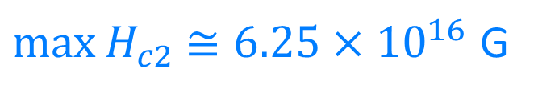
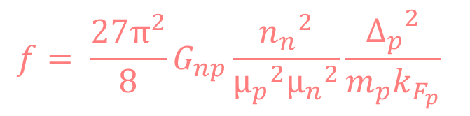
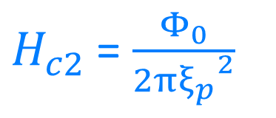
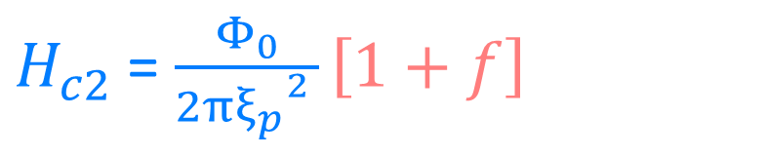
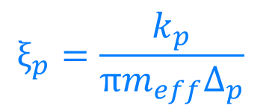
Superconductivity inside neutron stars
$H_{c2}$ = $\frac{Φ_{0}}{{2πξ_{p}}_{}^{2 }}\left[1+f\right]$
$H_{c2}$ = $\frac{Φ_{0}}{{2πξ_{p}}_{}^{2}}$
$$ξ_{p}=\frac{k_{p}}{πm_{eff}Δ_{p}}$$
$$f= \frac{{27π}^{2}}{8}G_{np}\frac{{n_{n}}^{2}}{{μ_{p}}^{2}{μ_{n}}^{2}}\frac{{Δ_{p}}^{2}}{m_{p}k_{F_{p}}}$$
$\max{H_{c2}}$ $≅6.25×{10}^{16}$ G

Slide 14

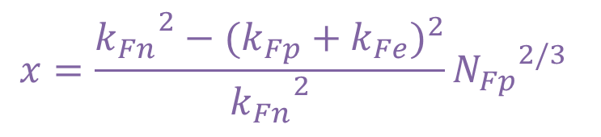
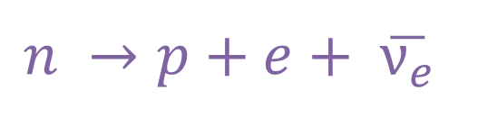

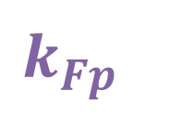
Neutrinio Emissivity
$$k_{Fn}$$
Neutrino emissivity
Direct Urca process
Pair-breaking process
$$n →p+e+ \overline{ν_{e}}$$
$$k_{Fp}$$
$$k_{Fe}$$
$$x=\frac{{k_{Fn}}_{}^{2}−{(k_{Fp}+k_{Fe})}^{2}}{{k_{Fn}}_{}^{2}}{N_{Fp}}_{}^{2/3}$$

Slide 15
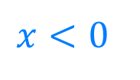

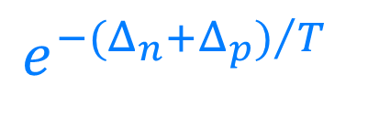
dUrca emissivity
$$e^{{−(Δ_{n}+Δ_{p})}/T}$$
$$x>0$$
$$x<0$$

Slide 16
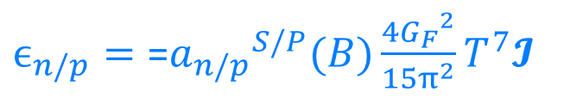
Pair-breaking emissivity
$ϵ_{n/p}=\text{=}{a_{n/p}}_{}^{S/P}(B)\frac{4{G_{F}}^{2}}{15π^{2}}T^{7}$𝓘

Slide 17
Summary
Presence of magnetic field introduces the anisotropic pressure in the system.
Negative contribution from field pressure of from interaction of matter with field to pressure leads to instability above a critical field.
Magnetars are fully of partially free of proton superconductivity depending on strength of field inside the magnetars.
Neutrino emissivity is affected due to unpairing effect.
Detailed cooling simulations are needed to confront the theory of magnetar with quenched superconductivity with the observations.
Heat capacity, reheating due to field decay are to be addressed under this condition.
Electrical conductivity, field decay, rotational dynamic, coupling of normal matter to superfluid matter should be revisited with this result.

