Slide 1
The Cherenkov Telescope Array (CTA)
B. S. Acharya, TIFR (acharya@tifr.res.in)
Advances in Astroparticle physics and Cosmology (AAPCOS-2015), SINP, October 12-17, 2015

Slide 2
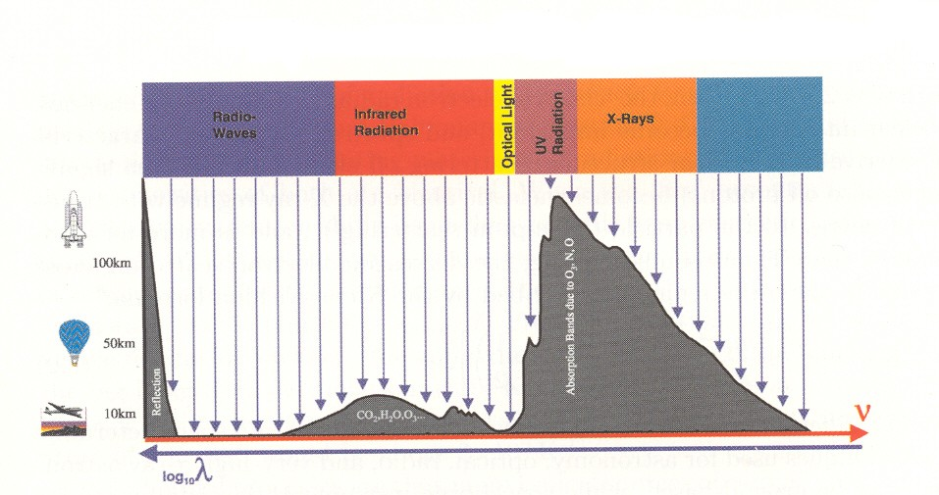
Transparency of Atmosphere to EM radiation
Observations
Satellite-based
Balloon-based
Air-plane altitudes
Mountain altitudes
Ground-based
Gamma-ray astronomy deals with highest energy photons from space.
It gives a perspective of non-thermal universe which compliments our view from other spectral windows.
Gamma radiation is generated under extreme conditions in objects or phenomena like black holes and violent explosions (supernova, hyper- nova, gamma-ray bursts etc) seen across the universe.
The objective is to study these powerful objects and violent events in order to understand Nature at its ultimate limits, which perhaps help to explore the limits of gravity and energy in the universe and to forecast our cosmic destiny.

Slide 3
Multi-messenger Astronomy

Slide 4
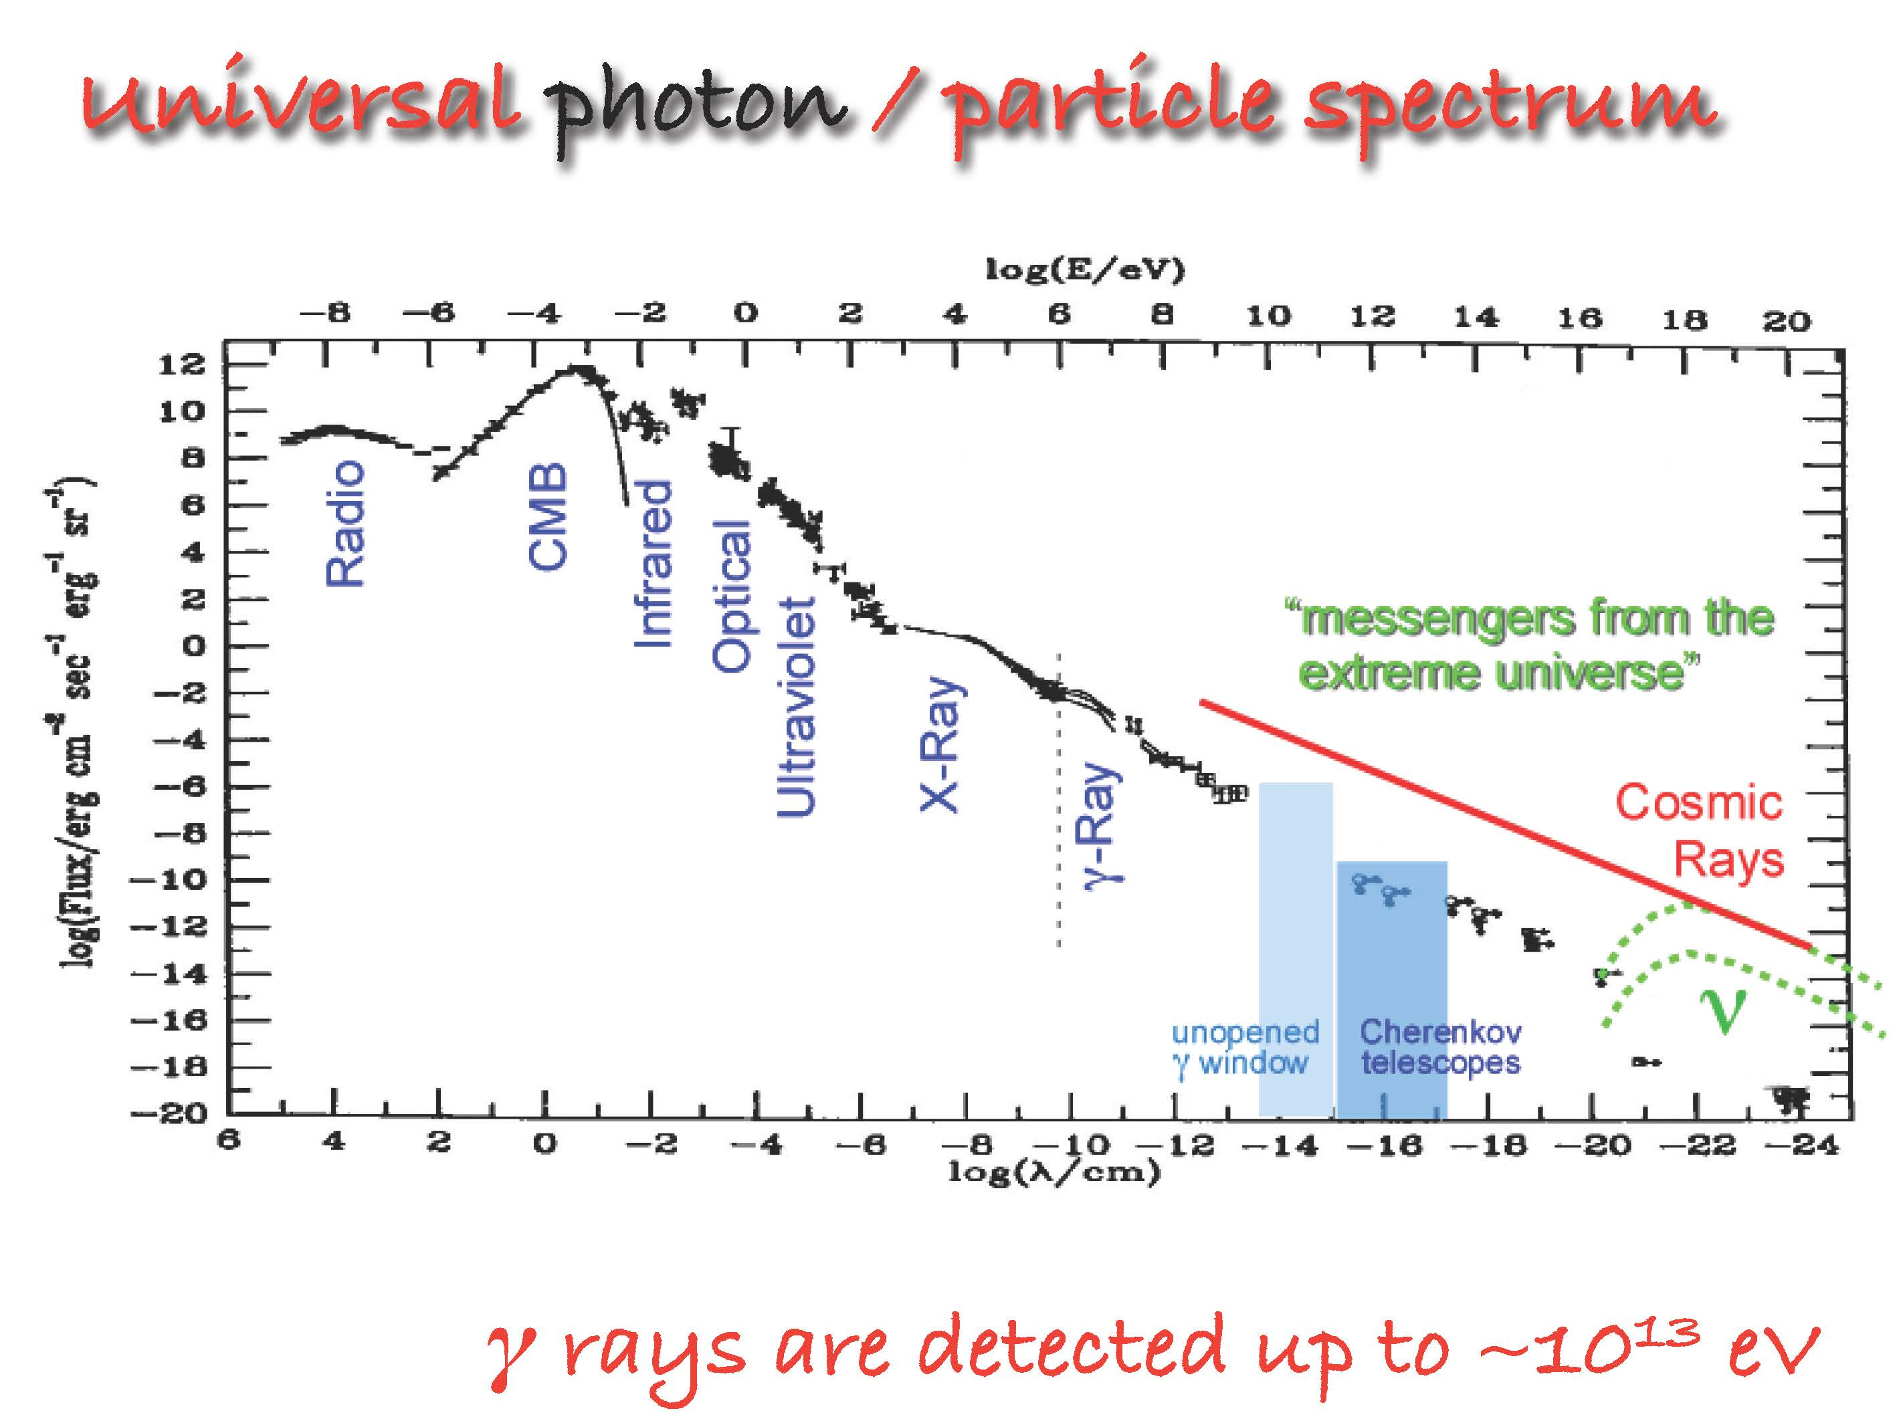

Slide 5
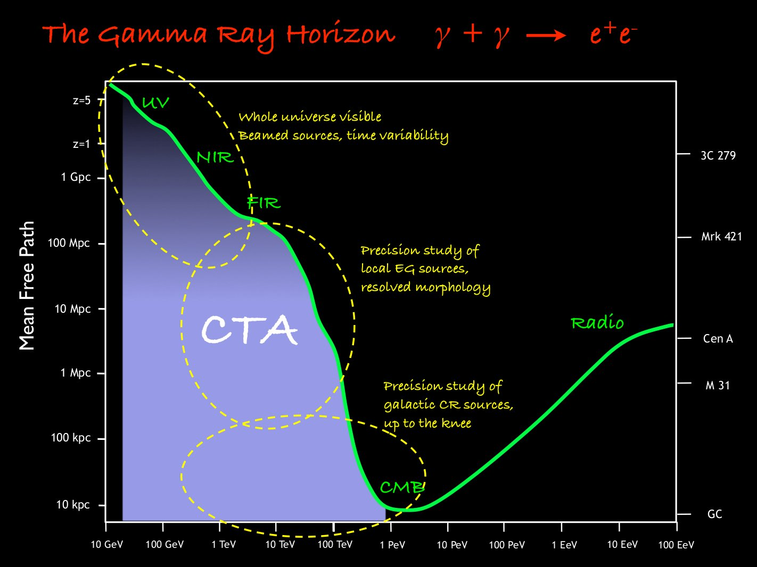

Slide 6
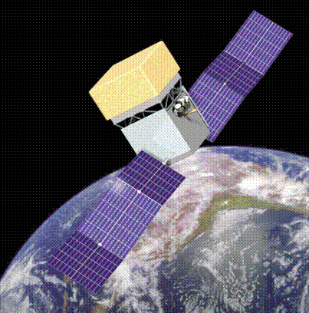
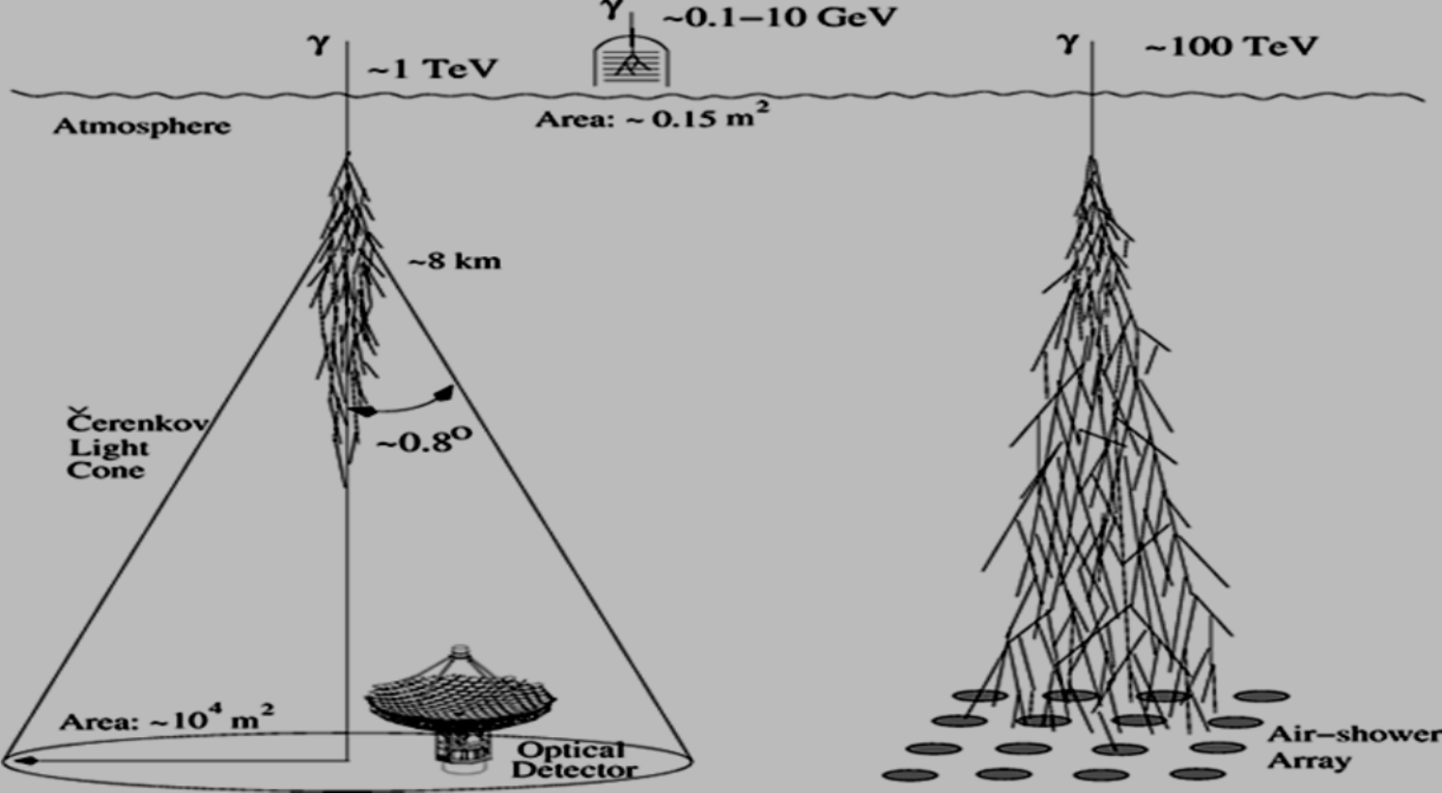
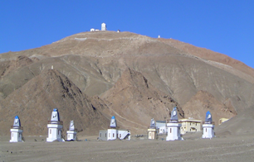
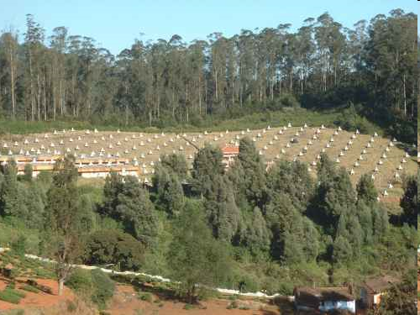
Gamma Ray Astronomy at different energy intervals
30 MeV-300 GeV
Satellite-based
Fermi-LAT
>10 TeV
EAS Technique
GRAPES- Ooty
Cosmic rays are a serious background
50 GeV – 50 TeV
Atmospheric Cherenkov Technique
HAGAR at Hanle

Slide 7
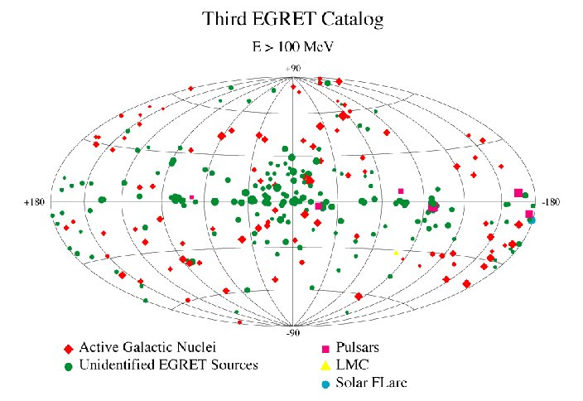
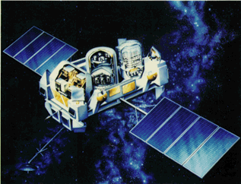
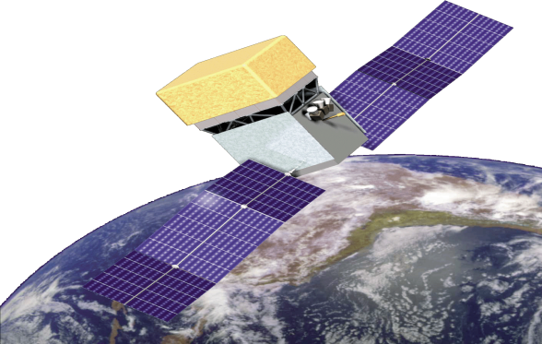
HE Gamma Ray Sources
No. of sources detected by EGRET
Onboard CGRO in five years = 271
EGRET onboard
CGRO (1991-2000)
No. of sources detected by LAT onboard
Fermi in 2 yrs = 1873
10 MeV to
300 GeV
Launched on
June 11, 2008
3033 point sources (4 years of data)
R. Dubois, SLAC

Slide 8
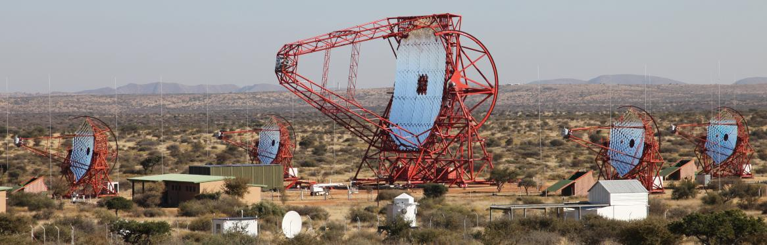
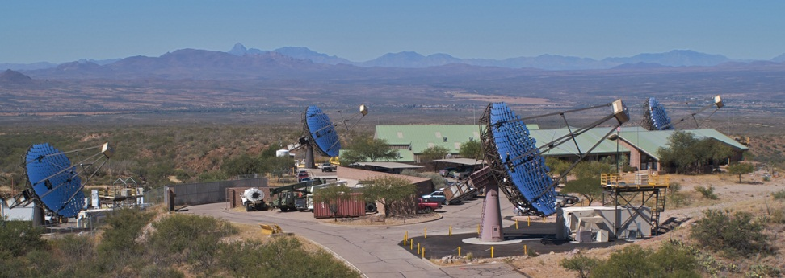
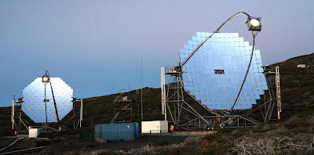
HESS
VERITAS
MAGIC

Slide 9
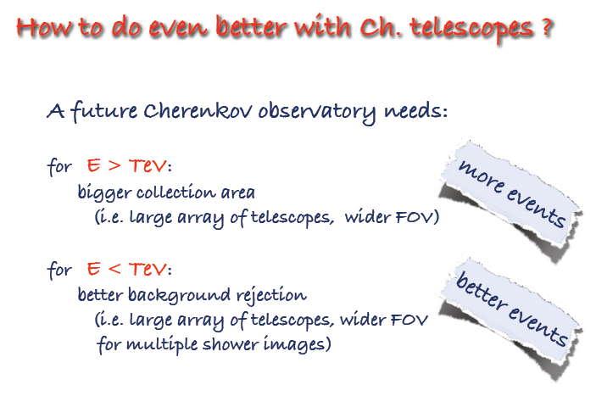
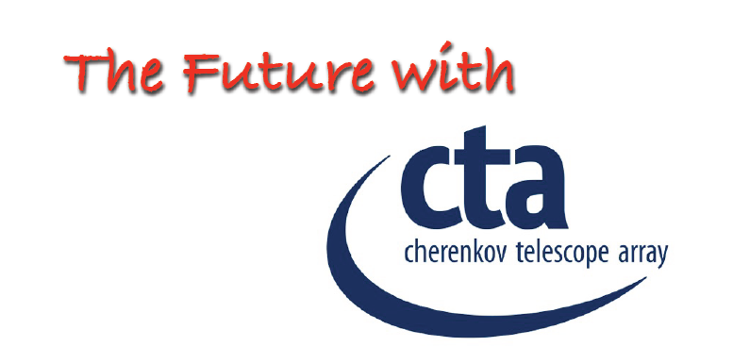
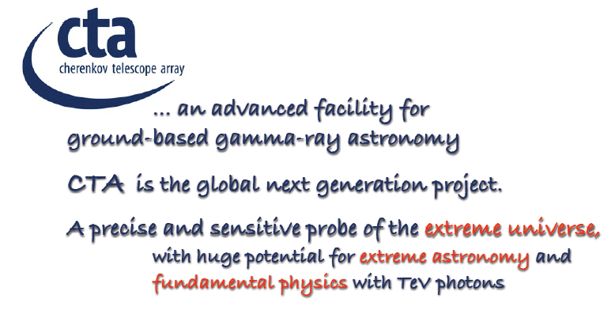
Astroparticle Physics, Volume 43, Pages 1-356 (March 2013)
Seeing the High-Energy Universe with the Cherenkov Telescope Array –
The Science Explored with the CTA
(Edited by Jim Hinton, Subir Sarkar, Diego Torres and Johannes Knapp) Articles 1-25

Slide 10
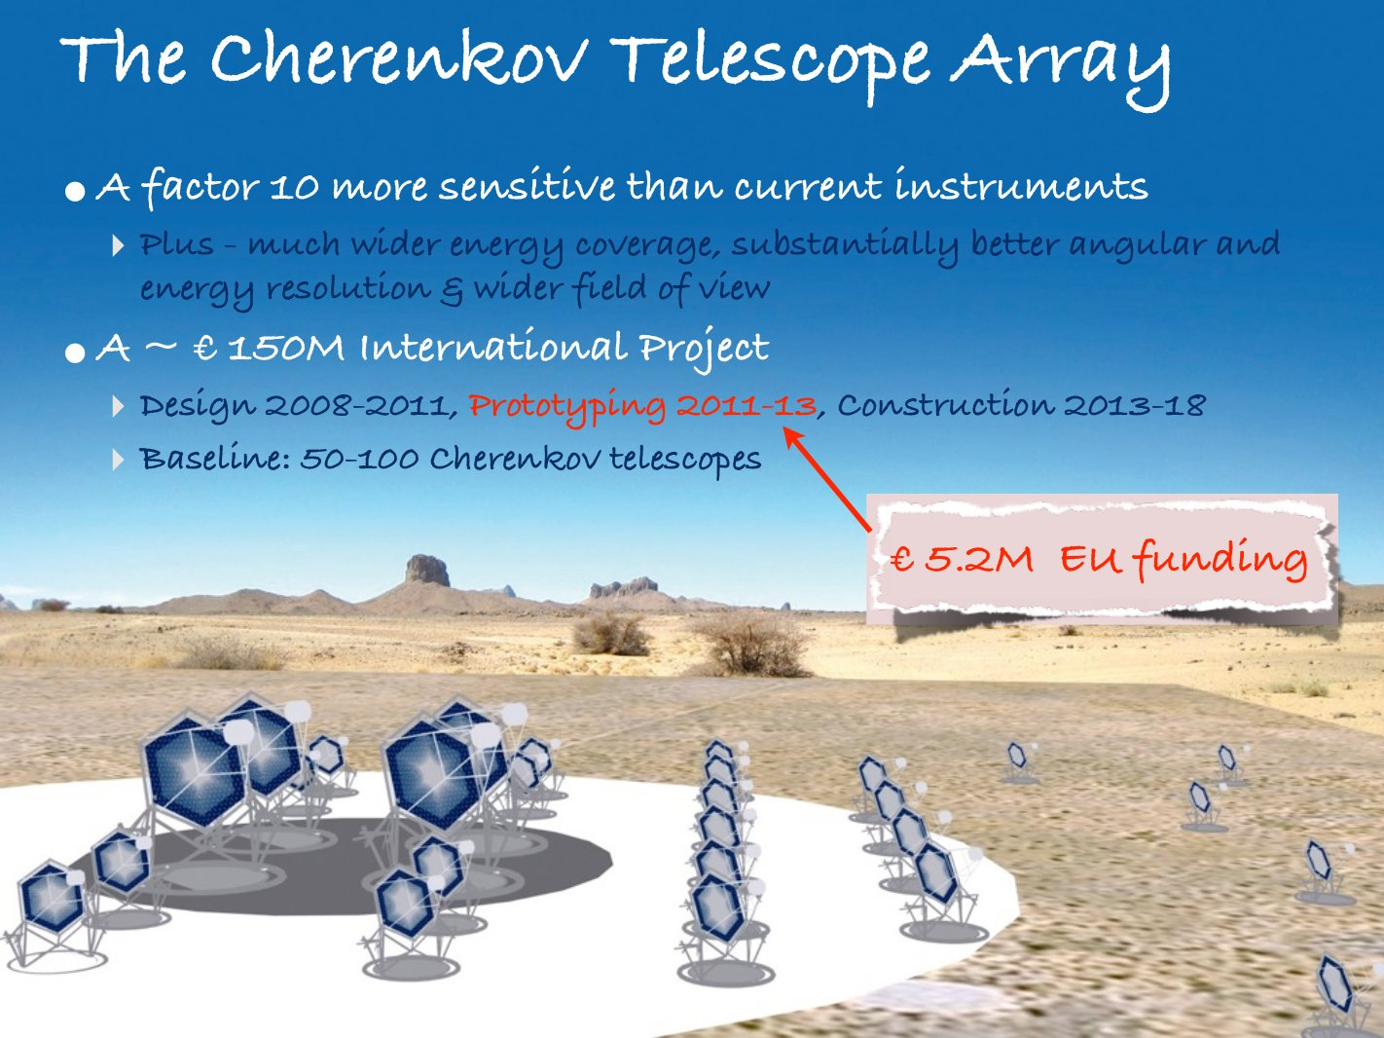
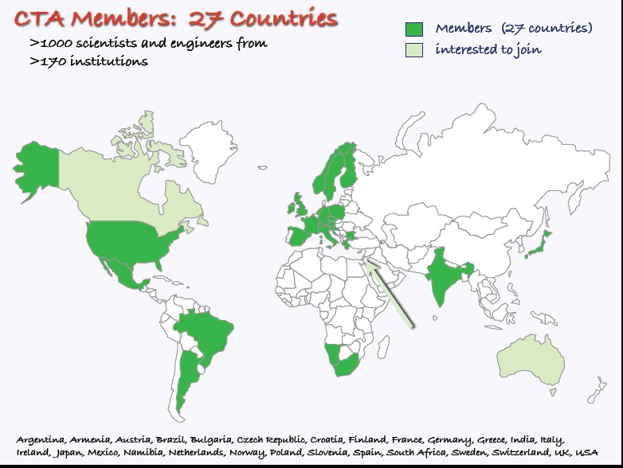
1200 members from 194 Institutions in 31 Countries

Slide 13
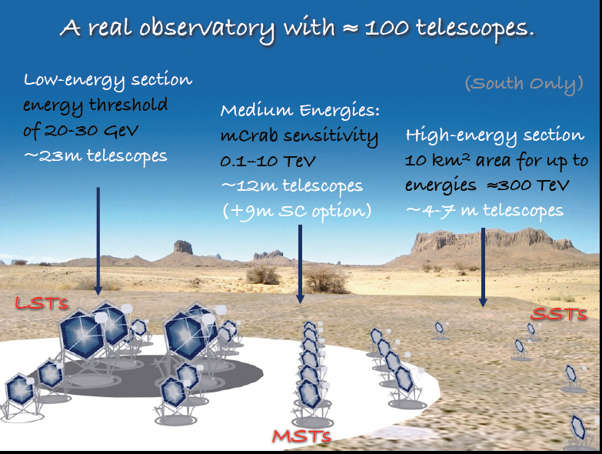

Slide 14
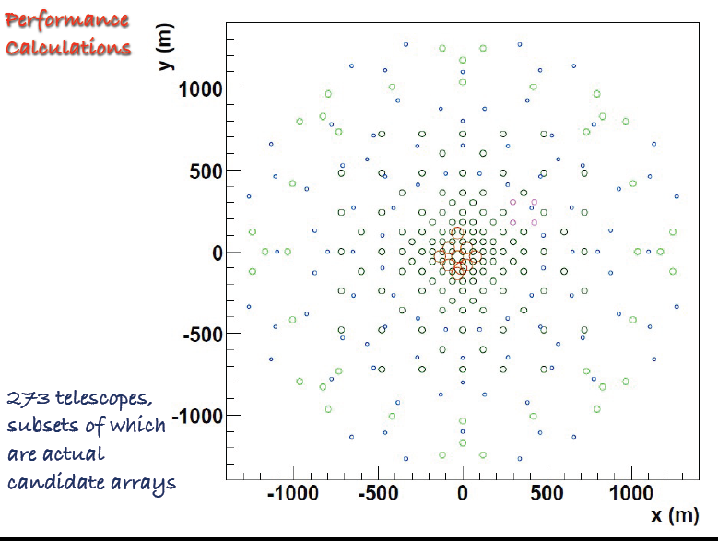
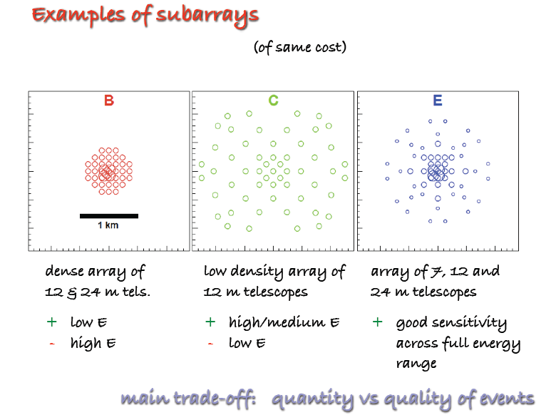
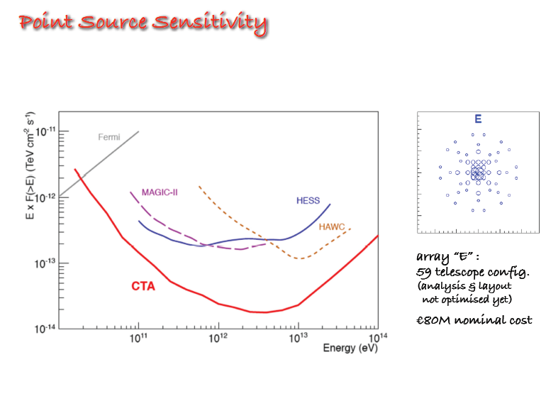
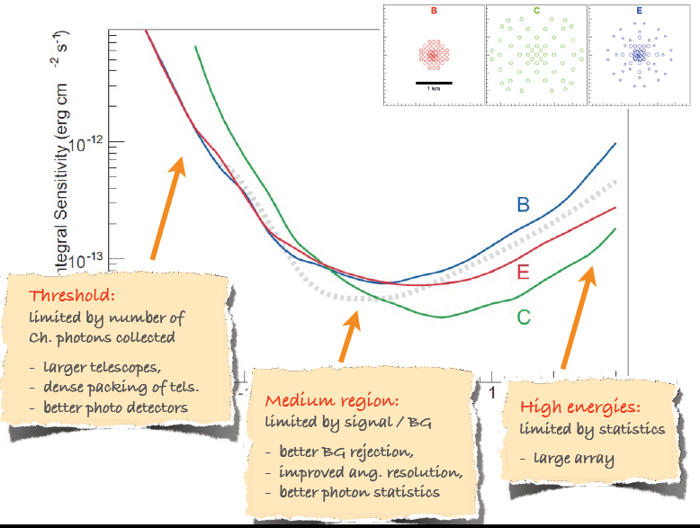

Slide 16
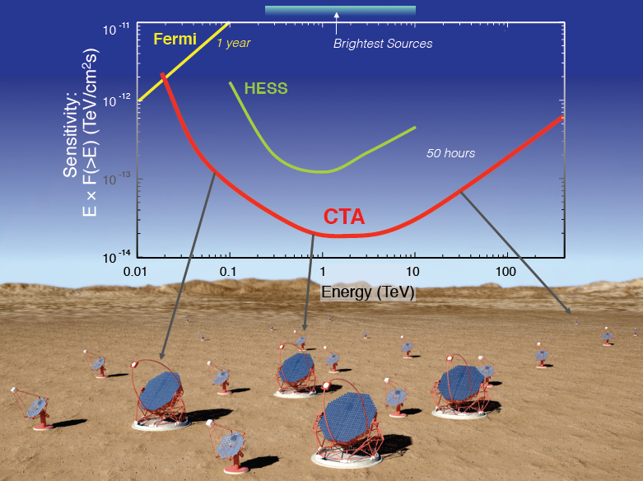
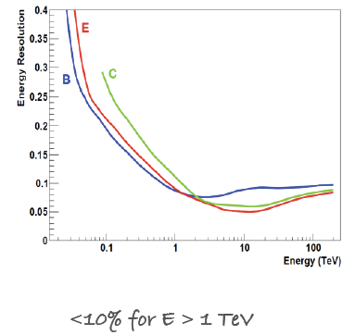
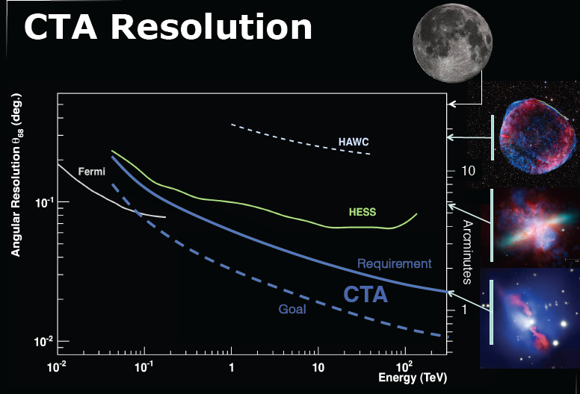
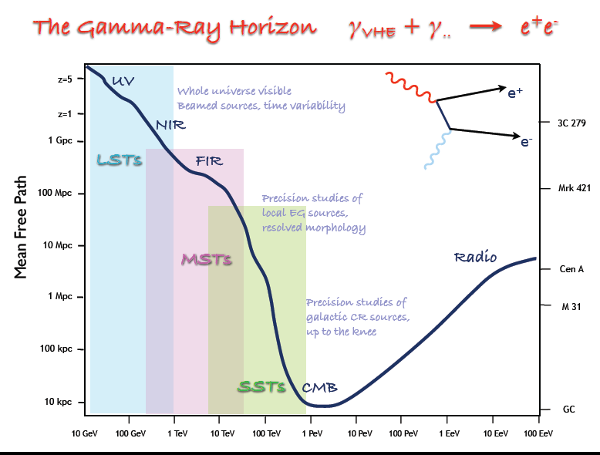

Slide 17
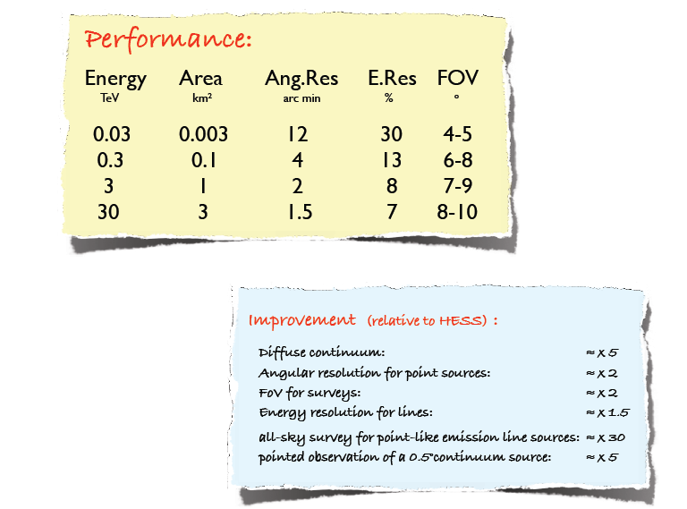

Slide 18
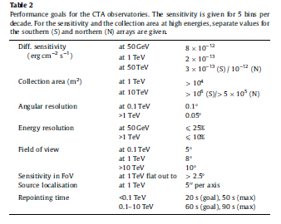

Slide 19
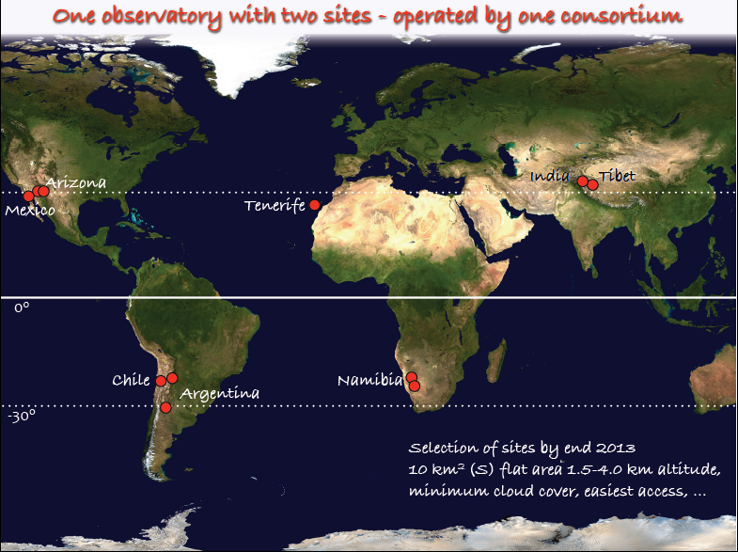
Tow sites to cover full sky at
20-30 degree N, S latitudes
Mainly Extra-galactic science
galactic & extra-galactic science
North: La Palma, Spain
South: Paranal, Chile

Slide 21
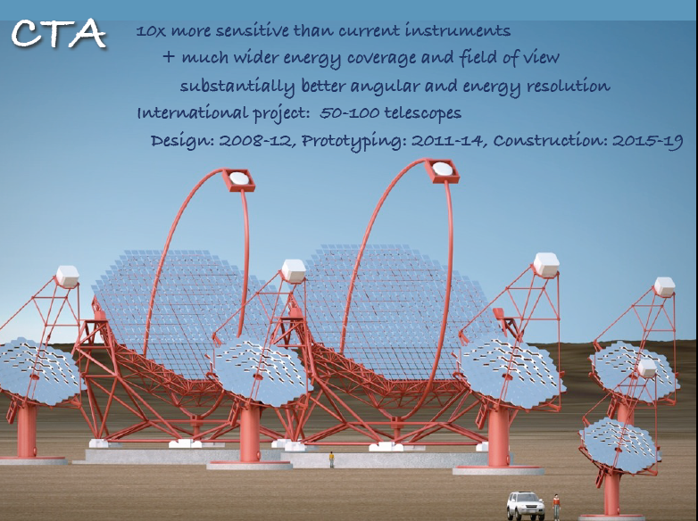
Design: 2008-13; Prototyping: 2013-15; Construction: 2016-2020

Slide 23
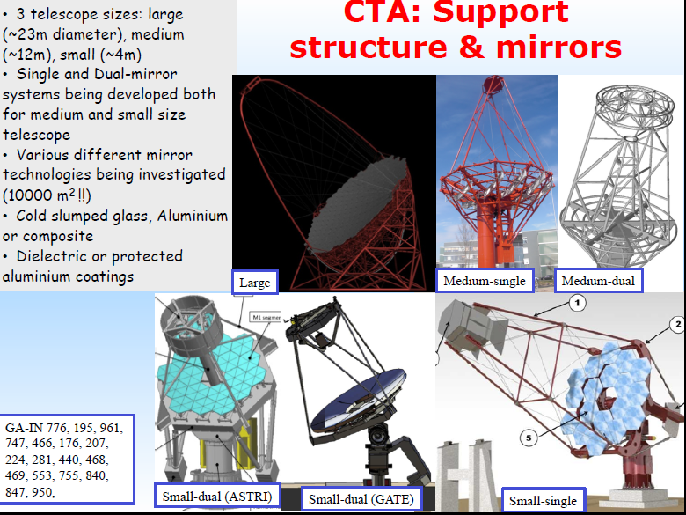

Slide 25
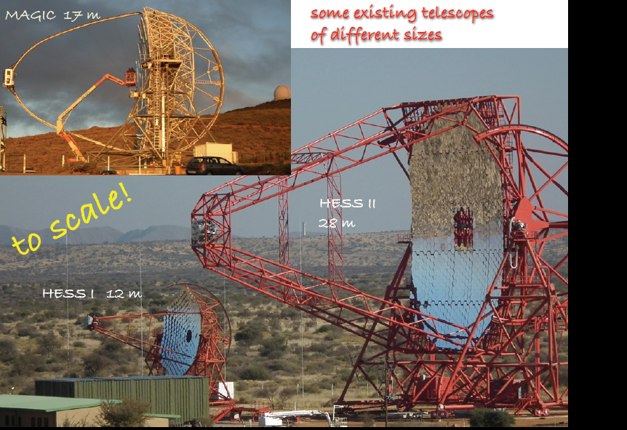

Slide 26
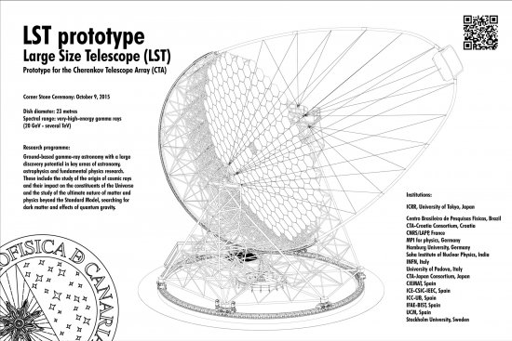
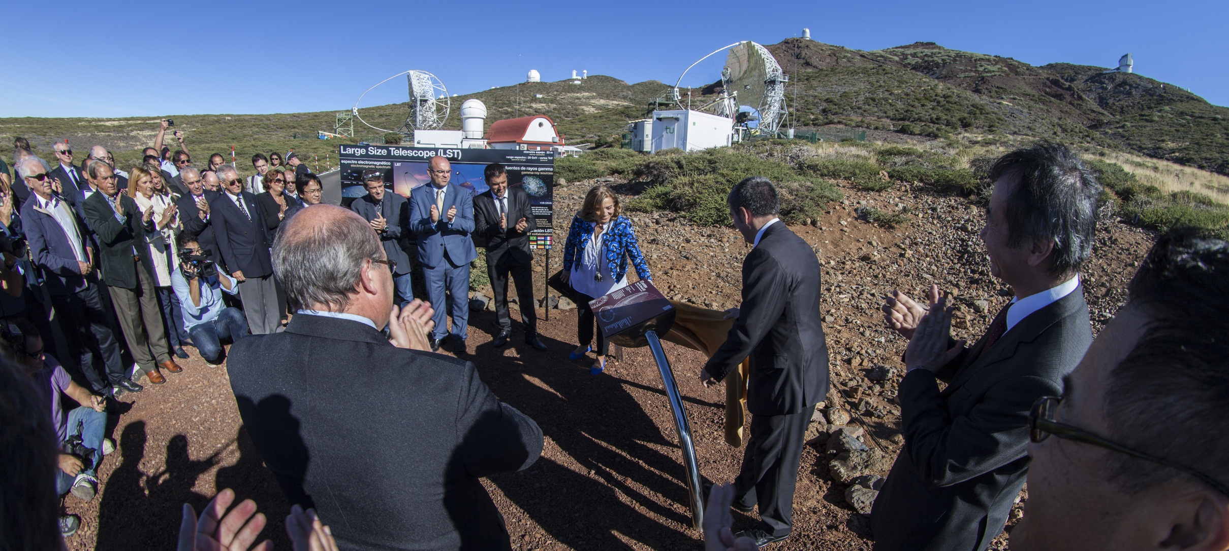

Slide 27
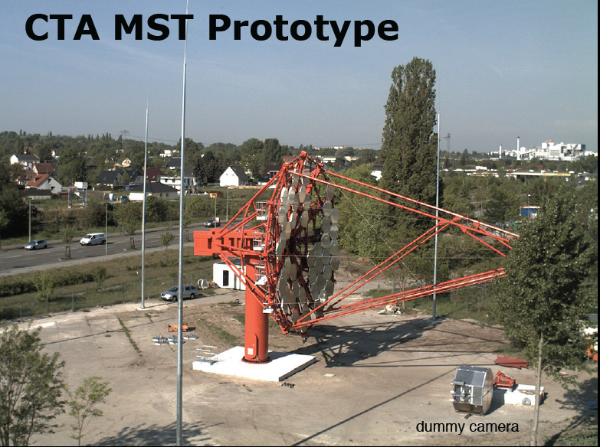

Slide 30
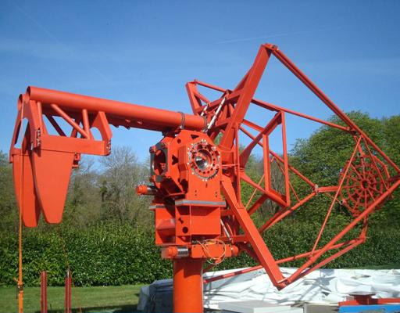
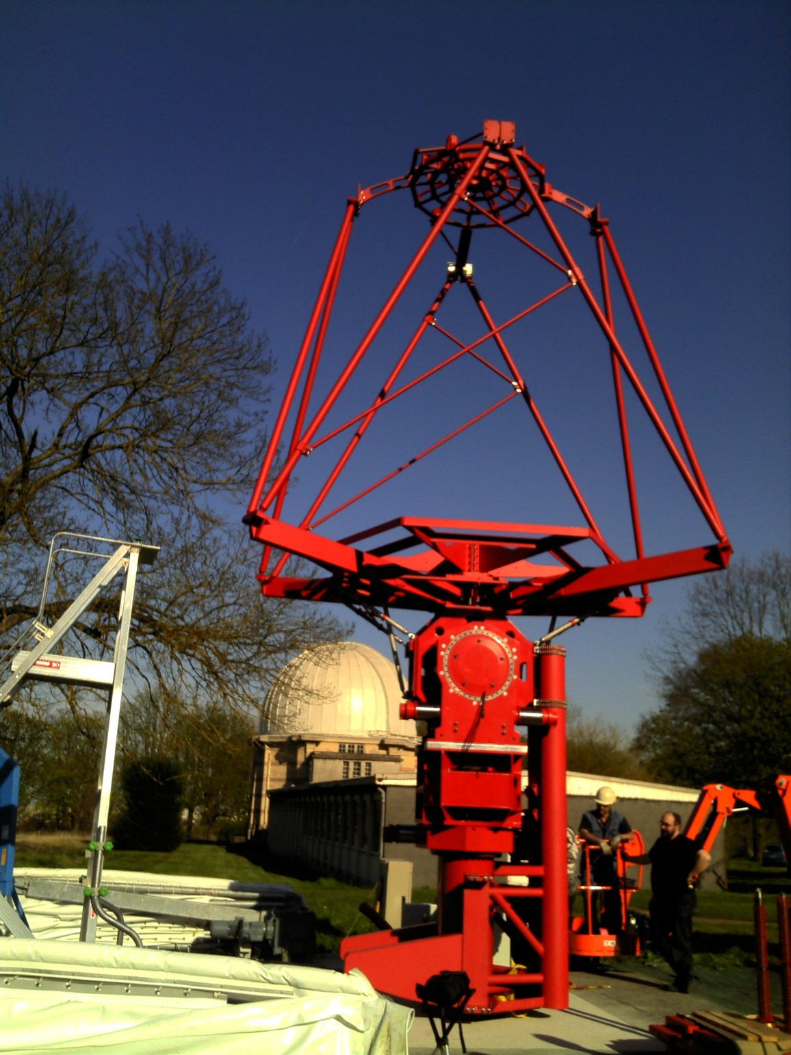
Dual mirror SST – in Paris

Slide 32
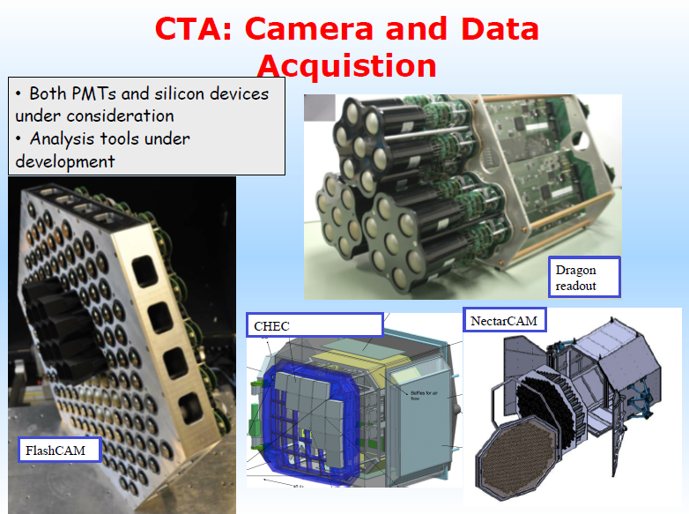

Slide 41
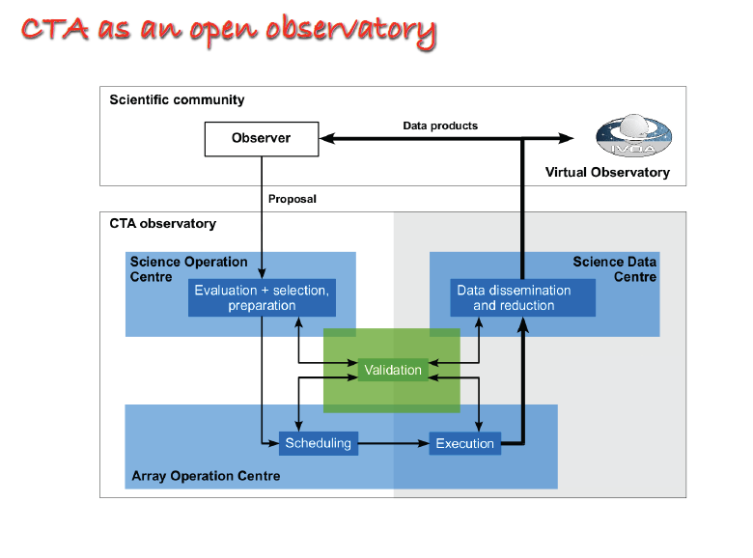

Slide 45
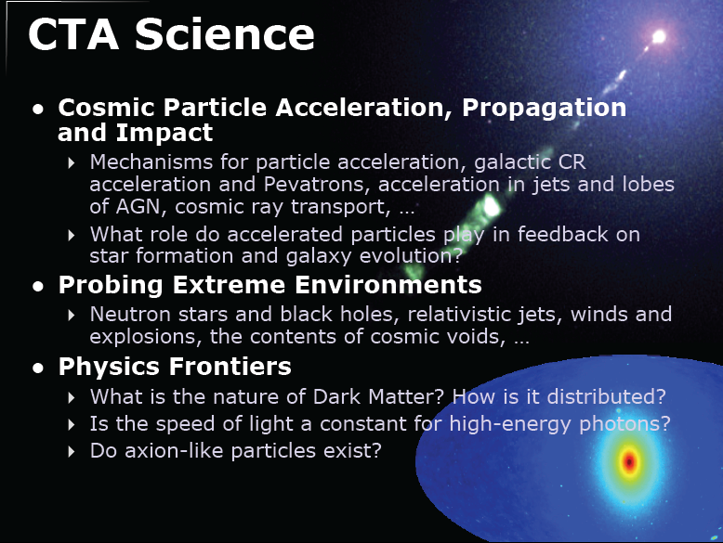

Slide 46
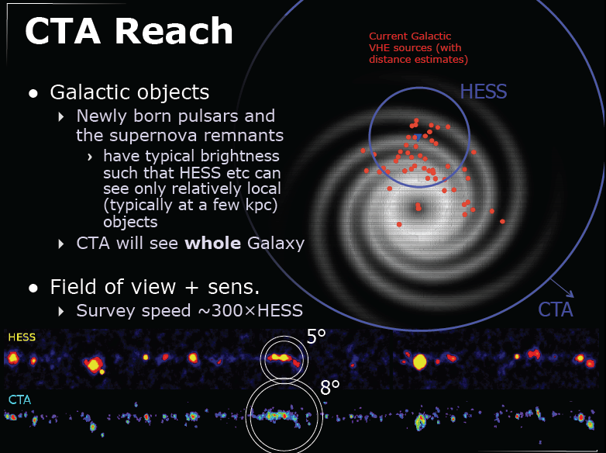

Slide 47
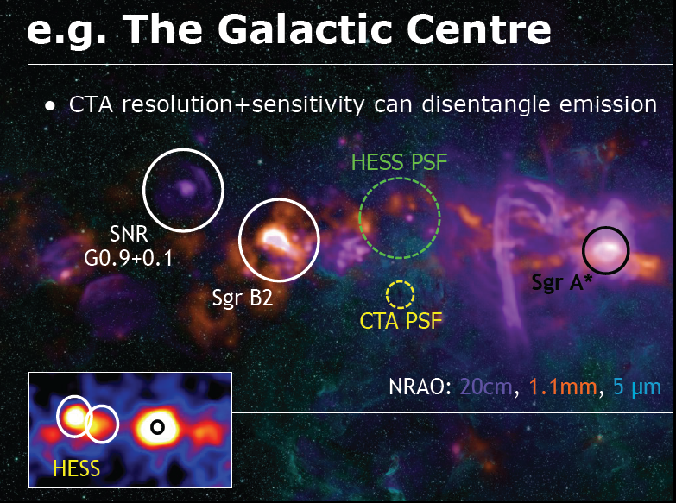

Slide 48
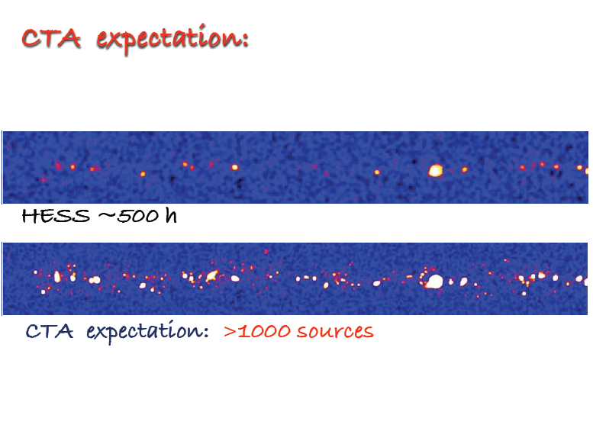

Slide 49
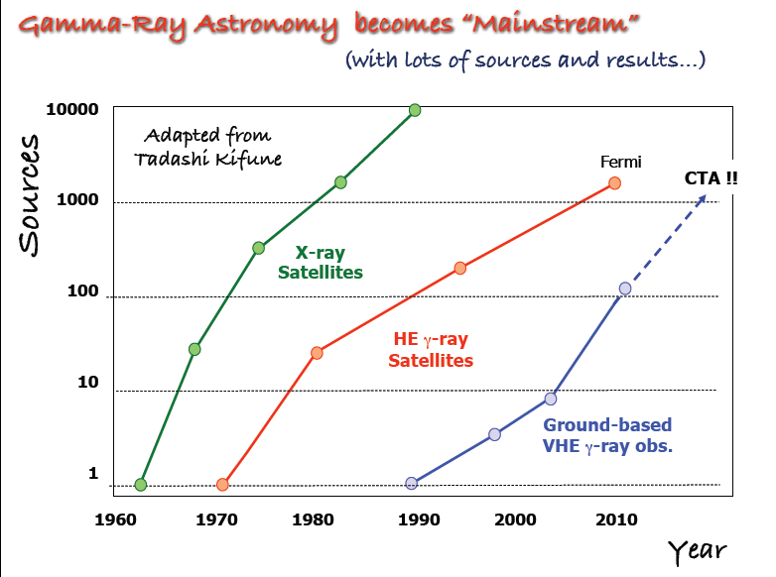

Slide 50
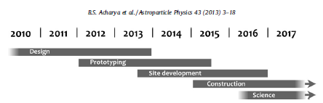
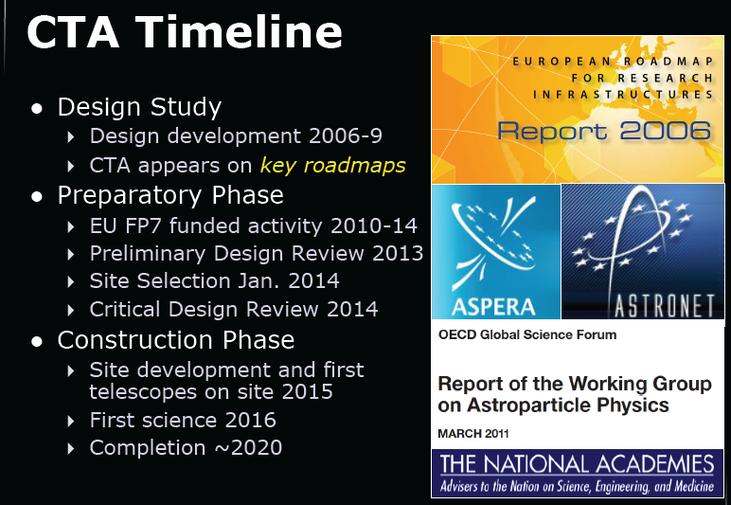
Status of Indian participation
Prototype calibration box for LST (LST work package)
Development of OPC-UA server software for various devices
associated with camera, telescopes and array
(ACTL work package)
Optical throughput calibration of CTA Using muon rings
(COM-CCF work package)
Cygnus region as key science project for CTA (PHYSICS work package)

Slide 51


Slide 52
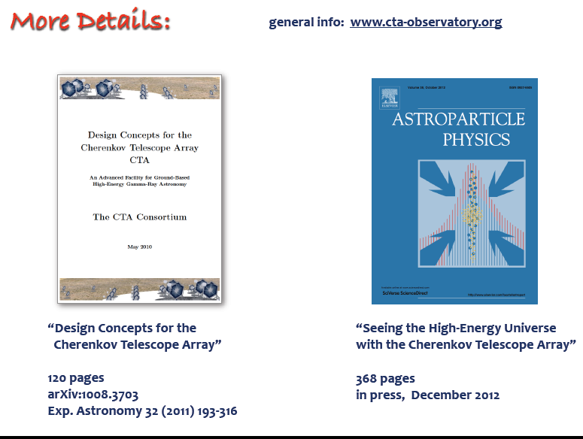
Volume 43, Pages 1-356, (March 2013)
Astroparticle Physics, Volume 43, Pages 1-356 (March 2013)
Seeing the High-Energy Universe with the Cherenkov Telescope Array –
The Science Explored with the CTA
(Edited by Jim Hinton, Subir Sarkar, Diego Torres and Johannes Knapp) Articles 1-25

Slide 53
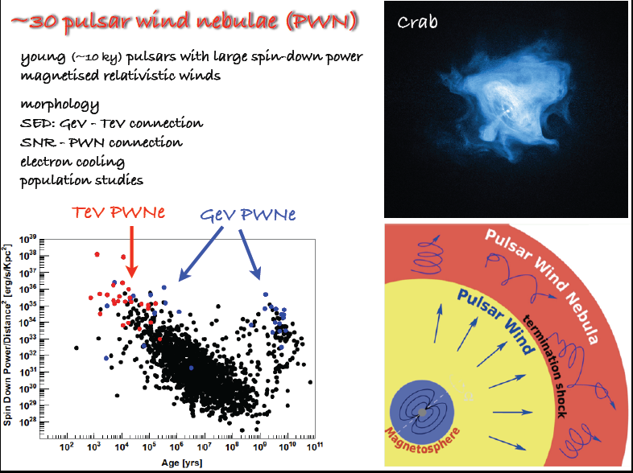
New population of pulsars pulsing only in Gamma-rays

Slide 54
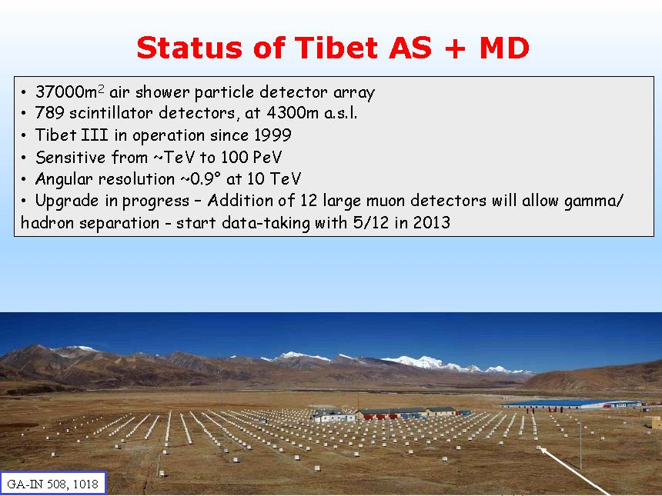


IACTs are not the only way to go. Other Competing or complimentary detectors to CTA.
Tibet AS _{γ} + ARGO-YBJ
LHAASO proposes a survey instrument consisting of
90,000 m2 water Cherenkov Detector Array (LHAASO-WCDA)
24 Wide FoV air Cherenkov Telescope Array (LHAASO-WFCTA)
1 km2 array of scintillator detectors + 1221 muon detectors(LHAASO-KM2A)
425 burst detectors for high energy secondary particles
Large High Altitude Air Shower Observatory at 4200 m amsl in Shangri-la, Yunnan Province , China. A Multi-purpose Cosmic Ray Experimental Project to cover 300 GeV to 1 PeV Gamma ray energy and 300 TeV to 300 PeV cosmic ray energy
HiSCORE: Hundredxi Square km Cosmic Origin Explorer at Tunka Valley, Siberia;Non-imaging technique at highest energies
HAWC: High Altitude Water Cherenkov Experiment at 4100 m amsl at Sierra Negra, Mexico: 300 water tanks 4.3 m height and 7.3 m dia. 50 GeV to 100 TeV

Slide 56


Slide 57


Slide 58

LHAASO (Large High Altitude Air Shower Observatory) at 4200 m amsl in Shangri-la, Yunnan Province , China.
LHAASO-KM2A (1 km2 array + 1221 muon detectors) + LHAASO-WCDA (Water Cherenkov Detector Array)
A Multi-purpose Cosmic Ray Experimental Project to cover 300 GeV to 1 PeV Gamma ray energy

Slide 60


Slide 65


