Slide 1


‘CLOUD10’ experimental run
Sept-Dec 2015
Hamish Gordon
CERN
8/10/15

Slide 2
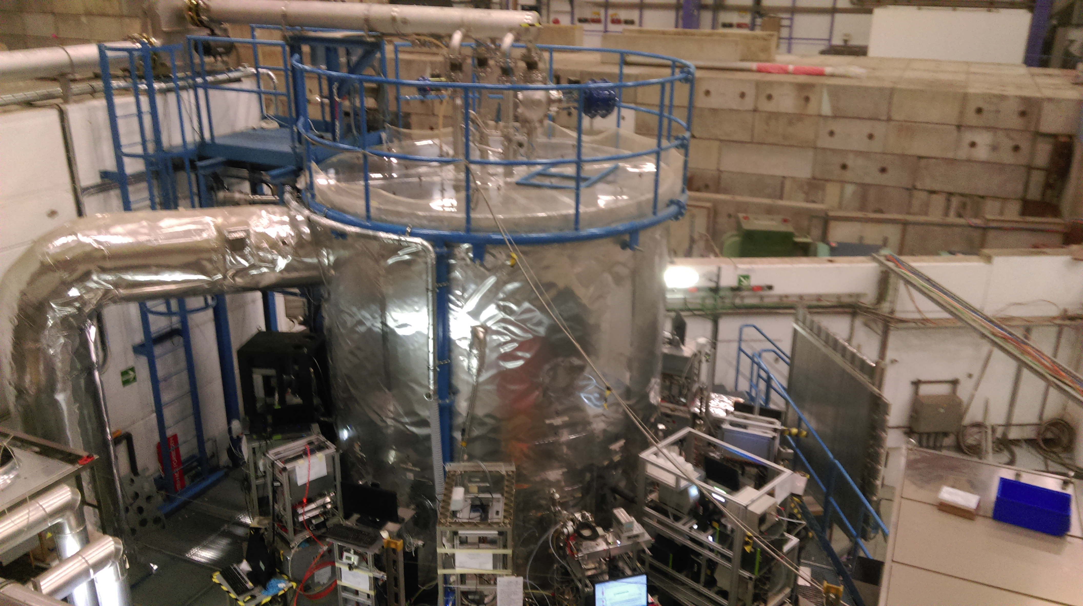
CLOUD status
Stainless steel chamber in East Hall, in operation since 2009
Collaboration of 50-100 people, about 20 institutes in Europe & USA
Focus on studying aerosol nucleation and cloud properties
CLOUD10 Sept-Dec 2015 (11 weeks, without beam after 15 Nov)
15-25 people continually at CERN

Slide 3
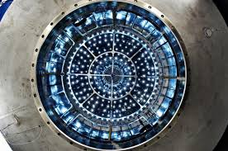
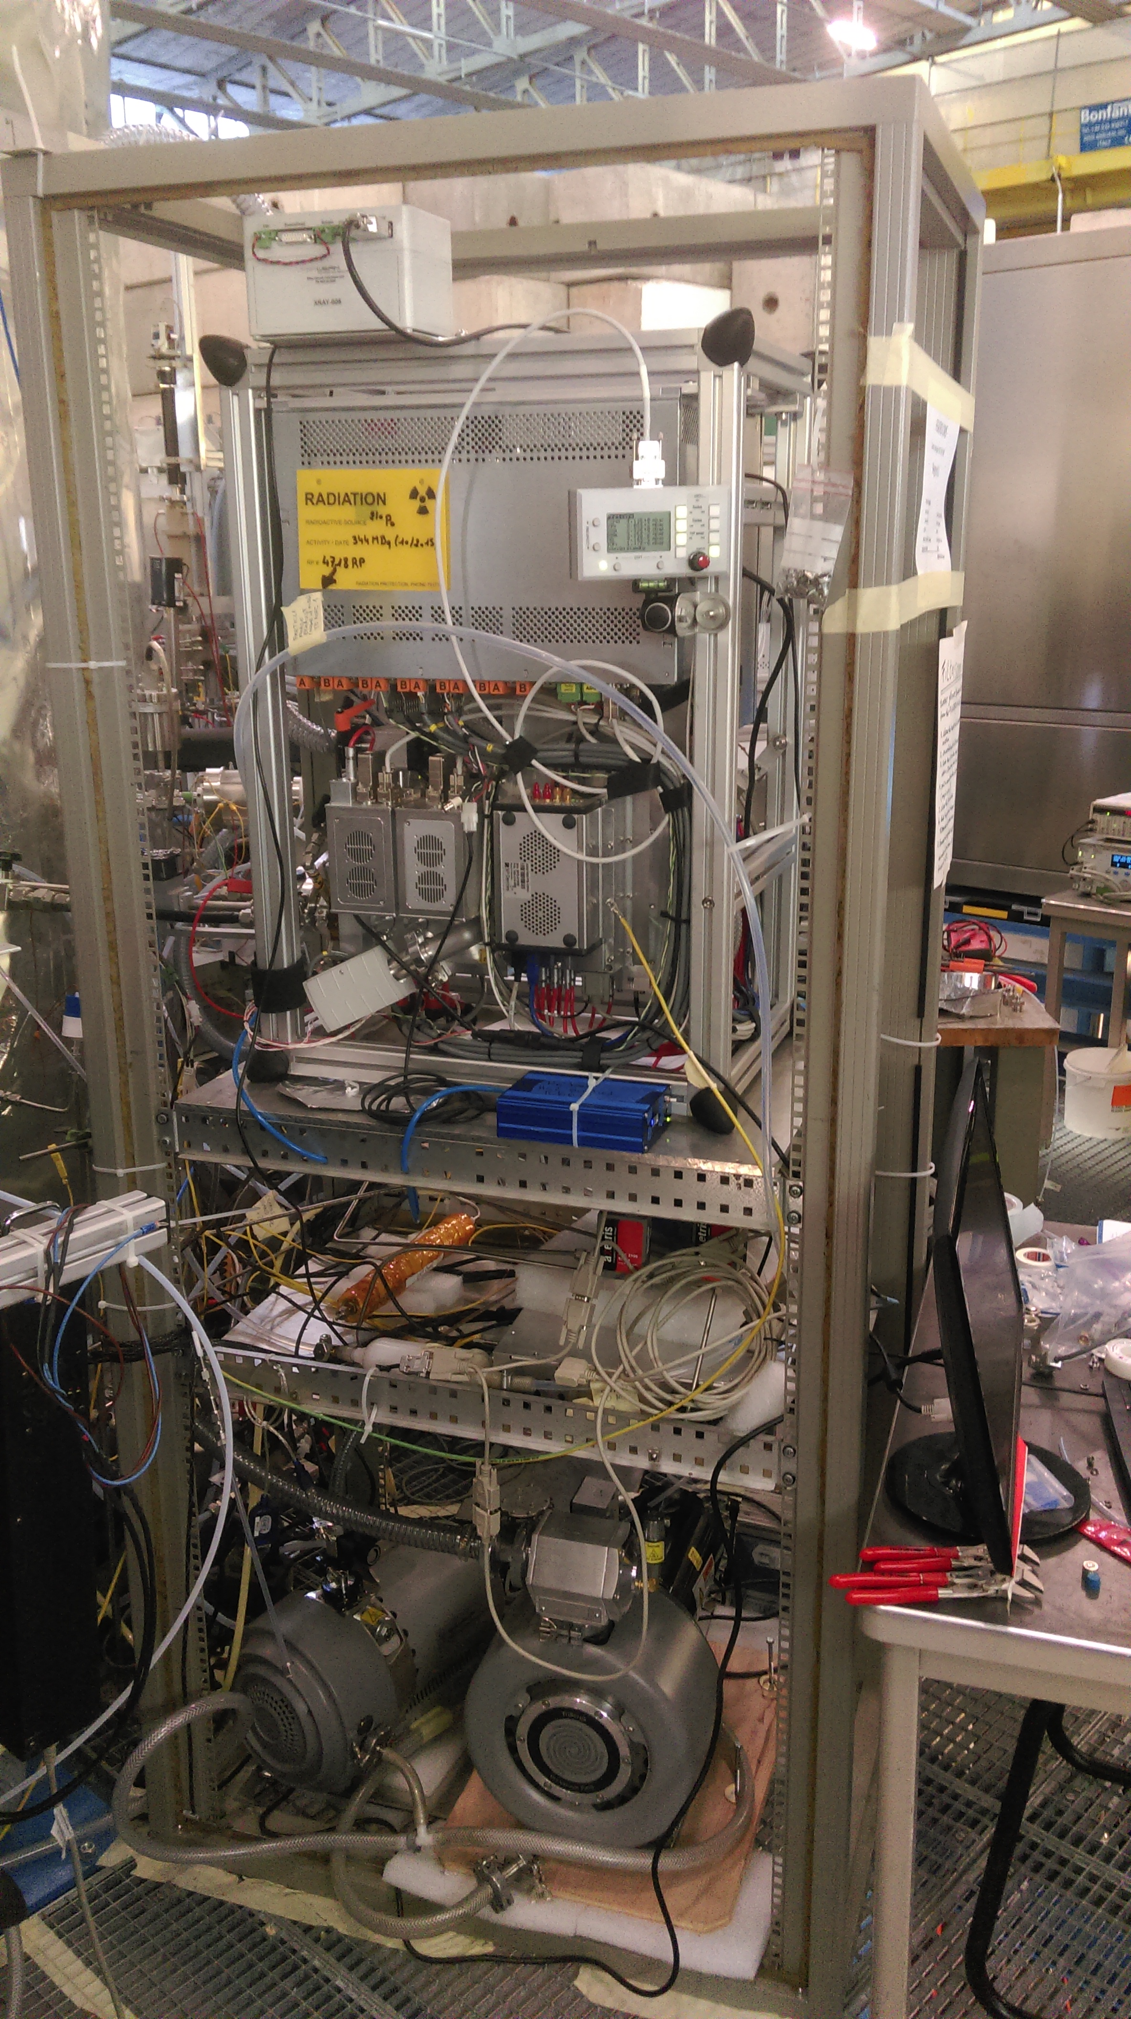
Technical developments
Light source upgrade: reproduce atmospheric photolysis rates of O3 and NO2 with excimer laser and strong LED lamps
Particle phase mass spectrometry of aerosols down to 10nm -> nanoparticle growth
More different chemical ionization techniques

Slide 4
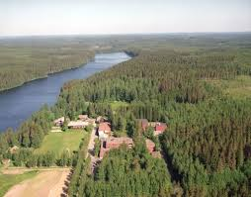

CLOUD10 aims
Understand chemicals responsible for aerosol particle formation in Hyytiala boreal forest
Provide parameterised nucleation rates for atmospheric aerosol models
Nanoparticle growth/isoprene
Charge in organic-only nucleation with beam

Slide 5
Plan for rest of run
Characterise nucleation rates at different temperatures in simple systems
Role of oxidation chemistry (OH from laser, NO from UV sources)
Role of charge
Role of ammonia
Thanks to Lau and the PS team for lots of stable beam, to Bruno for smooth and thorough safety inspections, and to Michael Lazzaroni et al for help in the hall

