Slide 1
Thin films and surfaces treatments in accelerator technology
M.Taborelli
On behalf of TE-VSC
Thin films for accelerating Nb cavities
Thin films for pumping
Thin films against electron cloud
Cleaning for UHV
Plating for accelerator applications
Electropolishing
9/4/2015

Slide 2
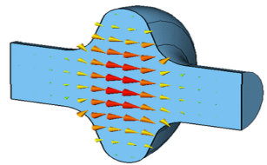
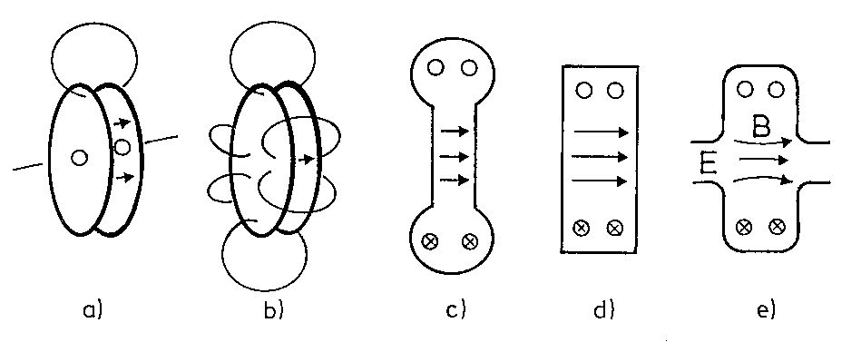
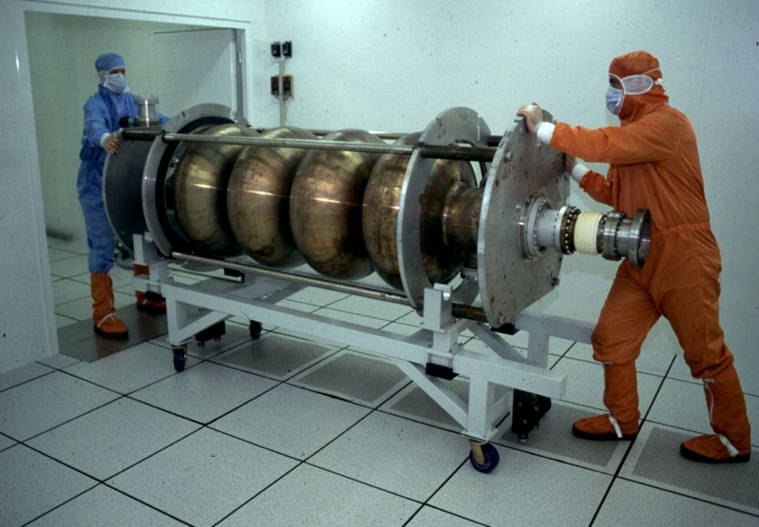
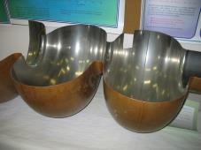
Superconducting niobium RF accelerating cavities
E
beam
CERN SPL
CERN, LEP
CERN, LEP 352MHz
Nb (T_{C}=8.5K) with the required purity is very expensive
1-2 µm Nb thin film are sufficient (skin depth) for 5-7 MV/m fields at 100MHz-GHz frequency range
successfully developed at CERN in the 80’s, recent development for HIE-ISOLDE project

Slide 3
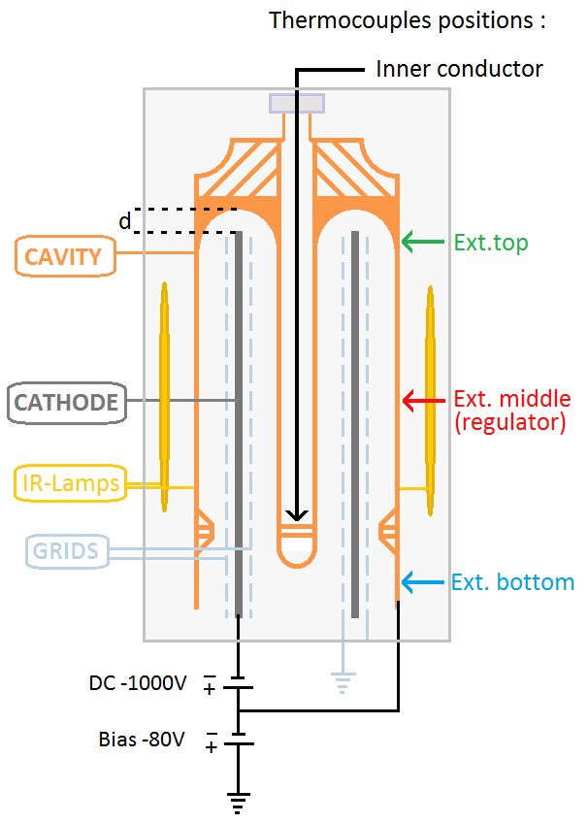
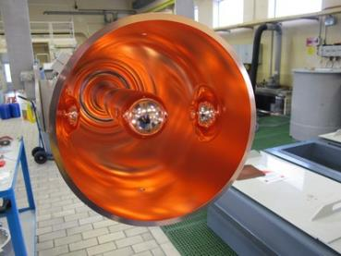
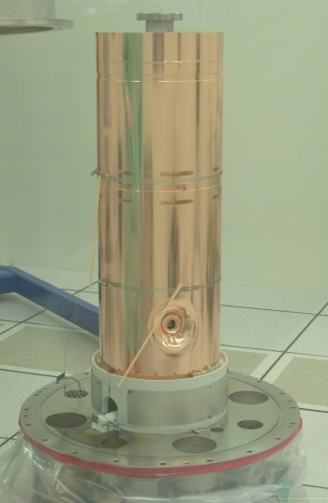

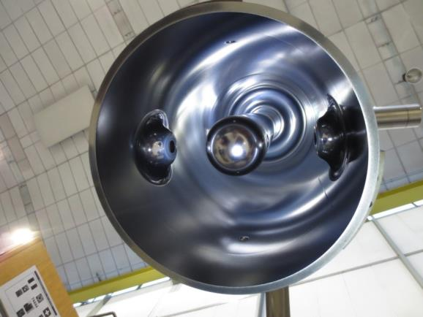
HIE Isolde quarter wave accelerating cavities:
Nb thin film coating
Diode sputtering, Nb (1-5 µm).
Purity (vacuum!) and substrate preparation (chemical polishing) are crucial to avoid field emission and related energy dissipation
High T bake out of the cavity (600°C)
Nb 14 layers
2 μm
Cu substrate
beam
FIB cross section, courtesy of EPFL
Coating in 14 steps (5 days)

Slide 4
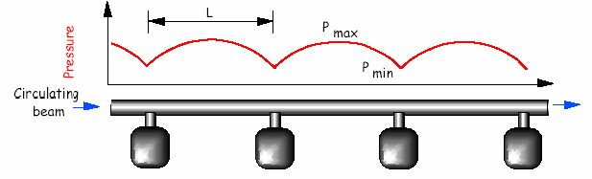
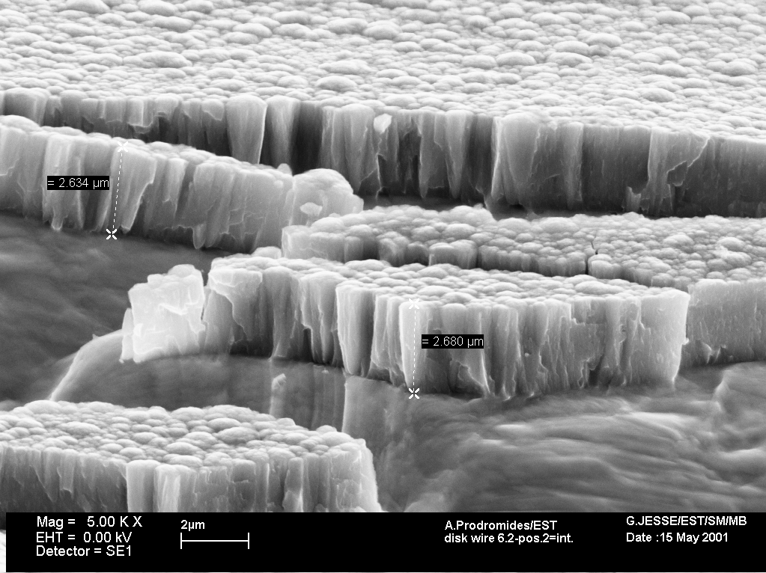
Thin film of Non-Evaporable-Getter as vacuum pump
In accelerators at ultra-high-vacuum (<10⁻¹⁰ mbar) the trend is to bring the pump closer to the outgassing source and distribute the pumping speed evenly.
Pump space hindrance and conductance vs pressure profile!
pump
pump
pump
pump
➔ transform the entire vacuum chamber in a pump by coating it with a getter thin film: ~2μm of TiZrV deposited by DC magnetron; activated with a standard vacuum bake-out at 180°C-230°C (24h), operates at RT
LEP dipole vacuum chamber
Pumps (chemisorption) H₂, CO, CO₂, …..
Does not pump CHx and noble gases
Characterised by XRD, EDX, SEM, XPS…
NEG
coating
Why?...

Slide 5
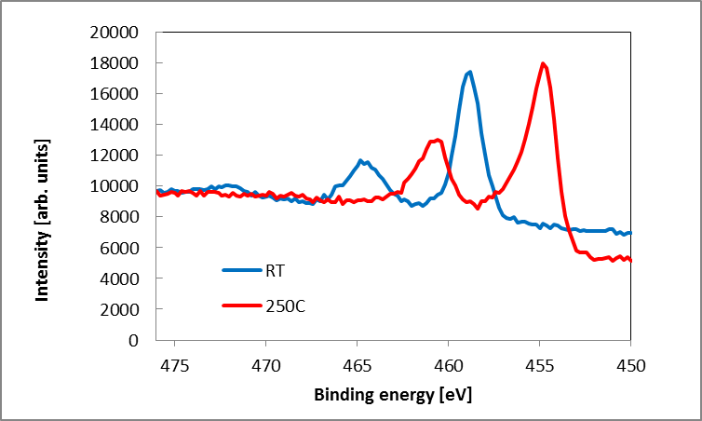
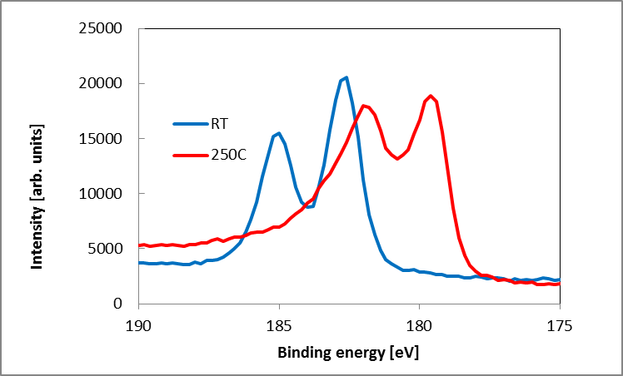
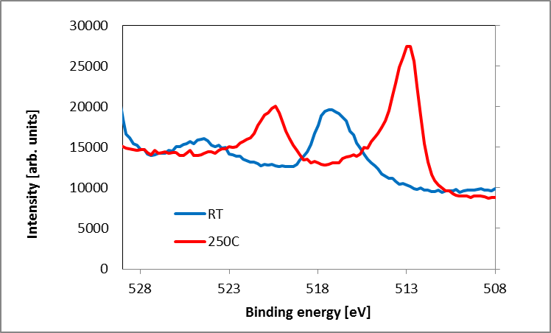
Activation process: Monitoring by surface analysis (XPS)
Ti
ox
Heating stepwise for 1h at each T
met
Diffusion of O into the bulk
Reduction of the surface oxides of all the metals: the surface is metallic and reactive
Zr
met
ox
Surface Oxygen decrease
V
met
ox

Slide 6
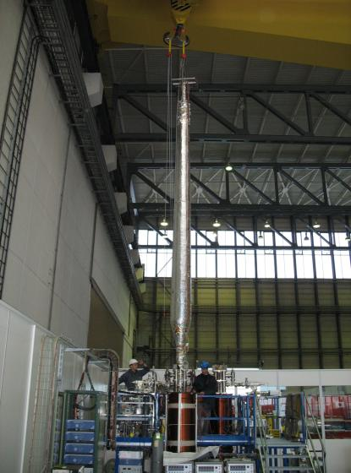
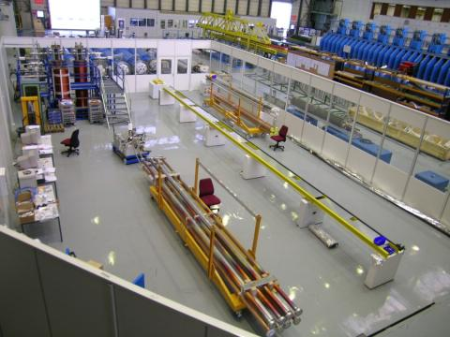
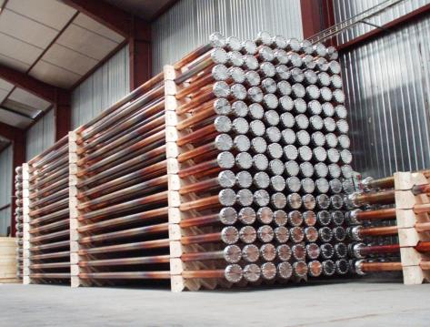
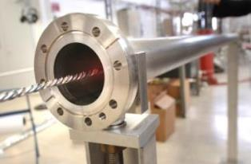
Coating plant for vacuum chambers up to 7 m length
7 km of LHC
CAPE09 Cambridge M.Taborelli CERN

Slide 7
Electron cloud and SEY
+
+
+
+
Proton bunch (charge +)
Gas molecule
Electron (charge -)
→ Perturbation of the beam (emittance growth), thermal load on cryogenics, noise on beam instrumentation; the problem is more important for high beam currents (beam potential) and short bunch spacing
To reduce the effect one must reduce the secondary electron yield (SEY) of the walls or attract the generated electrons by other means

Slide 8
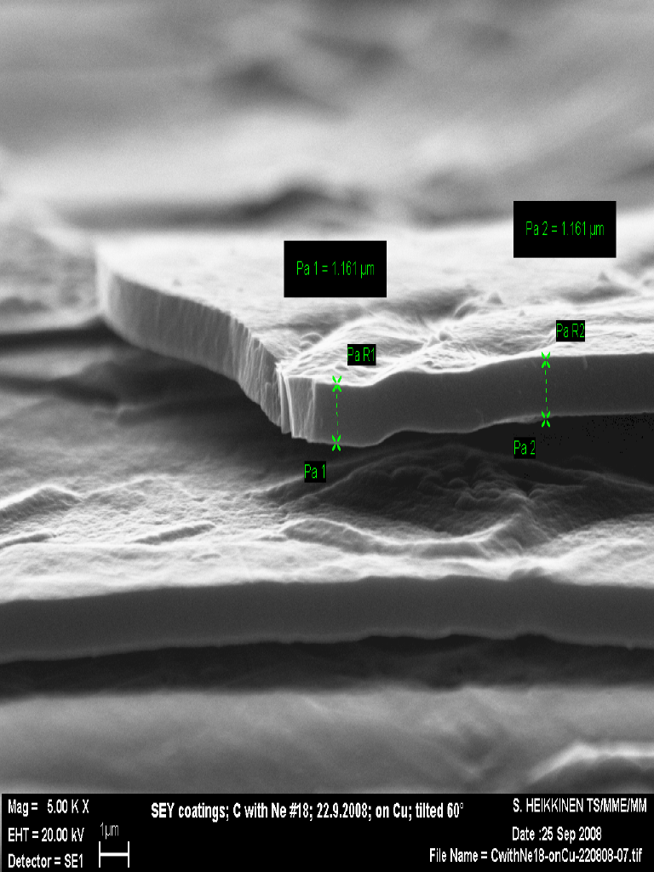
The possible solution : carbon a-C coatings
as received
a-C(Ne9)
Dose below
10⁻⁶ Clb/mm²
-Carbon (graphitic) coating on copper deposited by magnetron sputtering
-SEY does not change for thicknesses above 50 nm
-development started in 2008 for an upgrade of SPS

Slide 9
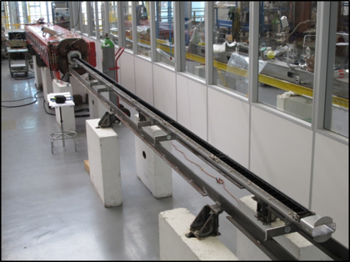
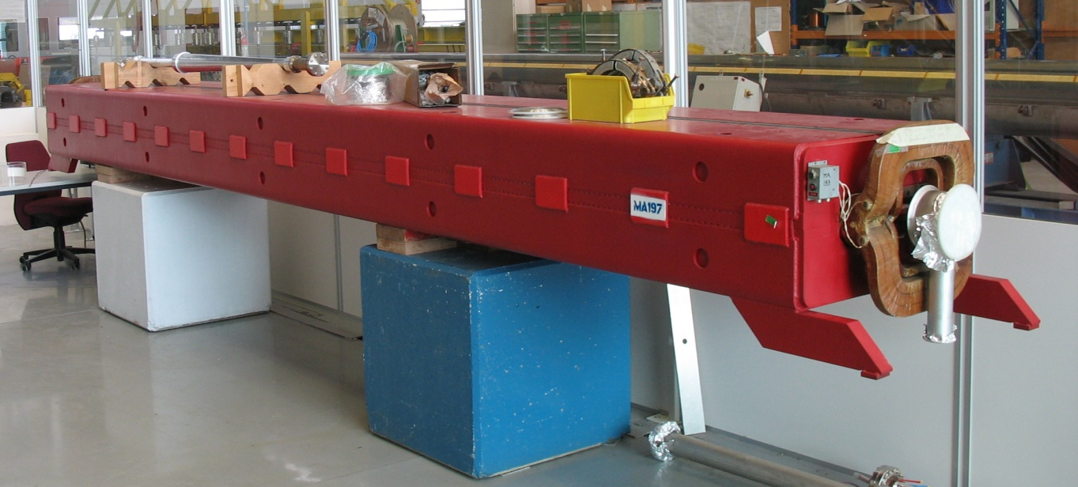
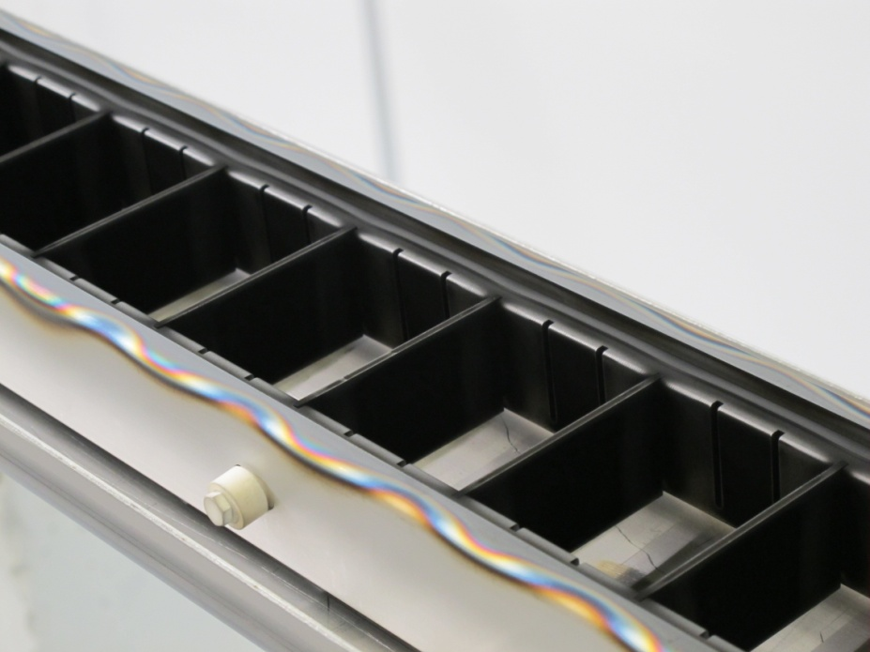
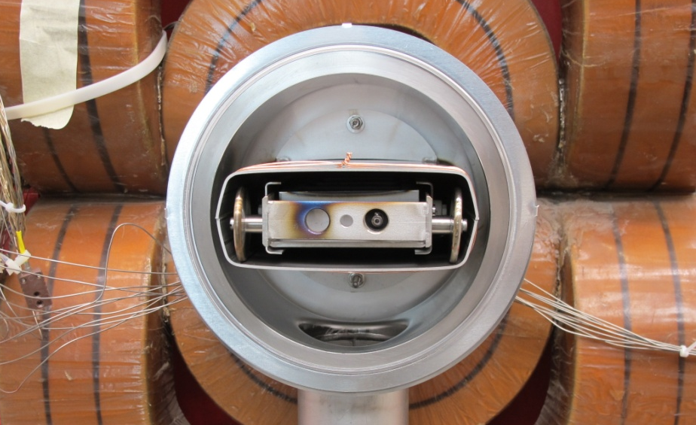
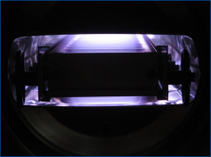
LIU-SPS: Carbon coating of the SPS vacuum chambers
`
Project of coating of the Super Proton Synchrotron dipoles with carbon to mitigate electron cloud (744 dipoles x 6.5 m each, 18 t)
hollow cathode coating (cannot apply axial B-field for magnetron in the yokes)
successful on short section, tested with beam in SPS (section ~200 m)
development ongoing to do the coating in the tunnel in 2018
6.5 m
6.5 meter
Cathode:
graphite targets
(cells)
Cathode in the SPS MBB dipole

Slide 10
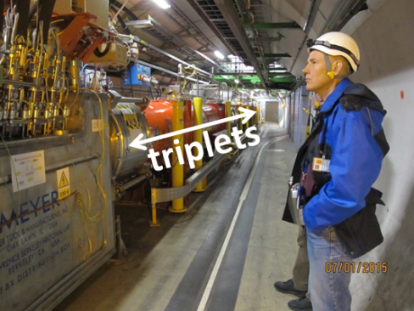
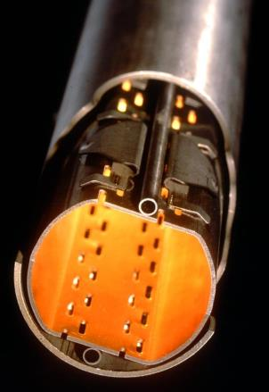
Carbon coating of triplet magnets of LHC in situ during LS2
In order to cope with the thermal load on cryogenics provoked by e-cloud
Close to interaction points
Coating 35 m of beamscreen without dismounting the cryogenic magnets
ARC types, ≥Q7 (c.bore inner diam. 50 mm)
LSS types, Q1–Q6 (cold bore inner diameters 50, 53, 63, 69 and 74 mm)
35 m

Slide 11
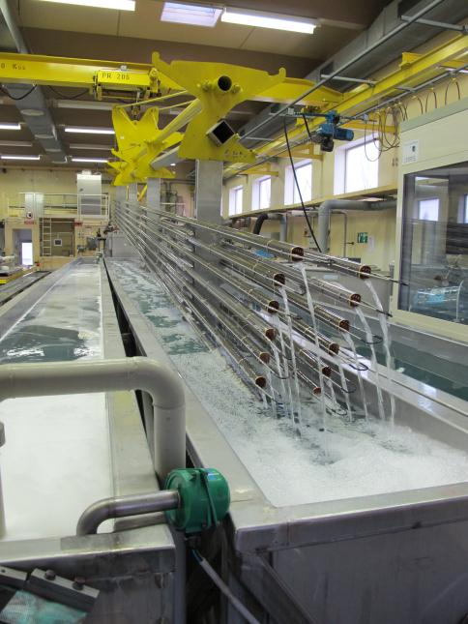
Cleaning UHV components and monitoring cleanliness :
CH₃ asymmetric deform. of Si-CH₃
Si-C stretching and CH3 rocking
Precision cleaning is important to reduce outgassing and achieve UHV (standard up to 7m length)
CH stretching of CH₃
Transmittance [%]
CH₃ symmetric deform. of Si-CH₃
Si-O-Si stretching
FTIR
Through elution with C₆H₁₄
Wavenumber [cm⁻¹]
S.Ilie, C.Petitjean, C.Dias-Soares
Stainless steel 316LN
XPS

Slide 12
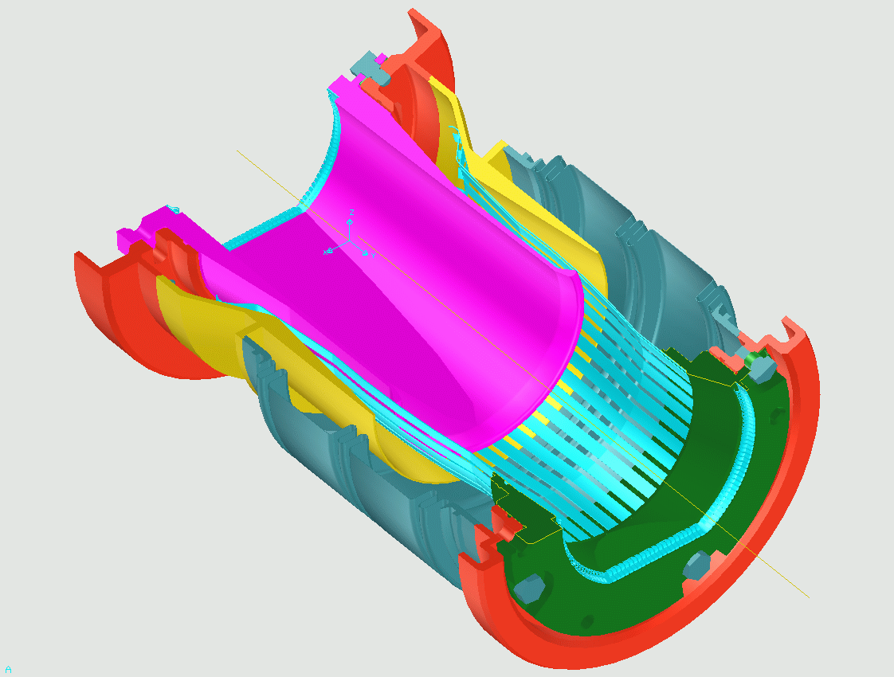
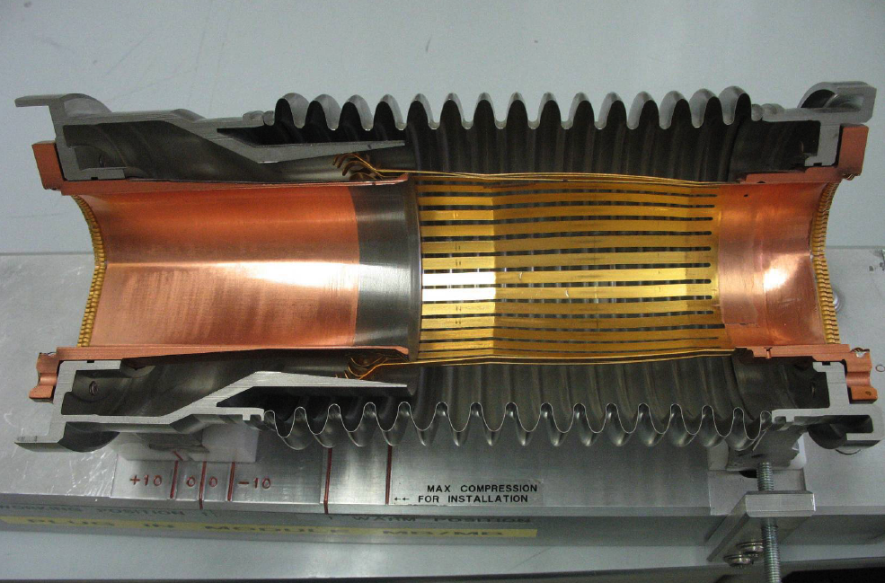
Plug-in Modules with RF Fingers
RF bridge (fingers) to interconnect superconducting magnets (~ 1 700 PIM)
Au/CuBe and Rh/Cu plating: different metals to avoid cold welding under vacuum and soft-on-hard contact to have sufficiently low resistivity (< 0.1 mOhm contact resistance)
Rh
Au
Screw & Spring washer
Upstream flange
Copper transition tube
RF bellows
RF-contact strips
coating 5 μm
Indium brazed
Rhodium coating 3 μm
RF-contact Gold coating 5 μm
Screw & Spring washer
Plug-in module transition tube
RF-contact transition flange
Downstream flange
Courtesy R. Veness
RF-contact strips
coating 5 μm
Indium brazed
Room temperature position
Working position at cryogenic temperature
cooling

Slide 13
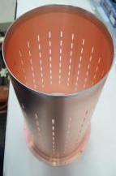
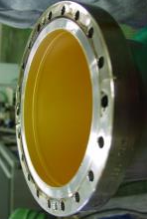
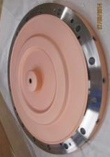
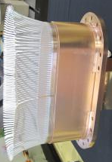
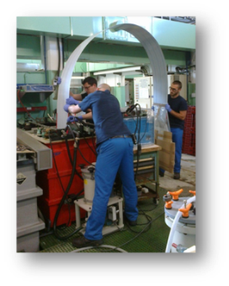
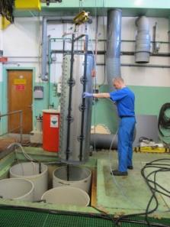
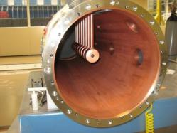
Electrolytic deposition: on stainless steel, copper and aluminum
Gold electroplating
Copper electroplating
Silver electroplating
Rhodium electroplating
LINAC3 test chamber
Cover of DTL LINAC 4
RF fingers TDI shield
RF transition LHCVSR
Ag plating on Al stripline contact AD
Cu plating on DTL tank of Linac 4

Slide 14
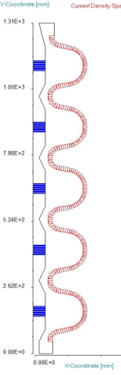
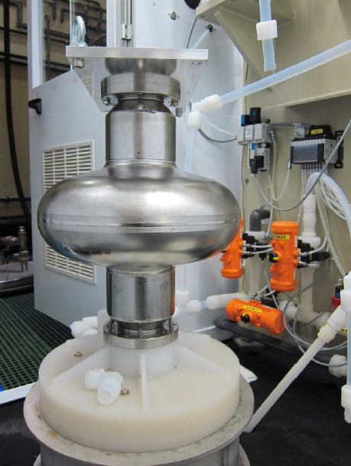
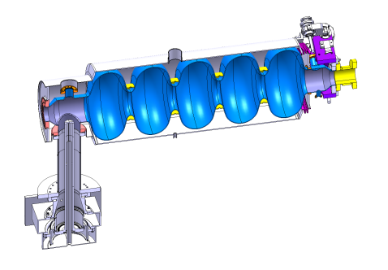
Bulk Nb superconducting cavities: Optimization of the Electropolishing
5-cell cavity
Electrode and current density map
Simulation with smooth electrode (red) and optimized electrode (blue) to get more uniform current and polishing
COMSOL
software

Slide 15
Ongoing projects and R&D interests
Carbon coating «in situ» (hollow cathode, RF magnetron, PLD…) X
SC RF cavities: coating by HIPIMS, new materials as Nb₃Sn… X, X
Simulations of plasma for coating systems X
flexible insulating coatings X
Treatments or coatings to lower the SEY of surfaces (metals and insulators) X,X
NEGs with lower activation temperature than TiZrV X
Coatings as permeation barriers for high transparency vacuum chambers X,X
Methods to produce thin films of refractory metals in small diameter tubes (< 10 mm), as electrochemical means… X,X
Novel cleaning techniques for UHV applications X
- ……..

Slide 16
THANK YOU!

Slide 17

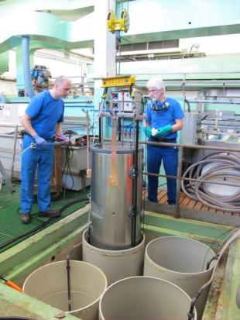
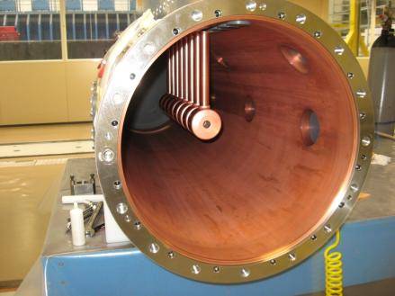
Wet surface treatments: Cu plating of DTL tank of LINAC4
Difficult to obtain uniform plating
and plating in the ports
Final assembly with the electrodes for the accelerator
17

Slide 18
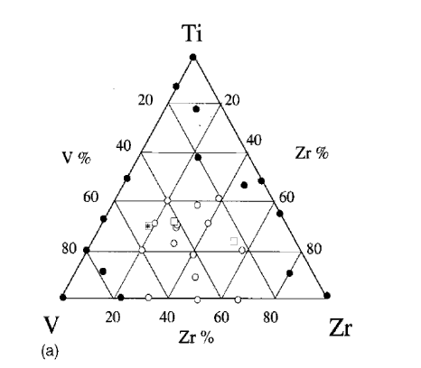
Range of composition of TiZrV thin films :
From surface analysis
From X-ray diffraction
low activation T
grain size below 5 nm
grain size
above 100nm
(EDX composition)
Strong correlation between composition, structure and activation T: fast diffusion at lower T is favoured in coatings with very small grains?

Slide 19
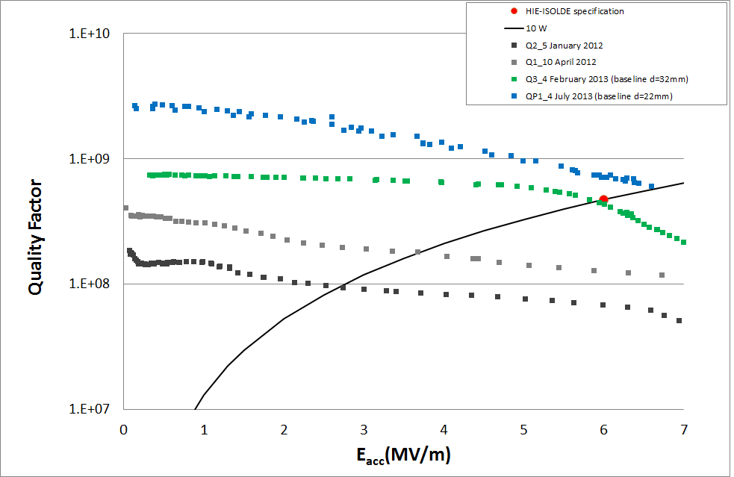
HIE Isolde quarter wave accelerating cavities:
Q factor performance
8kW, special bakeout, baseline recipe
Final geometry
8kW, special bakeout, baseline recipe
4kW, standard bakeout
2kW, standard bakeout
Preseries geometry

Slide 20
Pumping action of TiZrV NEG:
The sticking probability is the ratio between sticking and impinging molecules. It shows the pumping efficiency
The sticking probability increases when the NEG is activated (all measurements made at the same T, after thermal activation)
Sticking probability
Pumping speed [l s ⁻¹ cm⁻²]
150 200 250 300 350
2h heating temperature [C]
Pumping speed [l s ⁻¹ cm⁻²]
Sticking probability
150 200 250 300 350
2h heating temperature [C]

Slide 21
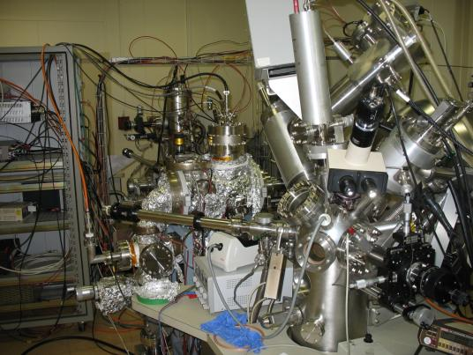
Measurement of SEY
electron gun
I_{p}
A
I_{c}
I_{c}
Sample
I_{s}
A
SEY
measurement
XPS
I_{p} = I_{s} + I_{c}
δ = I_{c} / (I_{s} + I_{c})
Coatings

Slide 22
XPS: comparison with graphite
C1s
a-C(Ne)
HOPG
cleaved in air
The C1s peak is wider than that of freshly cleaved graphite: due to the oxygen on the surface (8-10% typical) and chemical shift of C-O bonds or due to the more disordered structure and different C-C bond species?
Coatings

Slide 23

Structure from Raman
Based on the ratios of D/G peaks
and G position:
the coatings are in the region
of high sp² content
Graphite like/amorphous coating
..but, no clear correlation between SEY and the detailed position in the diagram (possibly because several effects are in competition)
A.Ferrari et al PRB65

Slide 24
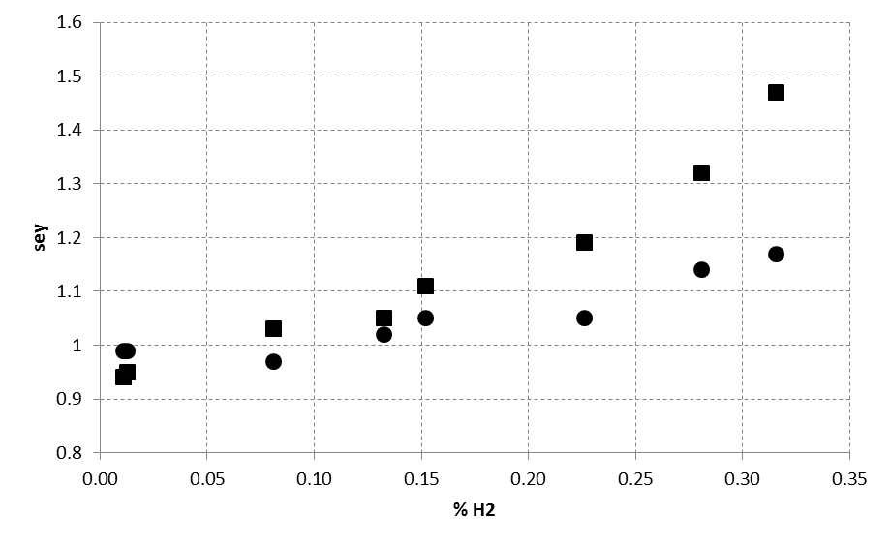
Effect of hydrogen content in the sputtering gas
1.6
1.5
1.4
1.3
1.2
1.1
1.0
0.9
0.8
Effect of hydrogen
SEY
0 0.05 0.10 0.15 0.20 0.25 0.30 0.35
H₂% in Ar gas
Hydrogen is the most important residual gas in a baked vacuum system (outgassing), therefore a special care must be taken to have a «clean» coating system
Remark: it is very difficult to measure the H content in a carbon coating!

