Slide 1
Activities in Radio-Frequency Engineering
Erk Jensen

Slide 2
CERN Accelerator Complex

Slide 3
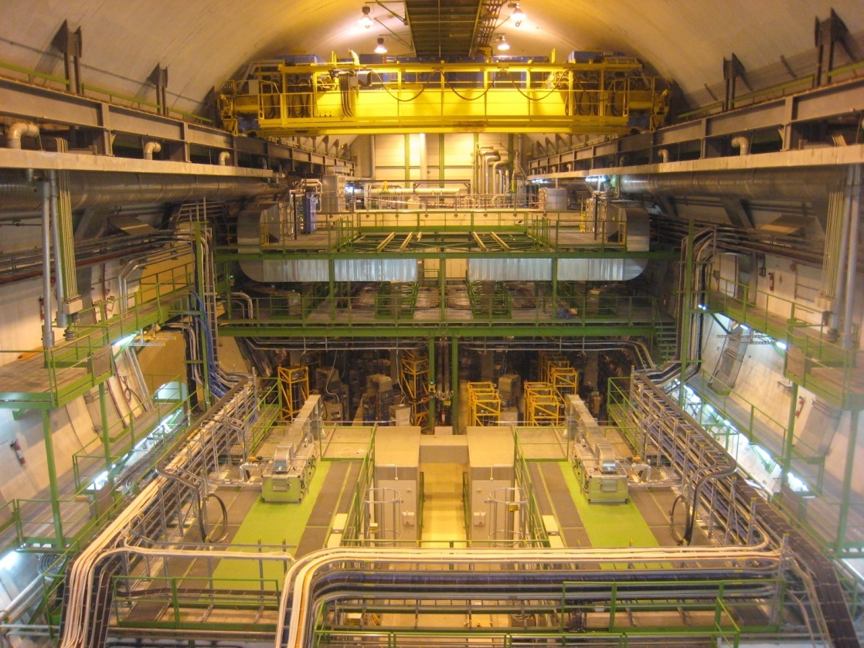
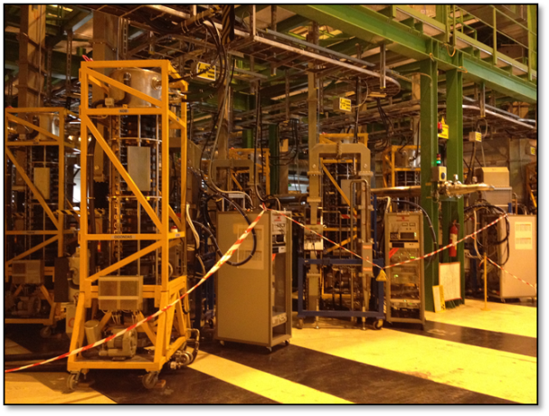
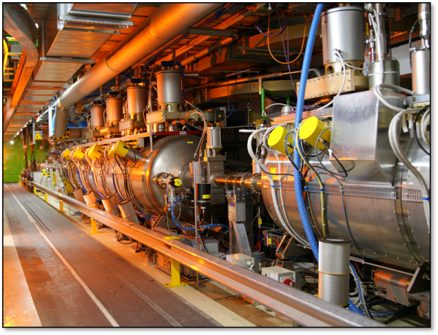
LHC RF Systems

Slide 4
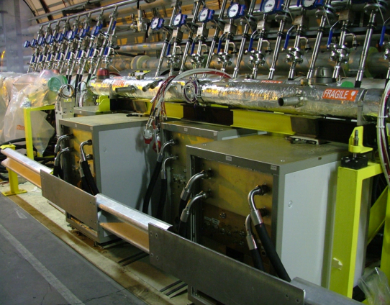
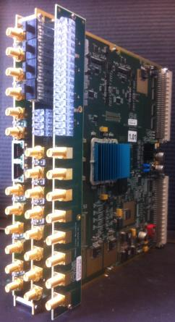
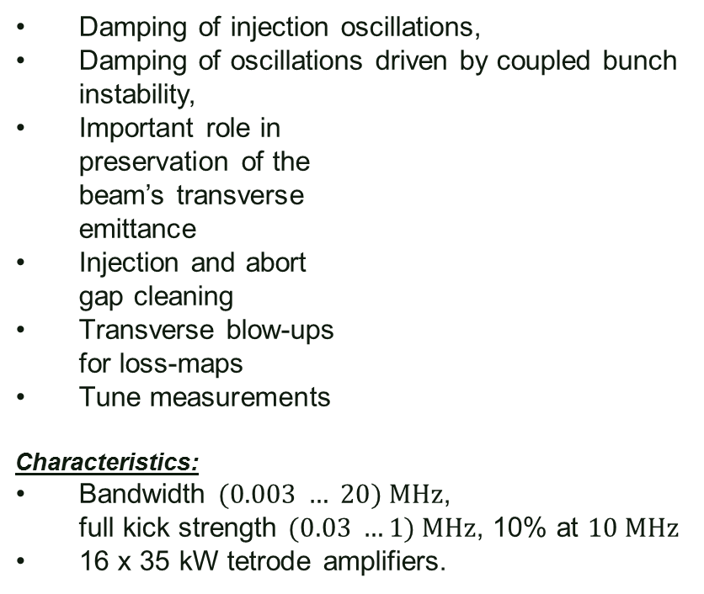
LHC Transverse Damper
Damping of injection oscillations,
Damping of oscillations driven by coupled bunch instability,
Important role in
preservation of the
beam’s transverse
emittance
Injection and abort
gap cleaning
Transverse blow-ups
for loss-maps
Tune measurements
Characteristics:
Bandwidth $(0.003 … 20) MHz$,
full kick strength $(0.03 …1) MHz$, 10% at $10 MHz$
16 x 35 kW tetrode amplifiers.

Slide 5
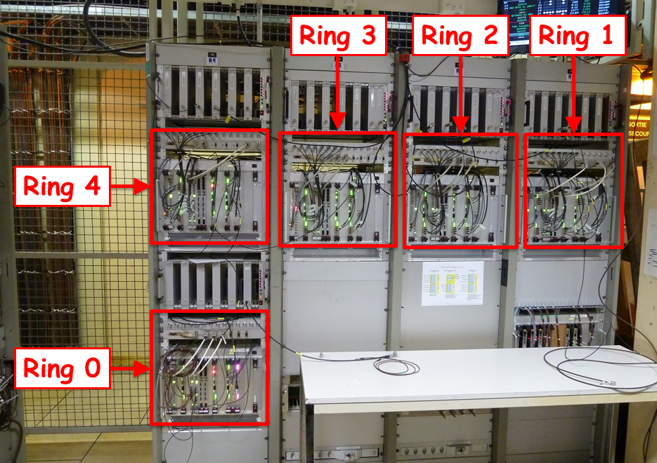
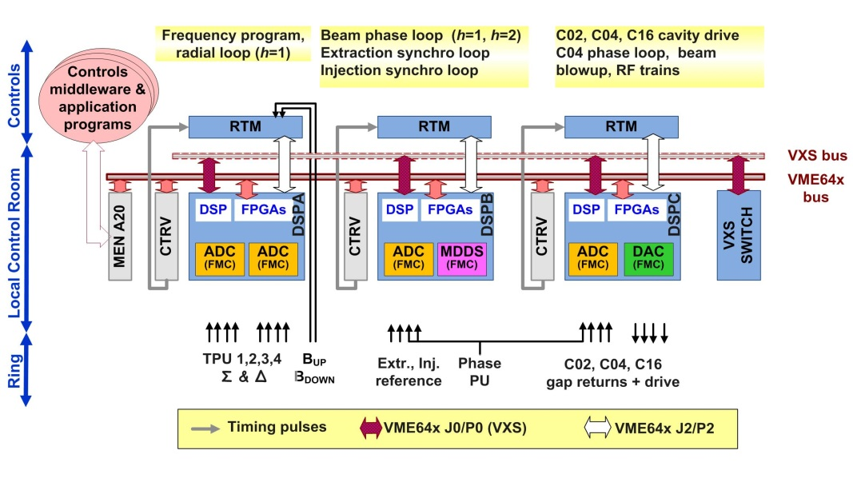
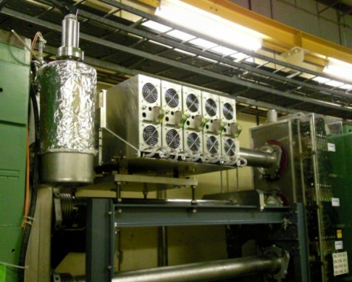
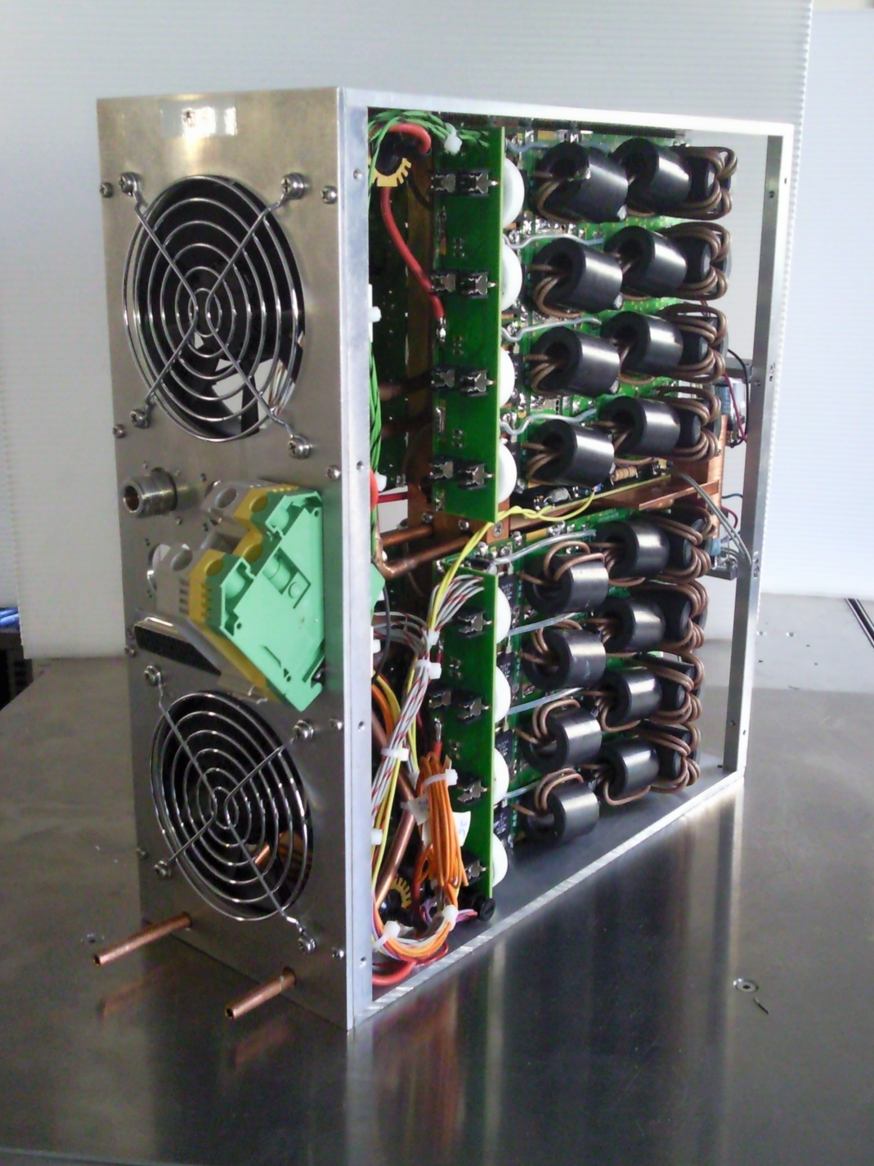
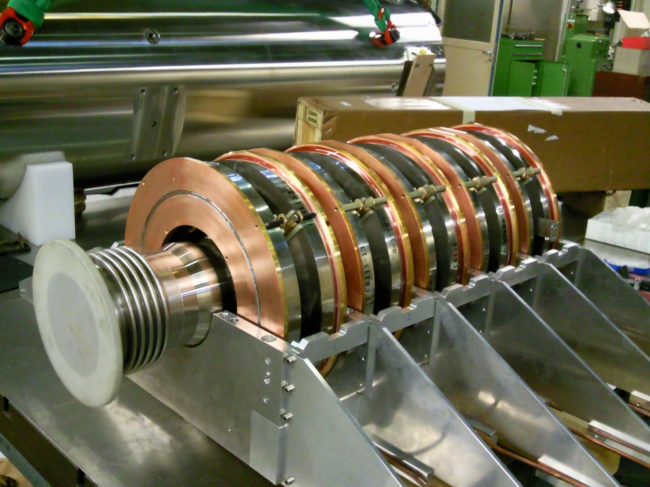
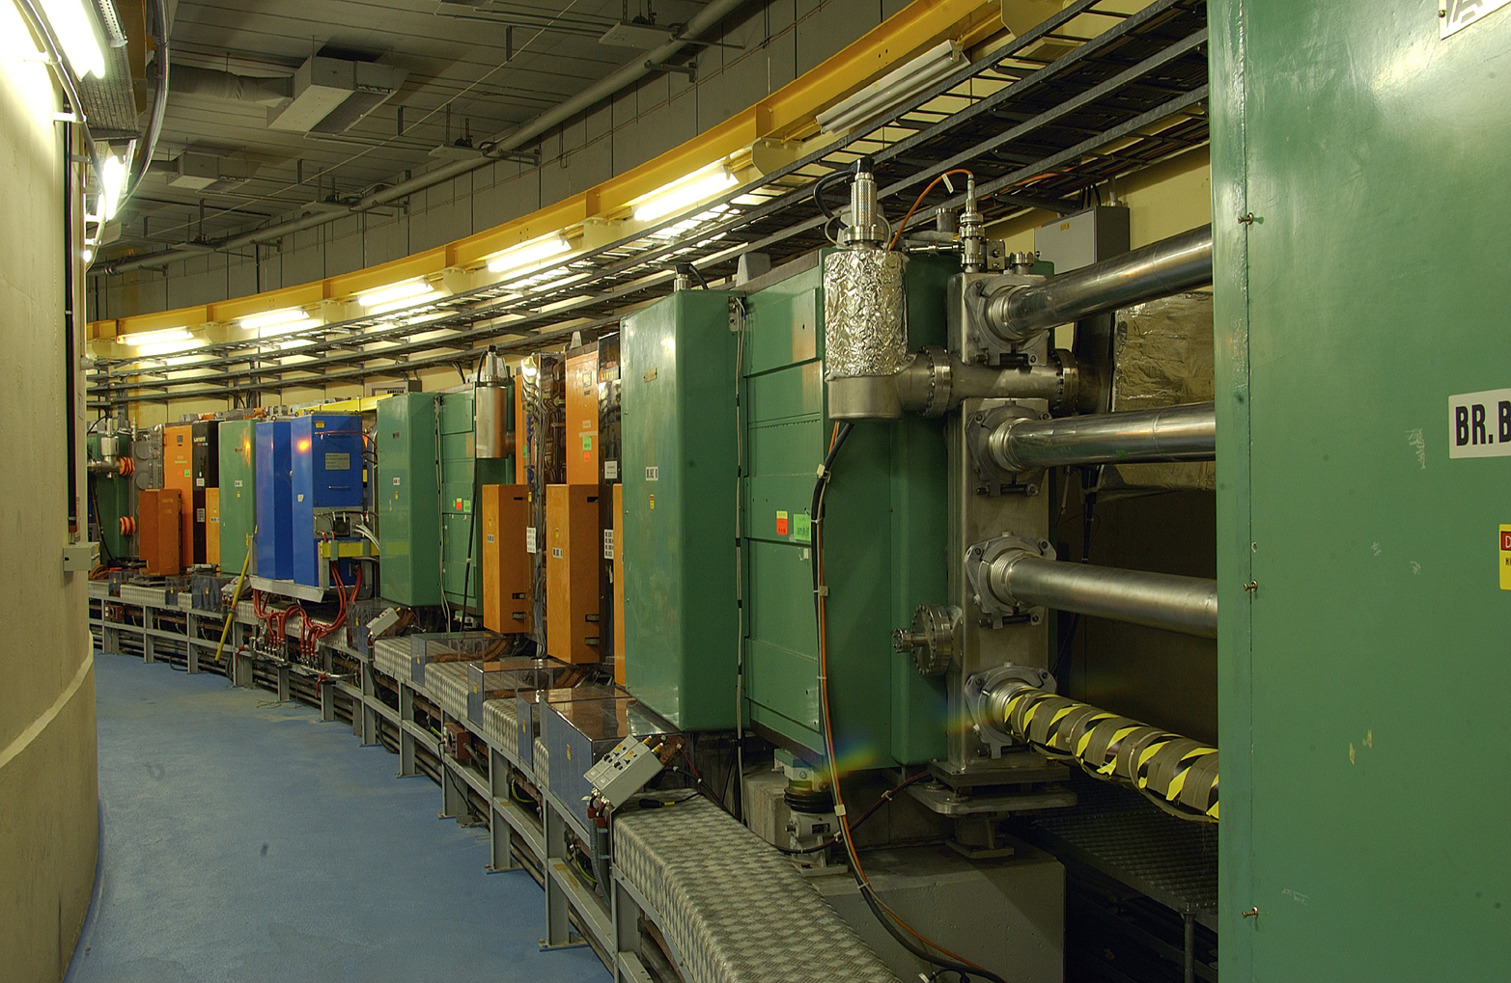
PSB Digital LLRF & Finemet
42 Motherboards (FMC-DSP-Carrier)
42 Rear-transition modules
23 Switch modules
(42 ADC, 30 DAC, 15 MDDS) FMCs
14 Cavity Control Interface modules
The hardware

Slide 6
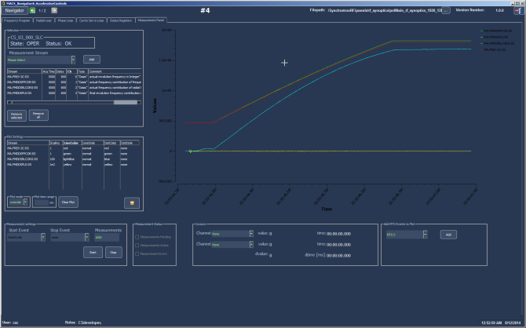
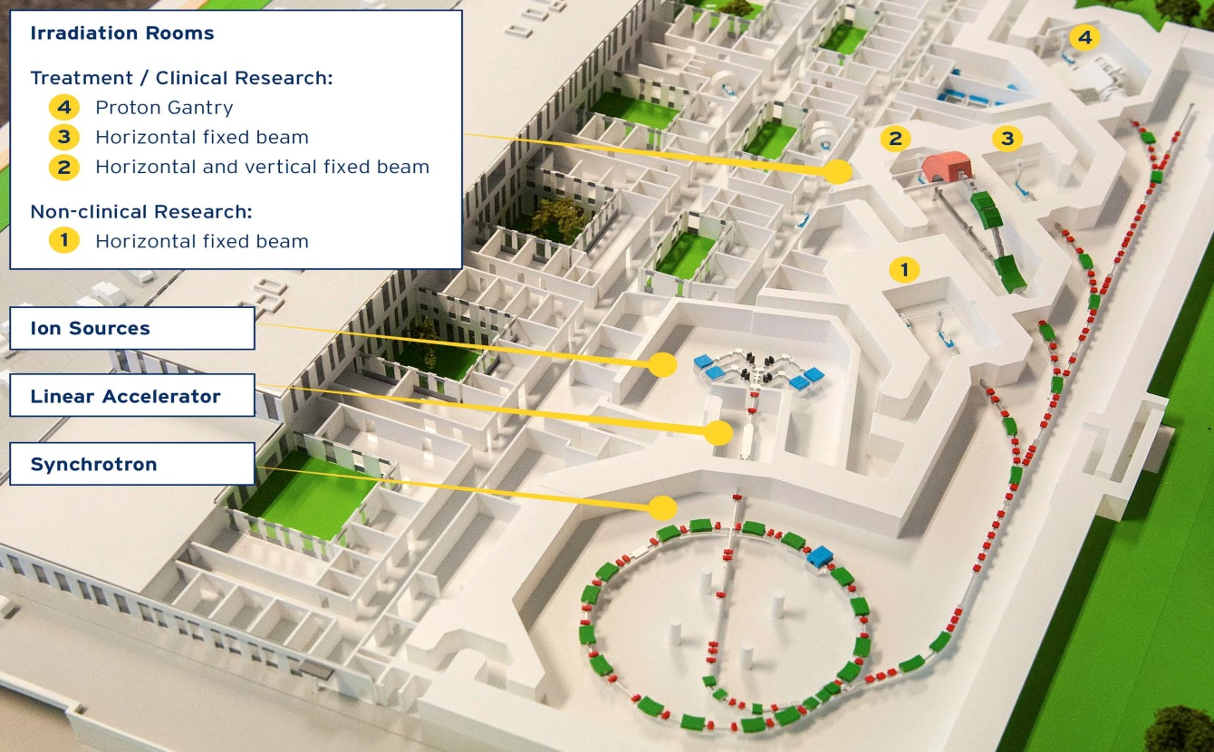
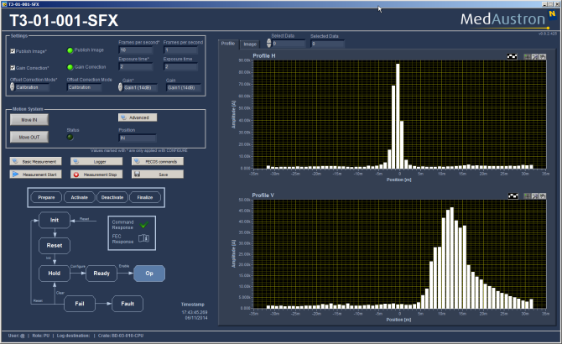
Hadron Therapy Collaboration
Successfully delivered & contributed to commission Digital LLRF (PSB-style) + HLRF (Finemet®-based ) systems for MedAustron synchrotron.
  6 Nov ‘14: 10E8 protons extracted to IR3 @ 250 MeV
  31 Mar ‘15: Entering Clinical Qualification Phase
Irradiation Room 3 (IR3)
MedAustron complex
MedAustron synchrotron

Slide 7
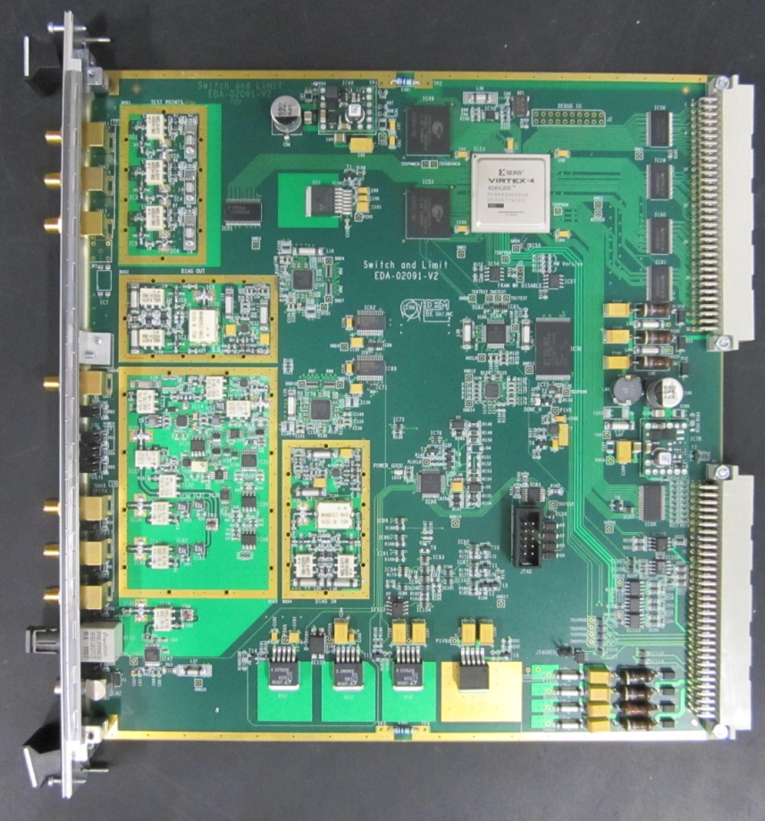
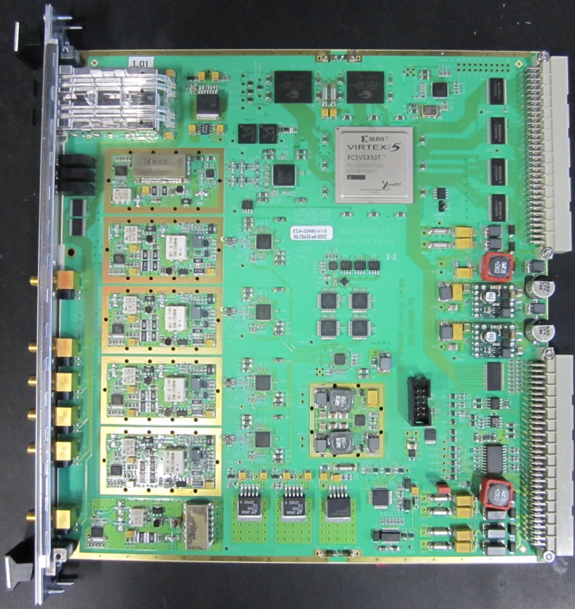
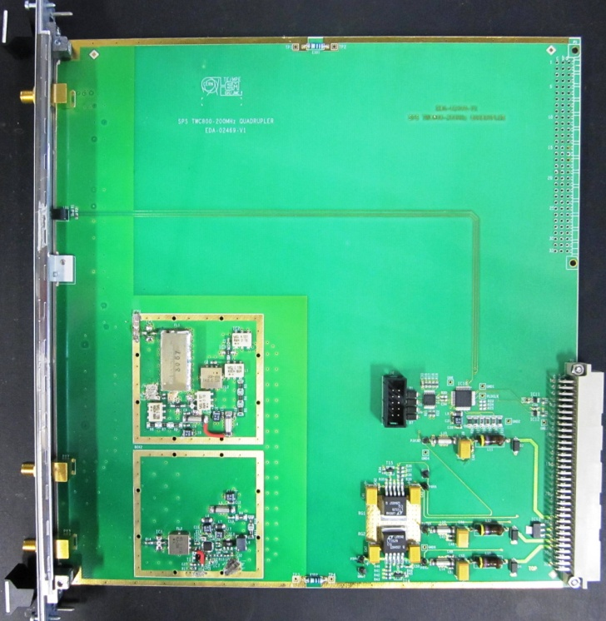
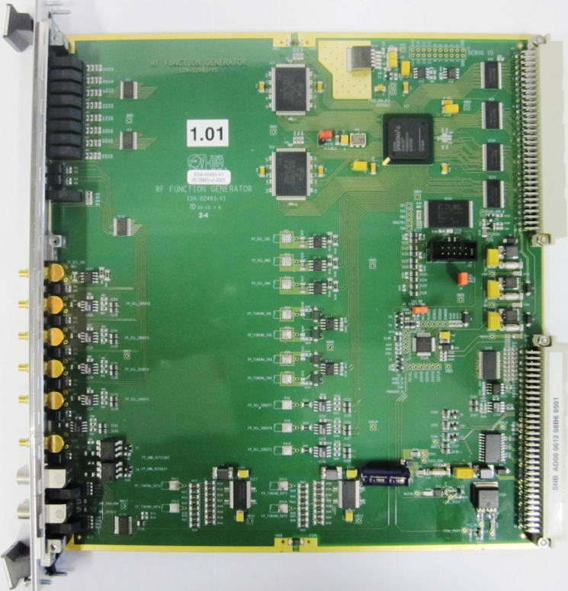
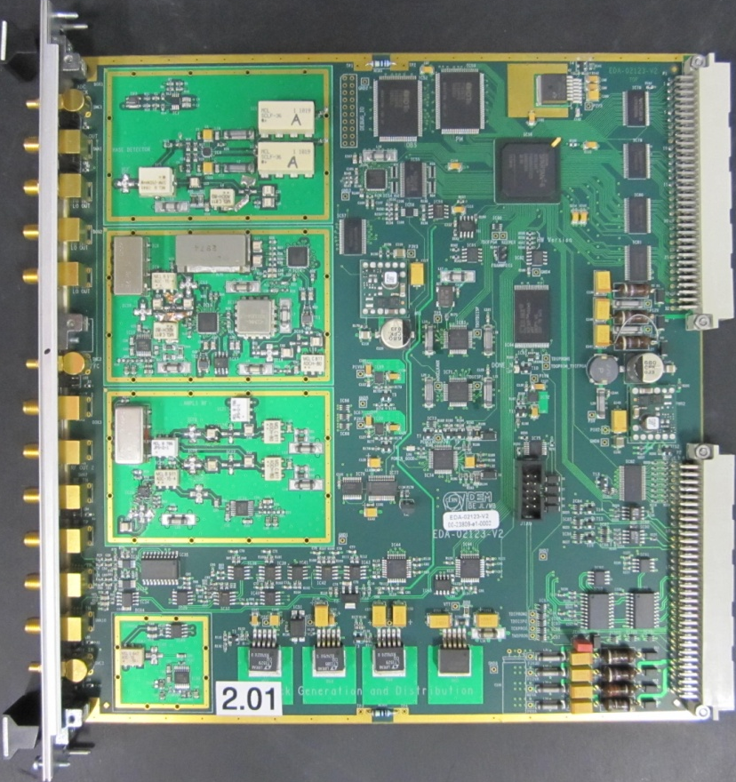
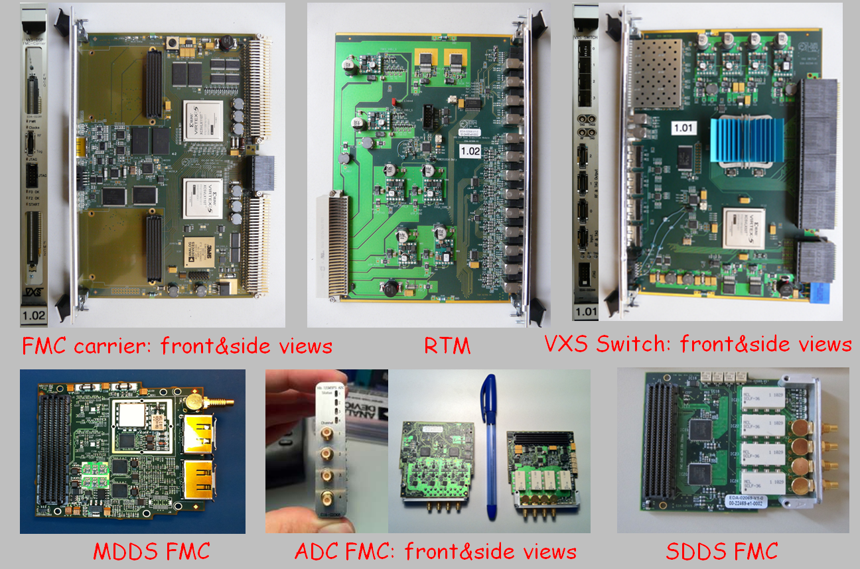
More digital LLRF
SPS 800 MHz system upgrade!
Switch&Limiter
Cavity Loops
f quadrupler
RF function generator
Clock distributor
PSB renovation & MedAustron LLRF systems
FMC Carrier
RTM
VXS Switch
MDDS FMC
ADC FMC
SDDS FMC

Slide 8
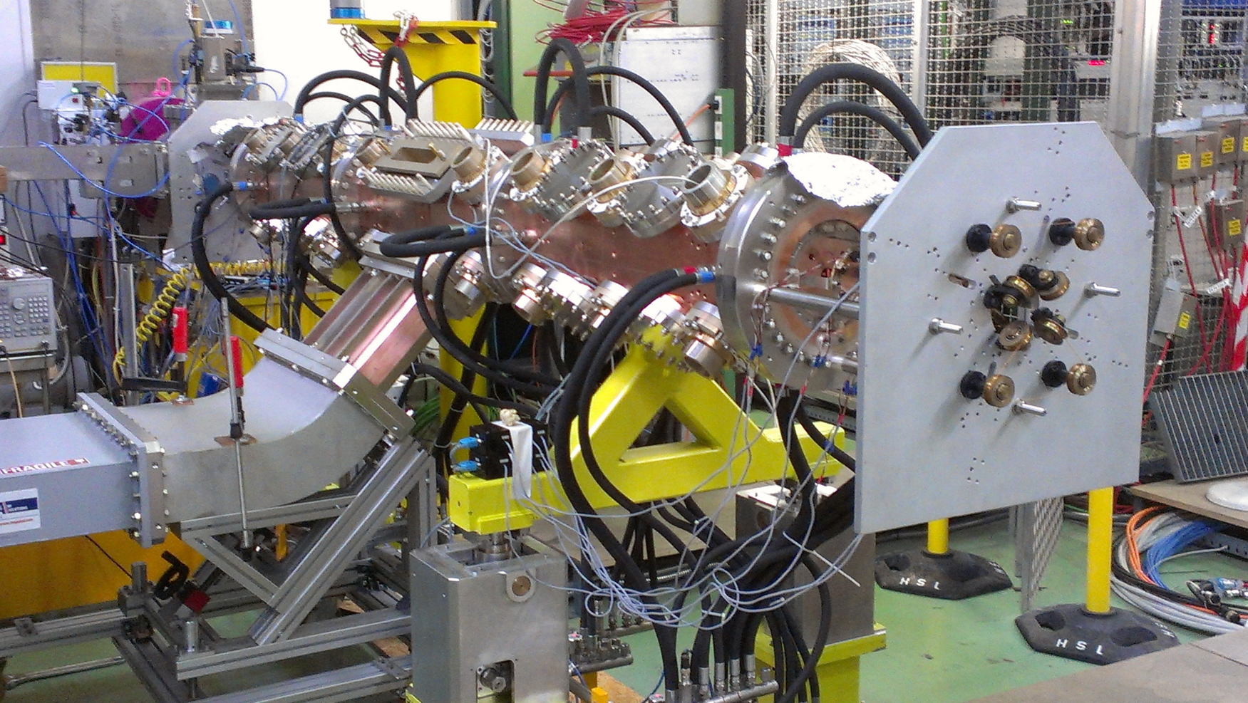
Linac 4 – RFQ

Slide 9
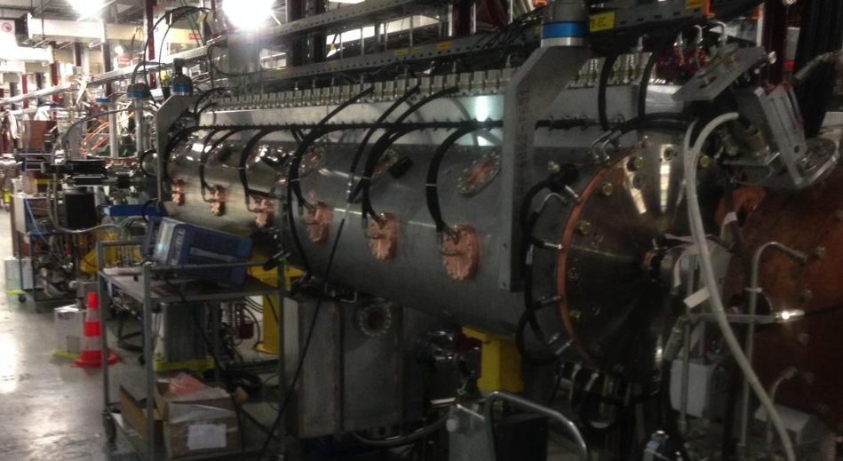
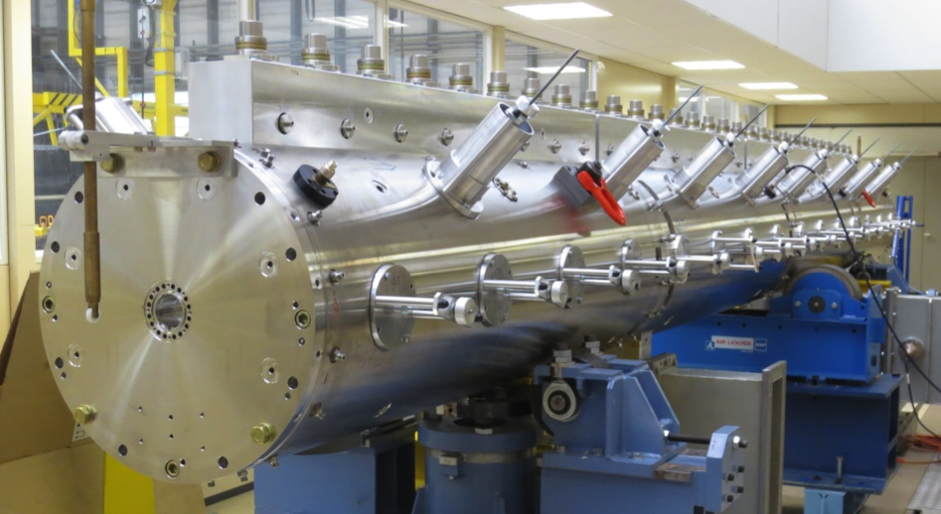
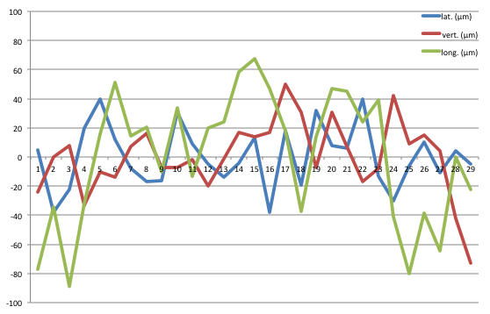
Linac 4 – DTL
6. August 2014: first beam through tank 1!
100% transmission
Success of drift tube alignment principle (over up to 7.3 m) < ±0.1 mm

Slide 10
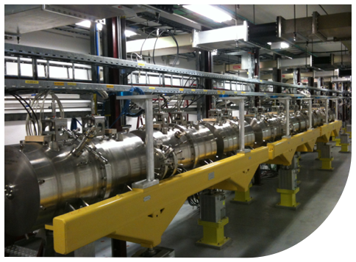
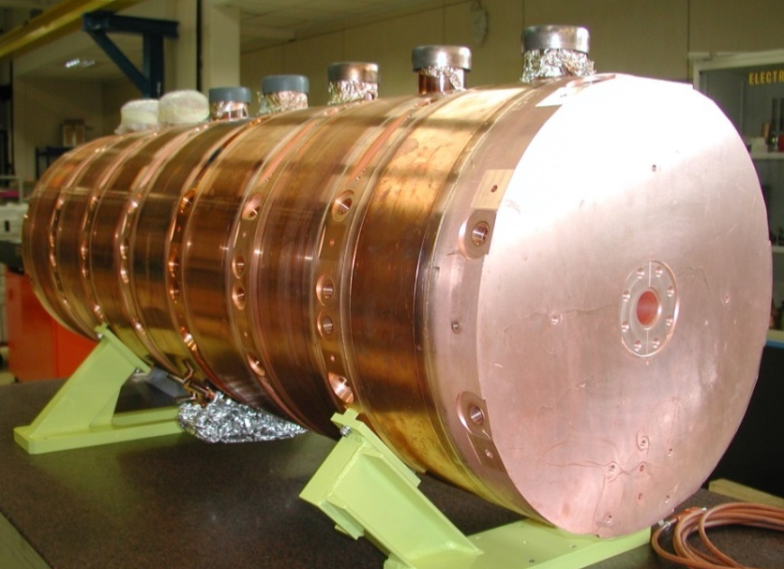
Linac 4 – CCDTL & PIMS
CCDTL (Cell-Coupled DTL, 3-50 MeV)
Assembly finished in 2013
4 out of 7 CCDTL modules are installed,
2 are fully conditioned, 2 more are presently being conditioned,
PIMS (PI-Mode Struct., 100 – 160 MeV)
First complete cavity assembled at CERN,
2nd cavity under assembly,10 to go…
Series production now in full swing.

Slide 11
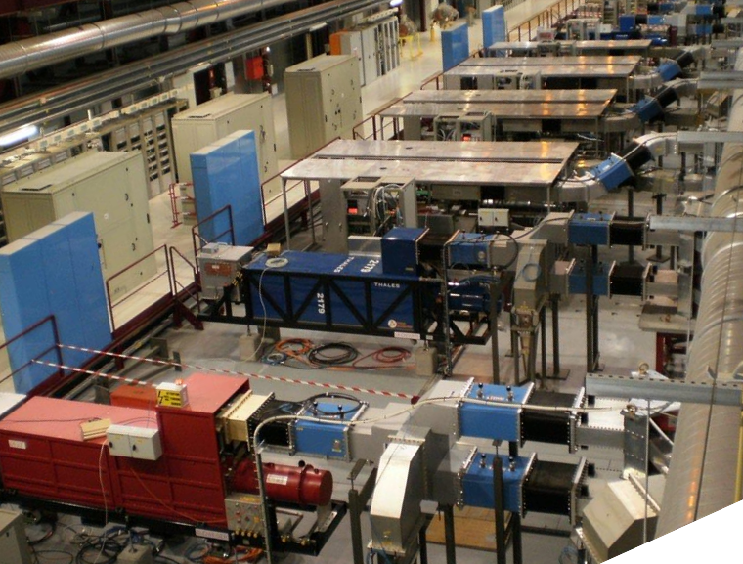
Linac 4 – High power RF

Slide 12
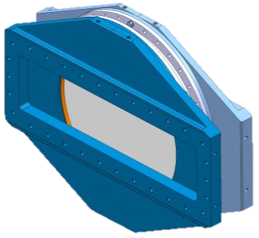
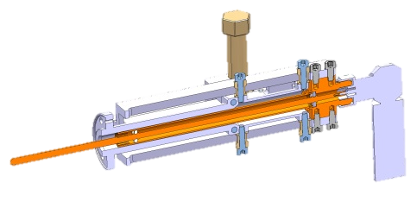
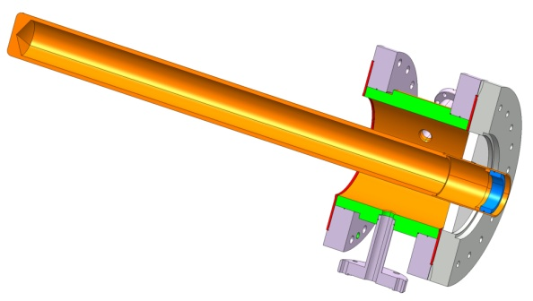
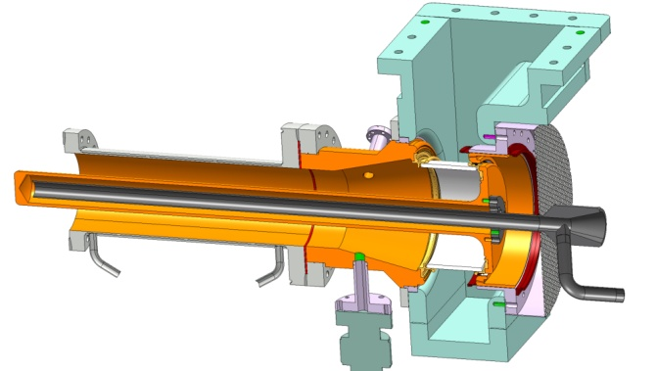
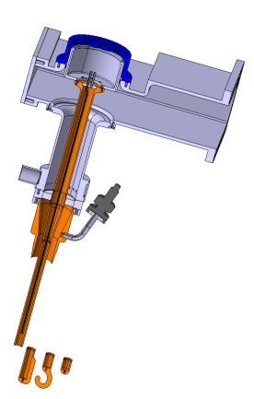
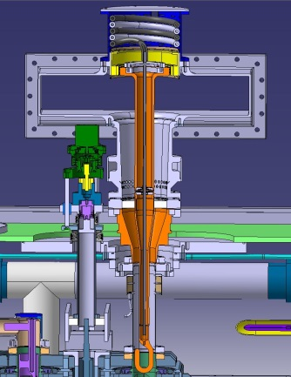
Fundamental Power Couplers
2014 FPC results
SPL cylindrical | 1 MW TW – 600 kW SW
SPL disk | 1 MW TW – 1 MW SW
Linac4 window | 750 kW SW, 4/28 series done
HIE-Isolde | 15 couplers done
Crab Cavities | 2 different designs, under construction
SPS800 | Old spare couplers tested
Medical RFQ | Under study
ESRF | 300 kW CW
SOLEIL | 300 kW CW – 250 kW SW
APS | 300 kW CW
ILC | New ceramic without coating
Linac 4
HIE-Isolde
SPL disk
SPL cylindrical
SPS
Crab cavity

Slide 13
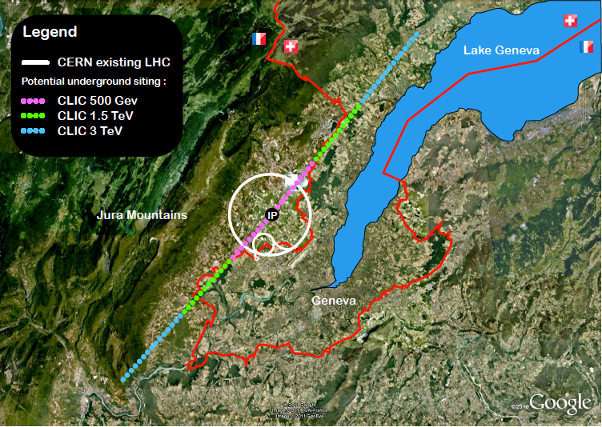
CLIC Study

Slide 14
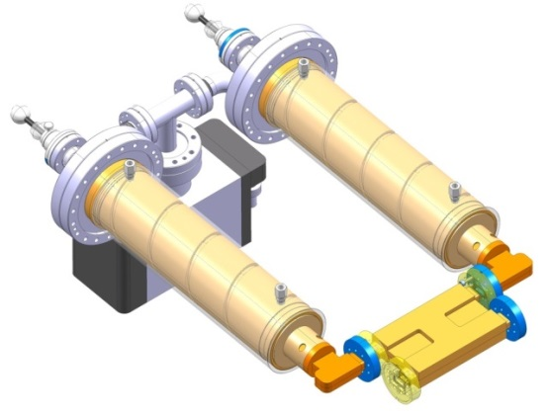
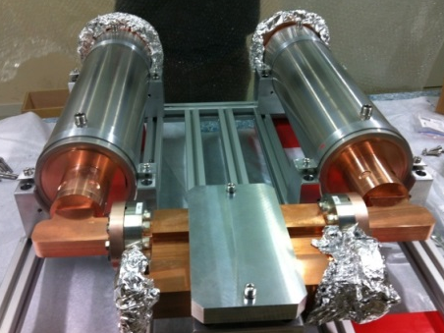
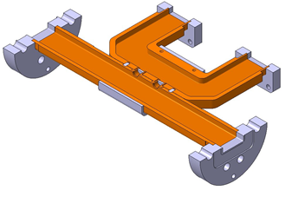
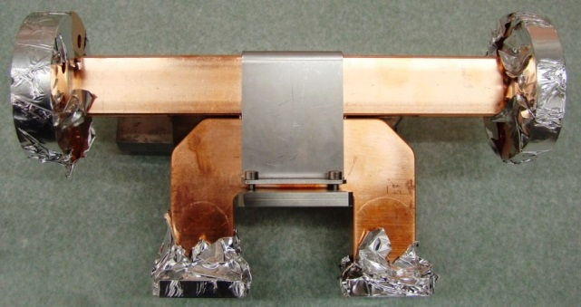
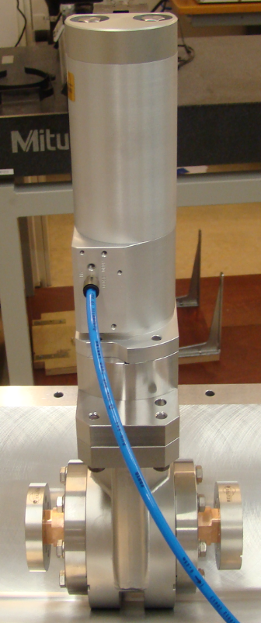
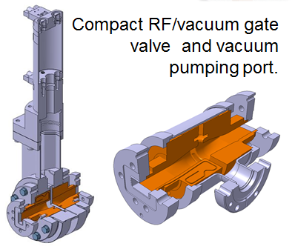
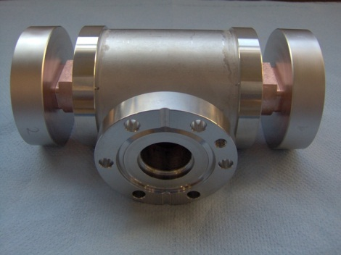
X-band (12 GHz) RF components
Pulse compressor
‘’Simple” -60 dB directional coupler.

Slide 15
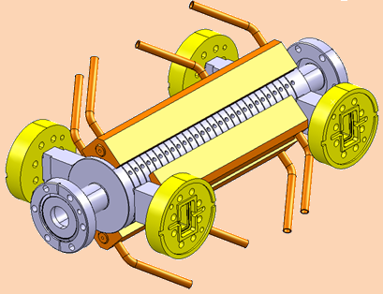
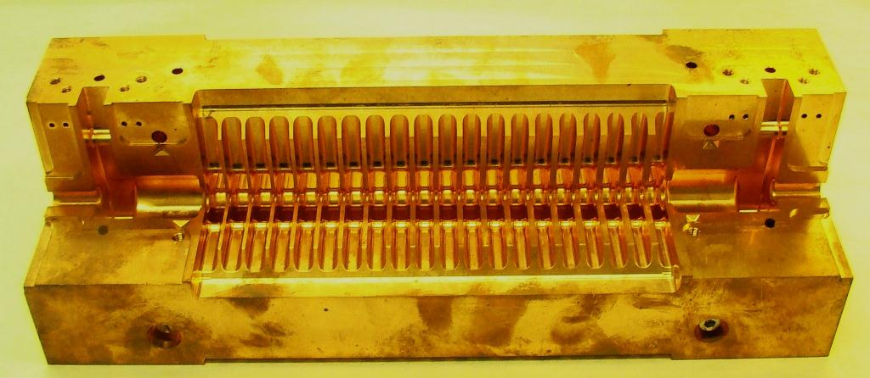
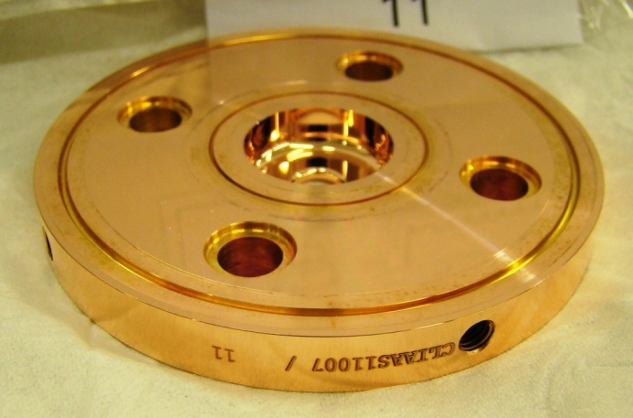
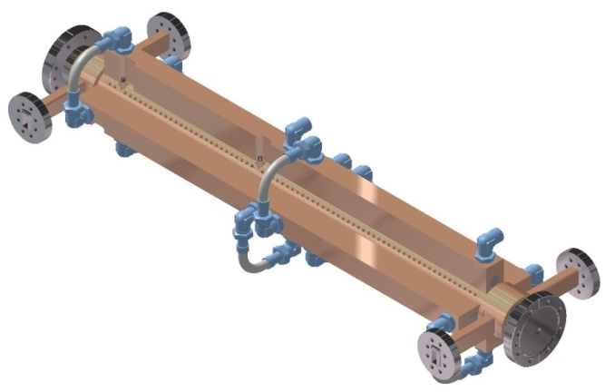
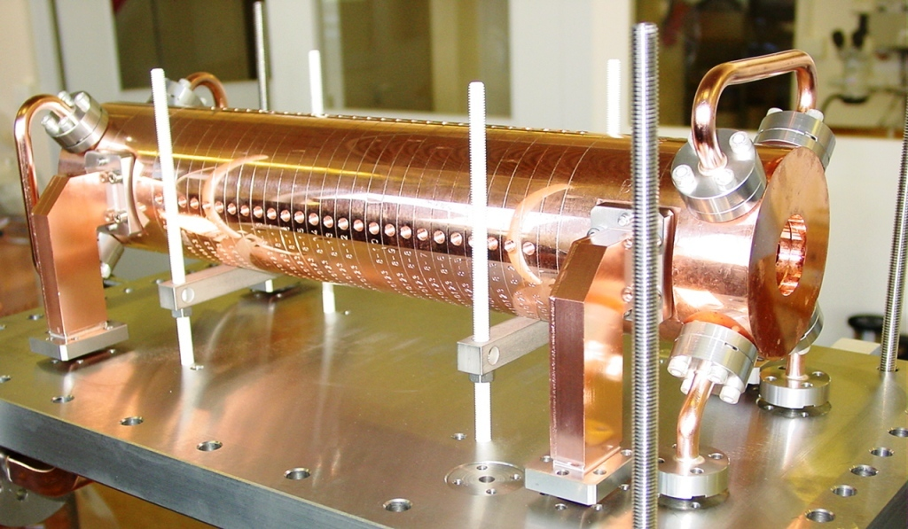
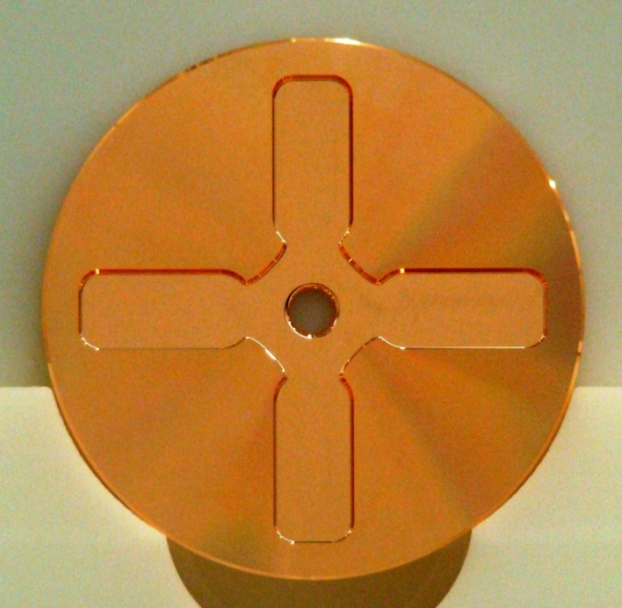
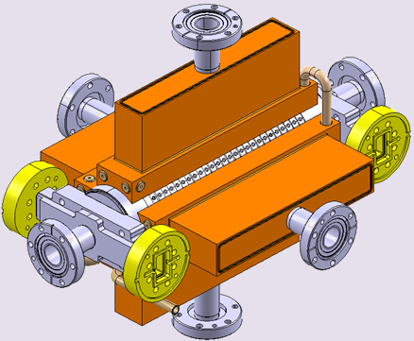
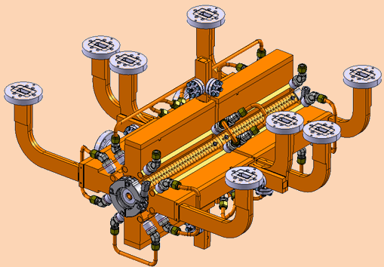


X-band Accelerating structures
TD26
TD24 SiC
TD2 6CLEX

Slide 16


X-band test facility Xbox-3

Slide 17



SRF – SPL & HL-LHC
SPL 5-cell cavity in He vessel
HL-LHC Crab Cavity Prototypes

Slide 18






SRF – HIE-ISOLDE
High-beta cryomodule
Cavities performances (last 2 prototype tests)
SM18, April 2015
High-beta quarter-wave cavity, Nb-coating un Cu substrate

Slide 19










SRF – Infrastructures

Slide 20


FCC Study – RF
Compare: LEP (1995), 288 Cavities, 17 MW CW
FCC: >1000 cavities, 100 MW CW!
Frequency? (400 MHz & 800 MHz)
Technology? (Nb sputtered on Cu)
RF power – high efficiency!!
Major R&D programme started
e+ e- collider
Collision energy 90 to 350 GeV
Very high luminosity
Hadron collider
16 T ⇒ 100 TeV for 100 km
20 T ⇒ 100 TeV for 80 km

Slide 21
Thank you very much!

