Slide 1

Beam Instrumentation
Protons (TT41) EDMS: 1491393
  BPMs
  BTVs
  BCT
  BLM
Electrons EDMS: 1385308
  Source instrumentation
  Faraday-cup and BPMs provided by TRIUMF/CA
  TT43 (BTVs)
Outlook
Baseline ‘cost to completion’

Slide 2
BPMs for protons #1
A total of 21 BPMs requested
  17 existing detectors available
  4 additional bodies/buttons available for assembly
  2 waiting for confirmation (VSC)
    ~10kCHF/piece to produce from new
Existing TT40 and ‘critical’ BPMs will be based on LHC electronics (optical fibres)
Cost (400 kCHF):
  Electronics: 180 kCHF (2015: 150kCHF)
  Cables: 20 kCHF (2015)
  PJAS (18 months): 180 kCHF (electronics design)
Original estimate:
  LHC electronics and fibres: 500 kCHF

Slide 3
BPMs for protons #2
Project milestones:
  Electronics performance Now -> Q2/15
  Analogue front-end design : Q2/15 -> Q3/15
  Firmware design : Q2/15 -> Q4/15
  Electronics production : Q3/15 -> Q1/16
  Software design/production: Q4/15 -> Q1/16
  Installation and commissioning: Q2/16 -> Q3/16

Slide 4
BTVs for imaging
A total of 9 standard BTVs to be provided (60 mm aperture)
  6 available (probably 1 more – radioactive)
  Produce new BI spares (40 kCHF/piece)
CNGS BTVs equipped with titanium and carbon screens
Options:
    Keep as are: limited resolution for pilots (titanium)
    Replace Carbon screens with Alumina for low intensity beams + improved calibration
      Dismantling from tunnel required
      Cost per device ~4 kCHF (FSU) (2 weeks estimated)
Overall cost envelope:
  80 kCHF -> 150 kCHF (options)
  (Original estimate: 150 kCHF)
Additional BTV detector requested downstream of plasma-cell
  Reuse BTV SPS detector
  Choice of screen material to be decided (AWAKE)

Slide 5
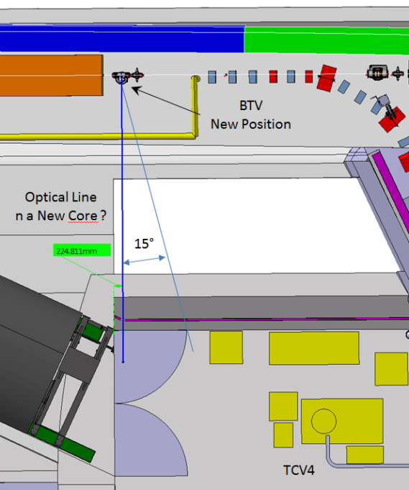
BTV for synchronisation
Streak-camera synchronisation (p+, e-, Laser)
  Optical line required (first proposal not ideal)
  Make hole from TT41 to TCV4 (20cm diameter)
    CE cost : paid by AWAKE project?
    Optical line: 15 kCHF
    Cables: 10 kCHF
  New BTV detector design required
    Design (MME) : 20kCHF
    Production: 40 kCHF
  Assume loan of CTF streak-camera
  (cost = 0)
Overall cost: 105 kCHF

Slide 6
Milestones for BTV
Clarify specifications : Q4/14 -> Q1/15
Decide on screen material: Q1/15 -> Q2/15
Design streak-camera tank: Q2/15 -> Q3/15
Produce mechanics: Q3/15
Order cables: Q1/15
Install detectors: Q2/16
Hardware commission: Q2/16

Slide 7
BCT for protons
Reuse existing CNGS detector (BCTF.412337) with minor refurbishment
Order cables to TSG4 location: Q1/15
Install detector: Q2/16
Hardware commissioning : Q2/16
Overall cost: 10kCHF

Slide 8
BLMs for protons
One detector relocated (BLM.412104)
One new detector requested (BLM.412314)
Order or reuse cables (cost ~10kCHF)
Mile-stones:
  Decide on new or reused cables: Q1/15
  Adapt electronics and software: Q1/16
  System commissioning: Q2/16

Slide 9
Electron source
Baseline to reuse PHIN instrumentation
  1 emittance meter (2 BTV tanks)
    Cost: ~40 kCHF/piece
    Manchester/UK involvement?
  1 BCT
  1 Phase monitor
  Cabling cost: 20 kCHF
  BPMs from TRIUMF

Slide 10
Electron beam-line
BPMs and Faraday-cup from TRIUMF/CA
  TRIUMF visit at CERN very helpful
    Collaboration agreement to be signed??
BTVs:
  Reuse of CTF/CLEX detectors?
  Production of new devices: ~40 kCHF/piece

Slide 11
Outlook/pending questions
Biggest system in terms of complexity = BPM
  Lab results expected by Q2/15 (single bunch/passage)
  Remaining doubts about p+/e- in common line (TRIUMF)
Choice of BTV screen material expected Q1/15
  Input to design of streak-camera tank
Streak-camera needs ‘direct’ optical line
  Hope for good news from ‘CE’ group (cost ..)
Question about PHIN instrumentation after 30 years and reuse of CTF/CLEX instrumentation

Slide 12
Baseline for AWAKE
p+:
  No replacement of carbon screens
  3 new BTV tanks to be produced
  Hole to be made for synchronisation monitor
  Total cost: 645 kCHF + CE
e-:
  Reuse of PHIN at source
  Reuse of CTF/CLEX BTVs for transfer-line
  TRIUMF: BPMs and Faraday-cup
  Cabling cost for BI: ~40 kCHF

