Slide 2
My Jobs at CERN
David.Collados@cern.ch

Slide 3
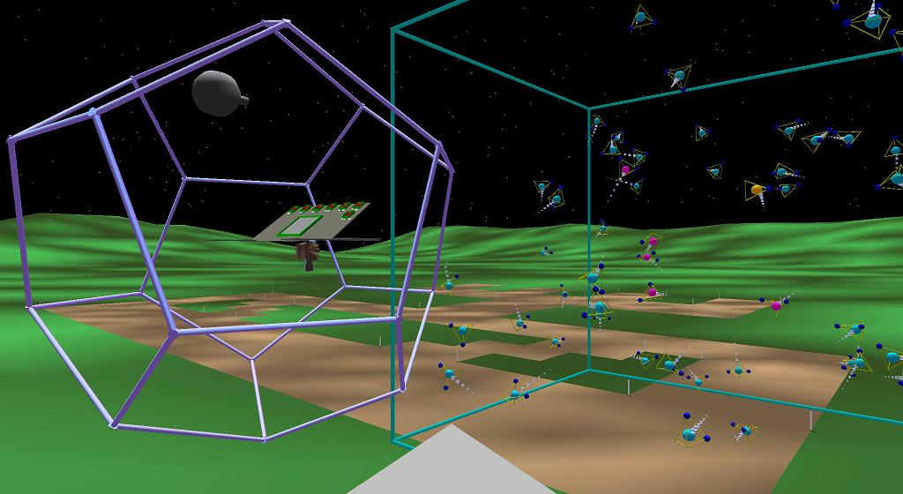
University - 1993
Computer Engineer (Granada, Spain)
  Math, programming, algorithms, databases.
Exchange Student (New Mexico, USA) - 1997
  Weekly evaluations. Practical approach
  ‘Homunculus’ Virtual Reality project @ Albuquerque HPCC
    Simulation & comprehension of complex software systems

Slide 4
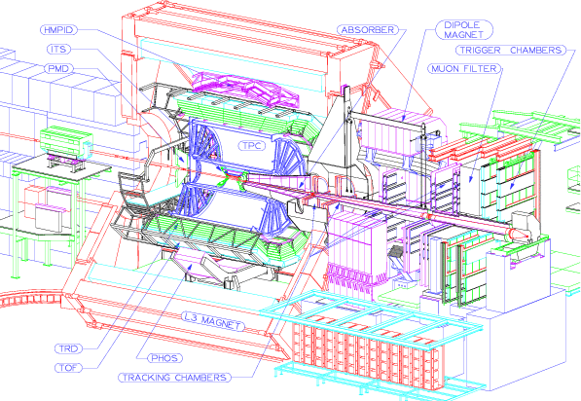
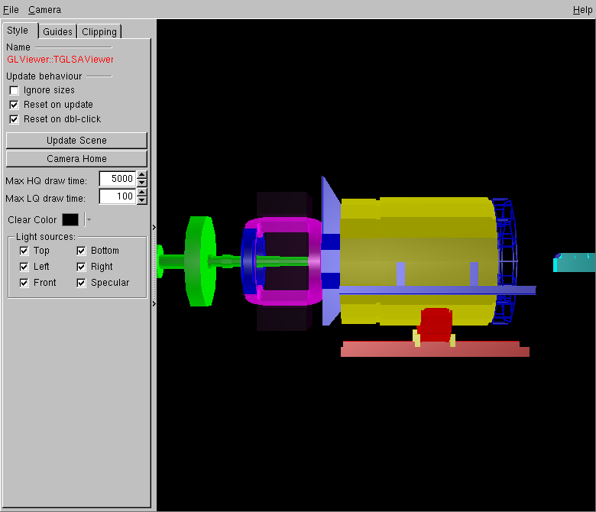
EP/AIP Technical Student - 1998
ALICE Off-line Project
  AliRoot framework for simulation, reconstruction and analysis.
  Develop application for visualization of the experiment
Notes:
Understand CERN & experiments’ challenges & goals

Slide 5
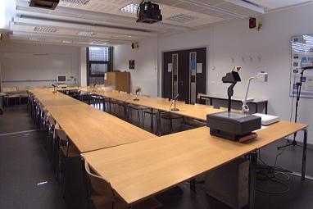
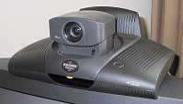
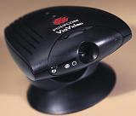
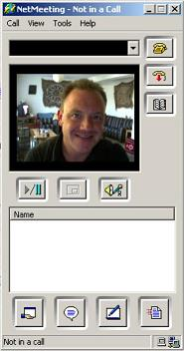
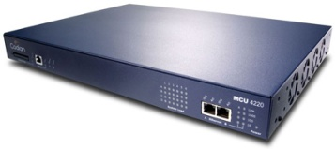
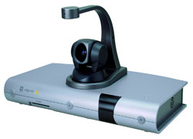
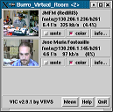
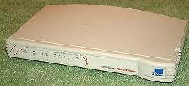
IT/IS – Videoconferencing - 1999
Maintenance of the videoconferencing HW in the rooms
User support in rooms (different hardware & software)
Documentation, automation, configuration, hardware evaluation, discussions with users and experiments

Slide 6
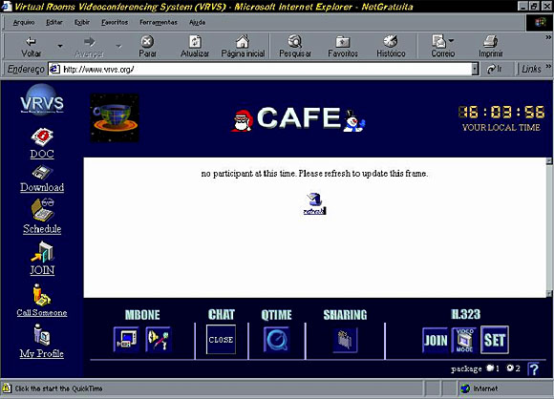
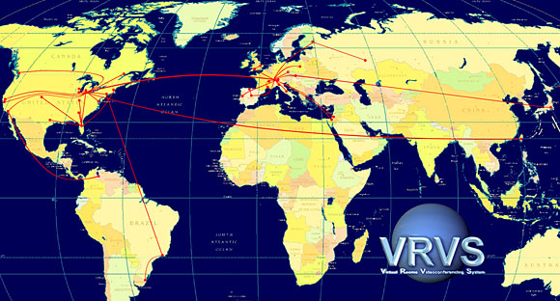
IT/IS - Videoconferencing
Virtual Room Videoconferencing System (VRVS)
  Developer, user support, service manager
  Deploy & maintain the network of reflectors (traffic distribution)

Slide 7
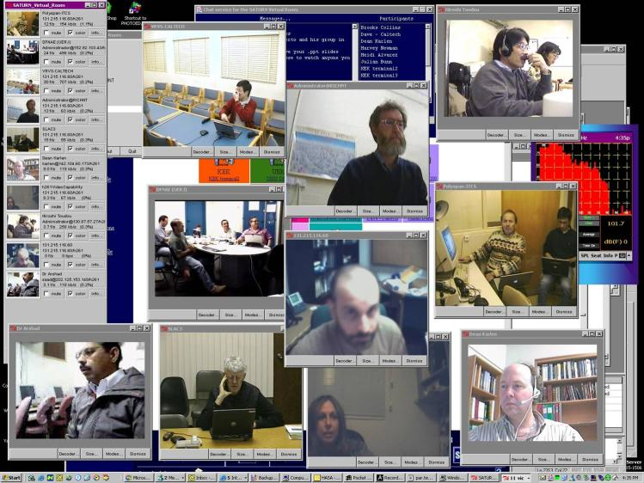
IT/IS - Videoconferencing
Providing real time global collaboration to educational & research communities
Notes:
Running a production service, 24/7 Worldwide support, Developments, Demonstrations, Discussions & meetings…
A huge effort!

Slide 8
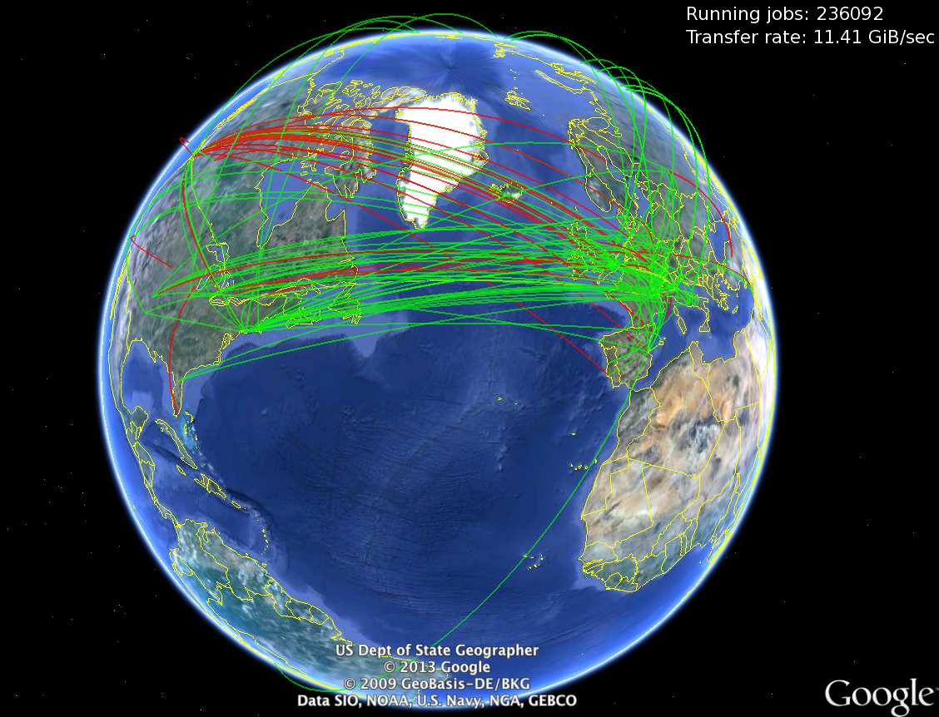

Slide 9
EGEE - IT/GM - Testing - 2004
Testing components of the gLite middleware
  IO Server and Fireman Catalogs (MySQL & Oracle)
Test the installation, configuration, functionality, stress testing, regression tests
  While reporting results on each release
In collaboration with the ARDA (A Realisation of Distributed Analysis for LHC) team
Improve the reliability of these components, finding bugs, reporting to the developers, building test suites

Slide 10
IT/GD – Operations – 2006
Develop Service Availability Monitoring (SAM) framework
  Increase reliability of WLCG sites by testing services
  Monitor WLCG sites and evaluate their performance
Involved in the EGEE and OSG Operations Teams
Grid monitoring support & service manager
Support the WLCG management board
Member of Operational Security Coordination Team
Collaborate in monitoring, debugging and support to Atlas production activities
Third level service expert for catalogs (LFC)

Slide 11
IT/GT - Tools for Ops & Monitoring - 2011
IT/GT/TOM Section Leader
WLCG Monitoring & Information Systems
CERN-India Collaboration in Computing for LHC

Slide 12
IT/DB – Database Services - 2013
Database on Demand Service
IT/DB Monitoring Strategy and Tools
CERN-India Collaboration in Computing

Slide 13



Slide 14
India – CERN Collaboration in Computing
Protocol P060/LHC (2002-2016), Computing and Grid Technology for LHC
780 Person months involved since 2003
Wide range of computational areas:
  Grid Performance monitoring
  Scientific Library
  AFS
  AliEn (AliEn to GridFTP and AliEn storage element)
  Problem tracking Grid performance
  Fabric Management & LCG Visualization
  Database/CORAL/MySQL
  Grid Monitoring (GridView and MyWLCG)
  Cloud Management (CloudMan and OpenStack)
April 2015
Notes:
All these collaborations on Computing for LHC fall into the Protocol for collaborative work in the framework of the development of computing and computational Grid technology for LHC at CERN (P060/LHC), signed on 24 September 2002 and extended until 31 December 2010, and later on until 31 December 2015, through an exchange of Letters between CERN DG and Dr. Srikumar Banerjee, Secretary of the Department of Atomic Energy.

Slide 15
India – CERN Collaborations
CMS, early 90’s, observer, study Higgs boson properties, super-symmetry, extra dimensions
ALICE, 1995, PMD and Muon Spectrometer, Indian team >100 members
NAT projects: CLIC, CTF3, LINAC4
Hardware, Software, and Commissioning
  Superconducting Corrector Magnets for LHC
  Precision Motion Positioning System Jacks (dipole magnets)
  Quench Heater Power Supplies and Local Protection Units
Notes:
NAT: Novel Accelerator Technologies
CLIC: Compact Linear Collider study is an international collaboration working on a concept for a machine to collide electrons and positrons (antielectrons) head-on at energies up to several teraelectronvolts (TeV). This energy range is similar to the LHC’s, but using electrons and their antiparticles rather than protons, physicists will gain a different perspective on the underlying physics.
LINAC4: 160 MeV H- Linac, is the first step in upgrading the LHC injector chain. Unlike CERN’s present injector linac, Linac4 will inject into the subsequent synchrotron via charge exchange injection.
PMD: Photon Multiplicity Detector

