Slide 2
Qstrips Power Converters Specifications
DE MALLAC Louis
LIU-PSB meeting

Slide 3
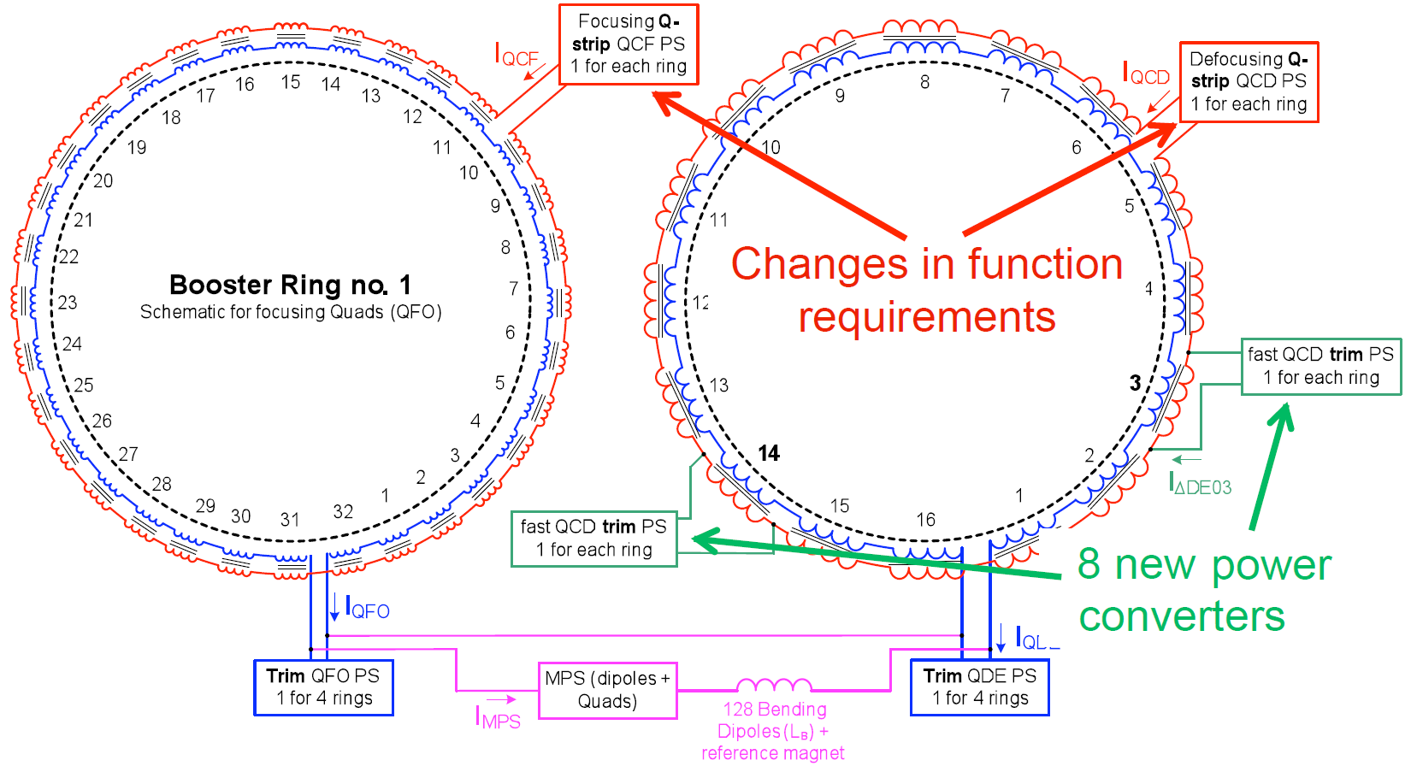
Baseline
QCF : 32x L = 24uH QCD : 16x L =42uH

Slide 4
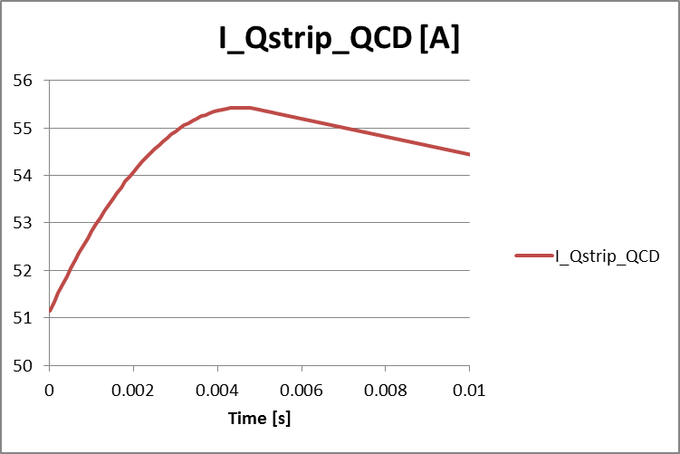
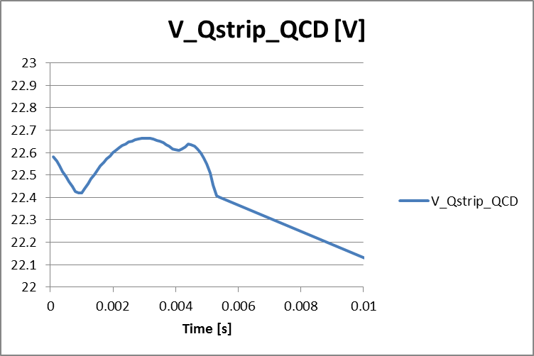
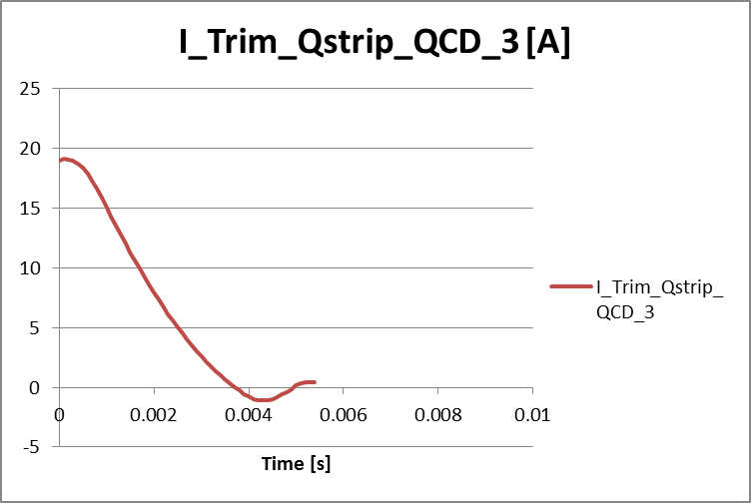
Trim on QCD3 and QCD14
Fast correction functions during 5ms after injection
Coupled system with 3 converters on the same circuit
Fast changes in the induced voltage on the main Qstrip
-> Very difficult for the converter to reject

Slide 5
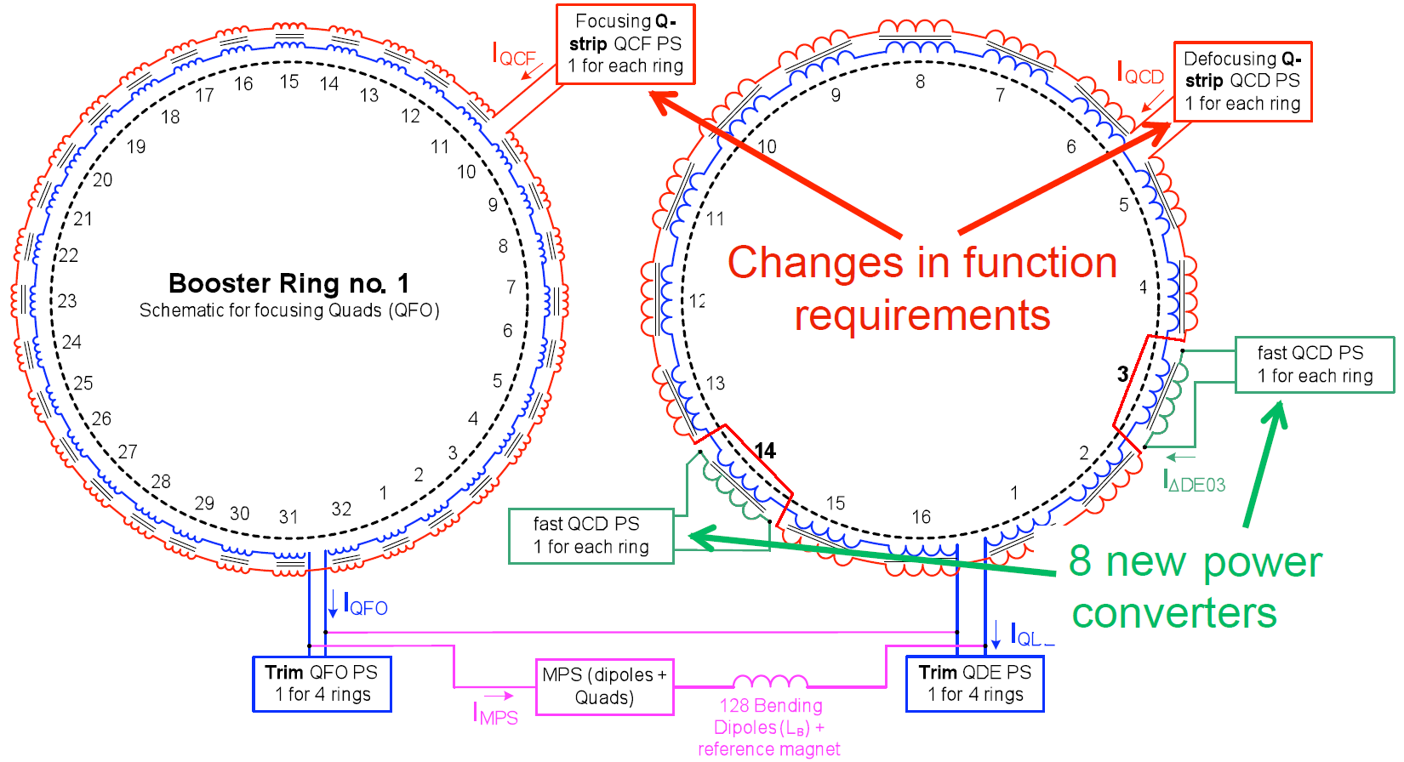
Proposed solution
QCF : 32x L = 24uH QCD : 16x L =42uH

Slide 6
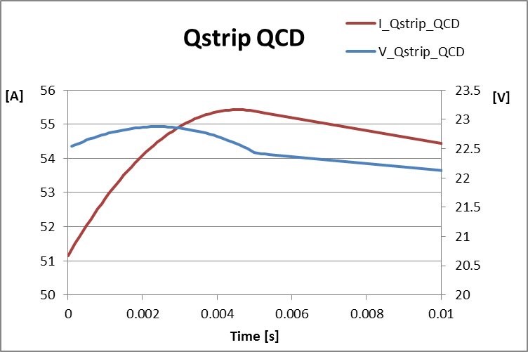
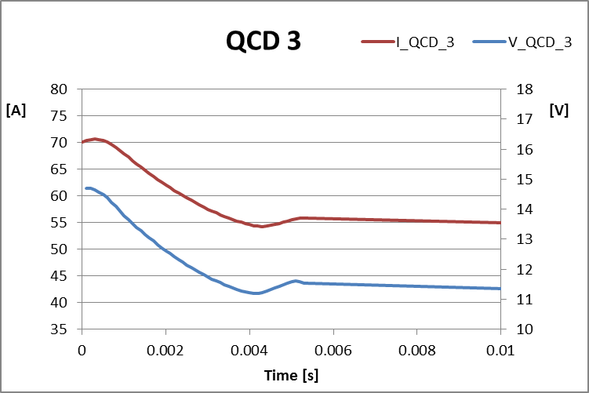
Proposed solution
Separate powering
Decoupled system
Similar to the baseline for the operators : functions merged in the software
Slightly better current matching after the fast ramp
Trim -> I_QCD + 0A 100ppm + 100-500ppm (rejection)
Separate -> I_QCD vs I_QCD3 100ppm + 100ppm

Slide 7
Proposed solution
Additional requirements:
Replacement of the QCD converters for function merging
( same control based on FGC3)
The replacement of the QCF converters is recommended for
global system coherence.

Slide 8
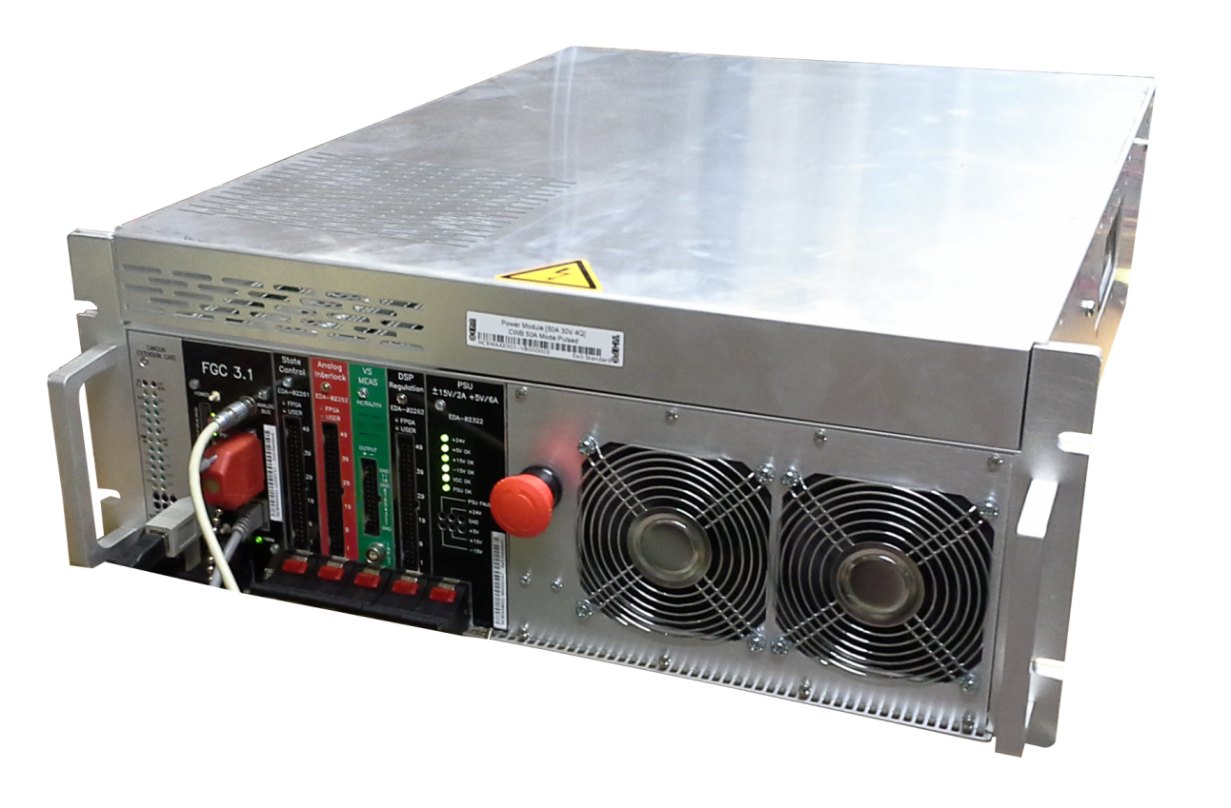
Proposed solution
Same converter for all circuits
16 + 2 spares CANCUN 100 converter [30V ; 100Apk ; 50Arms]
1000ppm overall current regulation with fast functions
100ppm precision on the slow parts of the function
FGC3 control
Total of 4 racks ( 8 racks for actual QCF and QCD converters)
Overall cost within the allocated budget (250 kCHF)

Slide 9
Conclusion
Workunit status: 8+1 converters in production (delivery September 2015)
Possibility to ask for 9 additional converters (in the coming weeks)
No more specific converters for Qstrip
(development cost for FGC3 upgrade during LS2)
Space saving with reduction of number of racks

