Slide 1
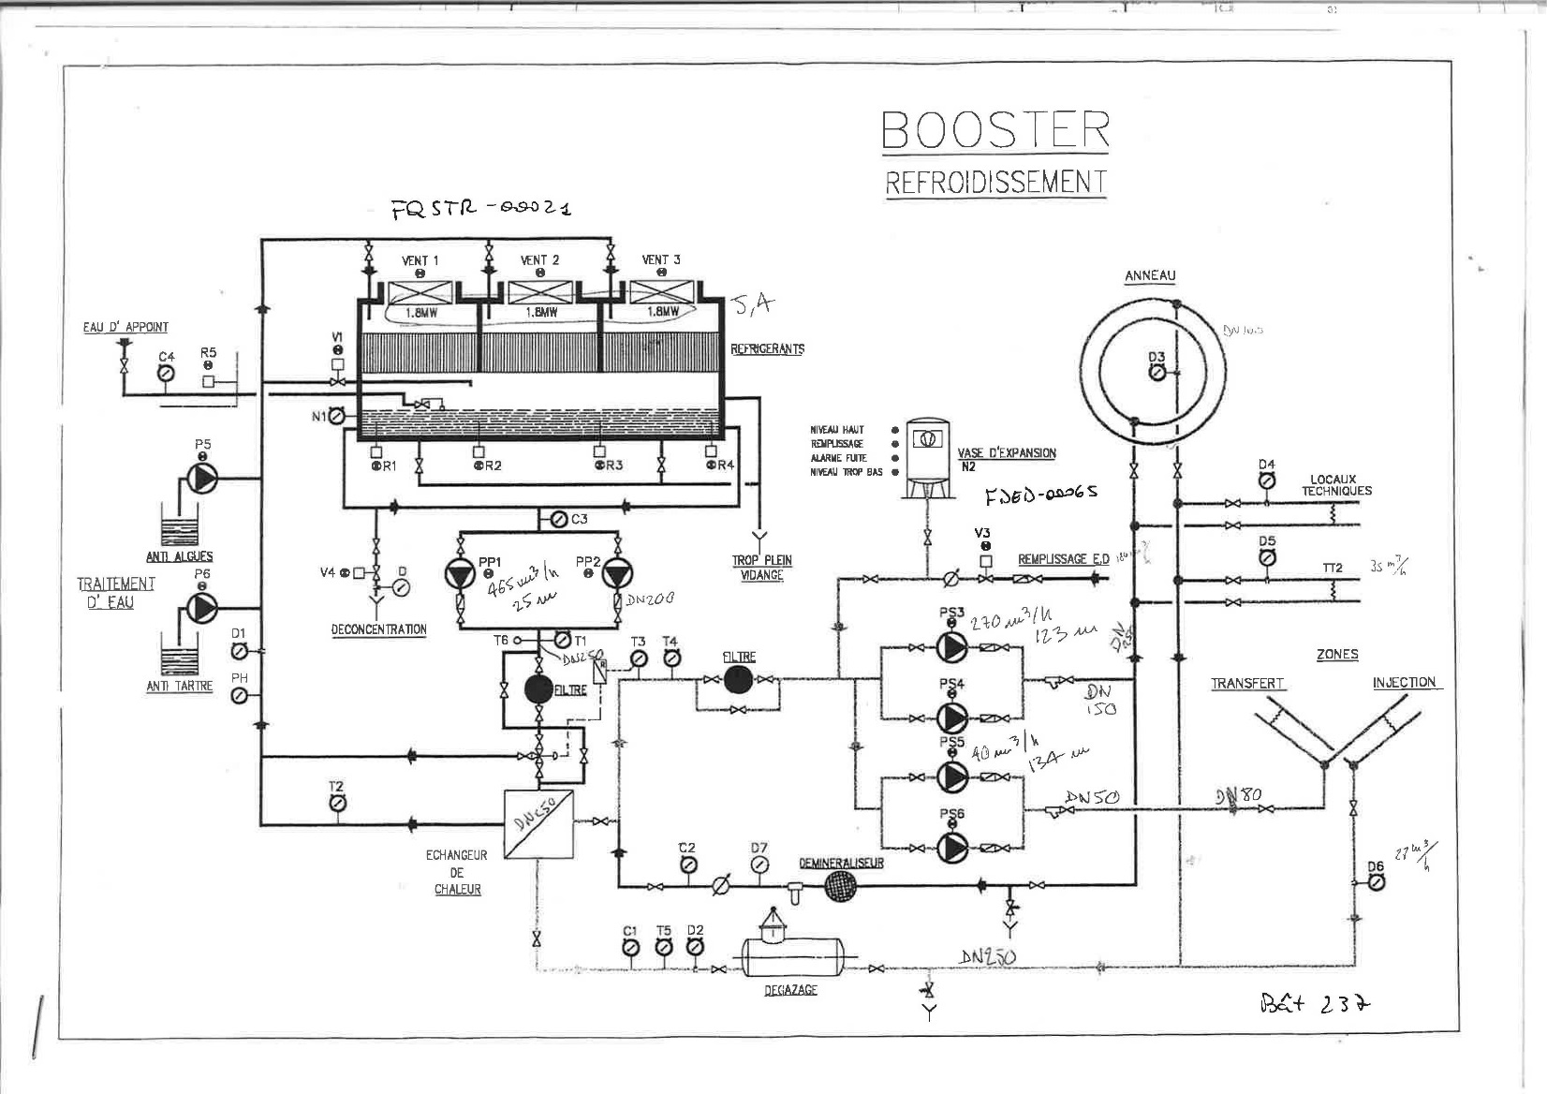
PSB Demi water cooling
Existing system
5.4 MW Cooling power.
2 Circuits, but common return pipe.

Slide 2
PSB Demi water cooling: Distribution
Post LS2
2 Separate circuits for RP requirements
Tunnel Circuit
Surface Circuit

Slide 3
TUNNEL CIRCUIT
Separate circuit

Slide 4
SURFACE CIRCUIT
Are these all the users?

