Slide 1
LIU-PSB Cabling Requests & Racks Integration Status
Georgi Minchev Georgiev EN/EL
16/04/2015

Slide 2
1. LIU-PSB Cabling for Linac4 connection and LS2
Description of task | Responsible | Cables to be removed | DEC | N0 cables to be removed | Cables to be pulled | DIC | N0 cables to be pulled
BI line
BI corrector magnets (power) | D. Nisbet | tbc (?) | Not received | ? | tbc (?) | Not received | ?
BI corrector magnet interlocks | P. Dahlen | yes (1) | Not received | ? | yes | Not received | ?
BI quadrupoles (power) | D. Nisbet | yes | Not received | ? | yes | Not received | ?
BI quadrupole interlocks | P. Dahlen | yes | Not received | ? | yes | Not received | ?
BI.BVT (power) | D. Nisbet | yes | Not received | ? | yes | Not received | ?
BI.BVT interlocks | P. Dahlen | yes | Not received | ? | yes | Not received | ?
BI.DIS | R. Barlow | yes | Not received | ? | yes | Not received | ?
BI.SMV: 3 transformers | J-M. Cravero | yes | Not received | ? | yes | Not received | 3 DC cables specified
BI.SMV position monitors | E. Bravin | yes | Not received | ? | yes | Not received | ?
BLMs in BI line and injection region | C. Zamantzas | no? (yes if done in LS2) | Not received | ? | yes | Not received | ?
Diamond BLMs in injection region | C. Zamantzas | no | N/A | N/A | yes | Not received | ?
Head-/Tail Dumps (at BI.SMV) | C. Maglioni | no | N/A | N/A | yes | Not received | ?
H0/H- Dumps (at BI.BSW4) | C. Maglioni | no | N/A | N/A | yes | Not received | ?
BI.KSW: control cables | G. Grawer | no? | ? | ? | yes | Not received | ?
BI.KSW: power cables | G. Grawer | yes | Not received | ? | yes | Not received | ?
BI.SMH | J. Borburgh | yes | Not received | ? | no | N/A | N/A
BI.BSW controls | E. Carlier | no | N/A | N/A | yes | Not received | ?
BI.BSW power | D. Aguglia | no | N/A | N/A | yes | Not received | 18 DC cables specified
Charge exchange foil | E. Carlier | no | N/A | N/A | yes | Not received | ?
H0/H- monitor | F. Roncarolo | no | N/A | N/A | yes | Received | 28
Stripping foil camera | S. Burger | no | N/A | N/A | yes | Received | 24
Vacuum equipment | P. Bellorini | no | N/A | N/A | yes | Received | 132
BR (Booster Ring)
Q-strip converters (QDE3+14) | D. Nisbet | no | Not received | ? | yes | Not received | ?
New RF cavities | M. Haase | yes | Received | 2240 LS2 | yes | Received | 855 LS2
Finemet Test Cavity | M. Haase | yes | Received | 115 LS2 | no | N/A | N/A
BTKRF | M. Haase | yes | Received | 15 LS2 | no | Received | 140 LS2
RF power interlocks | A. Blas | no? | ? | ? | yes | Not received | ?
Transverse damper kickers | A. Blas | yes | Not received | ? | yes | Not received | ?
Transverse damper pickup | A. Blas | yes | Not received | ? | yes | Not received | ?
Ring pickups | J. Belleman | yes | Not received | ? | yes | Received | 224
Watchdog BR.TMD8L1 | P. Odier | yes | Not received | ? | yes | Received | 24
BLMs (2 FLAT-ICs per section) | C. Zamantzas | no? (yes if done in LS2) | Not received | ? | yes | Not received | ?
Matching monitor | M. Duraffourg | no | N/A | N/A | yes | Received | 67
Shottky monitor | J. Tan | no | Not received | ? | yes | Not received | ?
New wire scanners | B. Dehning | no | N/A | N/A | yes | Not received | ?
Transfer lines (BT, BTP, BTM)
Wide-band pickup (BTP PS side) | J. Belleman | no | Not received | ? | yes | Not received | ?
Magnets power (number still tbd) | A. Newborough | yes | Not received | ? | yes | Not received | ?
Interlocks (WICs) for new magnets | P. Dahlen | no | Not received | ? | yes | Not received | ?
BLMs | C. Zamantzas | no? (yes if done in LS2) | Not received | ? | yes | Not received | ?
Surface
Beam Interlock System | C. Martin, S. Gabourin | yes (8) | Not received | ? | yes (57) | Not received | ?

Slide 3
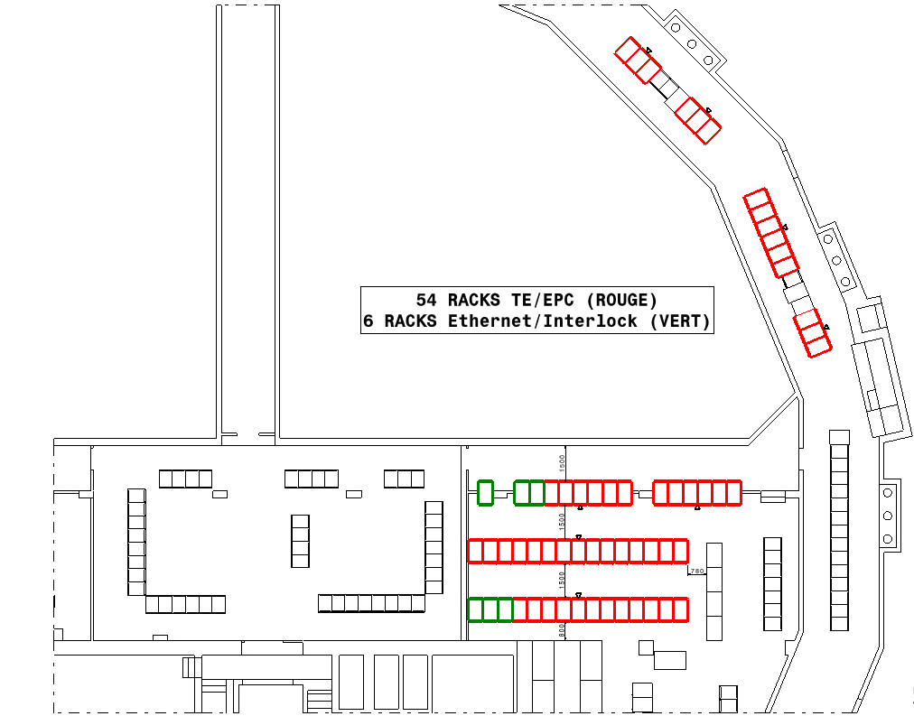
2. BRF2/BAT racks integration
Possible only if the four RF cabinets
are displaced.

Slide 4
THANK YOU!

