Slide 1
HiLumi LHC project presentation and Forthcoming procurement overview and schedule details
Isabel Bejar Alonso - CERN
HL-LHC Technical Coordinator
On behalf of the HL-LHC project team
Geneva – 26 June 2015

Slide 2
The HL-LHC Project
Goals, schedule and technologies

Slide 3
Goal of High Luminosity LHC (HL-LHC) as fixed in November 2010
From FP7 HiLumi LHC Design Study application
The main objective of HiLumi LHC Design Study is to determine a hardware configuration and a set of beam parameters that will allow the LHC to reach the following targets:
A peak luminosity of L_{peak} = 5×10³⁴ cm⁻²s⁻¹ with levelling, allowing:
An integrated luminosity of 250 fb⁻¹ per year, enabling the goal of L_{int} = 3000 fb⁻¹ twelve years after the upgrade.
This luminosity is more than ten times the luminosity reach of the first 10 years of the LHC lifetime.
Concept of ultimate performance recently defined:
L_{ult} ≅ 7.5 10³⁴ cm⁻²s⁻¹ and Ultimate Integrated L_{int ult} ∼ 4000 fb⁻¹
LHC should not be the limit, would Physics require more…
Notes:
A decisive increase of LHC luminosity is needed to maintain scientific progress and to explore full machine capacity
The European Strategy for Particle Physics in 2013 had confirmed as first priority in the large scale scientific activity the exploitation of the full potential of the LHC, including the high-luminosity upgrade of the machine and detectors
The importance of the LHC luminosity upgrade for the future of High Energy Physics has been also re-affirmed by the May 2014 recommendation by the Particle Physics Project Prioritization Panel (P5) to the High Energy Physics Advisory Panel (HEPAP) which in turn advises the US Department of Energy (DOE). The recommendation, a critical step in the updating of the USA strategy for HEP, states the following: “Recommendation 10: … The LHC upgrades constitute our highest-priority near-term large project.”

Slide 4
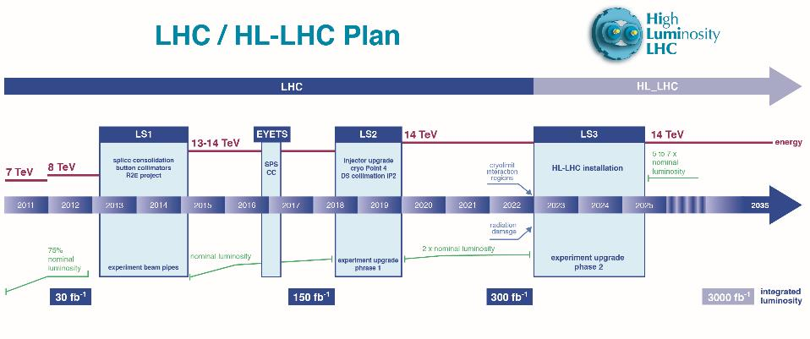
Run I
Run II
Run III
Run IV, V…
0.75 10³⁴ cm⁻²s⁻¹
50 ns bunch
high pile up ∼40
1.5 10³⁴ cm⁻²s⁻¹
25 ns bunch
pile up ∼40
1.7-2.2 10³⁴ cm⁻²s⁻¹
25 ns bunch
pile up ∼60
Technical limits to lumi increase (Machine & Experiments)
50 ⇒ 25 ns
New LHC Schedule
Notes:
A decisive increase of LHC luminosity is needed to maintain scientific progress and to explore full machine capacity

Slide 5
Project: the way to day
Jul-10 |  | Mandate to L. Rossi by D.A.T. to set up FP7-Design Study
Nov-10 |  | Application FP7-HiLumi LHC Design Study
Dec-10 |  | Institution of the HL-LHC as a project inside D.A.T.
Mar-11 |  | Approval FP7-HiLumi LHC Design Study
Apr-11 |  | CERN kick-off meeting of DS
Nov-11 |  | Start of FP7 DS and 1st General Meetign @ CERN
Jul-12 |  | Document CERN-ATS-2012-236 describing HL-LHC for EU strategy
Jul-12 |  | Decision MQXF (IT quad) aperture 150 mm
Nov-12 |  | 2nd General Meeting @ Frascati
May-13 |  | HL-LHC 1st Priority in EU strategy update(Council @ Brussels)
May-13 |  | International Review on Collimation
Jun-13 |  | First partial insertion iof HL-LHC in the MTP
Oct-13 |  | RLIUP (Review of LHC and Inj Upgrade Plans by CMAC)
Oct-13 |  | First HL-LHC detector ECFA workshop
Nov-13 |  | HL-LHC Project kick-off and 3rd General meeting @ Daresbury
May-14 |  | International Review on CC @BNL
Jun-14 |  | MTP CERN incorporate HL-LHC budget
Oct-14 |  | International Review on MQXF NbSn Conductor @ CERN
Nov-14 |  | 4th General Meeting @ KEK
Nov-14 |  | Preliminary Design Report (PDR)
Dec-14 |  | International Reviews on MQXF and MBH design @CERN
Mar-15 |  | Cost & Schedule Review @ CERN by CMAC
Notes:
The European Strategy for Particle Physics in 2013 had confirmed as first priority in the large scale scientific activity the exploitation of the full potential of the LHC, including the high-luminosity upgrade of the machine and detectors
The importance of the LHC luminosity upgrade for the future of High Energy Physics has been also re-affirmed by the May 2014 recommendation by the Particle Physics Project Prioritization Panel (P5) to the High Energy Physics Advisory Panel (HEPAP) which in turn advises the US Department of Energy (DOE). The recommendation, a critical step in the updating of the USA strategy for HEP, states the following: “Recommendation 10: … The LHC upgrades constitute our highest-priority near-term large project.”

Slide 6
Project: the way to future
2024-2026
Construction of Components
Main Prototypes
Main civil Engineering works
Notes:
The European Strategy for Particle Physics in 2013 had confirmed as first priority in the large scale scientific activity the exploitation of the full potential of the LHC, including the high-luminosity upgrade of the machine and detectors
The importance of the LHC luminosity upgrade for the future of High Energy Physics has been also re-affirmed by the May 2014 recommendation by the Particle Physics Project Prioritization Panel (P5) to the High Energy Physics Advisory Panel (HEPAP) which in turn advises the US Department of Energy (DOE). The recommendation, a critical step in the updating of the USA strategy for HEP, states the following: “Recommendation 10: … The LHC upgrades constitute our highest-priority near-term large project.”

Slide 7
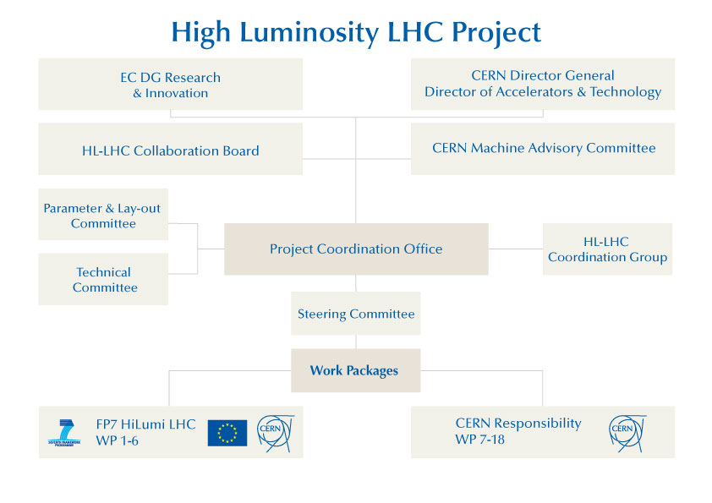

Slide 8
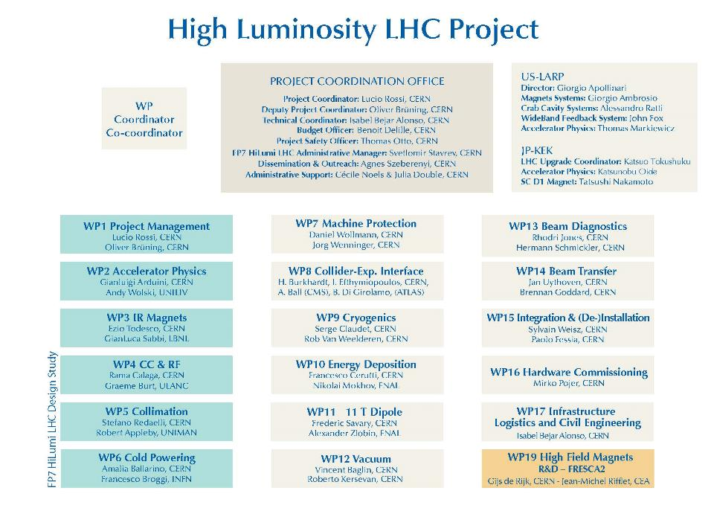

Slide 9






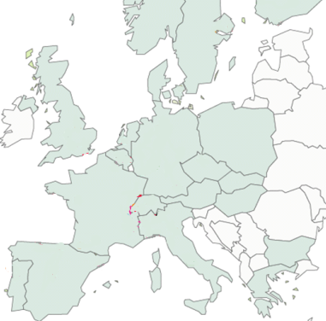












High Luminosity LHC Participants

Slide 10
The HL-LHC Project
Main components

Slide 11
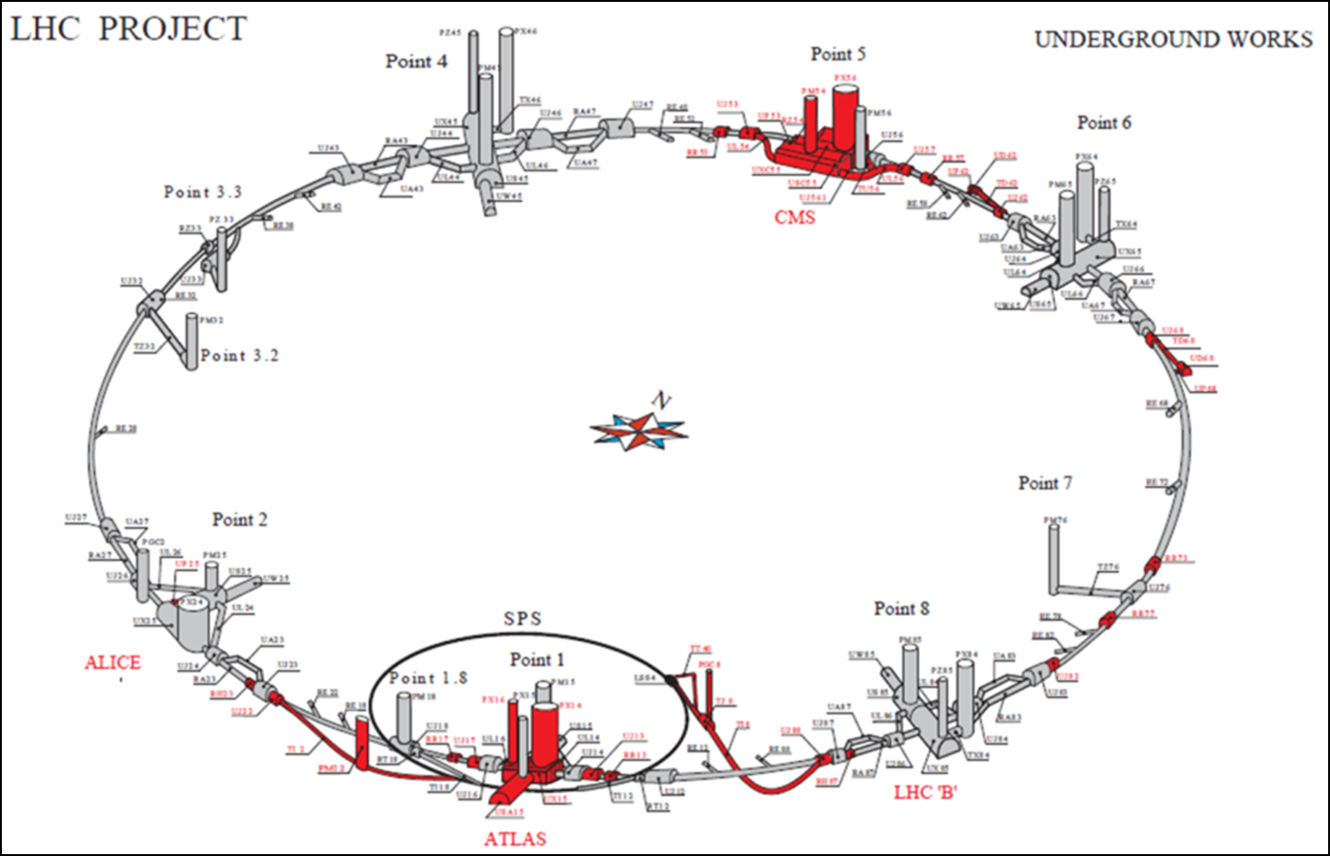
Many points around the ring

Slide 12
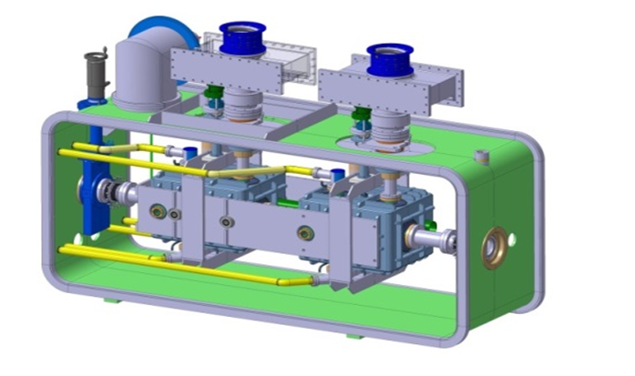
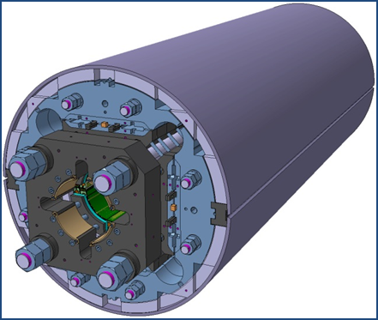
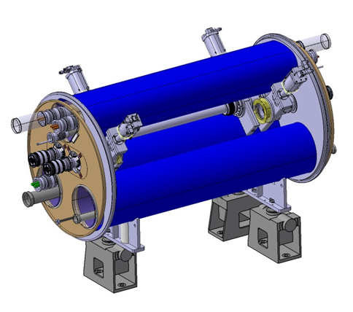
The largest HEP accelerator in construction
ATLAS
CMS
200 m
Dispersion Suppressor (DS)
Matching Section (MS)
Interaction Region (ITR)
Modifications
In IP2: new DS collimation with 11 T
In IP7 new DS collimation with 11 T
Complete change and new lay-out
TAN
D2
CC
Q4
All correctors
Q5 (Q6 @1.9 K?)
New MQ in P6
New collimators
Complete change and new lay-out
TAS
Q1-Q2-Q3
D1
All correctors
Heavy shielding (W)
Cryogenics, Protection, Interface, Vacuum, Diagnostics, Inj/Extr… extension of infrastr.
> 1.2 km of LHC !!
Notes:
Inner Triplet Magnets: Actual radiation damage on the Inner Triplets Magnets is expected already at the level of integrated dose of LHC. The replacement of the triplet must be anticipated before damage occurs, because of the serious and long intervention (requiring one to two years shutdown)
Collimation: The present collimation system will need an upgrade that takes in account the increased beam intensities and the need to protect the new triplets in IR1 and IR5. This would require the replacement of some of the LHC main dipoles with dipoles of equal bending strength (∼120 T⋅m), but obtained by a higher field (11 T) and shorter length (11 m) than those of the LHC dipoles (8.3 T and 14.2 m), gaining in this way enough room for installing the new special collimators.

Slide 13
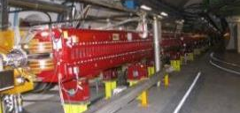
New Insertion Region lay out
(TAS, TAN, Q5 and collimators omitted)
Longer Quads; Shorter D1 (thanks to SC)
Interaction region length is unchanged
ATLAS
CMS
LHC
E. Todesco
ATLAS
CMS
HL LHC
Thick boxes are magnetic lengths -- Thin boxes are cryostats

Slide 14
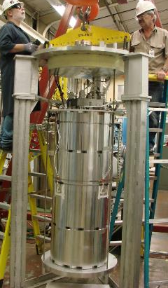
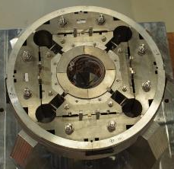
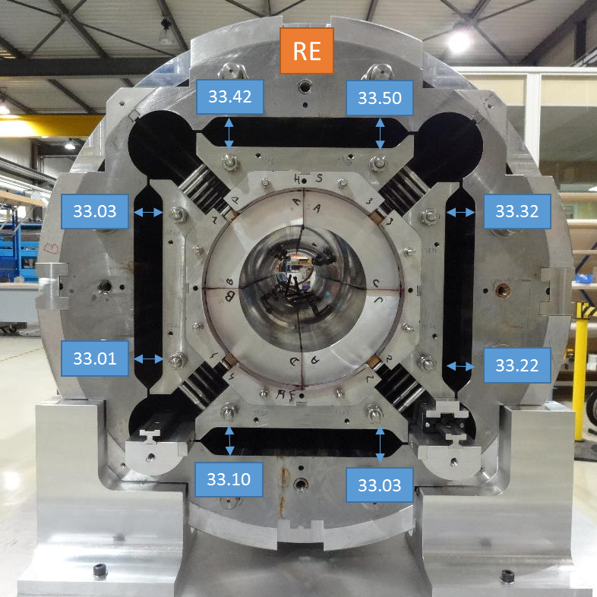
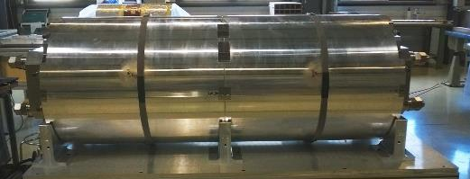
Working on the Inner triplet magnets
  1 mechanical model
  (15 cm long)
  2 short model structures with dummy coils
CERN
LARP
CERN

Slide 15
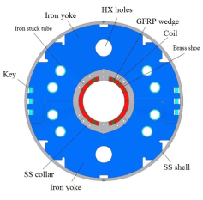
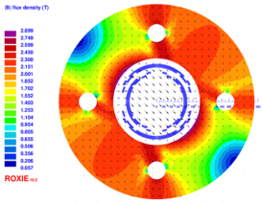
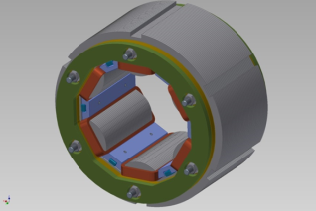
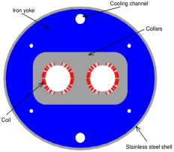
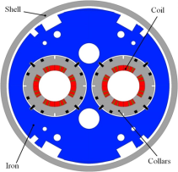
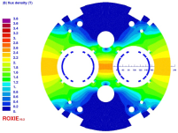
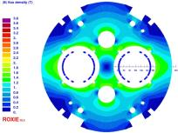
The HL-LHC Nb-T magnet zoo…
D1 (KEK)
Nested orbit corrector (CIEMAT)
HO correctors: superferric (INFN)
D2 (INFN)
Q4 (CEA)
D2 corr

Slide 16
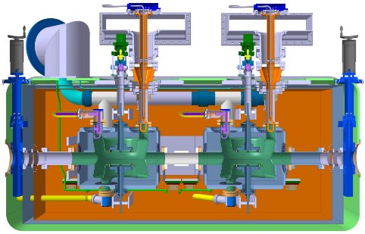
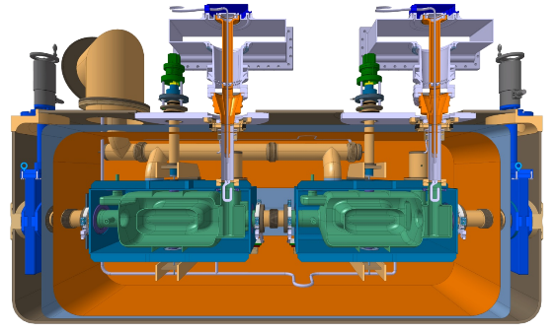
Crab cavities
Mostly standardized interfaces and common platform
Main differences
Cavity symmetry & length
HOM couplers
Double Quarter Wave,
Vertical Deflection
RF Dipole
Horizontal Deflection

Slide 17

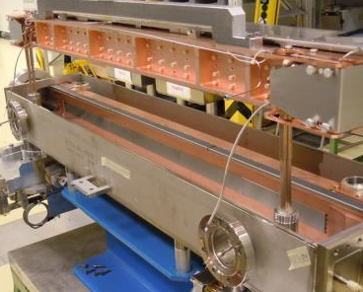
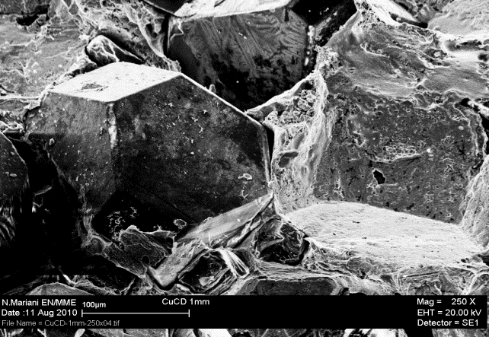
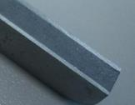
Low impedence collimators(LS2 & LS3)
New material: MoGr
Reduce impedance by > 2)
S. Redaelli et al.

Slide 18
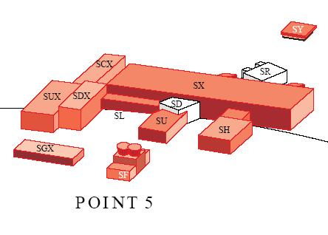
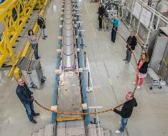
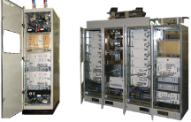
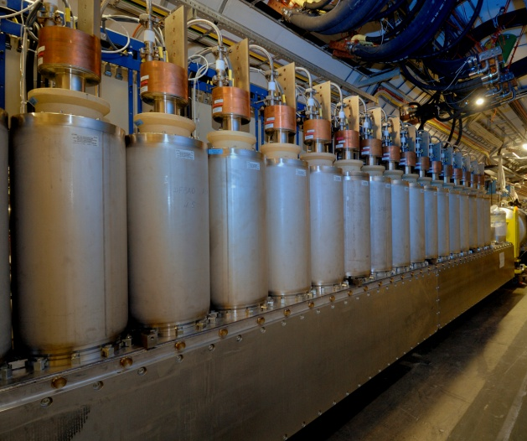
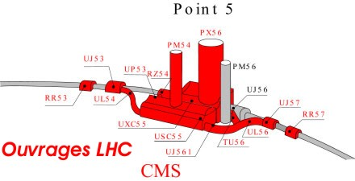
Increasing availability
4 pairs 150(+/- 75) kA for MS– LS3
4 pairs 100(+/-50) kA for ITR – LS3
All lines in MgB₂ (or HTS)
tens of 6-18 kA CLs pairs in HTS
Baseline: removal to Double Decker Underground
2×150 kA
Notes:
R2E and SC links for remote powering of cold circuits: replacement of radiation sensitive electronic boards of the power converter system with radiation-hard cards and the displacement of power converters/equipment to distant locations out of the tunnel thanks to a novel technology: superconducting links (SCLs) made from HTS (YBCO or Bi-2223) or MgB₂ superconductors.

Slide 19
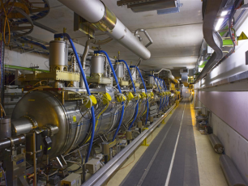
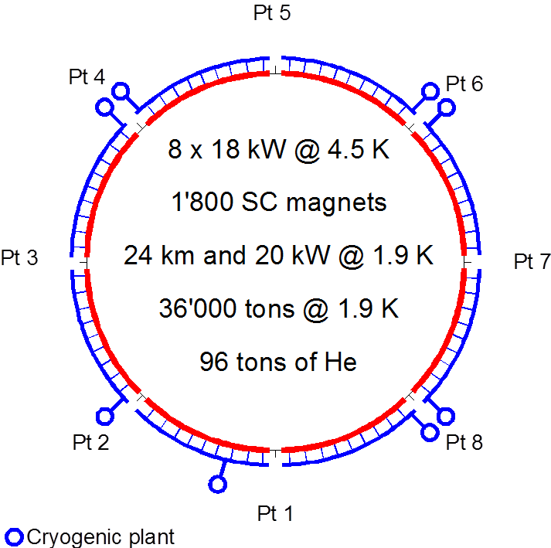
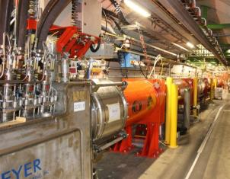
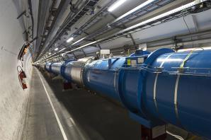
Eliminating Technical bottlenecks Cryogenics P4 and for IT
IT
IT
RF
RF
Never good to couple RF with Magnets !
Reduction of availabe cryo-power and coupling of the RF with the Arc (thermal cycle requires > 3 months and tests)
IT
IT
IT
IT
IT
IT

Slide 20

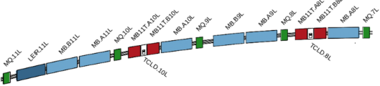

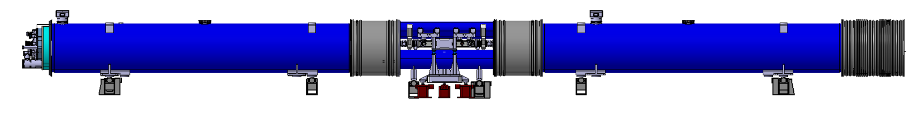
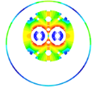
11 T Magnets
11 T Nb₃Sn

Slide 21
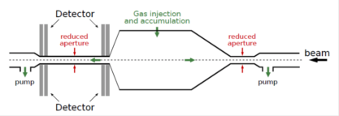
Bam diagnostic improvement
Cryogenic BLMs & Radiation Hard Electronics
  Cryogenic BLMs
  Radiation hard electronics
Fast WireScanners
Insertion Region BPMs
  Cold directional couplers
  Tungsten shielded cold directional couplers
  Warm directional couplers
  High precision electronics for insertion region BPMs
Luminosity Monitors
Diagnostics for Crab Cavities
Upgrade to Synchrotron Light Monitors
  Upgrade to existing monitor
  New light source
  Halo diagnostics
Beam Gas Vertex Detector
  Final Implementation
Long-Range Beam-Beam Compensator
  Prototype
  Final Implementation

Slide 22
And many other improvements
Machine protection: improved robustness to mis-injected beams, to kickers sparks will be required. The kicker system, collimation and TDI, is the main shield against severe beam induced damage.
Quench Protection System of SC magnets to remake a 20 years old design.
Remote manipulation: the level of activation around 2020 requires development of special equipment to allow replacing/servicing collimators, magnets, vacuum components etc., according to ALARA principle. Remote manipulation, enhanced reality and supervision is the key to minimizing the radiation doses sustained during interventions.
Vacuum …

Slide 23
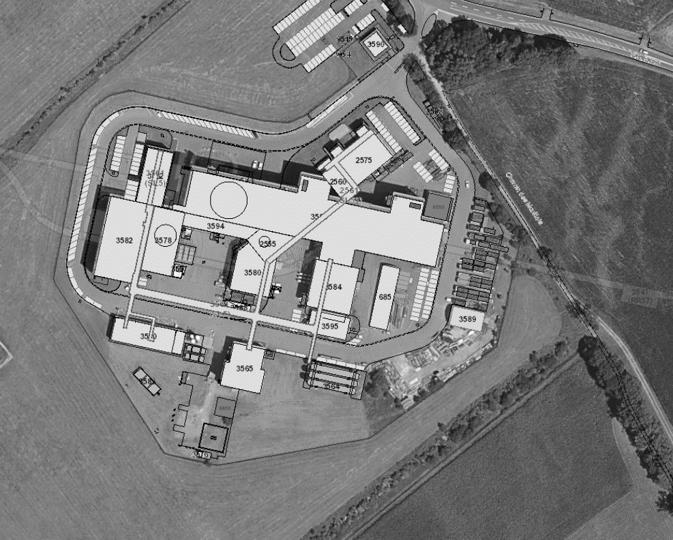

HL-LHC: SURFACE BUILDINGS
SHAFT INSIDE LHC RING
Buildings requirements..
SFA: Two additional cooling towers. Existing SF5 will be extended;
SHE: Helium tanks and platform close to the existing one;
SHM: Close to the helium tanks. New TGs to route services towards the SD;
SD-SDH: Similar layout as for Point 4;
SU: Closes to the SD for easy pipes and ducts connection;
SE: In a central position between the SD and existing EL bld. Foresee a new TG towards SR;
Existing fenced limit
10
4
SE57
30
15
15
X=26.5m
Y=182.5m
10
30
3
SDH57
20
SD57
40
SU57
20
Existing fenced limit
22
20
SFA57
11
15
17
50
SHE57
33
SHM57
New fenced limit
Landscaping Area
New CE Worksite/Storage Area

Slide 24
Technical Infrastructures
Technical infrastructures
EXISTING SURFACE
BUILDINGS
NEW SURFACE
BUILDINGS
NEW UNDERGROUND
TUNNELS
EXISTING UNDERGROUND
TUNNELS

Slide 25
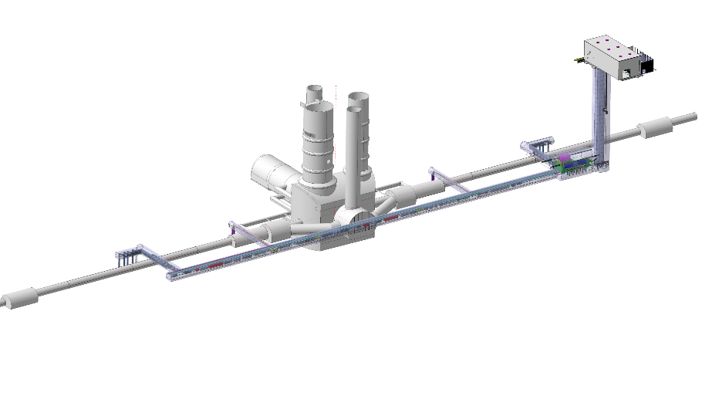
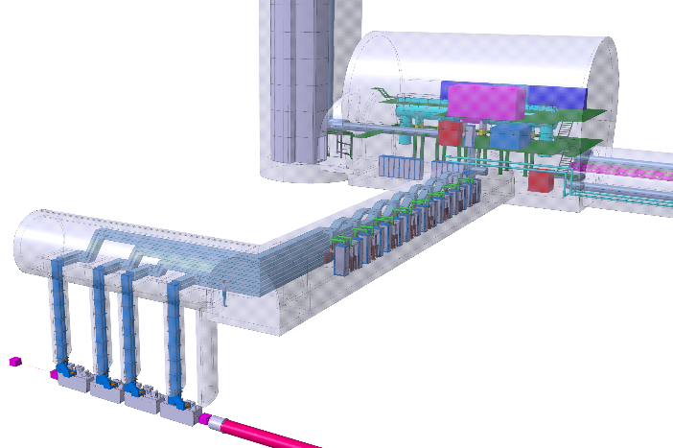
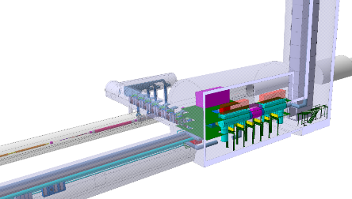
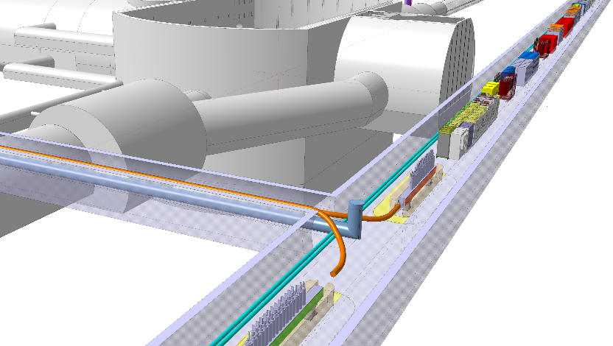
Underground Layout
Civil Engineering - New baseline – e.g. P1

Slide 26
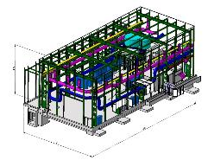
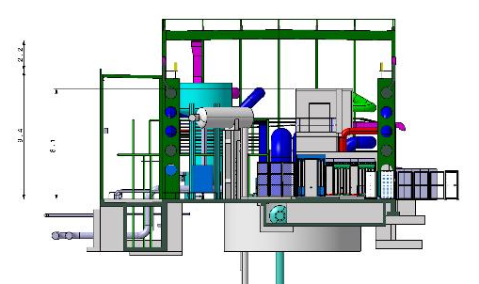
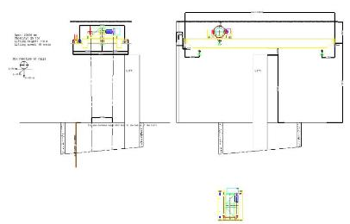
SD BUILDING
BUILDING | DIMENSIONS | HEIGHT | AREA
SD57 (Lift) | 20x40m | 15.2m | ~800m2
Elements delimiting height:
- Lift (8.1m) → height building 12m
- Crane 25T → height building 15m
LIFT
1.6
EN-HE-HM
3
CRANE AREA
10.6
Span 20m
Length 20m+-10m
Lifting height into the shaft: 110m
Clearance under lifting beam in the building: 10m (top of lift machinery is at 9m)
Minimum height inside building: 13,5m

Slide 27
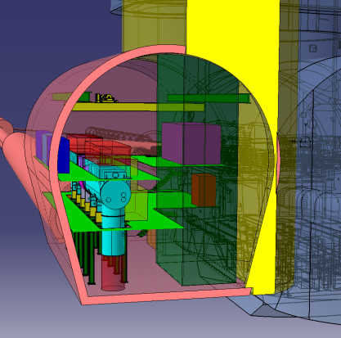
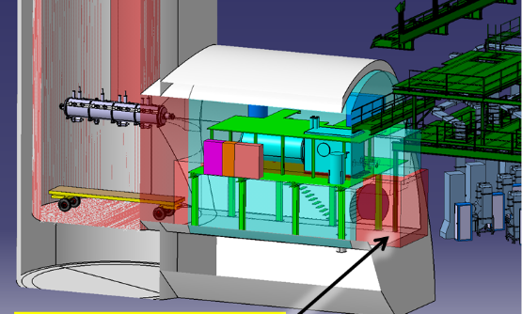
Technical Infrastructure
Metallic structures, cooling, ventilation, electrical distribution,
handling, tooling, controls, logistics …

Slide 28
HL-LHC
Impact on society

Slide 29
Technology areas
CERN has mapped in 2014 about 67 technology area of interests. There has been a steady growing number of new technologies between 1984 and 2004 at a rate of 1 new technology/year, then almost stable till today (→ there is need to innovate !!!)
The reference technology landscape is dominated, by size, connections to other areas and impact, by technologies embedded by accelerators, with 2259 patents.
HL-LHC is involved in all of the main mapped technological areas. Namely, NbTi, Nb3Sn, HTSC, cryogenics, vacuum. Of these many are showing a growing trend in the last years.

Slide 30
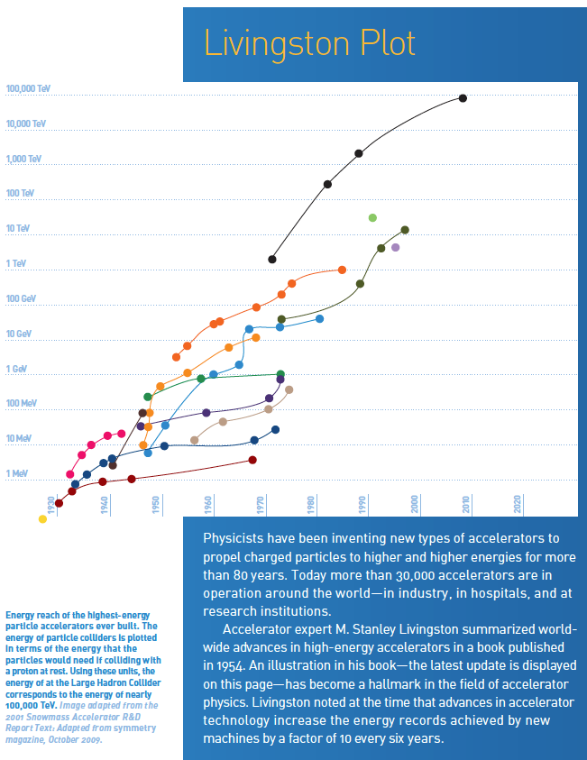
Impact on society
Application of accelerators has not yet
reached the full needs and opportunities
offered from many sectors.
Exploitation is expected even outside
of the known medical therapy field.
Examples: Accelerator-driven systems
able to provide a long-term strategy for
the growth of nuclear power –
Fusion energy - Industrial processes -
Gas and water cleaning - Demonstrations have shown the effectiveness and efficiency of particle-accelerator technology in treating flue gas emissions and polluted water.
Notes:
Advances in accelerator technologies advance the energy level by factor 10 every 6 y

Slide 31
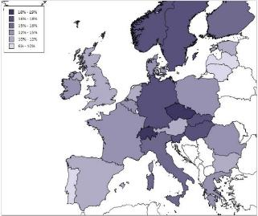
Impact on society
Physics-based industrial sector generated over 15% of total turnover and over 13% of overall employment within Europe’s business economy.
The turnover per person employed in the physics-based sector substantially outperforms the construction and retail sectors, and physics-based labour productivity was significantly higher than in many other broad industrial and business sectors, including manufacturing.
Physics related employment in %
Physics-based industries and enterprises were more resilient in comparison with the wider economy.
“The importance of physics to the economies of Europe” Report by Cebr
http://c.ymcdn.com/sites/www.eps.org/resource/resmgr/policy/EPS_economyReport2013.pdf
Notes:
Advances in accelerator technologies advance the energy level by factor 10 every 6 y

Slide 32
Industry
Procurement from HILUMI to
HL-LHC

Slide 33

HILUMI FP7

Slide 34
HILUMI Procurement till Dec 2014

Slide 35

Notes:
Dip in 2021. Big contributors like WP3,4, 11,6A (show their global spending profile) will have engage much of the money by then, while another big contributor WP9 and 6B willstart launching big contracts for the refrigerators in P1 and P5 and power converters.
<2021 : in-house procurement
>2021 : outside procurement – industrial equipment purchase

Slide 36

HL-LHC – IR Magnets
WP03 : most spending in GOODS, purchase of cables, cabling activities and components for Q1,Q2,Q3 magnets till 2020
In Kind USA
Notes:
Not all procurements – Some In kind

Slide 37


HL-LHC – Vacuum
Notes:
WP03 : most spending in GOODS, purchase of cables, cabling activities and components for Q1,Q2,Q3 magnets till 2020
WP11 : most spending in GOODS, purchase of cables, cabling activities and components for 11T series magnets till 2020
WP6B: Major contribution of family of 4-quadrant converters and high-current converters between 2021 and 2023
WP4: big purchases after 2019 – implementation of results form SPS tests
WP9: big contracts for P1/P5 refrigerators after 2021 – CE to be finished by then
WP5: purchase of TCTPM and TCL (IR cleaning)
WP6A : R&D before 2017, purchasing cables cryostats and main components between 2017 and 2021.

Slide 38
Industry
Make or buy

Slide 39

Ex. WP4 Crab Cavities and RF systems
Conceptual specifications
WP4
Crab cavities
Harmonic system
SPS
LHC
Wide-band feedback
RF services

Slide 40
Analysis of the subcomponents
WP4
LHC
(ACF)
Cryomodule
(ACFGA)
Vacuum vessel (ACFVT)
Cryostat components
(ACFAC)
Bare cavities with interfaces
(ACFCA)
Helium vessel
(ACFHT)
External supports
(HACF)
Instrumentation
(ACFIS)
Crab cavities
(ACF)
Tuning system
(ACFTU)
HOM couplers
(ACFHC)
Vacuum valves
(VVG)
SPS prototype
(idem to LHC)
Main coupler (ACFMC)
RF services
(ACFSV)
LLRF & Fast Controls
(ALL)
RF racks
(AY)
Transmission lines
(ACFWG)
Pick-ups
(APW)
Slow controls
(AS)
Dressed cavities
(ACFDC)
Magnetic shield
Thermal shield
Supports
Cryogenic circuits

Slide 41
Acquisition process
Inputs
Acquisition
Outputs
Acquisition strategy
In-kind/in-house construction
Internal/Collaboration Agreement
Make
or
buy process
Functional specification
MS/IT/DO specification
Industrial procurement
SCR
Engineering specification
Contract
Procurement templates
List of specification committee HL-LHC members
SCR: Specification Committee Review

Slide 42

Make or Buy Plan
PBS Element Life-Cycle

Slide 43

What and When
Looking for (short term)
- Collaborations with universities interesting in R&D on 2-quadrant topologies for converters up to 17kA to improve current ramp down (17kA/±18V) and squeeze time (6kA/±10V) – end 2015 - Potential suppliers from MS - before 2020
Contacts & more info
HL-LHC_Knowledge_and_Industry@cern.ch WWW: HL-LHC Knowledge & Industry

Slide 44


Example of procurement lists/suppliers
Domains of Activity
Power Converters
Presently identified as potential suppliers
MS | Firm | MS | Firm
AT |  | IL | 1
BE | 1 | IT | 2
BG |  | NL
CZ |  | NO
DE | 2 | PL
DK | 1 | PT | 1
FI | 1 | SK
FR | 1 | SP | 1
GR |  | SE
HU |  | CH
 |  | UK

Slide 45
Domains of Activity
Mechanical High DC Current Switches
Presently identified as potential suppliers
MS | Firm | MS | Firm
AT |  | IL
BE |  | IT
BG |  | NL
CZ |  | NO
DE |  | PL | 2
FI |  | PT
FR |  | SK
GE |  | SP
GR |  | SE
HU | 1 | CH
DK |  | UK
Requirements
Mechanical Switches 600A and 1500A Production of about 1500 units in total

Slide 46
Domains of Activity
Cryostat
Presently identified as potential suppliers
MS | Firm | MS | Firm
AT |  | IL
BE |  | IT | 1
BG |  | NL
CZ |  | NO
DE | 1 | PL
DK |  | PT
FI |  | SK
FR | 1 | SP | 1
GR |  | SE
HU |  | CH
 |  | UK
Examples
Steel Works for cryostat manufacturing. Suppliers of full cryostat or components

Slide 47
Our objective
The High Luminosity project seeks industrial suppliers and collaborations to start the construction phase and make the High Luminosity upgrade.
CERN aims at fostering R&D collaborations and knowledge exchange also with SMEs, a perfect opportunity to match their capacity with the requirements of HiLumi.
Next 4 years there will be intensive prototyping and the production of some of the first series of components.
Understanding our needs is the first step to tender successfully.
Understanding your capabilities and the know how that could come from industry is the best way to specify equipment that can be built by industry
Notes:
Advances in accelerator technologies advance the energy level by factor 10 every 6 y

Slide 48
This event is an unique opportunity to learn and exchange

Slide 49



… and let light shining over LHC many years more…

Slide 50
Procurement needs now->2018
Some examples
Notes:
Inner Triplet Magnets: Actual radiation damage on the Inner Triplets Magnets is expected already at the level of integrated dose of LHC. The replacement of the triplet must be anticipated before damage occurs, because of the serious and long intervention (requiring one to two years shutdown)
Collimation: The present collimation system will need an upgrade that takes in account the increased beam intensities and the need to protect the new triplets in IR1 and IR5. This would require the replacement of some of the LHC main dipoles with dipoles of equal bending strength (∼120 T⋅m), but obtained by a higher field (11 T) and shorter length (11 m) than those of the LHC dipoles (8.3 T and 14.2 m), gaining in this way enough room for installing the new special collimators.

Slide 51

What and When
2018
2018
Looking for (short term)
Collaborations interesting in R&D on Digital I/Q Demodulators & DSPs, low noise demodulators, Tetrode, IOT & SSPA, flexural guides , machining, forming techniques, E-beam welding and for Nb and NtTi sheets – by 2016 Potential suppliers from MS on raw materials (Nb and NbTi), machining and forming of raw materials, vacuum valves and RF equipment – before 2016
Contacts & more info
HL-LHC_Knowledge_and_Industry@cern.ch WWW: HL-LHC Knowledge & Industry

Slide 52
What and When
2018
Looking for (short term)
Potential suppliers from MS on Raw Materials for Advanced Collimators for Accelerators & manufacturers of Collimators – before 2016
Contacts & more info
HL-LHC_Knowledge_and_Industry@cern.ch WWW: HL-LHC Knowledge & Industry

Slide 53
What and When – WP6a: Cold Powering
2018
Looking for (short term)
Potential suppliers from MS on cabling of superconducting and semi flexible long cryostats – by 2016
Contacts & more info
HL-LHC_Knowledge_and_Industry@cern.ch WWW: HL-LHC Knowledge & Industry

Slide 54
What and When
Looking for (short term)
- Collaborations with universities interesting in R&D on 2-quadrant topologies for converters up to 17kA to improve current ramp down (17kA/±18V) and squeeze time (6kA/±10V) – end 2015 - Potential suppliers from MS – before 2020
Contacts & more info
HL-LHC_Knowledge_and_Industry@cern.ch WWW: HL-LHC Knowledge & Industry

Slide 55
What and When
2018
Looking for (short term)
Collaborations with universities interesting in R&D on design and manufacturing of Mechanical High DC Current Switches, Cold By-pass Diodes and Assembly of these Diodes – before 2016 Potential suppliers from MS – before middle 2017
Contacts & more info
HL-LHC_Knowledge_and_Industry@cern.ch WWW: HL-LHC Knowledge & Industry

Slide 56
What and When
2018
Looking for (short term)
Collaborations with universities interesting in R&D on design and manufacturing of Neutron absorbers for accelerators – end 2015 Potential suppliers from MS on machining in situ of radioactive materials – before 2016
Contacts & more info
HL-LHC_Knowledge_and_Industry@cern.ch WWW: HL-LHC Knowledge & Industry

Slide 57
What and When
2018
2018
Looking for (short term)
Potential suppliers from MS on Raw Materials Metallic and non-Metallic (Stainless Steel, Cooper, Low Carbon Steel, Fiberglass, Mica, Ceramic Binder), Machining of metallic components, Machining of composite component and Cryostats – before March 2016
Contacts & more info
HL-LHC_Knowledge_and_Industry@cern.ch WWW: HL-LHC Knowledge & Industry

Slide 58
What and When
2018
Looking for (short term)
Potential suppliers from MS on Raw Materials Metallic and non-Metallic (Stainless Steel, Cooper, Low Carbon Steel, Fiberglass, Mica, Ceramic Binder), Machining of metallic components, Machining of composite component and Cryostats – before March 2016
Contacts & more info
HL-LHC_Knowledge_and_Industry@cern.ch WWW: HL-LHC Knowledge & Industry

Slide 59
What and When
2018
Looking for (short term)
Collaborations with universities interesting in R&D on Laser Engineered Surface – before 2017 Potential suppliers from MS on Bake out System, Machining and Assembly of UHV Components, Raw Materials (W alloy, Al alloy, SS…), Beam screens, bellows for UHV, Supports and Vacuum system controllers – before 2018
Contacts & more info
HL-LHC_Knowledge_and_Industry@cern.ch WWW: HL-LHC Knowledge & Industry

Slide 60
What and When
2018
Looking for (short term)
Qualification of potential suppliers: cryogenic cables – before 2017 UHV RF feedthroughs – before 2017 Packaged diamond detectors – before 2017
Contacts & more info
HL-LHC_Knowledge_and_Industry@cern.ch WWW: HL-LHC Knowledge & Industry

Slide 61
What and When
2018
Looking for (short term)
Potential suppliers from MS on Raw Materials (Glidcop, Graphite, 3D C-C composites), machining of components, Welding (Electro Beam Welding), Brazing, Interferometers, Bake out coating, Vacuum equipment and Water System equipment – before 2017
Contacts & more info
HL-LHC_Knowledge_and_Industry@cern.ch WWW: HL-LHC Knowledge & Industry

Slide 62
Ready for the challenge?
Become a CERN supplier to built future accelerators
Notes:
Inner Triplet Magnets: Actual radiation damage on the Inner Triplets Magnets is expected already at the level of integrated dose of LHC. The replacement of the triplet must be anticipated before damage occurs, because of the serious and long intervention (requiring one to two years shutdown)
Collimation: The present collimation system will need an upgrade that takes in account the increased beam intensities and the need to protect the new triplets in IR1 and IR5. This would require the replacement of some of the LHC main dipoles with dipoles of equal bending strength (∼120 T⋅m), but obtained by a higher field (11 T) and shorter length (11 m) than those of the LHC dipoles (8.3 T and 14.2 m), gaining in this way enough room for installing the new special collimators.

