Slide 1
goes to Industry
Magnet Components and Assemblies
2015-06-26
F. Savary

Slide 2
Outline
Magnets for HiLumi LHC
New challenges
How can industry contribute to magnets for HL-LHC?
Examples of critical components
Summary

Slide 3



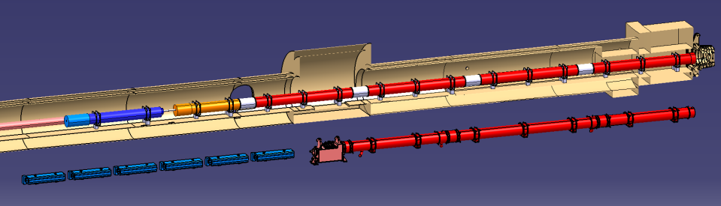


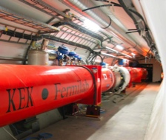
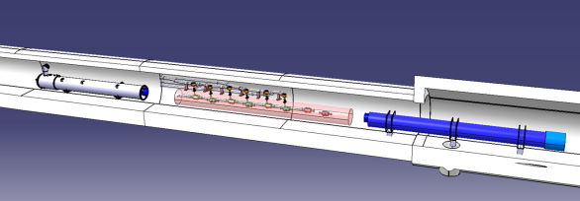


Magnets in the framework of HiLumi-LHC
Q2a
Q1
Corrector
Package
Q2b
Q3
SC D1
NC D1
Present triplets
Q4
CC
D2

Slide 4
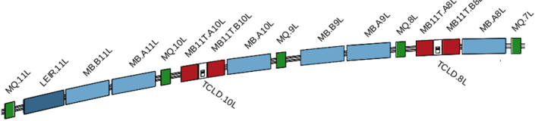
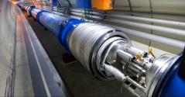
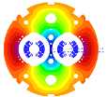
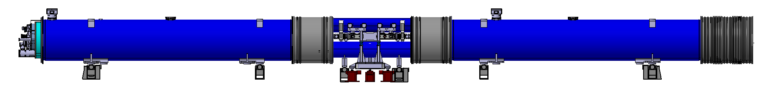
The 11T Dipole Two-in-One for DS
Create space in the dispersion suppressor regions of LHC, i.e. a room temperature beam vacuum sector, to install additional collimators (TCLD), which are needed to cope with beam intensities that are larger than nominal, such as in the High Luminosity LHC (HL LHC)
Replace a standard MB by a pair of 11T dipoles (the 11T dipole is also called MBH)
By-pass cryostat
15660 mm
11 T dipole cold mass
Interconnect
Space for Collimator

Slide 5
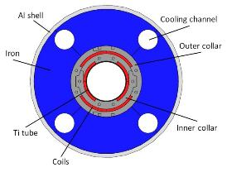
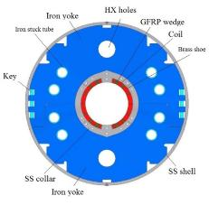
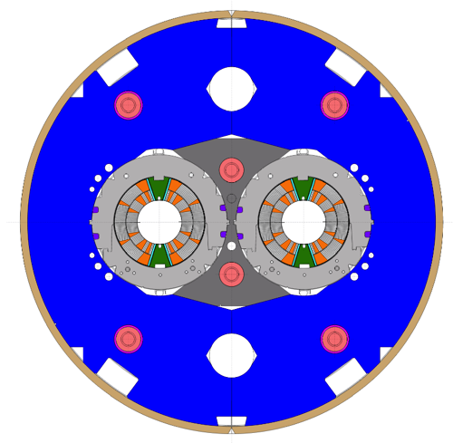
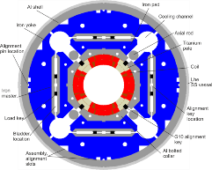
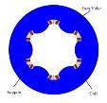
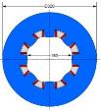
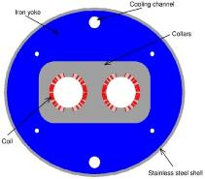
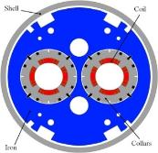
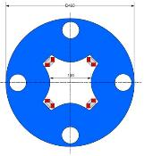
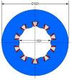
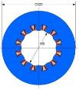
HiLumi LHC magnet zoo
Triplet QXF (LARP and CERN)
Orbit corrector (CIEMAT)
Separation dipole D1 (KEK)
11 T dipole (CERN)
Sextupole (INFN)
Octupole (INFN)
Skew quadrupole (INFN)
Recombination dipole D2
(INFN design)
Q4 (CEA)
Overall, about 150 magnets are needed
Decapole (INFN)
Dodecapole (INFN)

Slide 6





Main HiLumi-LHC Magnet Features
 | Type | Material | Field/Gradient (T) / (T/m) | Aperture (mm) | Length (m) | Units (-)
Q1,Q3 Q2 | Single aperture | Nb₃Sn | 11.4 / 132.6 | 150 | 2 x 4.2 2 x 7.2 | 40 (½ LARP, ½ CERN)
D1 | Single aperture | Nb-Ti | 6.5 | 150 | 6.3 | 6 (KEK)
D2 | Twin aperture | Nb-Ti | 4.5 | 105 | 7.8 | 6 (INFN)
Q4 | Two-in-one aperture | Nb-Ti | 6.0 / 115 | 90 | 4.2 | 6 (CEA)
DS 11T | Two-in-one aperture | Nb₃Sn | 11 | 60 | 2x5.5 | 12 (32) (CERN)

Slide 7
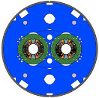
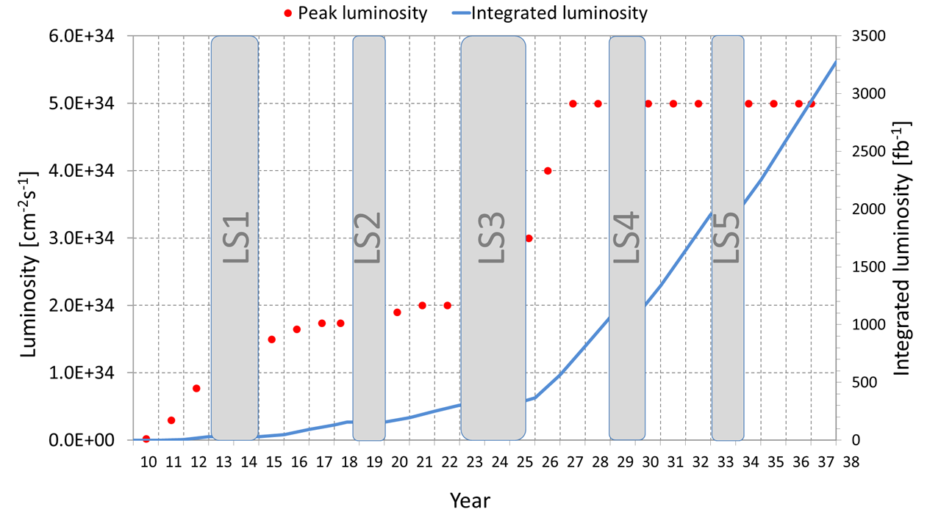
11T Dipole – 3 phases
1
2
3
TODAY
Graph showing nominal upgrade parameters - 3000 fb⁻¹ would be reached in 2036

Slide 8
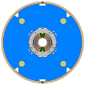
11T Dipole – scope in numbers
 | Phase 1 – LS2, all RRP | Phase 2 – LS3 | Phase 3 – LS4
Models | MBHSM101 (done) MBHSP101 (done) MBHSP102 (done) In addition: 3 x 1-in-1 2 x 2-in-1 | PIT (new X-section): 4 x 1-in-1 2 x 2-in-1 RRP (new X-section): 2 x 1-in-1 1 x 2-in-1 | None Same design as for LS3
Prototypes | P1: MBH_P001 | P2: MBH_P002 [PIT] P3: MBH_P003 [RRP]
Series baseline | First of a kind 1 x (2 MBH + 1 BPC¹) | 2 in IP2 + 2 in IP7 or 4 in IP7 tbc 4 x (2 MBH + 1 BPC) | To complete IP7 or in IP2 2 x (2 MBH + 1 BPC)
Series spares | - | - | 1 x (2 MBH + 1 BPC)
Option | - | - | IP1-IP5 Max. 8 x (2 MBH + 1 BPC)
BPC stands for By-Pass Cryostat

Slide 9
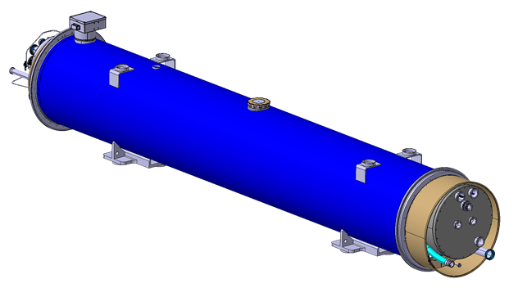
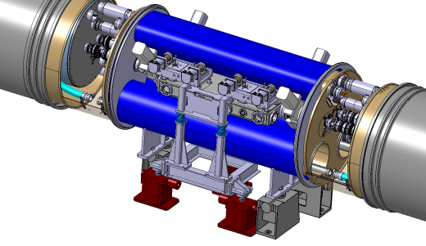
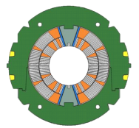
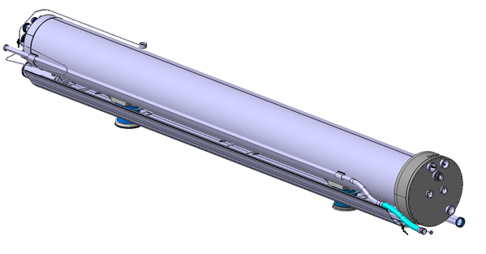
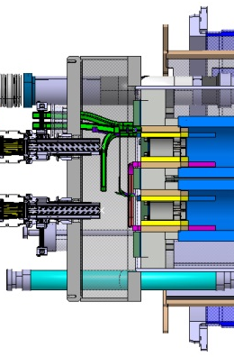
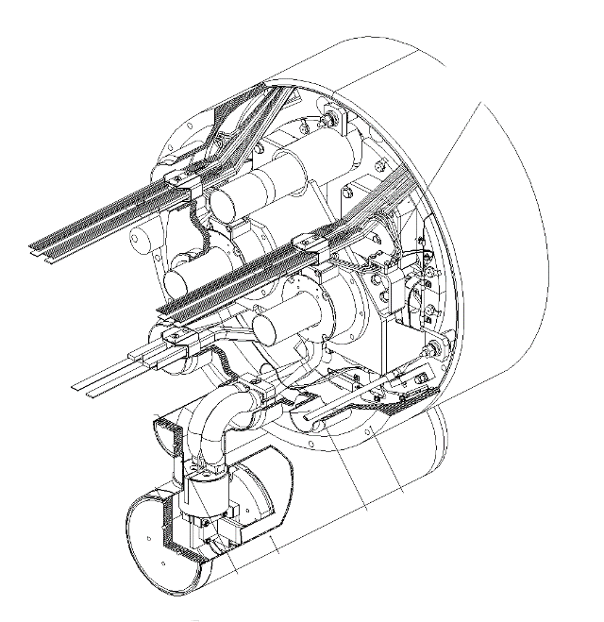
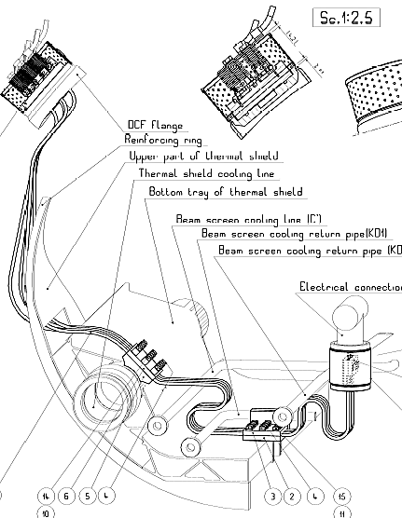
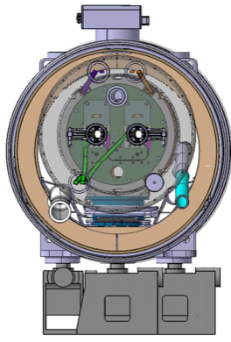
Assembly Breakdown Structure (main elements)
Cryo-assembly
  Cryostat, main and by-pass
  Bus bars for by-pass cryostat
  Jacks (RT support, cryostat to ground)
  Cold mass assembly
    Coils
    Collared coils
    Active part, including bus bars
    Ancillaries (e.g. spool pieces 6-poles, N-line, protection diode…)
    and cold mass envelope (e.g. end covers)
  Cold feet
  Thermal shield
  Current leads for trim
Interconnects (with W-bellows)

Slide 10
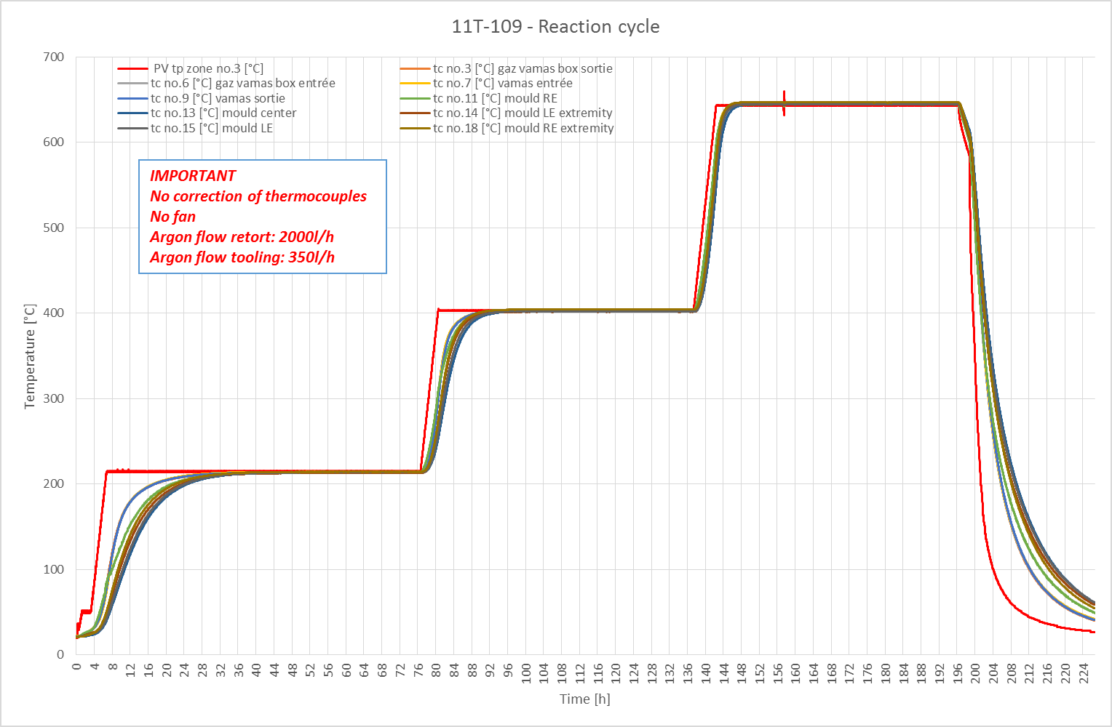
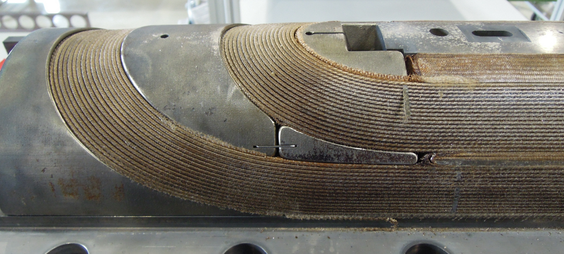
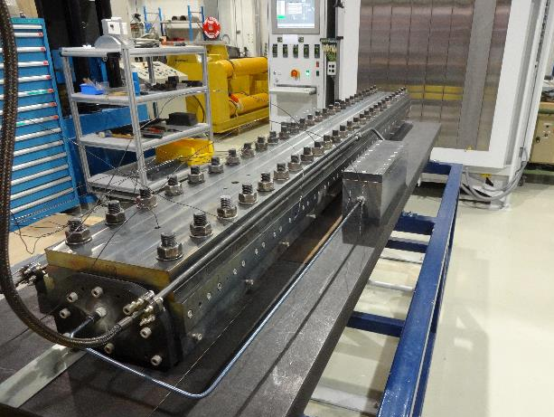
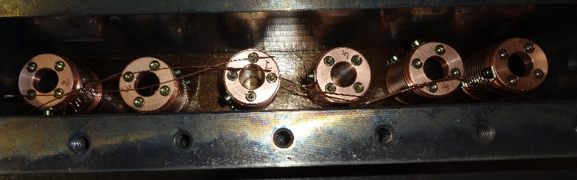
NEW challenges w.r.t. to Nb-Ti magnets - 1
Reaction treatment (48 h @ 210°C – 48 h @ 400°C – 50 h @ 640°C

Slide 11
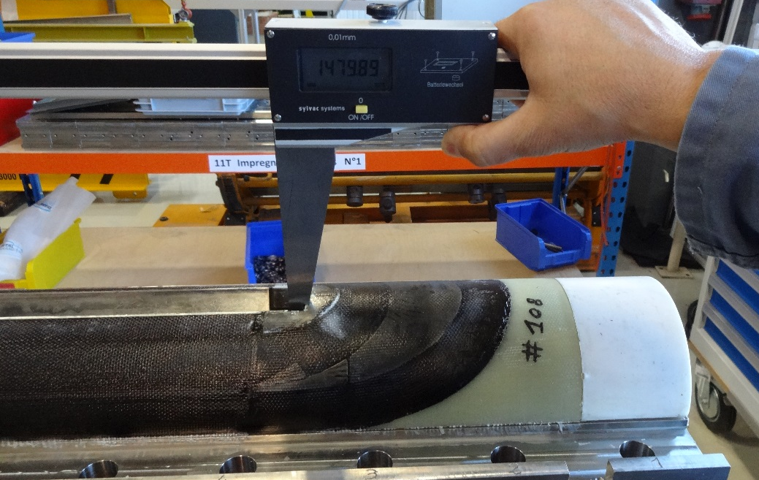
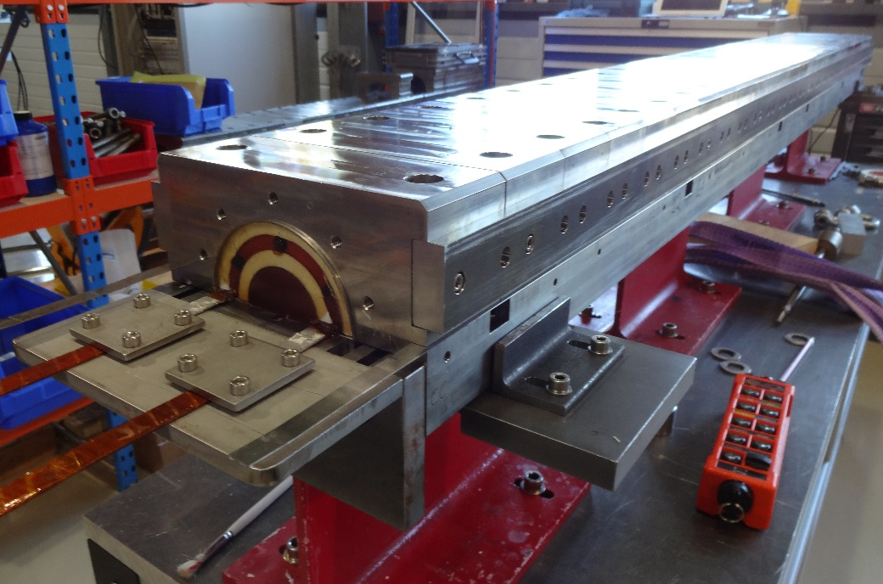
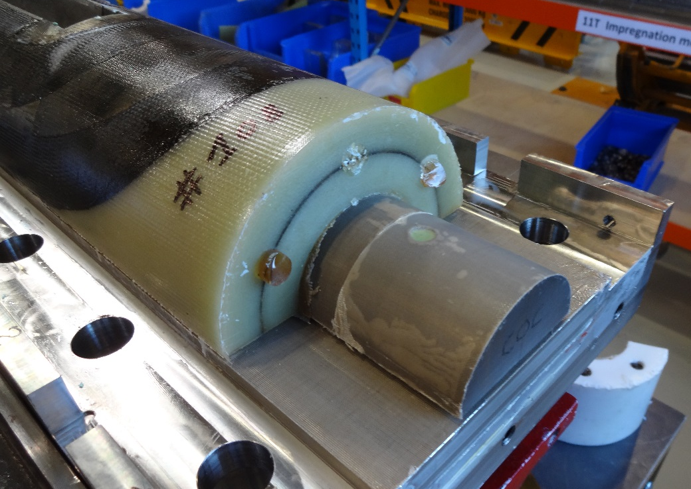
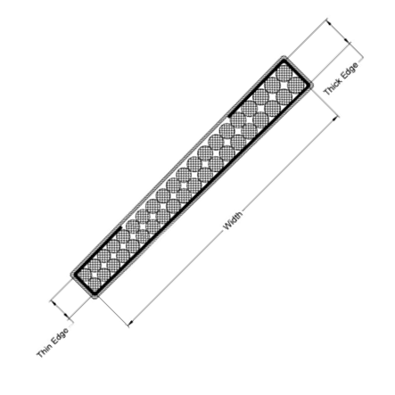
NEW challenges w.r.t. to Nb-Ti magnets - 2
Impregnation
Insulation system:
Mica C-shaped tape
Braided fiber glass
Impregnated with epoxy resin

Slide 12
How can industry contribute to magnets for HL-LHC?
Legend:
We are covered
We need more suppliers
We desperately need suppliers
Item # | Description | Raw material | 2018 | Later | What is challenging
1 | Coil keys | AISI 316 L – DIN 1.4435 |  |  | Machining (accuracy & elasticity)
2 | End spacers | SLS – AISI 316 L – DIN 1.4435 |  |  | 3D-metrology, electrical insulation is needed
3 | Saddles | Impregnated glass fiber as per IEC/EN 61212-3-1 EP-GC22 |  |  | 5-axes machining, GC22, accuracy
4 | Removable pole | TA6V annealed (Ti6Al4V; 3.7165) |  |  | Accuracy & material
5 | Wedges – precision profiles | Aluminum oxide dispersion strengthened copper (ODS) |  |  | Accuracy, material ODS
6 | Quench heaters | Polyimide – St.Steel – Copper |  |  | Flexible Printed Circuits
7 | Collars | YUS-130S (High Mn Steel) |  |  | Fine blanking, accuracy
8 | Collaring keys | AISI 316 L – DIN 1.4435 |  |  | Accuracy
9 | Yoke laminations & inserts | Low carbon steel |  |  | Fine blanking, accuracy
10 | Heat exchanger tube | Oxygen Free Cu – UNS C10200 |  |  | Cu quality
11 | Bus bars – hollow bars | Oxygen Free Cu – UNS C10200 |  |  | Length, Cu quality
12 | Lyras | Oxygen Free Cu – UNS C10200 |  |  | Cu quality
13 | Shells | AISI 316 LN – DIN 1.4429 |  |  | Raw material, thickness, accuracy
14 | End covers | AISI 316 LN – DIN 1.4429 |  |  | Raw material, accuracy

Slide 13
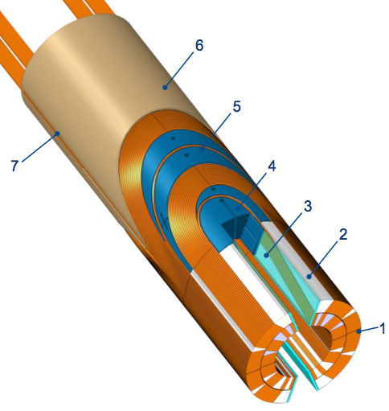
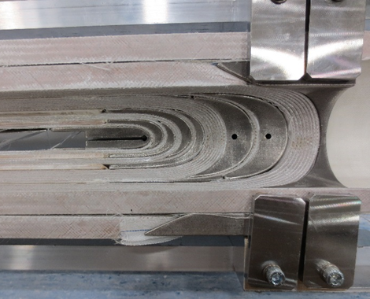
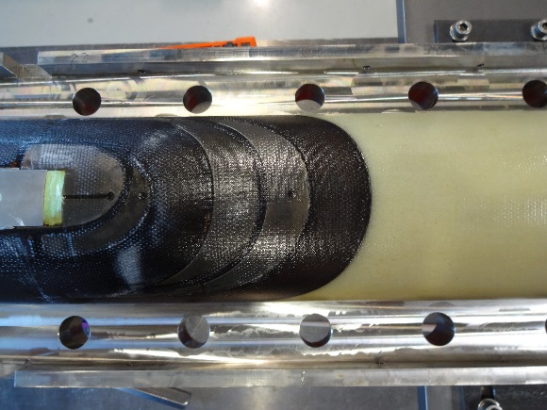
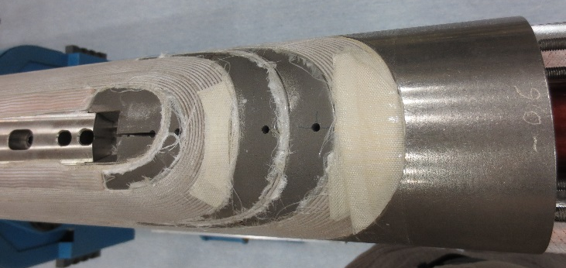
Coil keys – end spacers – saddles
Can be produced from STP files
Item 4: coil key, AISI 316 L
Item 5: Selective Laser Sintering (SLS) end spacer, AISI 316 L, with flex. legs
Item 6: Saddle, EP-GC22, base material woven glass cloth, matrix epoxy resin
After impregnation
After curing
After reaction

Slide 14
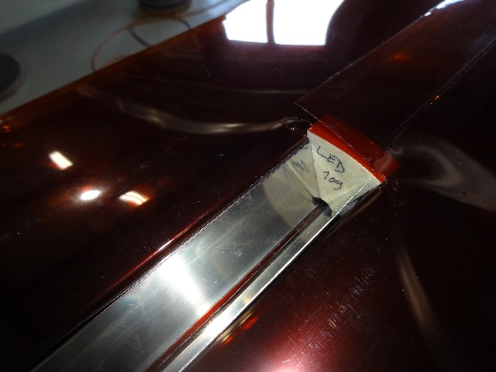
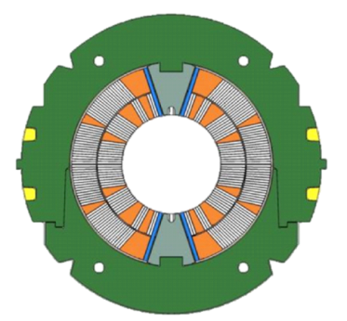
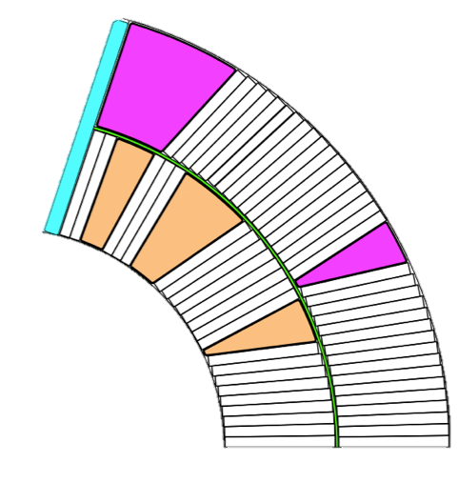
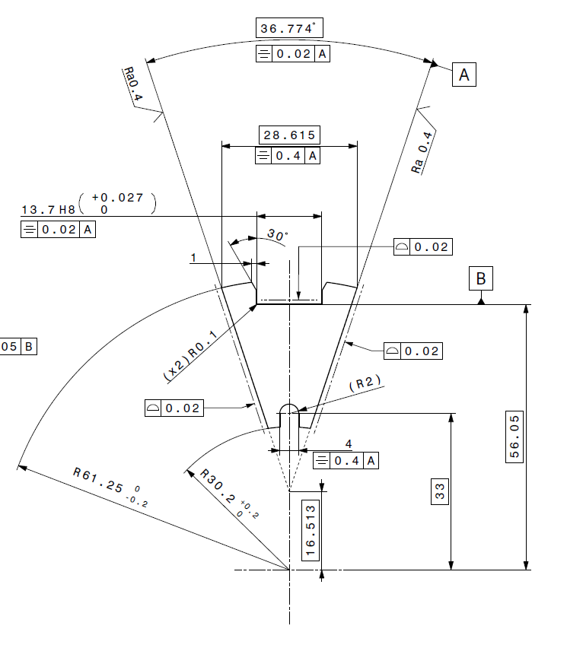
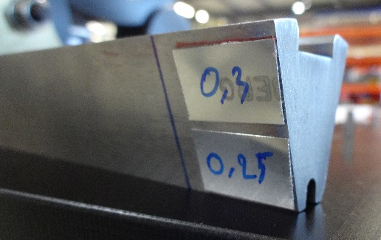
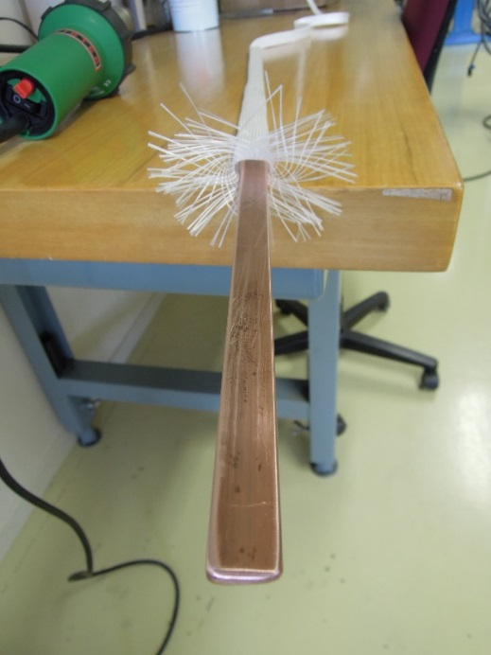
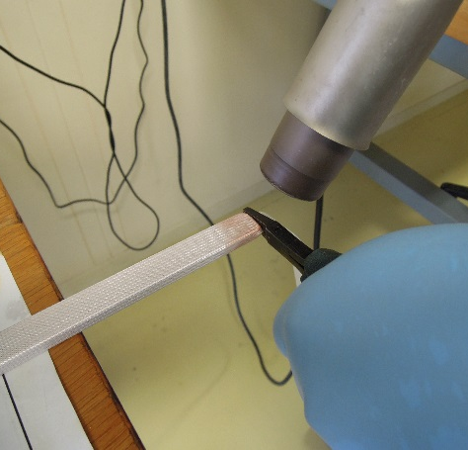
Loading pole – ODS Wedge
Loading pole, to be made of titanium, 240 mm long
Wedges, to be made of aluminum oxide dispersion strengthened copper, cold drawn in length of 2.6 m
c
d
Insulated cable
Filler Wedge
Loading plate
Inter-layer
Inner ground wrap
Outer ground wrap
f
b
a
e

Slide 15
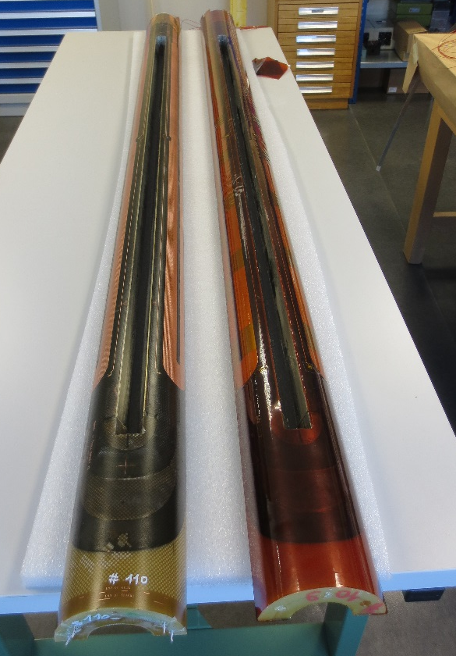
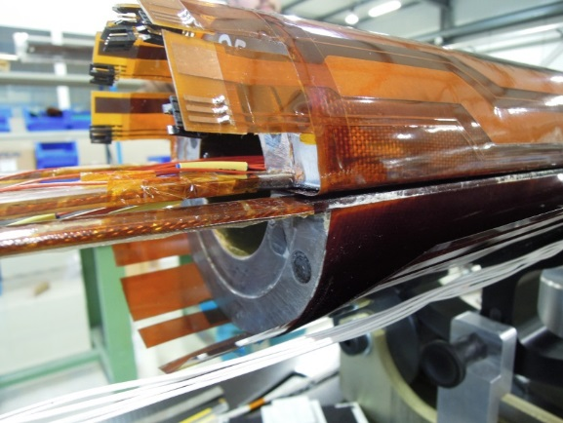
Quench heaters
Basically a strip of stainless steel of 20 μm running along the coil outer surface
A thin copper layer of 5 μm (electrolytic deposition) lower the resistance of the strip in between 2 heating areas
The substrate is a 50 μm polyimide film
The metallic circuit is encapsulated with a 37.5 μm to 50 μm thick polyimide film as cover layer with an adhesive coating
+
-
+
-
Polyimide film
(substrate)
Non-heating areas
(copper plated stainless steel)
Heating areas
(stainless steel)
Overall length: 5600 mm
Width: 160 to 300 mm

Slide 16





Collars – collaring keys – yoke laminations
Yoke laminations: 5.8 mm thick low carbon steel
Collars
    3 mm thick high Mn steel
    σ_{0.2} > 400 MPa

Slide 17


Shells – end covers, main parts of the He containment vessel
Material: AISI 316 LN, hot rolled plates formed in folding press
Thickness: 15 mm
Tight fit with yoke laminations, i.e. need to be precise
Leak tightness
Weldability
Material: AISI 316 LN
Powder metallurgy for the dished cover, or welded construction for the flat cover
Leak tightness
Weldability

Slide 18


Summary
We are seeking for additional suppliers for magnet components
Components are not standard, specifications are demanding
  Materials (remember … will work between -271°C and +640°C for the coil components)
  (Very) tight tolerances in most cases
Limited quantities, but quality counts
Technology development may be needed, e.g. quench heaters
Finding the Higgs boson, and more, requires exploring the unexplored, going beyond its own limits
Challenging, however rewarding

Slide 19
Thank you
for your attention

