Slide 1


HL-LHC Collimators and High Temperature Materials
Alessandro Bertarelli, CERN (EN/MME)
On behalf of the LHC Collimation Team
(BE-ABP, EN-STI, EN-MME)
HiLumi LHC Goes To Industry Workshop
CERN, Geneva, Switzerland – 26 June, 2015

Slide 2
Outline
HL-LHC Collimators
Why Collimators in the (HL-)LHC?
What must they do?
Where are Collimators?
What is a LHC Collimator?
How is a Collimator made?
What is a Collimator Jaw made of?

Slide 3


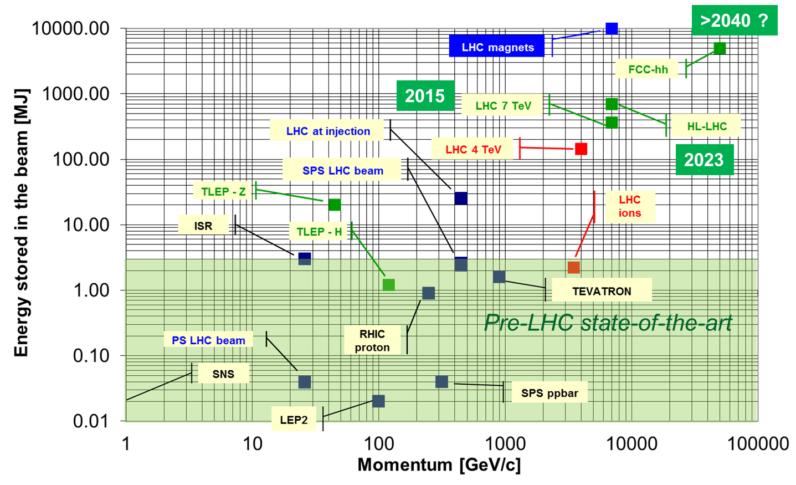
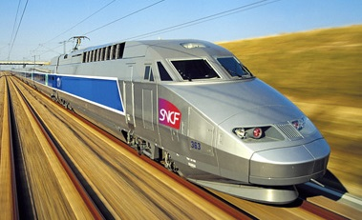

High Energy Particle Accelerators Challenges
Why Collimators in HL-LHC?
Beams circulating in last-generation accelerators can
store very high energies (678 MJ for future HL-LHC)
Beam-induced accidents, beam losses and beam stability represent one of the most relevant issues for high power particle accelerators!
Collimators are one of the most critical systems when these issues are of concern
What is HL-LHC Energy equivalent to?
v = 7 knots
30 kg Milk Chocolate
USS Harry S. Truman
v = 210 km/h
TGV
J. Wenninger
(CERN)
160 kg TNT

Slide 4
Beam Cleaning and Machine Protection
Why Collimators?
The collimation system must satisfy 2 main functions:
Multi-stage Beam Cleaning, i.e. removing stray particles which would induce quenches in SC magnets.
Machine Protection, i.e. shielding the other machine components from the catastrophic consequences of beam orbit errors.
Beam propagation
Core
Primary
halo (p)
Unavoidable losses
Secondary
halo
π
Primary Collimator
p
Shower
Impact
parameter
≤ 1 μm
π
Tertiary halo
Secondary Collimator
p
e
p
Shower
Absorber
Absorber
e
Super-conducting magnets
SC magnets and particle physics exp.
C/C
C/C
W
W

Slide 5
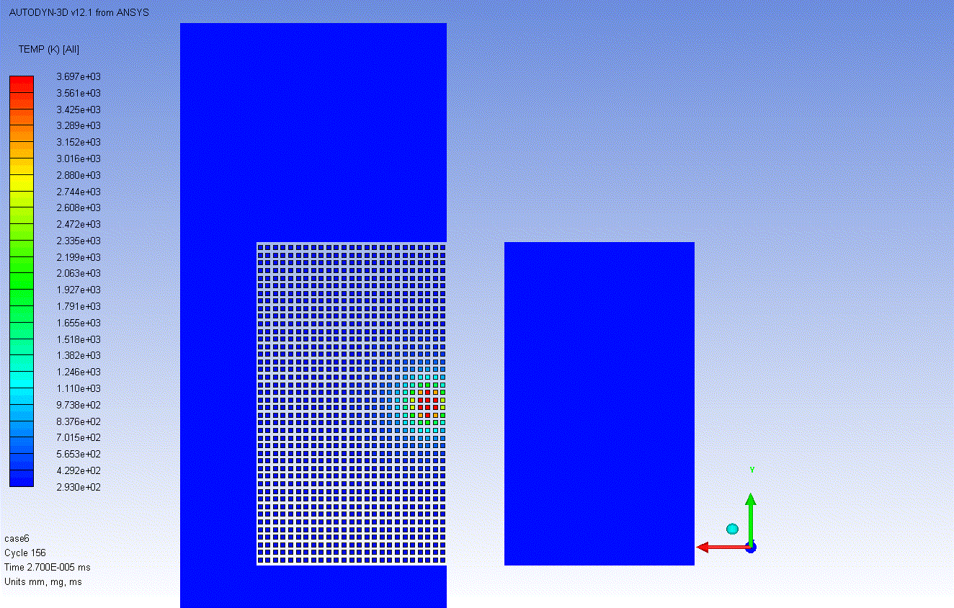
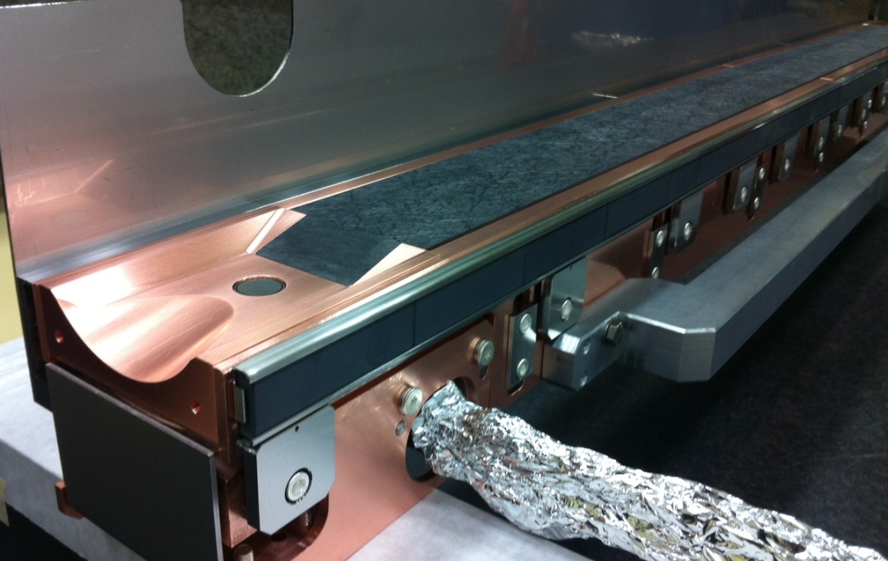
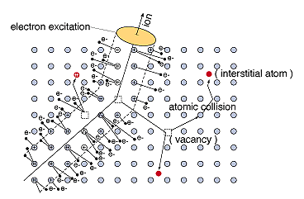
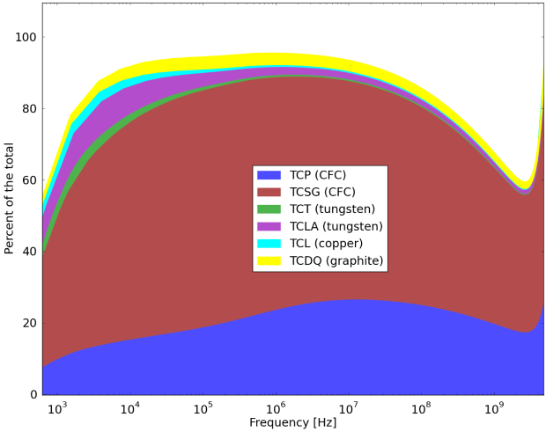
Requirements for LHC Collimators
What must they do?
Collimators are required to survive the beam-induced accidents to which they are inherently exposed given their vicinity to the beam
They must possess extremely accurate jaw flatness to maintain their beam cleaning efficiency
The collimation system is, by far, the highest contributor to accelerator EM impedance which may significantly limit machine performances: they must possess the lowest possible electrical resistivity
Their lifetime and efficiency should be conserved under long-term particle irradiation
Identifying collimator materials able to meet all requirements requires extensive R&D
Collimators impedance/
LHC Impedance

Slide 6
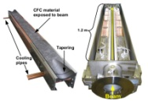
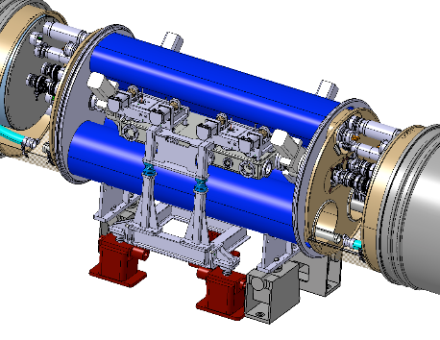
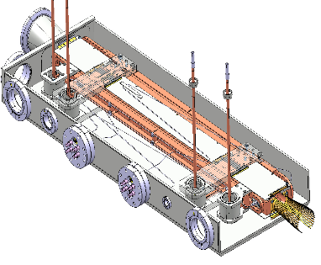
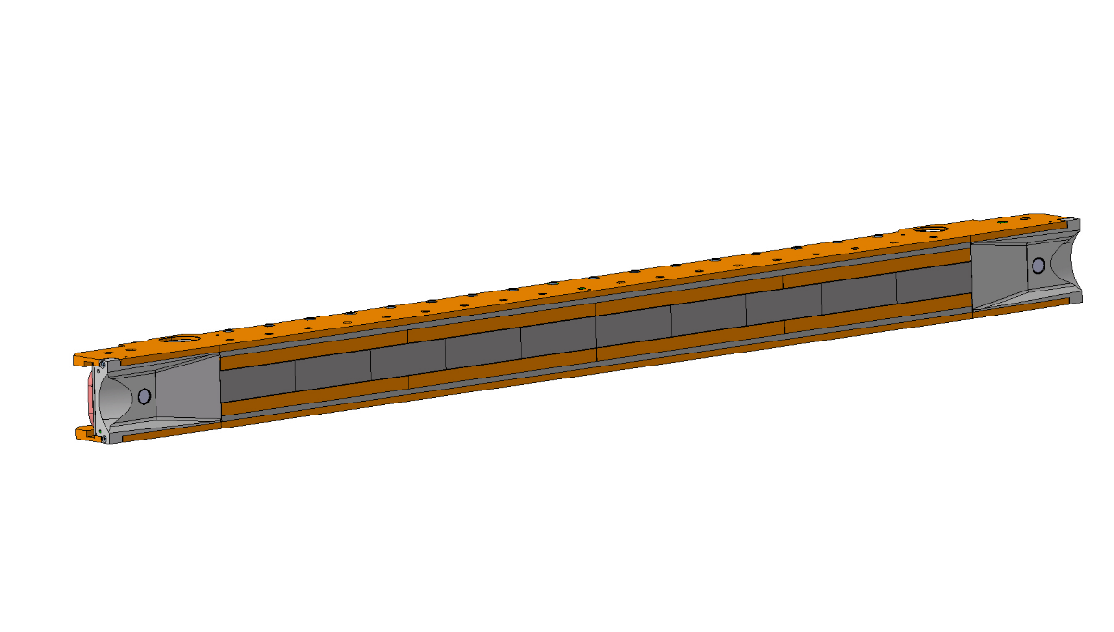
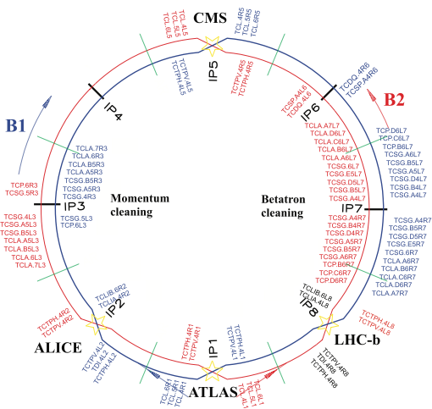
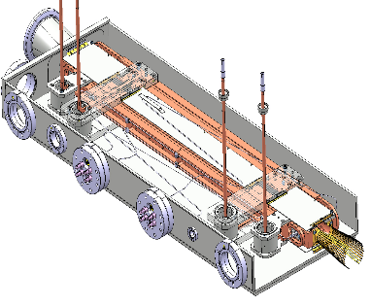
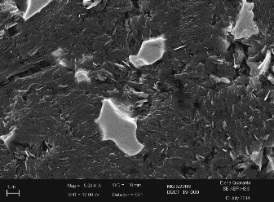
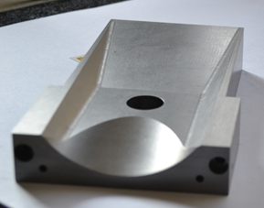
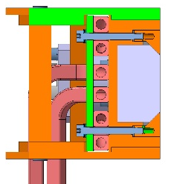
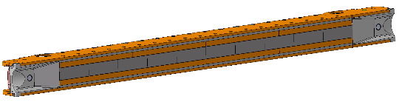
Collimation System for HL-LHC
Where are Collimators?
IR7 : DS collimators + 11T dipoles
IR1 + IR5:
New tertiary collimators and
physics debris absorbers
Completely new layouts
Novel materials
IR2 (Ion physics debris):
DS collimators + 11T dipoles
Final decision on installation to be taken based on Run 2 experience
IR7: Low impedance collimators
New design, novel advanced materials
Total of 118 collimators presently installed
~10 different design!
108 Movable units
No less that 40 units to be replaced for HL-LHC

Slide 7
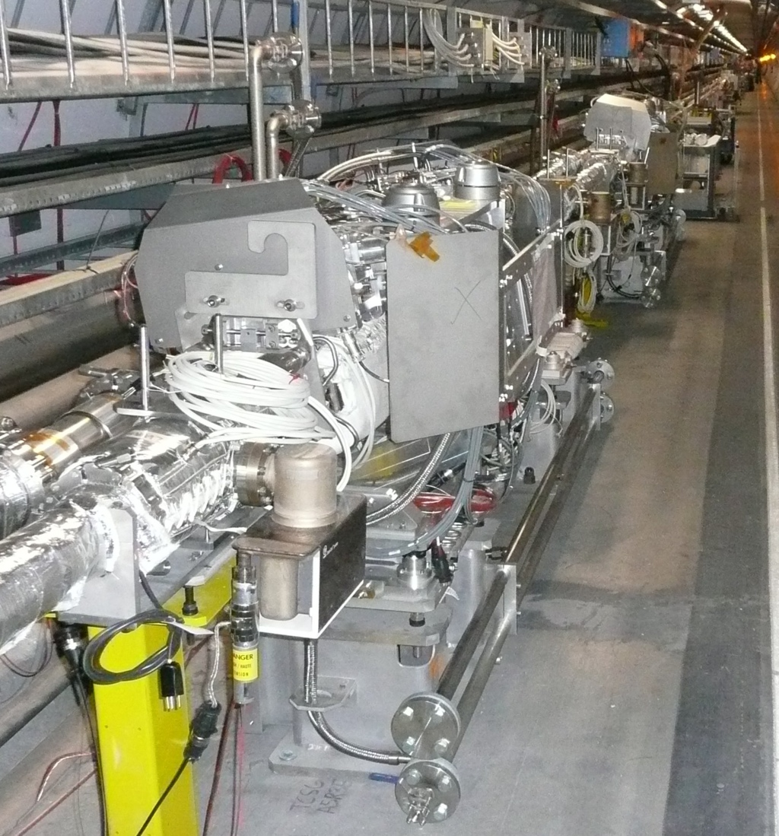
General Layout
What are Collimators?

Slide 8
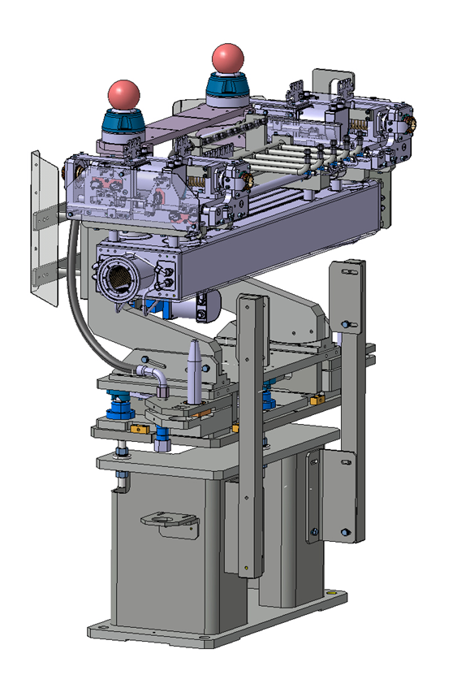
Horizontal Collimator Layout
What are Collimators?
Overall length: 1480mm
Tank width: 260mm
Collimator assembly
Adjustable (Horizontal) Stand
(Al Alloy)
Beam axis
Plug-in system
(integrates mechanical, hydraulic and electrical quick connections)
Fixed Support
(Stainless Steel)

Slide 9
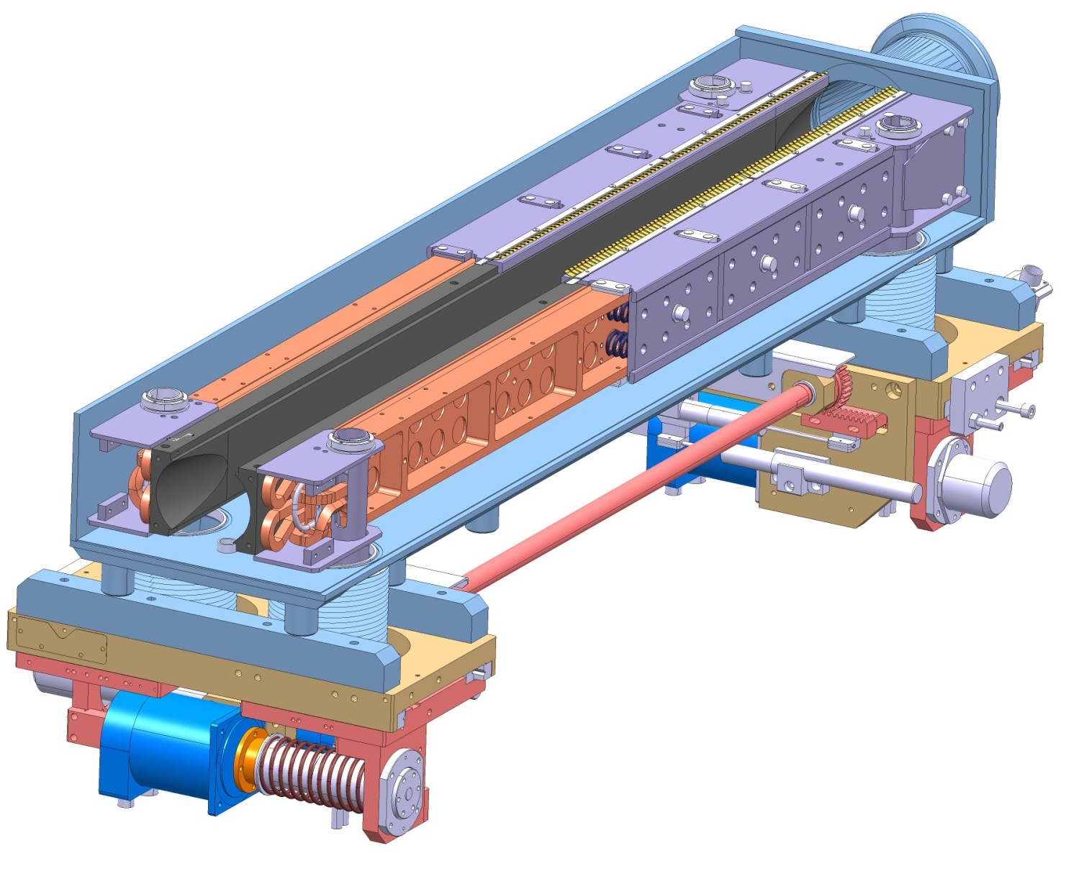
LHC Secondary Collimator (TCSG)
What is a Collimator?
The collimator and its jaws are expected to maintain their functionality after the impact of 288 SPS bunches at 450 GeV (1+ kg TNT)
Jaw Assembly (1.2 m long)
Up to 15 kW per jaw in regular operation
Jaw Block
(2D Carbon-Carbon)
1 m long
40 μm flatness in operation
Vacuum Vessel
Stainless steel
EB welded
Particle Beam
Actuation system
35 mm stroke
10 mm repeatability
High radiation compliant
Jaw Cooling system
Cu-Ni Pipes
Notes:
9

Slide 10
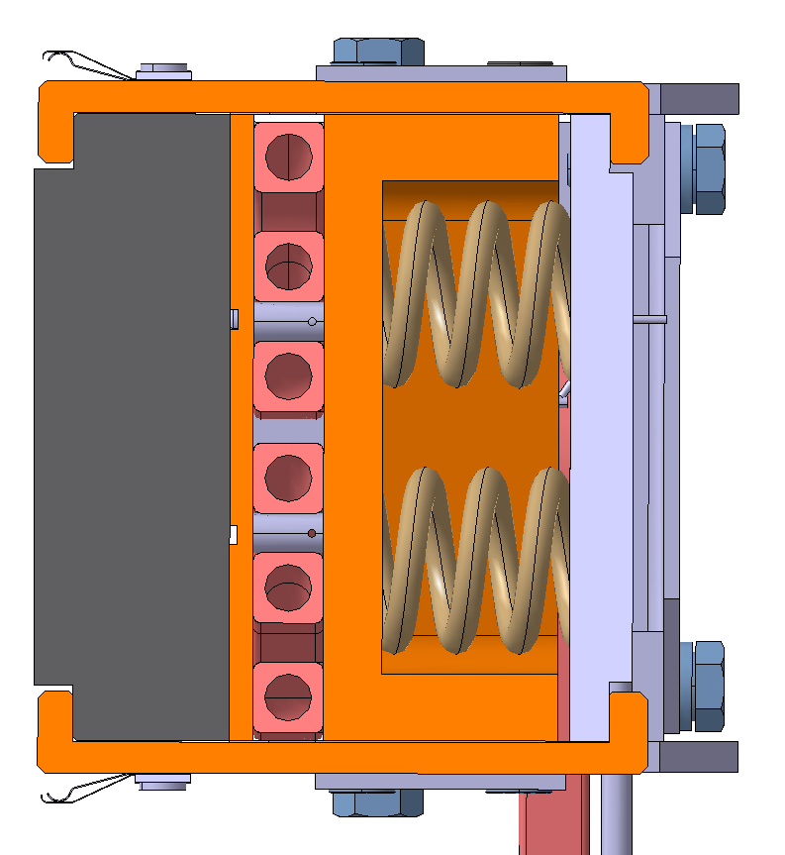
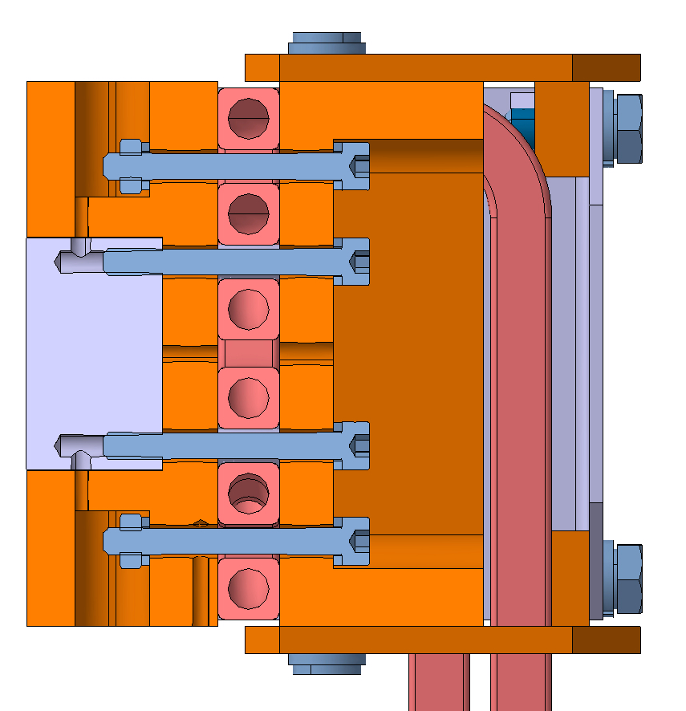
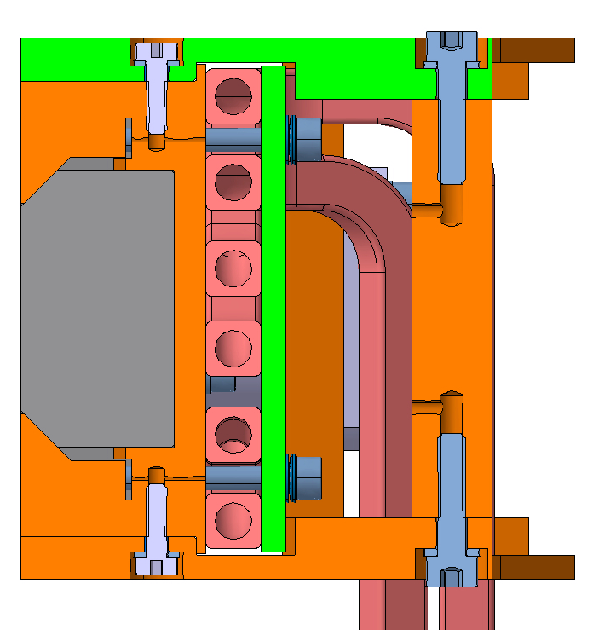
Jaw Assembly Designs
How is a Collimator made?
Materials of the jaws are the critical component because of the tough requirements (robustness, geometrical stability, electrical conductivity, radiation resistance ...)
New advanced materials being investigated for HL-LHC
TCPP /TCSP
(LHC and HL-LHC)
TCTP (LHC and HL-LHC)
TCSPM (HL-HLC)
Glidcop (Dispersion Strengthened Copper)
R&D currently ongoing
(candidate materials: MoGr and CuCD
2D Carbon-Carbon
Tungsten Heavy Alloy (95 W - 3.5 Ni - 1.5 Cu)

Slide 11
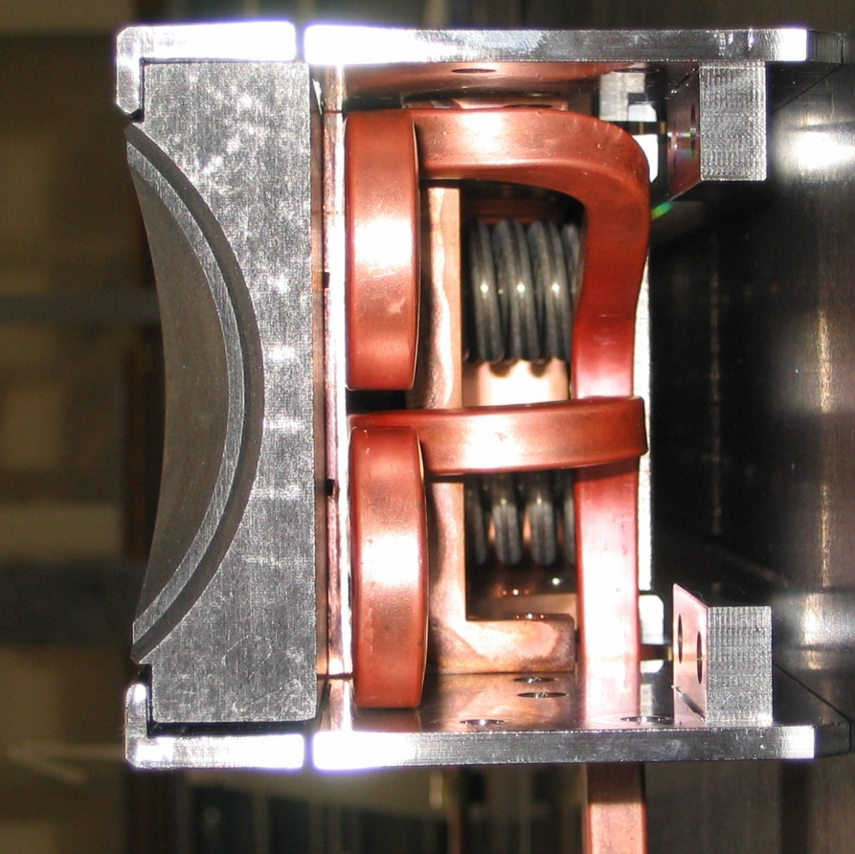
Jaw assembly Design
How is a Collimator made?
Vacuum Brazing
(Cu-Ni to Glidcop)

Slide 12
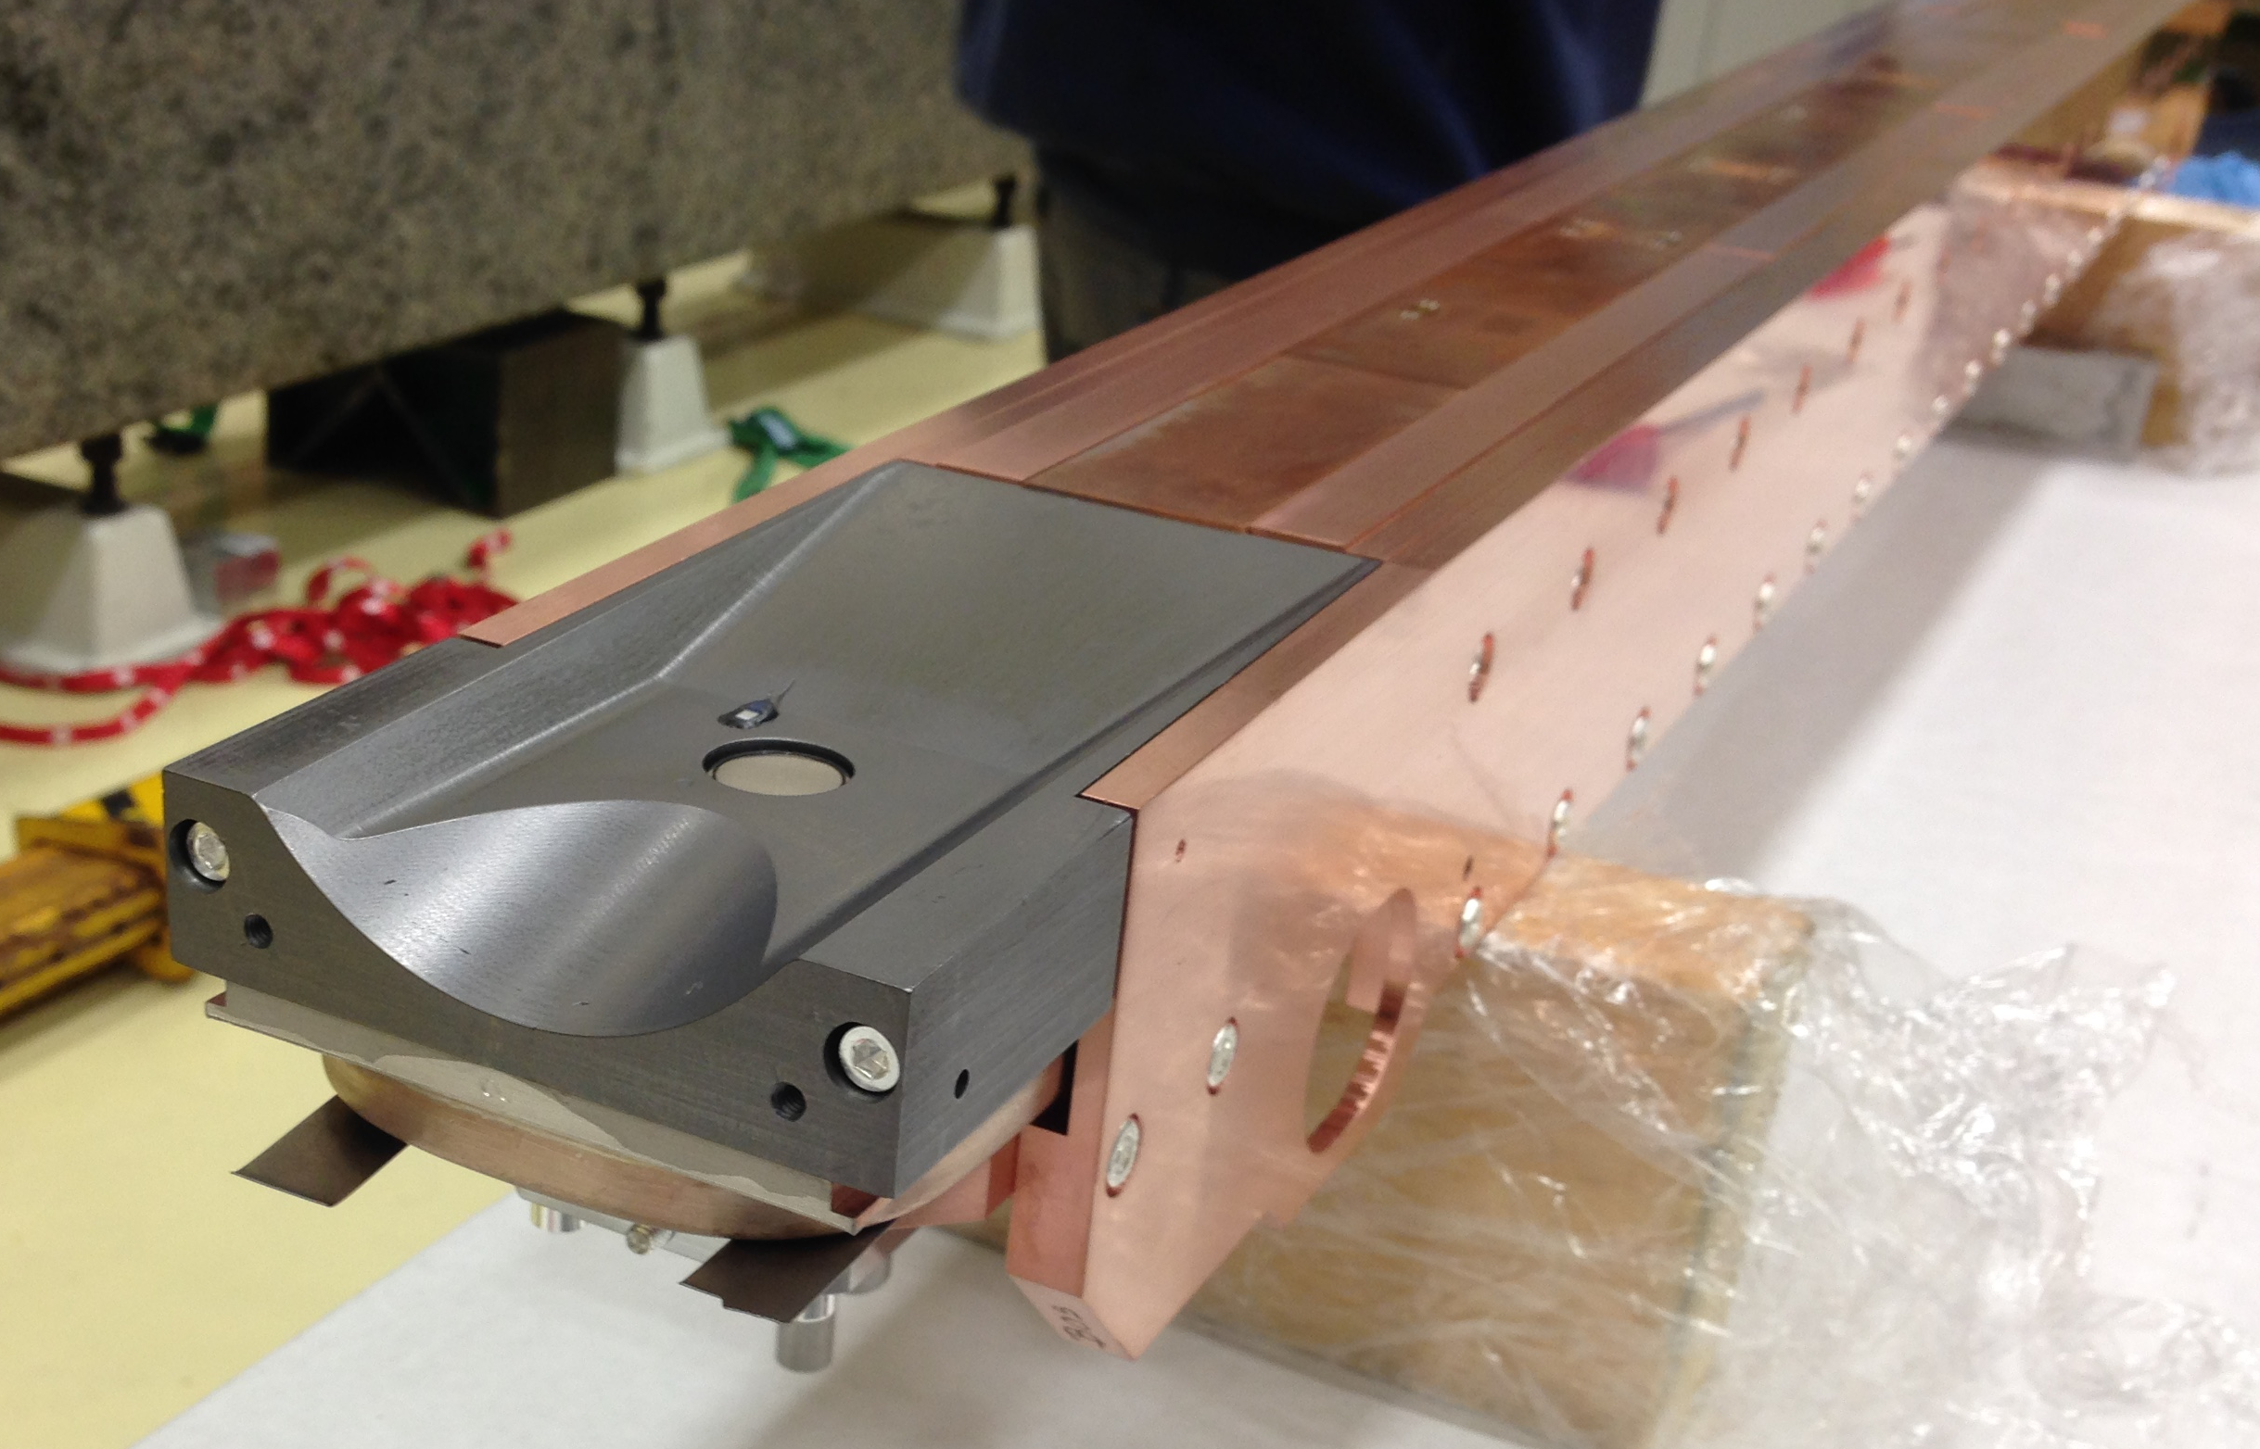
TCSPM Jaw Prototype
How is a Collimator made?
Copper – Diamond Blocks
BPM Button pickup
Molybdenum – Graphite Tapering

Slide 13
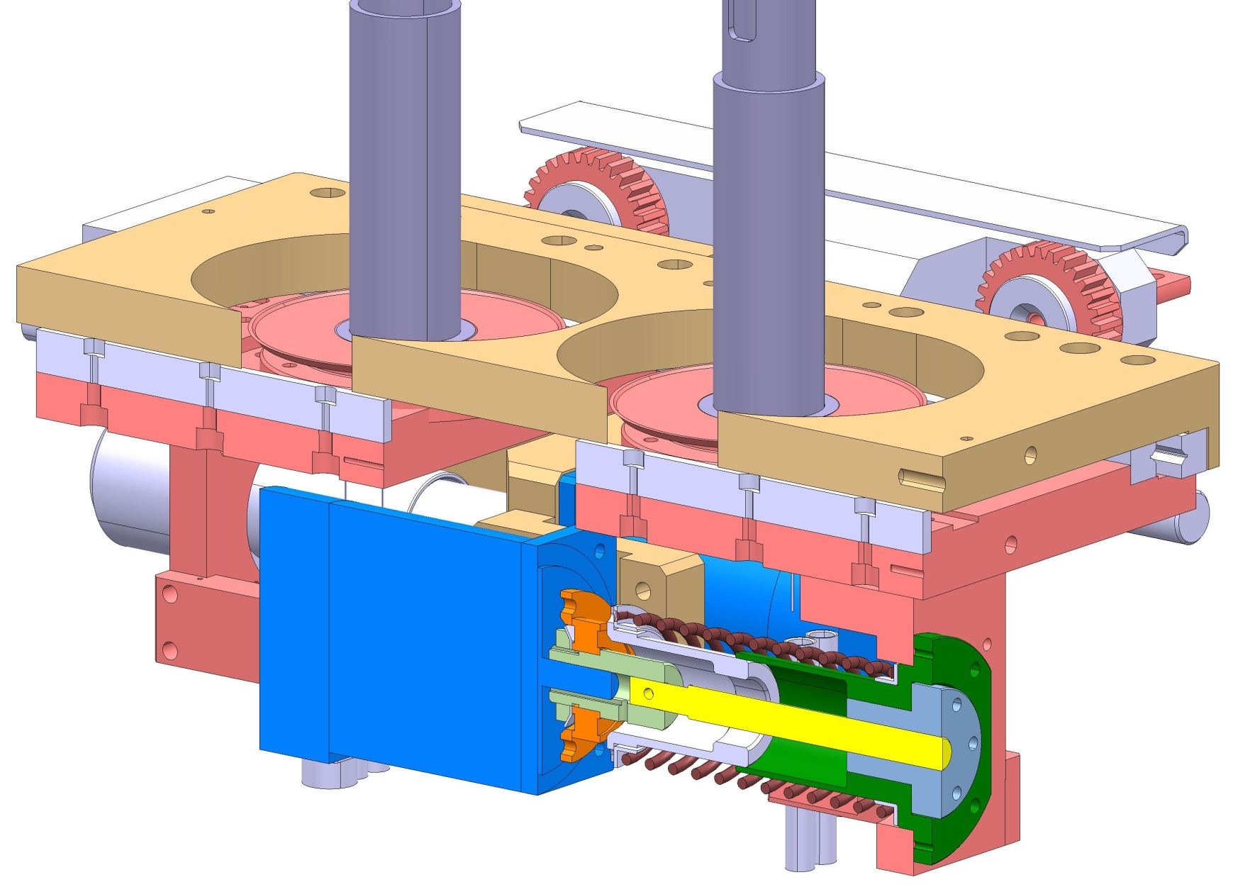
Actuation System Design
How is a Collimator made?
Each jaw is actuated by two independent actuators and supported on two axles. Hybrid stepper motors are used to drive the system
The system must operate for ~20 years in a harsh environment (15 MGy) with virtually no maintenance
Fixed table
Mobile table
35 mm stroke
Hybrid Stepper motor
Roller screw assembly
2 mm lead/rev
Return spring
To ensure auto-retraction

Slide 14
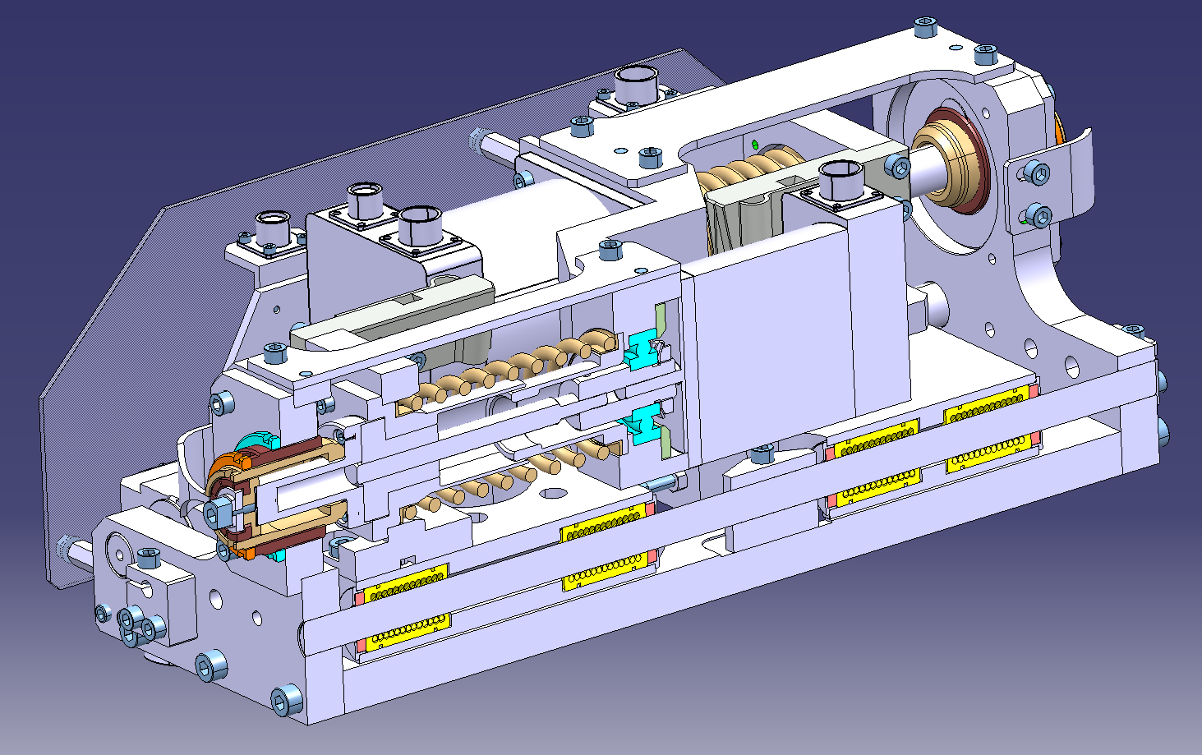
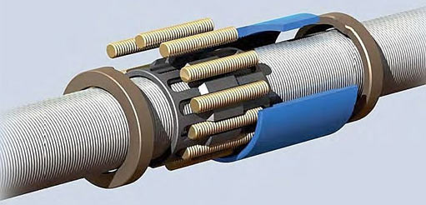
Actuation System Design
How is a Collimator made?
Linear Ball Bearing
High precision
Radiation hard lubrication
Stainless steel shaft
Roller screw assembly
High efficiency
High precision (6 μm/135 mm)
Radiation hard lubrication

Slide 15
Summary
Given the very high stored energy of the HL-LHC, collimation is one of the most critical systems of the accelerator.
A complex system made of ~120 units is presently installed and fully operational.
To meet HL-LHC tougher requirements, a significant fraction of the current system is expected to be replaced/updated/complemented.
Intensive R&D is currently ongoing to develop novel materials particularly for low-impedance collimators
Turn-key units will be procured in the industry.
CERN will procure and provide to system contractor critical components: these include jaw materials (novel composites, carbon-based materials, refractory materials etc.), dispersion strengthened copper, lead screws, Cu-Ni pipes etc.
Motorization, electronics, diagnostics and control systems (not covered here) represent a procurement effort as important as mechanics.
Finally, collimation is more than collimators .. New challenging projects in the pipeline such as Hollow Electron Lens, Crystal Collimation …

Slide 16
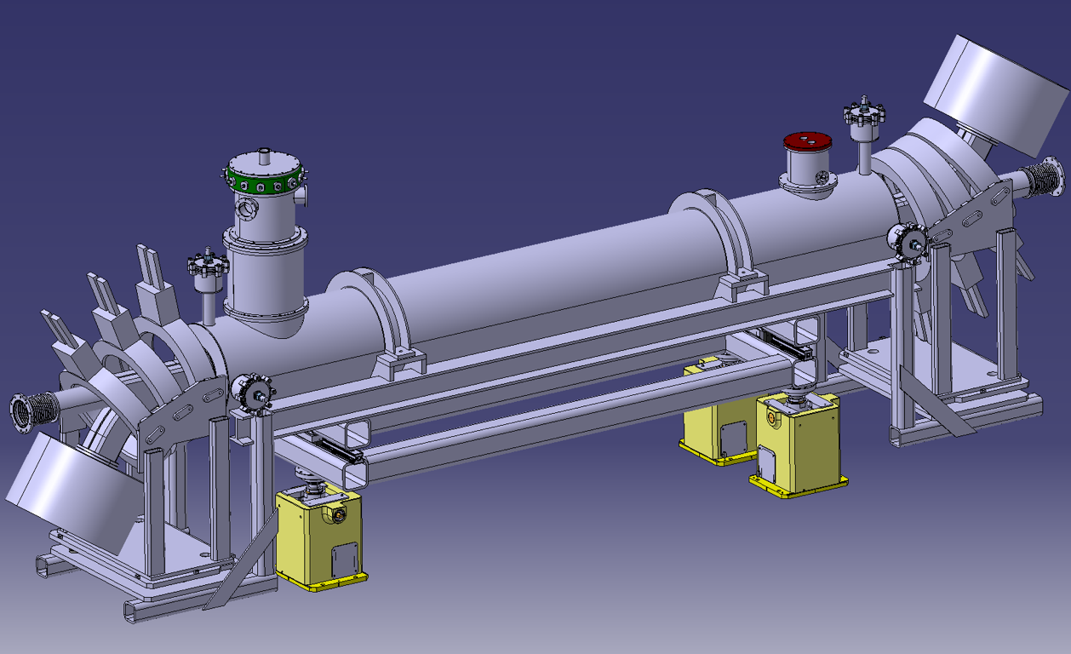

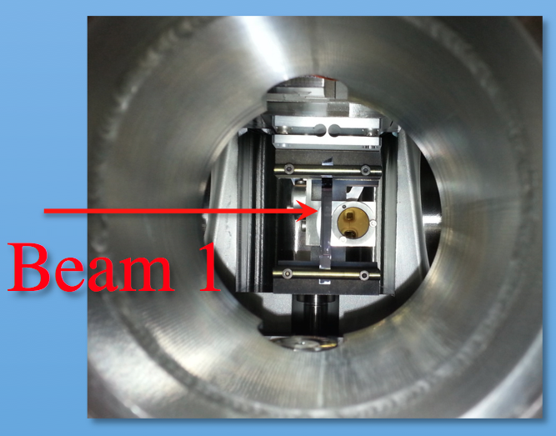
Summary
Hollow Electron Lens
Crystal Collimation

Slide 17
Thank you for your attention!
The research leading to these results has received funding from the European Commission under the FP7 Research Infrastructures project EuCARD, Grant Agreement 227579 and EuCARD-2 Grant Agreement 312453
alessandro.bertarelli@cern.ch

Slide 18
Collimation system for LHC RunII
Where are collimators?
Dedicated insertions for betatron (IR7) and momentum (IR3) cleaning systems.
Cleaning of incoming beam
in all experiments.
Physics debris collimation
in the high luminosity
IR1/5.
Total of 118 collimators
~10 different design!
108 Movable units
Roughly 40 units to be replaced for HL-LHC

Slide 19
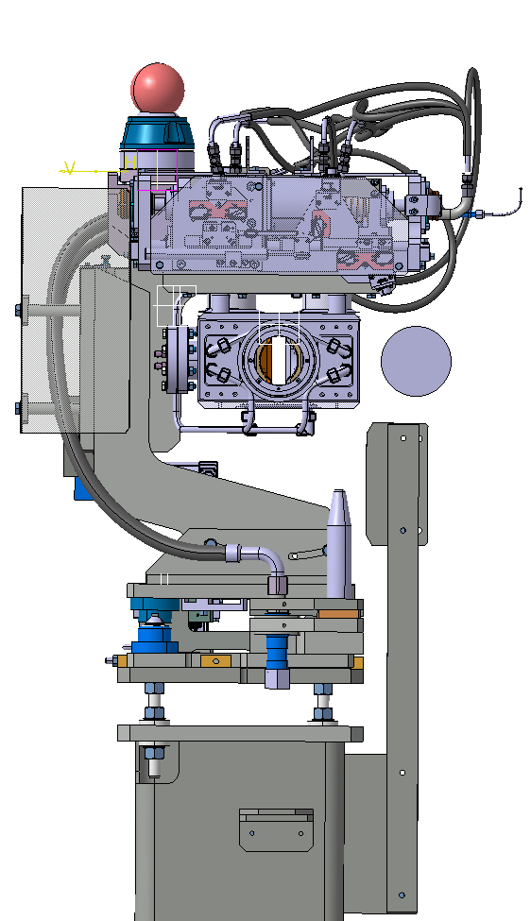
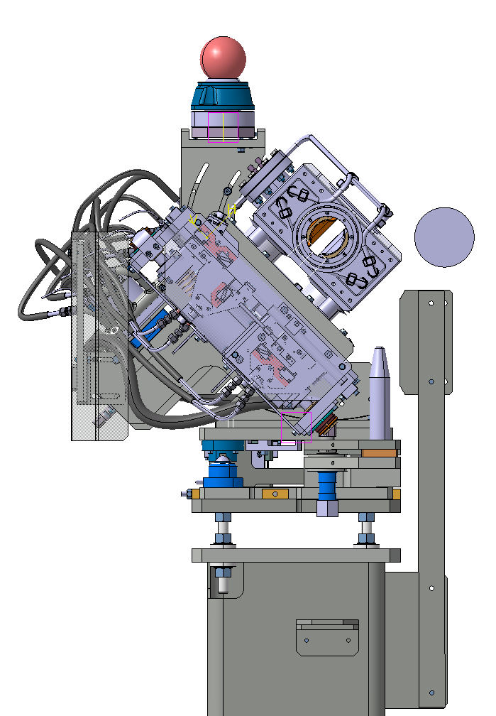
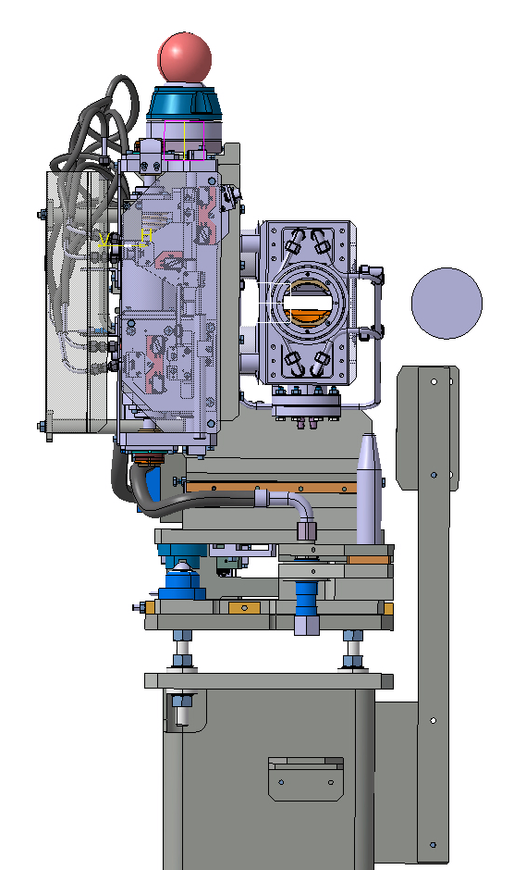
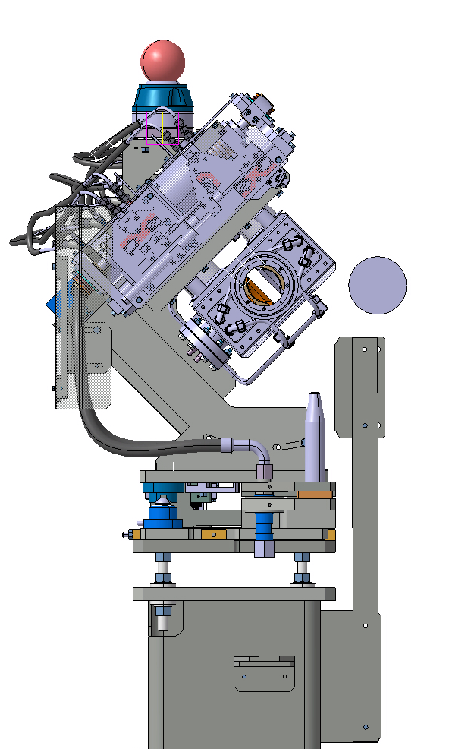
Support
Collimator
5th axe (±10mm)
0°
45°
90°
135°
Quick interconnection
Base support

Slide 20
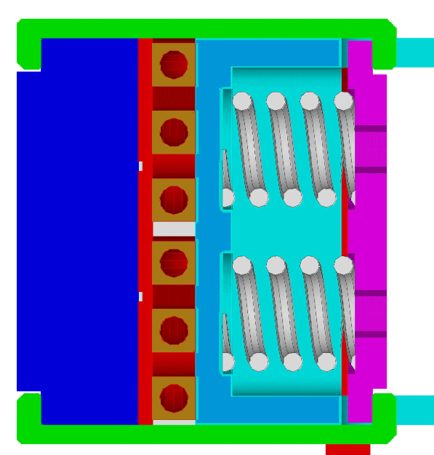
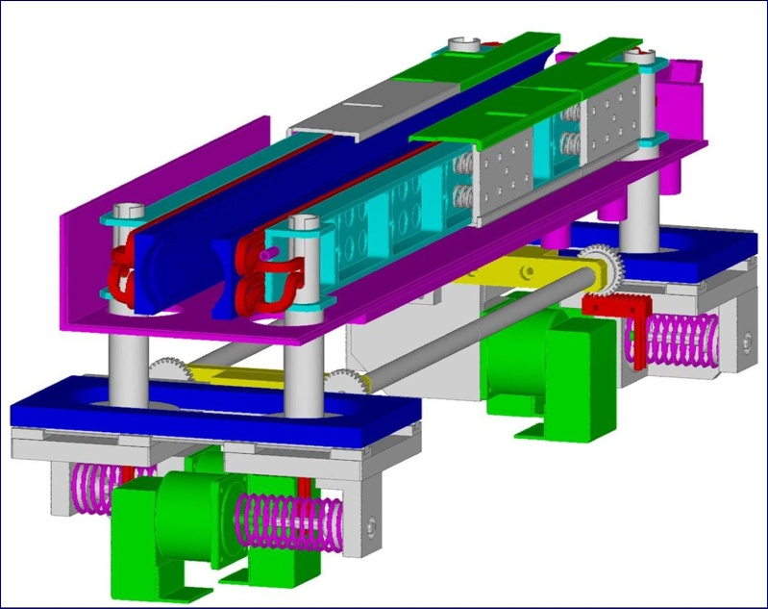
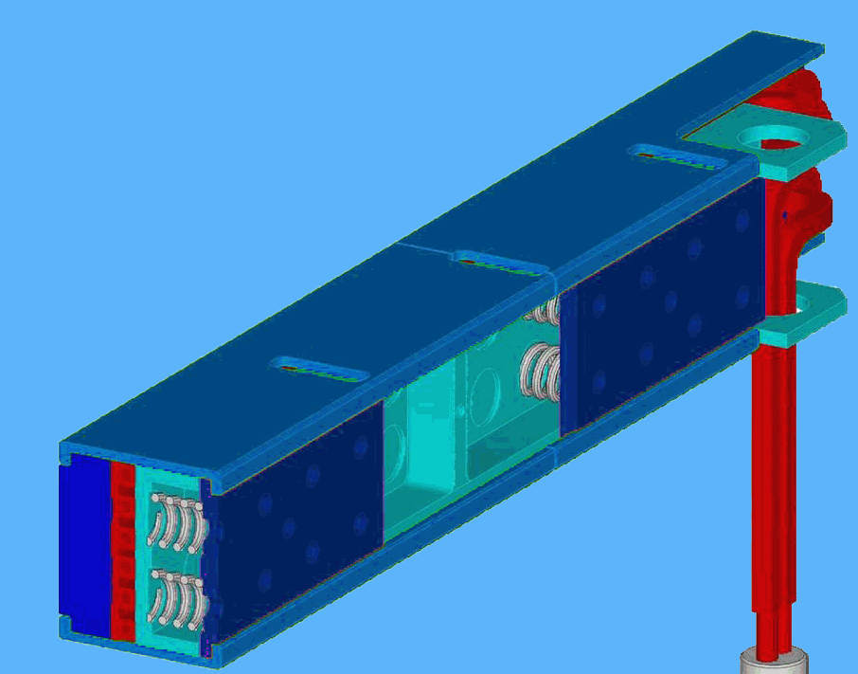
TCSG Jaw Assembly
(1)
(4)
(3)
(2)
(6)
Jaw Bloc Assembly
(1) Jaw Bloc (C/C composite)
(2) Main support beam (Glidcop)
(3) Cooling-circuit (Cu-Ni pipes)
(4) Counter-plates (Stainless steel)
(5) Clamping plates (Glidcop)
(6) Preloaded springs (Stainless steel)
(2)
(1)
(4)
(3)
(6)

Slide 21
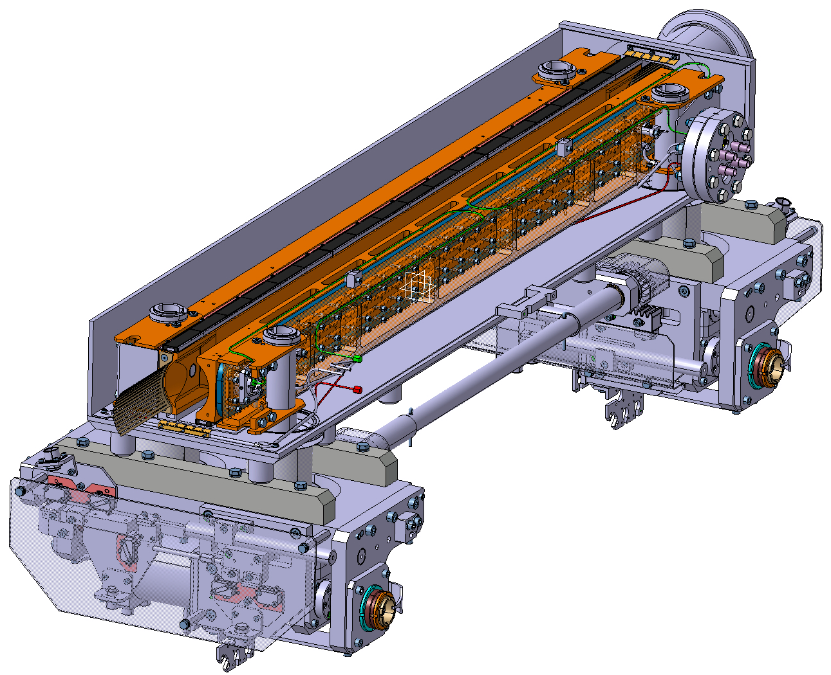
Vacuum tank
Jaws
Actuation system
Beam
Jaws
40µm surface flatness on 1m
10µm positioning accuracy
Heat load: up to 30 Kw

