Slide 1
Superconducting RF Crab Cavities
Marco Garlaschè – CERN EN/MME
On behalf of the Crab Cavities Team
HiLumi LHC Goes To Industry Workshop
CERN, Geneva, Switzerland – 26 June, 2015

Slide 2
Crab Cavities: Why?
Currently in LHC, at a given experiment…
Collision Point
2φ
…the AIM…
to increase the number of collisions between the two LHC beams by reducing the crossing angle φ

Slide 3
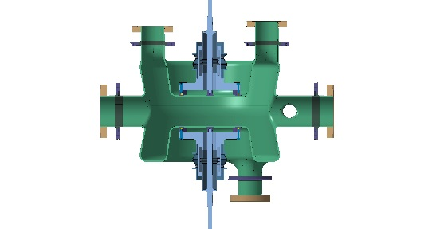

Crab Cavities: Why?
…the ANSWER…
Superconducting Radio-Frequency Cavities, a.k.a. CRAB Cavities

Slide 4

Crab Cavities: Where & When?
SM18 Area (~2016)
Initial testing: CRAB cavities, clean room & handling facilities..
SPS Test (before LS2)
2x Prototype Modules
LHC Point 5
Modules to be installed on each IP side & beam
LHC Point 1
Modules to be installed on each IP side & beam

Slide 5
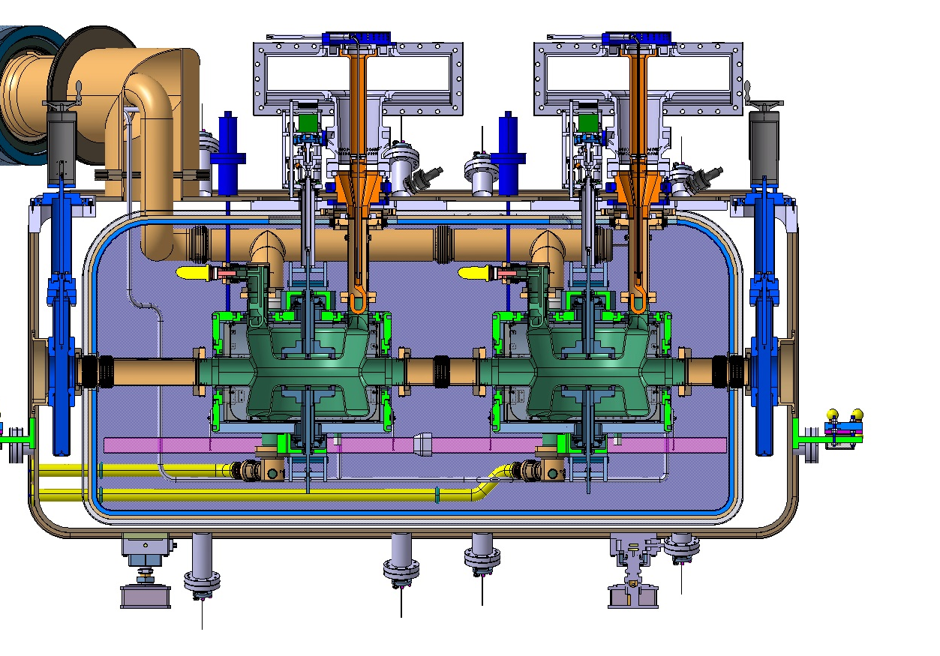
Crab Cavities: What?
…a Module is…
Cryostat embedding
2x CRAB cavities
auxiliary systems
80 K > T > 2 K
2 K
2 K
BEAM
300 K > T > 80 K

Slide 6
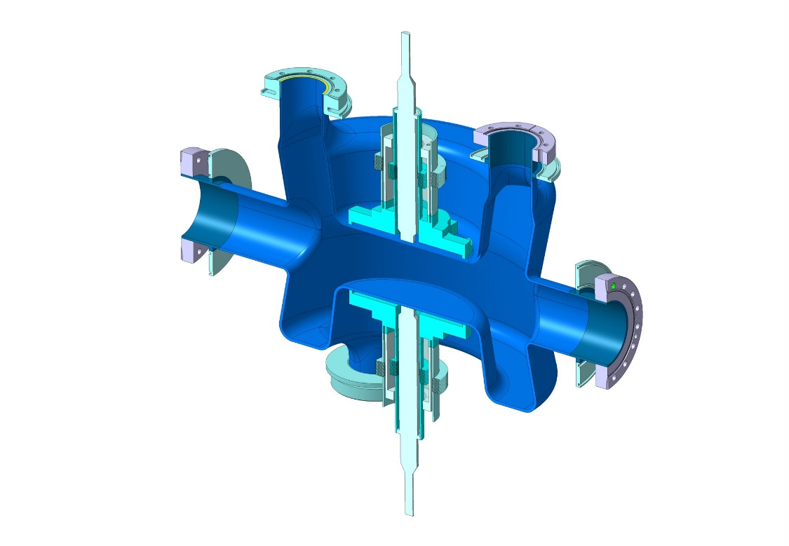
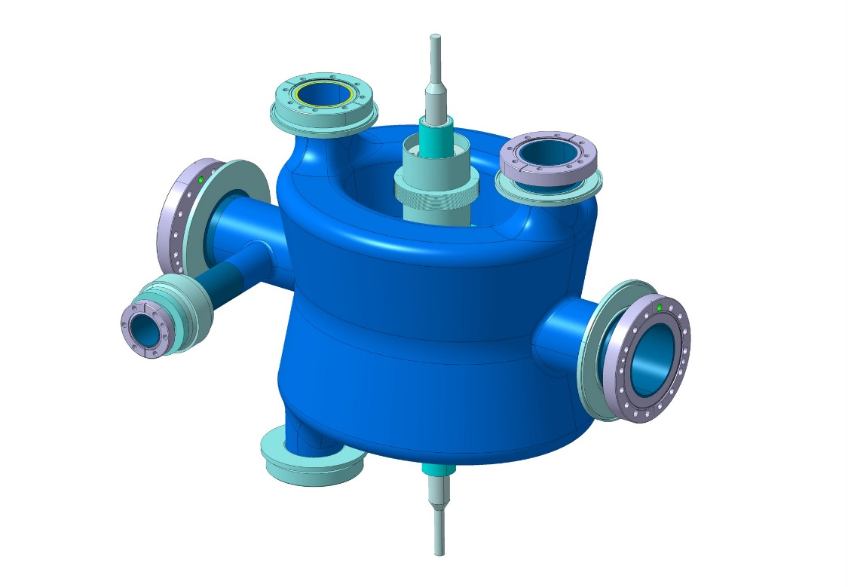
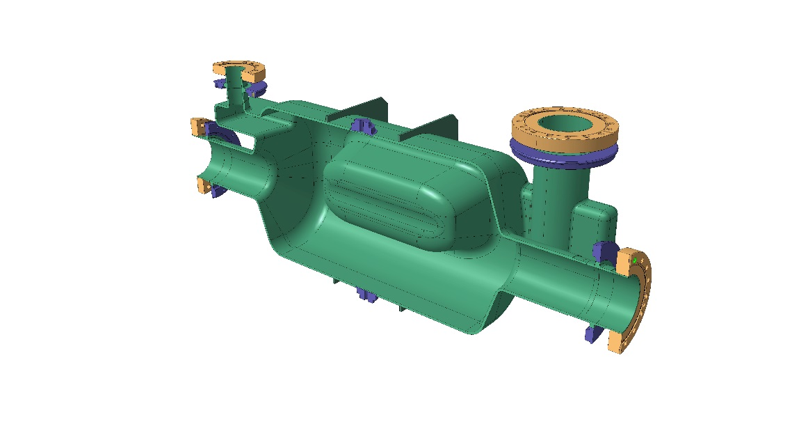
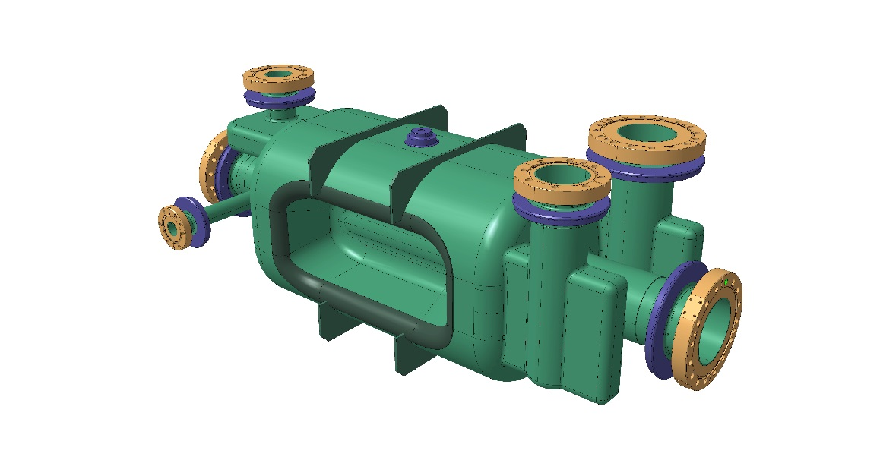
Bottom-Up View: Cavities
RFD Cavity
DQW
Cavity
900 mm
650 mm
2x designs!
Highly non-axialsymmetrical Niobium cavities
Technologies Involved:
Forming of 3÷4mm-thick Niobium sheets
  non axisymm. shapes, high aspect ratios, profile tolerance ~ 0.5mm
EB-welding (strict requirements …): Nb/Nb & Nb/NbTi
Brazing (or other) of Nb to S.Steel
Interest for
Suppliers
Not Needed
Much Welcome
Needed

Slide 7
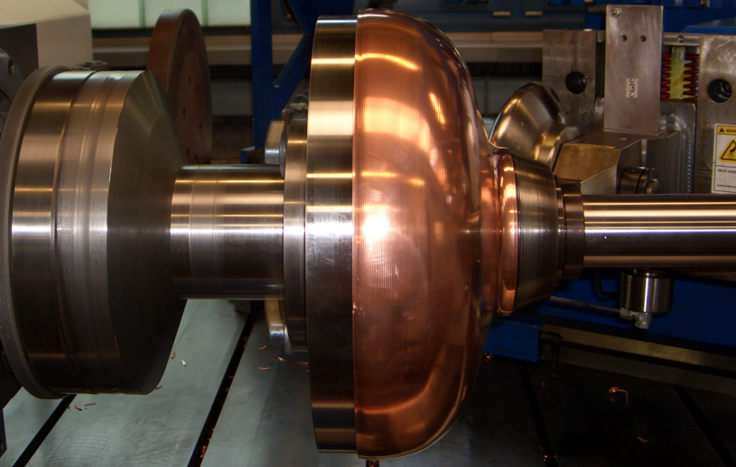
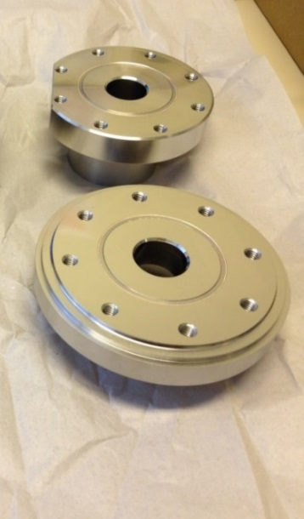
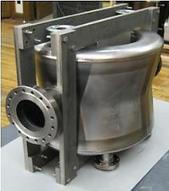
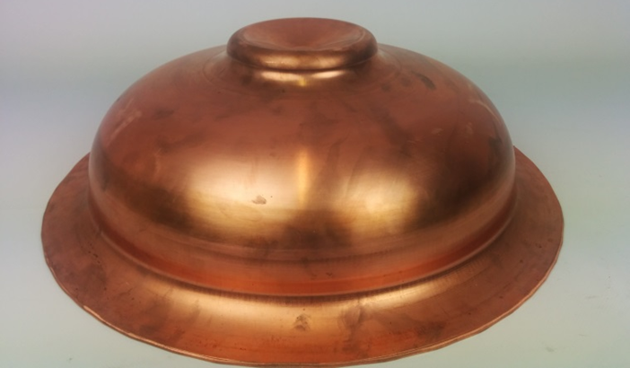
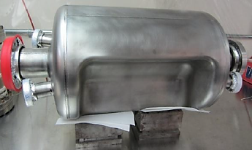
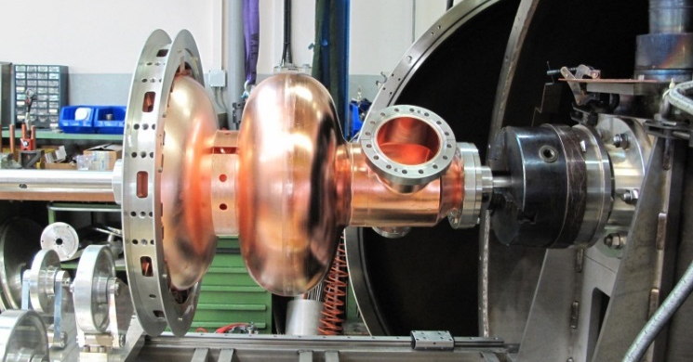
Manufacturing R&D with companies
SPL Project forming & welding of Cu → Nb
CRABS Initial tests qualification of forming and RF
Nb/SS CERN
CERN

Slide 8
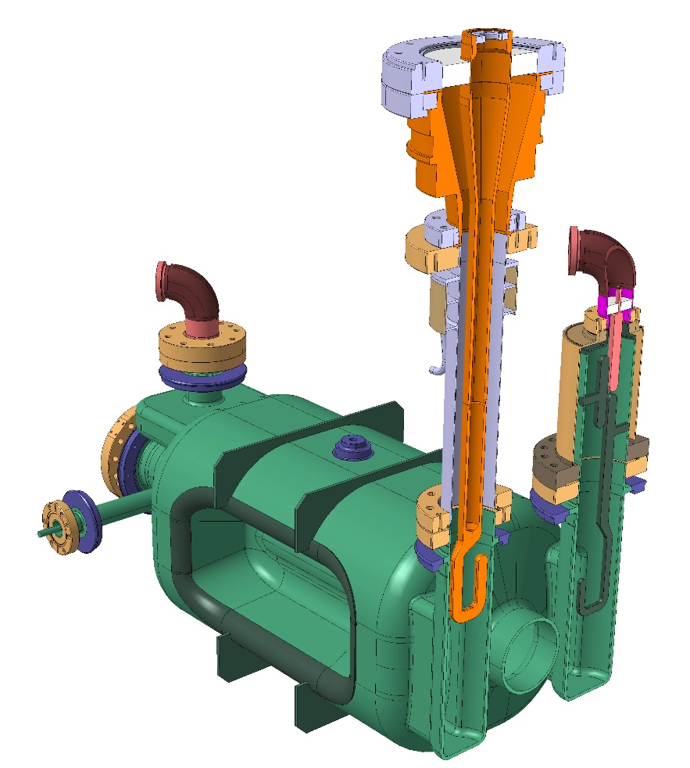
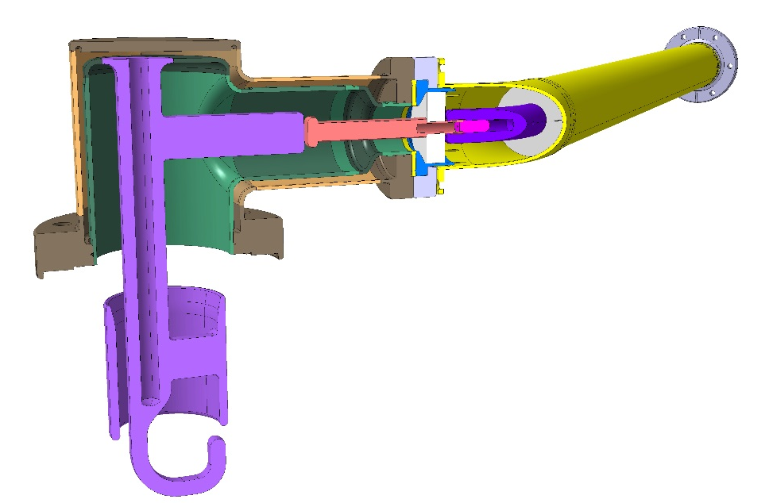
HOMs & FPCs¹
Al2O3
200 mm
Cu
Coaxial line
SS
Nb
620 mm
Input/Output systems
for power management inside cavities
Technologies Involved:
Mix turning + milling + assembly of Cu and Nb parts (assembly profile ~0.3mm)
Brazing of vacuum-air interfaces embedding Ceramic + Cu + S.Steel
¹ High Order Mode Dampers, Fundamental Power Couplers

Slide 9
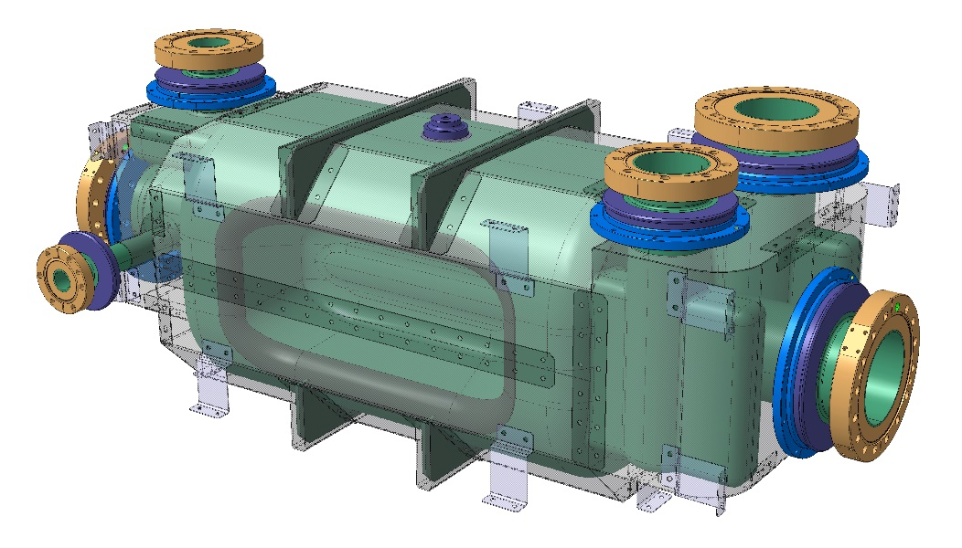
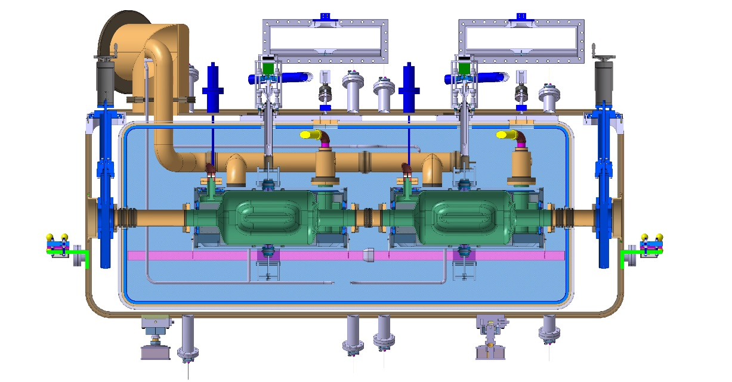
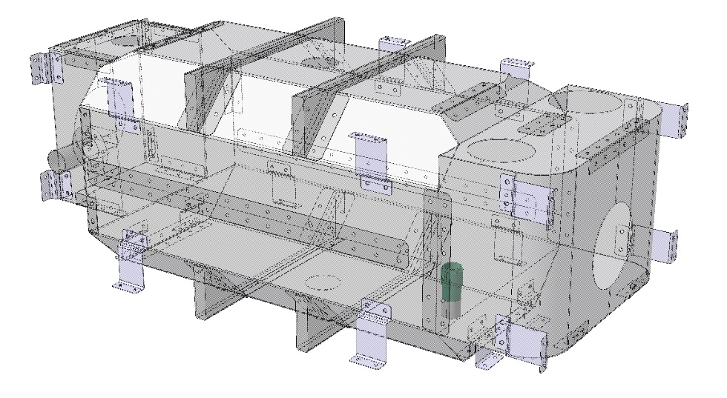
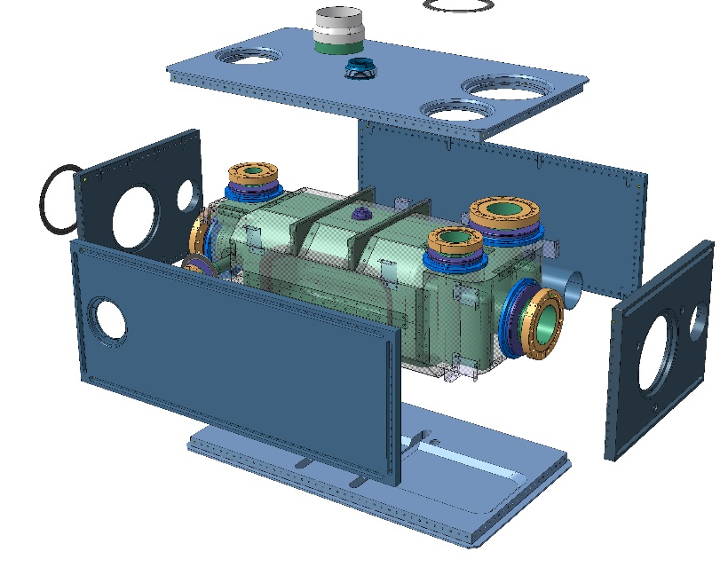
Magnetic Shieldings & He Vessel
T_{SHIELD}= 80K÷300K
T_{SHIELD}= 2K
Magnetic Shielding alloy:
Forming + assembly
Annealing treatment
Supply of raw Material (Nb, NbTi, Magn. Shielding, St. Steel, Titanium)
Helium Vessel:
Machining (Titanium Gr.2)
Assembly + Titanium TIG welding
Supply of Titanium bellows
900 mm

Slide 10
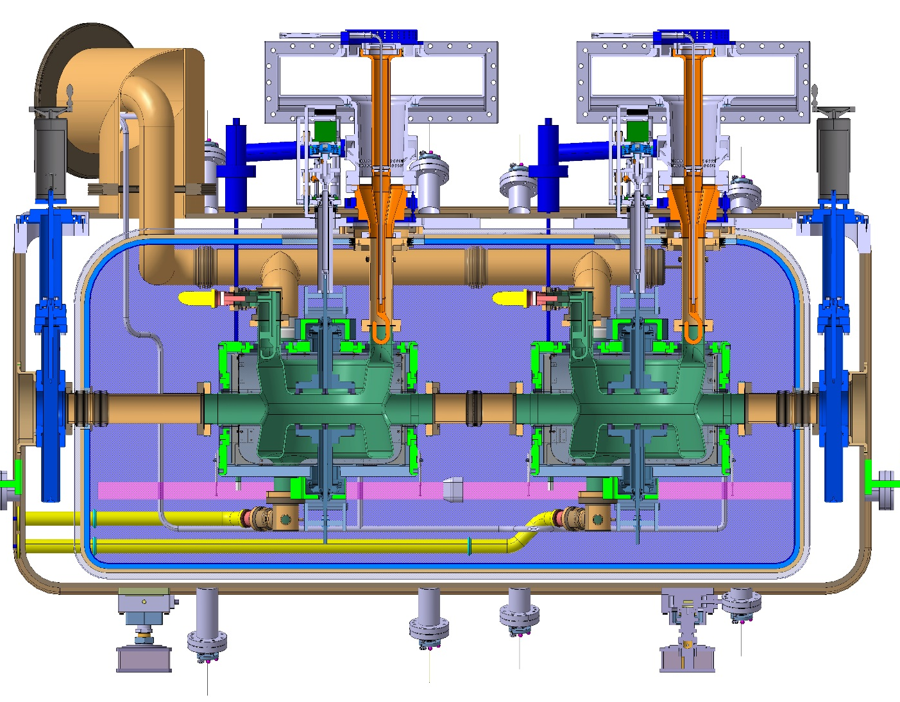
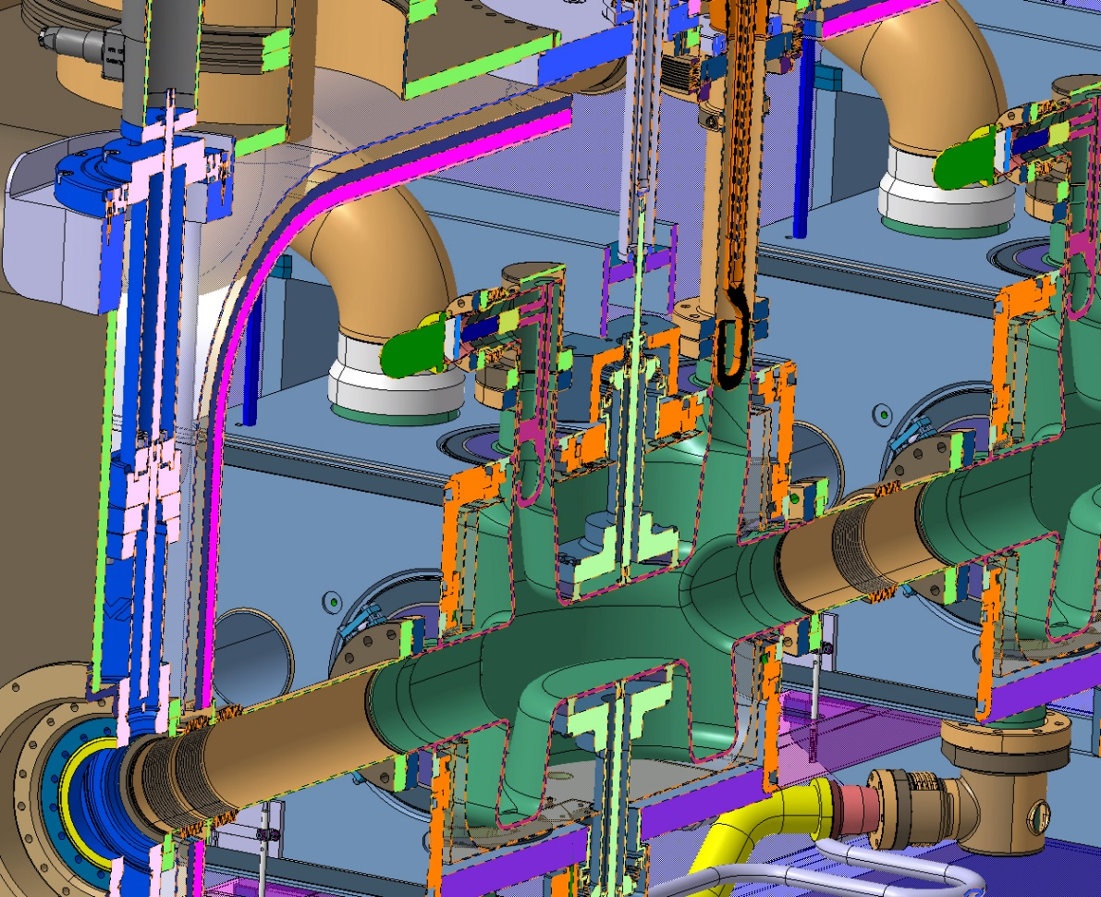
Cryostat
Manufacturing of Cryostat and Auxiliary systems
Sheet metal working of tank (precision interfaces)
Cryo Line (welds tight at 2K)
Ti/S.Steel direct transitions (also @ 2K)
SS Bellows and vacuum equip.
Thermal shielding with Helium cooling + MLI
…
1700 mm
2900 mm

Slide 11
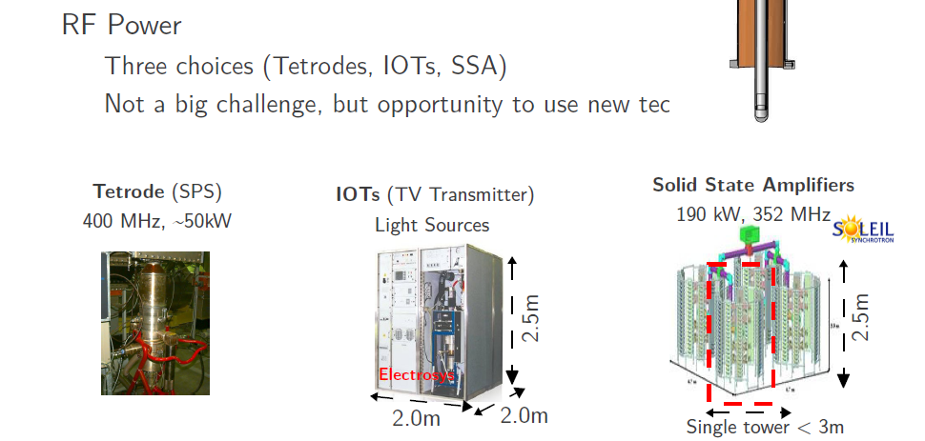
Electronics and Power supplies
Courtesy E. Montesinos
SPS Test
Series

Slide 12
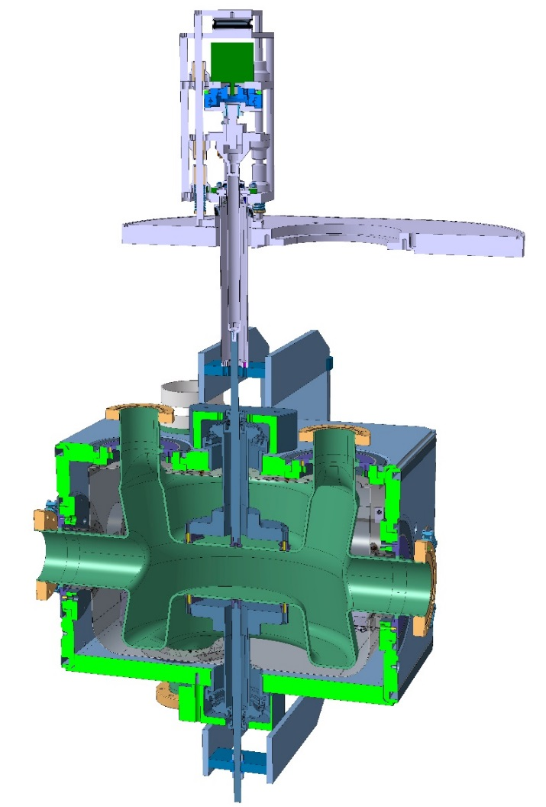
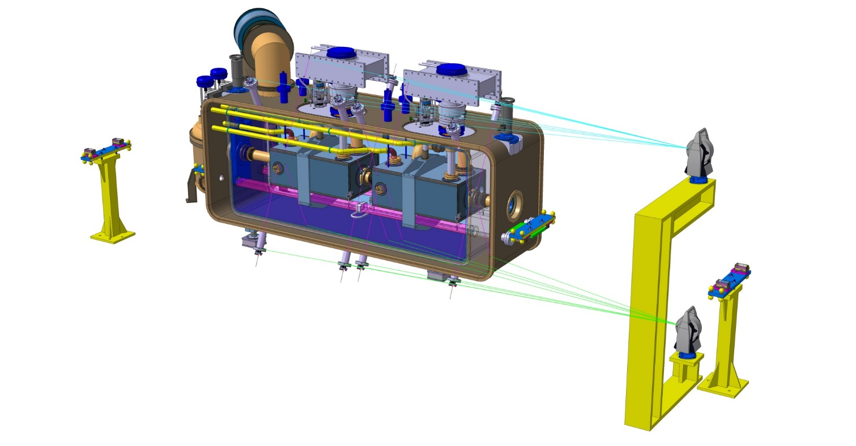
Not Forgetting…
Passive/active Tuning System
(ref. Kurt Artoos)
FSI¹ Alignment System
(ref. Mateusz Sosin)
Actuation
¹ Frequency Scanning Interferometry

Slide 13
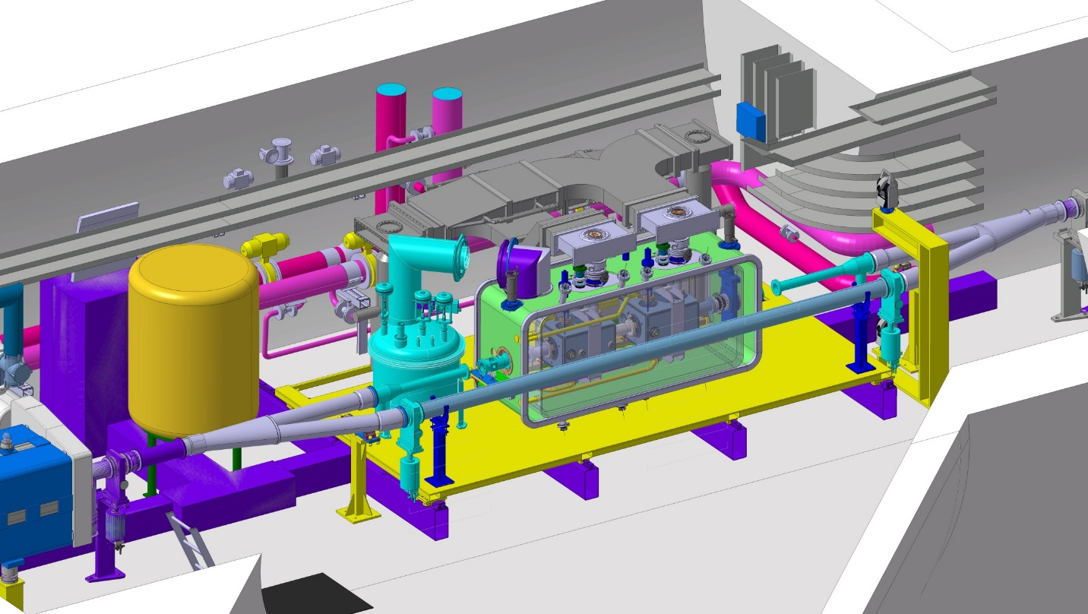
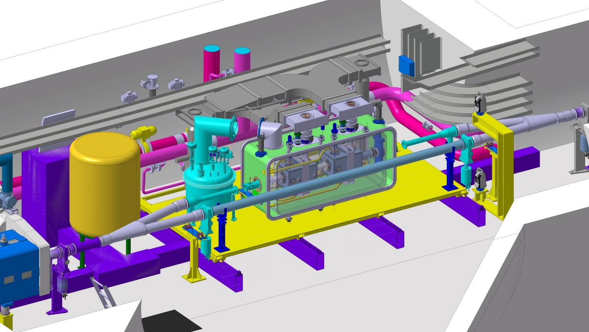
Not Forgetting…
Active Alignment @ SPS Test: motorized & remotely-controlled supporting systems

Slide 14


Thank you for your attention!
Accelerating Science and Innovation
Notes:
14

Slide 15
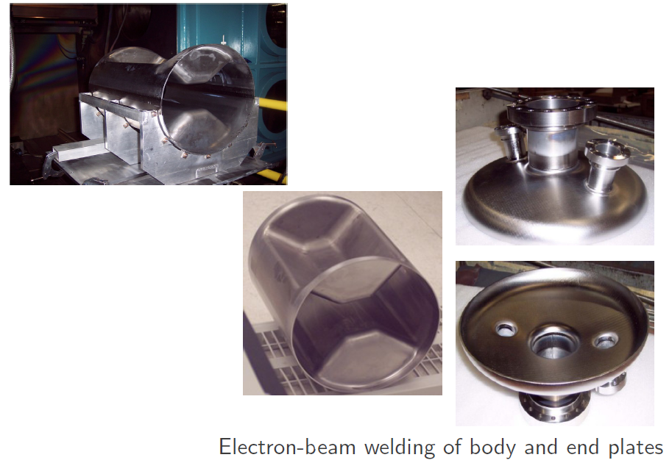
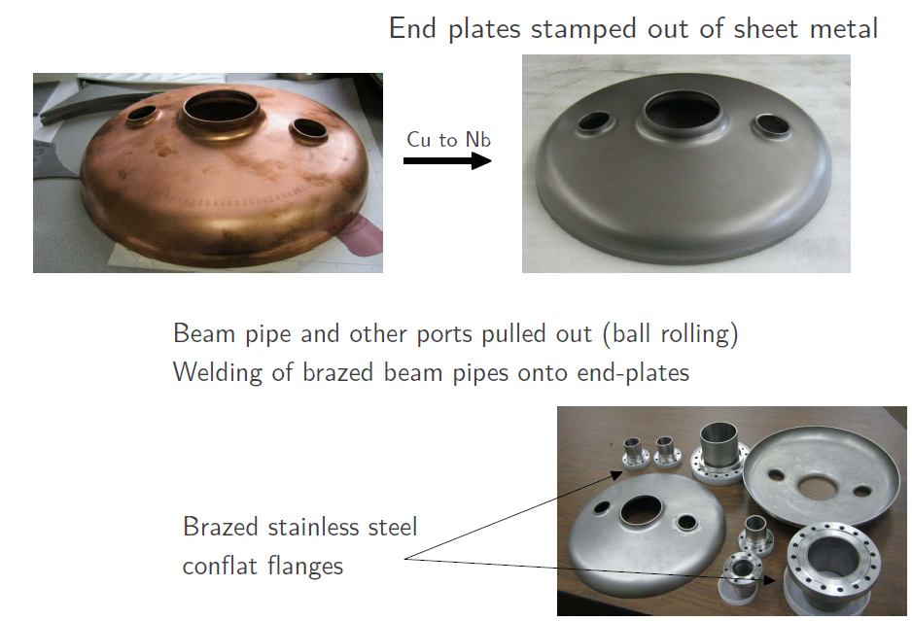
Technology for SC RF cavities

Slide 16
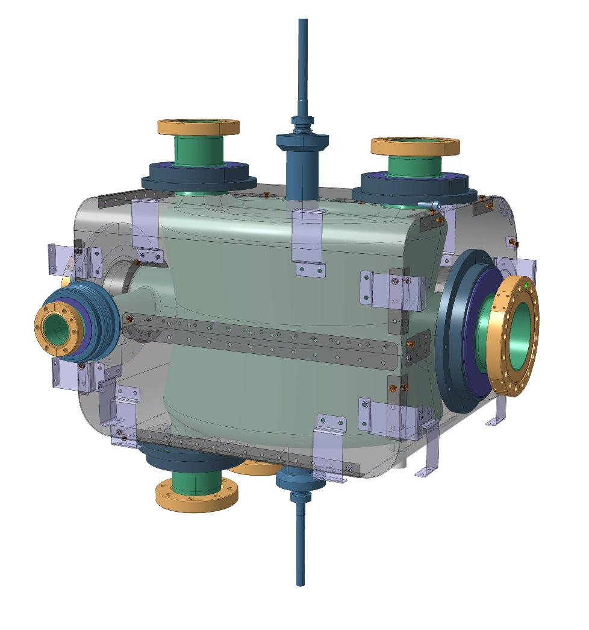
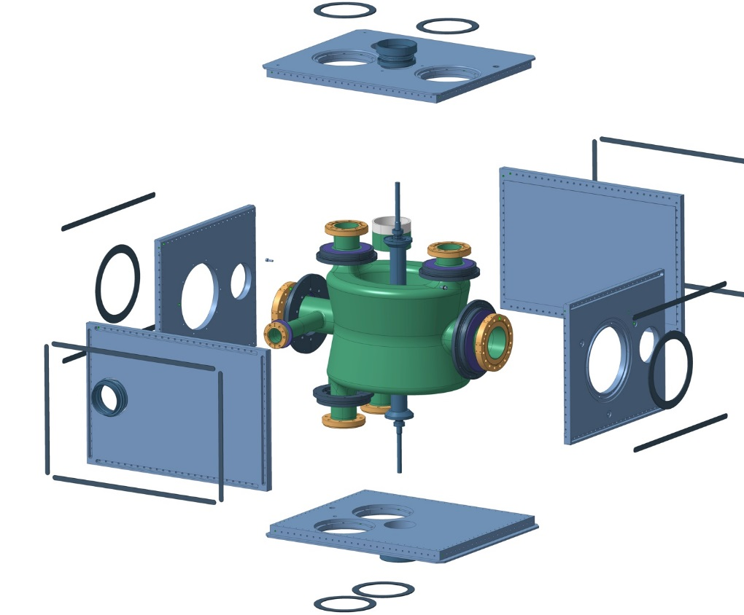
Magnetic Shieldings & He Vessel
DQW

Slide 17
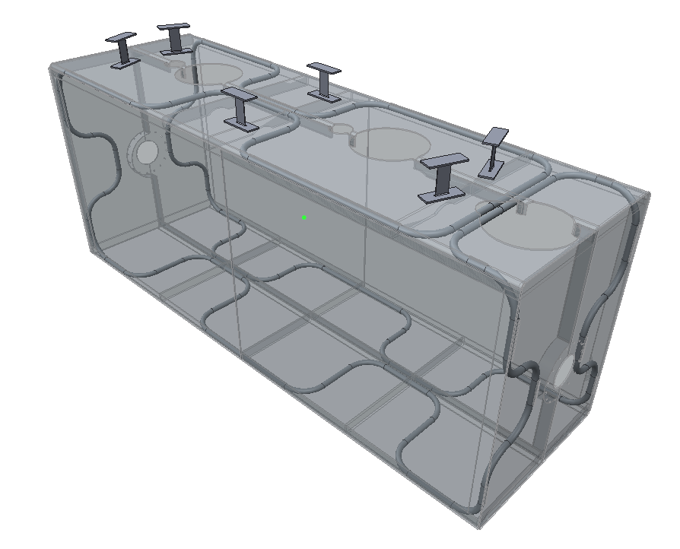
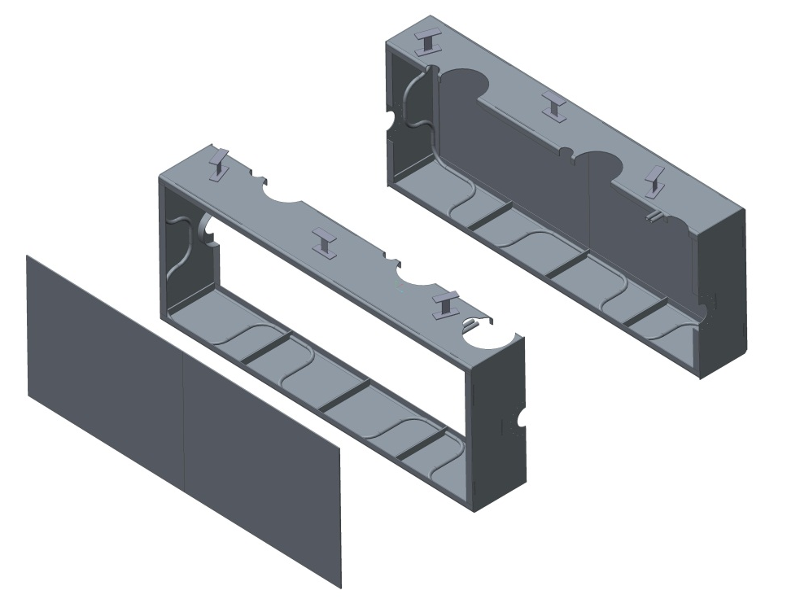
Thermal shield overview
Flexures
Courtesy Andy May & STFC
Thermal shield “Window frame”
Entire shield = 116Kg
Aluminium alloy tubing
1050 Aluminium shield
Removable side panels (fitted to frame during initial assembly)
Panel mass = 14Kg each at 6mm thick

