Slide 1
Welcome to the MEDICIS PROMED
Marie Curie Training H2020 kick-off meeting
CERN is proud to host this important kick off meeting for MEDICIS
In January 2014, CERN set up the medical applications office
One of the 7 initiatives is radio-isotope production and MEDICIS is a crucial element
ISOLDE facility has an enormous amount of experience in producing radio isotopes for Nuclear Research. Now will be producing for Nuclear Medicine
MEDICIS will benefit from this 50 years experience
Important decision: to finish the MEDICIS building during the LHC Long Shutdown (LS1)

Slide 2
Two Important Constraints
SAFETY: radiation and contamination risk
ISOLDE: MEDICIS must not disrupt ISOLDE operation

Slide 3
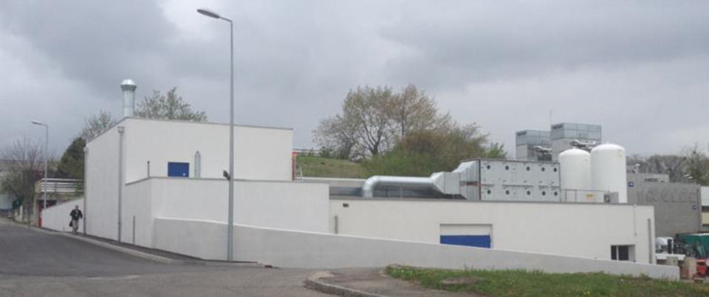
MEDICIS Building (on time!)

Slide 4

Next steps in this time period
Time line (Future) :
From Stefano Marzari
Finalize Handling Robot & monorail
Finalize Shielded doors
Off-line separator
Tests and final commissioning
9 | 10 | 11 | 12 | 1 | 2 | 3 | 4 | 5 | 6 | 7 | 8 | 9 | 10 | 11 | 12 | 1 | 2 | 3 | 4 | 5 | 6 | 7 | 8 | 9 | 10 | 11 | 12 | 1 | 2 | 3 | 4 | 5 | 6 | 7
2013 |  |  |  | 2014 |  |  |  |  |  |  |  |  |  |  |  | 2015 |  |  |  |  |  |  |  |  |  |  |  | 2016

Slide 5
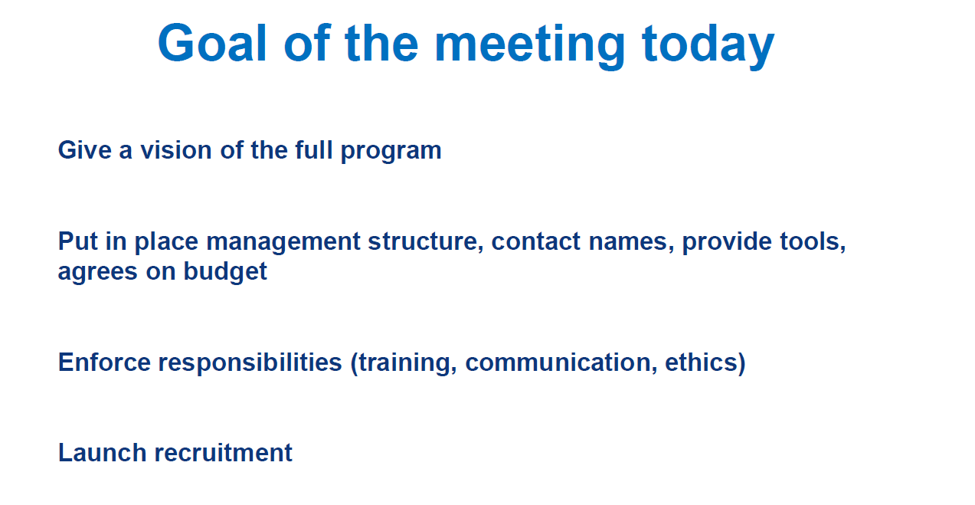
From Thierry’s presentation

