Slide 1
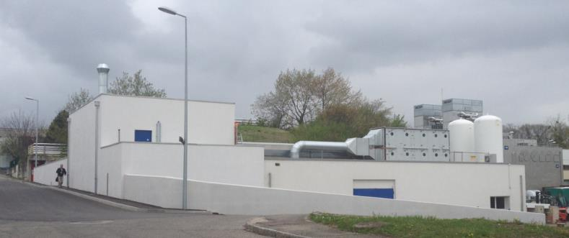

The CERN-MEDICIS project
MEDICIS-PROMED kick off 21 April 2015
Stefano Marzari EN-STI-RBS
Keith Kershaw EN-STI-TCD

Slide 2

Contents :
M E D I C I S
Medical Isotopes Collected from ISOLDE
How ISOLDE produces Isotopes
The MEDICIS idea
Main constraints on the project
Time line
Conclusions

Slide 3
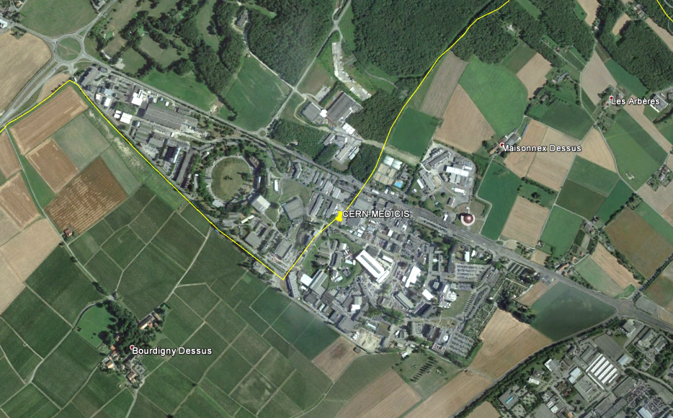
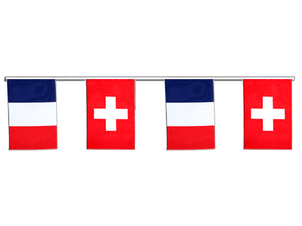
ISOLDE site since 1992 and future MEDICIS facility
ISOLDE
We are here
CERN site Meyrin

Slide 4
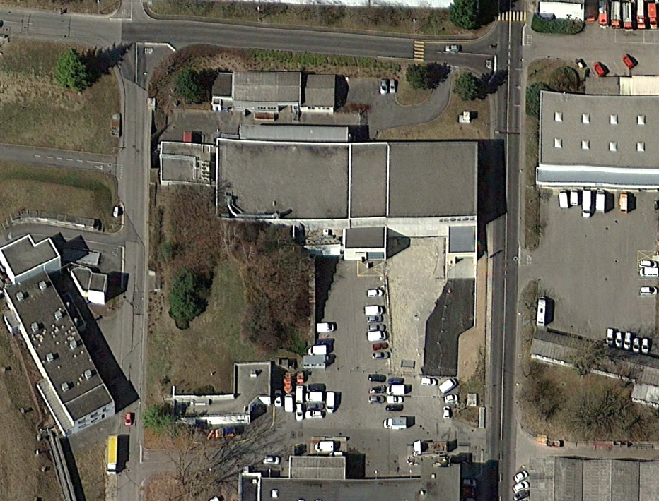
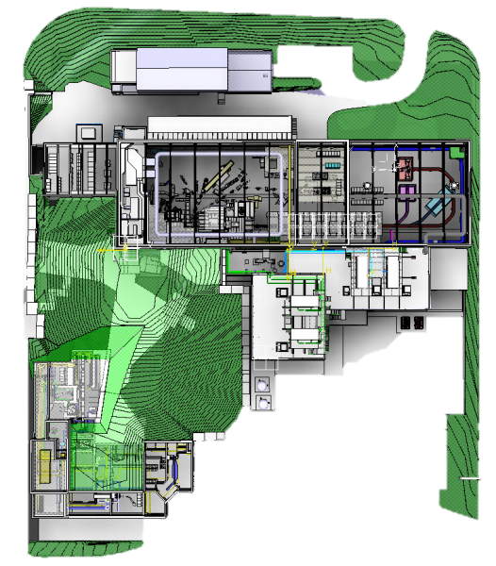
ISOLDE Area
ISOLDE experimental hall
ISOLDE Target area
Swiss – French border
CERN-MEDICIS project
ISOLDE Class A laboratory

Slide 5
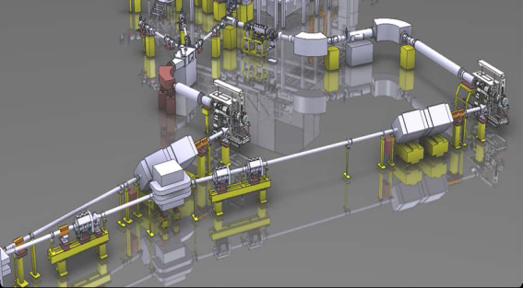
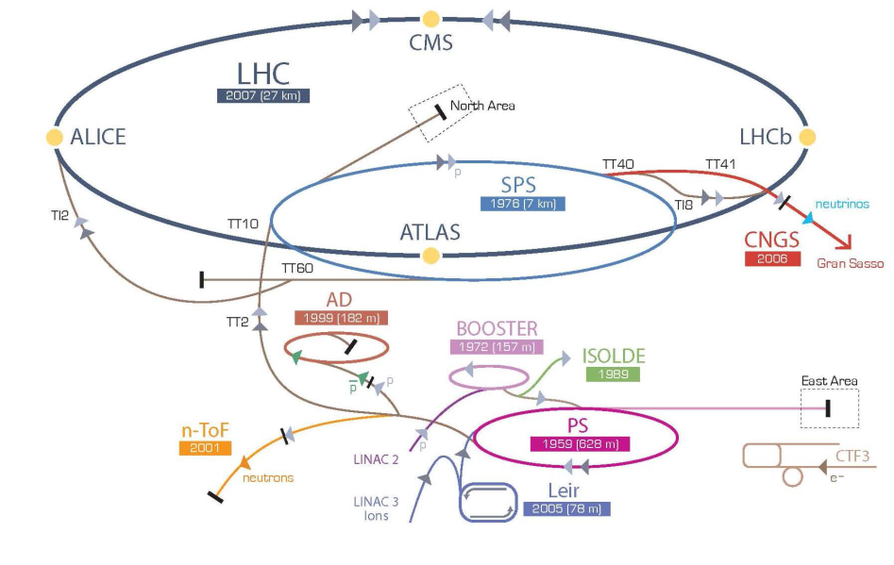
The ISOLDE facility
in the CERN Proton Accelerator scheme
PROTON 1.4 GeV, 2uA, delivery to ISOLDE
BOOSTER
ISOLDE
CERN-MEDICIS
LINAC 2

Slide 6
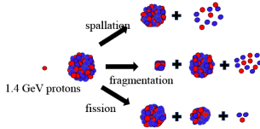
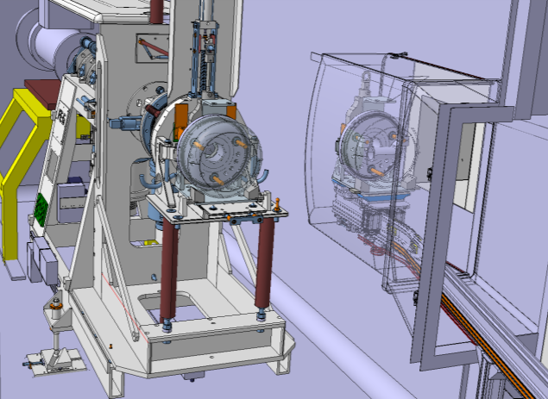

CERN-MEDICIS principle:
Use protons (~90%) normally lost into the Beam Dump
ZOOM
Isotopes for ISOLDE
ISOLDE Target
MEDICIS Target
Beam dump
Protons 1.4 GeV
Isotopes production

Slide 7



We have 2 main
PROCESSES :
Target Manufacture
(workshop)
2. TARGET life
Characterization test
(workshop)
1. ISOTOPE production
Irradiation
(ISOLDE)
Disposal
(PSI)
Isotope extraction
(MEDICIS)
Isotope separation
(MEDICIS)
Isotope collection
(MEDICIS)
Decay storage
(MEDICIS)
Dismantling
(Hot Cell)
Isotope purification
(MEDICIS)
Remote handling
(Robot or Monorail)
Manual handling
QA – packaging & shipping

Slide 8
Constraints on the MEDICIS Project
A) SAFETY: radiation and contamination risk
  Targets become radioactive / collected isotopes are radioactive :
  Radiation => shielding
  Contamination containment => nuclear ventilation
  Storage area for Target cool down
  Remote handling of targets
  Personnel Access control
  Provision in the lab for safe packaging and dispatch
B) MEDICIS must not disrupt ISOLDE operation
  All civil engineering and ventilation work had to be completed to a tight schedule during Isolde shut-down (2013 – 2014)
  MEDICIS operation must not interfere with ISOLDE physics

Slide 9
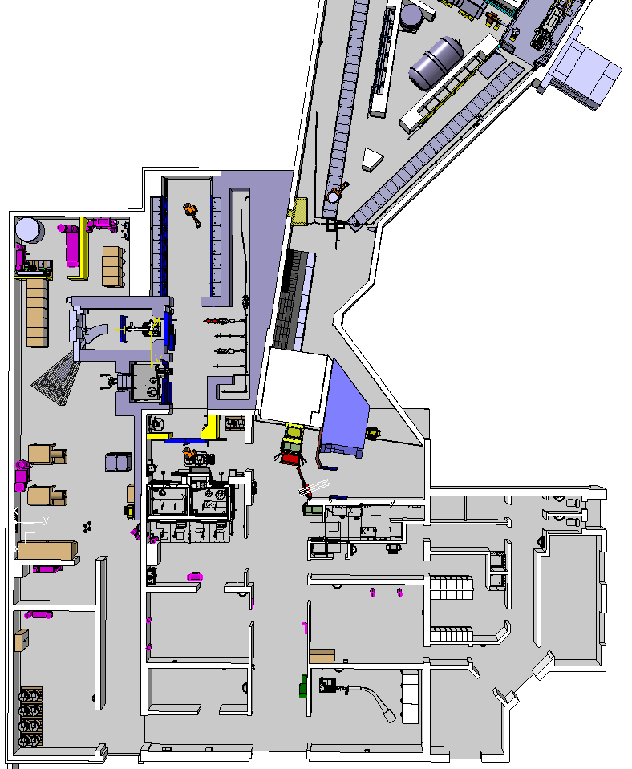
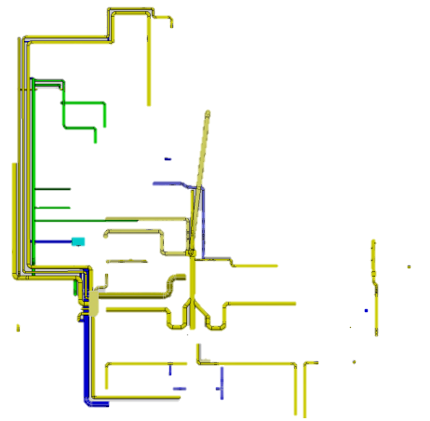

MEDICIS general layout :
ISOLDE buildings
Extension for MEDICIS
ISOLDE and MEDICIS irradiation points
MEDICIS Laboratory
Monorail for Target transport
Robot
Future Hot cell
Mass separator
Chemical lab (purification)
Radioactive target storage
Additional shielding
New nuclear ventilation
Fire doors (new fire sector)
Quality control and shipping

Slide 10
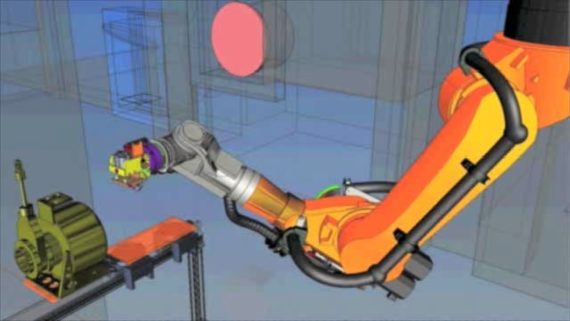
Handling: Robots and monorail working together…

Slide 11
What we already did in this time…
Time line (up to now):
Building
Shielding
Irradiation point
Ventilation system
Building connection
Robot installation and shielded doors (partially)
9 | 10 | 11 | 12 | 1 | 2 | 3 | 4 | 5 | 6 | 7 | 8 | 9 | 10 | 11 | 12 | 1 | 2 | 3 | 4 | 5 | 6 | 7 | 8 | 9 | 10 | 11 | 12 | 1 | 2 | 3 | 4 | 5 | 6 | 7
2013 |  |  |  | 2014 |  |  |  |  |  |  |  |  |  |  |  | 2015 |  |  |  |  |  |  |  |  |  |  |  | 2016

Slide 12
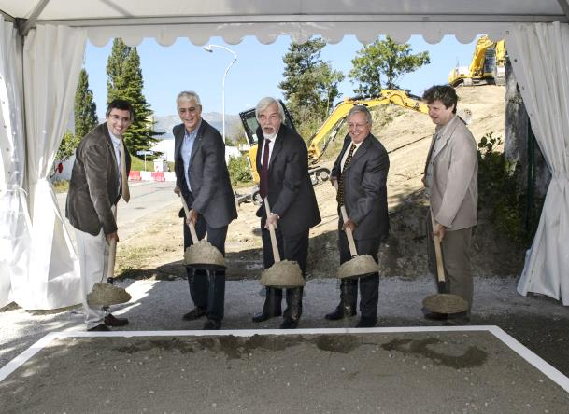
Ground breaking ceremony 4.9.2013
9 | 10 | 11 | 12 | 1 | 2 | 3 | 4 | 5 | 6 | 7 | 8 | 9 | 10 | 11 | 12 | 1 | 2 | 3 | 4 | 5 | 6 | 7 | 8 | 9 | 10 | 11 | 12 | 1 | 2 | 3 | 4 | 5 | 6 | 7
2013 |  |  |  | 2014 |  |  |  |  |  |  |  |  |  |  |  | 2015 |  |  |  |  |  |  |  |  |  |  |  | 2016

Slide 13
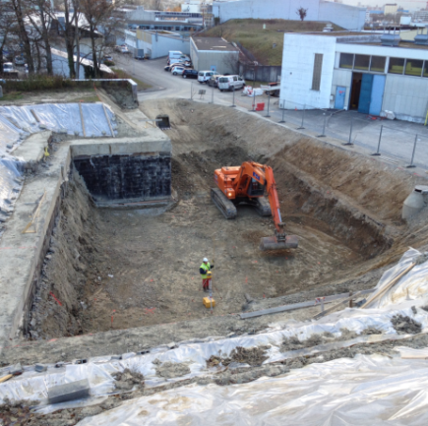
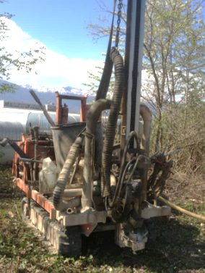
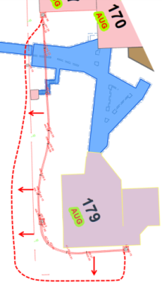
Earth works: Move electrical services and 4000m3 earth removal
Drilling machine for soil analysis by RP
9 | 10 | 11 | 12 | 1 | 2 | 3 | 4 | 5 | 6 | 7 | 8 | 9 | 10 | 11 | 12 | 1 | 2 | 3 | 4 | 5 | 6 | 7 | 8 | 9 | 10 | 11 | 12 | 1 | 2 | 3 | 4 | 5 | 6 | 7
2013 |  |  |  | 2014 |  |  |  |  |  |  |  |  |  |  |  | 2015 |  |  |  |  |  |  |  |  |  |  |  | 2016

Slide 14
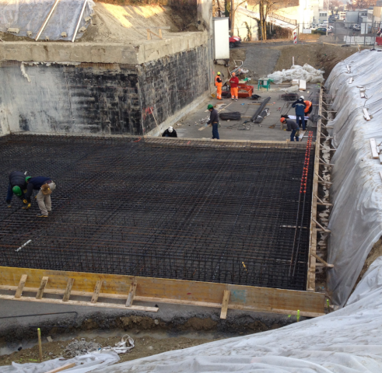
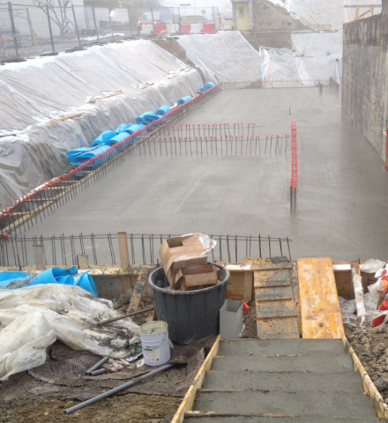
Building: concrete foundations
9 | 10 | 11 | 12 | 1 | 2 | 3 | 4 | 5 | 6 | 7 | 8 | 9 | 10 | 11 | 12 | 1 | 2 | 3 | 4 | 5 | 6 | 7 | 8 | 9 | 10 | 11 | 12 | 1 | 2 | 3 | 4 | 5 | 6 | 7
2013 |  |  |  | 2014 |  |  |  |  |  |  |  |  |  |  |  | 2015 |  |  |  |  |  |  |  |  |  |  |  | 2016

Slide 15
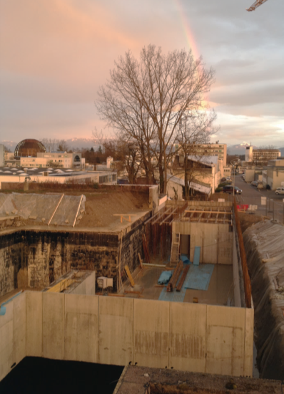
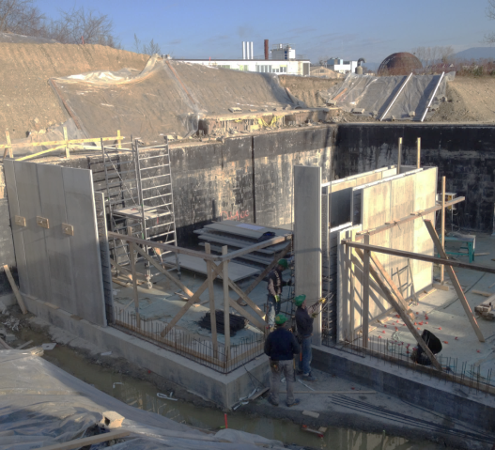
Building: prefab walls & concrete
Prefabricated walls
9 | 10 | 11 | 12 | 1 | 2 | 3 | 4 | 5 | 6 | 7 | 8 | 9 | 10 | 11 | 12 | 1 | 2 | 3 | 4 | 5 | 6 | 7 | 8 | 9 | 10 | 11 | 12 | 1 | 2 | 3 | 4 | 5 | 6 | 7
2013 |  |  |  | 2014 |  |  |  |  |  |  |  |  |  |  |  | 2015 |  |  |  |  |  |  |  |  |  |  |  | 2016

Slide 16
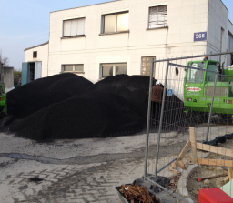
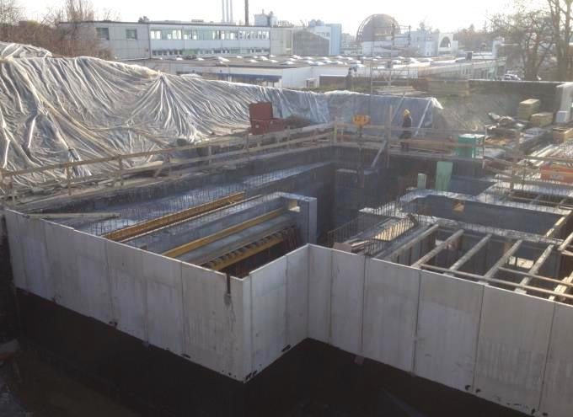
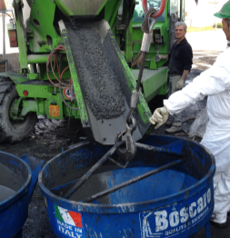
Building: Magnetite concrete walls for shielding
Magnetite concrete high density 3.9 kg/dm3 (normal concrete 2.2 kg/dm3)
Magnetite ore
Preparation
9 | 10 | 11 | 12 | 1 | 2 | 3 | 4 | 5 | 6 | 7 | 8 | 9 | 10 | 11 | 12 | 1 | 2 | 3 | 4 | 5 | 6 | 7 | 8 | 9 | 10 | 11 | 12 | 1 | 2 | 3 | 4 | 5 | 6 | 7
2013 |  |  |  | 2014 |  |  |  |  |  |  |  |  |  |  |  | 2015 |  |  |  |  |  |  |  |  |  |  |  | 2016

Slide 17
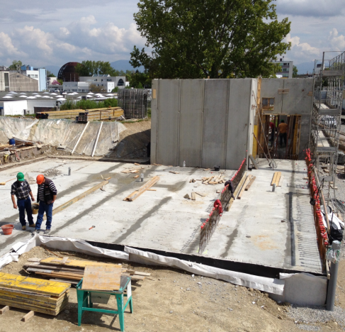
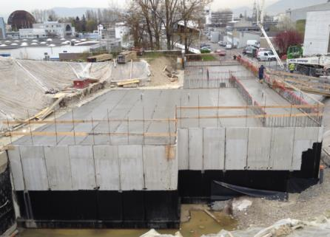
Building: Concrete roof, technical room for CV (ventilation) and lasers
9 | 10 | 11 | 12 | 1 | 2 | 3 | 4 | 5 | 6 | 7 | 8 | 9 | 10 | 11 | 12 | 1 | 2 | 3 | 4 | 5 | 6 | 7 | 8 | 9 | 10 | 11 | 12 | 1 | 2 | 3 | 4 | 5 | 6 | 7
2013 |  |  |  | 2014 |  |  |  |  |  |  |  |  |  |  |  | 2015 |  |  |  |  |  |  |  |  |  |  |  | 2016

Slide 18
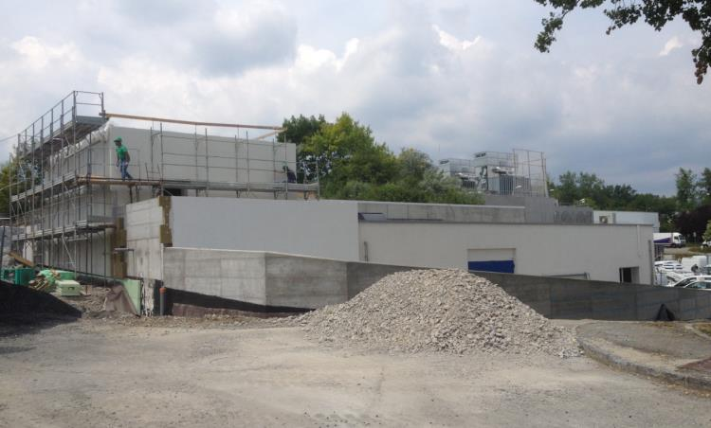
Building: External walls, water tightness & thermal insulation
9 | 10 | 11 | 12 | 1 | 2 | 3 | 4 | 5 | 6 | 7 | 8 | 9 | 10 | 11 | 12 | 1 | 2 | 3 | 4 | 5 | 6 | 7 | 8 | 9 | 10 | 11 | 12 | 1 | 2 | 3 | 4 | 5 | 6 | 7
2013 |  |  |  | 2014 |  |  |  |  |  |  |  |  |  |  |  | 2015 |  |  |  |  |  |  |  |  |  |  |  | 2016

Slide 19
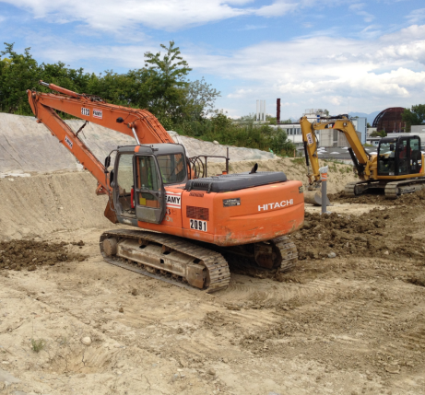
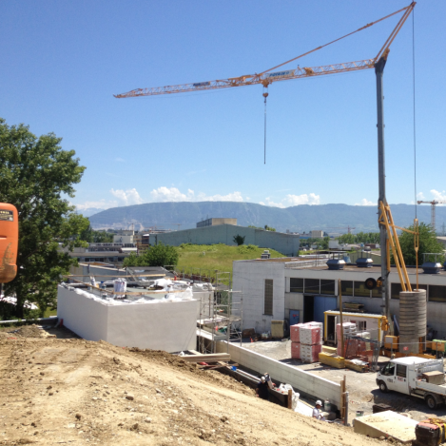
Building: Re-cover with earth~3000 m3
9 | 10 | 11 | 12 | 1 | 2 | 3 | 4 | 5 | 6 | 7 | 8 | 9 | 10 | 11 | 12 | 1 | 2 | 3 | 4 | 5 | 6 | 7 | 8 | 9 | 10 | 11 | 12 | 1 | 2 | 3 | 4 | 5 | 6 | 7
2013 |  |  |  | 2014 |  |  |  |  |  |  |  |  |  |  |  | 2015 |  |  |  |  |  |  |  |  |  |  |  | 2016

Slide 20
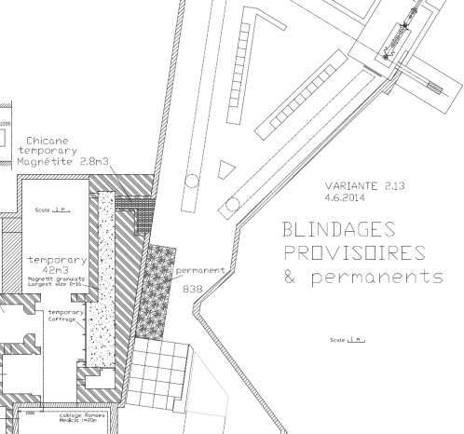
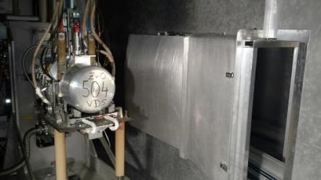
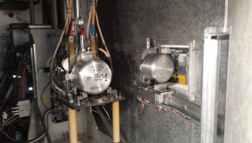
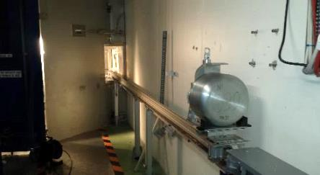
Internal: irradiation point and RCS (rail conveyor system)
Proton Beam
60 kV
Cover earthed
Tested with protons:
A success !
Design by M. Vagnoni
Test
9 | 10 | 11 | 12 | 1 | 2 | 3 | 4 | 5 | 6 | 7 | 8 | 9 | 10 | 11 | 12 | 1 | 2 | 3 | 4 | 5 | 6 | 7 | 8 | 9 | 10 | 11 | 12 | 1 | 2 | 3 | 4 | 5 | 6 | 7
2013 |  |  |  | 2014 |  |  |  |  |  |  |  |  |  |  |  | 2015 |  |  |  |  |  |  |  |  |  |  |  | 2016

Slide 21
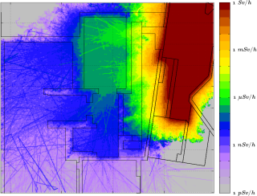
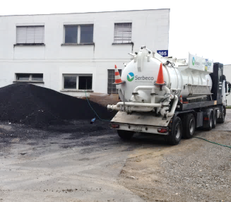
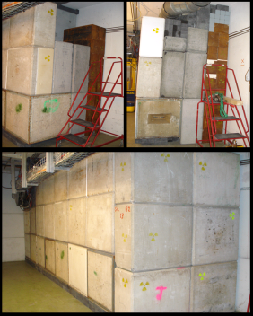
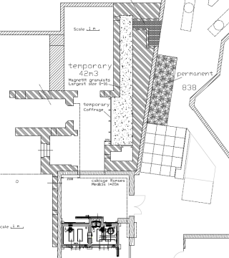
Internal: shielding (temporary and permanent)
Shielding Fluka optimization by Ricardo Augusto
<0.5 uSv/h during 2014 Isolde operation
42m³ of Magnetite ore temporary (by blowing)
22m³ blocks (magnetite, iron, concrete and barite).
End of shut down
ISOLDE start up
9 | 10 | 11 | 12 | 1 | 2 | 3 | 4 | 5 | 6 | 7 | 8 | 9 | 10 | 11 | 12 | 1 | 2 | 3 | 4 | 5 | 6 | 7 | 8 | 9 | 10 | 11 | 12 | 1 | 2 | 3 | 4 | 5 | 6 | 7
2013 |  |  |  | 2014 |  |  |  |  |  |  |  |  |  |  |  | 2015 |  |  |  |  |  |  |  |  |  |  |  | 2016

Slide 22
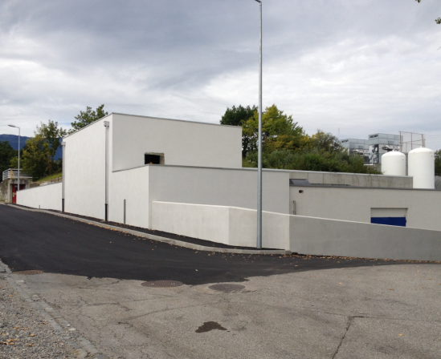


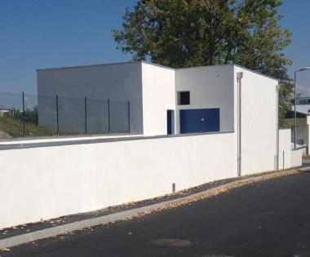
Building: external finishing and doors (fire, ventilation & sound insulation for CV technical room)
Many thanks to:
GS-SE-DOP
9 | 10 | 11 | 12 | 1 | 2 | 3 | 4 | 5 | 6 | 7 | 8 | 9 | 10 | 11 | 12 | 1 | 2 | 3 | 4 | 5 | 6 | 7 | 8 | 9 | 10 | 11 | 12 | 1 | 2 | 3 | 4 | 5 | 6 | 7
2013 |  |  |  | 2014 |  |  |  |  |  |  |  |  |  |  |  | 2015 |  |  |  |  |  |  |  |  |  |  |  | 2016

Slide 23
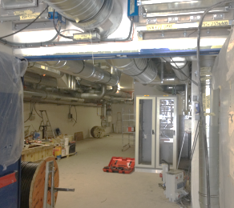
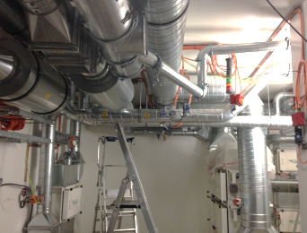
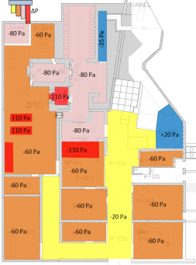
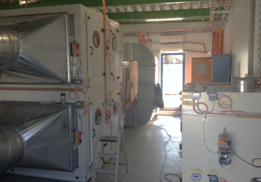
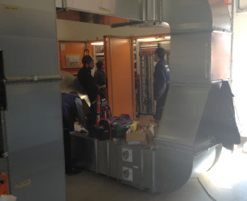

Ventilation & connection between old and new building
MEDICIS Laboratory
Building connections
Many thanks to:
CERN CV group and
CV room (aspiration and filters)
CV room (controls)
9 | 10 | 11 | 12 | 1 | 2 | 3 | 4 | 5 | 6 | 7 | 8 | 9 | 10 | 11 | 12 | 1 | 2 | 3 | 4 | 5 | 6 | 7 | 8 | 9 | 10 | 11 | 12 | 1 | 2 | 3 | 4 | 5 | 6 | 7
2013 |  |  |  | 2014 |  |  |  |  |  |  |  |  |  |  |  | 2015 |  |  |  |  |  |  |  |  |  |  |  | 2016

Slide 24

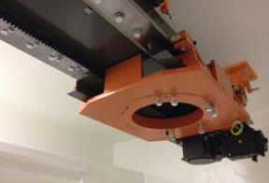
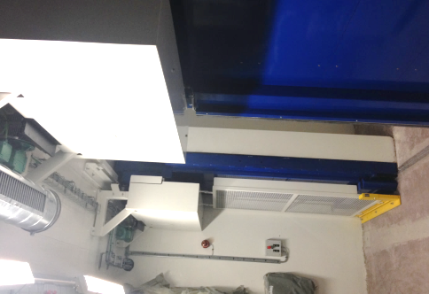
Internal: Robot rail and shielded door
Robot rail (J-L. Grenard)
Shielded door C:
(K. Kershaw)
9 | 10 | 11 | 12 | 1 | 2 | 3 | 4 | 5 | 6 | 7 | 8 | 9 | 10 | 11 | 12 | 1 | 2 | 3 | 4 | 5 | 6 | 7 | 8 | 9 | 10 | 11 | 12 | 1 | 2 | 3 | 4 | 5 | 6 | 7
2013 |  |  |  | 2014 |  |  |  |  |  |  |  |  |  |  |  | 2015 |  |  |  |  |  |  |  |  |  |  |  | 2016

Slide 25
Next steps in this time period
Time line (next steps) :
Finalize Handling Robot & monorail
Finalize Shielded doors
Off-line separator
Tests and final commissioning
9 | 10 | 11 | 12 | 1 | 2 | 3 | 4 | 5 | 6 | 7 | 8 | 9 | 10 | 11 | 12 | 1 | 2 | 3 | 4 | 5 | 6 | 7 | 8 | 9 | 10 | 11 | 12 | 1 | 2 | 3 | 4 | 5 | 6 | 7
2013 |  |  |  | 2014 |  |  |  |  |  |  |  |  |  |  |  | 2015 |  |  |  |  |  |  |  |  |  |  |  | 2016

Slide 26
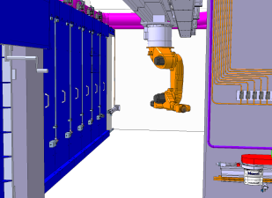
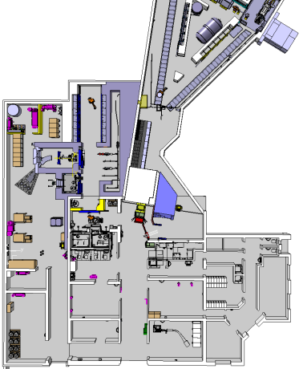
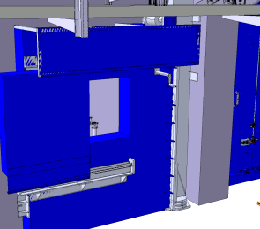
Robot & shielded doors & storage shelves finalization
Robot already delivered (J-L. Grenard)
Storage shelves (V. Barozier & Y.Gavrikov)
Shielded doors A & B:
(K. Kershaw)
9 | 10 | 11 | 12 | 1 | 2 | 3 | 4 | 5 | 6 | 7 | 8 | 9 | 10 | 11 | 12 | 1 | 2 | 3 | 4 | 5 | 6 | 7 | 8 | 9 | 10 | 11 | 12 | 1 | 2 | 3 | 4 | 5 | 6 | 7
2013 |  |  |  | 2014 |  |  |  |  |  |  |  |  |  |  |  | 2015 |  |  |  |  |  |  |  |  |  |  |  | 2016

Slide 27
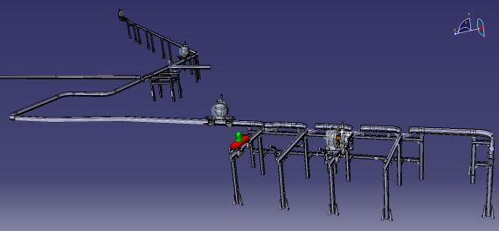
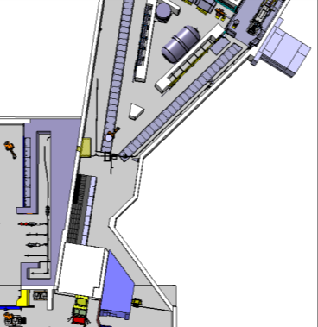

Rail conveyor system and shielding completion & ventilation air lock
Design by M. Vagnoni
Air lock
Final RCS network
Radiation Hard conveyor
Shielding completion
9 | 10 | 11 | 12 | 1 | 2 | 3 | 4 | 5 | 6 | 7 | 8 | 9 | 10 | 11 | 12 | 1 | 2 | 3 | 4 | 5 | 6 | 7 | 8 | 9 | 10 | 11 | 12 | 1 | 2 | 3 | 4 | 5 | 6 | 7
2013 |  |  |  | 2014 |  |  |  |  |  |  |  |  |  |  |  | 2015 |  |  |  |  |  |  |  |  |  |  |  | 2016

Slide 28




Frontend, separator, collection box and services (HV, control, vacuum)
Vacuum &
Gas storage
Power supply & HV
Separator (KU-Leuven)
Controls
Target station & separator
Collection box
9 | 10 | 11 | 12 | 1 | 2 | 3 | 4 | 5 | 6 | 7 | 8 | 9 | 10 | 11 | 12 | 1 | 2 | 3 | 4 | 5 | 6 | 7 | 8 | 9 | 10 | 11 | 12 | 1 | 2 | 3 | 4 | 5 | 6 | 7
2013 |  |  |  | 2014 |  |  |  |  |  |  |  |  |  |  |  | 2015 |  |  |  |  |  |  |  |  |  |  |  | 2016

Slide 29



Laboratory equipment
Glove boxes
Fume hoods
9 | 10 | 11 | 12 | 1 | 2 | 3 | 4 | 5 | 6 | 7 | 8 | 9 | 10 | 11 | 12 | 1 | 2 | 3 | 4 | 5 | 6 | 7 | 8 | 9 | 10 | 11 | 12 | 1 | 2 | 3 | 4 | 5 | 6 | 7
2013 |  |  |  | 2014 |  |  |  |  |  |  |  |  |  |  |  | 2015 |  |  |  |  |  |  |  |  |  |  |  | 2016

Slide 30

Final commissioning & start up…
Tests:
Handling (robot & conveyor)
Off line device (Frontend, separator, collection)
Access system
Safety monitoring (environment, radioprotection)
General safety (power cut, fire, ventilation…)
9 | 10 | 11 | 12 | 1 | 2 | 3 | 4 | 5 | 6 | 7 | 8 | 9 | 10 | 11 | 12 | 1 | 2 | 3 | 4 | 5 | 6 | 7 | 8 | 9 | 10 | 11 | 12 | 1 | 2 | 3 | 4 | 5 | 6 | 7
2013 |  |  |  | 2014 |  |  |  |  |  |  |  |  |  |  |  | 2015 |  |  |  |  |  |  |  |  |  |  |  | 2016

Slide 31
Conclusions :
Civil engineering schedule in the 2013-2014 long shut down was extremely tight
=> Building finished on time !
The 2015 shut down was also challenging with the new ventilation system and building integration
=> Ventilation close to completion !
Luckily for this project we benefit from 50 years previous experience at ISOLDE :
  i.e. Design inputs, risk analysis, ISOLDE operations and target production…
  Industrial Kuka robots and failure risk analysis (like ISOLDE)
  Front End, separator design and process (like ISOLDE)

Slide 32

THANKS for your Attention !
Acknowledgements !
Roland Arnoul, Ricardo Augusto, Roger Barlow, Vincent Barozier, Michele Battistin, Ana-Paula Bernardes, Michel Bonnet, Alexandre Broche, Francesco Canepa, Richard Catherall, Michal Czech, Mathieu Deschamps, Alexandre Dorsival, Yury Gavrikov, Jean-Louis Grenard, Ielyzaveta Kobzeva, Camille Lemesre, Roberto Losito, Christophe Loup, Yisel Martinez, Christophe Mitifiot, Frank Moro, Rene Necca, Julien Parra-Lopez, Eliseo Perez-Duenas, Andrea Polato, Giacomo Potuto, Silvain Samson, Eva Sanchez, Christelle Saury, Alexander Stadler, Thierry Stora, Matteo Vagnoni, Francesco Venturini, Joachim Vollaire

Slide 34


