Slide 1
Femtoscopy: the way back in the energy scale from ALICE to NICA - part II
P. Batyuk, Yu.Karpenko, L. Malinina, K. Mikhaylov, R. Lednicky,
O. Rogachevsky, D. Wielanek
Nica DAYS / XI WORKSHOP ON PARTICLE CORRELATIONS AND FEMTOSCOPY

Slide 2
Outline
Short description of MPD experiment
MC generators for MPD energies
Plans for future

Slide 3
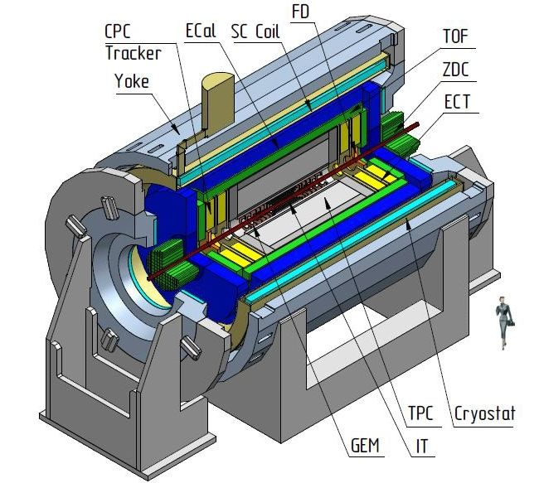
MPD
Multi Purpose Detector
Collider experiment
At NICA facility
Energy 4-11 GeV per nucleon for AuAu collision
Femtoscopic measurement – one of most important.

Slide 4
MC models
Before experiment starts
  Statistic prediction
  Information about needed resolution -> detector optimization
  Testing software for tracking and analysis
  Testing/developing new methods of analysis that will be used
When experiment starts
  Explanation of observables measured by experiment

Slide 5
MC model requirement
Model used in MPD experiment must fulfill following criteria:
Taking into account CP/phase transition physics
Use full 3+1D hydrodynamics
Reasonable simulation time
Good description of data available today

Slide 6
NicaFemto package
NicaFemto was used for analysis:
  tool for femtoscopic analysis
  allow to make other analysis – simplified flow analysis and spectra
  based on FairROOT, created for MPD – can be transferred between different experiments like MPD, BM@N, CBM (future software for femtoscopic analysis in those experiments)

Slide 7
Comparison of models
Two models were tested :
  UrQMD 3.4 with ideal hydro mode enabled and chiral equation of state (crossover)
  vHLLE+UrQMD model (Iu. Karpenko) – crossover (chiral) or 1st order transition (Bag Model), with or without viscosity
  And compared with data from:
  STAR (10.1103/PhysRevC.92.014904 same sign pion analysis)
  Na-49 (10.1103/PhysRevC.77.064908 π⁻π⁻ analysis)
  Convention in this talk: all energies written in this presentation are sqrt(sNN) energies!

Slide 8
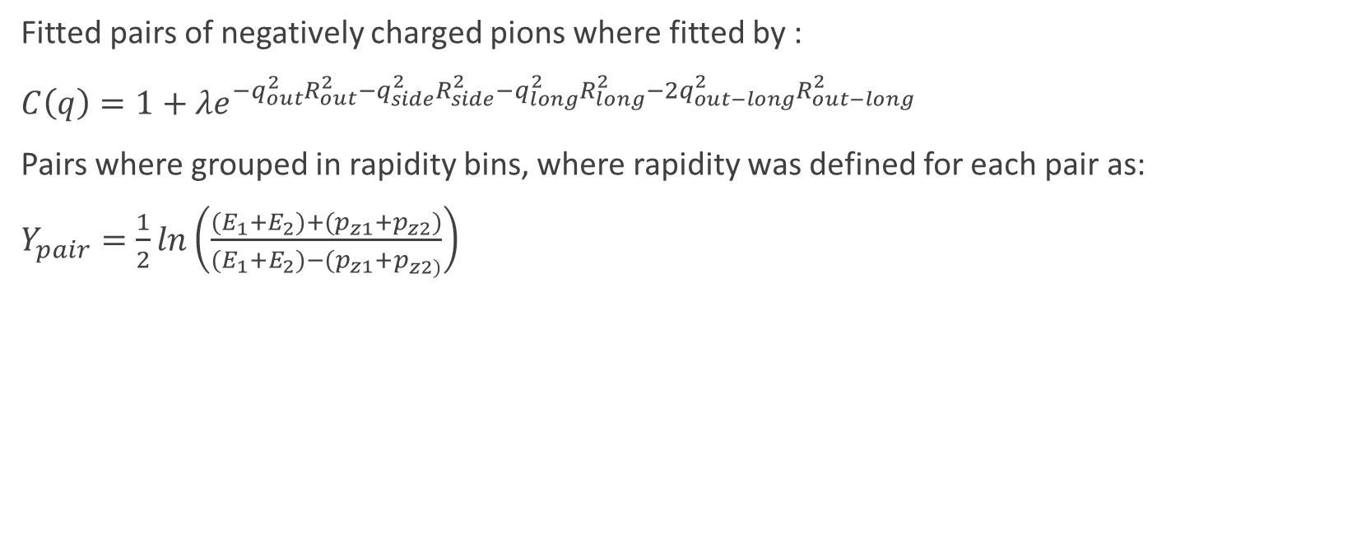
Comparison of models – Na49 sample
Fitted pairs of negatively charged pions where fitted by :
$C\left(q\right)=1+λe^{−q_{out}^{2}R_{out}^{2}−q_{side}^{2}R_{side}^{2}−q_{long}^{2}R_{long}^{2}−2q_{out−long}^{2}R_{out−long}^{2}}$
Pairs where grouped in rapidity bins, where rapidity was defined for each pair as:
$Y_{pair}=\frac{1}{2}ln\left(\frac{{(E}_{1}+E_{2})+{(p}_{z1}+p_{z2})}{{(E}_{1}+E_{2})−{(p}_{z1}+p_{z2)}}\right)$

Slide 9

Compared data
STAR data were with Gaussian fit
$C\left(q\right)=1+λe^{−q_{out}^{2}R_{out}^{2}−q_{side}^{2}R_{side}^{2}−q_{long}^{2}R_{long}^{2}}$

Slide 10
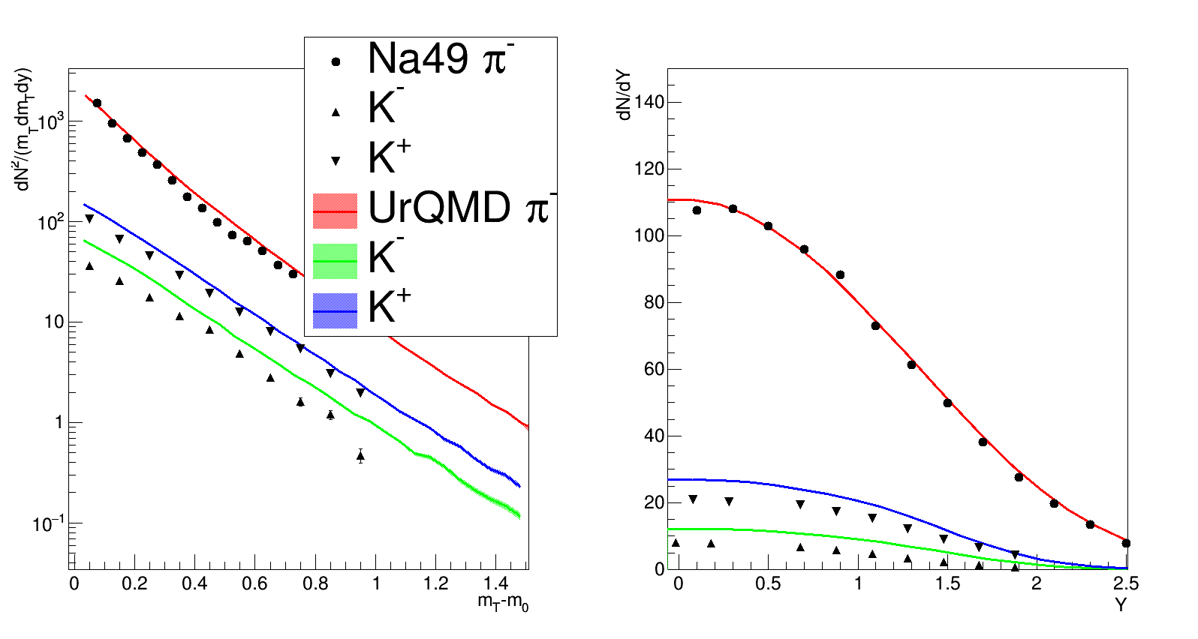
Spectra from UrQMD
Note:
Similar Energy (Na49 8.7 vs 9 GeV for UrQMD)
Similar system (PbPb from
Na49 vs AuAu in UrQMD)
Good description of pions

Slide 11
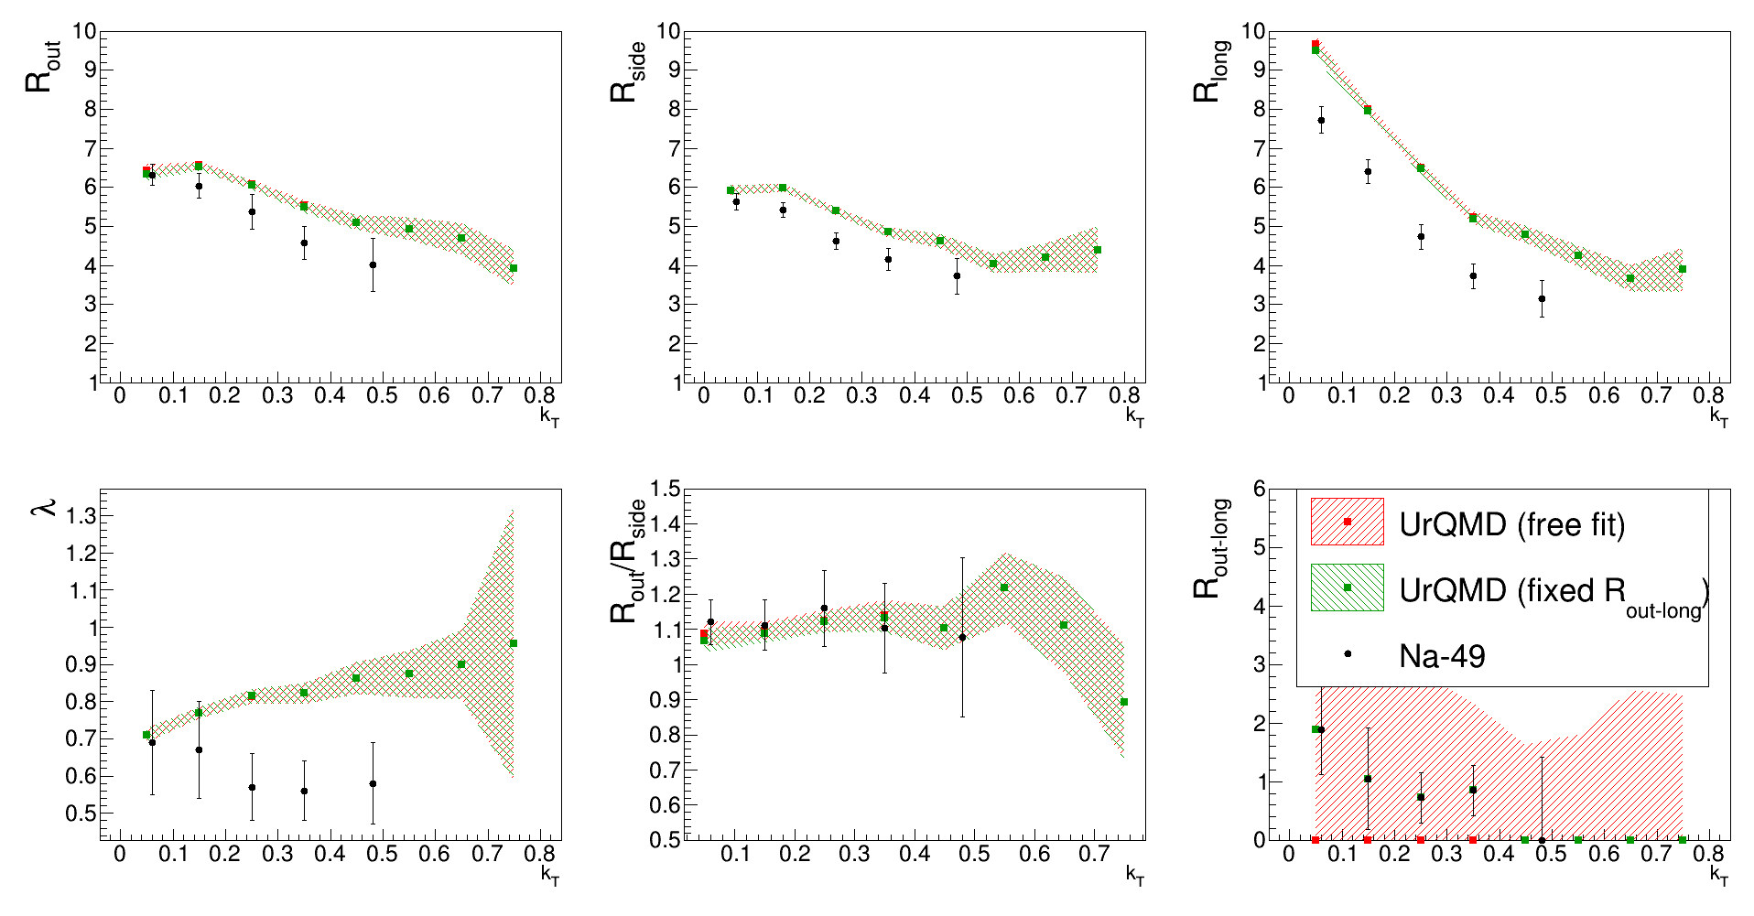
UrQMD 0<Y_{pair}<0.5
Note:
Similar Energy (Na49 8.7 vs 9 GeV for UrQMD)
Similar system (PbPb from
Na49 vs AuAu in UrQMD)
Applied cuts: as acceptance
Radii overestimated
Not enough statistic to fit R_{out-long} properly

Slide 12
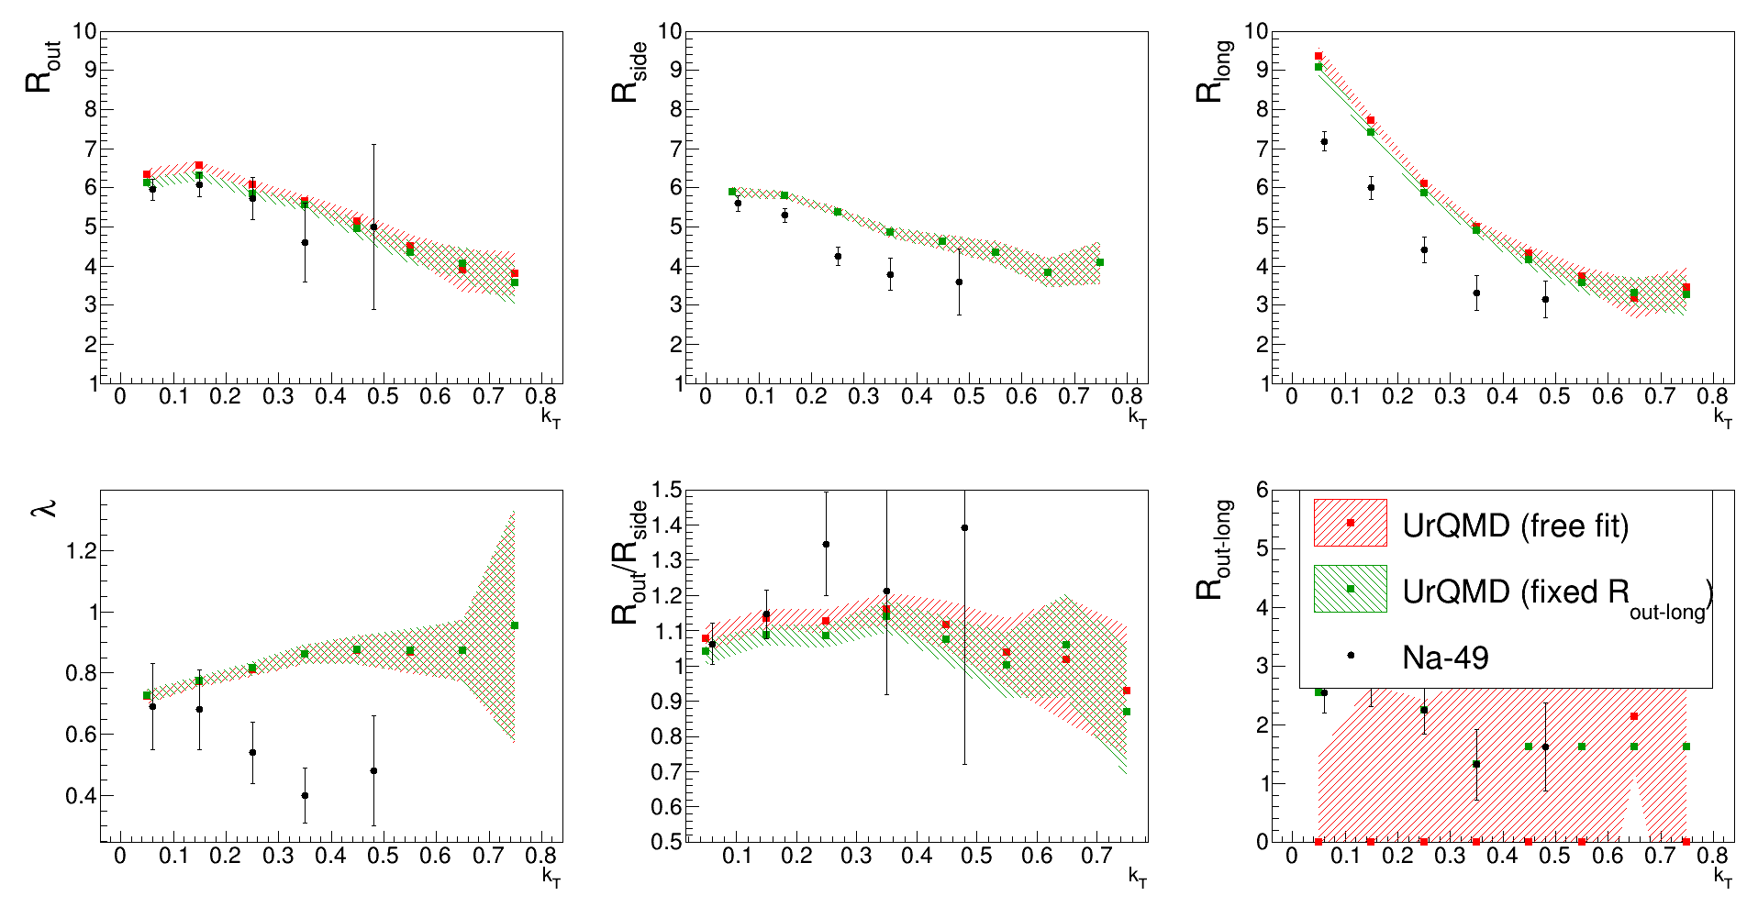
UrQMD 0.5<Y_{pair}<1.0

Slide 13
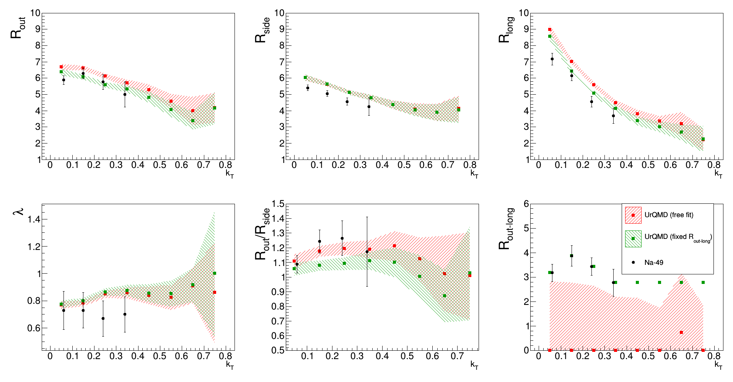
UrQMD 1.0<Y_{pair}<1.5

Slide 14
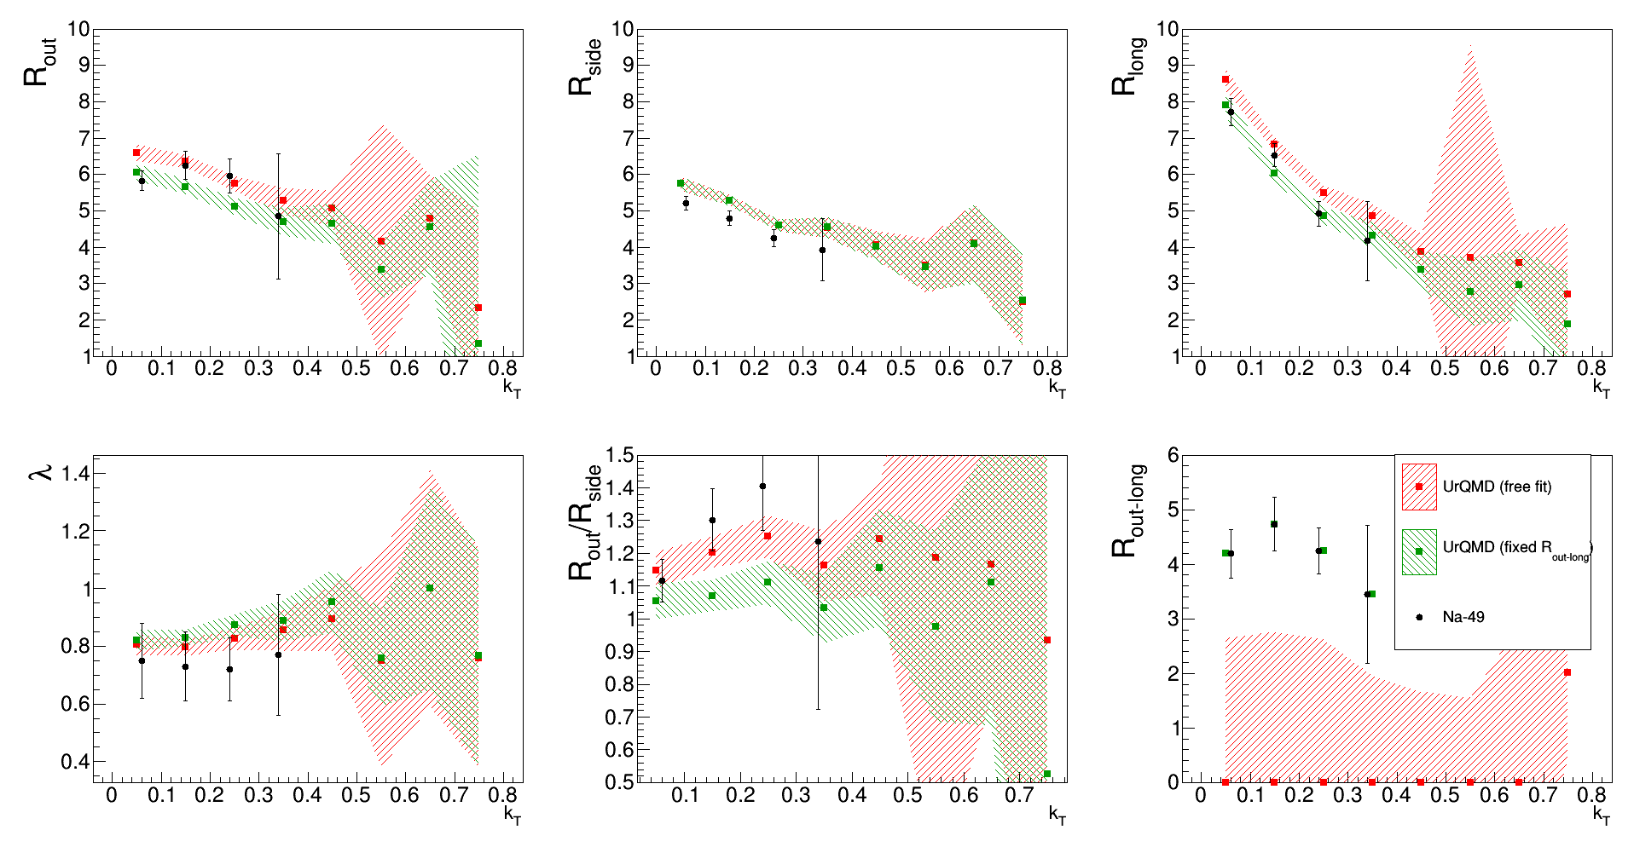
UrQMD 1.5<Y_{pair}<2.0
Quite good description of radii for „forward” rapidity pairs

Slide 15
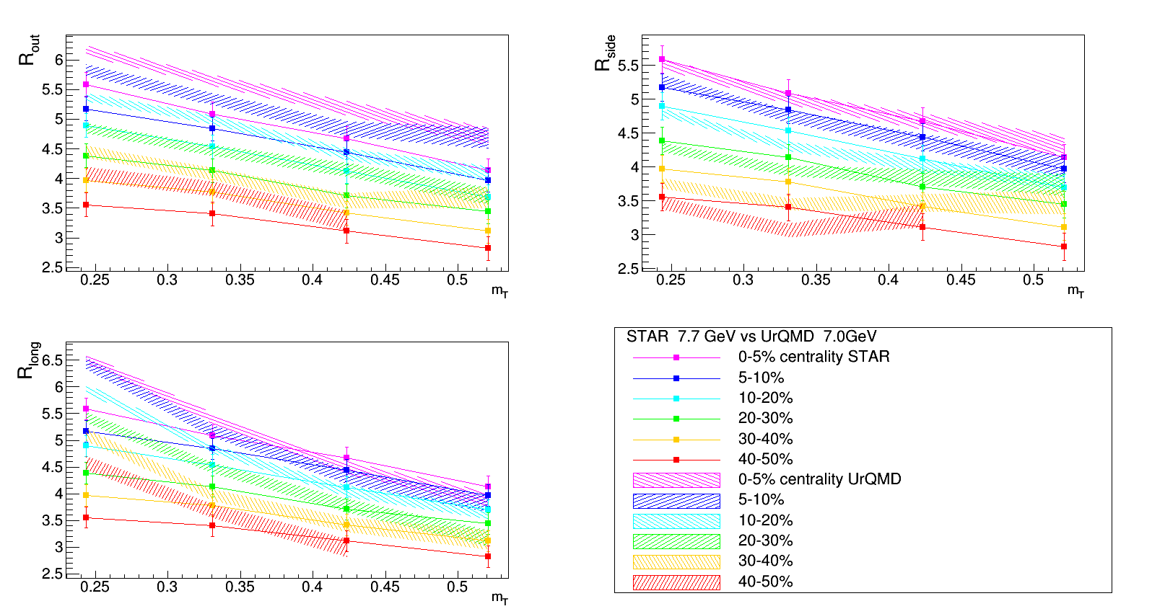
UrQMD and STAR data
R_{side} – good
R_{out} – overestimated
R_{long} – strongly overestimated, different slope

Slide 16
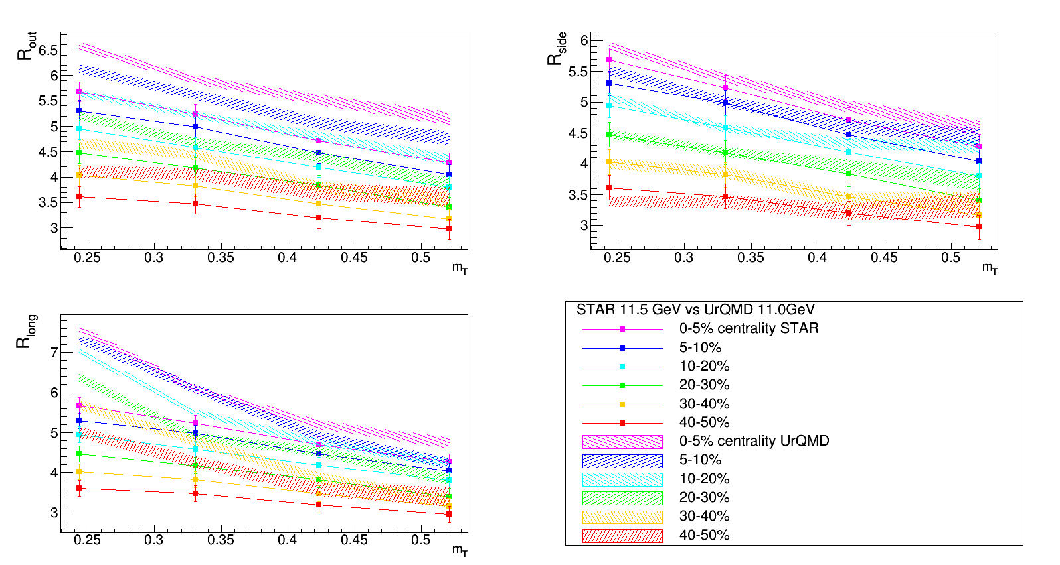
UrQMD and STAR data
Effects of overestimation it’s bigger!

Slide 17
UrQMD model
Not well reproduction of femtoscopic observables, radii are usualy overestimated
Huge computer resources required – about 1h per single event (with hydrodynamics enabled)
Probably can be tuned by manipulating parameters – but this require too much time

Slide 18
vHLLE+UrQMD model
Simulation steps:
  Initial conditions – taken from UrQMD
  From fixed τ till fixed value of ε – 3+1D hydro code is used
  Particlization, switching to UrQMD code for cascades
Parameters are tuned for transverse momentum, rapidity distributions and elliptic flow. Many cascade simulations for one hydro simulation can be done (oversampling).
In Na49 like analysis - crossover with perfect hydro was used.

Slide 19
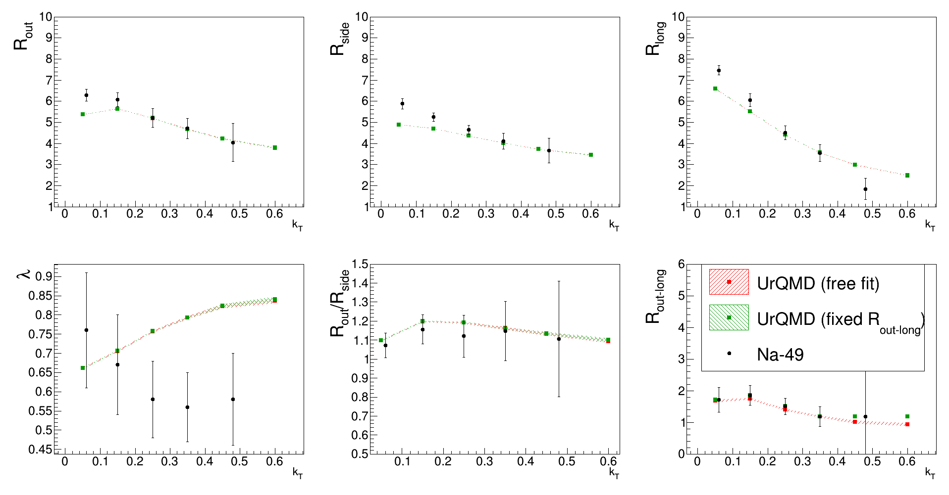
vHLLE + UrQMD 0<Y_{pair}<0.5
Much better statistic- better fits, smaller uncertainties, radii seems to be rather underestimated for lowest kt bin, for higher kt bins – quite nice description of radii.Very good description of R_{out-long}
Note:
Similar events :Na49 PbPb vs model AuAu
Similar centrality:
0-7.2% for Na49 data and 0-5% for model
Similar Energy – 7.6 for Na49 data and 7.7 for model
Cuts applied – like Na49 acceptance

Slide 20
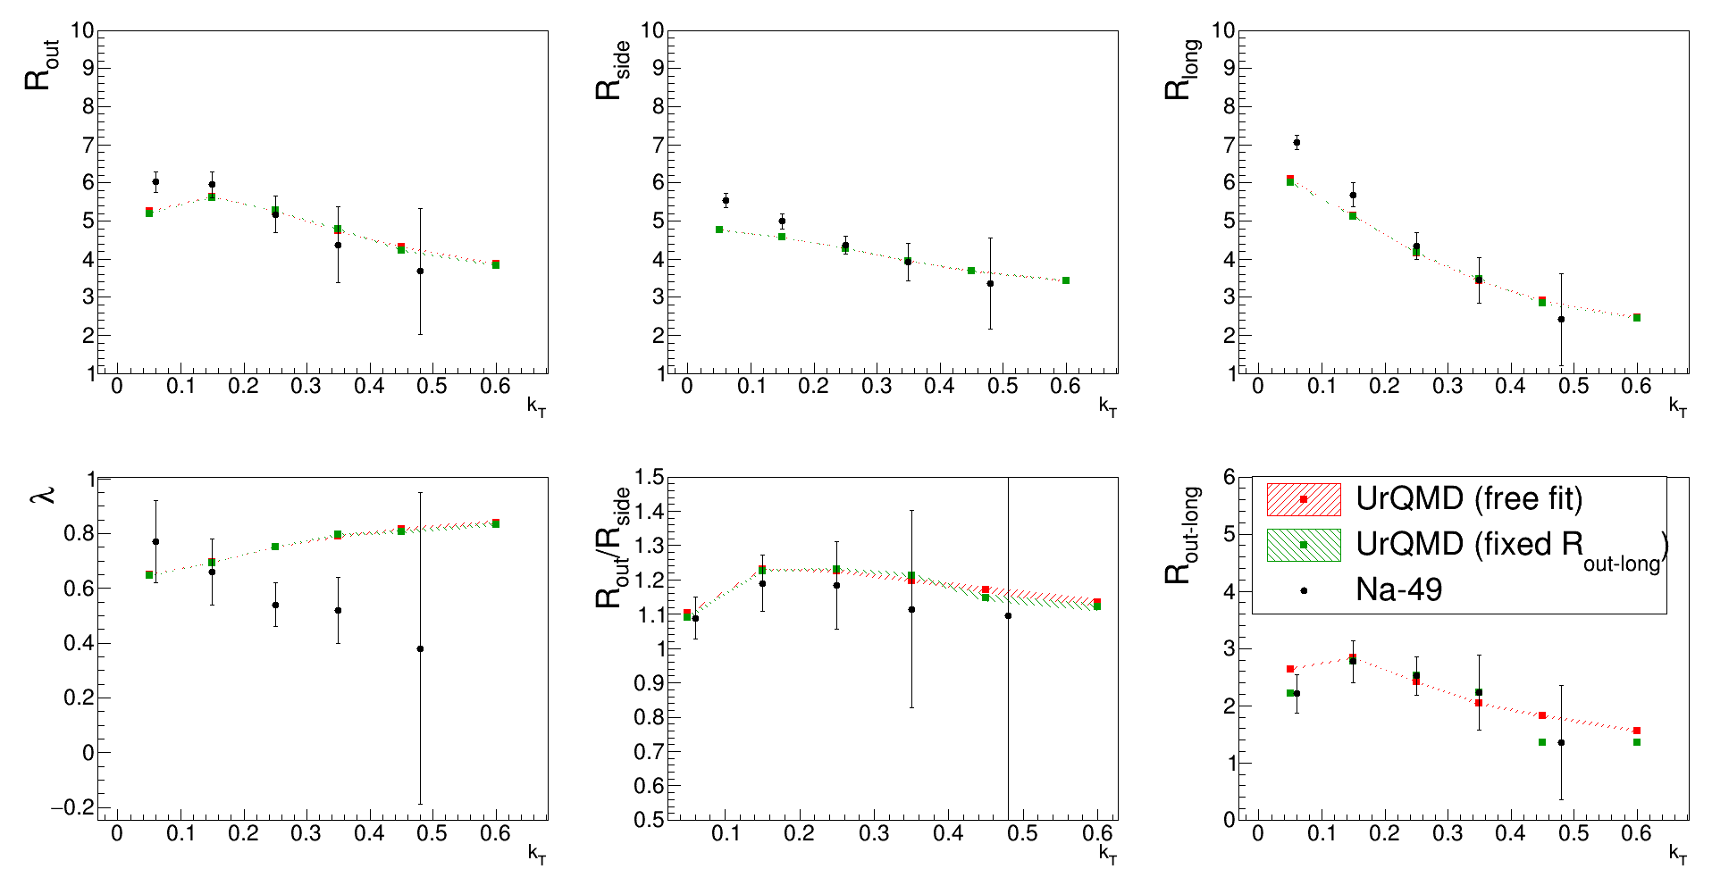
vHLLE + UrQMD 0.5<Y_{pair}<1.0

Slide 21
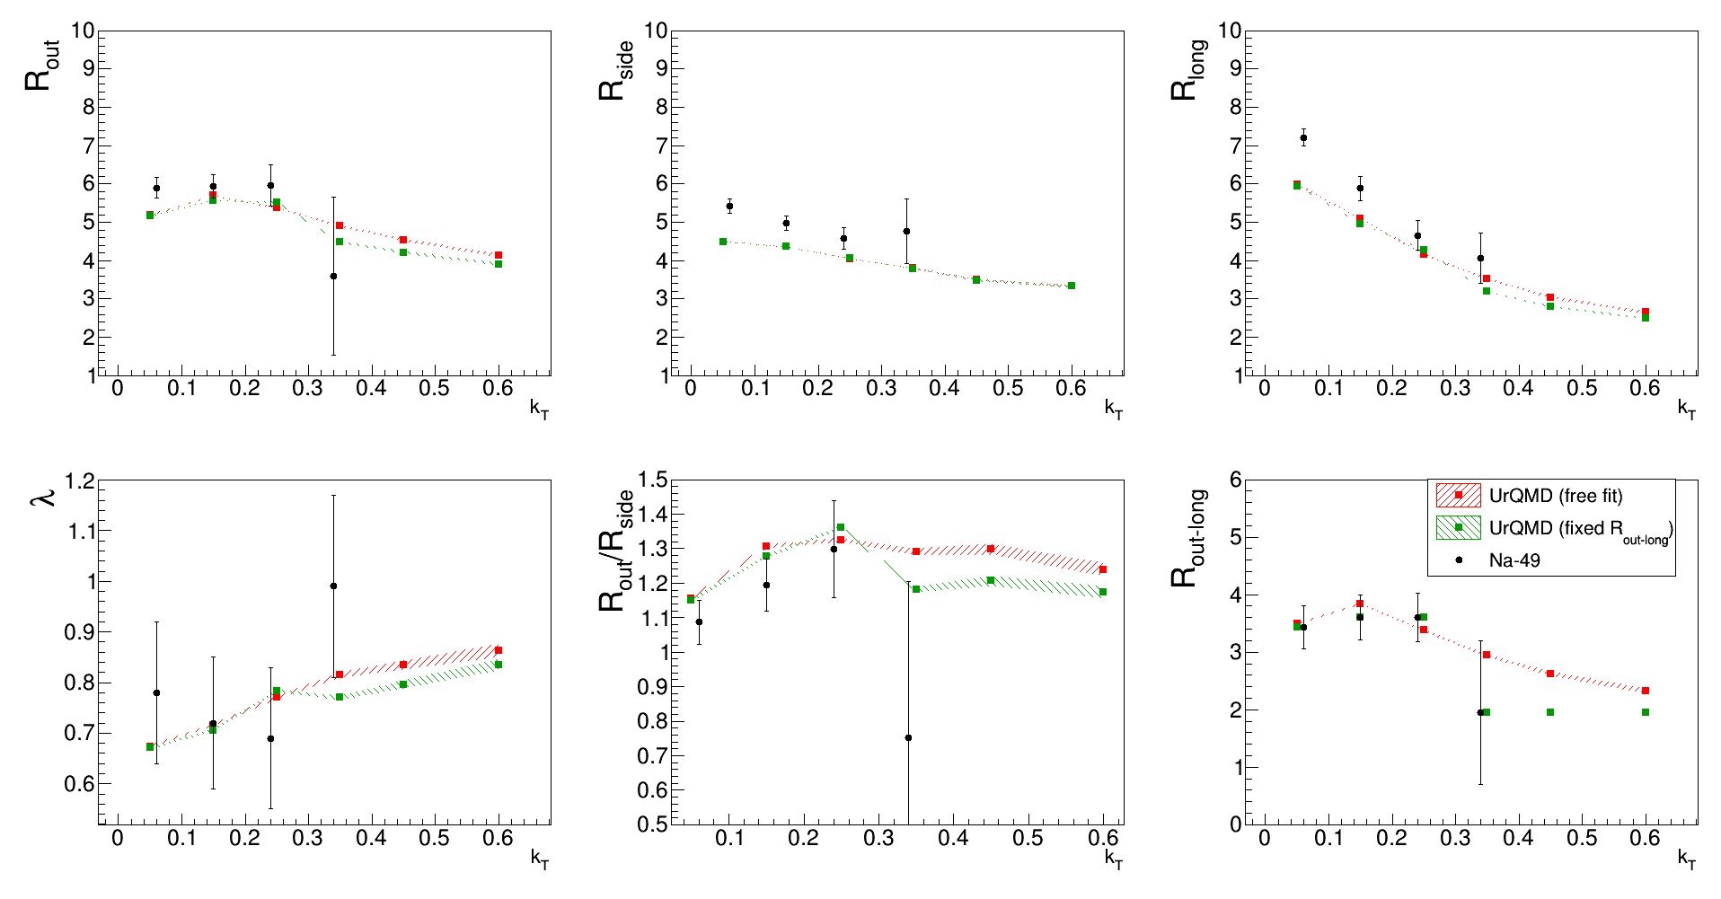
vHLLE + UrQMD 1.0<Y_{pair}<1.5

Slide 22
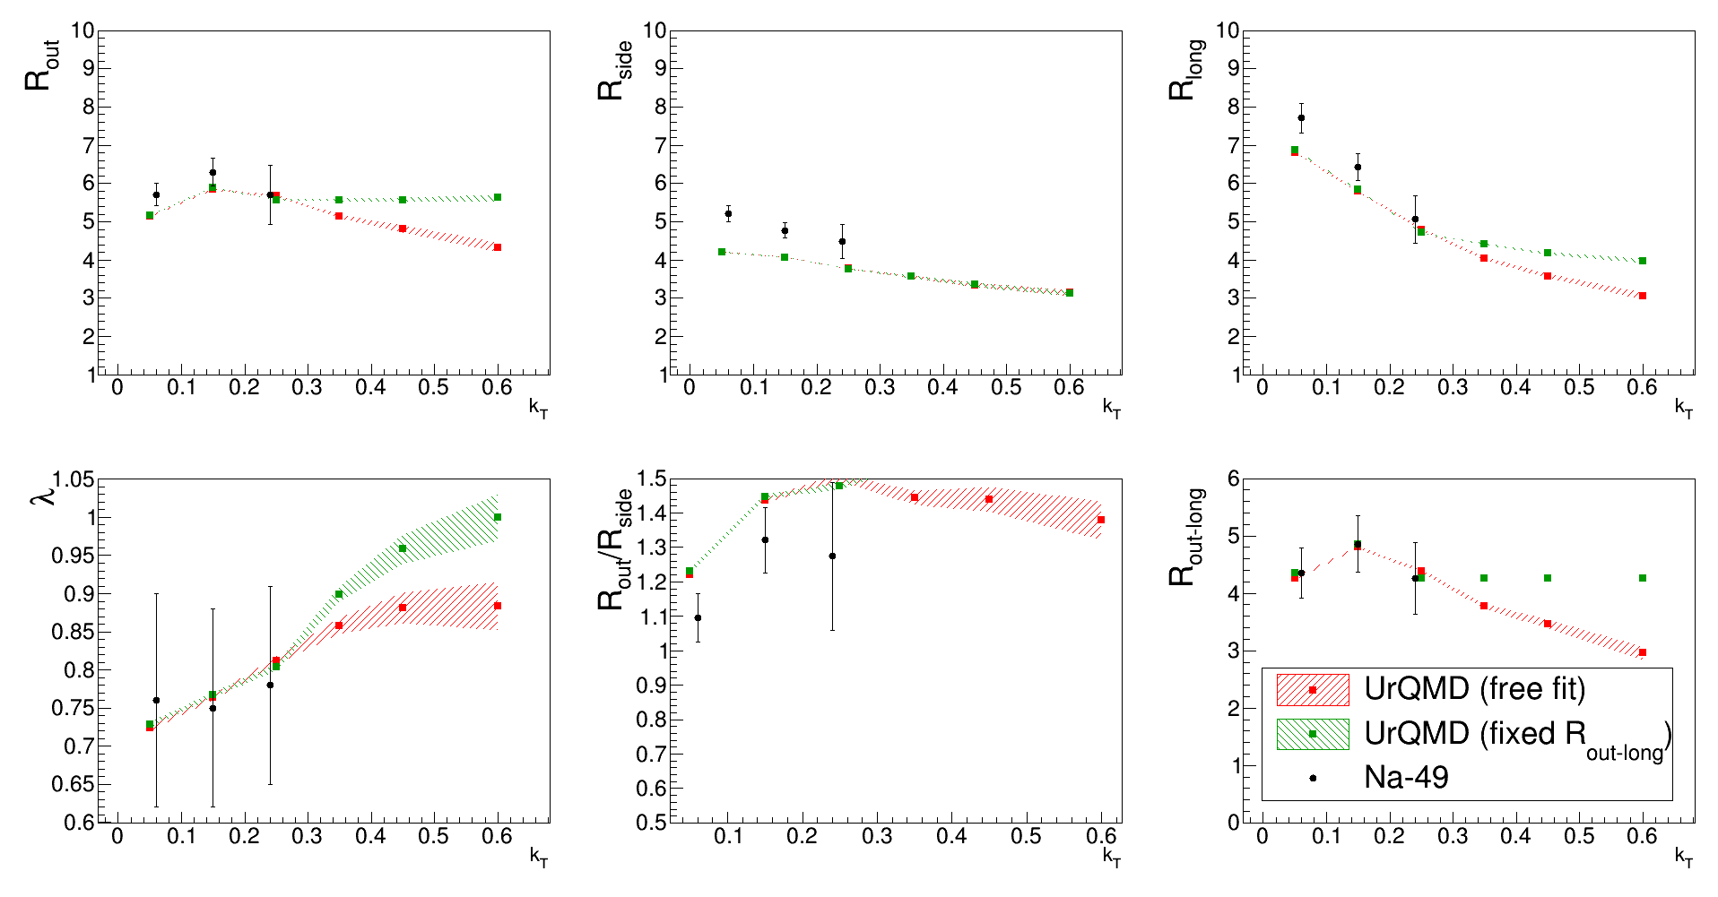
vHLLE + UrQMD 1.5<Y_{pair}<2.0
Problem with description of R_{side}

Slide 23
vHLLE+UrQMD vs STAR data
Following convention is used
Blue line – perfect hydro + crossover phase transition
Red line – perfect hydro + 1st order phase transition
Green line – viscous hydro + crossover phase transition
Full line – full simulation
Dotted line – no cascade processes

Slide 24
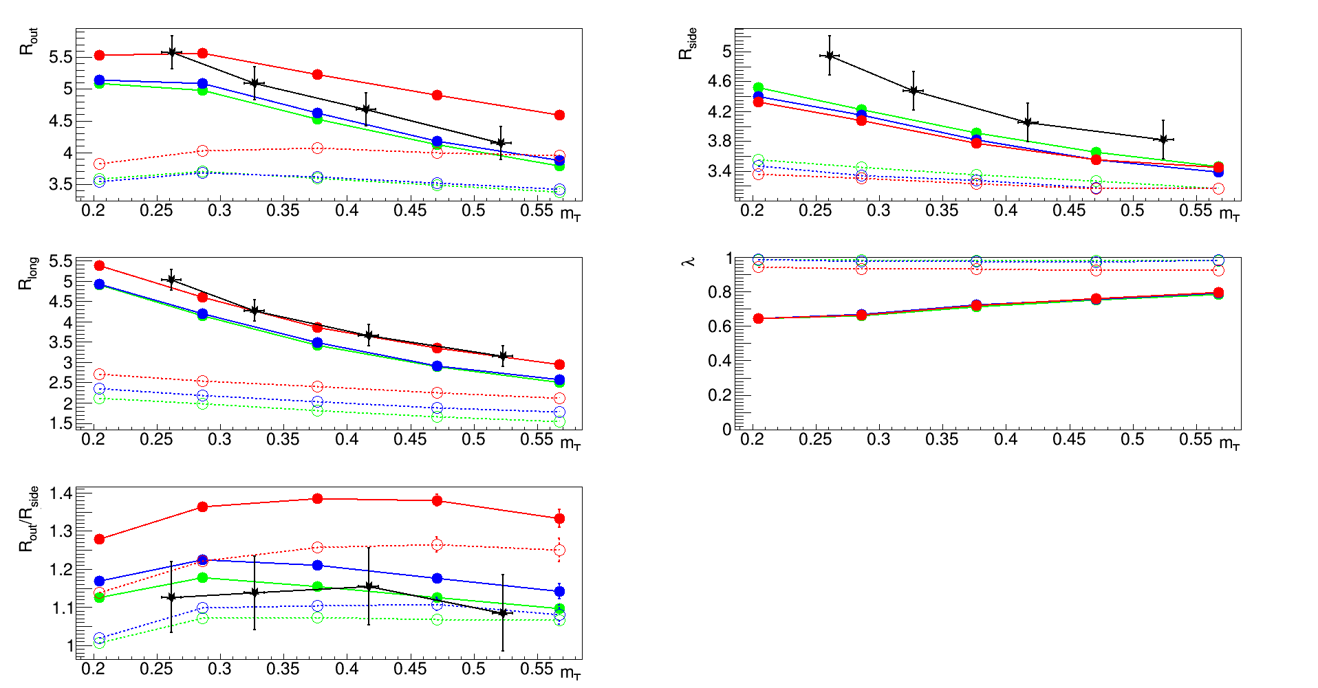
vHLLE + UrQMD and STAR data
7.7 GeV centrality: 0-5%

Slide 25
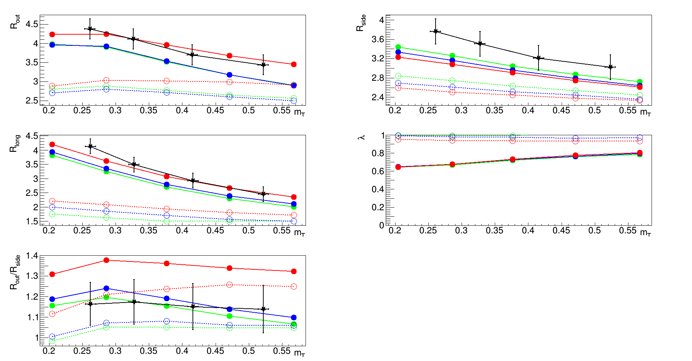
vHLLE + UrQMD and STAR data
7.7 GeV
centrality: 20-30%

Slide 26
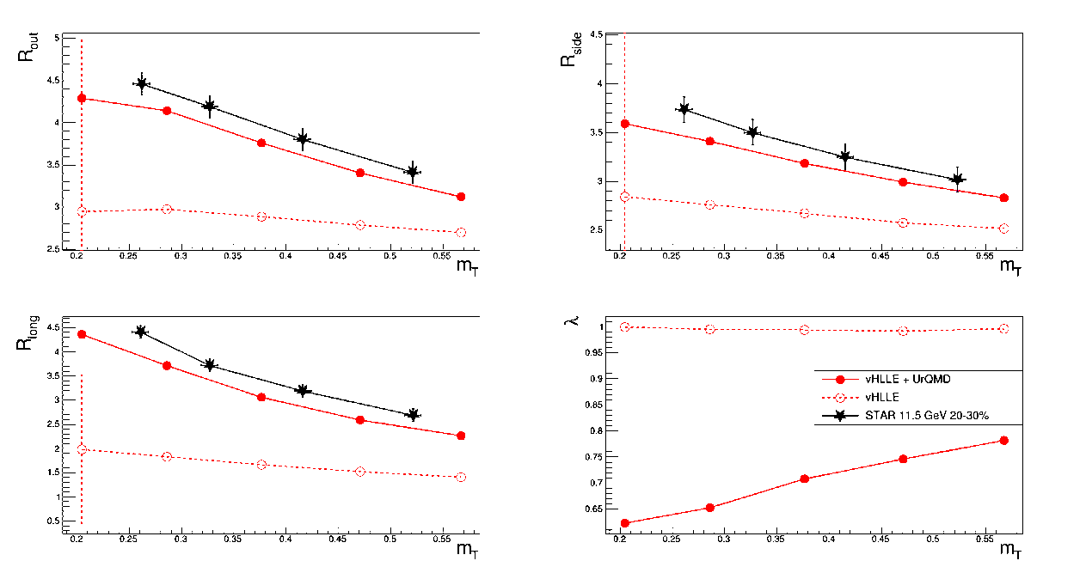
vHLLE + UrQMD and STAR data
11 GeV
centrality 20-30%

Slide 27
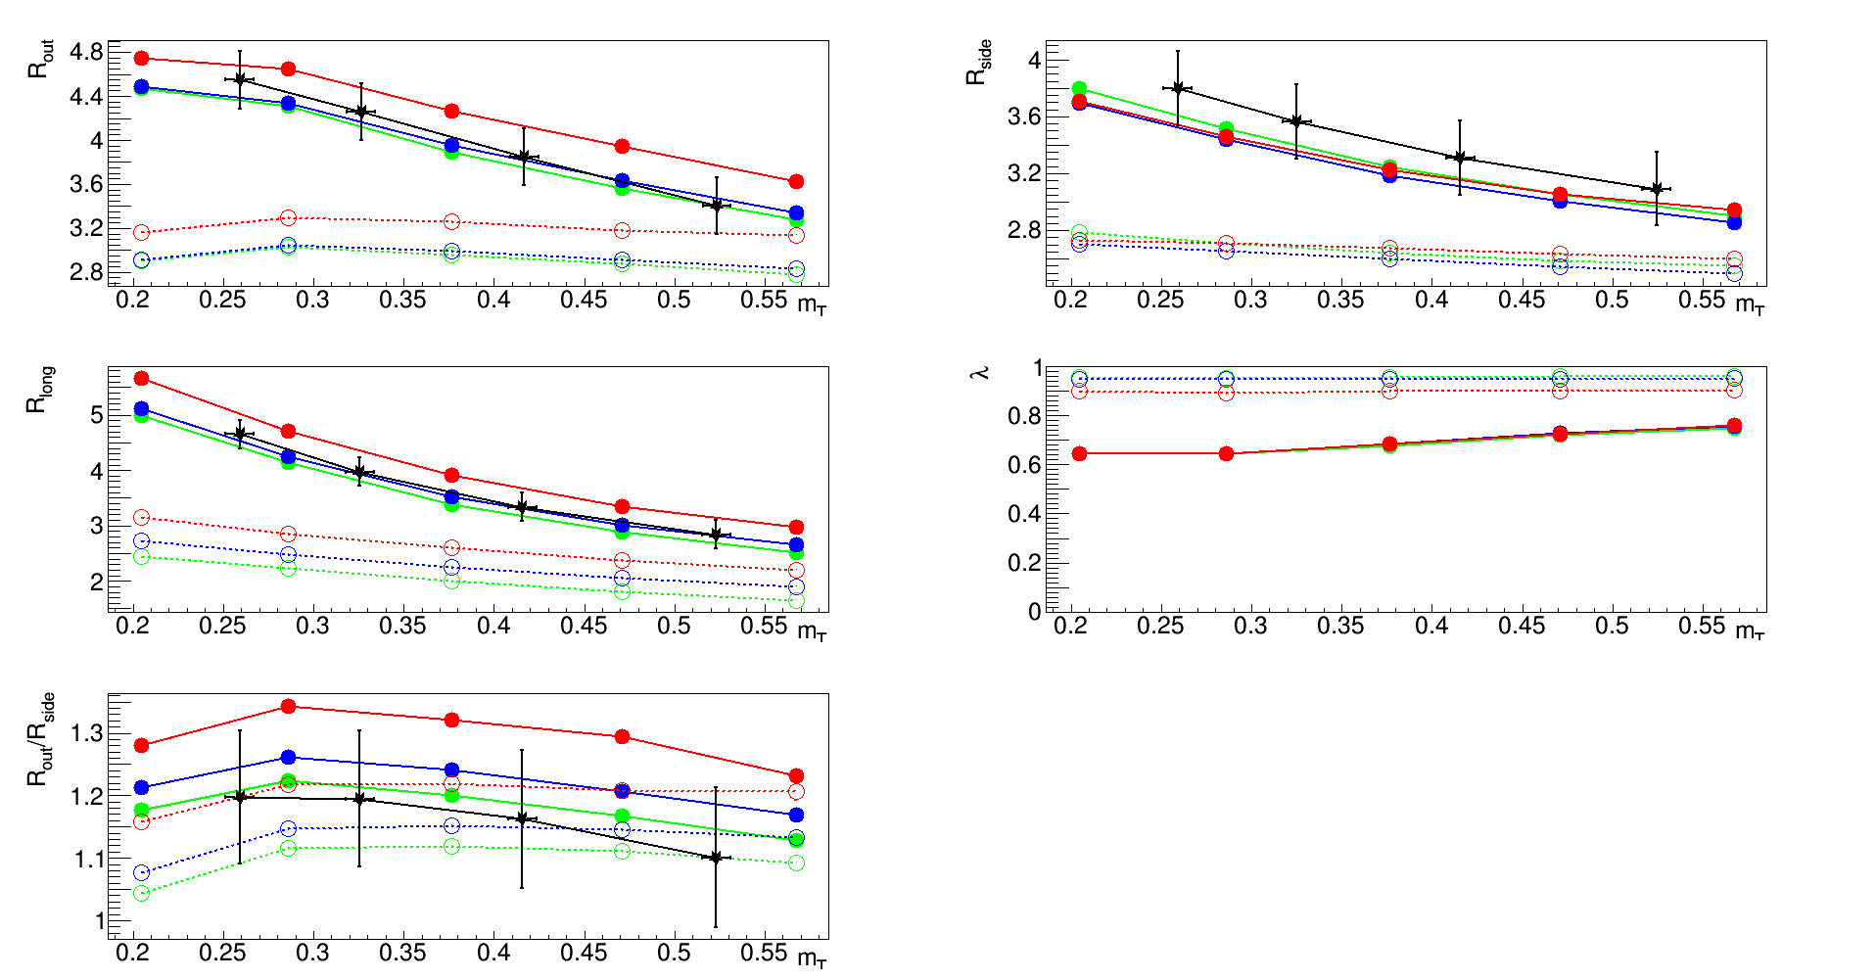
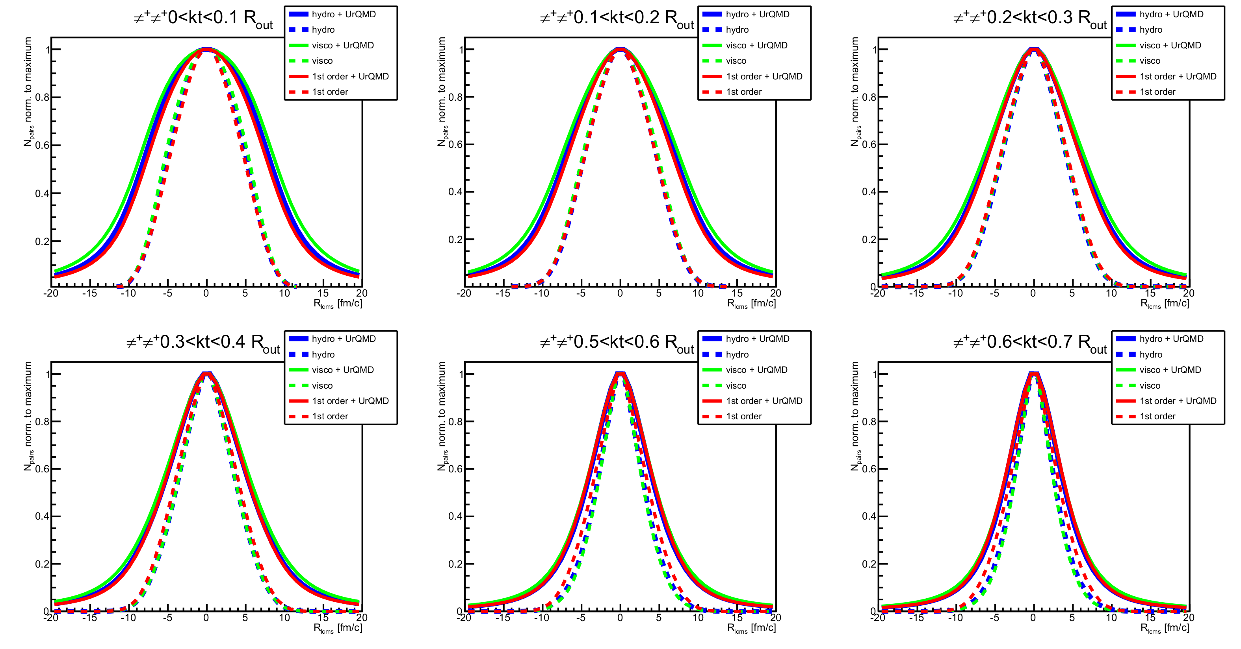
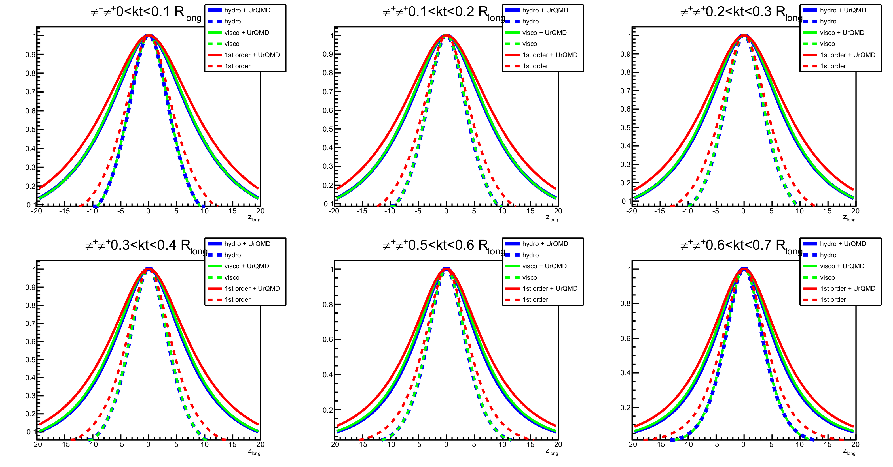
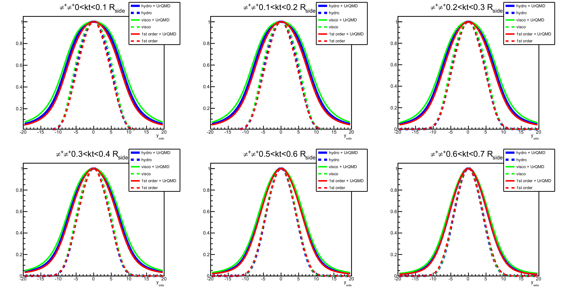
vHLLE+UrQMD and femtoscopic radii distribution at 19.6 GeV
All radii in LCMS system
Small differences in out and side direction . Relatively big differences in long direction - 1st order phase transtion – bigger system.
19.6 GeV
centrality 20-30%
Difference in Rout/Rside observed.
Is it useful?

Slide 28
vHLLE+UrQMD model
Better description of femtoscopic radii (except R_{side})
Femtoscopic observables are reproduced „out of box” (model wasn’t tuned for femtoscopy)
Much faster – oversampling (many cascade simulations for one single hydro simulation)
  For example 2h of computing gives:
  ~2 full hydro events in UrQMD
  ~1 full hydro event in vHLLE + ~60 „posthydro” events - >60 „effective” events (or one „superevent”)
Statistic for track based observables multiplied by factor of 30
Statistic for two-track observables multiplied by factor of 1800!
(but there are some „hooks”)

Slide 29
What we have learned from UrQMD and vHLLE+UrQMD?
Standard R_{out}/R_{side} ratio measurements might be not enough to distinguish between different phase transition types – imaging method might be very promising
Rescaterring, resonance decays strongly affect femtoscopic measurements, however final radii still depend on phase transition
R_{long} observable seems to be more promising than simple looking on R_{out}/R_{side} measurements
Femtoscopic radii changes dynamically with different rapidity bin – data from „standard” measurements are not enough for tuning MC models

Slide 30
First result of reconstruction
Two track reconstruction is crucial for femtoscopic analysis. Due to limited resolution of detector following cases can occur:
  Merging - real pair of tracks is reconstructed as single track –pair is missing -> value of CF is artificially reduced
  Splitting – real track is reconstructed as two tracks – artificial pair is added -> increase value of CF
  First analysis was made with:
  Kalman tracks obtained from MC hits in TPC
  „Anti double-track” cut – pair of Kalman tracks is removed if both have the same parent MC
  Cut monitor for Δφ*Δη (Δφ* - is kind of analogy for Δφ but take into account influence of magnetic field inside detector)

Slide 31
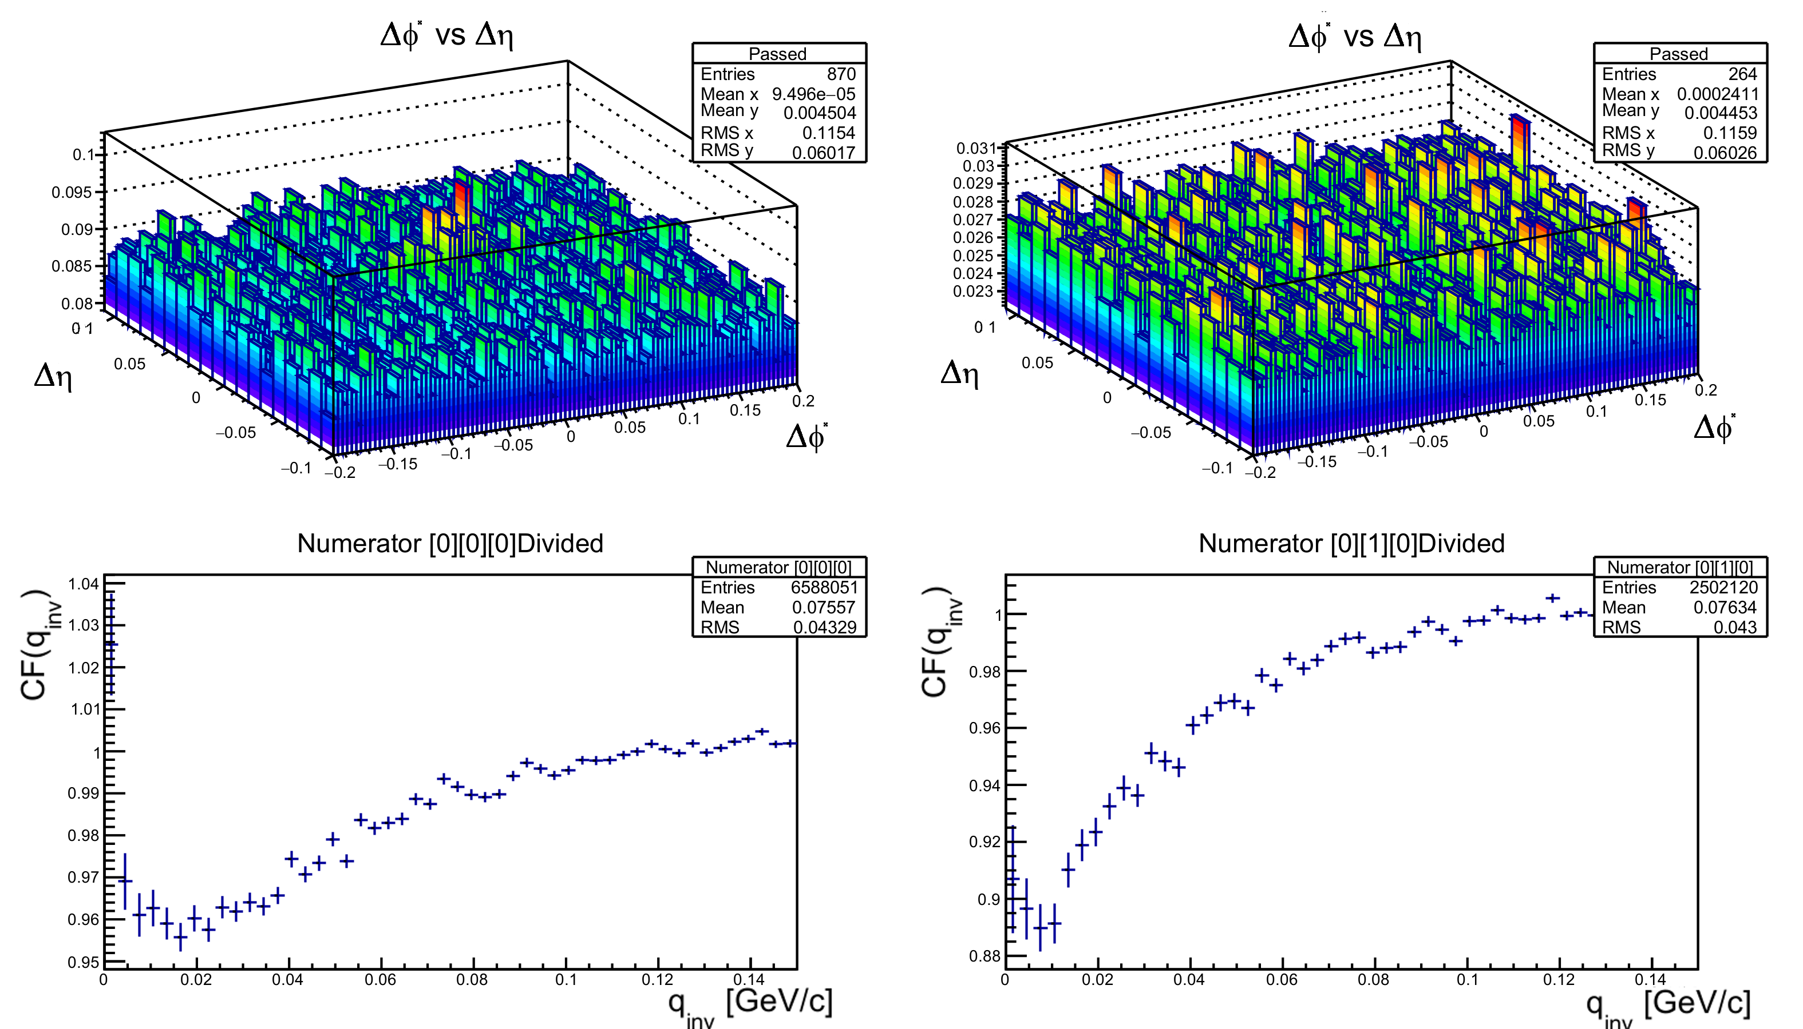
First result of using MPD reconstruction chain
No” anti double-tracks cut”, splitting is visible
With anti double-tracks cut, splitting has been removed/reduced
Size of splitting peak seems to depend on lower pt cut value -> splitting caused mostly by particles that make „loops” in TPC
Source of merging – now unknown

Slide 32
Summary
We tested two models with hydro, vHLLE + UrQMD seems to be promising model that fulfil all conditions necessary for our needs.
We tested software for femtoscopic analysis (NicaFemto) with both kind of data – from generator and after reconstruction.

Slide 33
Plans for future
Expanding comparison by using more MC event generators like PHSD
Testing new methods of analysis like differential femtoscopy
Making analysis with MPD reconstruction algorithms

Slide 34
Thank you for your attention

Slide 35
References
Presentation about hybrid model
Beam Energy Scan using a viscous hydro + cascade model

Slide 36
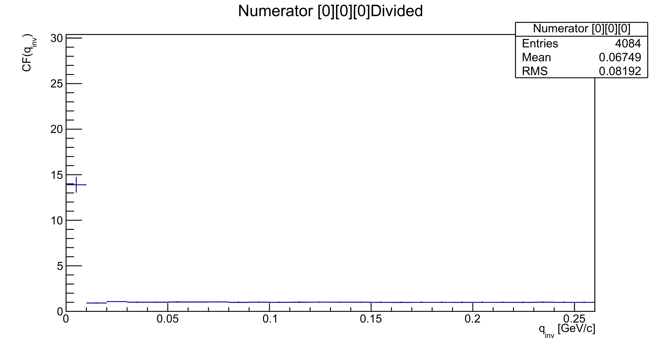
Backup slides
CF for Kalman tracks with 0.15<pT<1.0

