Slide 2
Benchmarking PyHEADTAIL against HEADTAIL
Kevin Li
PDM – 20. 03. 2015

Slide 3
Context
PSB simulations gave inconclusive results
PS simulations of the injection oscillations with indirect space charge wakes (low β) need to be redone with direct space charge added
Can we use PyHEADTAIL?

Slide 4
Context
PSB simulations gave inconclusive results
PS simulations of the injection oscillations with indirect space charge wakes (low β) need to be redone with direct space charge added
Can we use PyHEADTAIL?
→ Only if PyHEADTAIL passes the benchmark tests against HEADTAIL!

Slide 5
PS TOF beam with indirect sc wakes

Slide 6
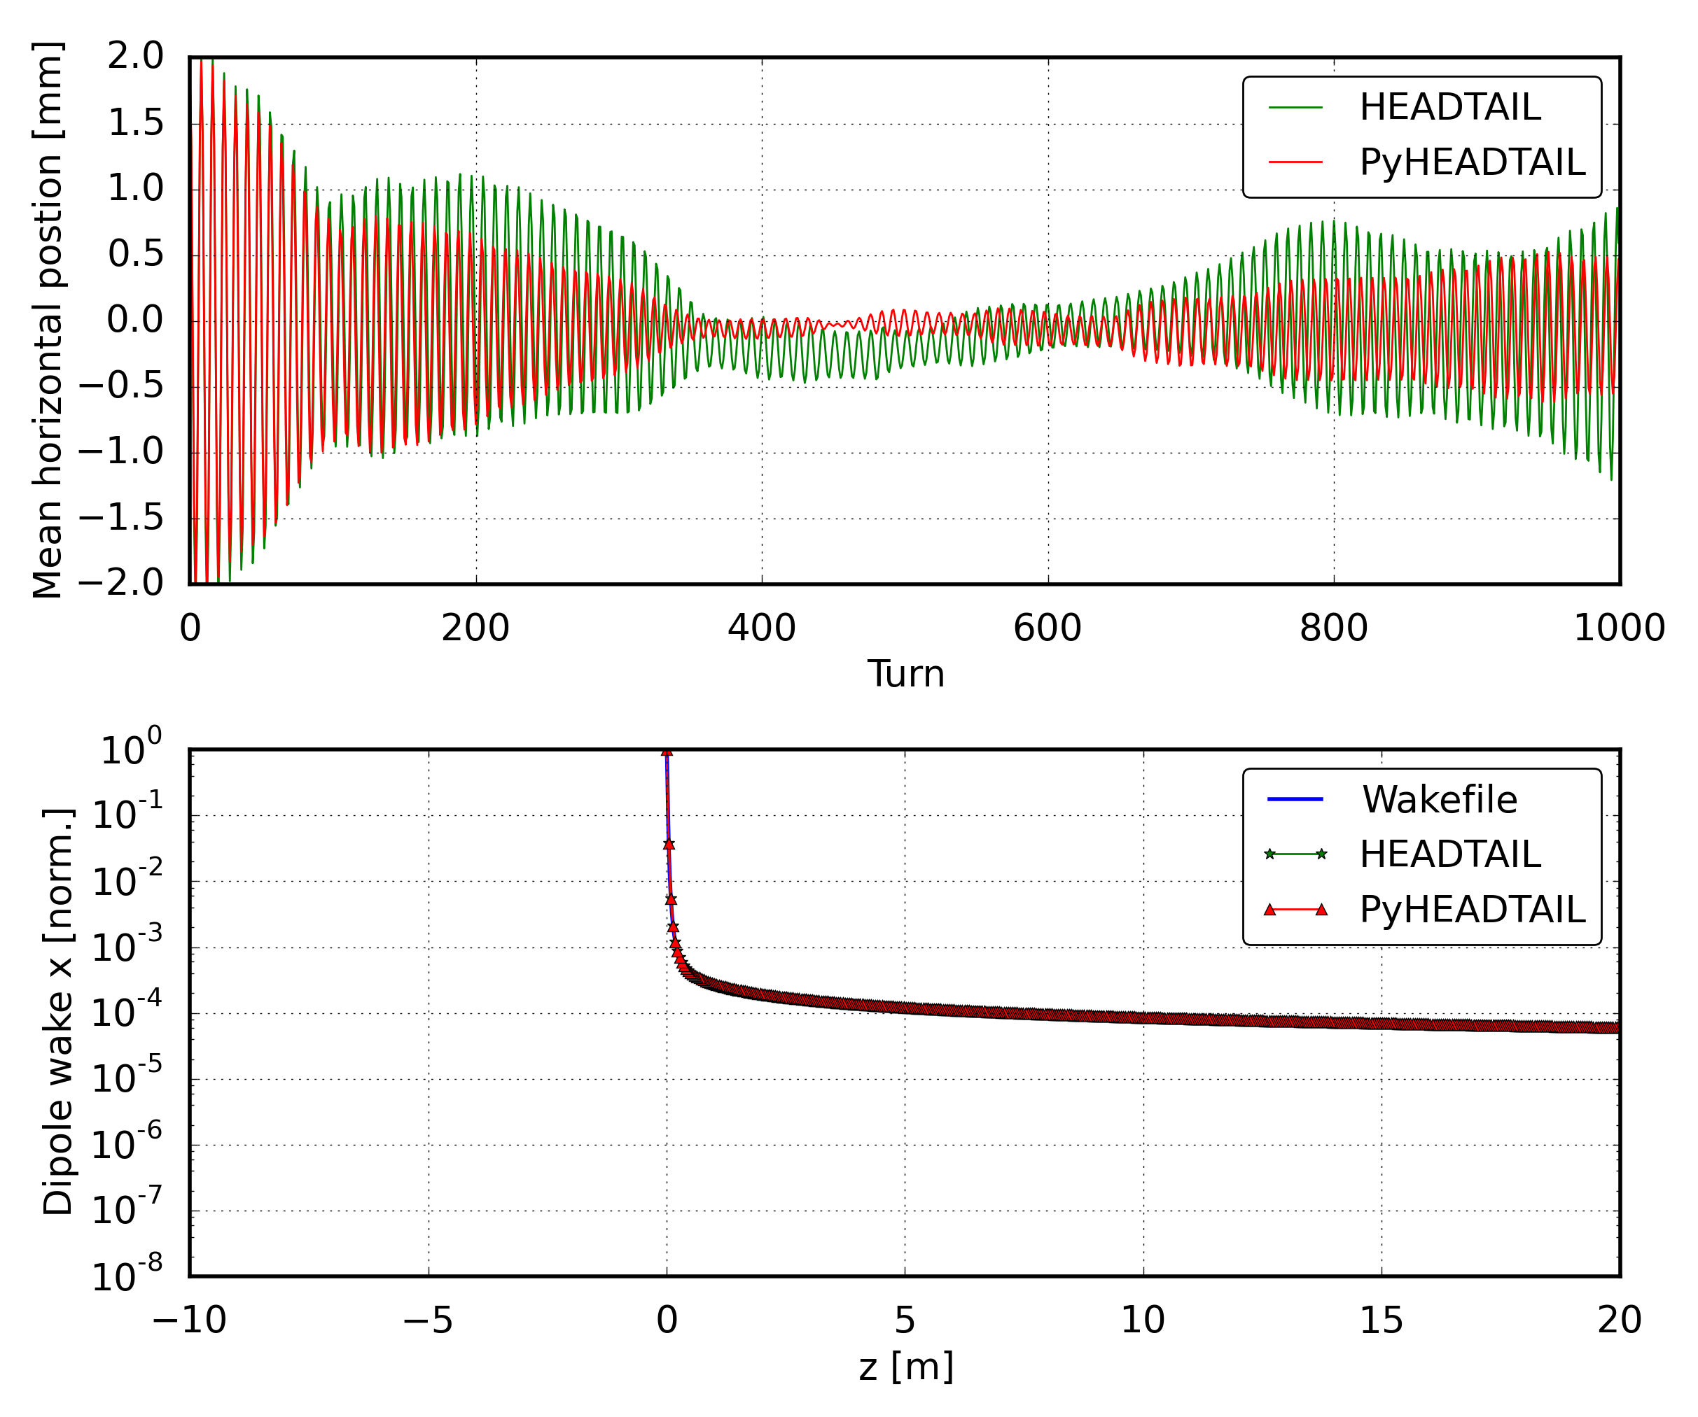
Bad agreement of coh. bunch motion

Slide 7
Wakes behind agree well

Slide 8
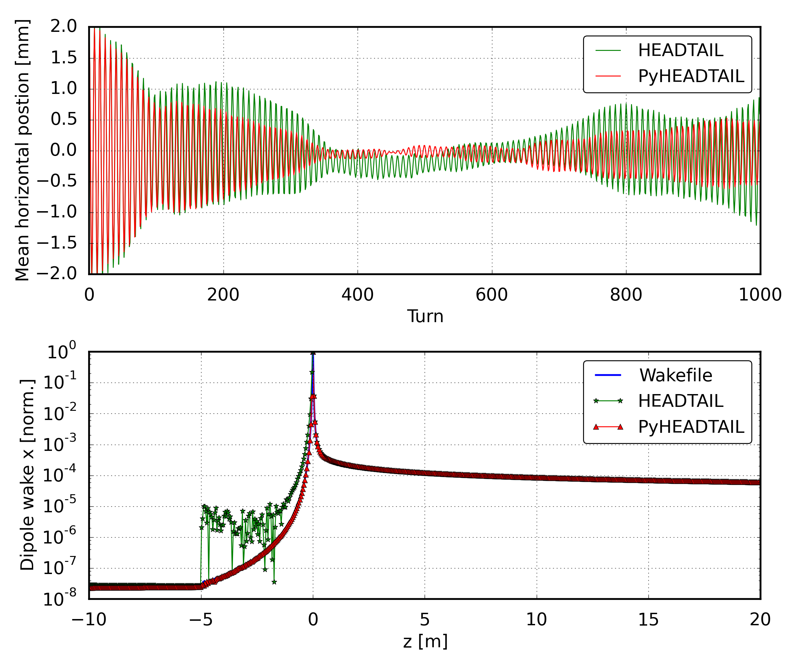
Wake in front is badly interpolated

Slide 9
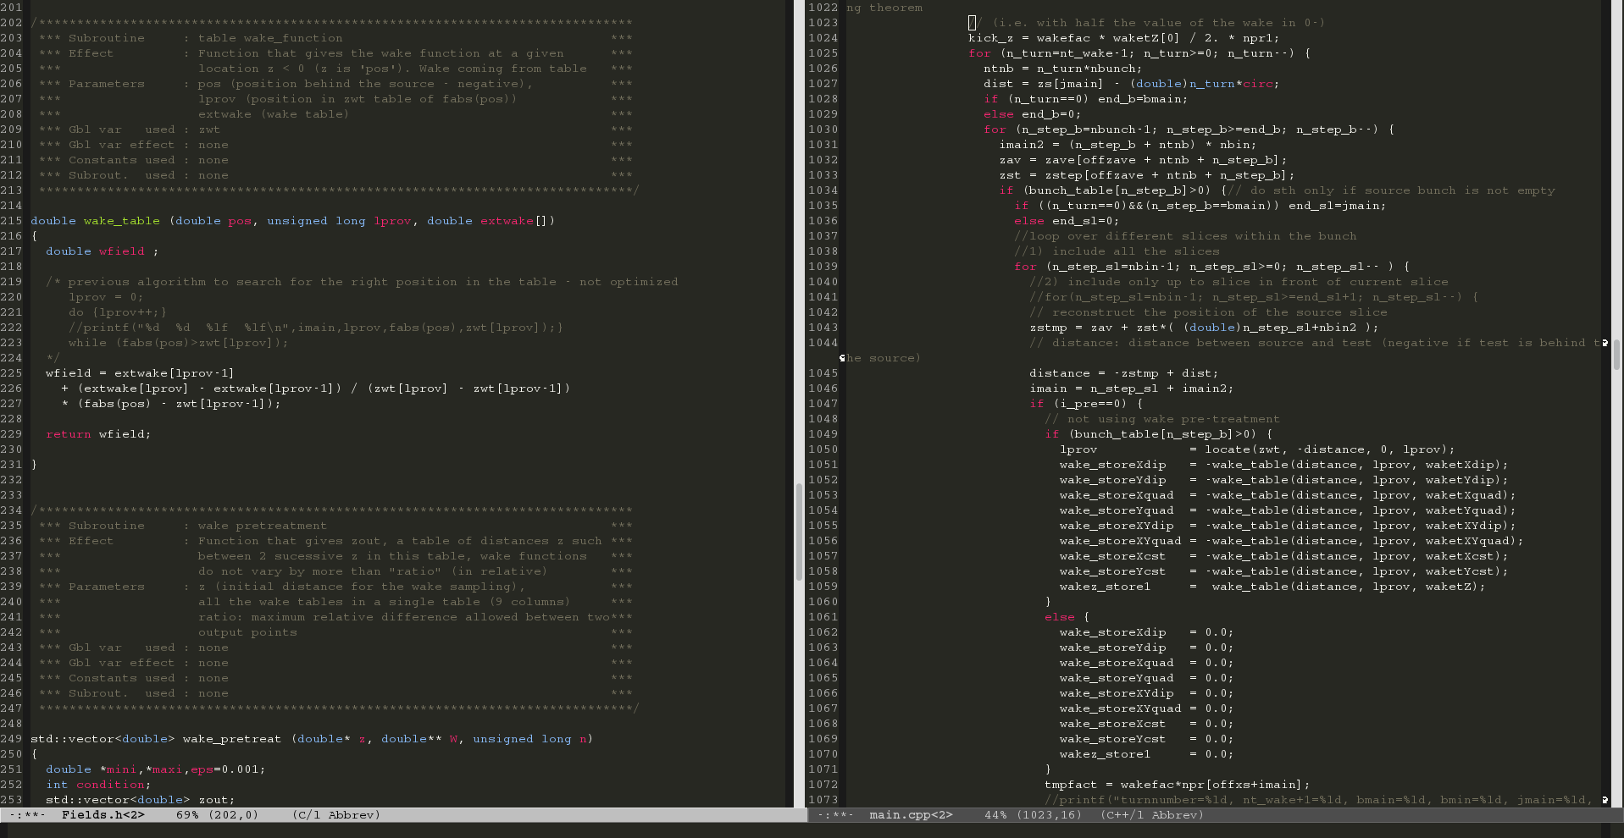
Original

Slide 10
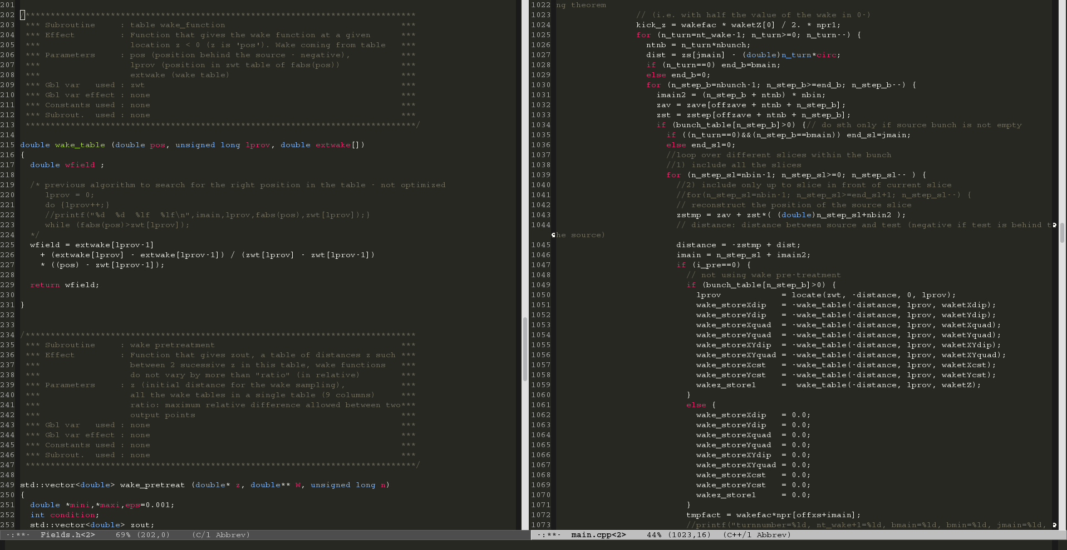
Fixed

Slide 11
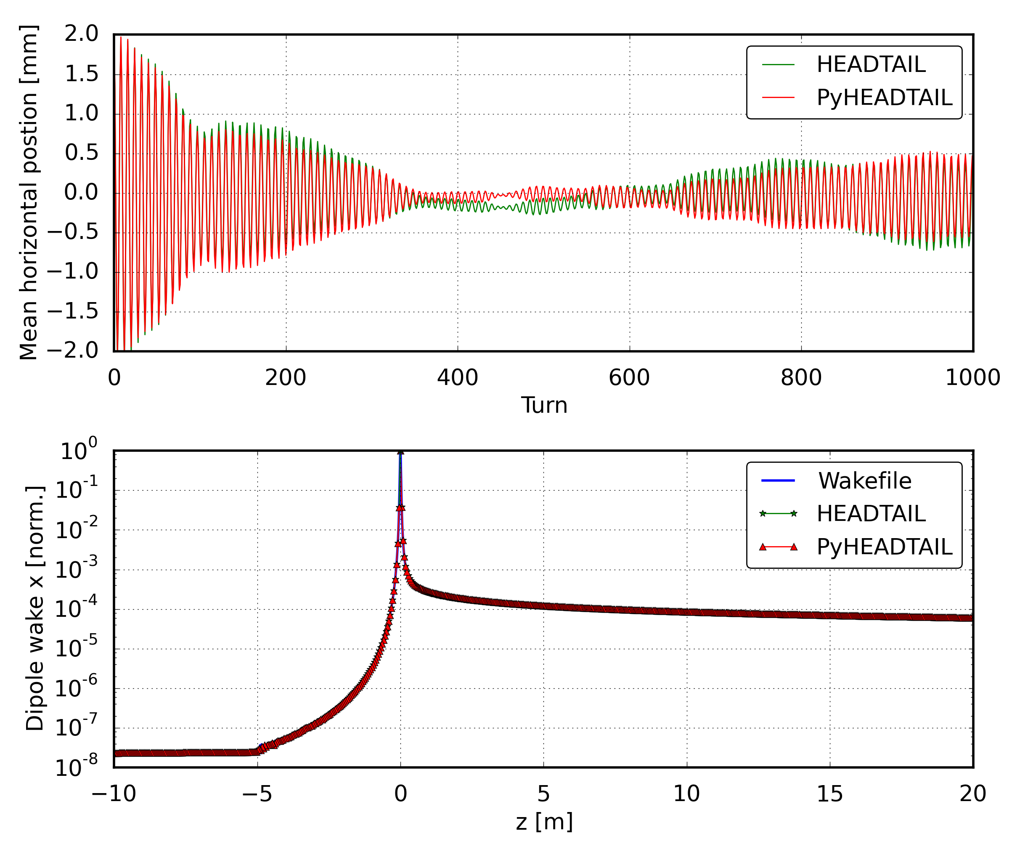
After fix – wake fields agree

Slide 12
After fix – problem with dispersion left

Slide 13
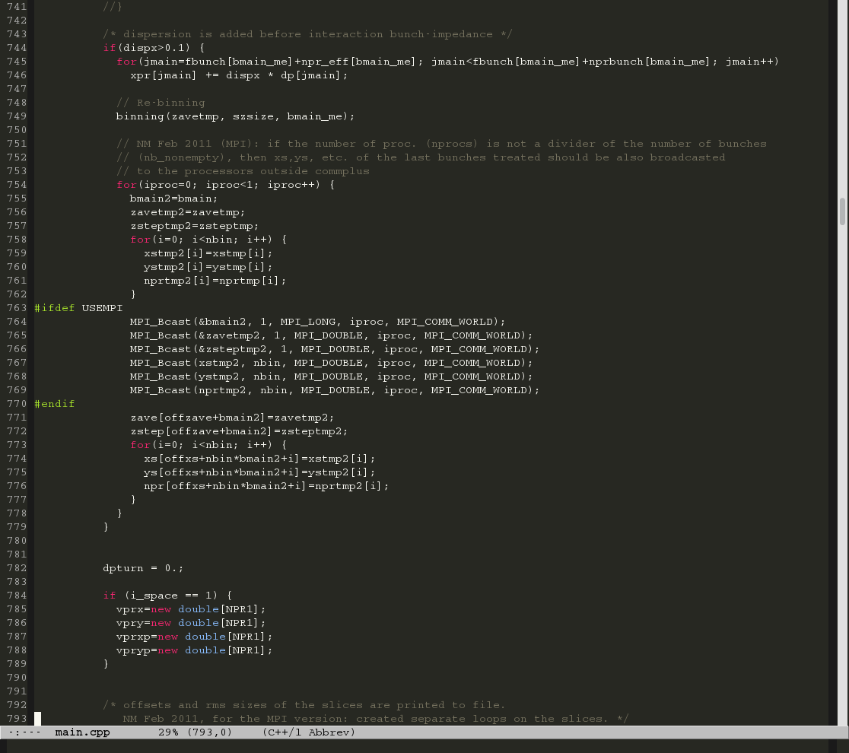
Return to HEADTAIL – fix re-binning
Dipolar wake kicks based on slice first moments
Slice first moments calculated without dispersion
We need to re-bin after adding dispersion → slice first moment with dispersion
Thanks Giovanni!

Slide 14

Finally ist seems like PyHEADTAIL works

Slide 15
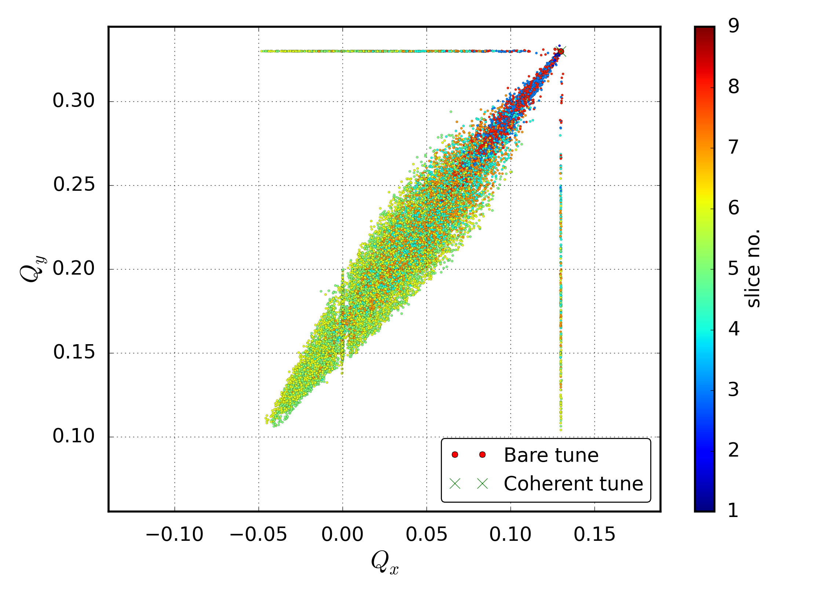
... also with direct space charge

Slide 16
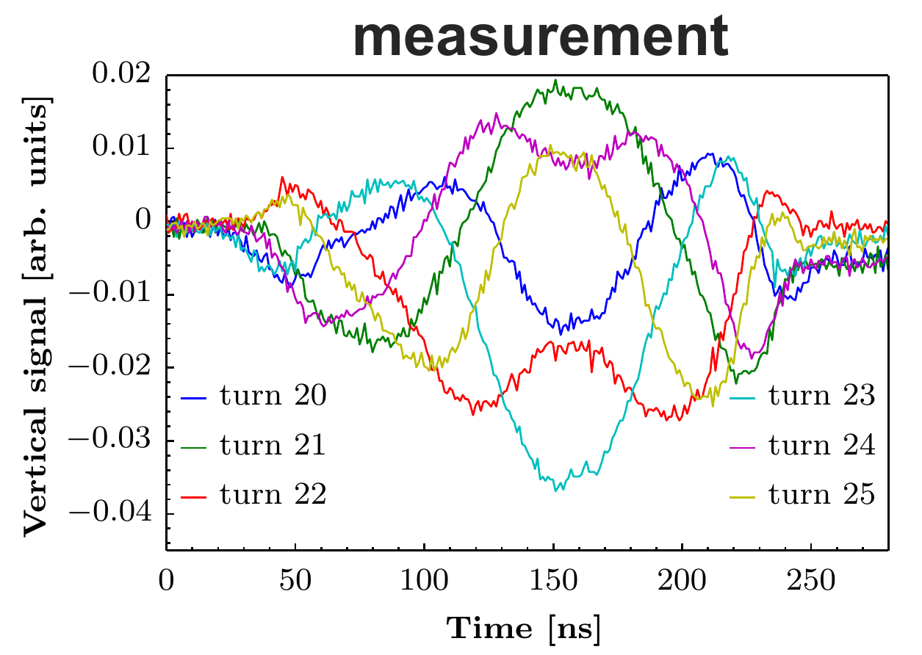
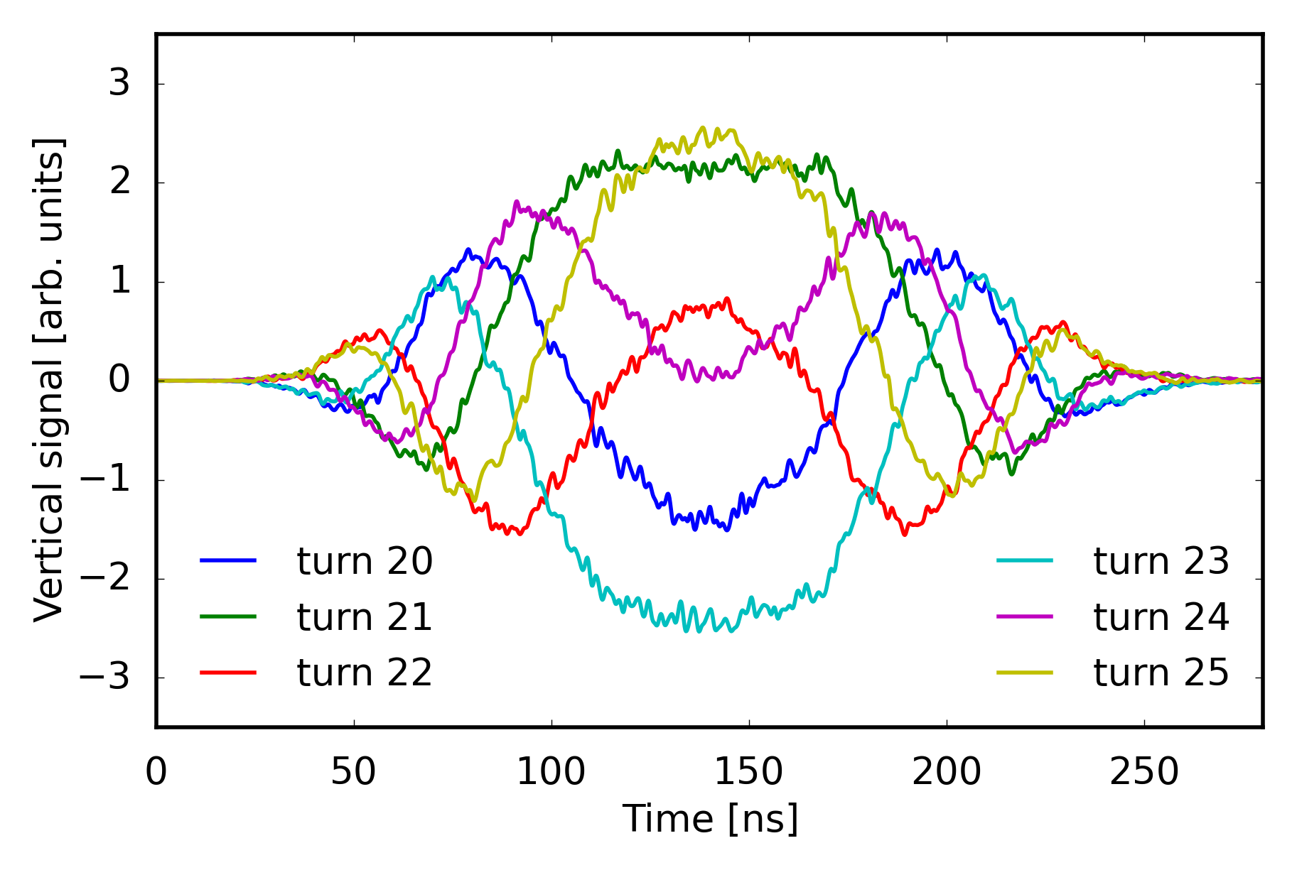
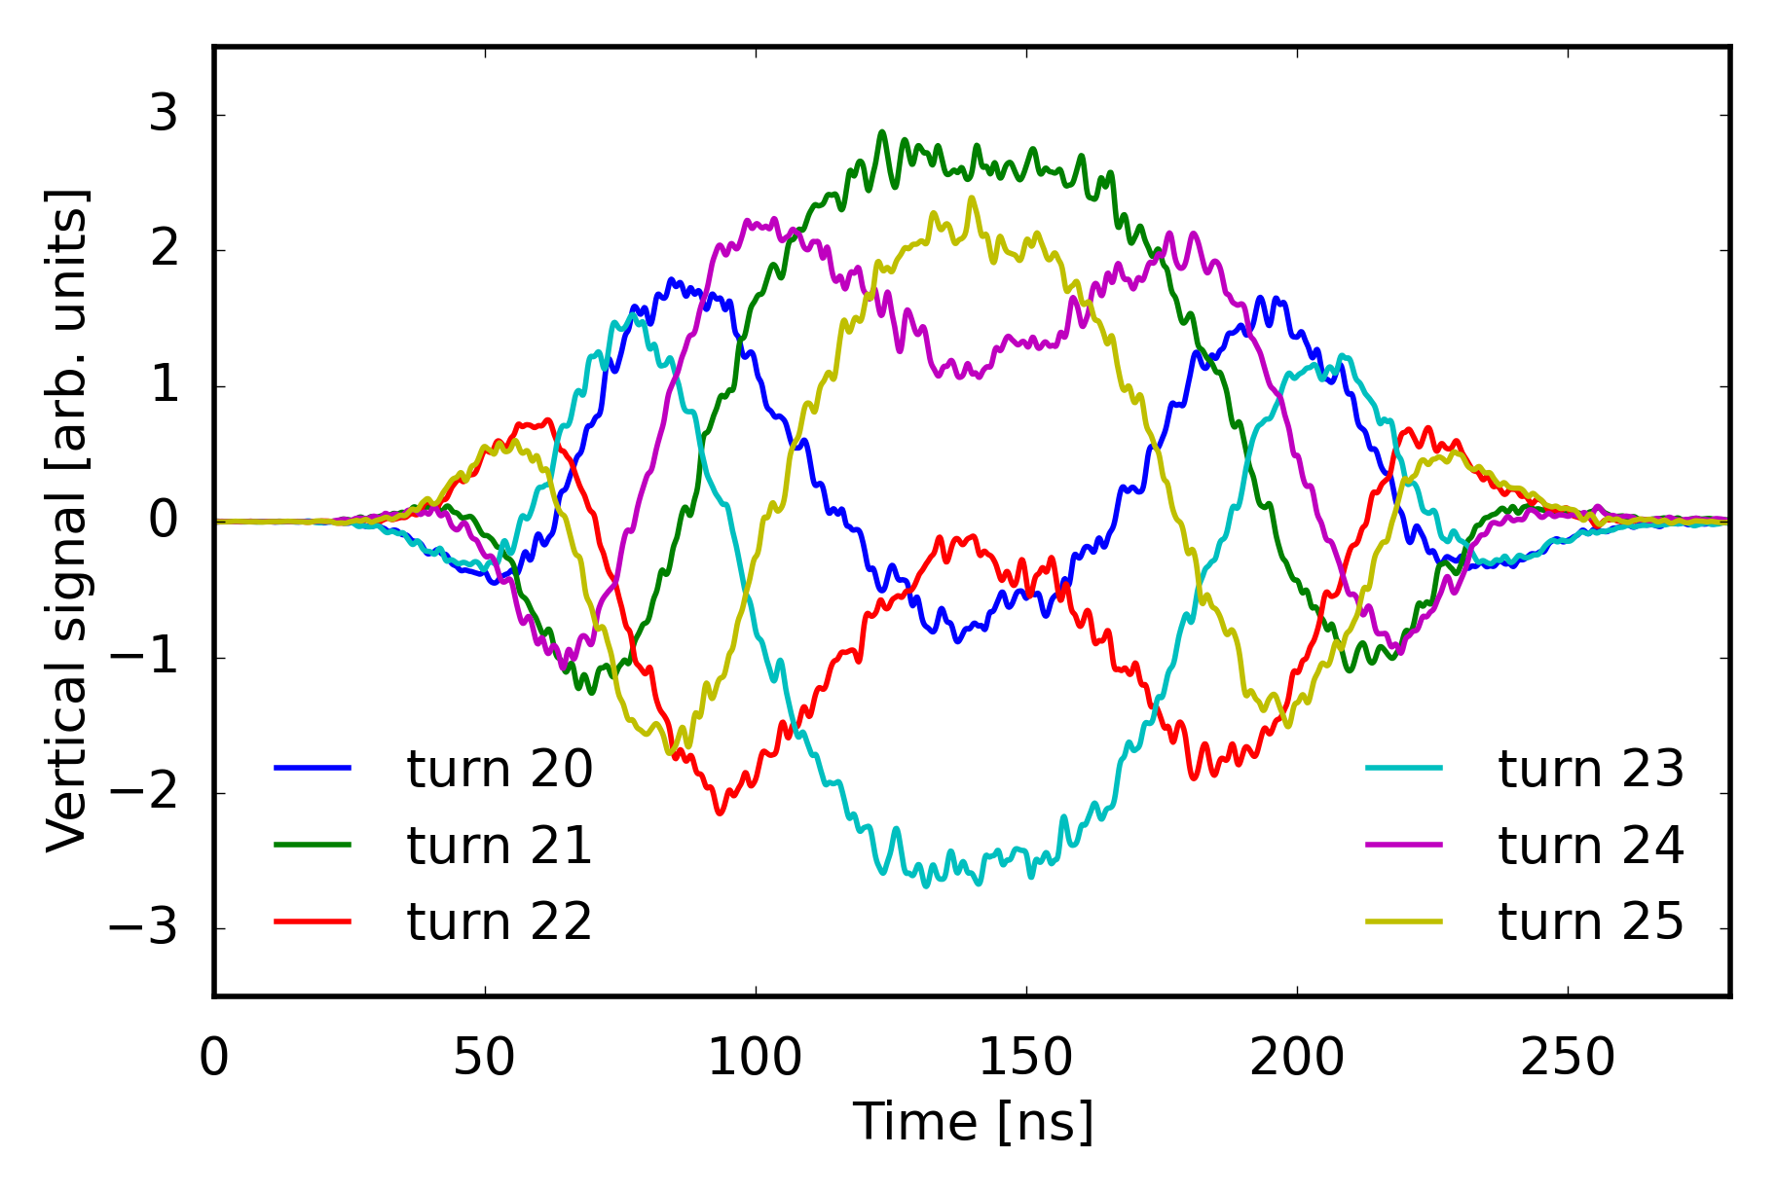
PyHEADTAIL – benchmarks (PS)
Measurements
Unfortunately, with all these „corrections“ the resemblence with measurements is no longer that striking!
PyHEADTAIL simulations
A. Huschauer et al.

Slide 17
Conclusions
PyHEADTAIL successfully benchmarked against HEADTAIL for PS low β wakes.
Wakes in front treated correctly
Dispersion treated correctly
PS simulations with direct space charge launched
PSB simulations still pending… include multi-turn wakes

