Slide 1
Open Data
Patricia Herterich
16.04.2015

Slide 2
On the way to Open Science…
Open Source
Open Access
Open Data
Open Science

Slide 3
Benefits of Open Science
For society:
  Public availability & reusability of scientific data
  Public accessibility & transparency of scientific communication
For scientific communities:
  Reproducibility of research results
  Leveraging web-based tools to facilitate scientific collaboration

Slide 4
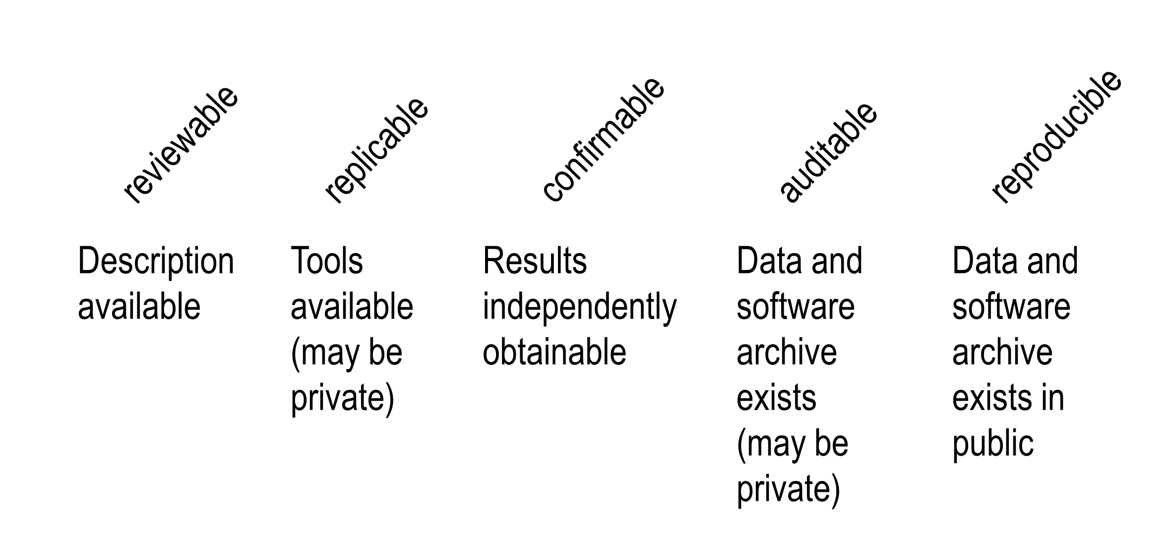
Re-producible research

Slide 5
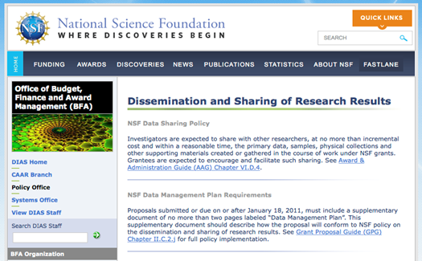
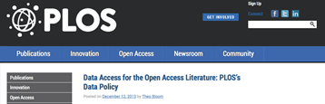
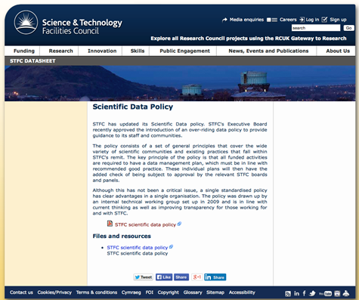
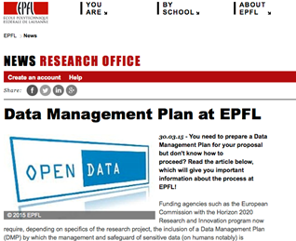
Open Data: incentives
Funder policies

Slide 6

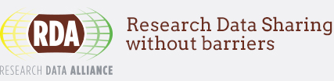

Open Data: initiatives

Slide 7
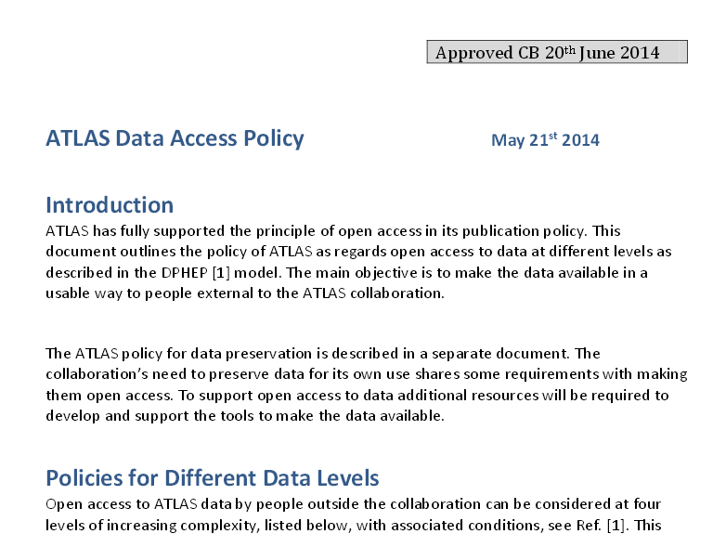
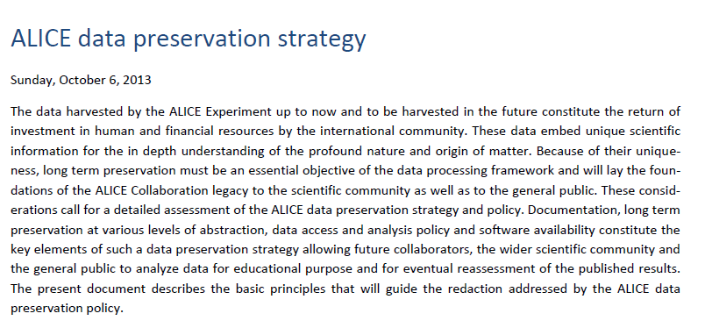
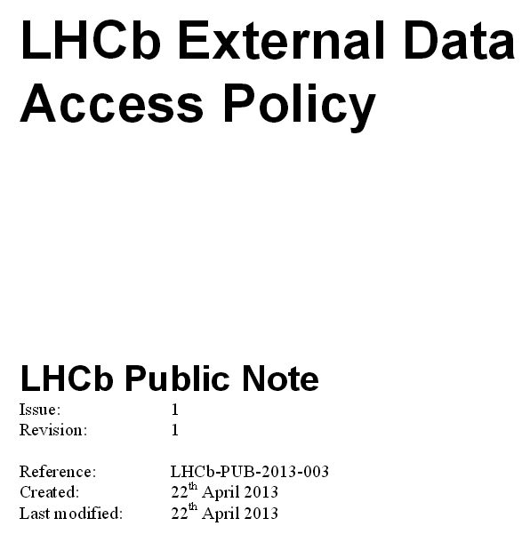
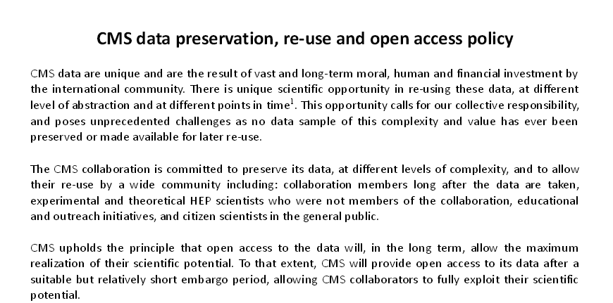
HEP
Open Data

Slide 8
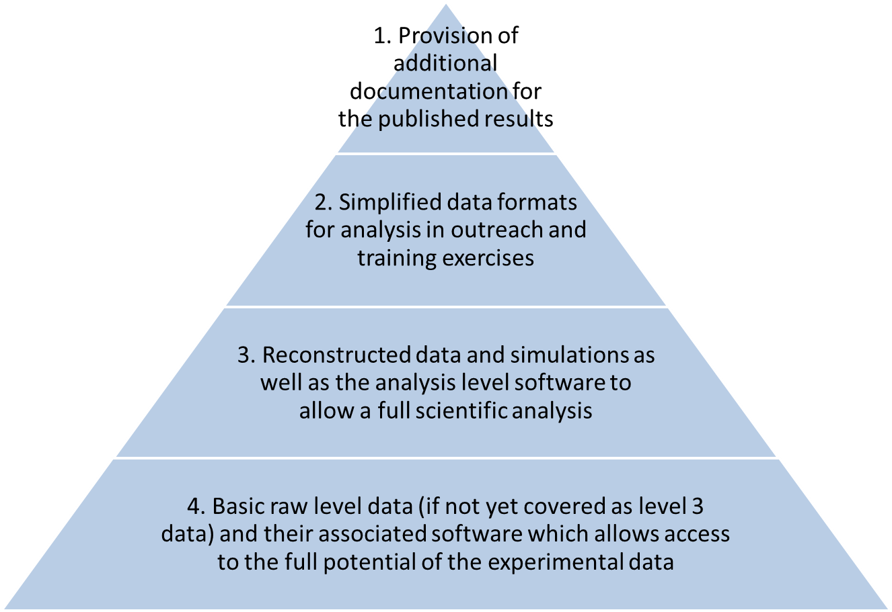
Data in High-Energy Physics

Slide 9
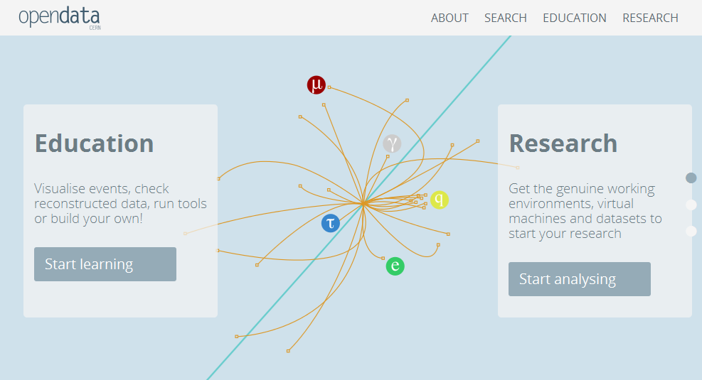
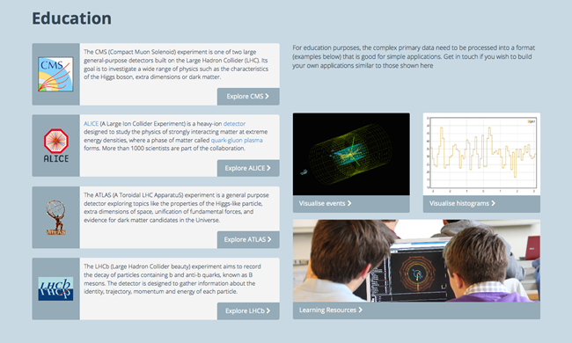
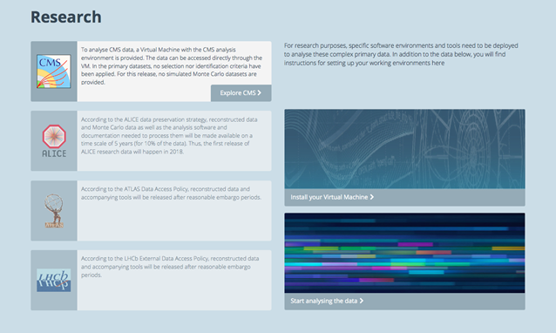
But how to make them open?

Slide 10
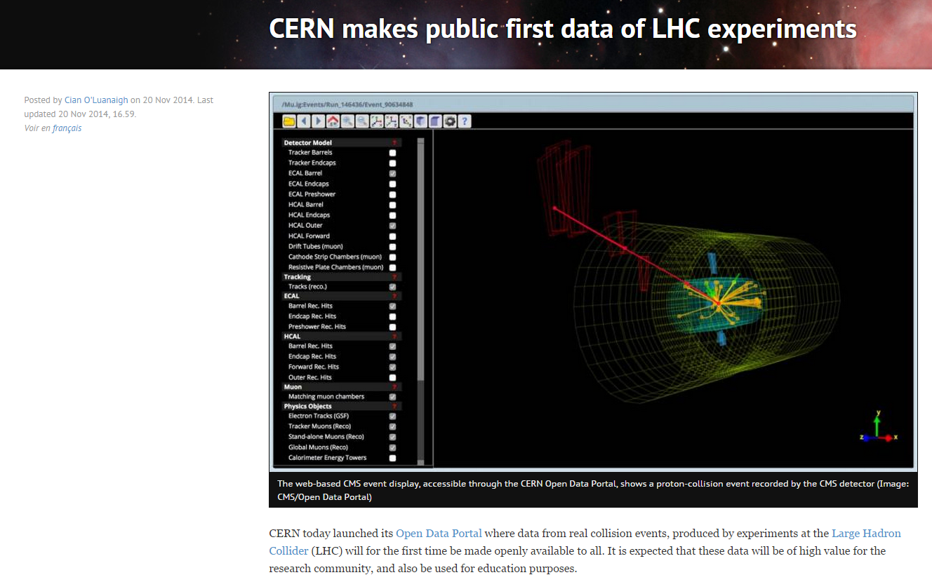
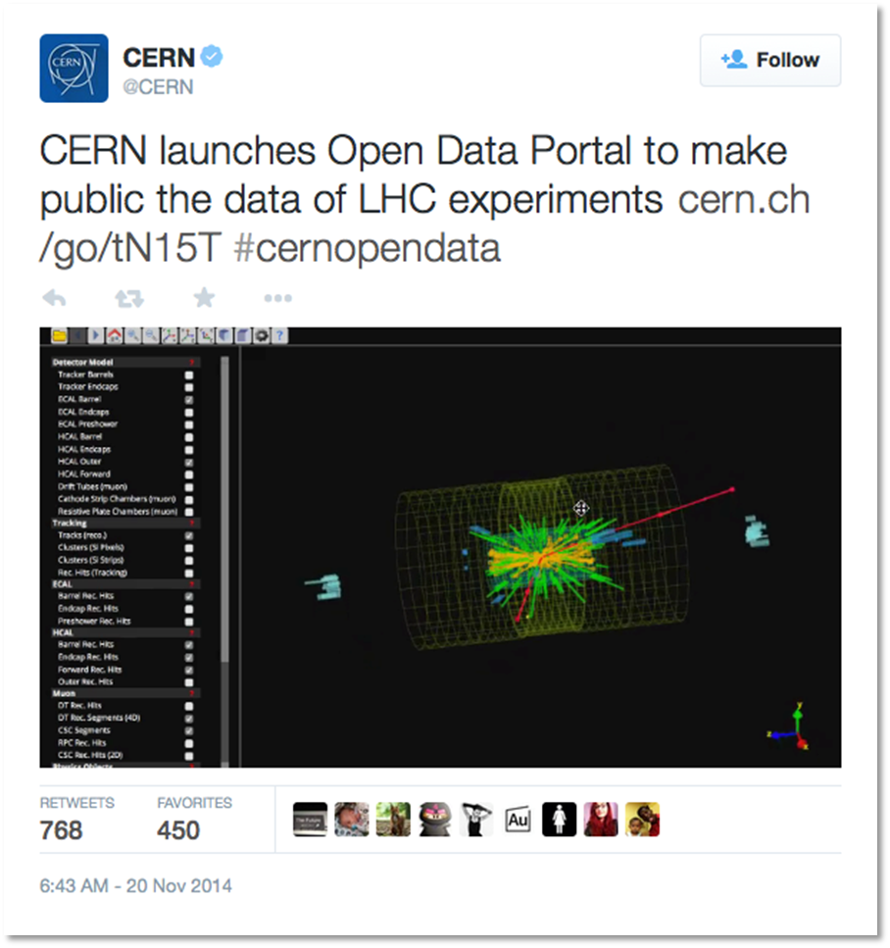
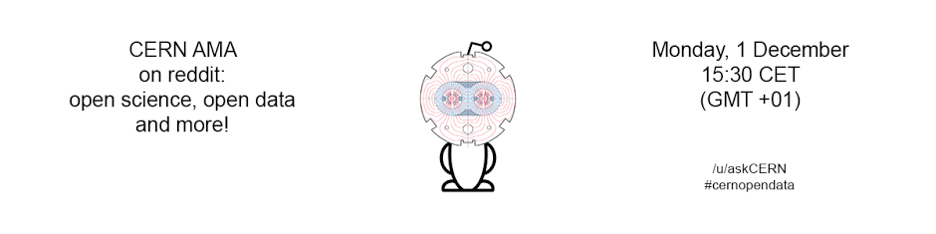
Release

Slide 11
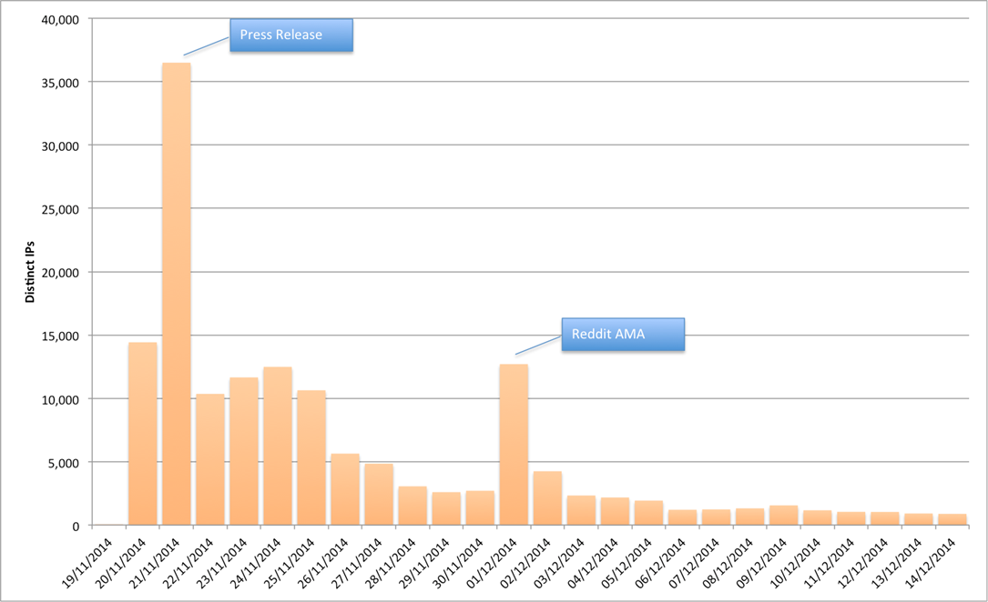
Some numbers…
At the public release:
  Serving ~15 GB per hour [usage ~50 times now]
  After a day or two was about ~4 GB per hour [~20 times now]
Typical day now:
  ~1000 visitors, out of which about
    ~10 people download EOS files
    ~400 people look at detailed record pages
    resulting in various amounts GB being served

Slide 12
…and other impact
We know that the CODP release resulted in:
  New collaborations
  Re-use of primary datasets for machine learning and “real physics” analysis
  New data “mash-ups”
  Adaption of code examples for new analysis

Slide 13
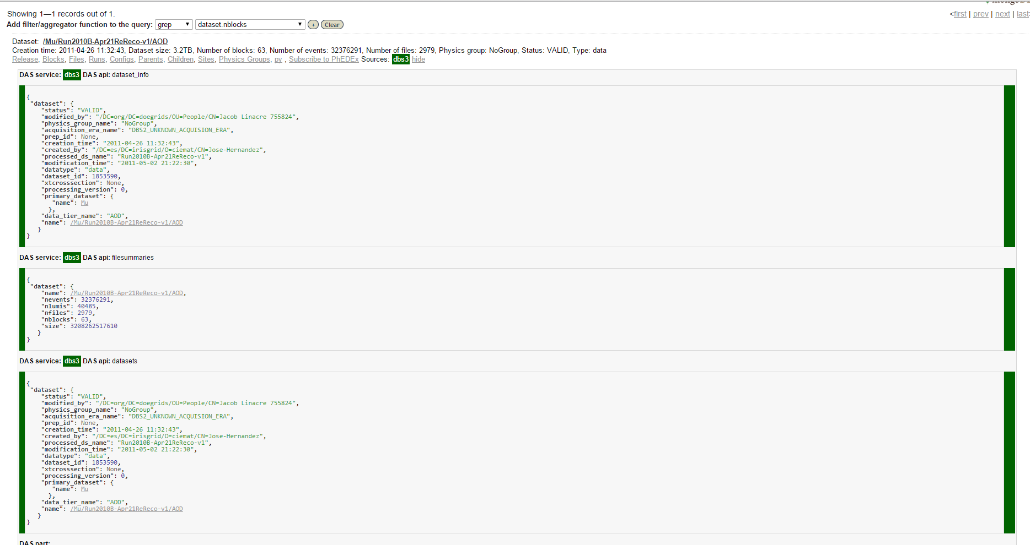

Metadata challenges

Slide 14
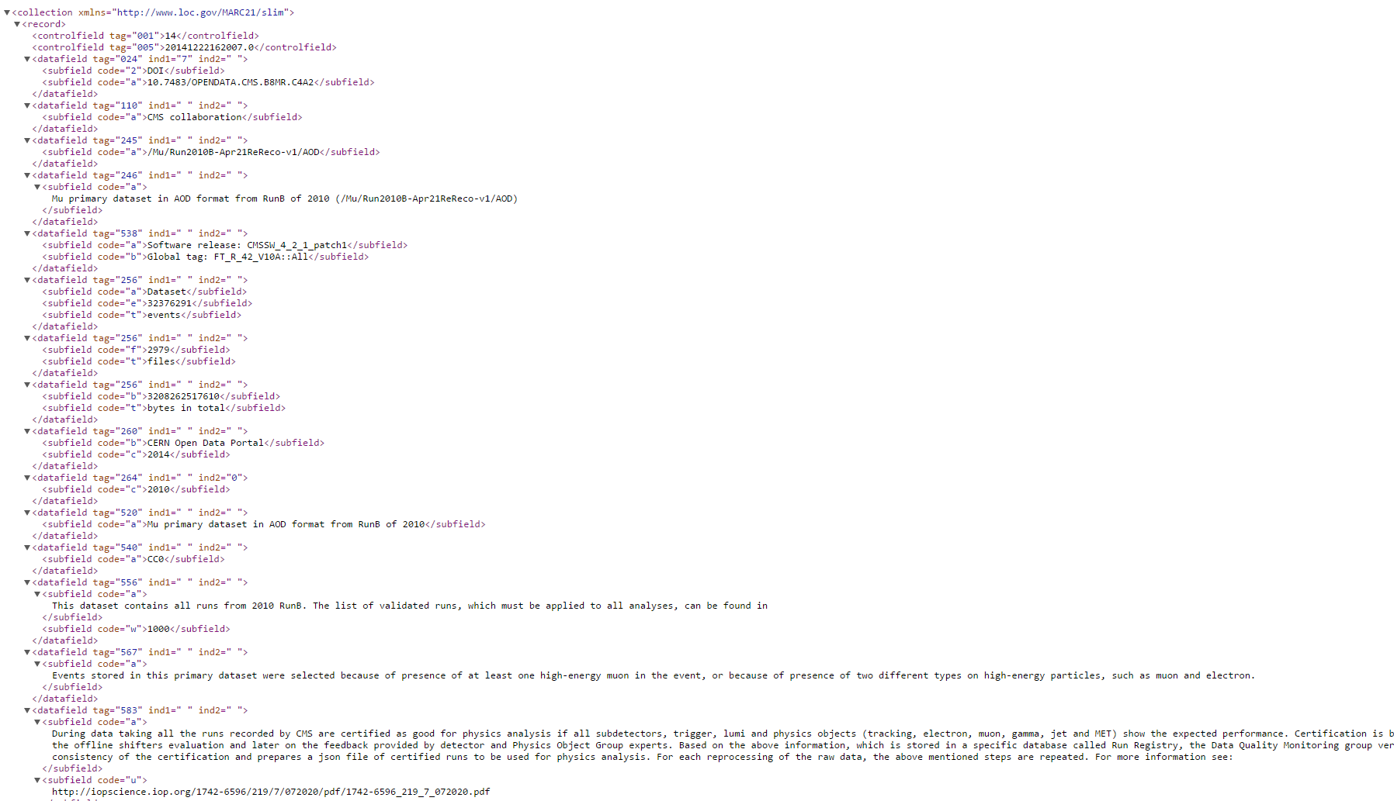
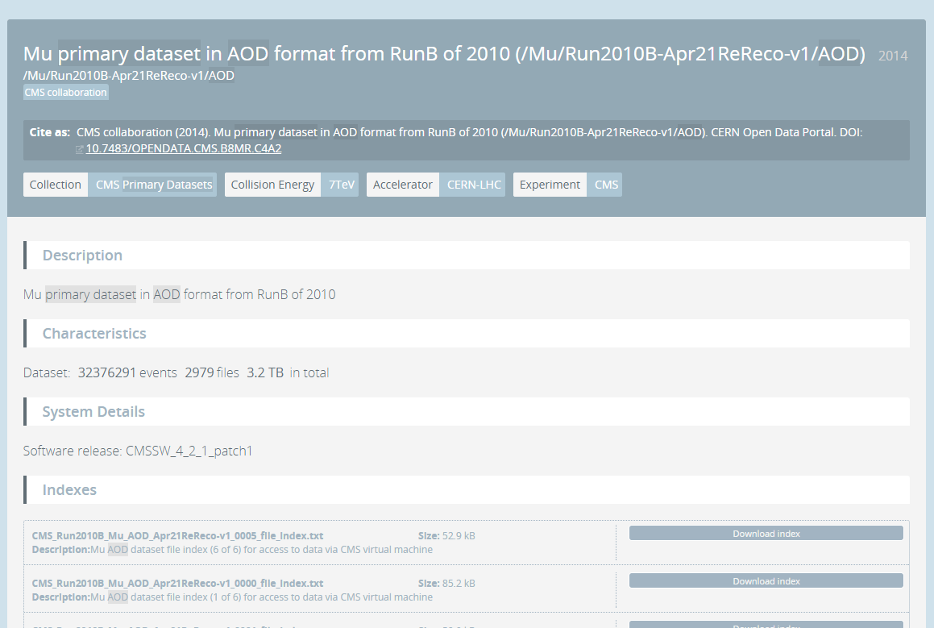
Our solution

Slide 15
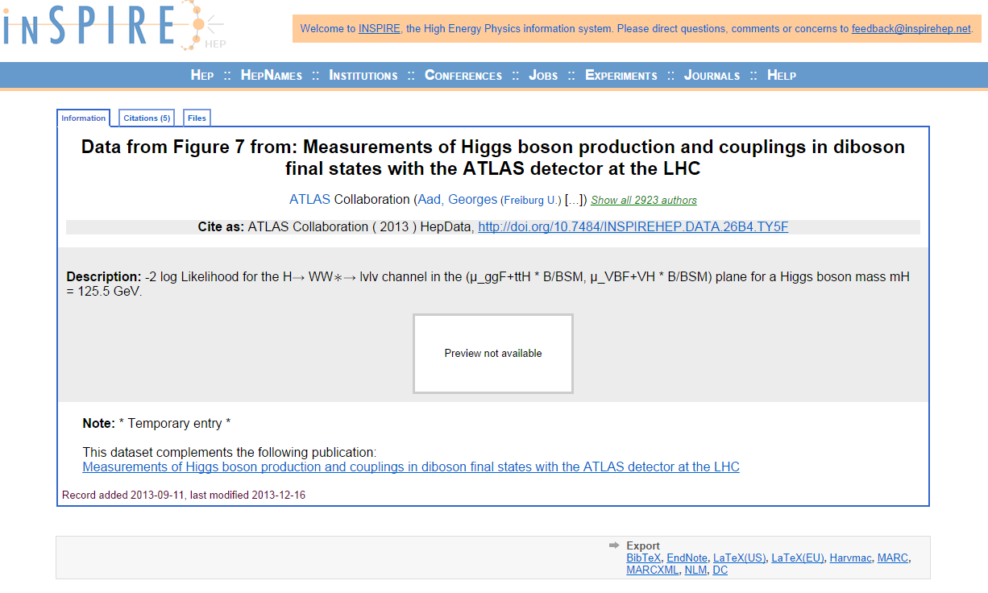
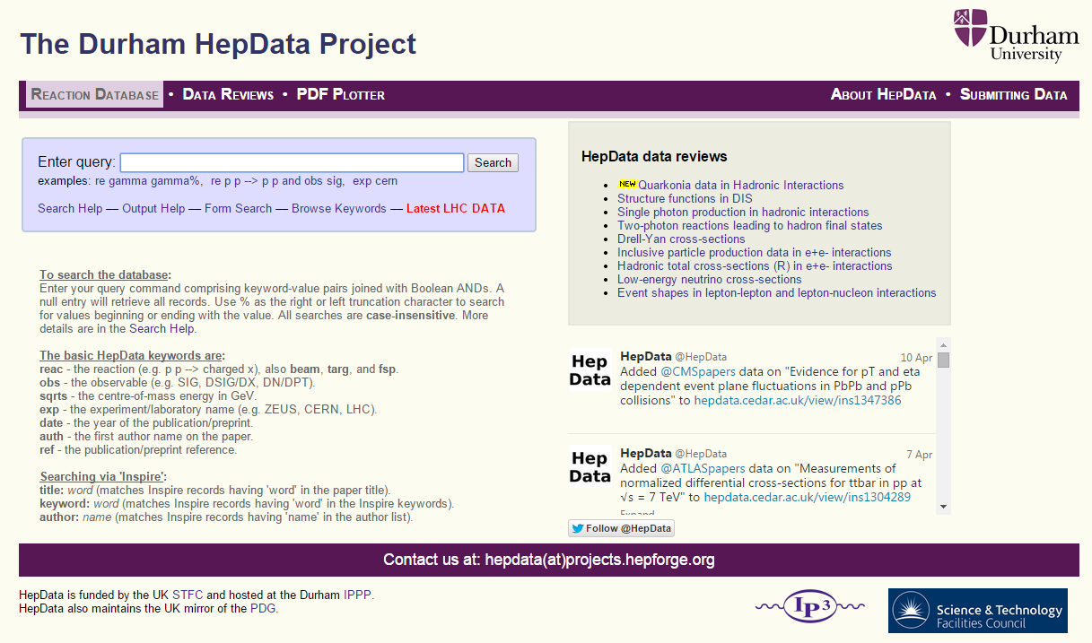
Small scale data

Slide 16
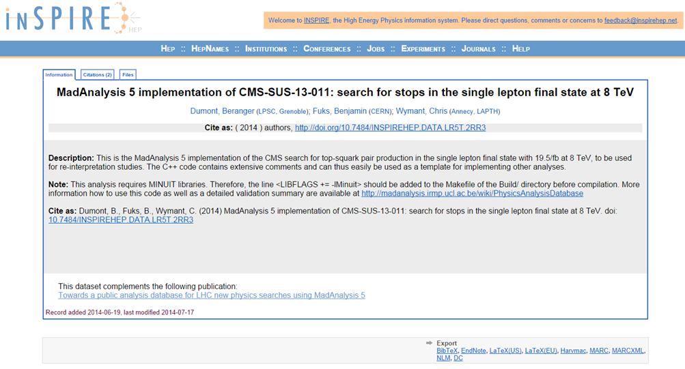
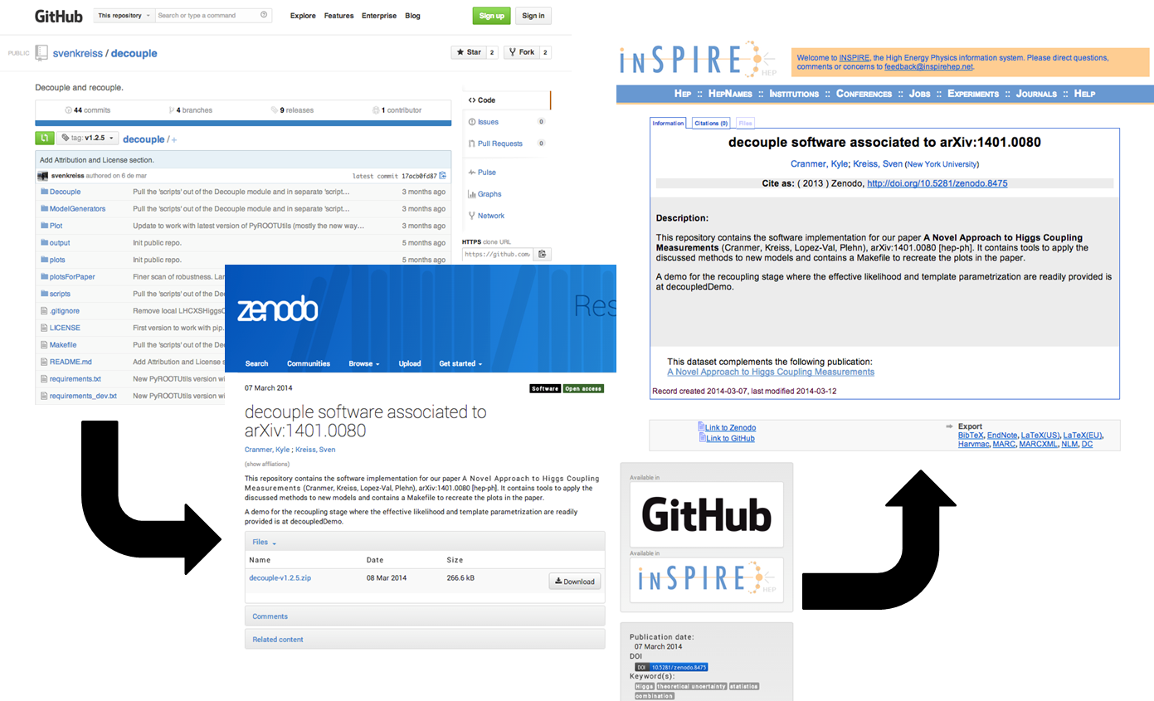
Code

Slide 17
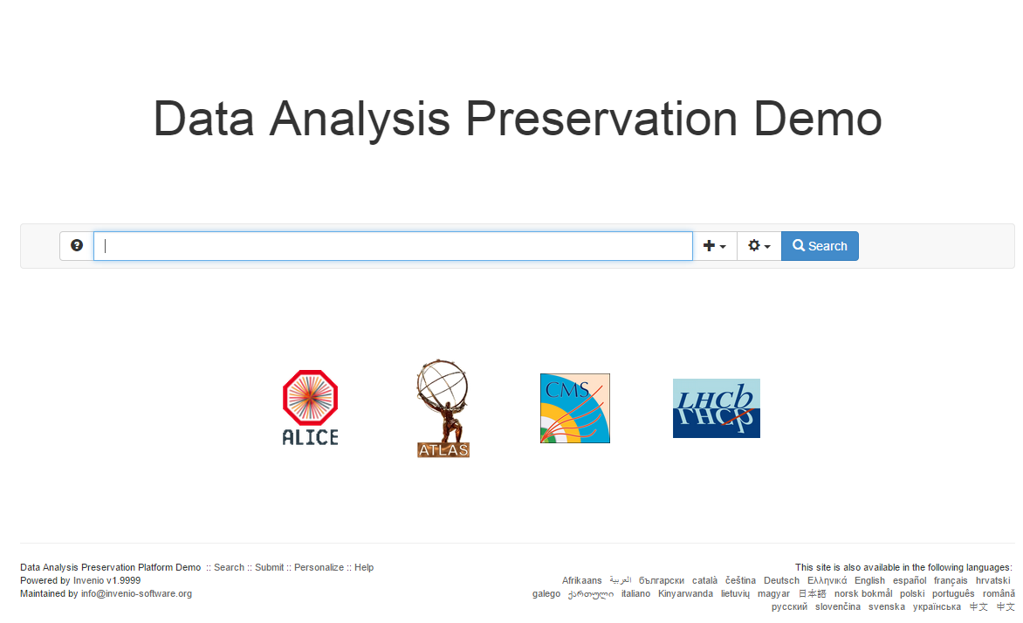
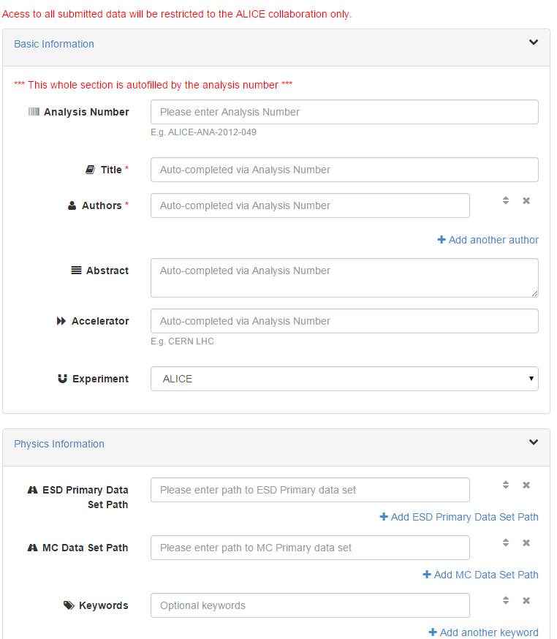
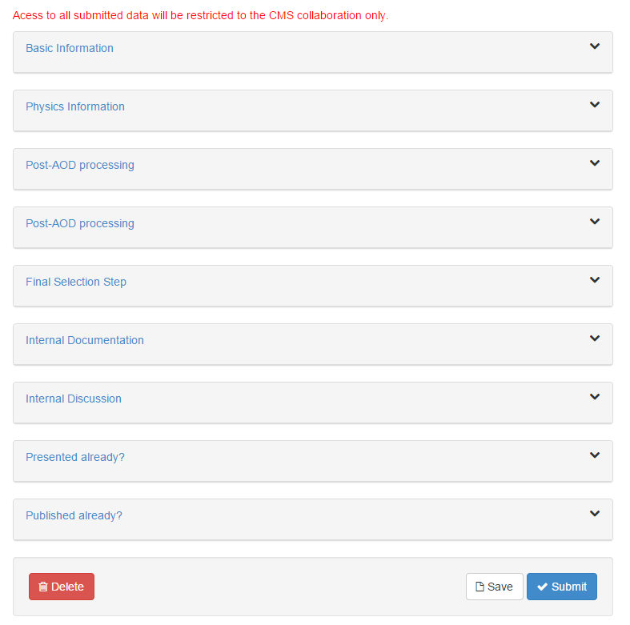
Open Data is just the tip of the RDM iceberg…
An analysis capturing and management tool for HEP

Slide 18
Data Analysis Preservation
Capture
  Entire workflow
  With data, code, statistical models, documentation
  Environment, Virtual Machines
  OAIS compatible
Interoperability with
  Experiments’ databases
  Existing platforms such as the CERN Open Data Portal, INSPIRE

Slide 19
Sources
V. Stodden, J. Borwein, and D.H. Bailey. “Setting the default to reproducible". In: computational science research. SIAM News 46 (2013), pp. 4-6.
ATLAS Collaboration (2014). ATLAS Data Access Policy. CERN Open Data Portal. DOI: 10.7483/OPENDATA.ATLAS.T9YR.Y7MZ
ALICE Collaboration (2013). ALICE data preservation strategy. CERN Open Data Portal. DOI: 10.7483/OPENDATA.ALICE.54NE.X2EA
CMS Collaboration (2012). CMS data preservation, re-use and open access policy. CERN Open Data Portal. DOI: 10.7483/OPENDATA.CMS.UDBF.JKR9
LHCb Collaboration (2013). LHCb External Data Access Policy. CERN Open Data Portal. DOI: 10.7483/OPENDATA.LHCb.HKJW.TWSZ

Slide 20
Websites
http://opendata.cern.ch/
http://analysis-preservation.cern.ch/
http://home.web.cern.ch/about/updates/2014/11/cern-makes-public-first-data-lhc-experiments
https://cmsweb.cern.ch/das/
https://www.datacite.org/
https://rd-alliance.org/
http://www.re3data.org/
http://www.openscience.org/blog/?p=269
https://inspirehep.net/
http://hepdata.cedar.ac.uk/
https://www.plos.org/data-access-for-the-open-access-literature-ploss-data-policy/
https://actu.epfl.ch/news/data-management-plan-at-epfl/
http://www.nsf.gov/bfa/dias/policy/dmp.jsp
https://www.stfc.ac.uk/1386.aspx

Slide 21

Acknowl-edgements
  My colleagues from the CODP and DAPF team
  Work sponsored by the Wolfgang Gentner Programme of the Federal Ministry of Education and Research

