Slide 1
E-books, e-lending and more
Setting the scene
The e-book market
Acquisition models
Our acquisition policy for e-books
What do we buy? What we subscribe to?
How we expose them?
Demand-driven acquisition
Outlook
Epilogue: text and data mining
Tullio Basaglia, Library Services
CERN Scientific Information Service

Slide 2
Setting the scene: CERN
21 members countries
More than 100 countries represented
2,400 staff + 10,000 particle physicists
98% of the physicists are not staff: nomadic community
physicists, but also computer scientists, engineers, administrative staff
“Early adopters”
Used to non-intermediated access to information
“Open Access culture”
Prepublications are e-only since the mid-Nineties. Our subscriptions to journals are e-only since Jan. 2008

Slide 3
The e-book market
Few actors, worldwide publishers: some are owned by investment groups, which are heavily business-oriented.
Concentration due to mergers and acquisitions – monopolistic market.
Competition between publishers and suppliers who are aggregating content from multiple sources.
Strong pressure on libraries to buy packages, instead of doing a selection.

Slide 4
Acquisition models
Perpetually purchased content is usually available in the form of a DRM-free PDF file (access control is done at the Institution level, IP-number based)
‘virtual loans’ consist in a non-permanent download of a DRM-protected PDF file, which also implies some limitations in copying, sharing, printing etc. Subscribed content is in general DRM-protected
Acquisition model A:
  Perpetual purchase
    “Pick and choose”
    Package: all or nothing
  “e-lending”
    Pay-as-you-go
    Flat fee subscription
Acquisition model B (the future?): Demand-Driven Acquisition
Library does the selection

Slide 5
Our acquisition policy for e-books
    “Content [=quality and subject coverage] is king” when selecting a supplier
    Formats available (PDF, Mobi, Kindle etc.) are a key aspect when selecting a supplier. Is a plugin needed to read them? Are they DRM-protected? Compatibility issues (content <-> support)!
    Perpetual purchase of e-books from the publishers in core subject areas, complemented by pay per usage access in other subject areas
    Avoid as much as possible ‘package purchases’ (Springer is an exception!), pick-and-choose preferred
    Purchase a title on paper and e-book if it is on a ‘core subject’ or by CERN author(s), otherwise we tend to rely on the e-book version
    E-book is the preferred format for IT titles. Paper bought if there is an explicit request
    ‘Books for consultation’ are purchased – if there is an explicit request – e-only

Slide 6
What do we buy – what do we subscribe to?
We buy perpetually core subjects’ titles from a few key publishers: Springer (book packages: P&A, Mathematics, Engineering), and from others on a ‘pick-and-choose’ base: CUP, OUP, T&F, Wiley, World Scientific…etc.
For non-core subjects’ titles, we subscribe to two aggregators’ platforms: EBL (Ebook Library = Proquest), www.eblib.com and Safari proquest.tech.safaribooksonline.de (Proquest!).
Access: on EBL, the end-user can browse for 5’ or 10’, then s/he has 2 options: stop browsing or do a 2-weeks ‘virtual loan’ (=non-permanent download of a DRM-protected PDF). Copying and printing limitations.
Note: on EBL, the reader could also trigger the acquisition of the ebook. We do not use this functionality. We prefer to acquire the ebook from the publisher.
Access: on Safari, online reading only is possible. No copying, printing limitations.
For EBL, we pay a low platform fee per year, and we pay per usage (=a fee is charged at every 2-weeks ‘virtual loan’, 10-15% of the list price). Monthly invoicing.
For Safari, we pay a platform fee.

Slide 7
CERN Library books collection
    On the whole, 116,000 book titles: 70,000 e-books and 46,000 on paper. There are 6,000 hybrid titles.
41.89% are “rented”, 58.11% are perpetually purchased
5.17%
Paper books
46 k (39.65%)
e-books
70 k (60.3%)
6 k

Slide 8
From acquisitions to collection development
    Dichotomy between the efforts towards a sound, balanced development and the pressure to buy ‘en masse’ coming from the market
    Advantage of the subscription-based platforms (EBL and Safari): we can expand and reduce our collection indefinitely, especially in ‘non-core’ subject areas (e.g. engineering, materials science, some sectors of physics), where many small communities have very differentiated needs.
    We are a research library. We (also) need to liaise with experts. Different paths exist: email, web forms, personal contacts… However, ‘discovery patterns’ need to be created (no printed publisher’s catalogue circulation!), that should be adapted to the way our users work
    To achieve this goal, we have to develop our own tools, because we cannot rely on services provided by traditional book vendors/agencies (we are not their clients)
    Constraints:
      Some readers still prefer the paper version
      DRM is not compatible with some operating systems, Adobe Digital Editions does not work under UNIX

Slide 9
How we expose them?
We import records into our online catalogue. No manual cataloguing, no ‘list of online resources’. The record is on cds.cern.ch (=our online catalogue), and the links point to the publishers’ or aggregators’ servers.
      Ingestion of book records into our catalogue is not painless…
We periodically import records in batch, from the publishers’ or aggregators’ web or ftp sites.
We import all records we buy, we selectively import records from aggregators (subject profile defined at the aggregators’ end).
We convert the records (generally available in XML) into MARC.
We run a script to match the imported records against already existing records in CDS, because we want a single record for paper and e-book.
We delete records from aggregators, when we detect that there is no usage, except for core subjects’ titles.

Slide 10
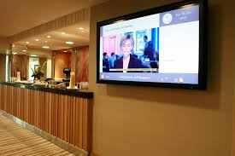
Can we do better to expose them? How?
Enrichment of records -> book TOCs and abstracts are imported from external sources: ebook suppliers or external library catalogues (27.500 titles)
Visibility: digital signage and
book reviews on the CERN Courier
‘Crowdsourcing of acquisition proposals” (=Demand-Driven Acquisition) depends heavily on enhancements of the layout of the records (=e.g. virtual browsing of shelves), or of search hits (=facets, subject tree)
The librarian has still a role to play!

Slide 11
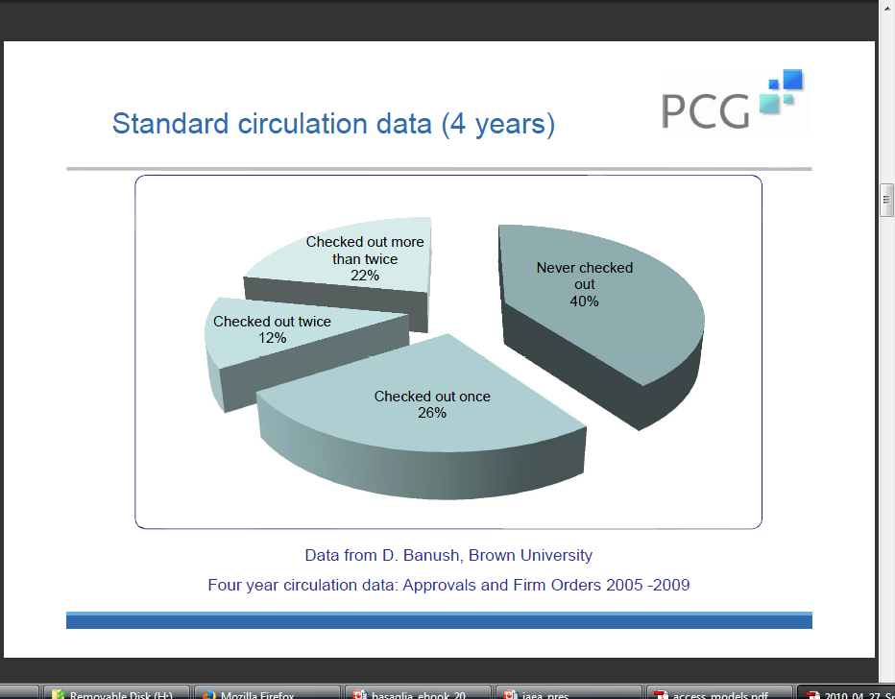
Demand-driven acquisition: why?
Publishers Communication Group is a sales and marketing consulting firm. They ran a survey among 74 US libraries in March 2010, asking which percentage of their books bought in 2005-09 was borrowed

Slide 12
Demand-Driven Acquisition: how does it work?
Also called patron-driven acquisition
Model usually linked to e-books acquisition, but it could also be applied to print books acquisition
Aims at optimizing resources and shaping collections on the base of users’ needs. Collections can be hugely expanded, because a very low flat fee ‘per annum’ allows the importation of an infinite amount of records
Spend money only on books that will be used
How does it work?
Book metadata imported and exposed user discovers the e-book
S/he triggers the purchase by the library
Note: on EBL, the reader could also trigger the acquisition of the ebook. We do not use this functionality. We are experimenting DDA with paper books …

Slide 13
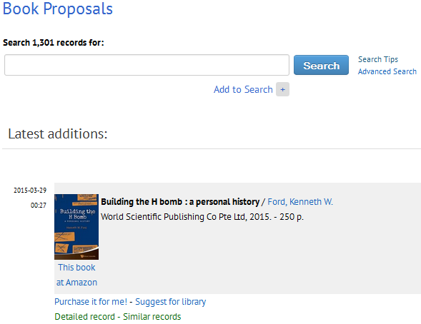
Experimenting with DDA
We periodically import records from several Amazons. The importation derives from a subject-based query
The imported records go to a special ‘collection’: book proposals
The end-user will be able to suggest the acquisition
We will approve it, trigger the acquisition and transform the record into a ‘normal’ book record, or we will refuse it, proposing e,g. an ILL

Slide 14
DDA: caveats
As said, it requires effective strategies to promote discoverability, but also effective mechanisms of budget control!
When selecting a platform, the flexibility of the administrative interface is crucial. On EBL e.g., we can:
  set up a cost threshold for the virtual loans (=a loan should not cost more than x). The threshold can be 0 (=all loans require approval from the librarian) up to “no limit” (=no approval needed). This can be modified at any time
  We can select the length of virtual loans
  We can monitor at any given moment the usage of the collection

Slide 15
Open Access Ebooks
  SpringerOpen Books:
    Books, conference proceedings (~50 titles at present)
    OA fee are charged. Authors at member institutions get a 15% discount on the OA fee.
    An e-book is produced and, if one wishes, a print on demand book can be purchased
    Books are published under the Creative Commons Non-Commercial (CC-BY NC) license
    They are on the Directory of Open Access Books (http://www.doabooks.org)
  De Gruyter (€ 10,000 OA fee + royalties on print sales), Taylor & Francis
  Proceedings of conferences – a crucial publication outlet in Part. Phys.:
    EPJ Web of Conferences (EDP Science)
    Journal of Physics: Conference Series (IOP)
    Joint Accelerator Conference Website (JACoW)
    Nuclear and Particle Physics Proceedings (Elsevier)
    Physics Procedia (Elsevier)
    Proceedings of Science (PoS) (SISSA)

Slide 16
Outlook
24/24 7/7 365/365 access and remote authentication are necessary (=nomadic community) but not sufficient; increasing demand for barrier-free and easily ‘portable’ e-books
Today: smart devices, dumb content
Future: “layered” content (multimedia integration, data integration)?
E-lending for research libraries through Amazon?
The main challenge consists in leveraging the huge amount of content we are now adding to our collections. In short: text-mining of the well-structured e-books content

Slide 17
Text and Data Mining
“Text and data mining (TDM) is the process of deriving information from machine-read material. It works by copying large quantities of material, extracting the data, and recombining it to identify patterns.”
“LIBER (Ligue Européenne des Bibliothèques de Recherche) advocates for a more flexible copyright system that would allow TDM to be used to its full potential”:
http://libereurope.eu/wp-content/uploads/2014/11/Liber-TDM-Factsheet-v2.pdf (factsheet)
“The Hague declaration on knowledge discovery in the digital age” was drafted at the beginning of 2015 by a panel of experts brought together by LIBER. It will be presented officially on the 6th of May in Brussels
Key principle: copyright not intended to govern access to facts, ideas and data, nor should it

Slide 18
Library 2020
“Ci sono segni di una serie di quiete e modeste rivoluzioni che avranno conseguenze di lungo termine. Le biblioteche pubbliche nel 2020 saranno messe nella condizione di non poter piu’offrire accesso ai bestsellers; questo crea una grande opportunità, quella di portare altri contenuti all’attenzione del loro pubblico. Piccoli editori (scientifici ma anche commerciali di nicchia), insieme a scrittori indipendenti, negoziano condizioni mutualmente vantaggiose per pubblicare le loro opere attraverso le biblioteche pubbliche, particolarmente in formato elettronico.[...] Autori locali, musicisti locali, drammaturghi e registi sono alla ricerca di un pubblico, e le biblioteche pubbliche sono in grado di creare questo pubblico.”
Clifford Lynch, in “Library 2020: today’s leading visionaries describe tomorrow’s library”, ed by J. Janes, Scarecrow Press, 2013

Slide 19

Questions?

