Slide 1

Beam Dynamics
Linac4 Beam Coordination Committee
Eleonora Belli
30/04/2015

Slide 2
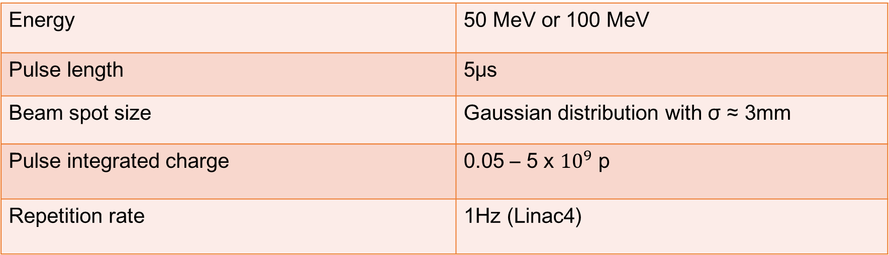
Introduction
Beam dynamics solutions for ADAM Ionization chamber test in Linac4
Beam requirements
Energy | 50 MeV or 100 MeV
Pulse length | 5μs
Beam spot size | Gaussian distribution with σ ≈ 3mm
Pulse integrated charge | 0.05 – 5 x ${10}^{9}$ p
Repetition rate | 1Hz (Linac4)
$$I_{peak}= \frac{Pulse integrated charge ∙Particle electric charge}{Beam pulse length}=1.6 −160 μA$$
1

Slide 3
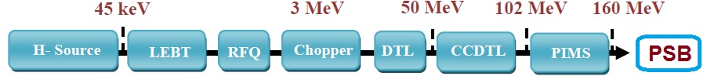
Reducing the beam current
Linac4
Source current | 45 mA
Average current during beam pulse | 40 mA
Three possible solutions:
Reducing the current in the LEBT at 45keV and in the MEBT at 3MeV
Reducing the current only in the LEBT at 45 keV
Reducing the current in the RFQ → different beam dynamics and possible sparking
2

Slide 4
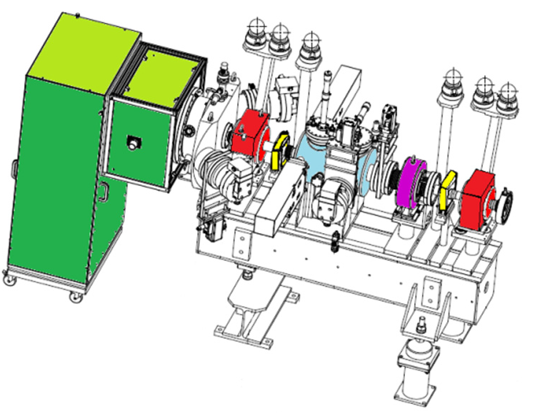
Using the LEBT
Diverging beam from the source → 2 solenoids in the LEBT to focus the beam and match the beam to the RFQ
1st solenoid OFF to enlarge the beam size and lose part of the beam on the beam pipe without rearranging the field of the 2nd solenoid to match the beam to the RFQ
Nominal → 91.5% = 41.175 mA
Reduced current → 0.445% = 200.25 μA
3

Slide 5
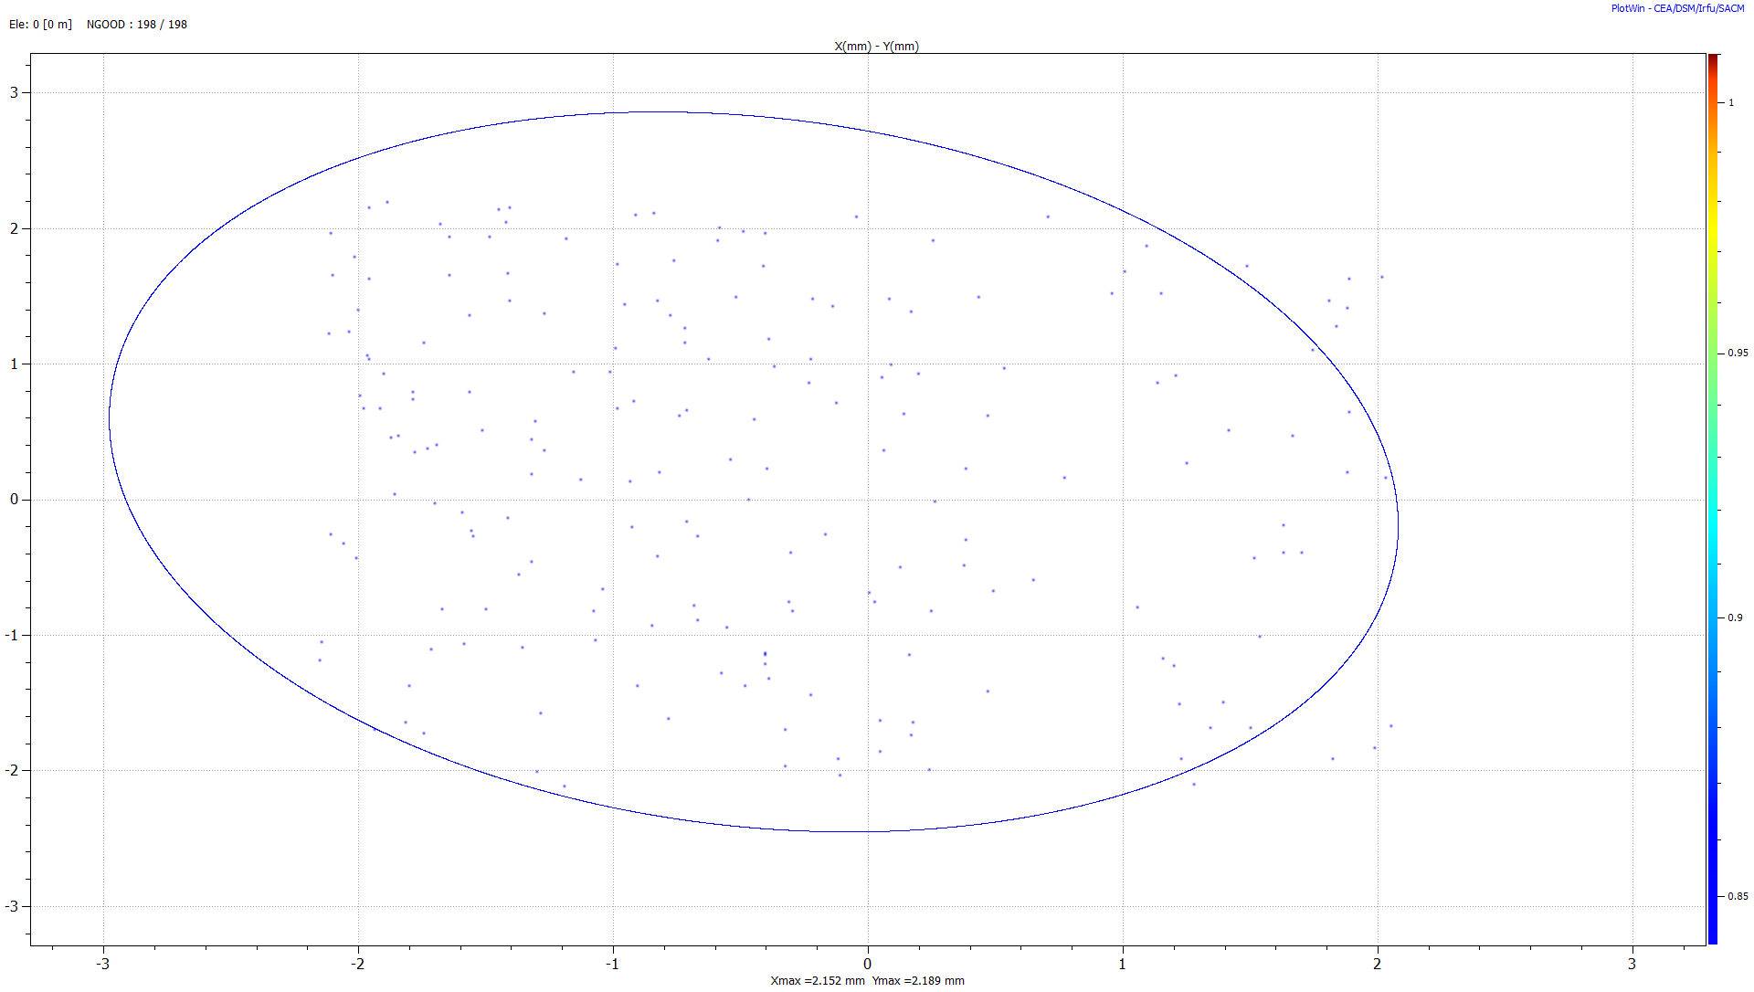
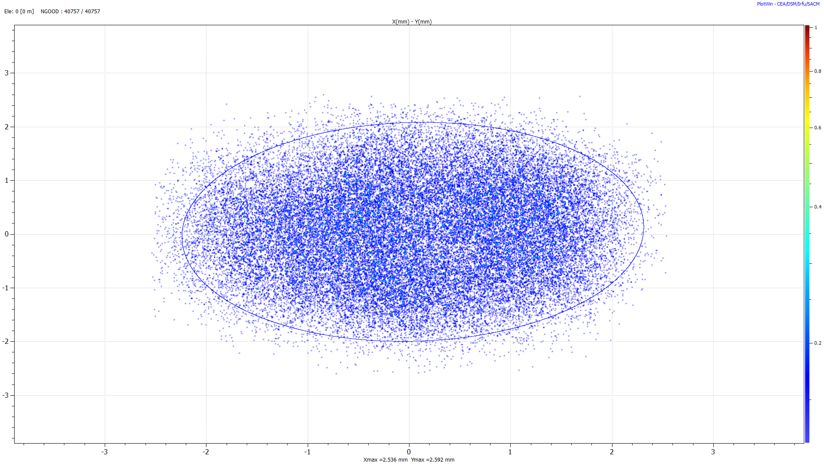
Using the LEBT
Emit [rms] = 1.4365 mm²
Emit [rms] = 0.9704 mm²
Reduced current
Nominal
The transverse emittance is a bit larger. This is due to the fact that the beam enters the second solenoid with a very large divergence, and a solenoid converts divergence into emittance growth.
Adjust the beam size with quadrupoles in the new test bench
4

Slide 6
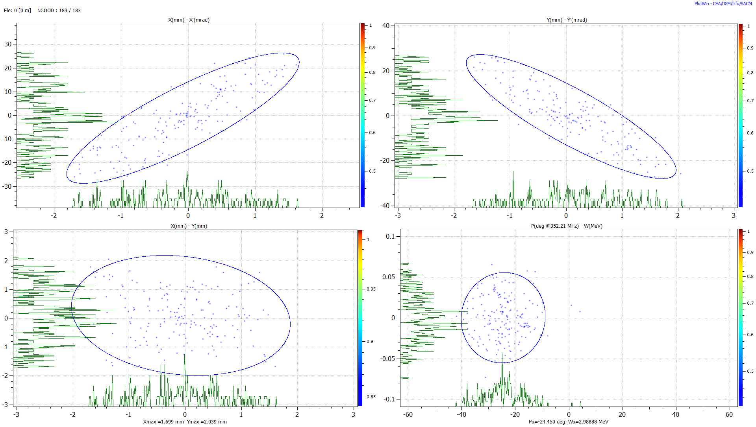

92.4% = 185.03 μA
RFQ output
Emit [rms] = 0.4072 Pi.mm.mrad [ Norm. ]
Beta = 0.1210 mm/Pi.mrad
Alpha = -1.6436
Emit [rms] = 0.4137 Pi.mm.mrad [ Norm. ]
Beta = 0.1360 mm/Pi.mrad
Alpha = 1.7326
Emit [rms] = 0.6521 mm² [ Norm. ]
Beta = 0.9464
Alpha = 0.1519
Emit [rms] = 0.1927 Pi.deg.MeV [ Norm. ]
Beta = 282.9953 deg/Pi.MeV
Alpha = -0.0312
$σ_{\left\{x,RMS\right\}}$= 0.8372 mm
$σ_{\left\{y,RMS\right\}}$= 0.8040 mm
5

Slide 7
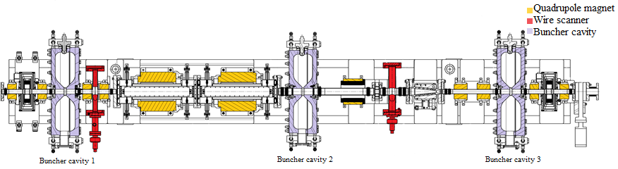
Using the MEBT
Increase the current of the quadrupole between the chopper and the dump
Chopping efficiency has to be conserved
L4L.QFC03130
Nominal value 110 A
Maximum current 185 A
Hp: 155 A
L4L.MQF.4140
Nominal value 119.4 A
Maximum current 275 A
Hp: 159 A
6

Slide 8
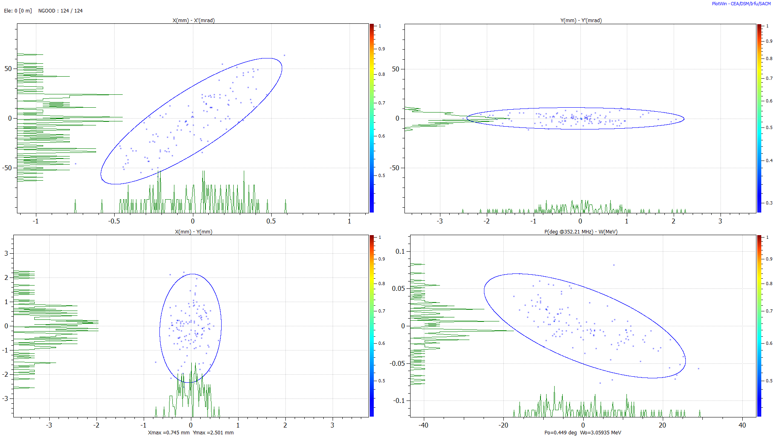

67.8% = 125.45 μA
MEBT output
Emit [rms] = 0.3231 Pi.mm.mrad [ Norm. ]
Beta = 0.0167 mm/Pi.mrad
Alpha = -1.5425
Emit [rms] = 0.3005 Pi.mm.mrad [ Norm. ]
Beta = 0.2125 mm/Pi.mrad
Alpha = 0.0410
Emit [rms] = 0.2290 mm² [ Norm. ]
Beta = 0.2909
Alpha = -0.0640
Emit [rms] = 0.2280 Pi.deg.MeV [ Norm. ]
Beta = 489.6281 deg/Pi.MeV
Alpha = 0.9077
$σ_{\left\{x,RMS\right\}}$= 0.2581 mm
$σ_{\left\{y,RMS\right\}}$= 0.8892 mm
7

Slide 9
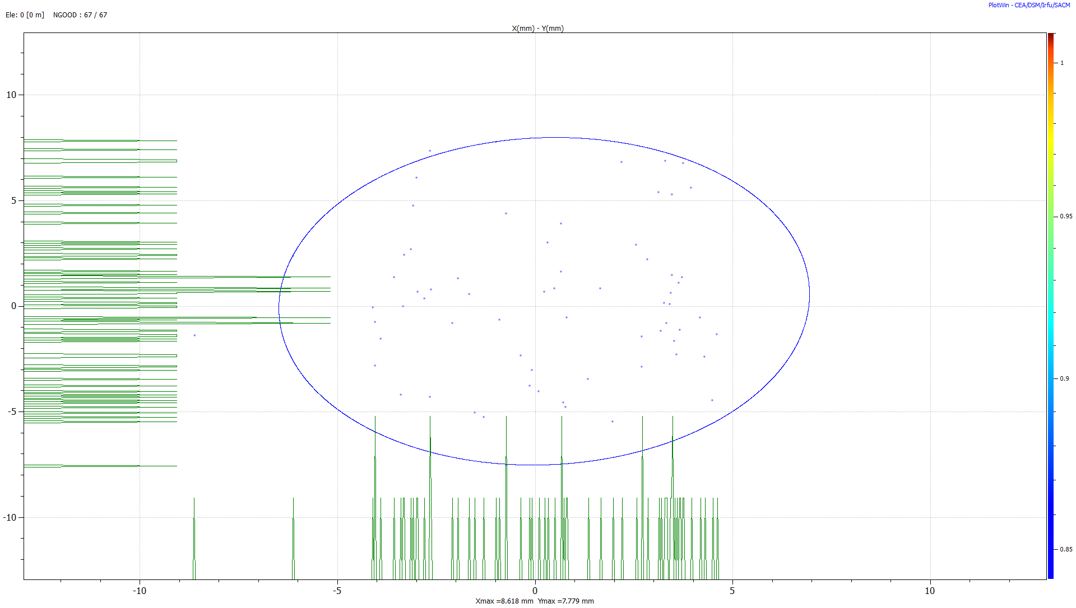
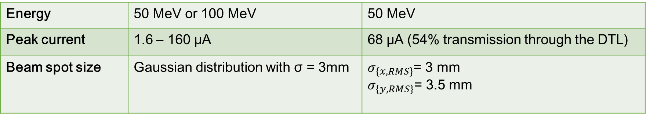
DTL output
Adjust the beam size by decreasing the current of the two quadrupoles in the new test bench
Energy | 50 MeV or 100 MeV | 50 MeV
Peak current | 1.6 – 160 μA | 68 μA (54% transmission through the DTL)
Beam spot size | Gaussian distribution with σ = 3mm | $σ_{\left\{x,RMS\right\}}$= 3 mm $σ_{\left\{y,RMS\right\}}$= 3.5 mm
8

Slide 10
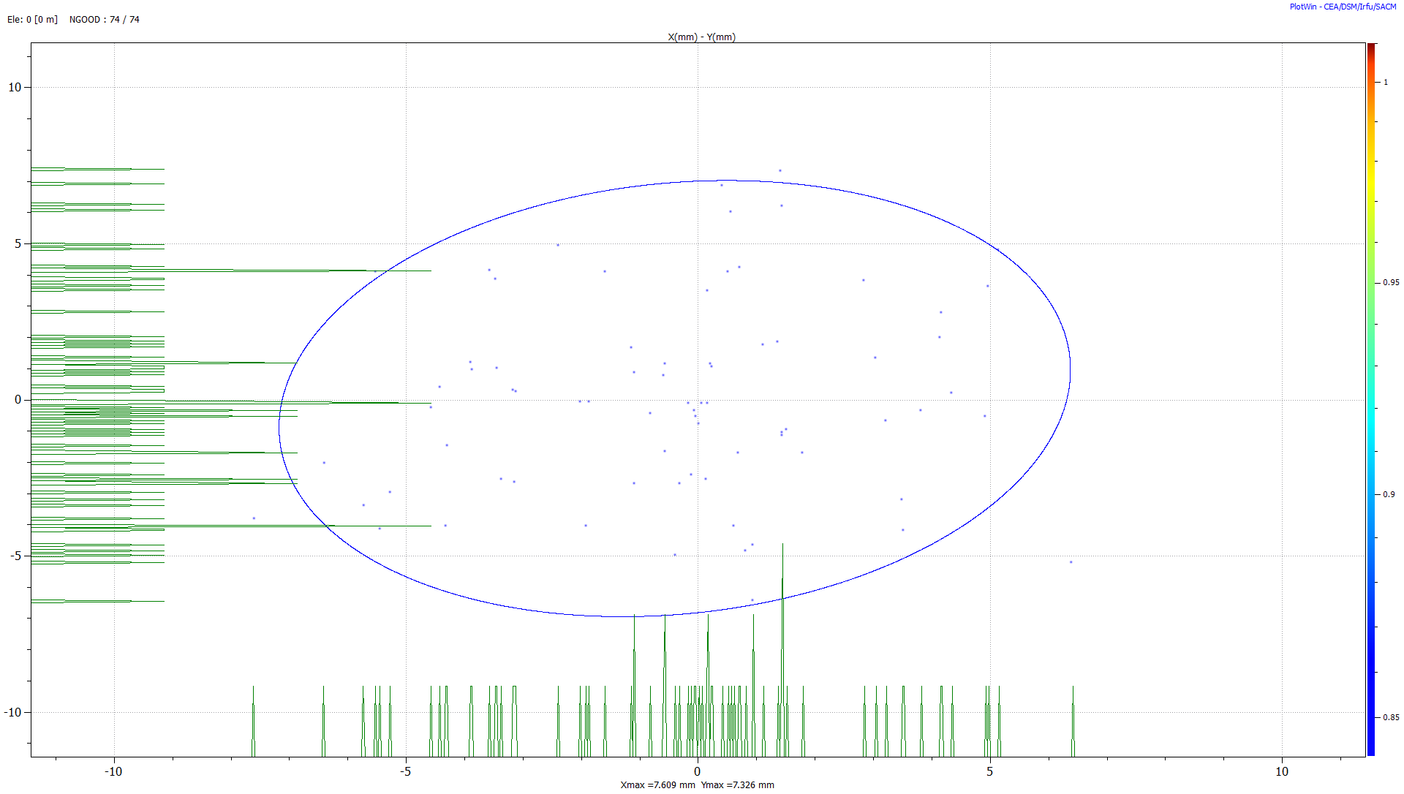
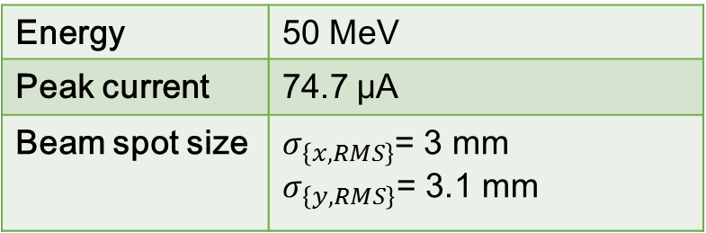
Using only the LEBT
LEBT
Turn off the 1st solenoid
Reduce the field in the second solenoid
Transmission 0.267%=120.15 μA
RFQ
Transmission 88.2%=105.97 μA
MEBT (Nominal)
Transmission 70.5%=74.7 μA
DTL
Decrease the current of the 2nd quad in the new test bench
Transmission 100% = 74.7 μA
Output beam
Energy | 50 MeV
Peak current | 74.7 μA
Beam spot size | $σ_{\left\{x,RMS\right\}}$= 3 mm $σ_{\left\{y,RMS\right\}}$= 3.1 mm

Slide 11
Conclusions
Reduce the peak current from 40 mA to 1.6 – 160 μA in the low energy part of the line
RFQ solution excluded
First solution: LEBT and MEBT
  Turn off the 1st solenoid in the LEBT at 45 keV
  Increase the current of the quad between chopper and dump in the MEBT at 3 MeV, conserving the chopping efficiency
  Adjust the beam size with quads in test bench
Second solution: LEBT
  Turn off the 1st solenoid
  Decrease the field of the 2nd solenoid
  Adjust the beam size with quads in test bench
Both work well but second one better than first (we have to manage only the LEBT at 45 keV)
9

