Slide 1

Synergies between the Big Data Value (BDV) Public Private Partnership and the Helix Nebula Initiative (HNI)
Sergio Andreozzi
Strategy & Policy Manager, EGI.eu
The Helix Nebula Initiative & PICSE: Towards a European Open Science Cloud 26/06/2015, Geneva, Switzerland
“To drive forward the Big Data Value ecosystem and its Digital Agenda for the benefit of Europe, its Companies and Citizens; and to engage in the Big Data Value Public Private Partnership, its Programme and Opportunities“

Slide 2
Outline
What is Big Data for Big Data Value (BDV)
What is the BDV cPPP and BDVA
Synergies between HNI and BDV cPPP

Slide 3
What is Big Data for Big Data Value (BDV)?

Slide 4
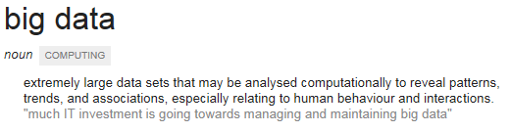

‘Academic’ View (technical challenge)
www.powerdata.es/
Big data is an all-encompassing term for any collection of data sets so large and complex that it becomes difficult to process them using traditional data processing applications.

Slide 5




When is Data ‘Big’?
Volume
Velocity
Variety
Veracity
Value
€
€
€
€
€
€
€
€
Data at Rest
Data in Motion
Data in Many Forms
Data in Doubt
Data into Money
Uncertainty due to data inconsistency & incompleteness, ambiguities, latency, deception
Terabytes to
exabytes of existing
data to process
Streaming data, requiring mseconds to respond
Structured, unstructured, text, multimedia,…
Business models can be associated to the data
Adapted by a post of Michael Walker on 28 November 2012

Slide 6
Industry View (business opportunities)
Sectors/Domains | Big Data Value
Public administration | EUR 150 billion to EUR 300 billion in new value (Considering EU 23 larger governments)
Healthcare & Social Care | EUR 90 billion considering only the reduction of national healthcare expenditure in the EU
Transport and Logistics | USD 500 billion in value worldwide in the form of time and fuel savings, or 380 megatonnes of CO2 emissions saved
Retail & Trade | 60% potential increase in retailers’ operating margins possible with Big Data
Geospatial | USD 800 billion in revenue to service providers and value to consumer and business end users
Applications & Services | USD 51 billion worldwide directly associated to Big Data market (Services and applications)

Slide 7
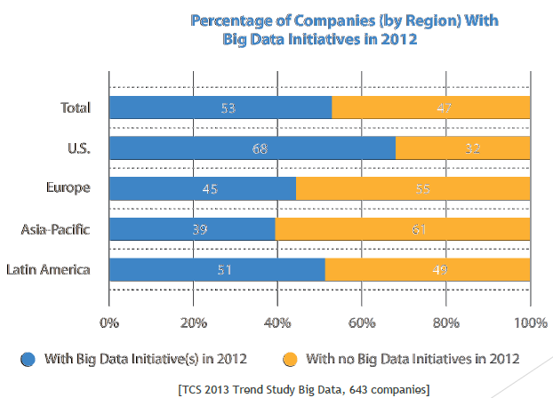
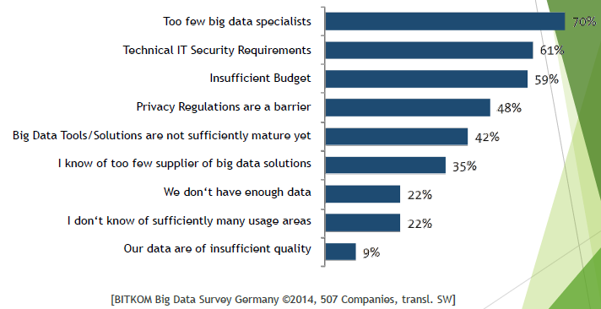
Big Data uptake (Europe vs. US)
Barriers for
Big Data uptake

Slide 8
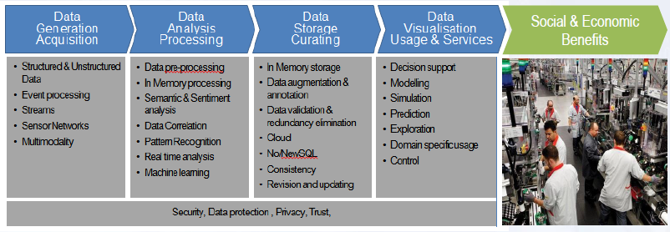
Data Value Chains: the need for ecosystems
Several European companies and in particular research institutions and startups have created interesting technologies and services along the data value chain.
However, both in business & science, data use is handled in a fragmented way.
In particular SMEs lack skills to capitalize on data assets in order to improve their competitiveness.
Actors along the data value chain should cooperate and form the basis of a strong and vibrant data-driven ecosystem to maximise big data value creation.

Slide 9
BIG Data Value cPPP & BDVA

Slide 10
The EU and Industry launched the
Contractual Public Private Partnership
(cPPP) on Big Data Value in October 2014
The Big Data Value Association represents ‘Private’ side
“In the Commission's view, strategic cooperation through a contractual Public-Private Partnership (cPPP) can play an important role in developing a data community and encouraging exchange of best practices. In line with the principles set out in H2020, the Commission considers that a sufficiently well-defined cPPP would be the most effective way
to implement H2020 in this field,…”
Commission Communication "Towards a thriving data-driven economy" - 2 July 2014
“… EU action should provide the right framework conditions for a single market for Big Data …”
European Council Conclusion – 24/25 October 2013
“Big Data is possibly one of the few last chances for Europe‘s software industry to take a true leadership“
CEO Software AG,
Karl-Heinz Streibich

Slide 11
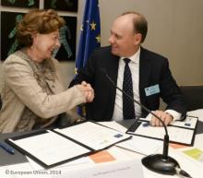

Launch of the BDV cPPP and
1st BDVA summit
Signature of BDV PPP – 14 October 2014
Jan Sundelin (TIE Kinetix CEO), 1st President of BDVA
Neelie Kroes, European Commission Vice-President
1st BDVA Summit – 17-19 June 2015
350 people across the days
50 sessions
17 speakers

Slide 12
BDV cPPP Structure
European Commission
Contractual
Arrangement
Association proposes research objectives
Grant Agreement
per project
EU and Industry agree on a cPPP to conduct strategic Big Data Value research and to run innovation projects
Requires setting up of a Big Data Value association
Involvement of a broad stakeholders community
Stakeholder Community
NESSI
Big Data Value Association
Industry driven
Defines Research and Innovation Agenda
Specifies Key Performance Indicators
Big Data Projects
within Horizon 2020
Projects running within 2017 – 2021
Expected Total Funding
~ 500 MEUR
Stakeholders
Industry Large
Industry SME
Research
User
…
Notes:
NESSI: European Technology Platform behind BDVA cPPP

Slide 13
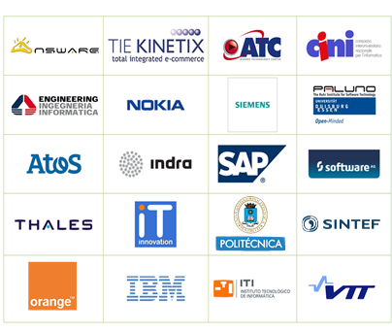
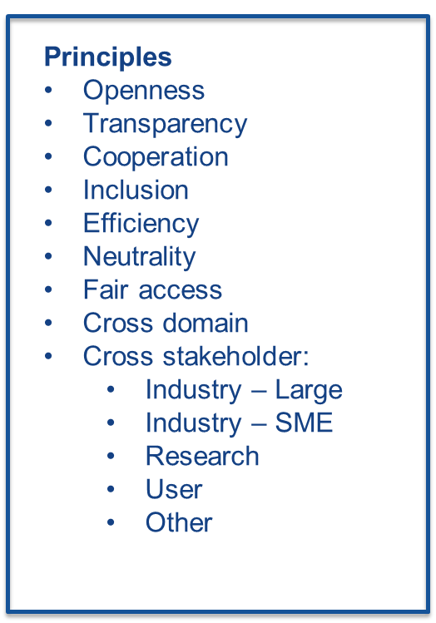

BDVA Founding Members
Complete list at the web site: www.bdva.eu

Slide 14

BDV cPPP - Scope
Foster European Big Data Value technology leadership for job creation and prosperity by creating a European wide technology and application base and building up competence and the number of European Data Companies including Start-Ups;
Reinforce the European industrial leadership and capability to successfully compete on global level in the data value solution market by advancing applications transformed into new opportunities for business to achieve a 30% market share by 2020;
Enable research and innovation work, including the support of interoperability and standardisation, for the future basis of Big Data Value creation in Europe;
Facilitate the acceleration of business ecosystems and appropriate business models with particular focus on SMEs, enforced by Europe-wide benchmarking of usage, efficiency and benefits;
Provide successful solutions for major societal challenges Europe is facing such as: Health, Energy, Transport and the Environment;
Increase awareness about Big Data Value benefits for businesses and public sector and better acceptance by citizen, to engage them as prosumers and accelerate take-up.

Slide 15
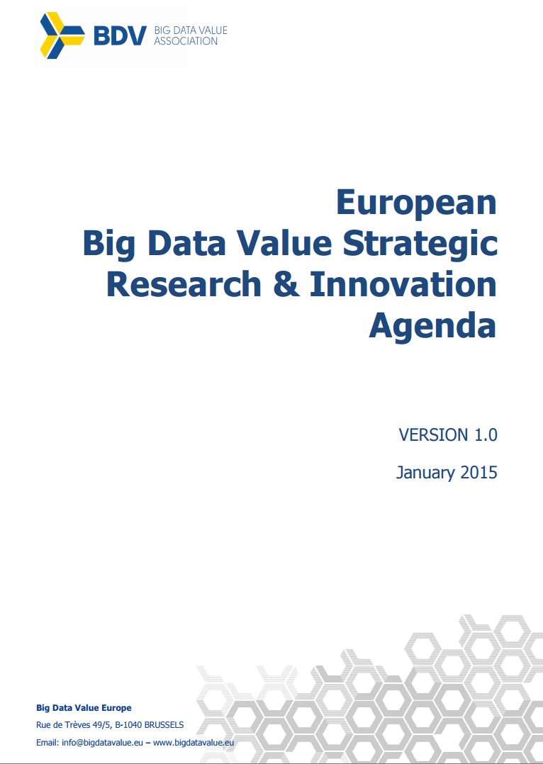
Big Data Value Strategic Research and Innovation Agenda (SRIA)
Overall goals, main technical and nontechnical priorities, and a research and innovation roadmap for the European contractual Public Private Partnership (cPPP) on Big Data Value
Revised annually
Currently open for comments - mail to: secretarygeneral@core.bdva.eu
http://www.bdva.eu/sites/default/files/europeanbigdatavaluepartnership_sria__v1_0_final.pdf

Slide 16
BDVA Task Forces
Big Data Value SRIA

Slide 17
Implementation
R&I Projects
Large Targeted research and innovation projects, delivering foundational Big Data technology
Data Management
Data Processing Architectures
Deep Analytics
Data Protection
Advanced Visualization
Innovation Spaces
Hubs for bringing data, technology and application developments together; catering for development of skills, competence, and best practices.
Lighthouse Projects
Large scale demonstrations focusing on certain sectors and domains

Slide 18
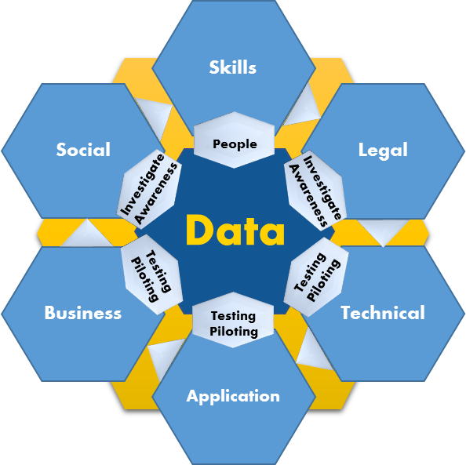
i-Spaces Projects incubators for new businesses and for the development of skills, competence and best practices
Data Sources – Data Access
Private & Industrial
Open Data
Secure / Confidential Environment
Infrastructures
Hardware
Platforms (OSS – Proprietary)
Scientific Personal
Access and Support for Test/Trials/Validation
Skills / Training
Tools /Methods
Data scientists = IT & Domain
Interdisciplinary
Cross sectorial activities
….
Network/Federation
Collaboration
Notes:
Asset Support: Supporting data providers in integrating data sets in a quality
maintaining a catalogue of available data assets.
• ICT Support: Providing basic ICT assistance as well as focused support by Big Data scientists, data
specialists, and business development during research and innovation projects. This includes assistance
in benchmarking data sets, technologies, applications, services, and business models.
• On-boarding: Running an induction process for new project teams.
• Resourcing: Allocating the resources (computing, storage, networking, tools, and applications) to
individual research and innovation pr
• Privacy: Data protection and privacy including ensuring the compliance with laws and regulation as well
as the deployment of leading
controlling data access.
• Federation: Supporting linkages to other innovation spaces and facilitating experiments across multiple
innovation spaces. An effective federation will help to support research and innovation activities
accessing and processing data assets across national borders.

Slide 19

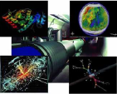



Lighthouse projects a mechanism for large-scale demos and awareness
The major mechanism for Europe to demonstrate Big Data Value ecosystems and sustainable data marketplaces
Running data-driven large scale demonstrations
Propose replicable solutions by using existing technologies or very near to market technologies that could be integrated in an innovative way and show evidence of data value
Create high level impact and broadcast visibility and awareness driving towards faster uptake of Big Data Value applications and solutions

Slide 20
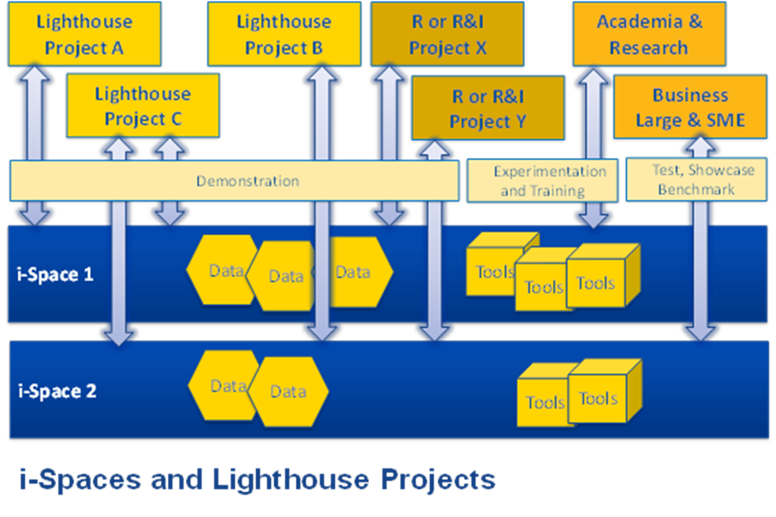
Relationship between
BDV PPP projects

Slide 21
Big Data PPP topics in
H2020 WP2016-17
The BDVA SRIA has already promoted the following topics in WP2016-17
  Multi-sector and multi-disciplinary innovation spaces
  Lighthouse projects in data-driven sectors
  Research technology challenges in big data
  Actions for improving skills and evaluate the program
  Research in Privacy issues in Big Data

Slide 22
Synergies between HNI and BDV cPPP

Slide 23
Common memberships within
HNI and BDVA
Full members
Atos
Orange
EGI.eu (joined 29 March 2015)
Membership categories: http://www.bdva.eu/?q=membership-categories
Forms to get involved: http://www.bdva.eu/?q=get-involved

Slide 24
Opportunities for HNI in BDVA
Easy mapping from Helix Nebula business ecosystem to BDVA i-Spaces
  Public and private data already in place
  Available infrastructures (physical, software, etc)
  Stakeholders already working together
Existing vertical pilots around big data in HNI can be useful for the instrument of lighthouse projects
  Scientific cases like ESA (space), EMBL (biology), ECWMF (climate)…
Collaboration in joint Research & Innovation projects combining cloud and big data disciplines to address technical challenges

Slide 25
Conclusions
BDVA is defining, driven by industry, the Big Data Strategy in H2020
HNI has a running ecosystem of public-private cooperation in science and challenges around Big Data have been identifed
Opportunities for HNI towards BDVA are focused on
  Mapping of HN ecosystem into innovation space
  Leveraging existing pilots into lighthouse projects
  Establishing cooperation networks for accomplishing together Research and Innovation projects
  HNI members can join the BDVA to influence the evolution of the SRIA and contribute to the task force activities

