Slide 1
ESA Information as a Service (InfoaaS) stimulus project
Earth Observation Data to build a value chain from science to business
Wolfgang Lengert

Slide 2
HN derived business model InfoaaS:
Science interfacing with private sector
Content Provider (Research)
Satellite data
(ESA/Copernicus)
Customer
Data
€
Knowledge
Helix Nebula Ecosystem
Information
Customer
Tools
GEO-IT & App
Provider (SME)
€
€
Customer
Computing & IT
€
Lower upfront
investment
Fast access to EO and other geodata resources
Disruptive technology
Customer
Service Provider (Industry)
Risk and profit sharing
Sustainability
Data Value Chains

Slide 3
InfoaaS Overall Model
Challenge:
Contracting and liability throughout the value chain
Notes:
Challenge: HNI is looking at it, some aspects are also addressed in the Stimulus. All exist as 1 to 1 relationship but now as a dynamic system

Slide 4
Information as a Service adding research IP to ESA data in a business environment
Johan Louter
June 2015

Slide 5
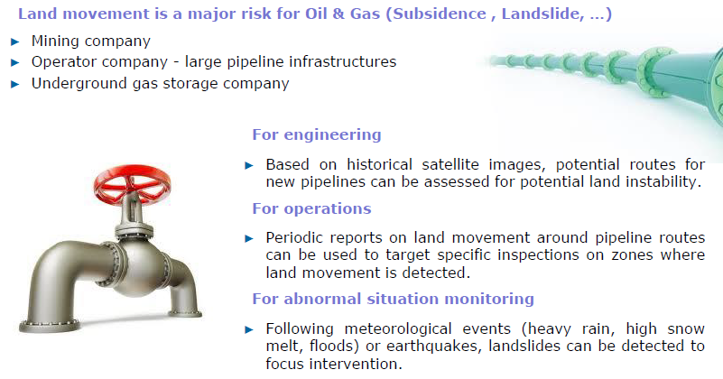
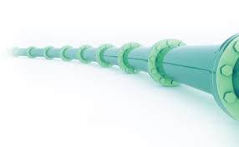
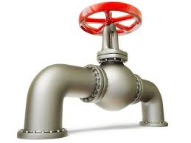
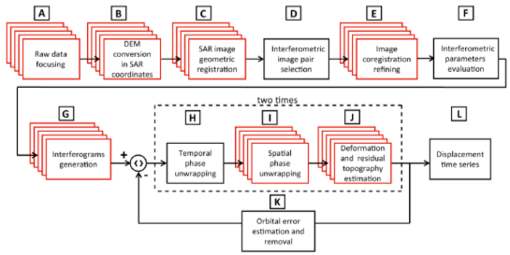
INFOaaS
Stake
Land movement is a major risk for oil & gas company (gas storage, pipeline, …)
  Data format: SAR data – ERS / Envisat dataset
  Follow-up of DORIS
Solution
Infrastructure based on Helix Nebula IaaS - Atos
Industrial Data Analytics platform - Atos
Long term monitoring Algorithms based on SBAS-DInSAR technique – CNR
ERS / Envisat Dataset – ESA
Final customer – French Oil & Gas company
  Ground deformation monitoring
Based on the Small Baseline Subset (SBAS) Differential Synthetic Aperture Radar Interferometry (DInSAR) which is a microwave remote sensing technique enabling to estimate deformations within centimetre to millimetre accuracy.
  DInSAR processing chain able to process SAR data stacks acquired by all the current available satellite, such as ERS, ENVISAT, TerraSAR-X, and Cosmo-SkyMed.
Notes:
For engineering
Based on historical satellite images, potential routes for new pipelines can be assessed for potential land instability.
For operations
Periodic reports on land movement around pipeline routes can be used to target specific inspections on zones where land movement is detected.
For abnormal situation monitoring
Following meteorological events (heavy rain, high snow melt, floods) or earthquakes, landslides can be detected to focus intervention.

Slide 6
INFOaaS
Oil & Gas Service : A complex processing workflow
Stake
Land movement is a major risk for oil & gas company (gas storage, pipeline, …)
  Data format: SAR data – ERS / Envisat dataset
  Follow-up of DORIS
Solution
Infrastructure based on Helix Nebula IaaS - Atos
Business Data Analytics Platform - Atos
Long term monitoring Algorithms based on SBAS-DInSAR technique – CNR
ERS / Envisat Dataset – ESA
Final customer – French Oil & Gas company
  Ground deformation monitoring
Based on the Small Baseline Subset (SBAS) Differential Synthetic Aperture Radar Interferometry (DInSAR) which is a microwave remote sensing technique enabling to estimate deformations within centimetre to millimetre accuracy.
  DInSAR processing chain able to process SAR data stacks acquired by all the current available satellite, such as ERS, ENVISAT, TerraSAR-X, and Cosmo-SkyMed.
Notes:
For engineering
Based on historical satellite images, potential routes for new pipelines can be assessed for potential land instability.
For operations
Periodic reports on land movement around pipeline routes can be used to target specific inspections on zones where land movement is detected.
For abnormal situation monitoring
Following meteorological events (heavy rain, high snow melt, floods) or earthquakes, landslides can be detected to focus intervention.

Slide 7
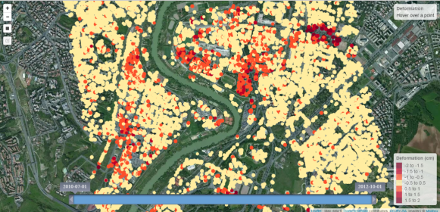
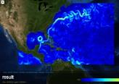
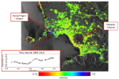






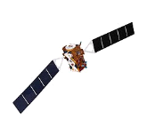



INFOaaS
Oil & Gas Service - Solution overview
End user
Advanced web Mapping
OGC Web Services
INFOaaS
Data science
DinSAR processing chain
PaaS
BDAP
Storage, processing & network
IaaS
Data sources
Envisat, ERS

Slide 8




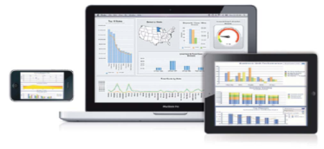
Where is ATOS so far on EO data valorisation ?
R&D projects
Helix Nebula
IDA
INFOaaS
- Oil & Gas service
CNES – PEPS
EO data dissemination
SparkInData
- Oceanography
- Agriculture
- Urbanism
- Risk assessment
- Defense

Slide 9

ESA Stimulus
Enabling an eco-system for downstream services
Jurry de la Mar

Slide 10
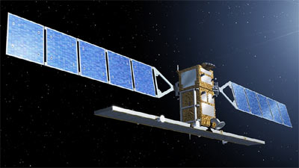
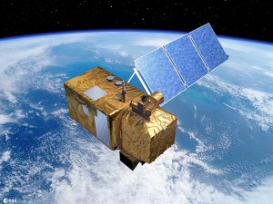
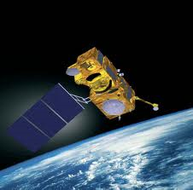





Copernicus downstream for sme.
Downstream SME
Service Providers:
Sentinel Satellites and contributing missions
Pre-processed Copernicus data
access via Ground Segment and Data Hubs
Cloud
Computing
Interfaces,
Processes, Tools,
Quality Standards etc.
Water Quantity
Water Quality
Project : APPS4GMES
Agriculture
Environment
Climate

Slide 11
ESA Stimulus – downstream on helix nebula

Slide 12
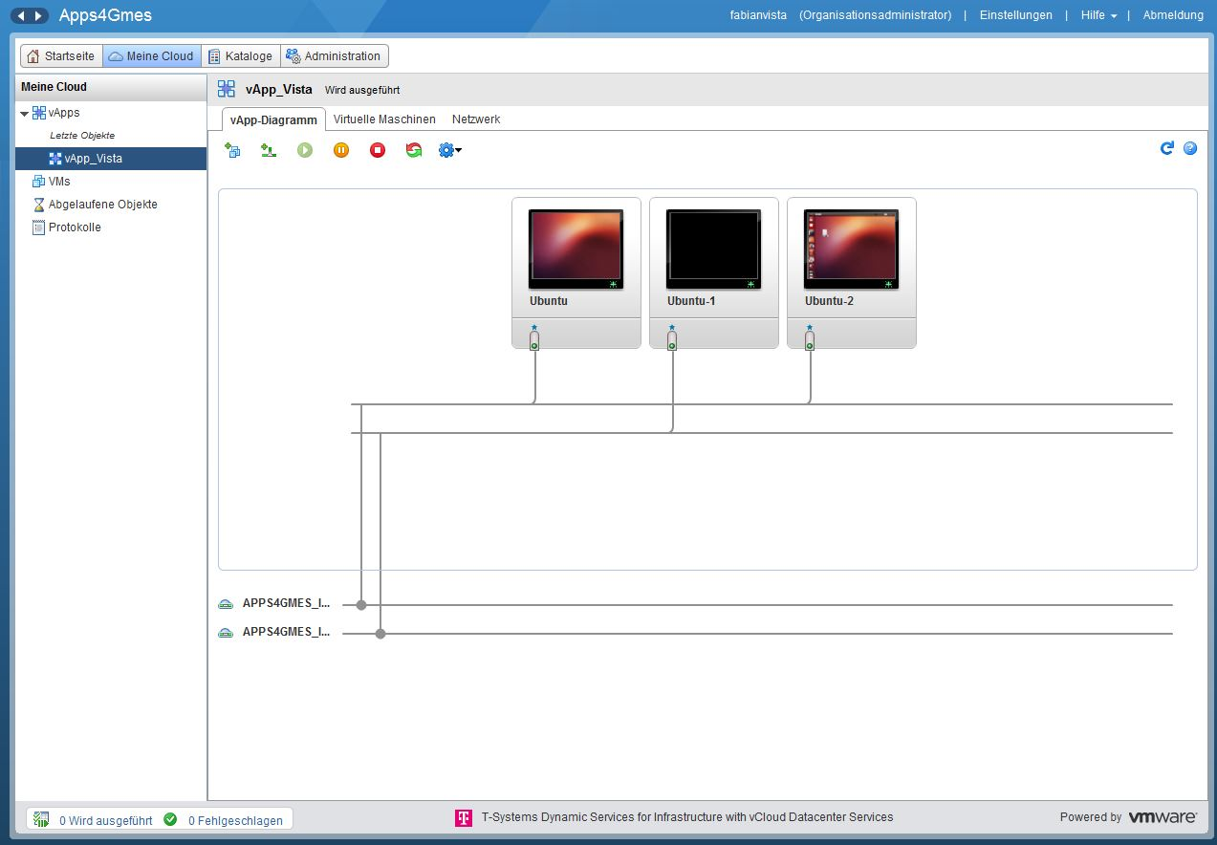
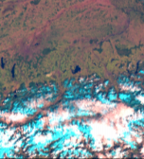
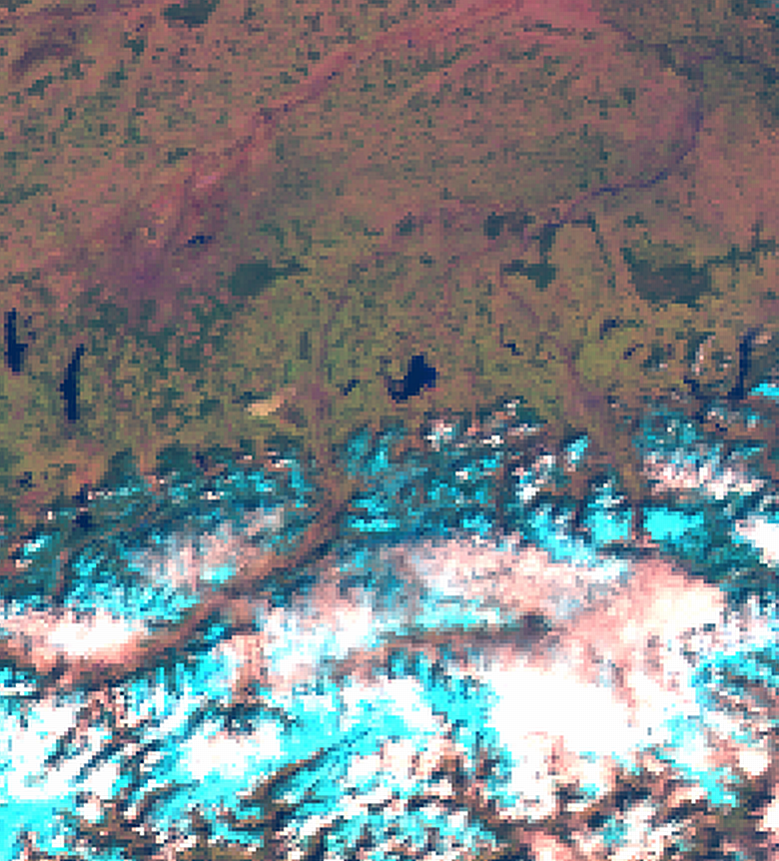
InputDataPortal
OPTICAL
Satellite Data
InputDataPortal
OPTICAL
Satellite Data
InputDataPortal
SAR
Satellite Data
Snow Cover
SnowWater
Equivalent
RUNOFF
RUNOFF
HYDROPOWER

Slide 13
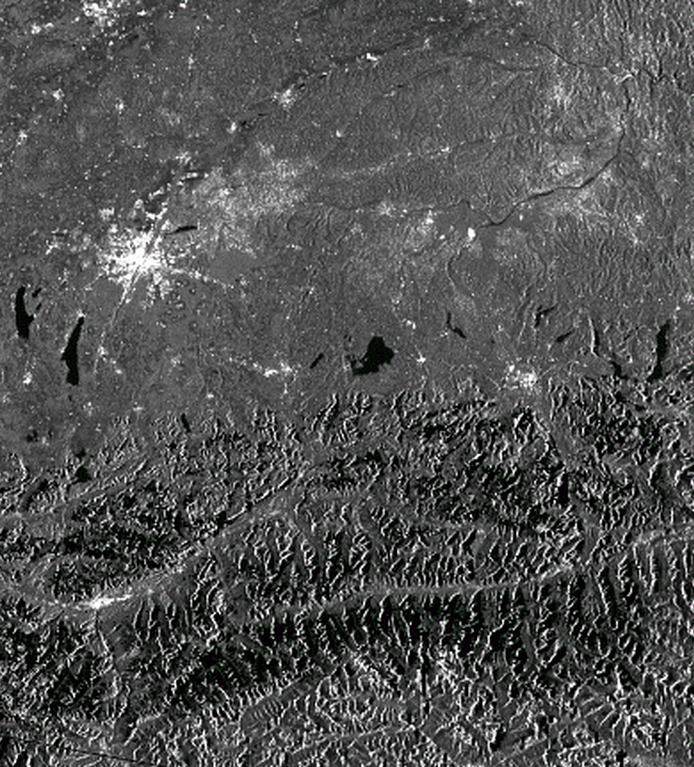
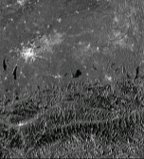
VISTA HydroSense
InputDataPortal
OPTICAL
Satellite Data
InputDataPortal
SAR
Satellite Data
InputDataPortal
SAR
Satellite Data
Snow Cover
SnowWater
Equivalent
RUNOFF
RUNOFF
HYDROPOWER

Slide 14
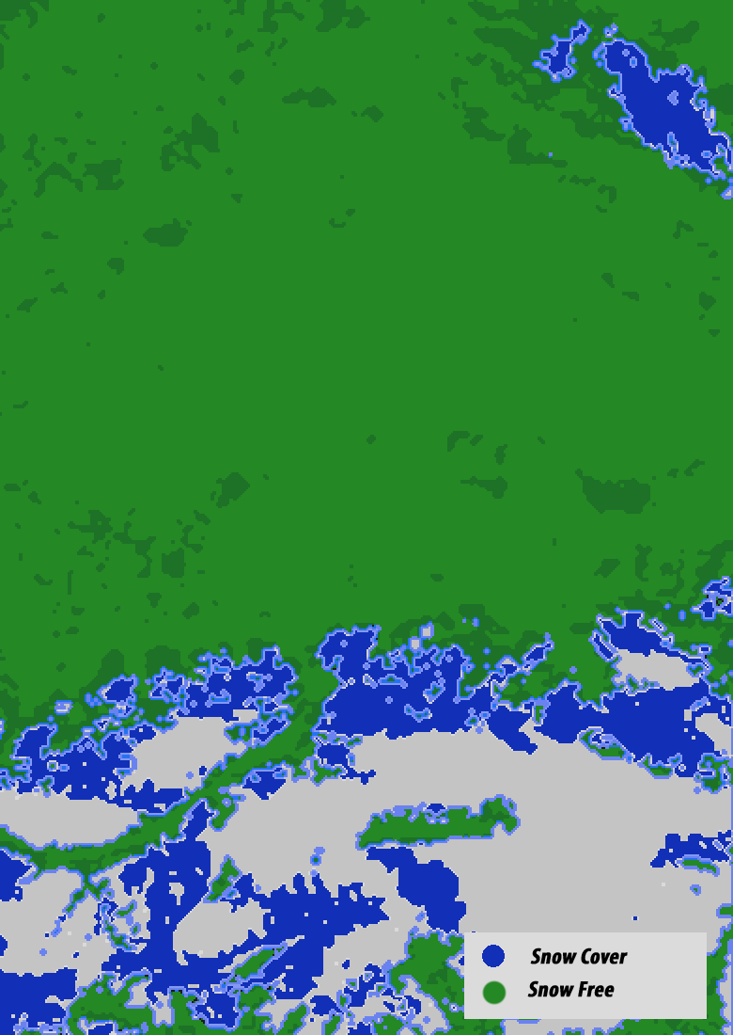
VISTA HydroSense
InputDataPortal
OPTICAL
Satellite Data
InputDataPortal
SAR
Satellite Data
SnowCover
Snow Cover
SnowWater
Equivalent
RUNOFF
RUNOFF
HYDROPOWER

Slide 15
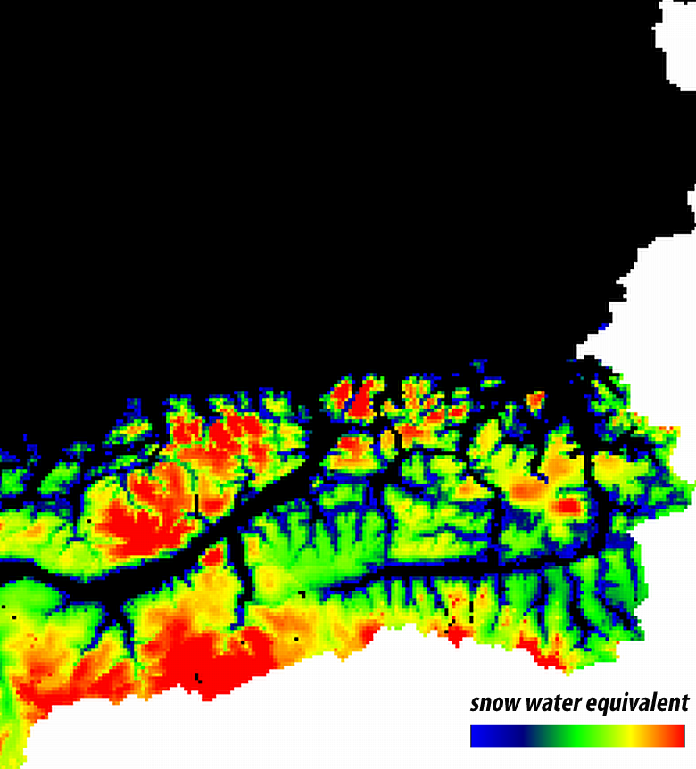
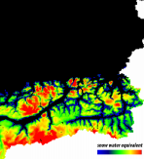
VISTA HydroSense
InputDataPortal
OPTICAL
Satellite Data
InputDataPortal
SAR
Satellite Data
Snow Cover
SnowWater
Equivalent
SnowWater
Equivalent
RUNOFF
RUNOFF
HYDROPOWER

Slide 16
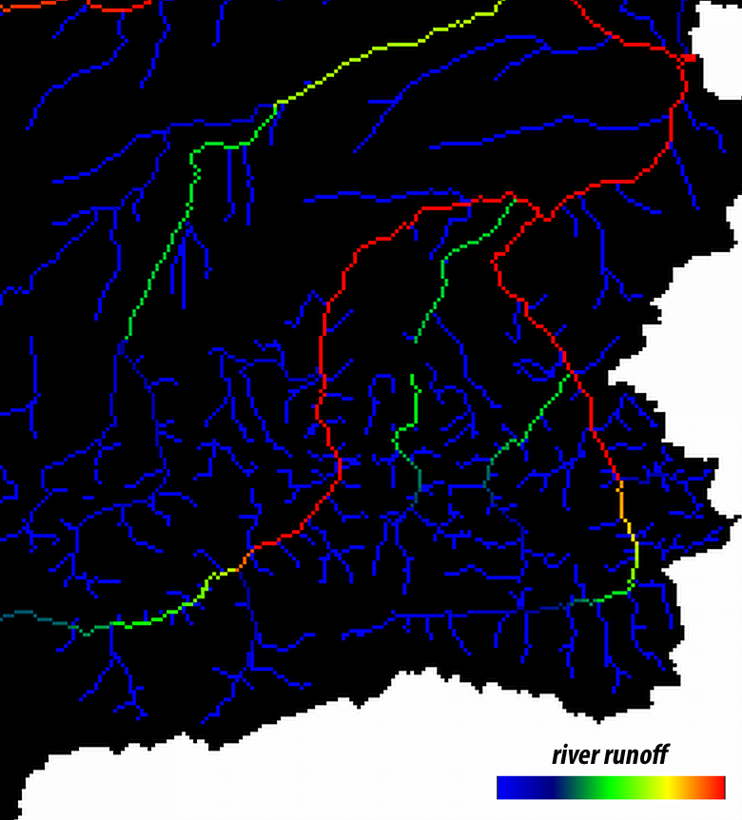
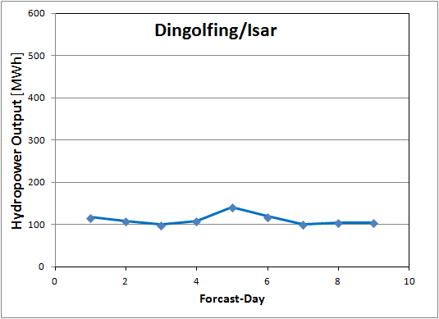
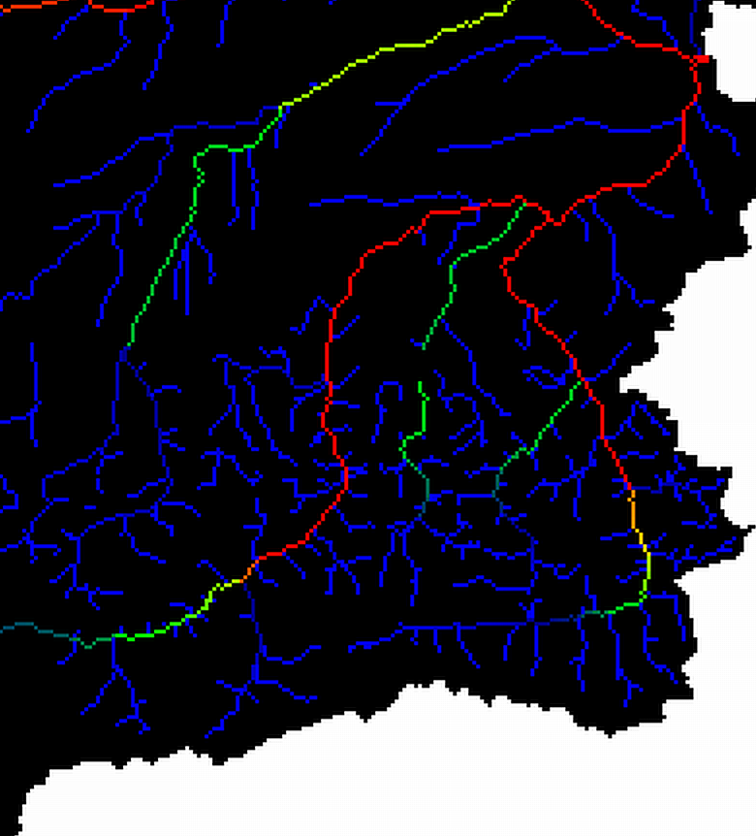
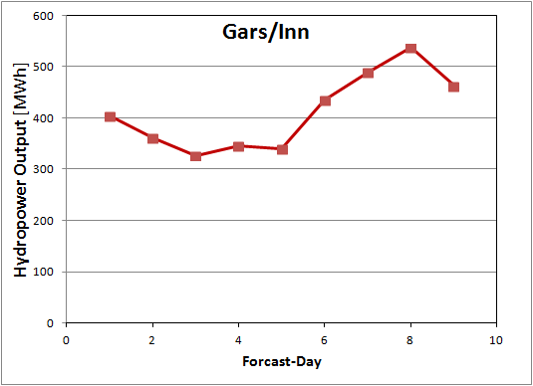


VISTA HydroSense
InputDataPortal
OPTICAL
Satellite Data
InputDataPortal
SAR
Satellite Data
Snow Cover
SnowWater
Equivalent
RUNOFF
RUNOFF
HYDROPOWER
HYDROPOWER
Storage
Power Plant
River Run-off
Power Plant

Slide 17
Downstream Services in the
Helix Nebula Marketplace
-
Overarching Architecture
Notes:
Science is becoming digital in all fields. The amount of data being taken by scientific instruments is growing rapidly and consequently so are the computing resources needed to store, process and share that data. Let me show you just 2 examples.

Slide 18
Service Architecture – Open Eco-System
Users
Copernicus InfoaaS Front-end Store
3rd Party Front-end Store
Web Application Server
Present
Order
Report
Present
Order
Report
Identity Server
Authentication
Authorisation
Business Process Server
App Service Chain Manager for Data Modelling, Data Analytics and Data Processing Providers
GeoServer
Discovery
Service
Notification
Service
Data Service
Provider 1
Data Service
Provider 2
Data Service
Provider n
Other Geo Server
(EOx, ERDAS Apollo)
Enterprise Service Bus
Workbench
Service
OGC
Service
Portrayal
Service
Streaming
Service
FTP
Service
Resources
ICT
Data
Software
Experts

Slide 19
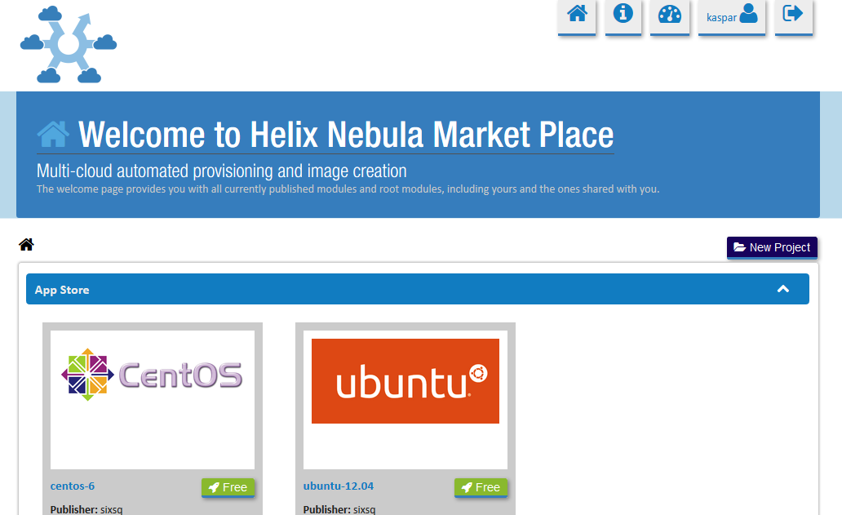


Extending apps in the Marketplace
IDP/ODP ESA Sentinel
Copernicus

Slide 20


