Slide 1
Dark Matter Searches and the
Neutrino Bound
Malcolm Fairbairn
King’s College London

Slide 2
Ways to Detect Dark Matter – Make, Shake and Break
Proton
Dark Matter
Dark Matter
Dark Matter
Proton
Dark Matter
Nucleus
Nucleus
Make – collider production
Shake – direct detection scattering
Dark Matter
SM Particle
Dark Matter
SM Particle
Break – indirect detection of annihilation

Slide 3
Outline
Effective Lagrangians and Simplified Models of Dark Matter
Problems with resonances in simplified models
Using complementarity to probe these regions
Future methods to cope with the neutrino bound
Based on:-
1305.3452 with Robert Hogan
1406.3288 with John Heal
1406.5047 with Philipp Grothaus and Jocelyn Monroe
1409.4075 with various

Slide 4
FROM DAVID’S TALK

Slide 5
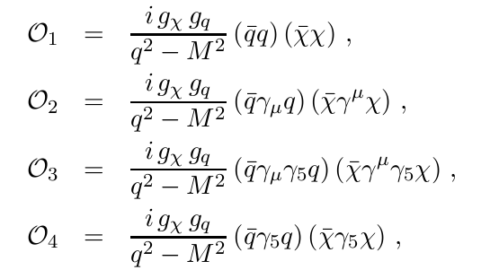

Relativistic Effective Lagrangians
Imagine some purely phenomenological contact interactions for coupling between dark matter and standard model particles
Scalar
Vector
Axial Vector
Pseudo-scalar
Bai, Fox and Harnik arXiv:10053797

Slide 6
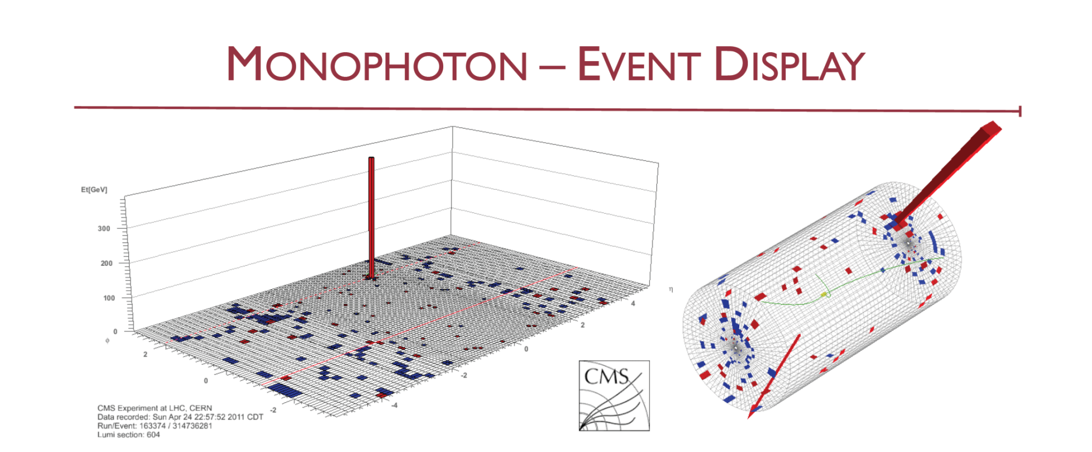
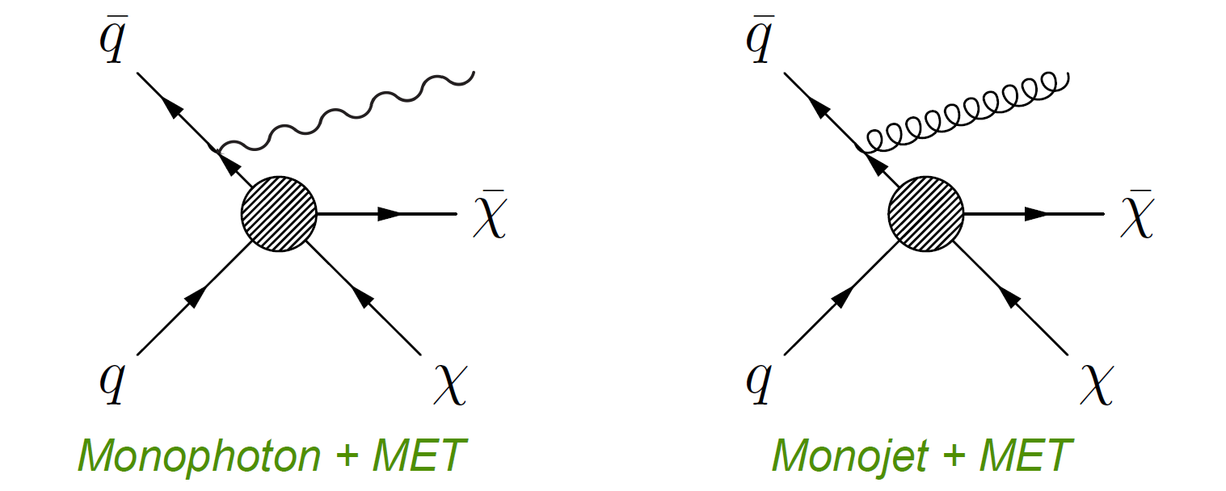
Slide stolen from Steve Worm Oxford Presentation

Slide 7
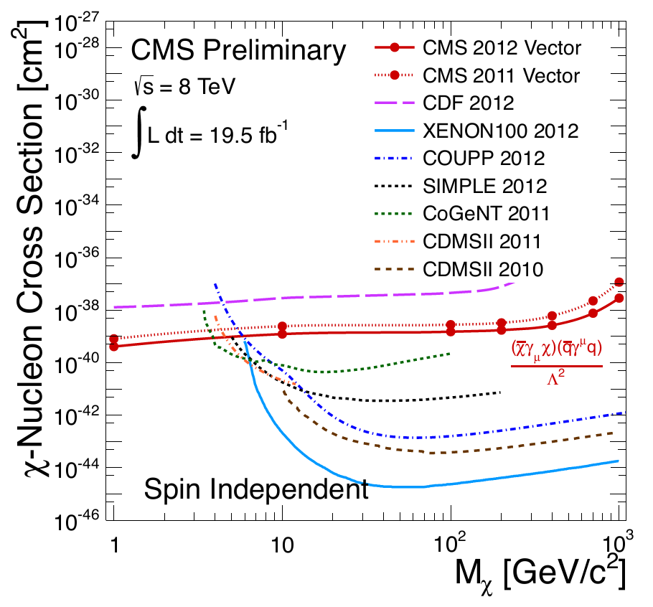
Monojet/Monophoton Constraints from colliders
CMS collaboration CMS-PAS-EXO-12-048
Precise constraints vary hugely depend upon assumed nature of interaction, Majorana vs Dirac etc…

Slide 8
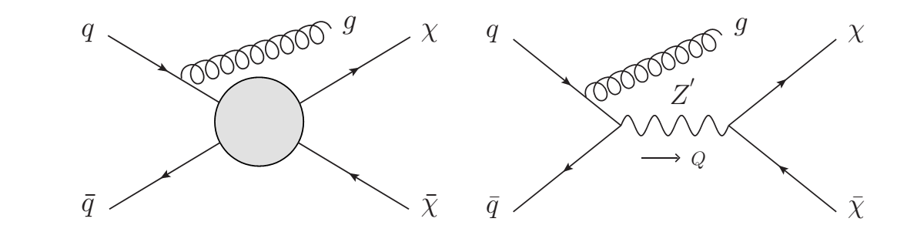
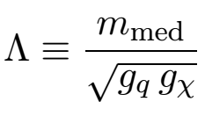
How well can you trust this approach?
Compare Axial-Vector Effective contact theory with actual exchange of Vector
Buchmuller, Dolan and McCabe, 2013

Slide 9
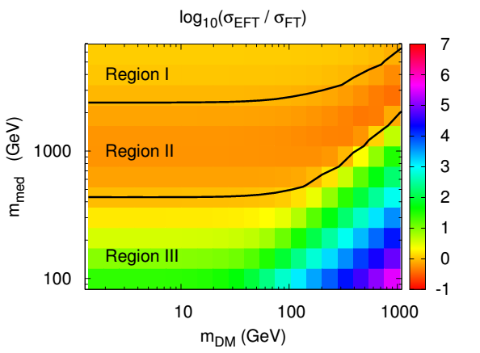
How well can you trust this approach?
Region 1, both approaches in reasonable (20% agreement)
Region 2, field theory cross section larger due to resonance in propagator
Region 3, effective field theory overestimates the cross section relative to actual field theory
On the right, the high mass of DM means that Q² has to be large and the dynamics are set by the final state.
Buchmuller Dolan and McCabe, 2013

Slide 10
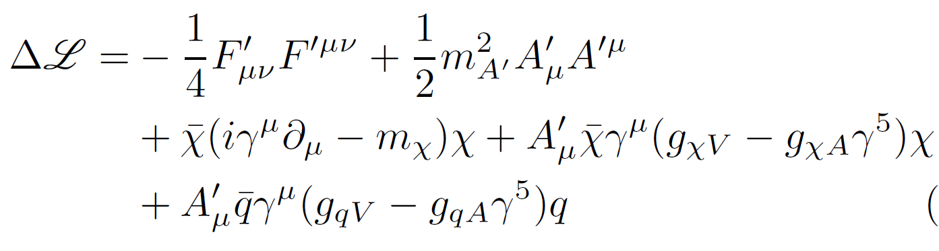
MSDM Minimal Simplified Model of Dark Matter
Simplified Model Lagrangian –
Vector coupling to DM and Quark sector
arXiv:1409.4075

Slide 11
Simplified Model of Dark Matter – monojet constraints
Not competitive for Spin independent cross sections

Slide 12
Simplified Model of Dark Matter – monojet constraints
Projected limits with High Luminosity LHC at 14 TeV c.o.m.

Slide 13
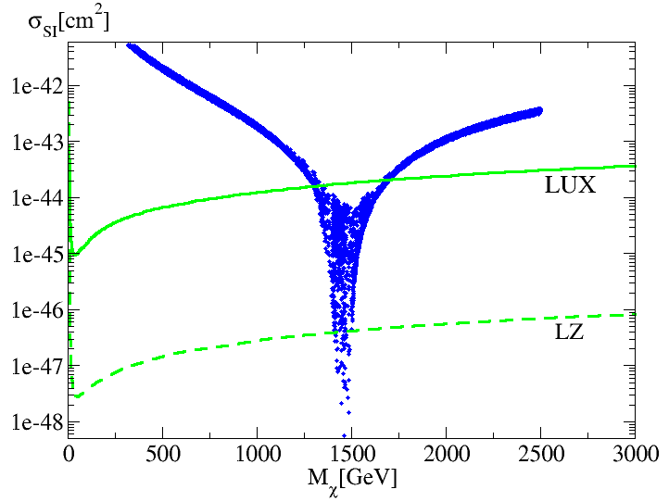
Simplified Model of Dark Matter – dijet constraints

Slide 14
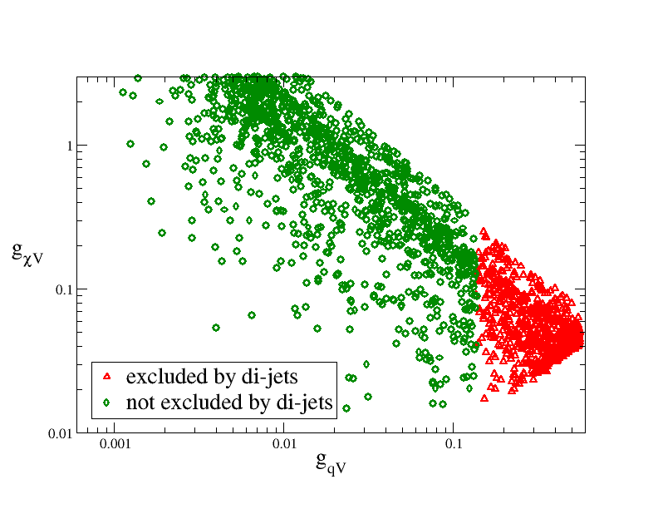
Which Points Are Excluded by Dijets?
M_{mediator} = 3 TeV
All points here give same (naive) relic abundance – fairly simple pattern!

Slide 15
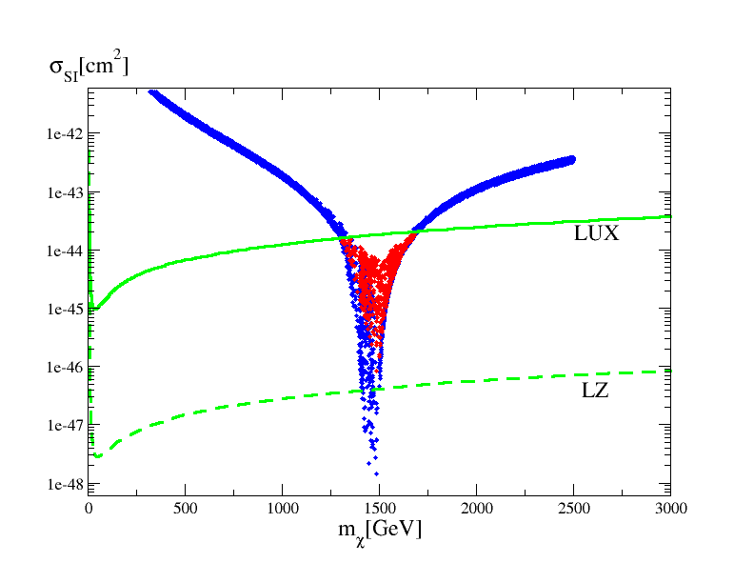
How well can dijets solve our resonance problem?
We only check dijet constraint below LUX line
RED - excluded by dijets
BLUE – not excluded by dijets
Large g_{χV} small g_{qV} + resonance abundance GOOD
Large g_{χV} small g_{qV} direct detection BAD

Slide 16
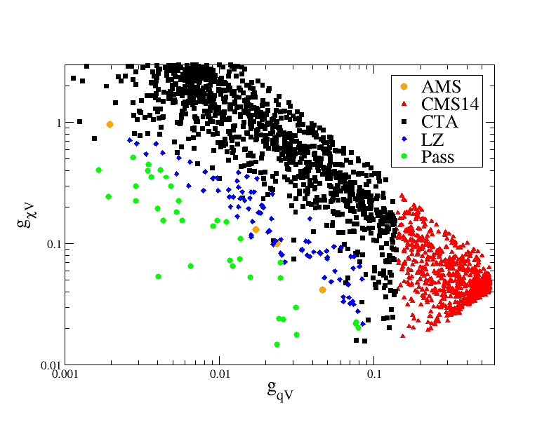
What if we add other constraints?
M_{mediator} = 3 TeV
Cuts are performed in the order that they appear in the key

Slide 17
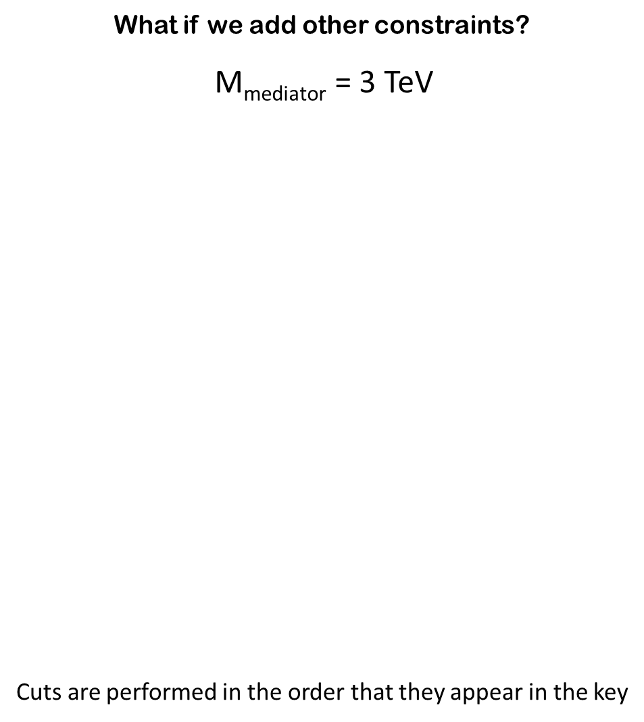
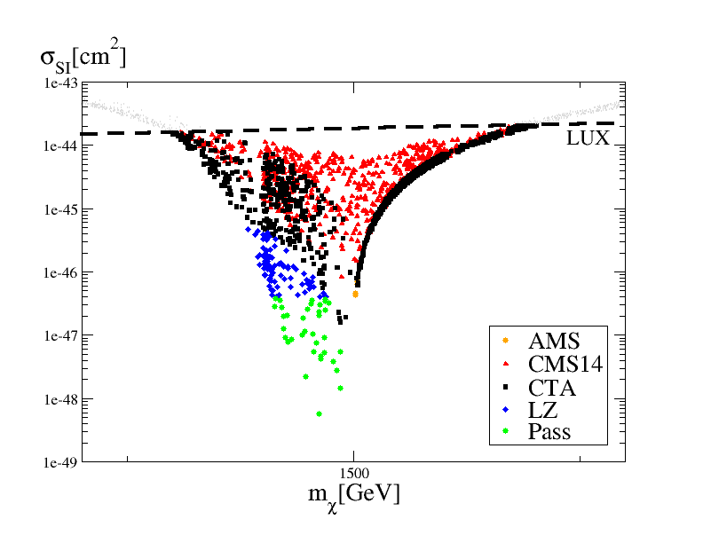

Slide 18
There are different constraints if the new vector particle also couples to leptons,
see Arcadi at al 1401.0221

Slide 19
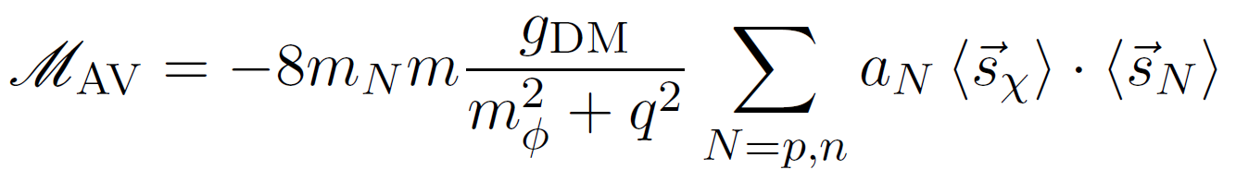
Axial Vector Coupling
Spin dependent so no coherent enhancement across whole nucleus,
However apart from that it’s OK, one can look for it.
Del Nobile et al. arXiv: 1502.07682

Slide 20
Axial Vector Coupling –
monojet constraints
Test cases are for fixed arbitrary couplings.
Mediator mass varied until collider limit violated
Corresponding direct detection cross section then calculated.
Colliders win here!

Slide 21
Pseudo-scalar coupling
factors of q in matrix element result in strong energy dependence in the direct cross section
Direct detection therefore extremely difficult
Del Nobile et al. arXiv: 1502.07682
Number of events in LZ :-
Boehm et al. hep-th/1401.6458

Slide 22
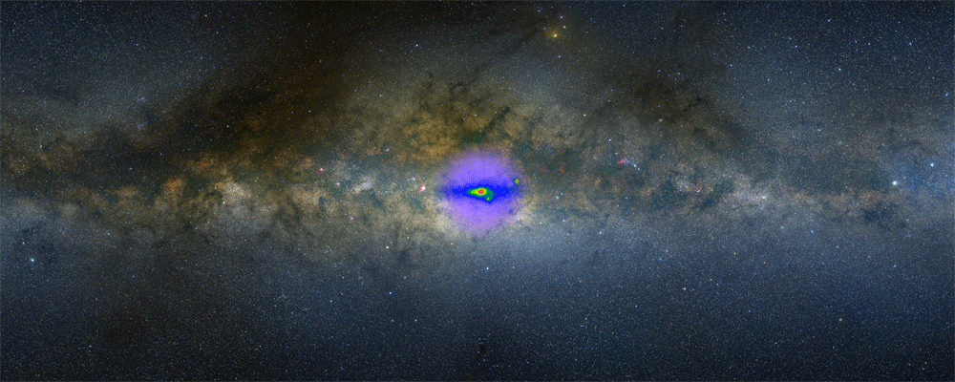
Galactic Centre Excess detected by Fermi Gamma Ray Telescope
Consistent with 30 GeV DM annihilating into b quarks
Approximately right density profile, annihilation cross section
May also be consistent with Millisecond pulsars
Next Fermi data release may clarify the situation
May require instrument with better angular resolution (Pangu?)

Slide 23
Example of pseudoscalar coupling – Coy Dark Matter
(can explain gamma ray excess)

Slide 24
At colliders, not much difference between scalars and pseudo-scalars
Monojet limits from Haisch, Kahlhoefer and Unwin (arXiv:1208.4605)
Red limit with naïve couplings – Green limit with heavy quark loops
Models with scalar models can mix with Higgs leading to other constraints…

Slide 25
One particular example of Scalar Coupling:-
Singlet Fermionic Dark Matter
McDonald, (1994)
H. Davoudiasl, R. Kitano, T. Li, and H. Murayama, (2005)
Burgess, Pospelov, and ter Veldhuis,(2001)
Kim, Lee, and Shin,(2007/2008)
Qin, Wang, and Xiong, (2011)
Lopez-Honorez, Schwetz, and Zupan, (2012)
Baek, Ko, Park, and Senaha, (2012)
We heavily used
Espinosa, T. Konstandin, and F. Riva, (2012)

Slide 26
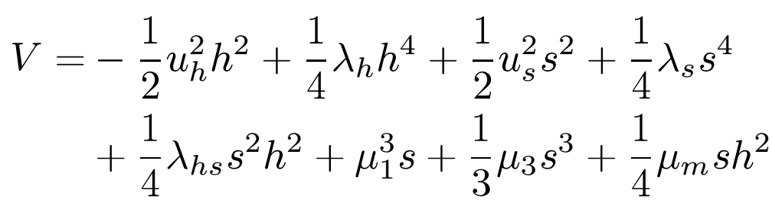
Extra Scalar Field as Dark Matter
If you assume s = -s then s is a good dark matter candidate
However, you cannot get 1st order phase transition AND all the relic abundance (Cline et al 2012)

Slide 27

Remove symmetry of extra Scalar Field
These terms arise from not assuming field s = -s
then assume dark matter is a fermion that couples to s field
has global U(1) charge to prevent mixing with SM

Slide 28
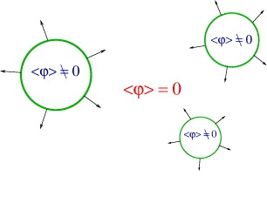
Electroweak Baryogenesis
Figures from “Electroweak baryogenesis”
David E Morrissey and Michael J Ramsey-Musolf 2012 New J. Phys. 14

Slide 29
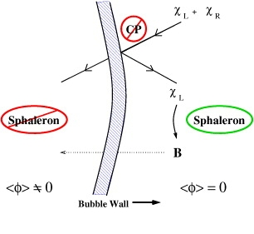
Electroweak Baryogenesis
Figures from “Electroweak baryogenesis”
David E Morrissey and Michael J Ramsey-Musolf 2012 New J. Phys. 14

Slide 30
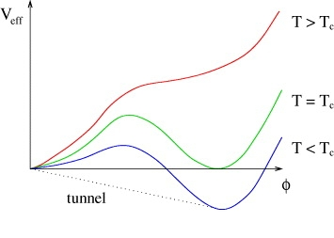
Electroweak Baryogenesis
Figures from “Electroweak baryogenesis”
David E Morrissey and Michael J Ramsey-Musolf 2012 New J. Phys. 14

Slide 31
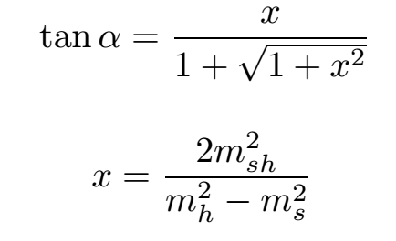
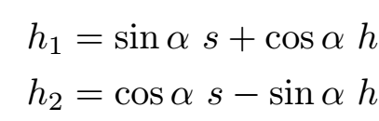
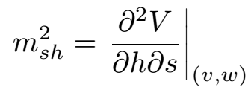




The Phenomenology of the Extra Scalar Field
Two mass eigenstates:-
Effective branching ratio of needs to be calculated. Introduce parameter
Then current constraints are
Likewise can look at coupling of to the standard model. Signal strength is
and for , this latter constraint dropping rapidly as the mass increases
For LHC constraints,
Ellis and You 2013
Falkowski, Riva and Urbano 2013
CMS 1304.0213

Slide 32
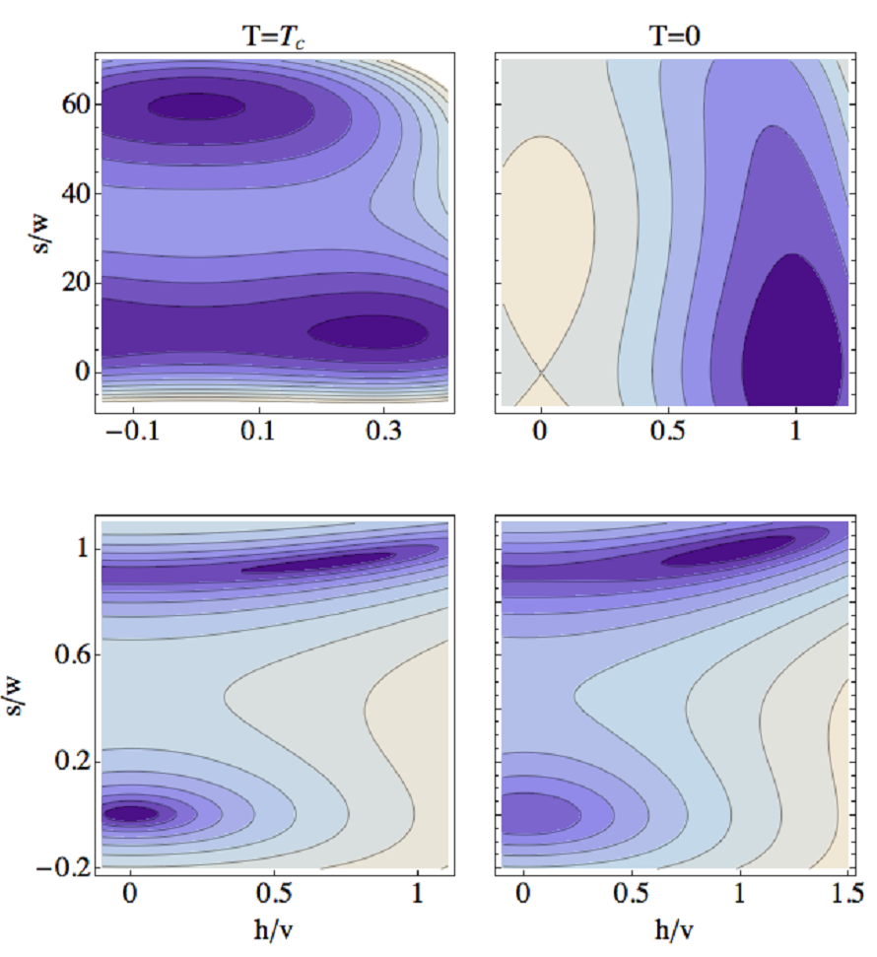
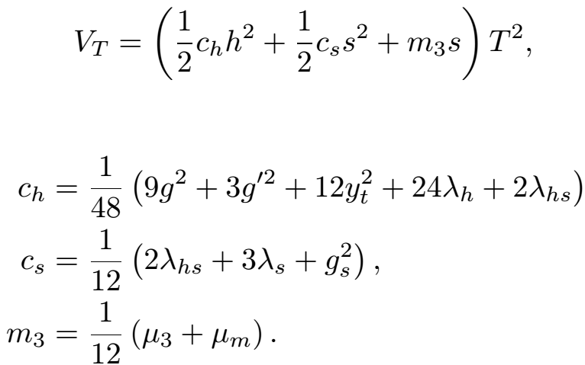
Electroweak Phase
Transition with h and s
Fairbairn and Hogan 2013
The thermal correction to the tree level potential is given by

Slide 33
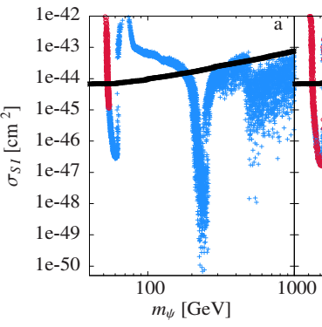
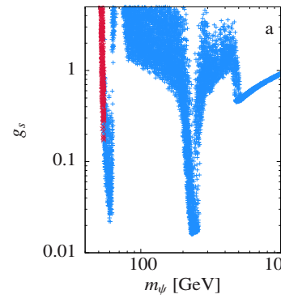

PROBLEM:- When M_{DM} = M_{Mediator}
relic abundance couplings and σ_{direct} drop
XENON100
Higgs Portal model with additional scalar field coupled to dirac Fermion (Fairbairn and Hogan 1305.3452)

Slide 34
Improvement in LHC exclusion if we move from 10% to 1% in branching ratio accuracy in next runs
This is a generic problem in simple models, other mechanisms like cancellations and mixings can create the same problems in more complicated theories. Many potential effects in a theory such as pMSSM.

Slide 35
What does this tell us?
Despite our best efforts, some models will remain immune to many upcoming LHC and indirect detection search strategies.
Direct detection is powerful for thermal relics but also cannot get all of them, even new upcoming state of the art detectors.

Slide 36

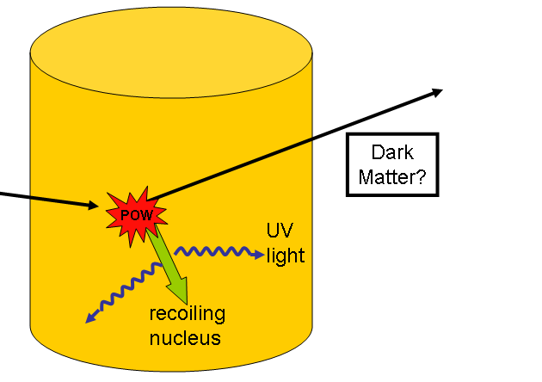
Surely just a problem of scale?

Slide 37
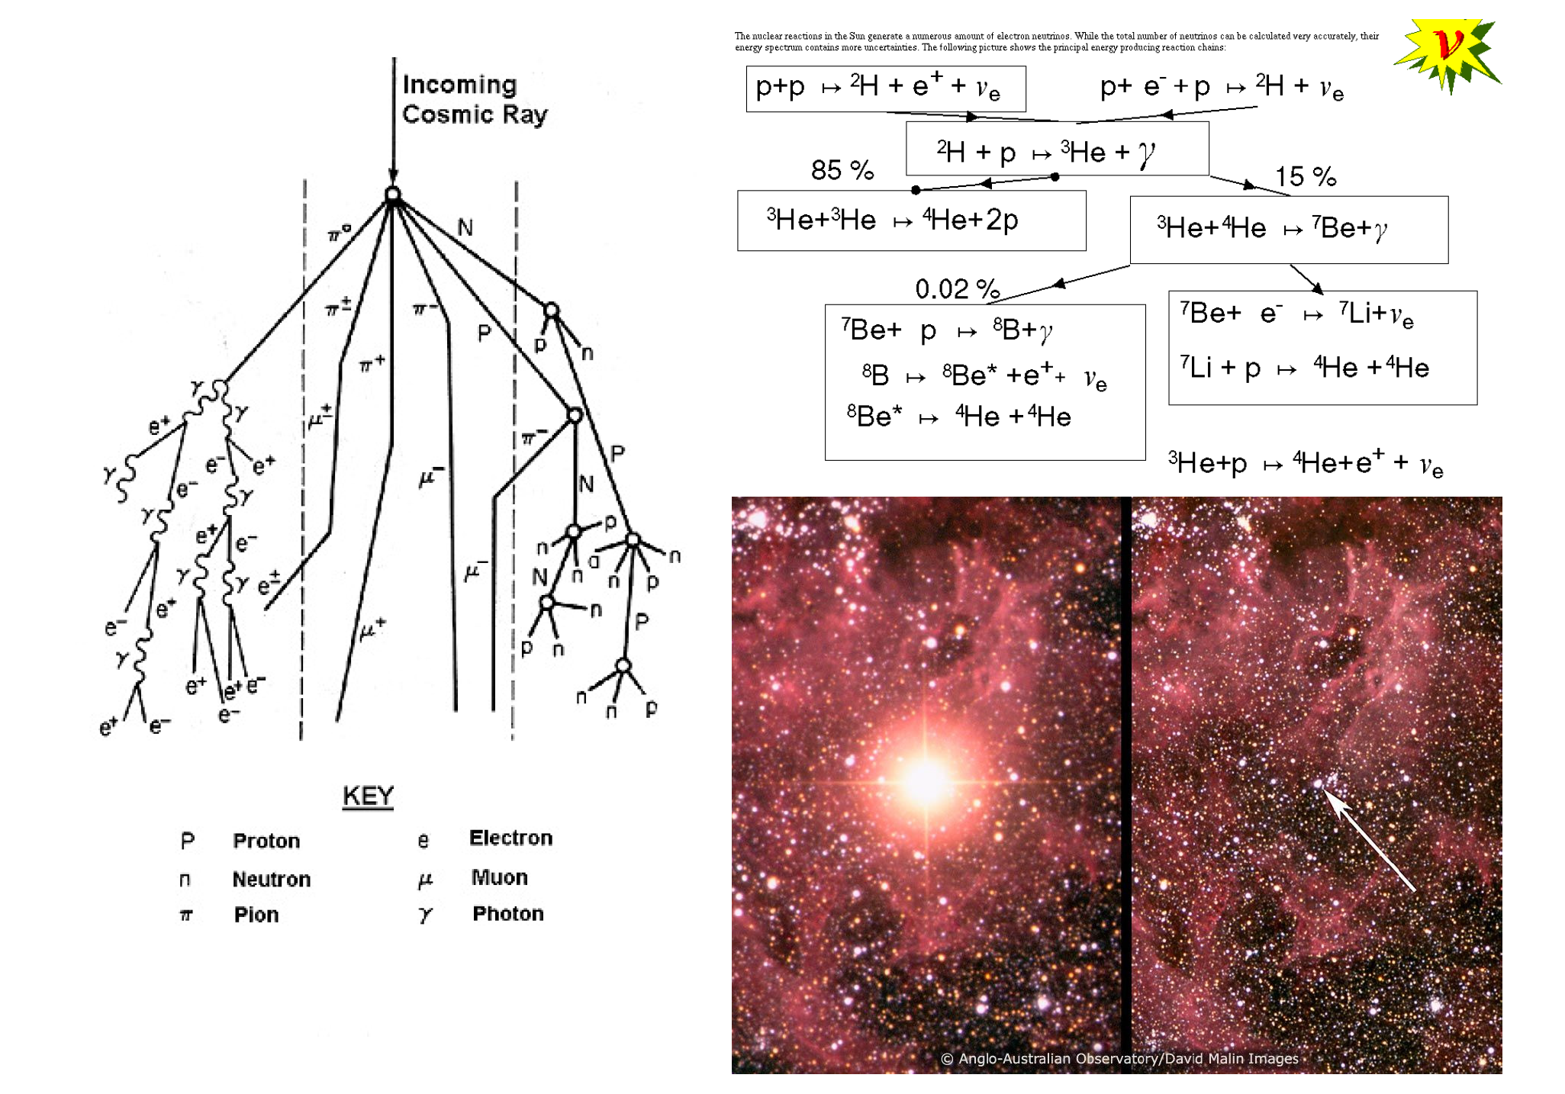
Astrophysical Neutrino Sources

Slide 38
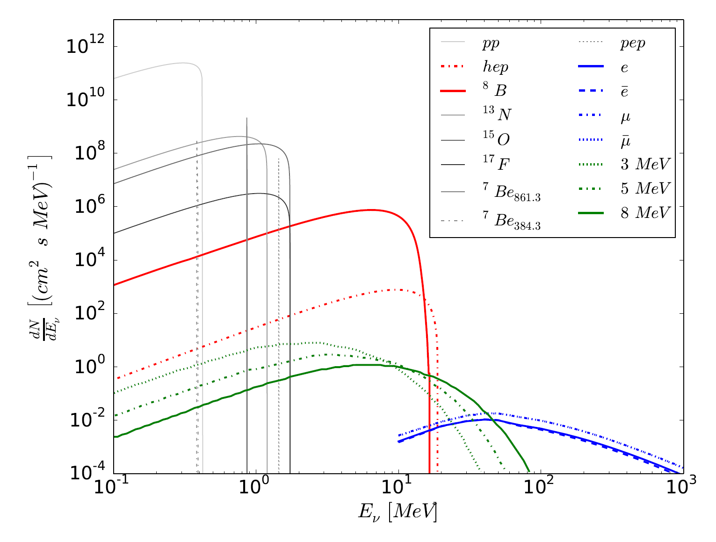
Neutrino Background
SOLAR
DIFFUSE SUPERNOVA
ATMOSPHERIC

Slide 39
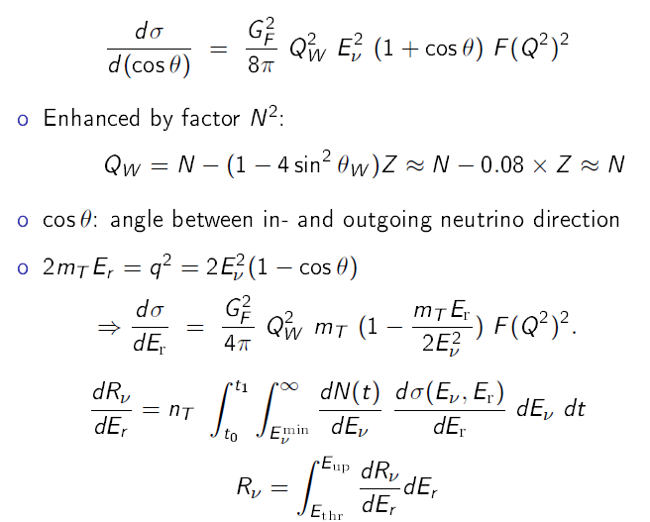
Coherent Neutrino-Nucleon Flux

Slide 40
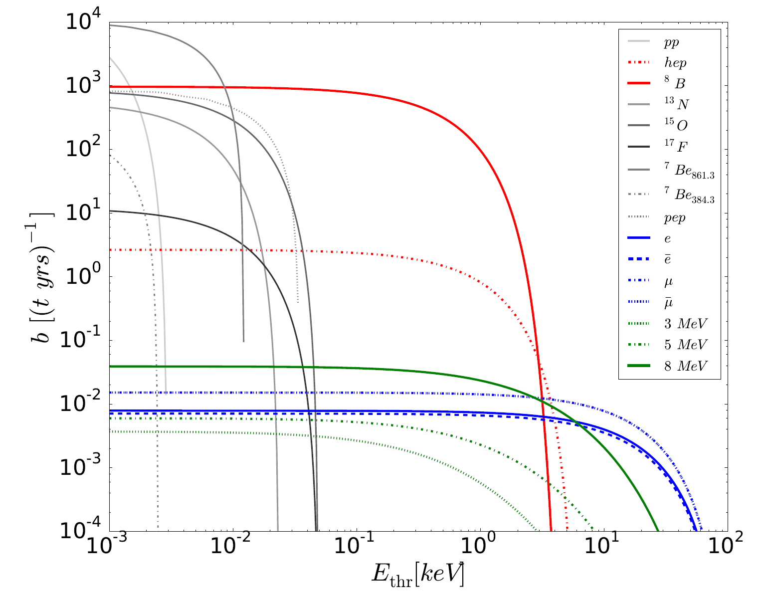
Integrated Event Rate in CF₄ detector above different Thresholds

Slide 41
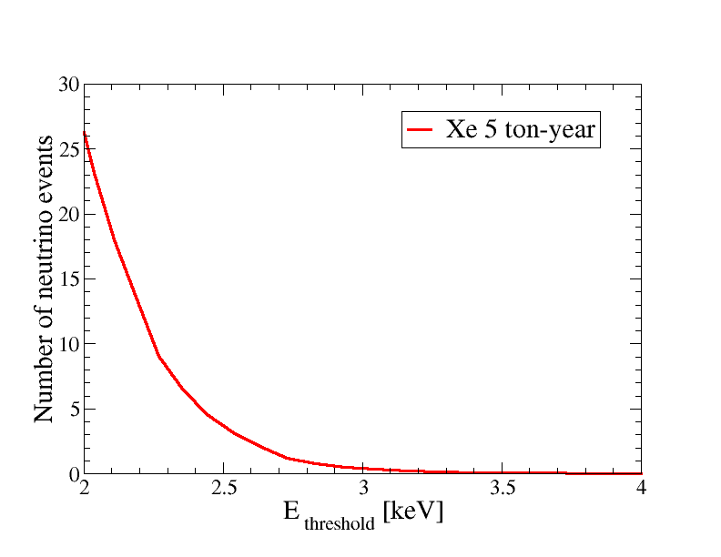
Integrated Event Rate in Xe detector above different Thresholds

Slide 42
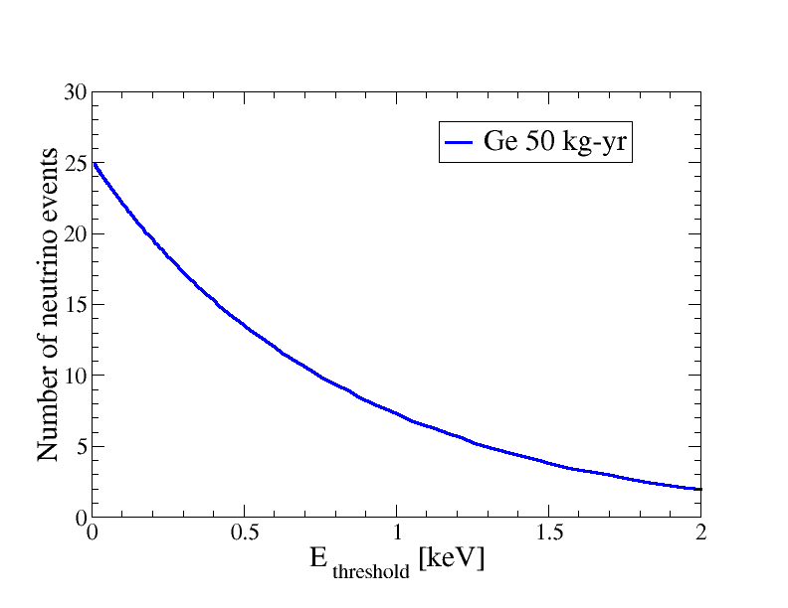
Integrated Event Rate in Ge detector above different Thresholds
(just B8 and hep, good approx…)

Slide 43
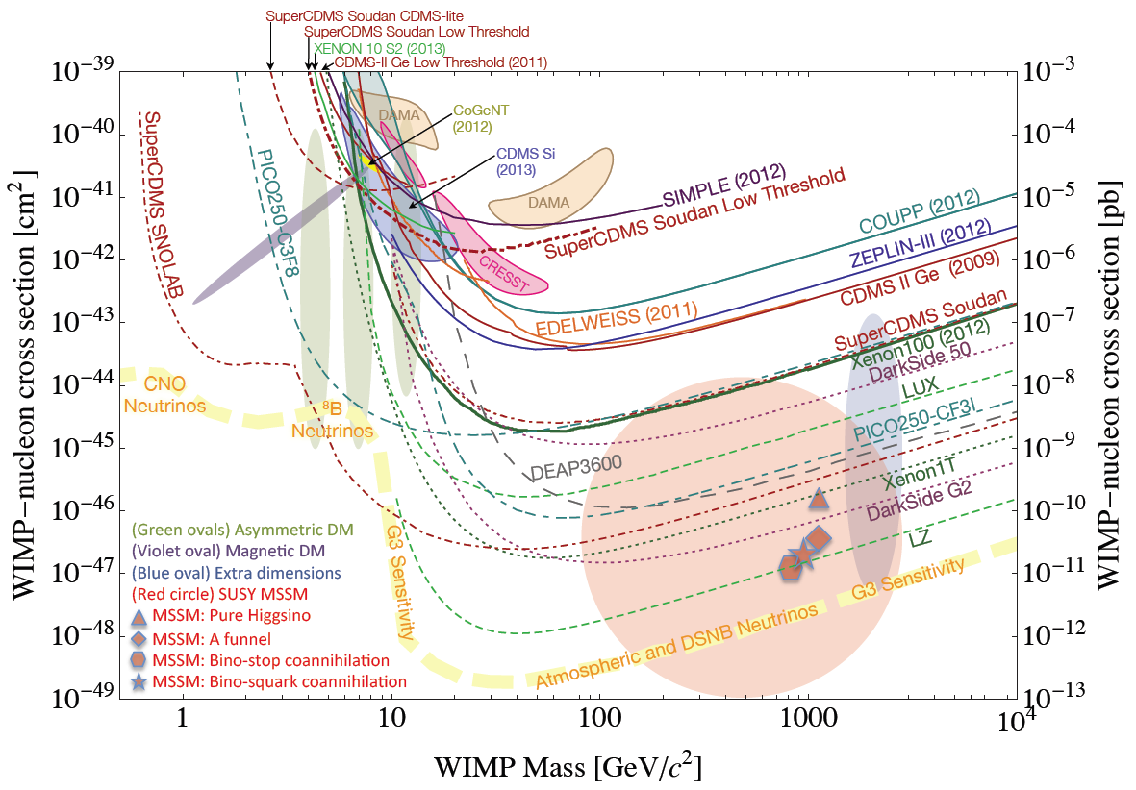
This leads to this plot which is becoming famous.
SNOWMASS Cosmic Frontiers 2013
Key reference :- Billard, Strigari & Figueroa-Feliciano arXiv:1307.5458
ν PROBLEM

Slide 44
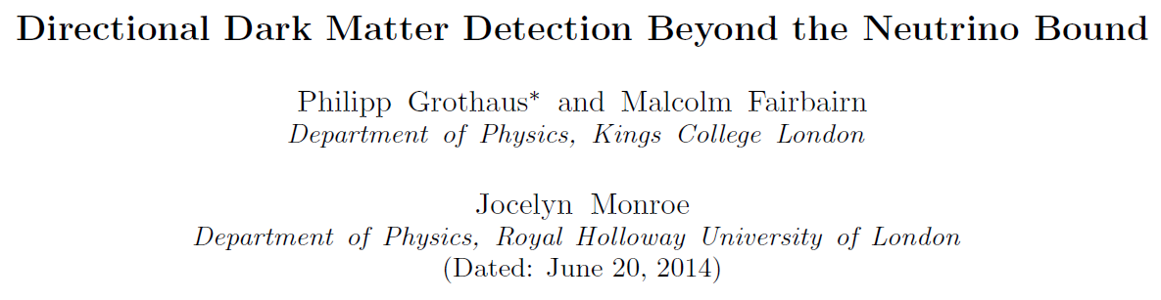
Here was our first attempt to look at the problem.
arXiv:1406.5047

Slide 45
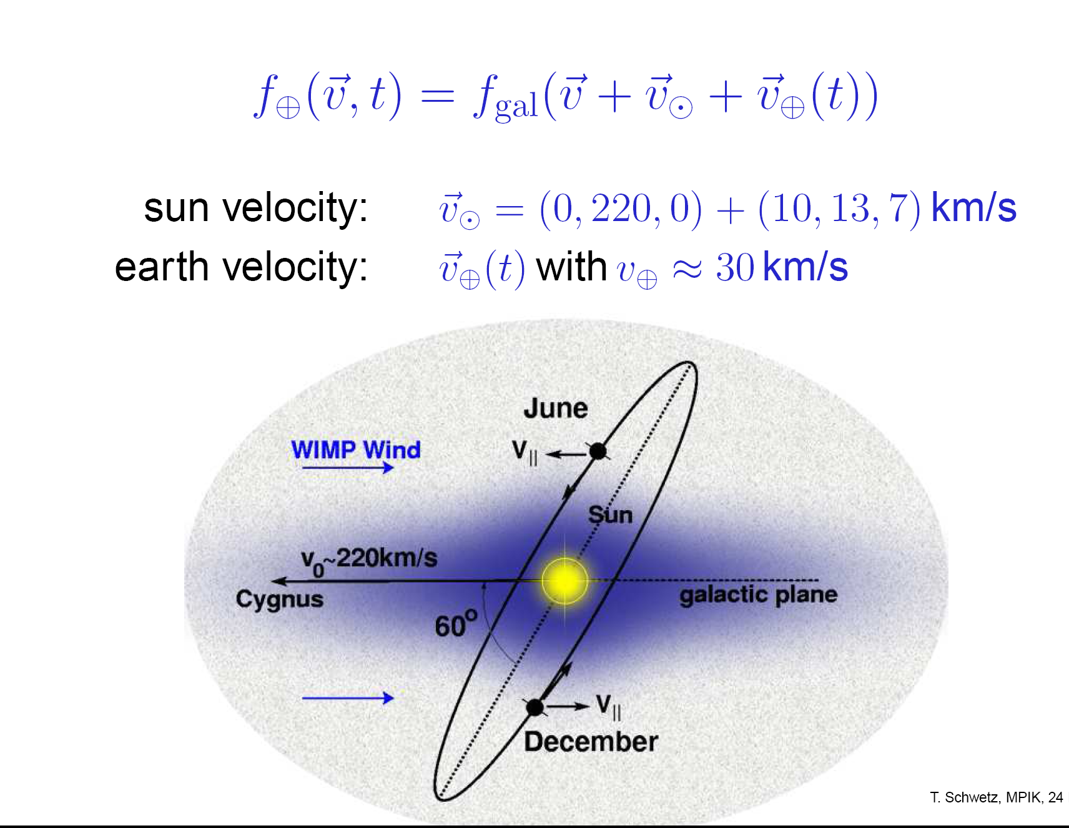
Motion of Earth relative to sun
Earth goes round Sun, Sun goes round Galaxy

Slide 46
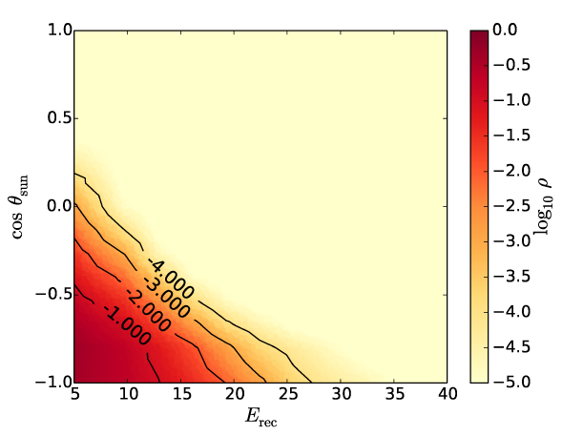
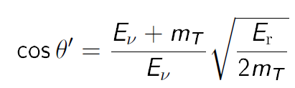
Relative angle between recoil from Solar neutrino and sun

Slide 47
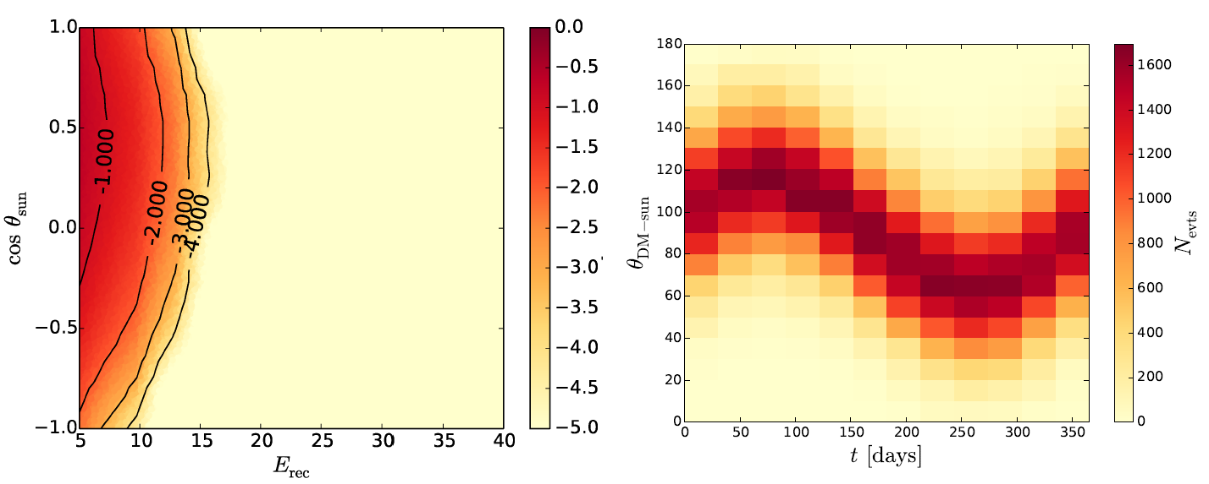
Relative angle between recoil from Dark Matter and sun
Preferred arrival direction roughly from Cygnus A
This changes during the year
Lighter (heavier) dark matter more (less) directional above a given threshold

Slide 48
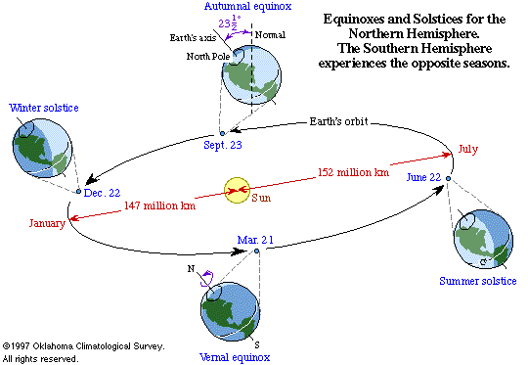
Also, distance between Earth and Sun changes throughout Year
modulates neutrino flux

Slide 49
two event distributions in 3D parameter space
(3D = energy, time, scattering angle)
Distributions:- A) neutrino
B) neutrino + dark matter
can we separate background from signal plus background?

Slide 50
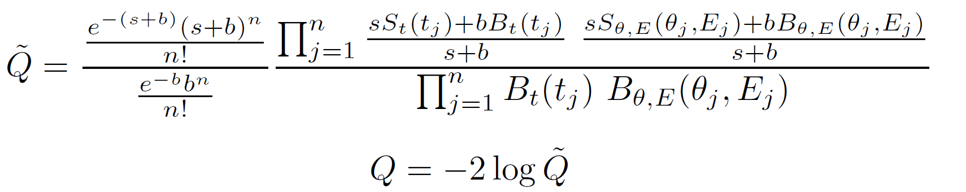
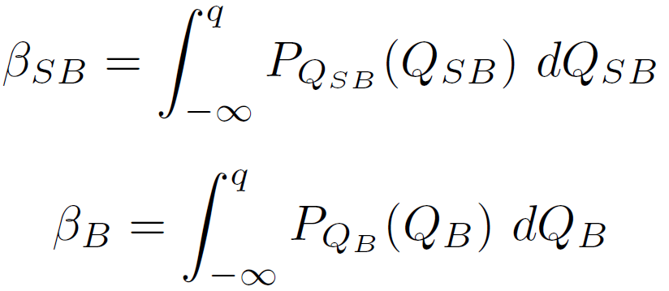
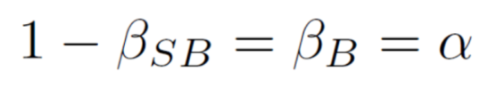
Statistics
Calculate expected number of ν events then generate n₁ events using Poisson
Choose dark matter mass and cross section and generate n₂ dark matter events
Generate Q_{B} for n1 ν events and Q_{SB} for n₁+n₂ ν+DM events, then
Choose integral limit q such that
where α is your desired exclusion probability.

Slide 51
Similarity of 6 GeV WIMP and Boron 8 background
Ruppin et al 1408.3581

Slide 52
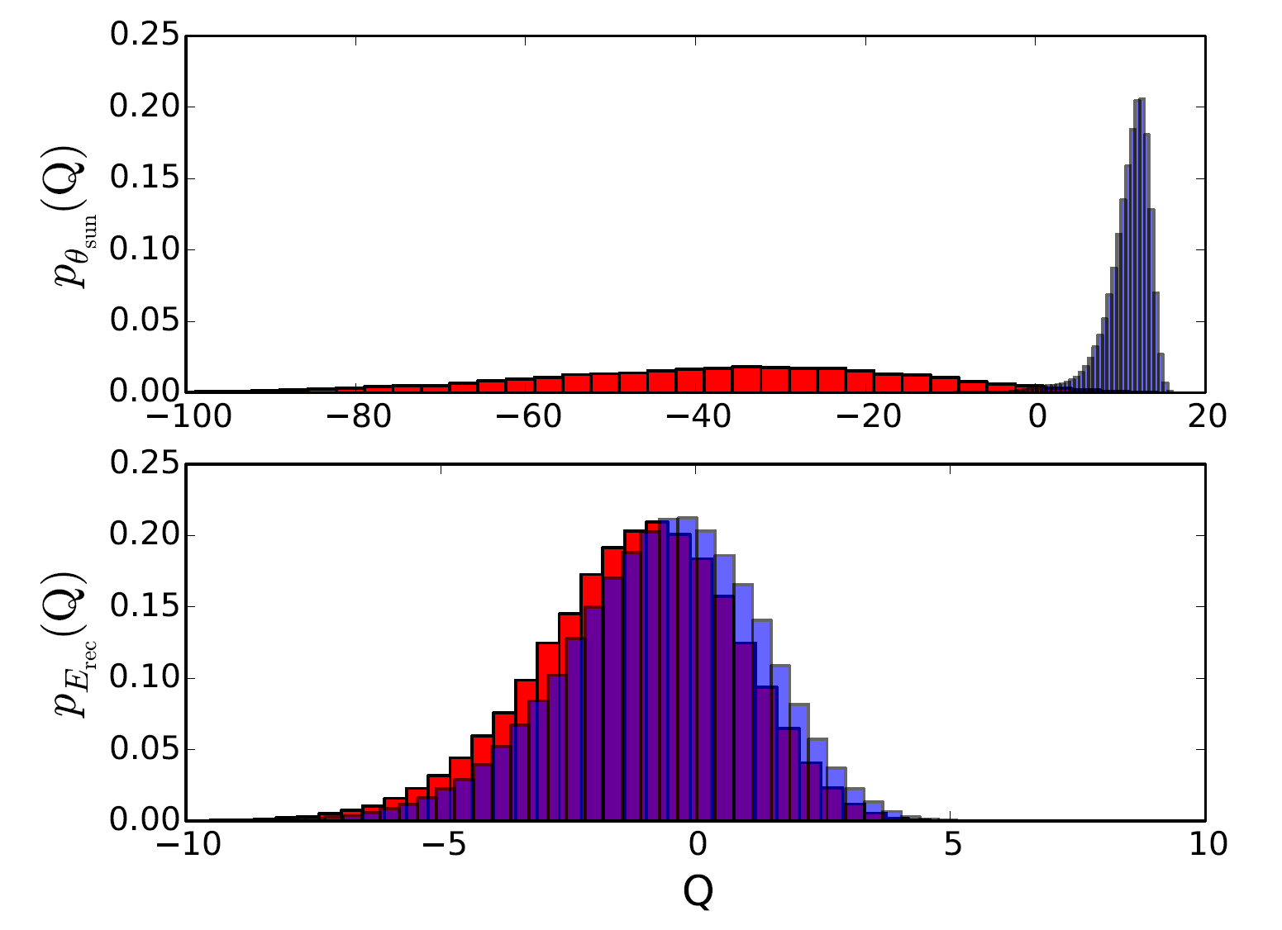
The normalised background only distribution p_{B}(Q_{B}) (blue) and signal plus background distribution p_{SB}(Q_{SB}) (red) including angular information (top) and excluding angular information (bottom) for s=10 and b=500 for a 6 GeV dark matter particle in a CF₄ detector.

Slide 53
Various Effects, some of which compete with each other:-
For Low mass DM, only fastest moving particles will give a signal, so that points right back to Cygnus, easy to discriminate from the Sun
High mass DM can give a signal for DM coming from all directions so directionality less important, but it has an energy spectrum quite different from solar neutrinos
Higher energy recoil tracks have a much better directional angle reconstruction

Slide 54
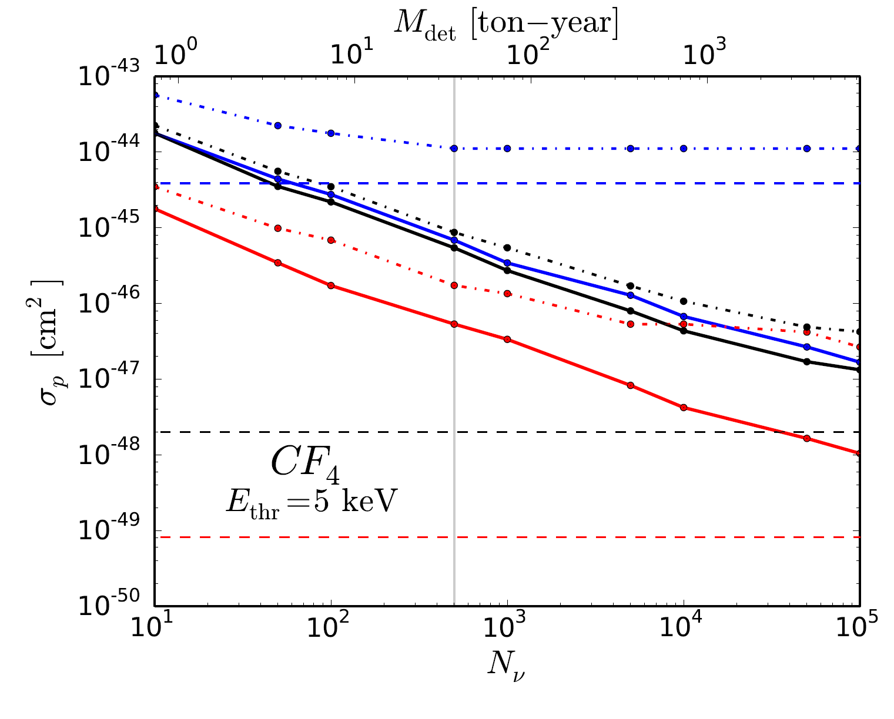
How far can we push things?
Horizontal Dashed lines are naïve neutrino barrier. Dot dash is without directional, solid with directional.
6 GeV
30 GeV
1000 GeV
Ultimately, this depends on how well we know the neutrino background

Slide 55
Same thing for imaginary Xenon Directional Detector
6 GeV
30 GeV
1000 GeV

Slide 56
Effect of Time resolution on the 6 GeV case
Davis arXiv:412.1475

Slide 57
Effect of Time resolution on the 6 GeV case
There are things we can do to get past the neutrino bound, but they are really hard.
Lets hope we don’t have to!
Davis arXiv:412.1475

Slide 58
Conclusions
Ongoing Searches for dark matter.
No completely convincing evidence so far.
Devices are in place and running / will start in the next years, LHC, LUX, SuperCDMS, Xenon 1T, LZ, Fermi, CTA - critical next period.
Neutrino bound will help shape future of
direct detection.

Slide 59
ADDITIONAL MATERIAL

Slide 60
Future Prospects for understanding background
Solar flux in our range of interest dominated by B-8 and He-p neutrinos – depends sensitively upon iron abundance in core of Sun, abundance problem
SNO+ will measure B-8 and Be-7 neutrinos which will hopefully tie this down.
Longer term Hyperkamiokande would detect hundreds of B-8 neutrinos per day and test for time variation!
Possible upgrade of Superkamiokande with Gadolinium will increase discrimination and should make it capable of detecting the Diffuse supernova and atmospheric neutrinos
A supernova might go off! Would be very useful. Please lobby your local deity.
Studies of geomagnetic field, solar wind and nuclear propagation models will all reduce uncertainties in atmospheric neutrinos.

Slide 61
For example, this is the effect of reducing error on Atmospheric neutrino flux
Ruppin et al 1408.3581

Slide 62
Current Experimental Status of Directional Detection
Essentially still in R & D phase, detectors with directional sensitivity not yet competitive
Small prototypes have demonstrated energy thresh-
olds of a few keV
at higher thresholds (50 keV-100keV) have demonstrated angular resolution of 30-55 degrees

Slide 63
Current Experimental Status of Direct Detection
DMTPC experiment
(for example)
50 Torr pressure CF₄
Camera images tracks
Electronics veto electrons
See e.g. arXiv:1301.5685
10cm
TINY experiment,
Only a few grams for now!
27cm

Slide 64
Simplified Model Lagrangian –
Dijet analysis
Choose mass close to resonance and some couplings
Obtain relic abundance (using full expression not velocity expansion)
Test for relic abundance, see if its within Planck errors (if not goto 1)
Use Madgraph and Pythia to generate events with at least 2 jets with p_{T} > 30 GeV and |η| < 2.5
Use Fastjet to form outgoing jets using trigger parameters from CMS analysis m_{jj} > 890 GeV and |η_{jj}| < 1.3
Look for constraints based upon 300 fb⁻¹ at 14 TeV assuming similar signal to background ratio to run 1
We respect Γ_{A’} < 0.15 m_{A’} to allow events to be studied in context of CMS narrow dijet search :-
CMS-PAS-EXO-12-059

Slide 65
Combining different targets not particularly effective for Spin Independent Searches…
Ruppin et al 1408.3581

Slide 66
…but more interesting for Spin Dependent Searches
Ruppin et al 1408.3581

Slide 67
The Phenomenology of the Extra Scalar Field
Two mass eigenstates:-
Effective branching ratio of needs to be calculated. Introduce parameter
Then current constraints are
Likewise can look at coupling of to the standard model. Signal strength is
and for , this latter constraint dropping rapidly as the mass increases
For LHC constraints,
Ellis and You 2013
Falkowski, Riva and Urbano 2013
CMS 1304.0213

Slide 68
Statistics
Calculate expected number of ν events then generate n₁ events using Poisson
Choose dark matter mass and cross section and generate n₂ dark matter events
Generate Q_{B} for n1 ν events and Q_{SB} for n₁+n₂ ν+DM events, then
Choose integral limit q such that
where α is your desired exclusion probability.

Slide 69
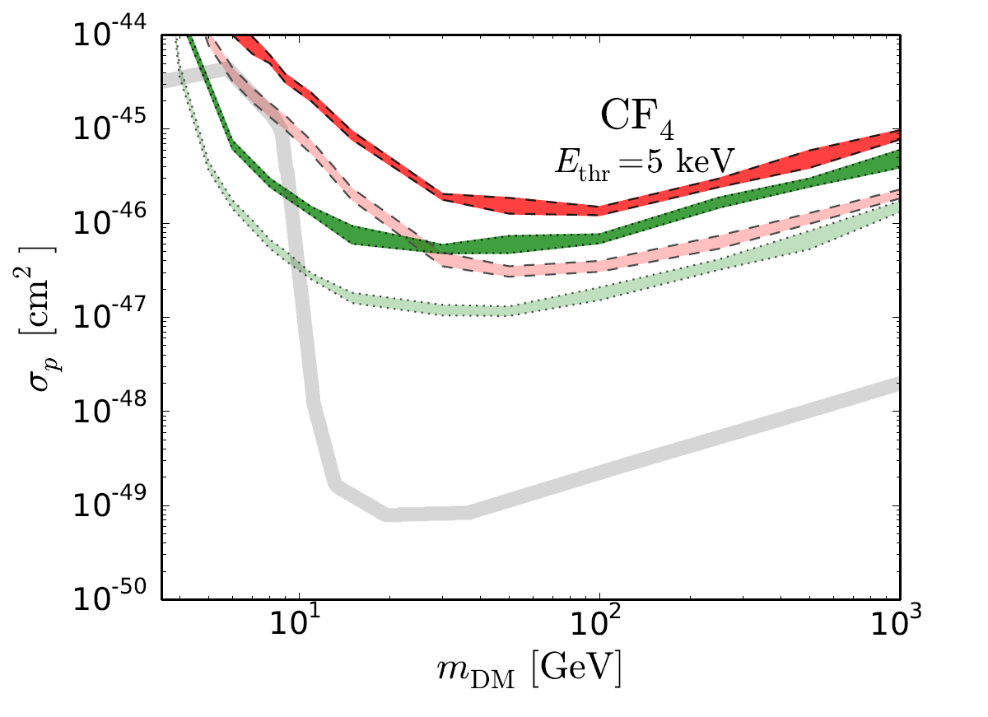
Results (in comic sans)
36 ton years of CF4 (500 neutrino events)
Energy threshold = 5 keV
Green is with directional dependence, red without.

Slide 70
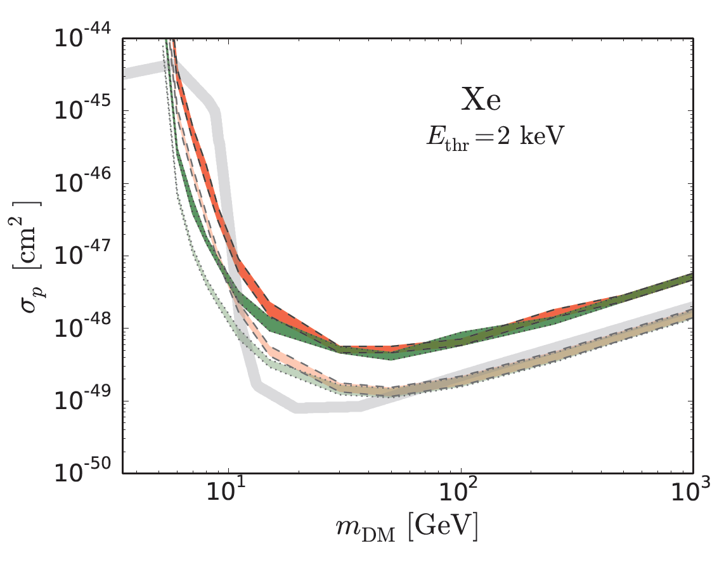
Results
NOTE THIS IS ALL THE XENON. ALL OF IT.
367 ton years of Xe (500 neutrino events)
Energy threshold = 2 keV
Green is with directional dependence, red without.

Slide 71
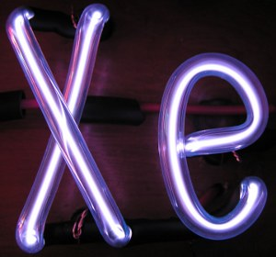
Some fun facts about Xenon
(mostly from Wikipedia)
Makes up 0.1 ppm of air - 10¹² tons in total
Costs about $3 per gram
Only about 36 tons obtained per year
Increased demand might actually lower the cost (that was the one that didn’t come from wikipedia)
Xenon is used as a general anaesthetic
Ultraviolet laser
Fluoresces with same colour as noon day sun
Photographic Flash Tube
Protects against brain and cardio damage when blood supply compromised
Couldn’t tell from Wikipedia if it gets you high

Slide 72
Philosophy
Understand and quantify problem of neutrino background
Estimate the size of detectors required to fight the problem
Throw ideas around
Can we come up with ideas for viable detectors? (not yet)
YES
NO
OK, should we build them?
OK, end of direct detection.

Slide 73
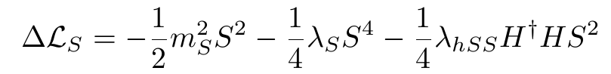
Higgs Portal Dark Matter
Simply another particle which couples to the Standard model through the Higgs
Scalar dark matter
Standard model Higgs Field
V. Silveira, A. Zee, Phys. Lett. B161, 136 (1985);
J. McDonald, Phys. Rev. D50 (1994) 3637-3649;
C. P. Burgess, M. Pospelov, T. ter Veldhuis, Nucl. Phys. B619 (2001) 709-728;
L. L. Honorez, E. Nezri, J. Oliver, M.H.G. Tytgat, JCAP 0702 (2007) 028

Slide 74
Higgs Portal Dark Matter
Simply another particle which couples to the Standard model through the Higgs
Scalars dramatically improve vacuum stability
V. Silveira, A. Zee, Phys. Lett. B161, 136 (1985);
J. McDonald, Phys. Rev. D50 (1994) 3637-3649;
C. P. Burgess, M. Pospelov, T. ter Veldhuis, Nucl. Phys. B619 (2001) 709-728 [hep-ph/0011335]

Slide 75
Higgs Portal Dark Matter
Feng et al. arXiv:1412.1105

Slide 76
Higgs Portal Dark Matter
Feng et al. arXiv:1412.1105
Difficult to rule out, perhaps not impossible

