Slide 1
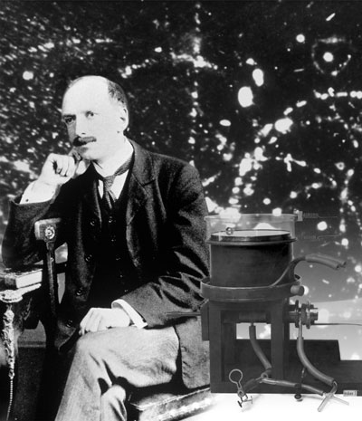
CLOUD CHAMBER
There are more particles around us at all times.
We just needed to learn how to look.
Particles
  Bringing particle physics to life, we can build our own cloud chamber.
Detectors
Cloud Chamber: 1911, C.T.R. Wilson (Nobel Prize)
  Vapors condensate into tiny droplets around ionized atoms along charged particle trajectories.

Slide 2
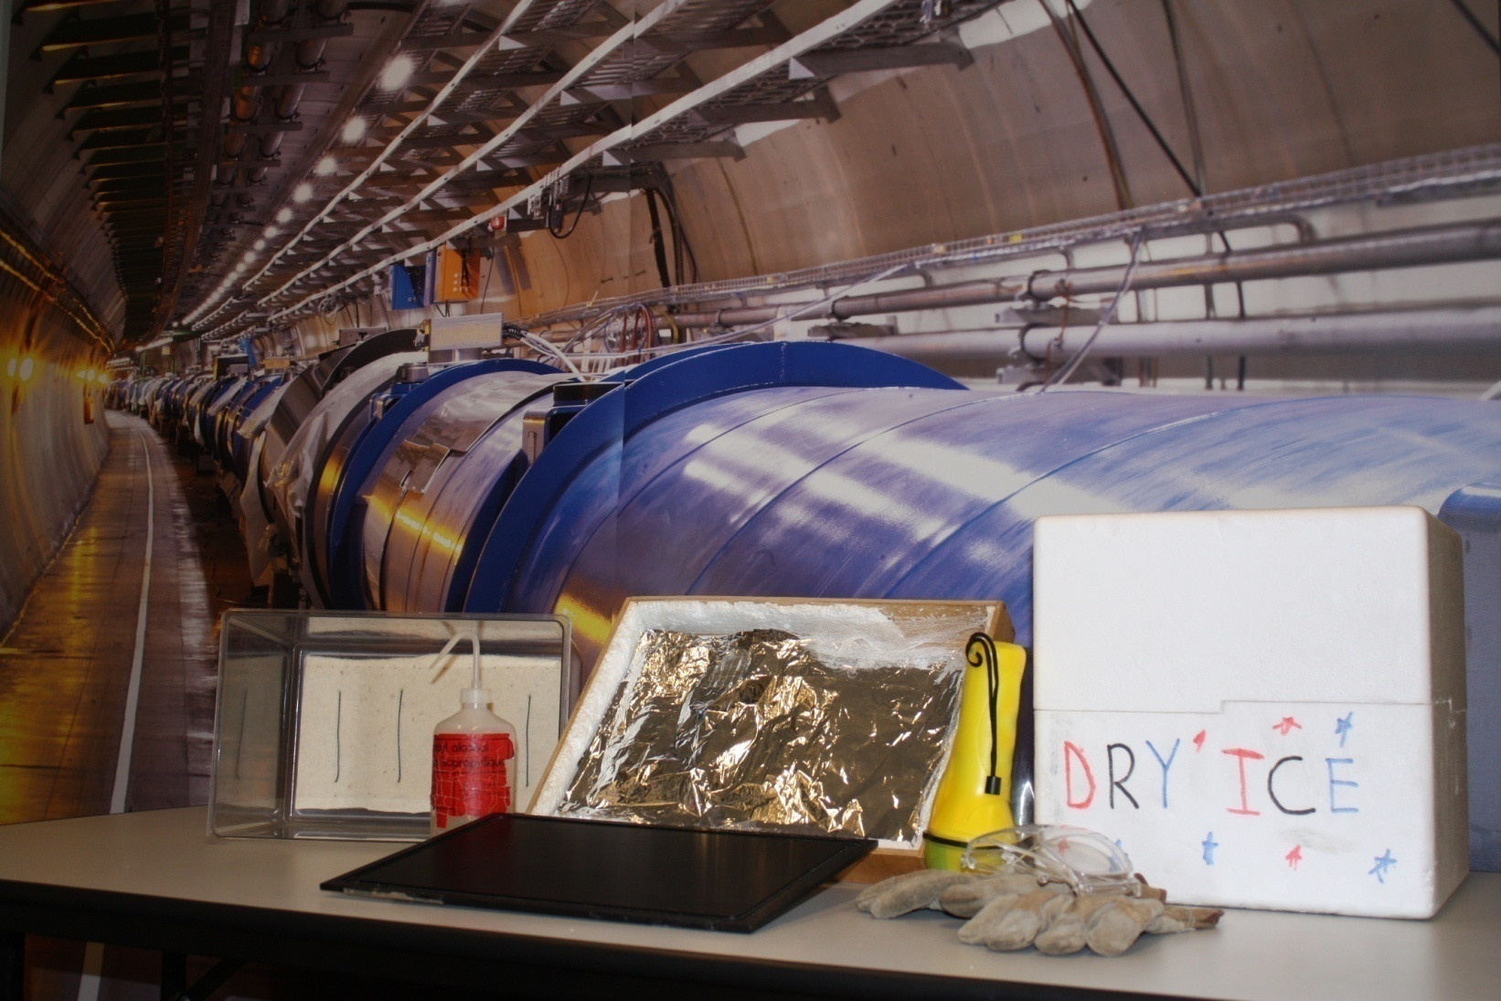
CLOUD CHAMBER
Wood Box + Aluminium Foil + Net
Pure Isopropyl Alcohol
Dry Ice
Small Metal Wire
Light Source
Thick Felt
Plastic Container
Metal Plate
Gloves + Goggles

Slide 3
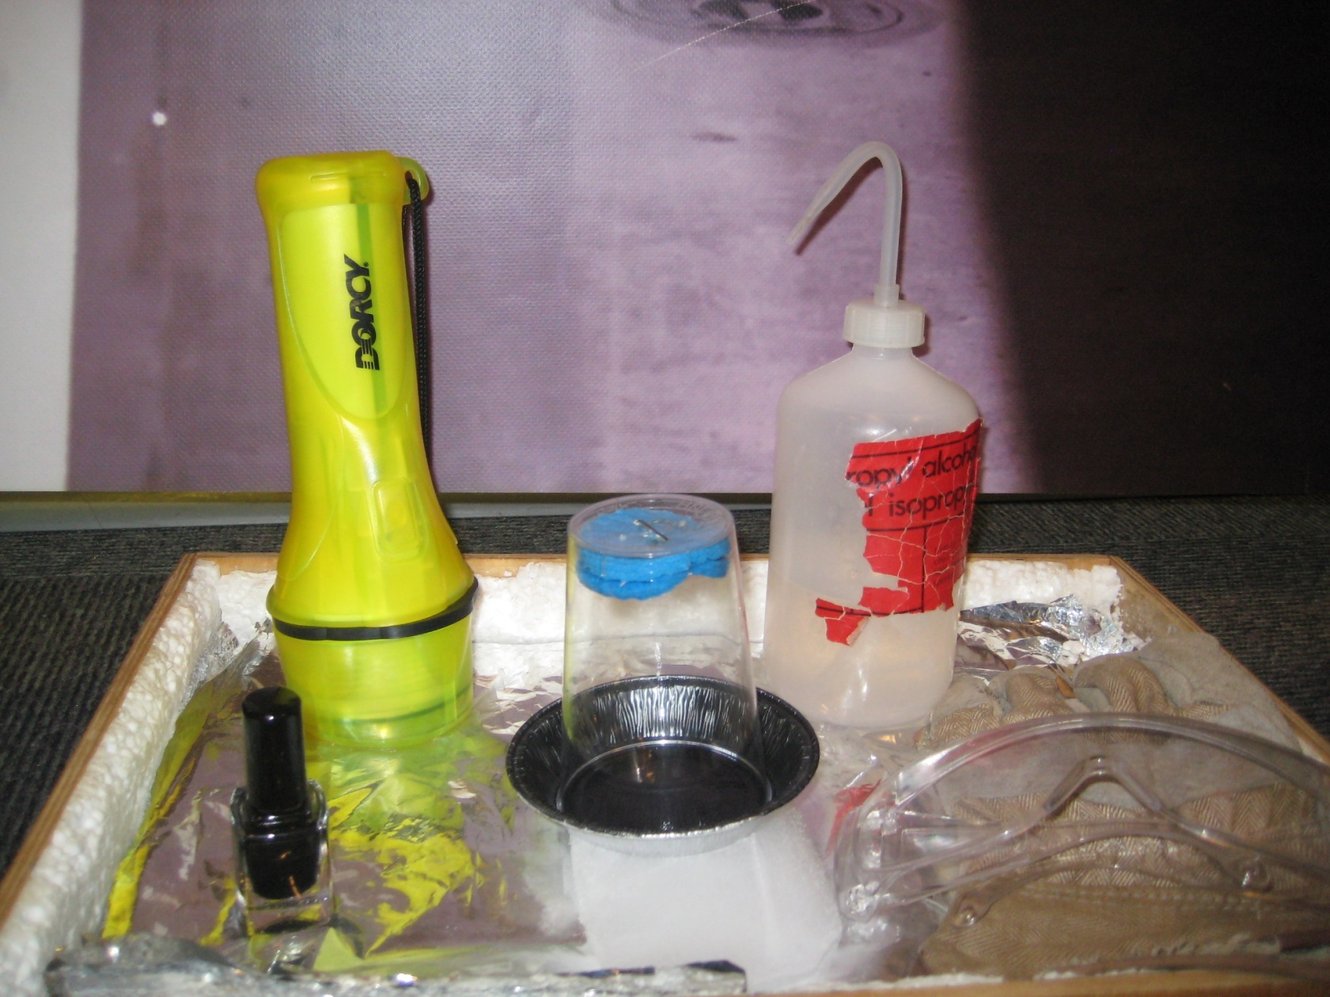
GSSH’s CLOUD CHAMBER
Seyhan
Supattra
Hassan
Gökçe
Pure Isopropyl Alcohol
Light Source
Small Metal Wire
Thick Felt
Rubber Foam
Plastic Container
Plastic Glass
Dry Ice
Black
Metal Plate
Nail Polish
Aluminium Ravier
Gloves + Goggles

Slide 4
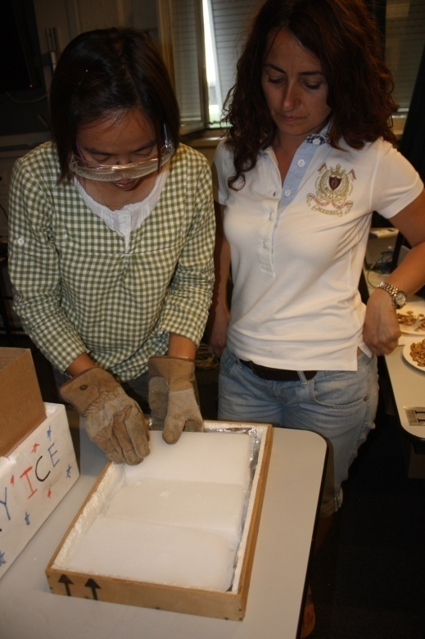
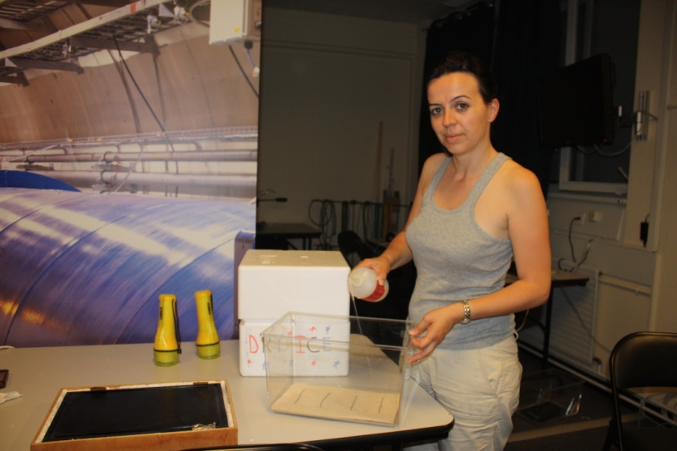
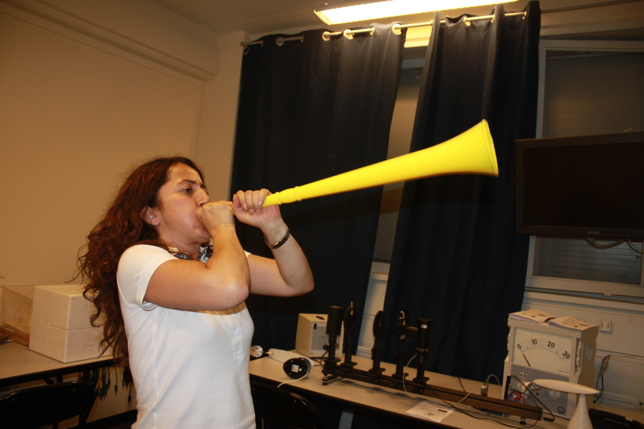
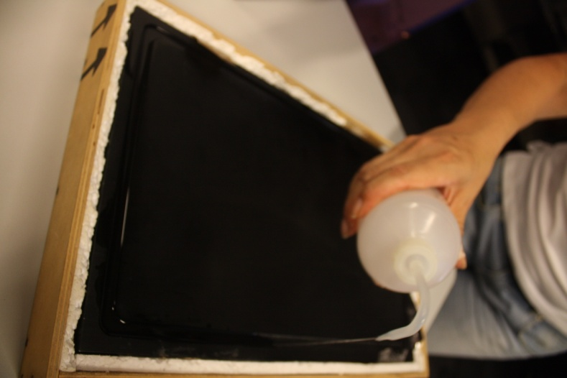
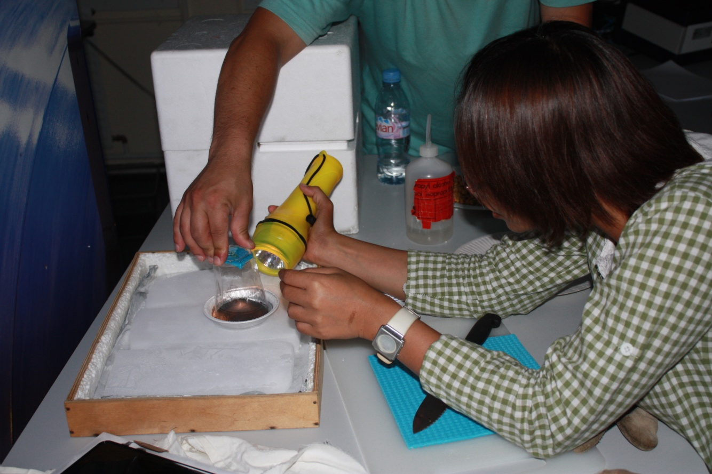
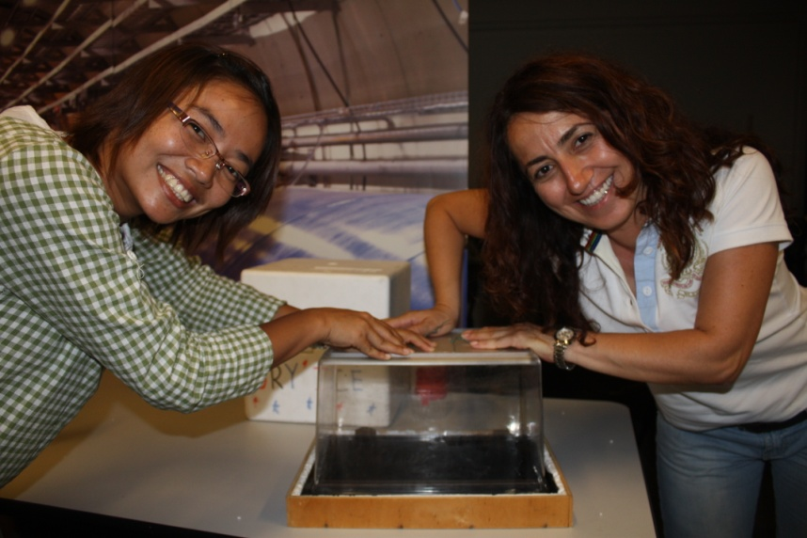
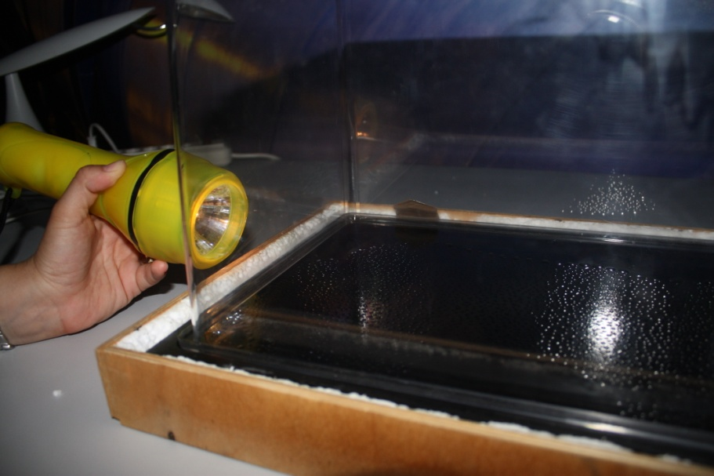
CLOUD CHAMBER

Slide 5
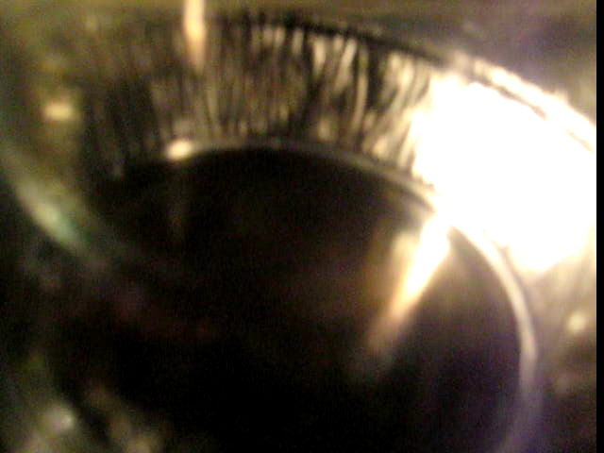
CLOUD CHAMBER

Slide 6
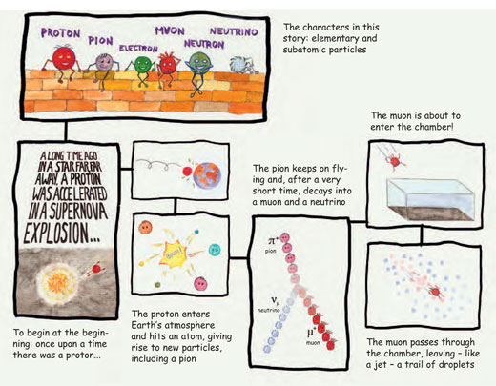
CLOUD CHAMBER
http://www.scienceinschool.org/2010/issue14/cloud

Slide 7
CLOUD CHAMBER
Showing your class a working cloud chamber is one of the best ways to generate student interest in modern physics.
Cloud chambers can be used to show students.
  Now we are heading back to space, to see what more we can figure out!

