Slide 1
Status of Super-FRS Construction
M. Winkler
CERN-GSI Technical Coordination Meeting

Slide 2
Outline
Super-FRS Layout and Design Principles
SC Magnets, Testing and Local Cryogenics
NC Magnets (radiation hard)
Target Area Installation and Infrastructure
Super-FRS Beam Diagnostics and Instrumentation
Civil Construction
Summary
Presentation as shown on April 28, 2015 at the
13th FAIR - Machine Advisory Committee Meeting
Notes:
In-Flight → energies as high as 1500 MeV/u

Slide 3
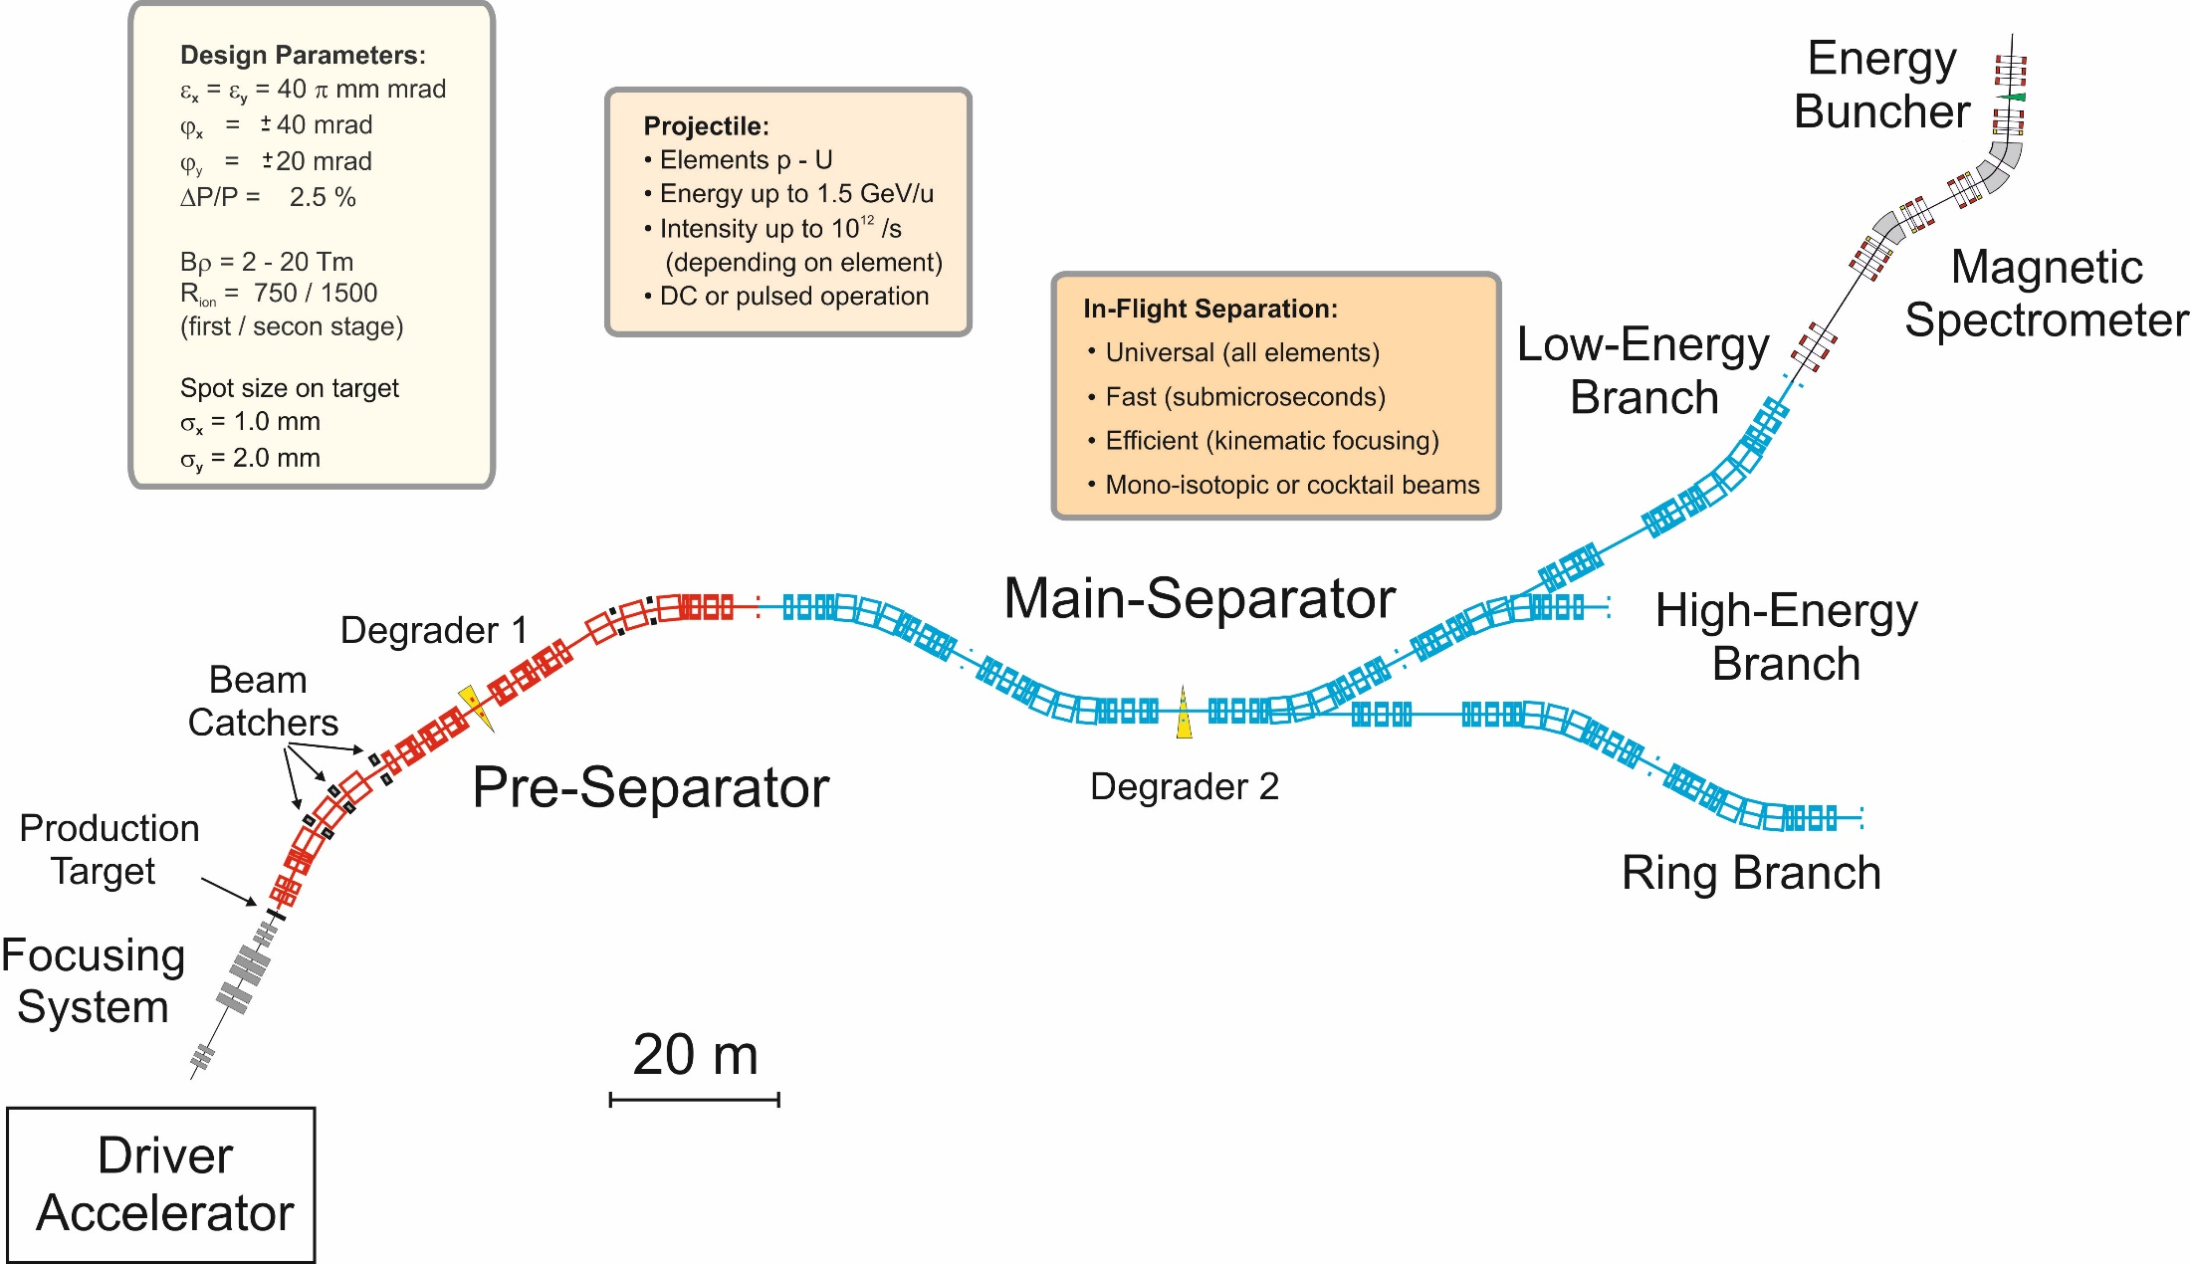
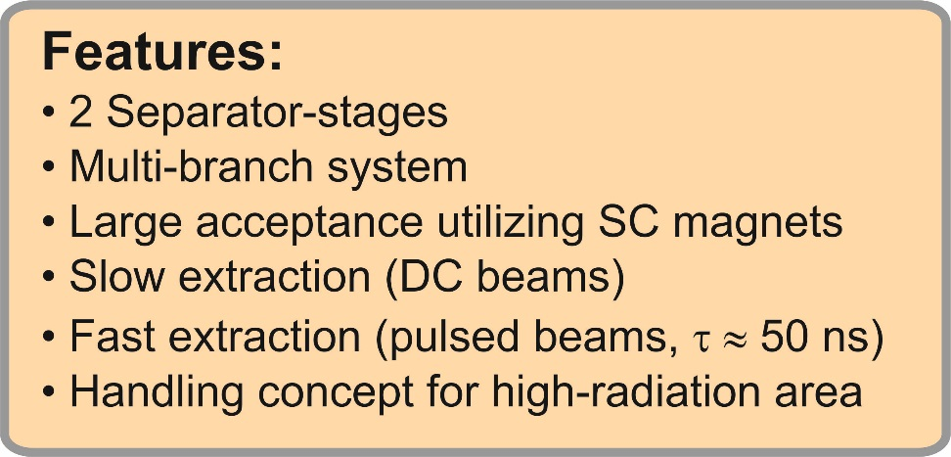
Super-FRS Layout (Full Version) and Design Principles
±
The Design Parameters and Principles (energy range, separation performance, lattice, aberration scheme) were intensively reviewed during the SRG in 2008
(international advisors from RIKEN, NSCL-MSU, CERN, Texas A&M)

Slide 4
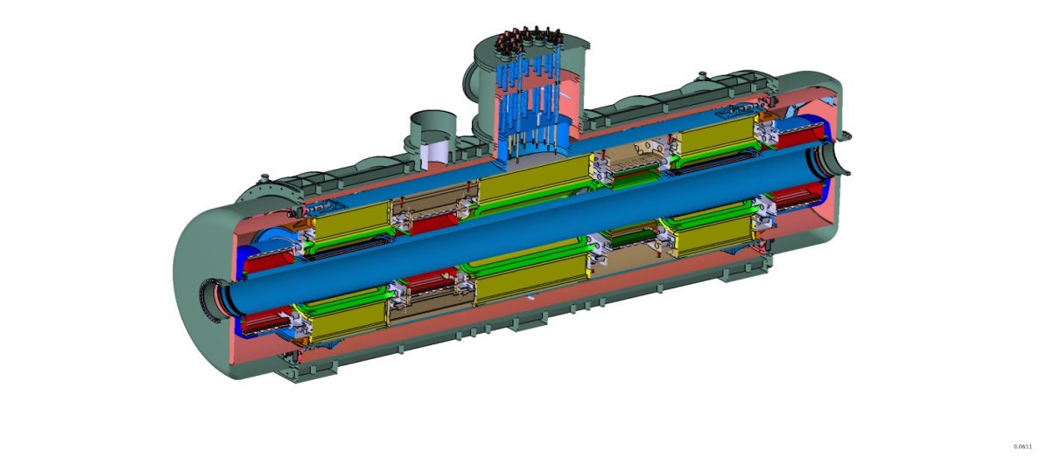
SC Multiplets
Overall Status:
Tender opened in Q3/2013
Tender was running regularly including 2nd round negotiation (Q2/2014)
Tender needed to be interrupted and re-initalized during 3rd round negotiation
  change of lot distribution required
  process supervision by a specialist solicitor
  establishing and assessment of revised tender documents 11/14
  revised offers (4) in 01/15
  negotiation with 2 companies in 03/15
  binding offers expected for April, 30
  → contract awarding
contract signing expected Q2/2015
FAT of first short multiplet Q1/2017
FAT of first long multiplet Q2/2017
Series testing: Q2/2018 – Q2/2021
7 m
25 long multiplets (mainly MS)
8 short multiplets (PS)
Quadrupol triplet / QS configuration
up to 3 sextupoles and 1 steerer
Octupole coils in short quadrupoles
offers received,
evaluation running
iron dominated, cold iron (≈40 tons)
common helium bath, LHe ≈ 1.300 l
warm beam pipe (38 cm inner diameter)
per magnet 1 pair of current leads
max. current <300A for all magnets

Slide 5
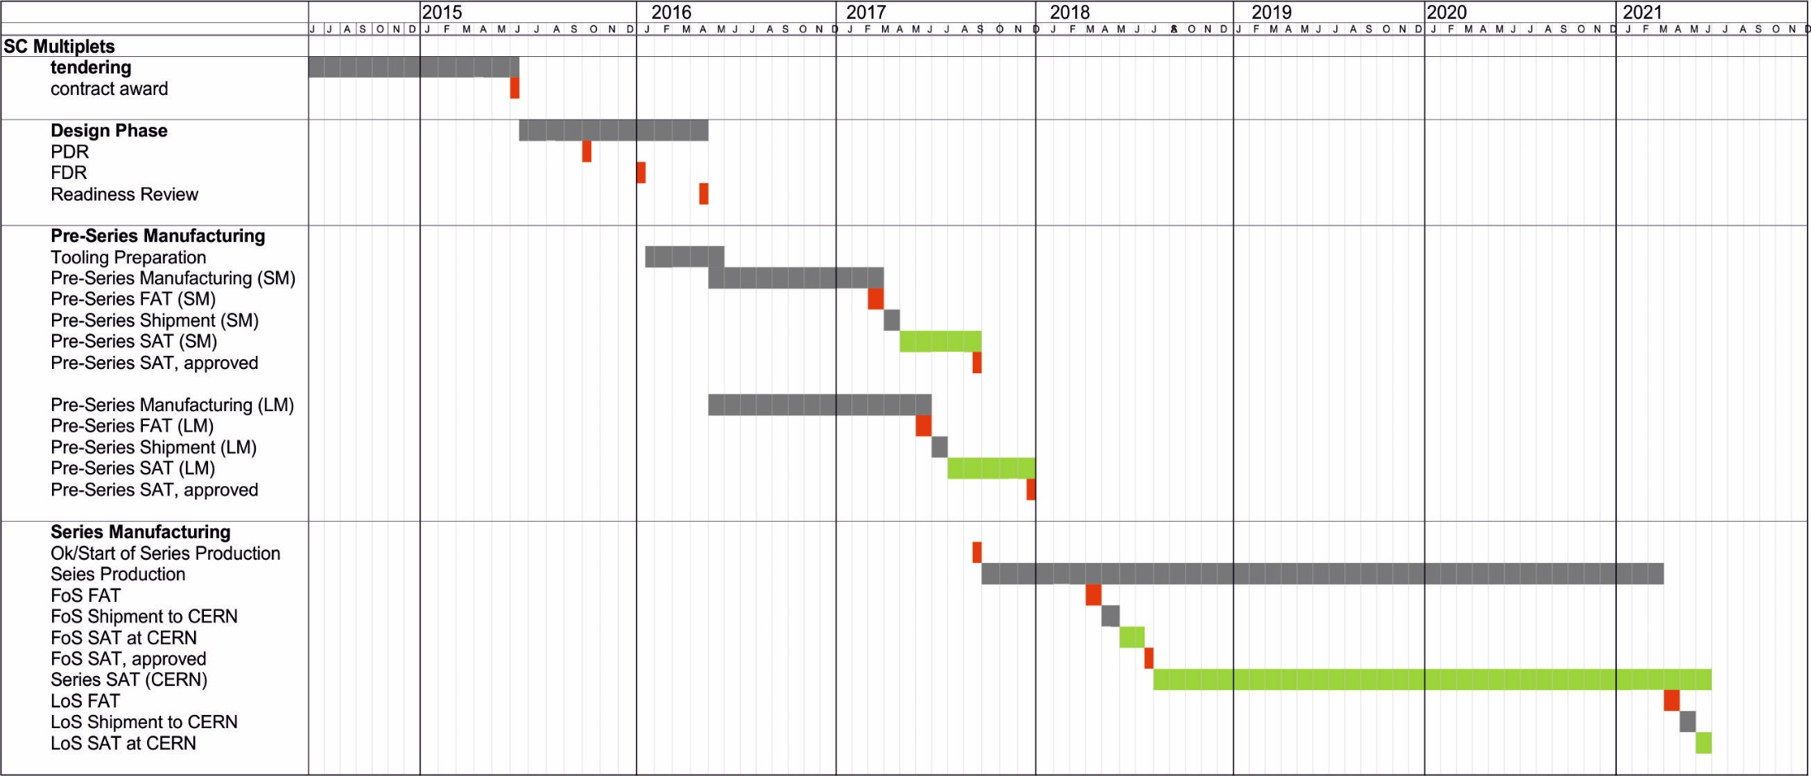
Overall Manufacturing and Testing Schedule for SC Multiplets
under discussion with CERN
Shown is the proposed timeline of bidder 1. The proposal of bidder 2 foresee a one month longer production time of the pre-series units and two month longer for the series

Slide 6

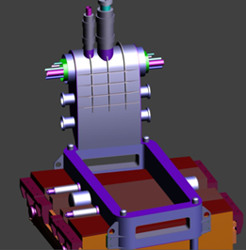
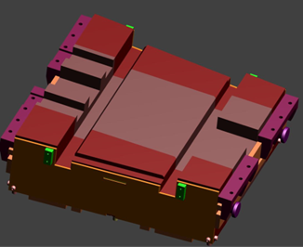
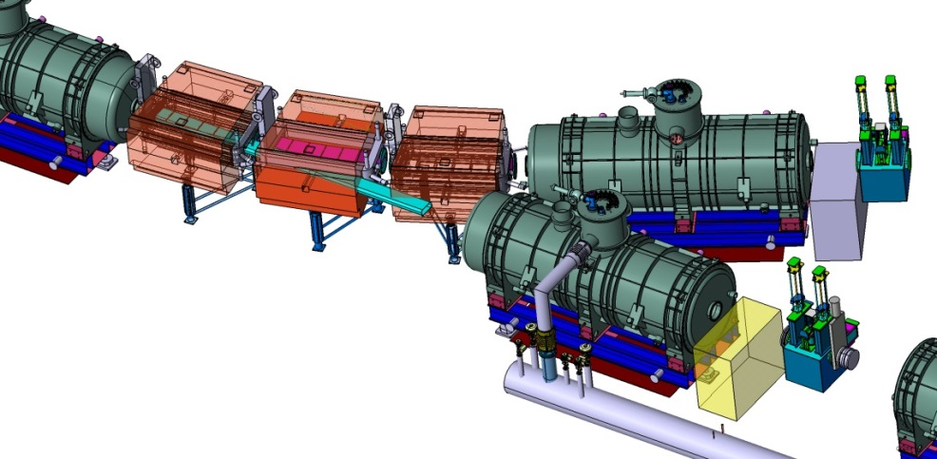
SC Dipole Magnets
IMP
Overall Status:
Collaboration agreement with CEA/Saclay:
  Detailed design, Technical follow-up
Technical Kick-off 1/2014
IMP Visit 04/2014 (CEA & GSI)
PDR July 3, 2014 (includes external advisor)
FDR Dec. 11, 2014 (excluding branching dipoles)
Pre-bidder information meetings Q4/2014
Tendering of SC wire, ready for awarding
Design finalization, preparation of documents
Tender by FAIR: Q3/2015
FAT Pre-Series: Q1/2017
SAT Series: Q2/2018 – Q2/2020
PDR
FDR
Branching Point
3 dipole units 11°
21 dipole units 9.75°
  3 times modified cryostat
Warm iron, SC coil
Aperture ±190mm x ±70mm
Weight: 50 to 60 ton
cryostat & yoke
modification
small yoke
modification

Slide 7
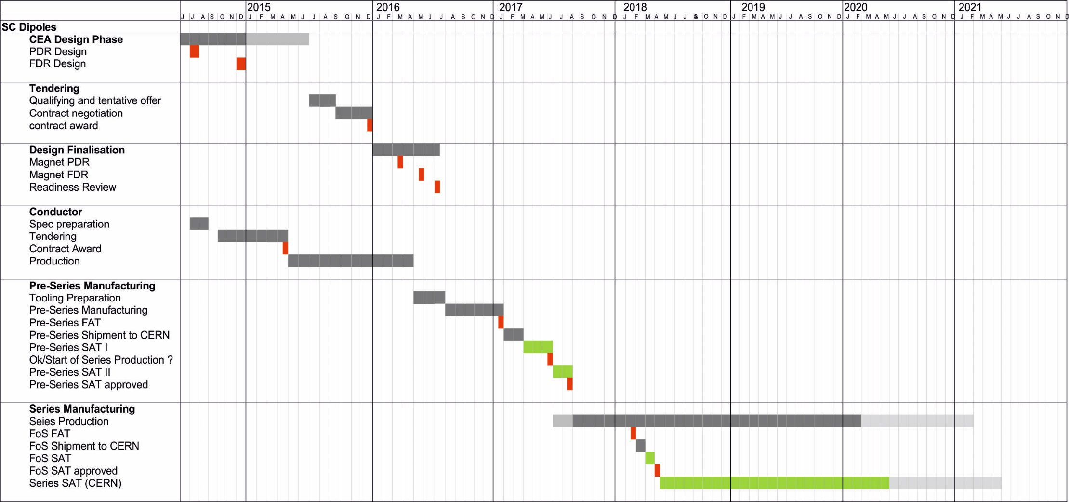
Overall Manufacturing and Testing Schedule for SC Dipole Units
design of branching units to be done (Q2/2015-Q2/2016)
worst case: go for NC solution (→ cooling water in tunnel)
long shipment period foreseen
pre-series testing period coincide with SM pre-series-testing

Slide 8
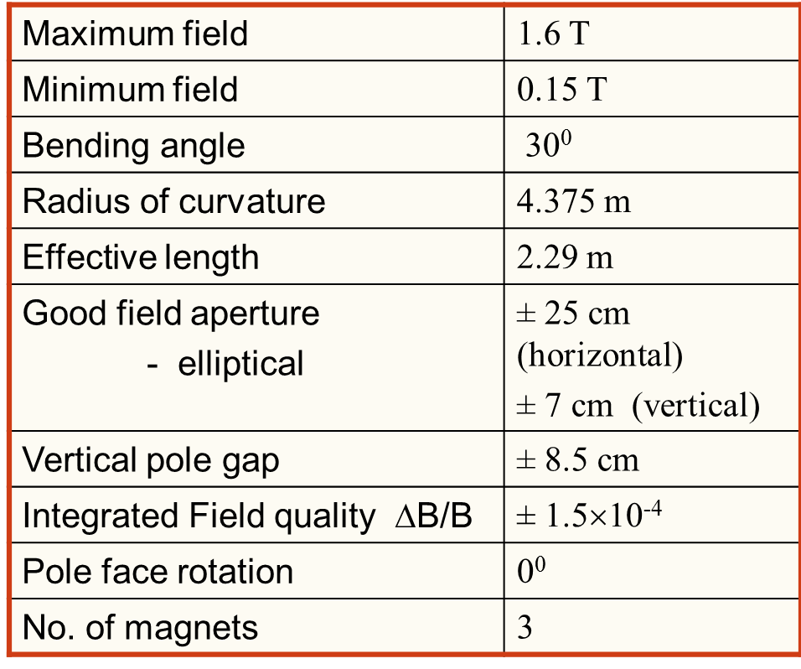
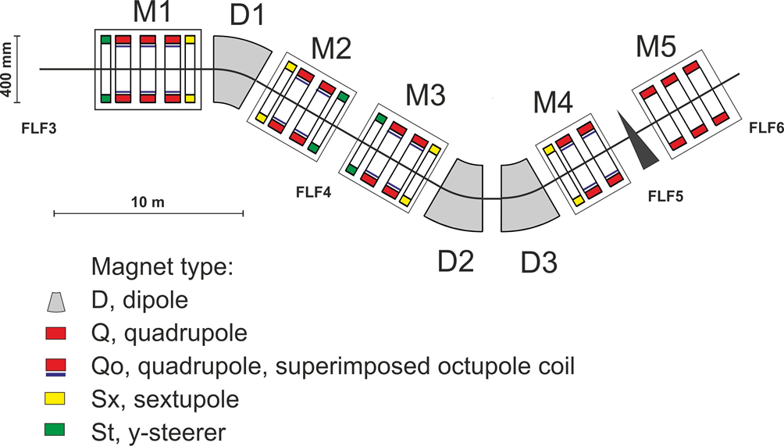
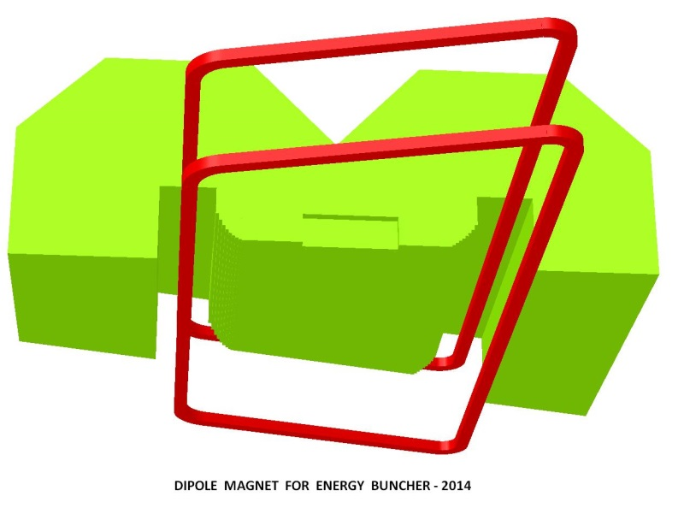
Magnets for Energy Buncher
Magnets are Indian in-kind
Layout and magnetic parameters fixed
VECC colleagues finalizing magnetic design
3 dipole units with 30°deflection angle
    superferric, warm iron, SC coils
    challenging: required field quality
    new design: weight ≈67 ton + cryostat
    Multiplet: identical magnet parameters like used in the separator, but different configuration required

Slide 9
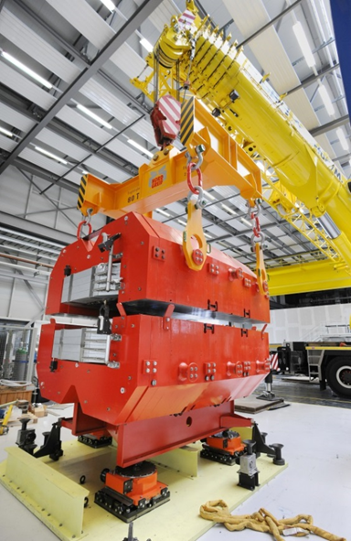
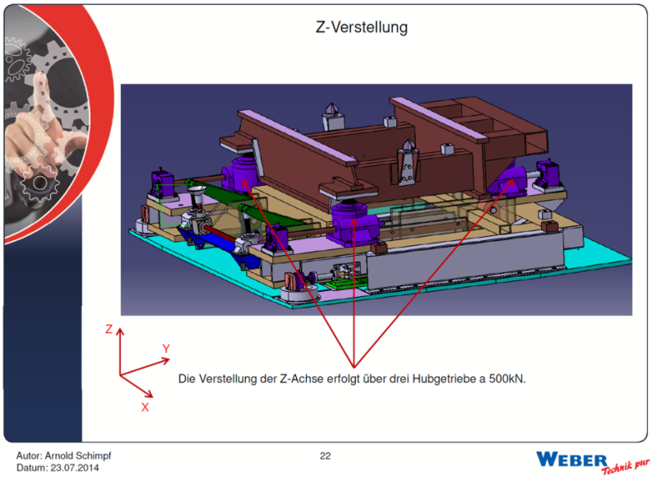
Radiation Resistant Magnets
(at the Target Area of Super-FRS)
Normal conducting magnets using MIC cable
3 dipole units, 3 quadrupoles, 2 sextupoles
Magnetic parameters are fixed
Prototype dipole built (95 ton) and tested by BINP
Handling tests at GSI in 08/2014
Modification of remote alignment
Remote connectors under revision
Specification in preparation
Tendering via FAIR (→ IKRB; Q3/2016)

Slide 10
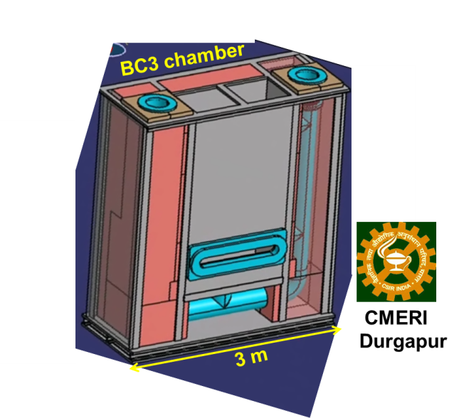
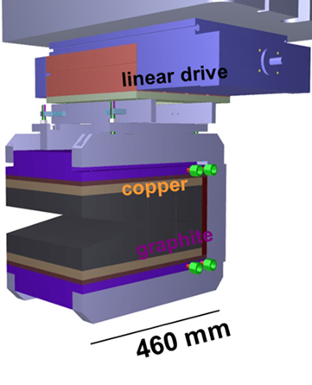
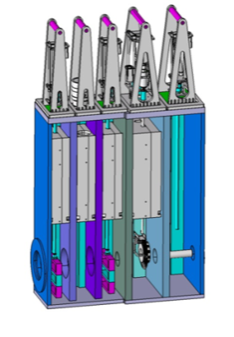
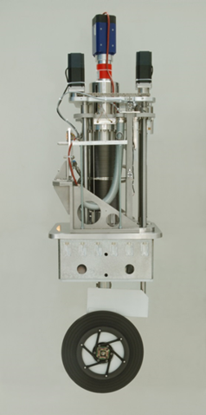
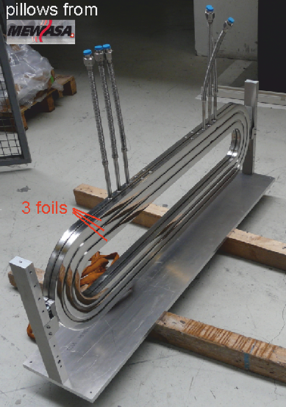
Target Area Installation
Target chamber & plug inserts (German in-kind)
  draft specification existing
  collaboration contract with KVI-CART in preparation
Target wheel & plug inserts (German in-kind)
  Prototype wheel existing, long term R&D running
  collaboration contract with KVI-CART in preparation
Beam catcher (Indian in-kind, chamber & plug inserts)
  visit of CMERI colleagues in Q4/2014 →
  definition report agreed → preparation of specification
Pillow seals (German in-kind)
  Prototype set-up (large size) existing
BC chamber
BC plug insert
Pillow seal
set-up
Target
chamber
Prototype
target
wheel

Slide 11
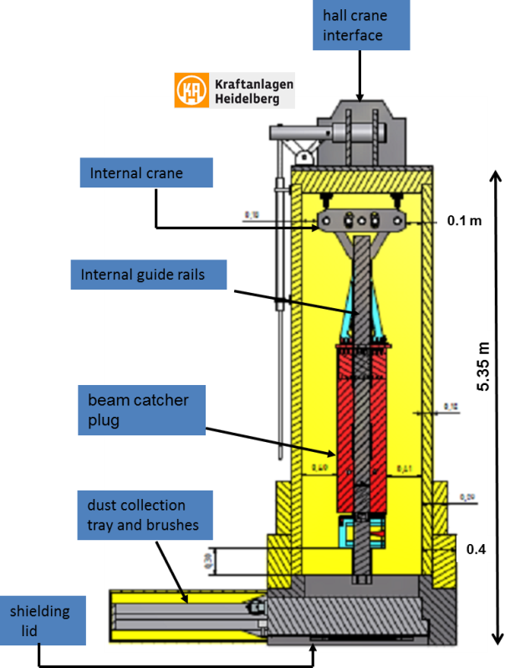
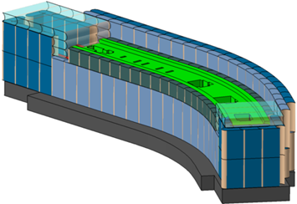
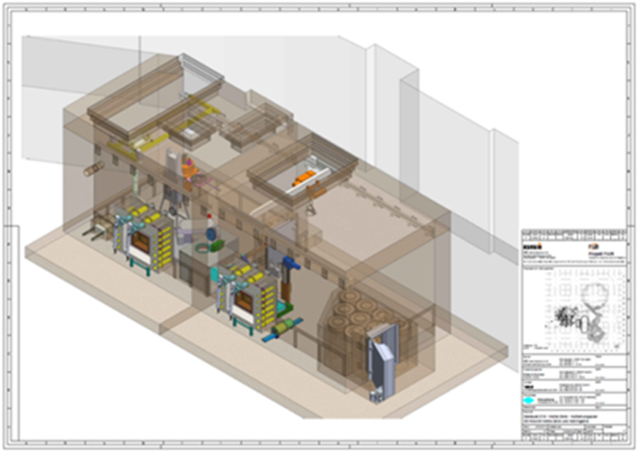
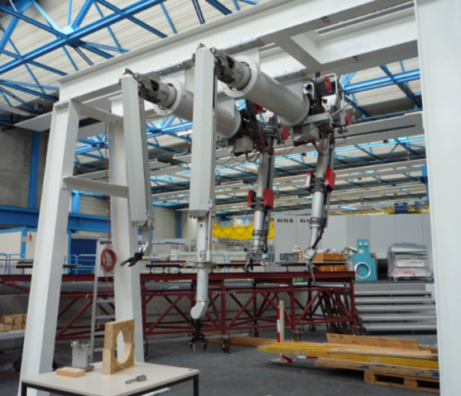
Target Area Infrastructure
Hot Cell Complex (German in-kind)
  Two-cell concept (maintenance and storage)
  Prelim. & approval planning by nuclear eng. company
  Mock-up installed on ESR roof
Shielding flask (Finnish in-kind, 50 ton)
  Draft specification available
  Finnish partner identified (Hollming Works LTD, U Aalto)
  GSI/FAIR will have responsibility on permissions issues preplanning → approval process → order production.
Iron shielding (previous ‘missing item’, not yet assigned)
  Draft specification available
  Σ ≈ 7.000 ton; however, fast production possible (<1year)

Slide 12
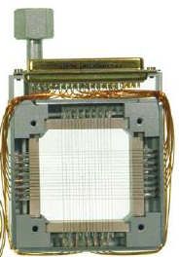
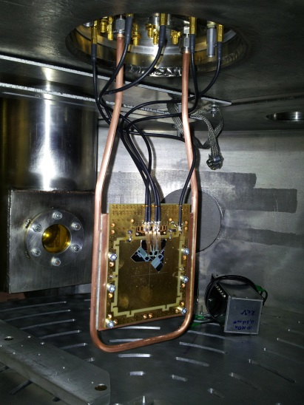
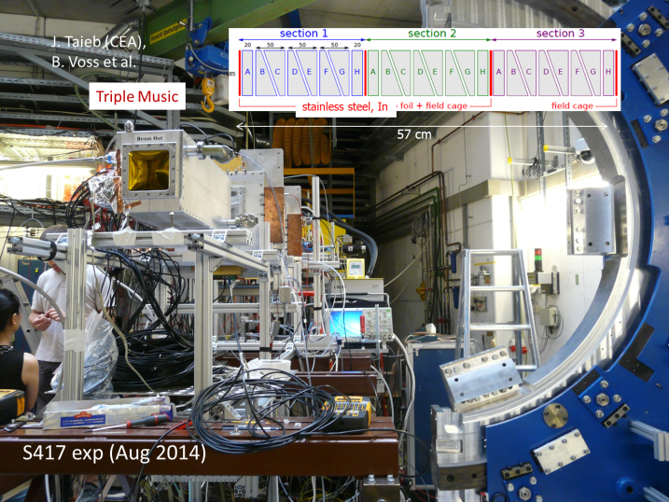
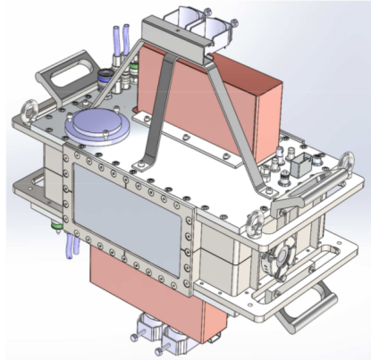
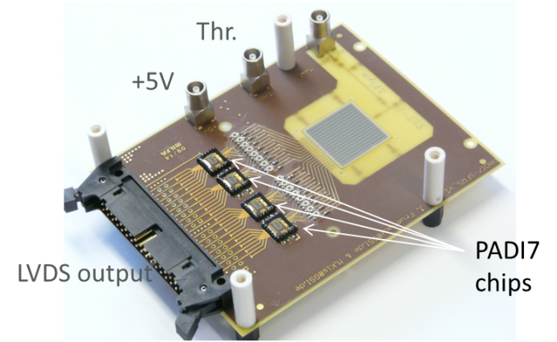
Beam Diagnostics
SEM grid
    Full isotope identification (x, y, x', y', ΔE and TOF)
    Operation modes: fast- and slow-extracted beams
    Detector systems (all systems are in R&D / Prototype Phase)
      SEM-GRID & ladder system (Finnish in-kind, GSI)
      GEM-TPC (Finnish in-kind, U Bratislava, GSI)
      Silicon detectors (Russian in-kind, Ioffe PTI)
      Diamond detectors (Russian in-kind)
      Plastics (Swedish in-kind)
      MUSIC detectors (EoI Finland, GSI, CEA Bruyère)
    Beam tests in 2015/2016 at: Jyv, LNS Catania, Riken
    DAQ (Swedish in-kind) -> NUSTAR EDAQ
Si
MUSIC
Diamond strip
detector
GEM TPC
prototype

Slide 13

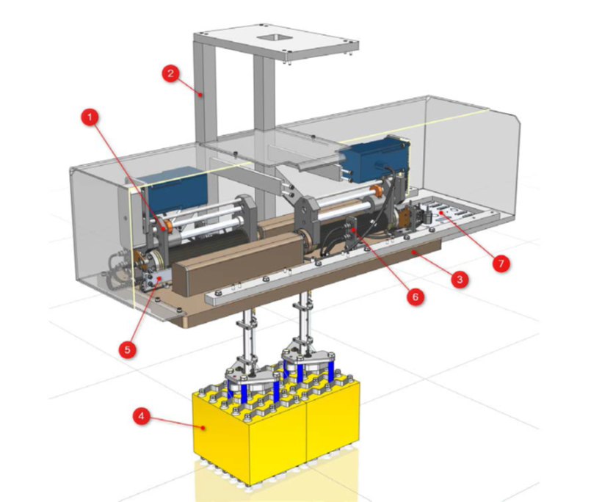
Beam Instrumentation
(slits, degrader, secondary targets, ...)
x-slit system:
block size: 200mm x 200 mm
y-slit system:
Block size: 400mm x 90 mm
Material: Densimet
x/y Slit-systems
  Overall 18 slit pairs required
  Remote handling foreseen
  Specification established
  Collaboration contract with KVI-CART
  PDR done 08/2014,
    Pre-design existing
    thermal simulation / cooling issues considered
  Pre-Series slit-system expected Q3/2015
Media pannel,
robot operated

Slide 14
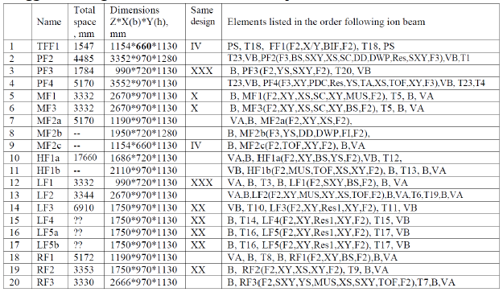
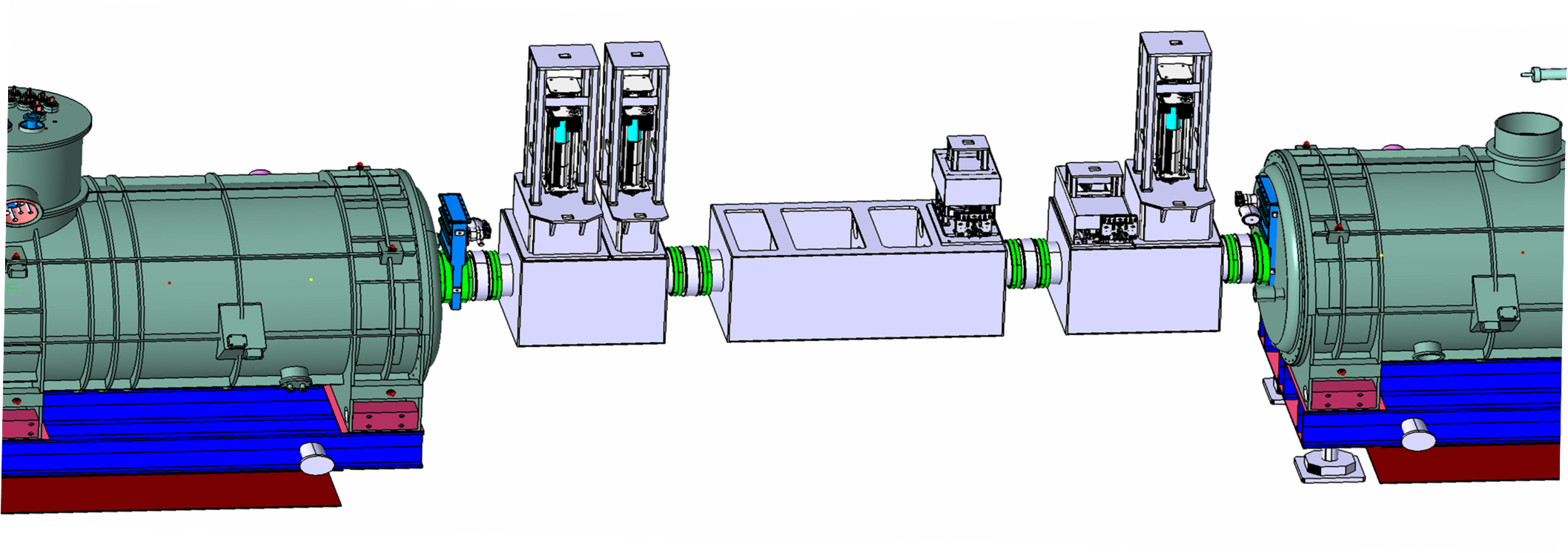
Vacuum System / Focal Plane Chambers
Large and very large size chambers
Try to ‘standardize’
Remote handling capability
(e.g. robotic, Pre-Separator)
Consider requirements from experiments
(i.e. flexible focal-plane arrangement)
Specification in preparation
Russian in-kind (via BINP)
1.860 mm

Slide 15
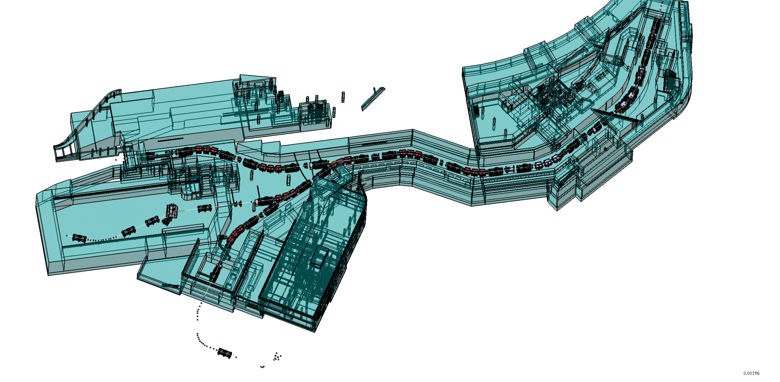
Overview Super-FRS Buildings (MSV)
Build. 006a, Service building
3 floors (~2000 m²)
Technique (PS, controls, ... )
Experimental preparation
Control room, electronics
Gas supply, gas mixing station
Main tunnel access
Basic evaluation completed
Preliminary planning completed
Approval planning completed
Execution planning (approval): on-hold
Route planning (cable, pipes, cryo): on hold
Establishing cable base bank
Review 02/2015: consider LEB cave
FLF2
Experimental Area
Build. 018, Target building
5 floors
Target area, shielding
Technique (PS, controls, ... )
Hot Cell complex
Tunnel 103
(Separator tunnel, supply tunnel)
To CR
FHF1
(End Focus HEB)
Build. 006
(High-Energy cave)
On top: Build. 17.2
(FAIR service building)
100 m

Slide 16
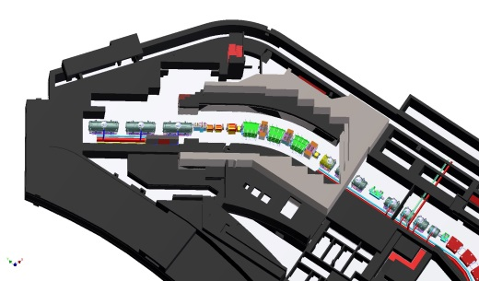
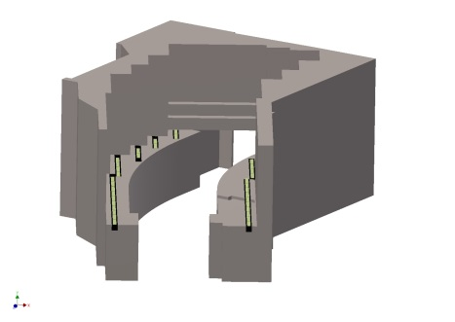
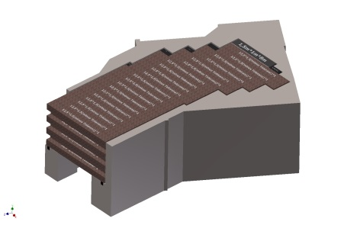
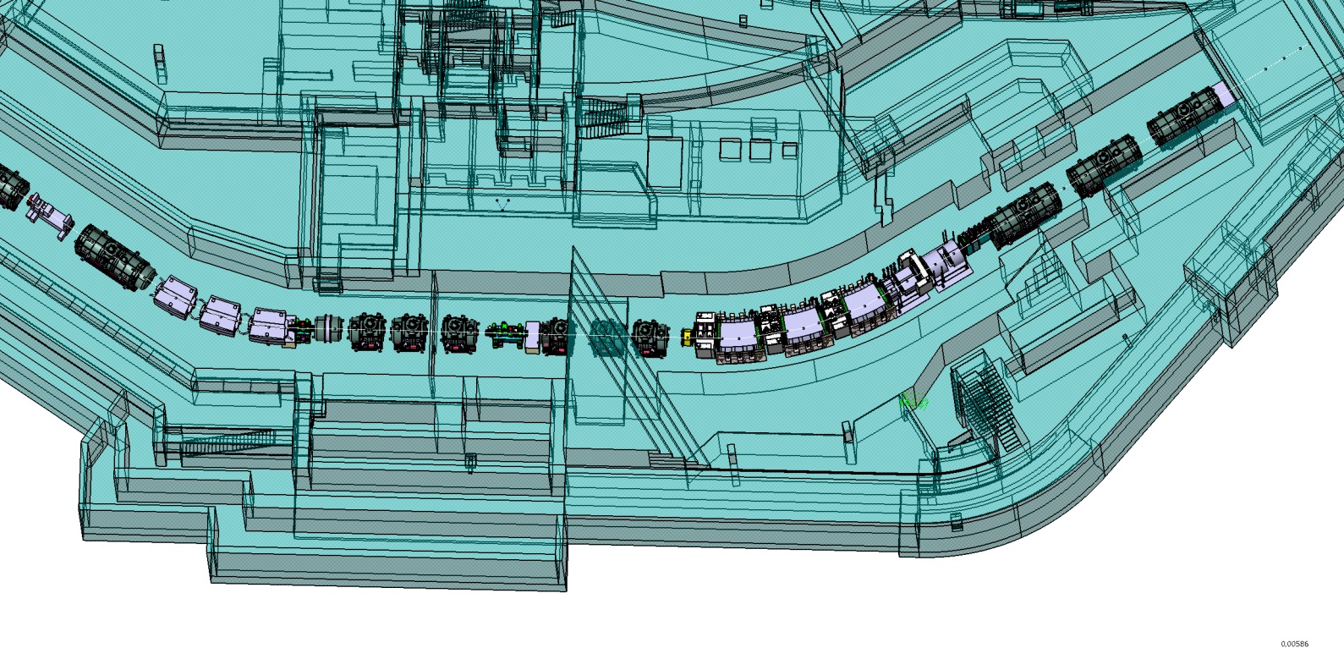
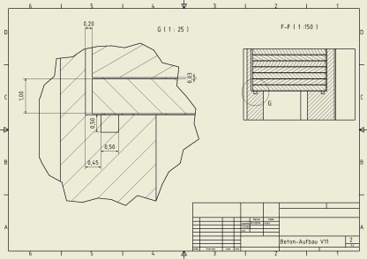
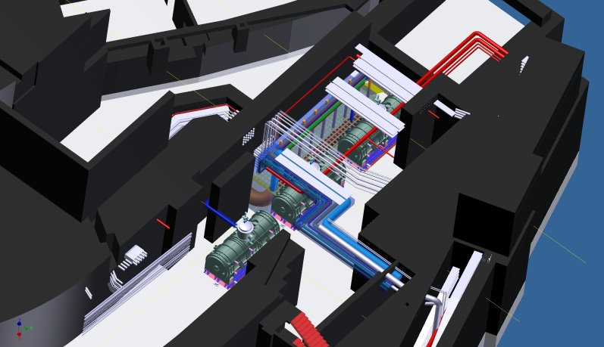
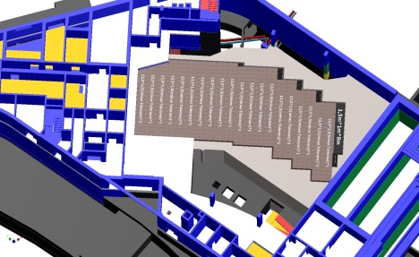
Target Building (Build. 018)
Shielding planning, including details
  input for radio-protection approval
Decission: FAIR will get one common cryo-plant
new connection to cryo-plant – DB 2
cryo connection DB2 – TFS
Media planning TFS and target maintenance area
Hot Cell planning
FAIR Cryo-Plant
DB 2
Target Focussing System
SIS 18 / SIS100

Slide 17
Summary
SC multiplets: negotiation closed, contract close to be awarded, most time critical item
SC dipoles: collaboration agreement with CEA/Saclay, design finalization and tendering documents in preparation; design of branching units still tbd
NC magnets: remote alignment under revision, specification in preparation
Long-term tests of target area components and preparation of specifications ongoing (will be partly procured in collaboration with KVI-CART)
Development of various beam detection and instrumentation items in prototype phase (various in-kind/collaboration partners)
Civil Construction
  review on target shielding design
  execution planning on-hold
  route planning on hold

Slide 18
I would like to thank all WPL of Super-FRS for their contribution to this presentation

