Slide 1

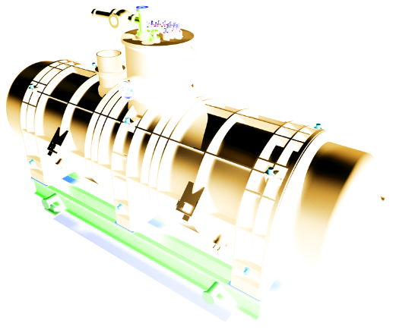




Slide 2
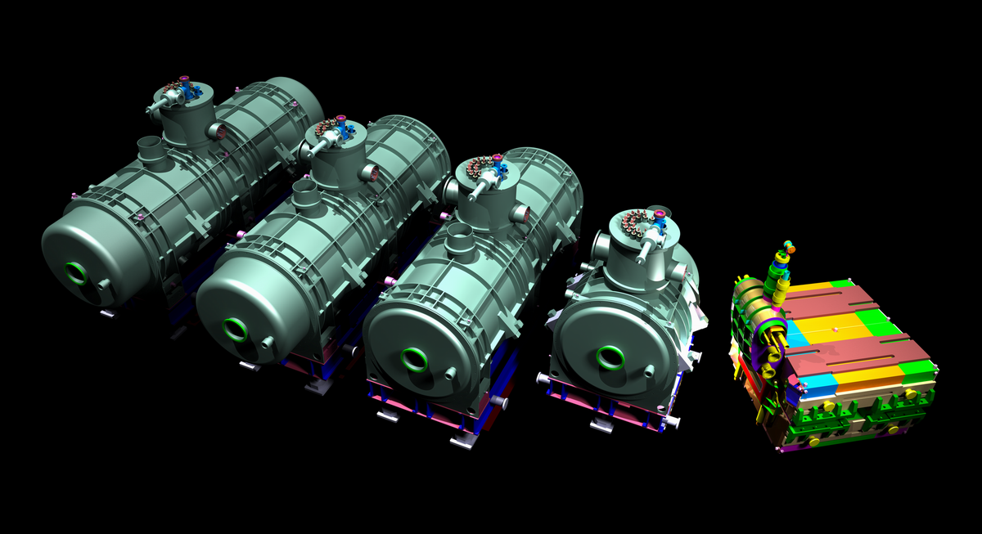
3D magnets from GSI

Slide 3
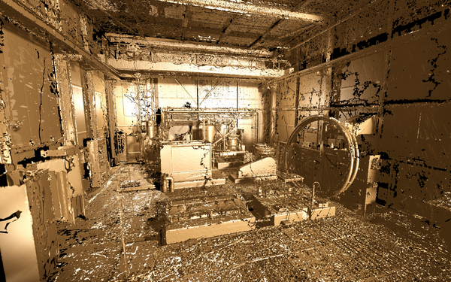
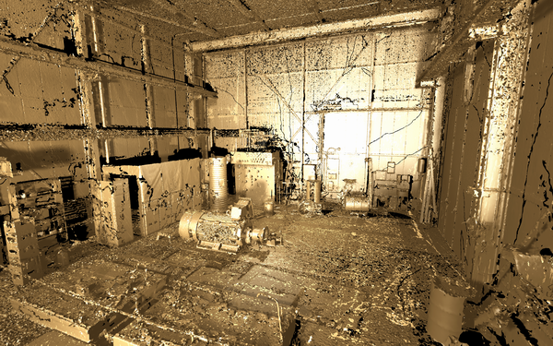
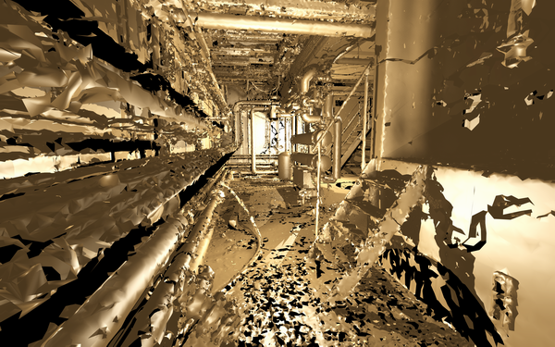
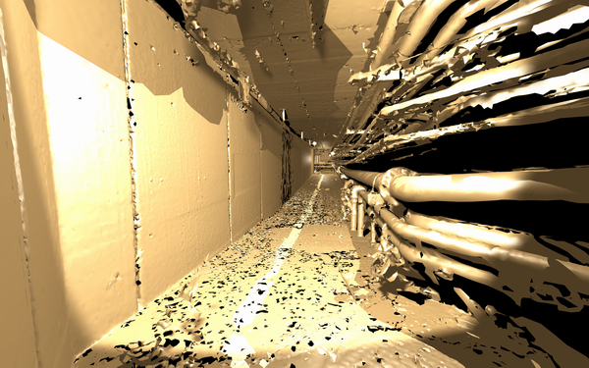
3D scans

Slide 4
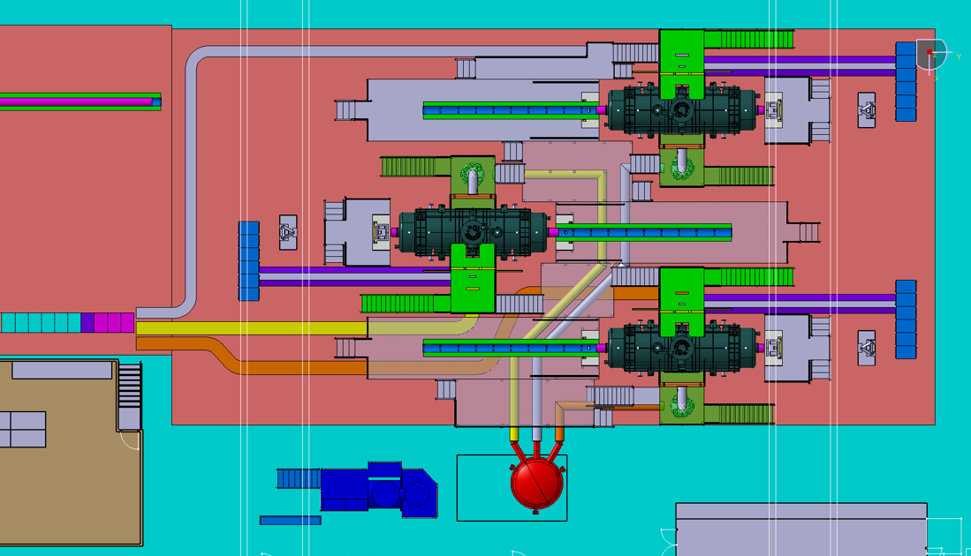
HISTORY…

Slide 5
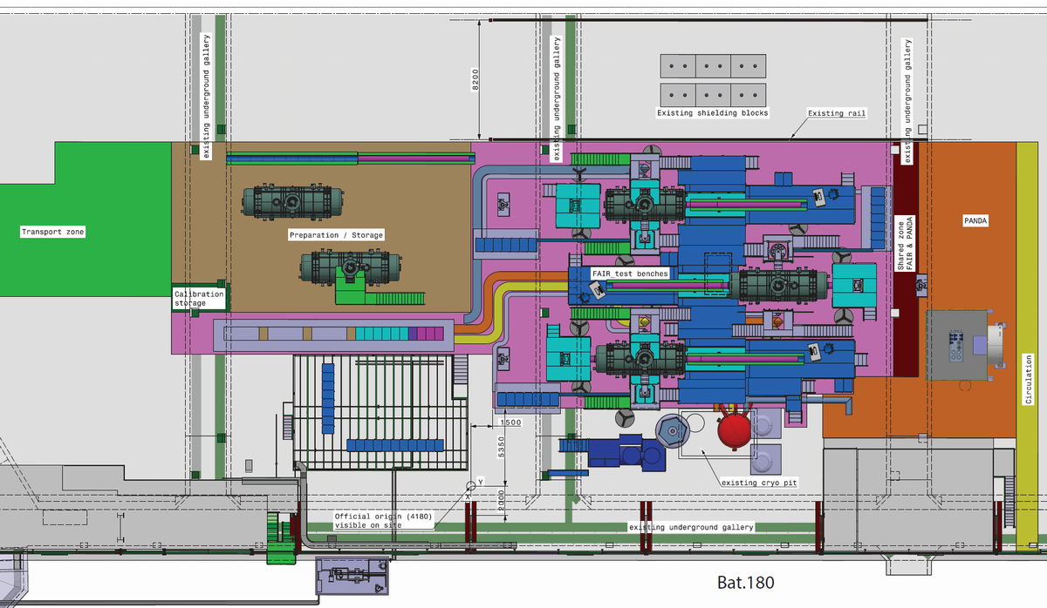
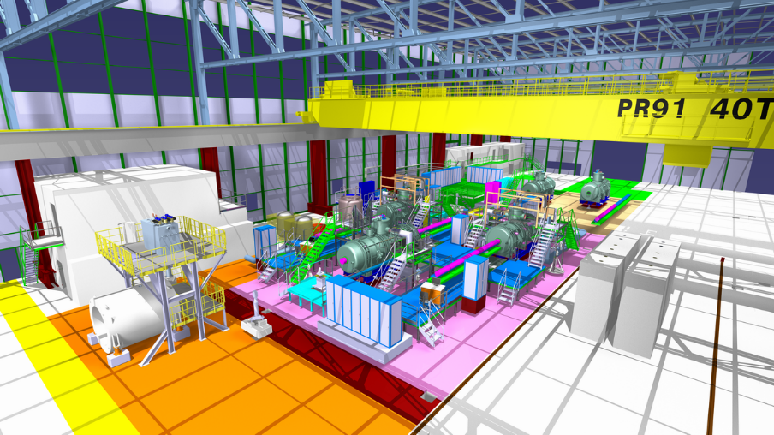
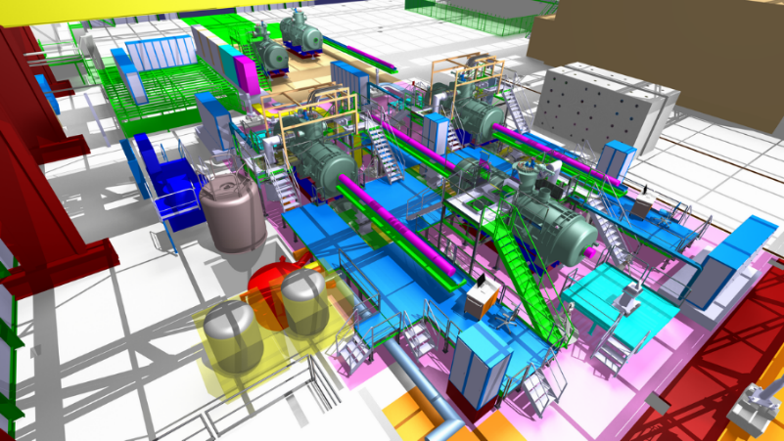
HISTORY…

Slide 6
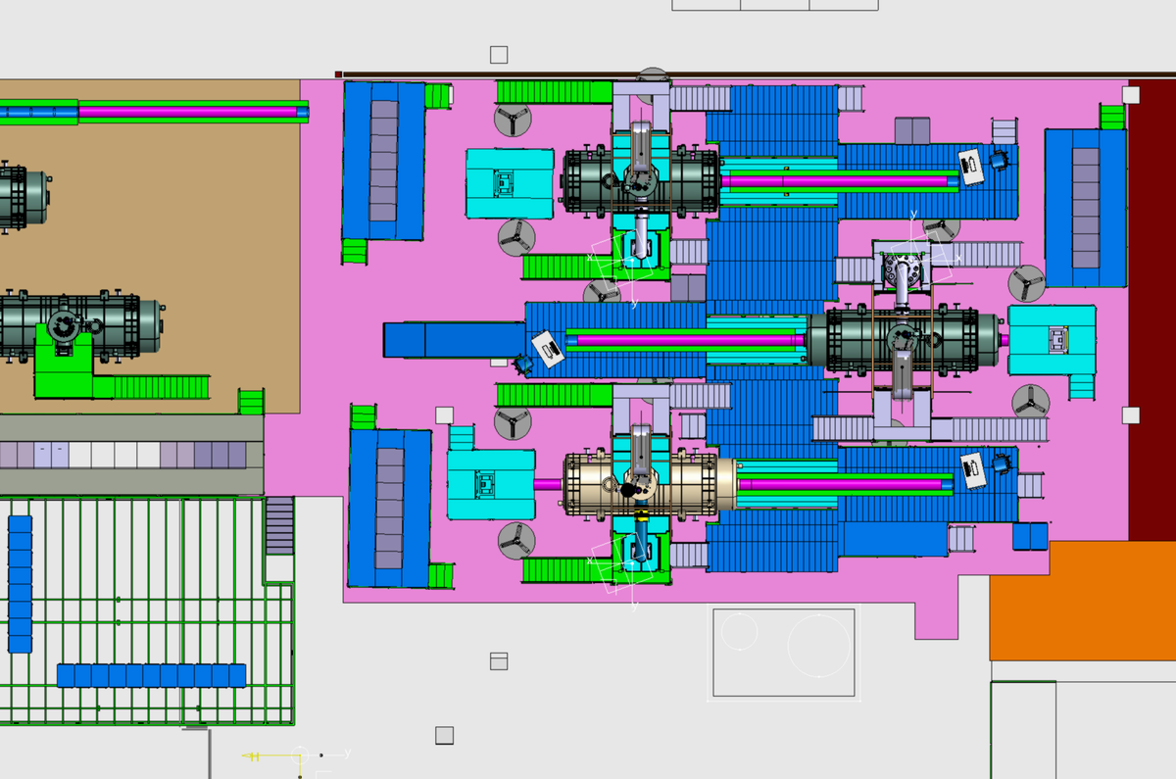
HISTORY…

Slide 7
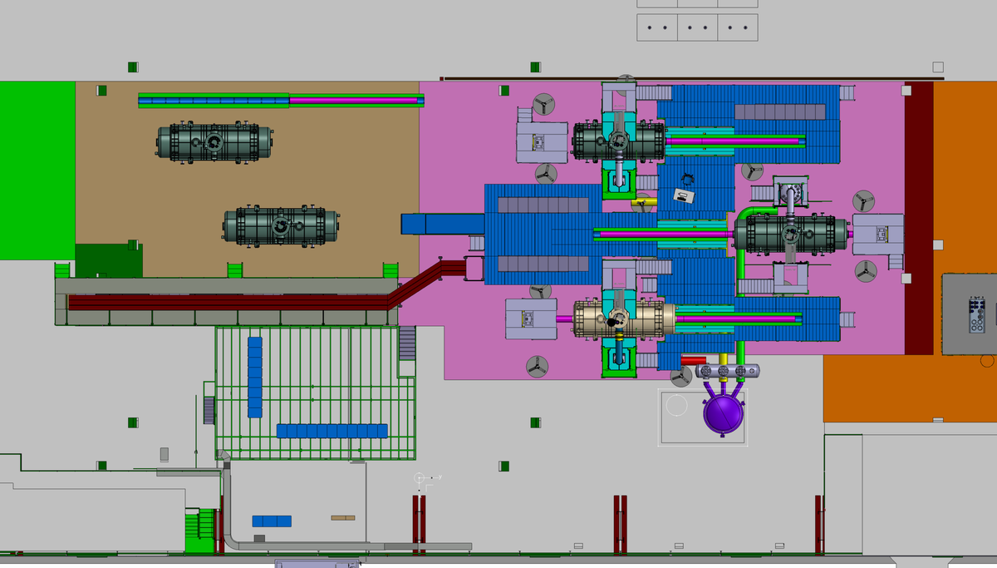
HISTORY…

Slide 8
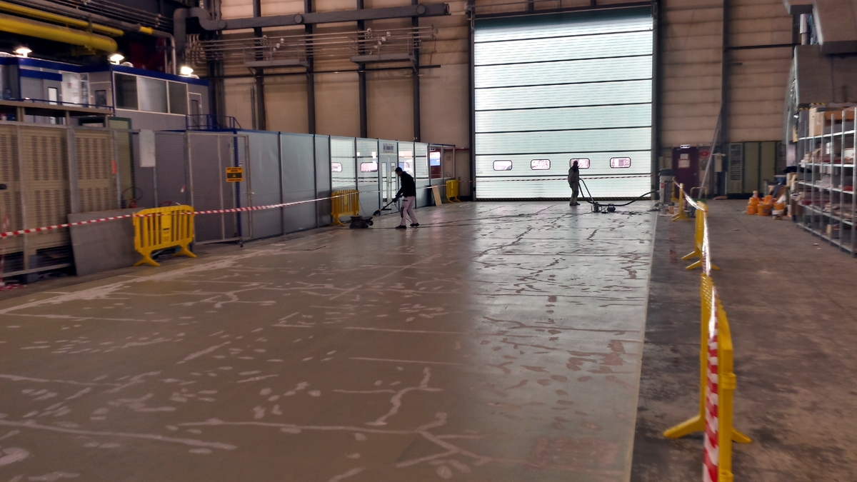
180_ Preparation of the floor

Slide 9
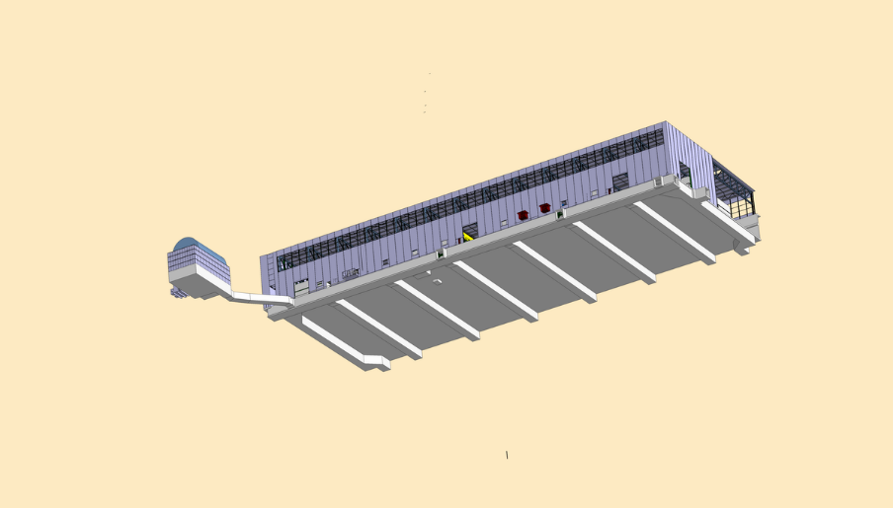
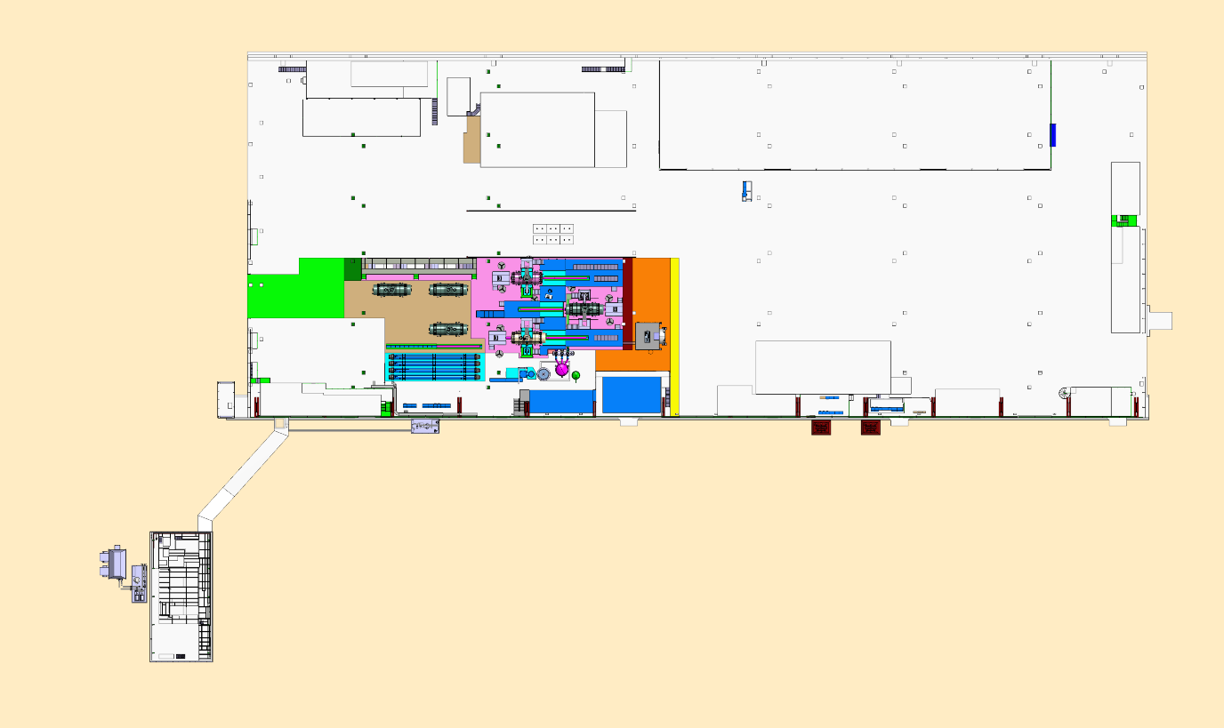
Building 180
Building 279
Bottom view_Galleries
General view
Building 180
Building 279

Slide 10
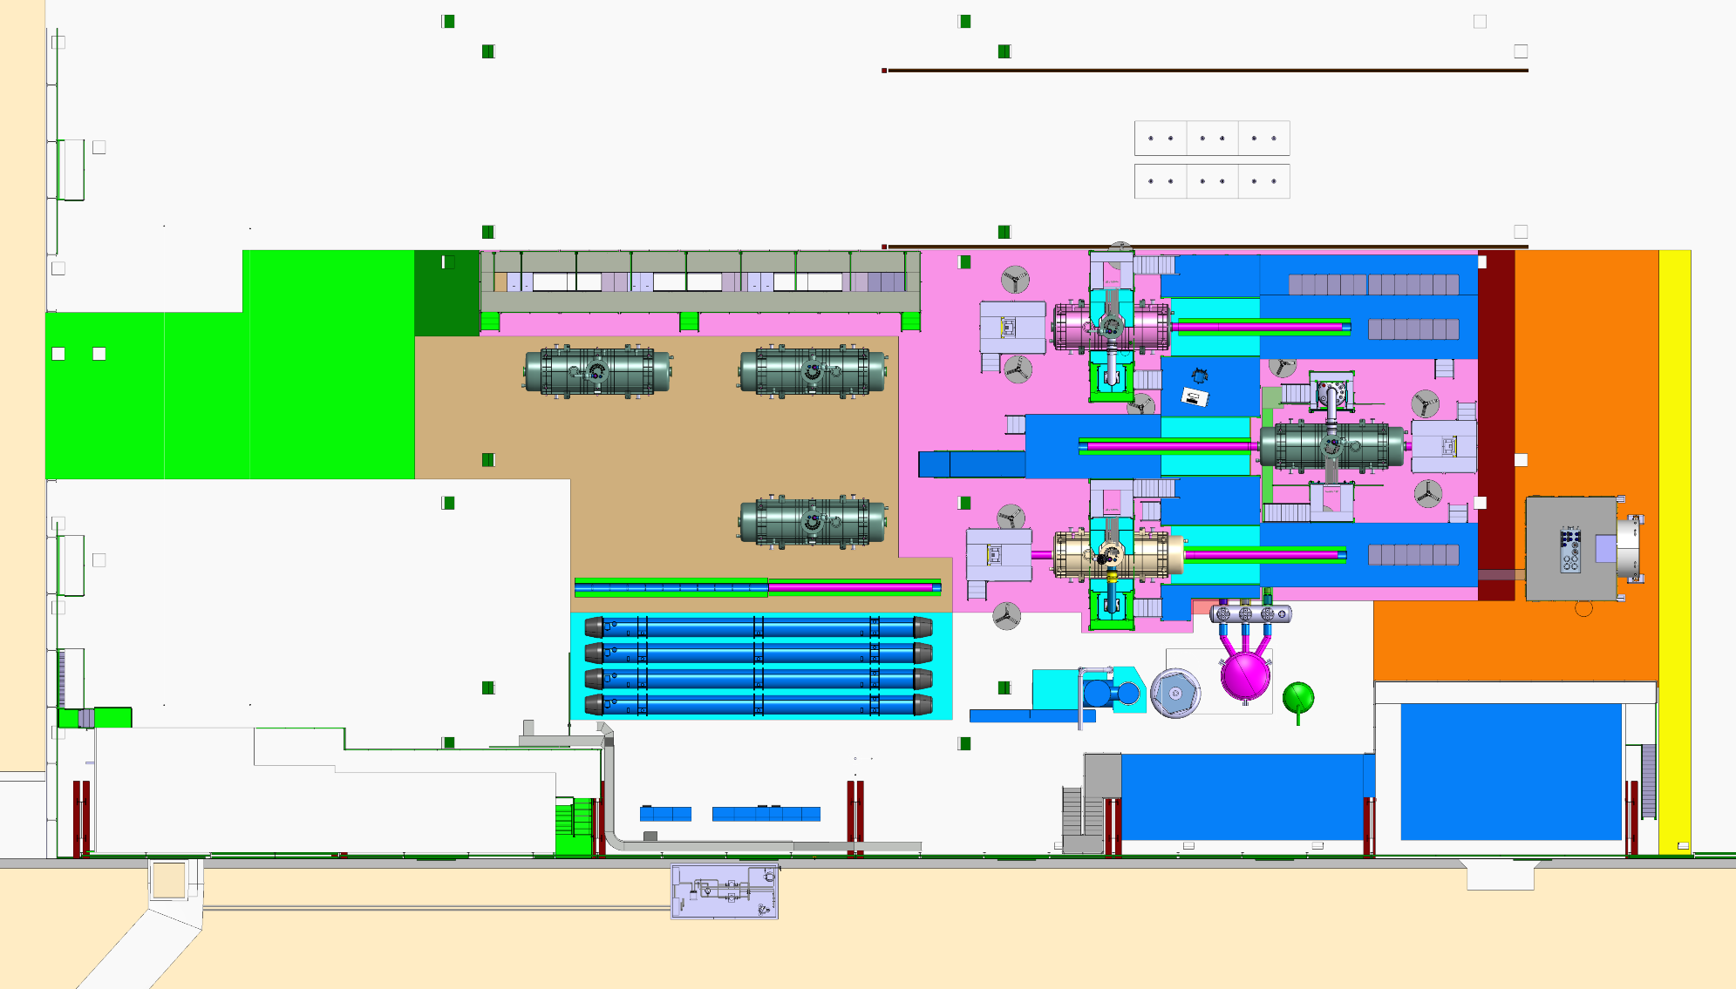
Transport
Preparation area
Test area
PANDA
Main door
General view_ Latest configuration to be approved
LHC dipoles
Personnal access
Stockage & Offices
Atelier & Control room

Slide 11
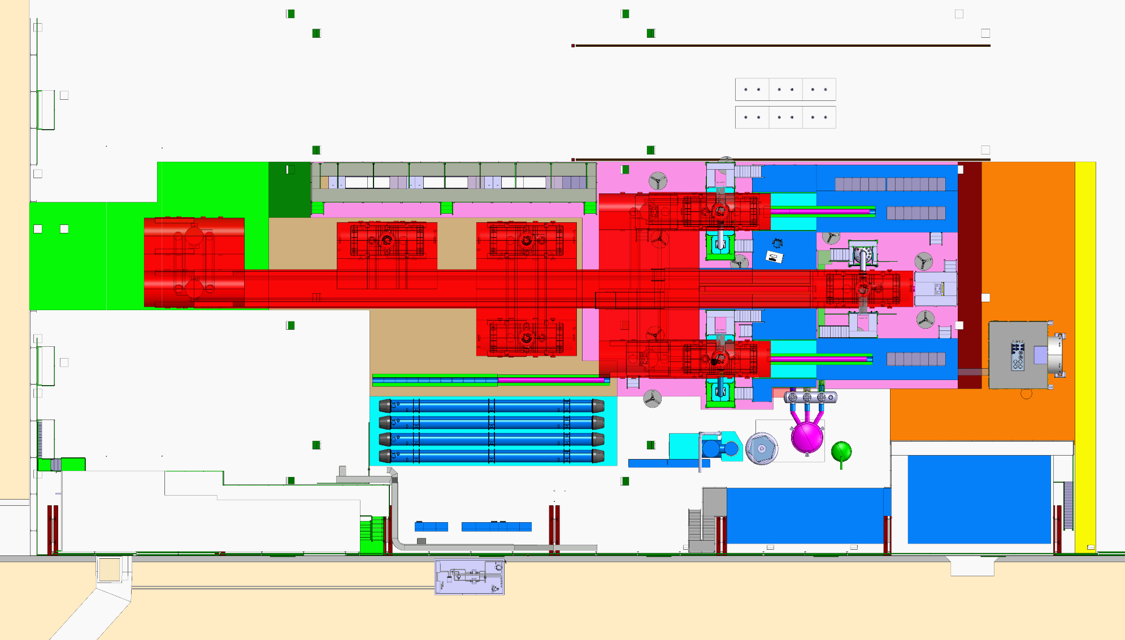
Transport
Preparation area
Test area
PANDA
Magnets transport zone
General view
LHC dipoles
Stockage & Offices
Atelier & Control room

Slide 12
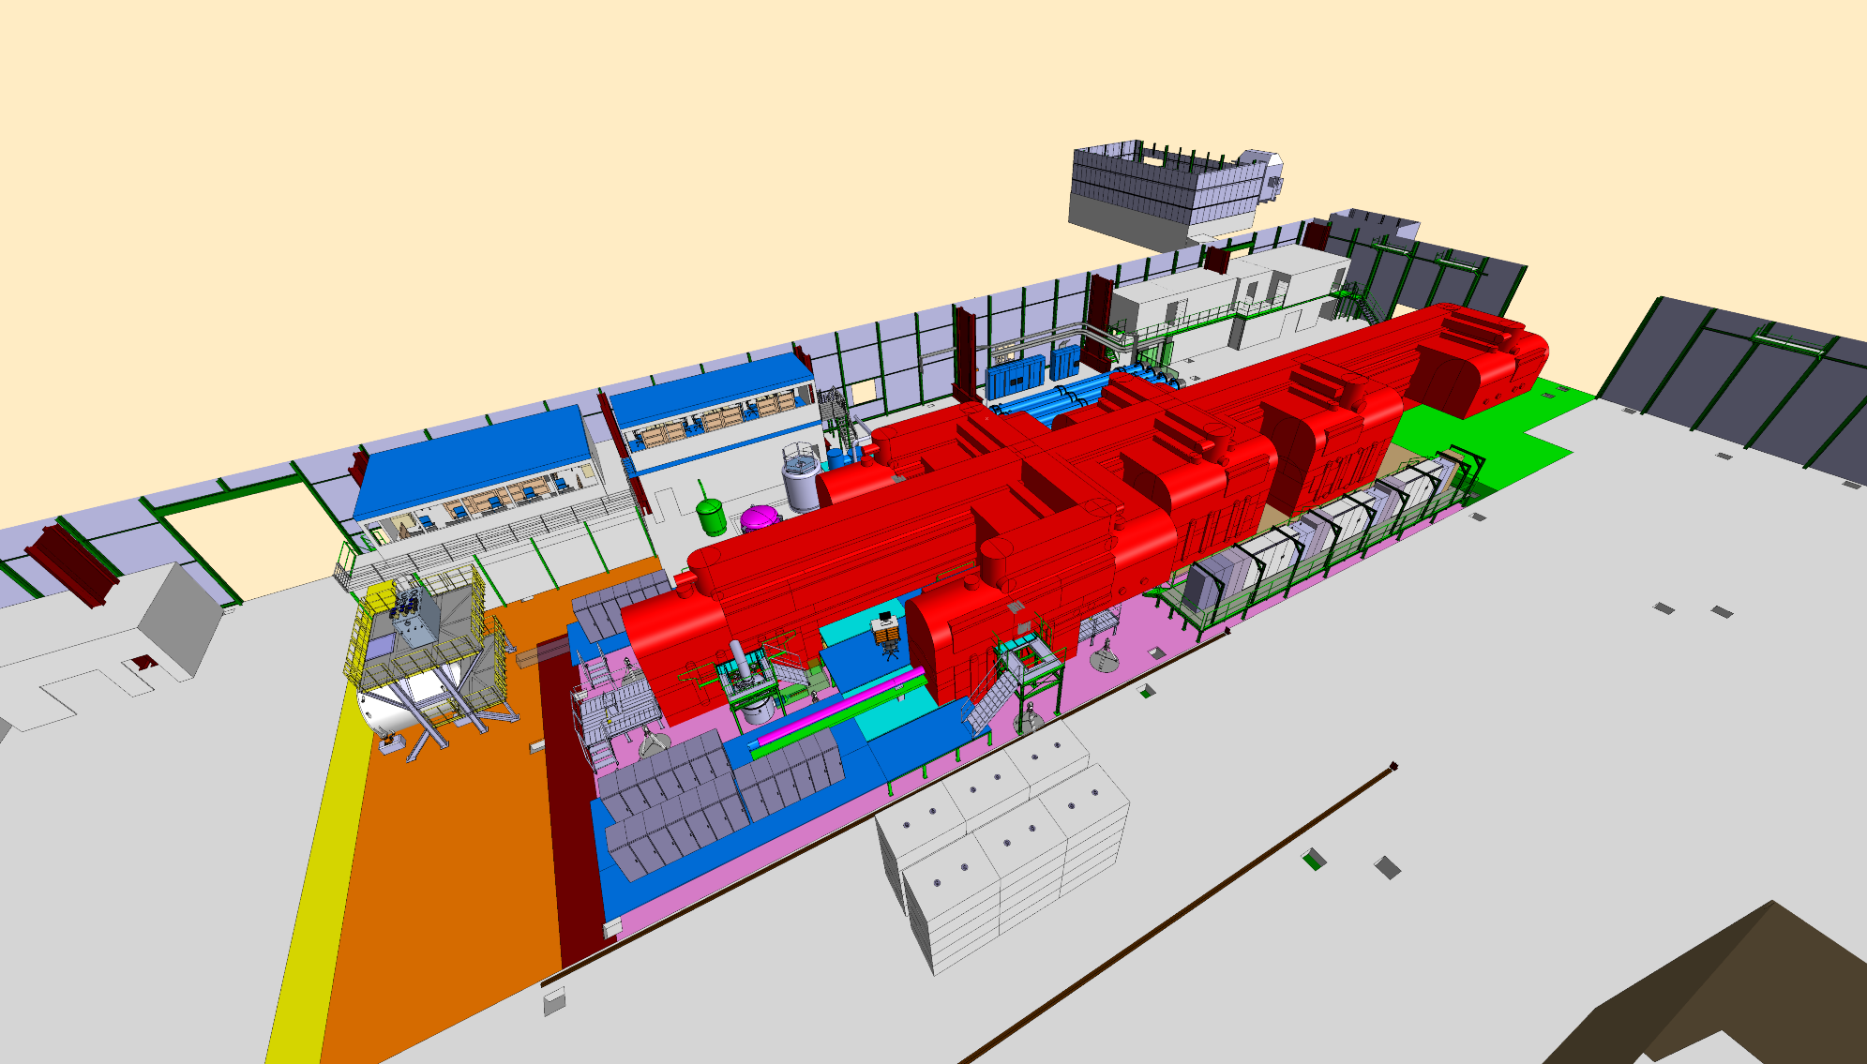
Test area
Stockage & Offices
Atelier & Control room
Magnets transport zone
Transport
The invisible but huge transport zone
Preparation area
PANDA
Racks

Slide 13
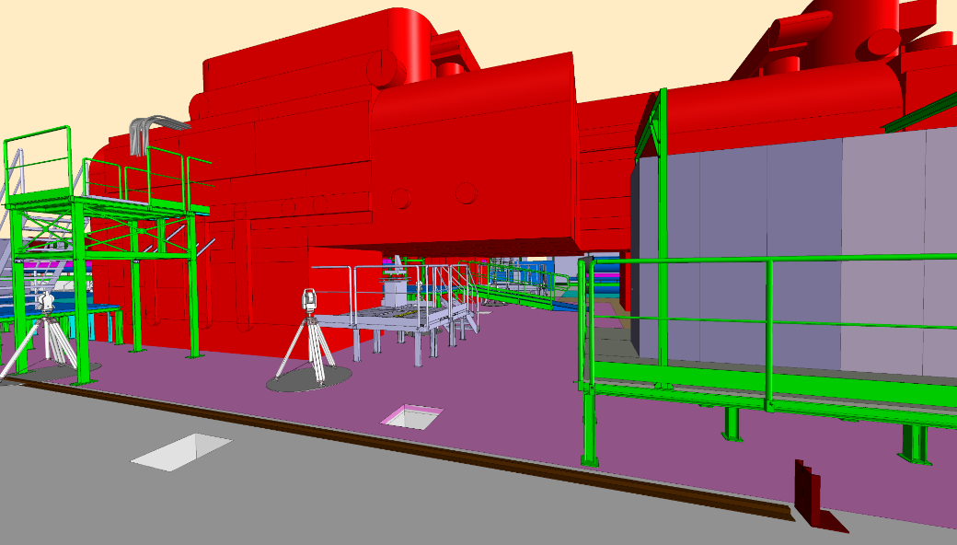
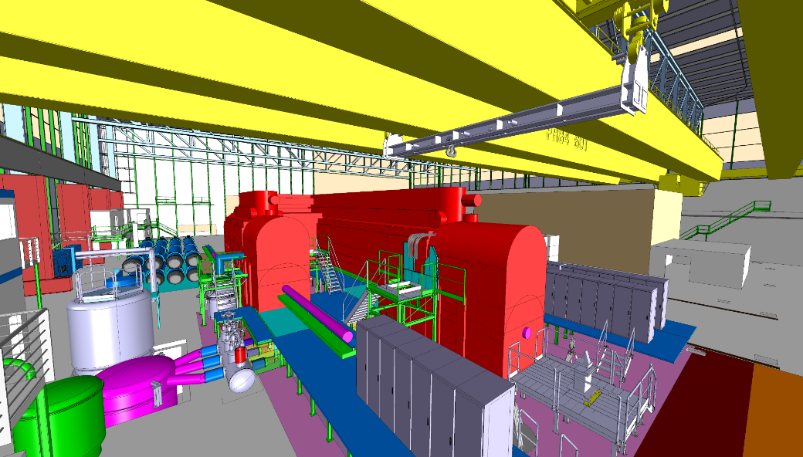
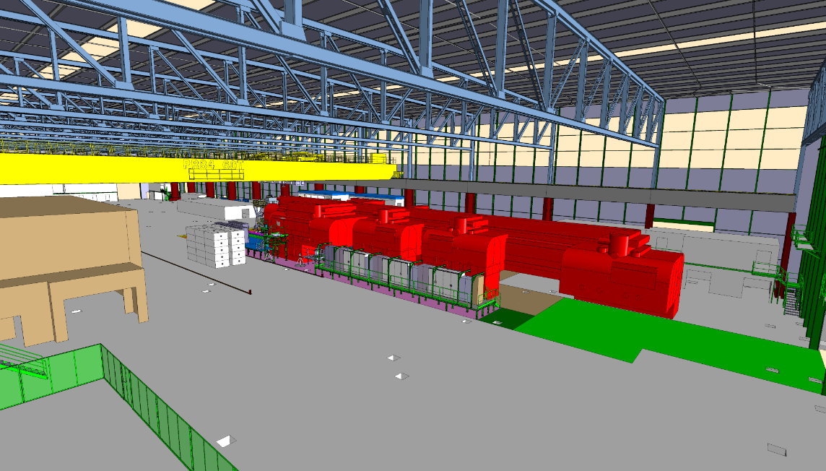
The invisible but huge transport zone
Magnets transport zone
Magnets transport crane system

Slide 14
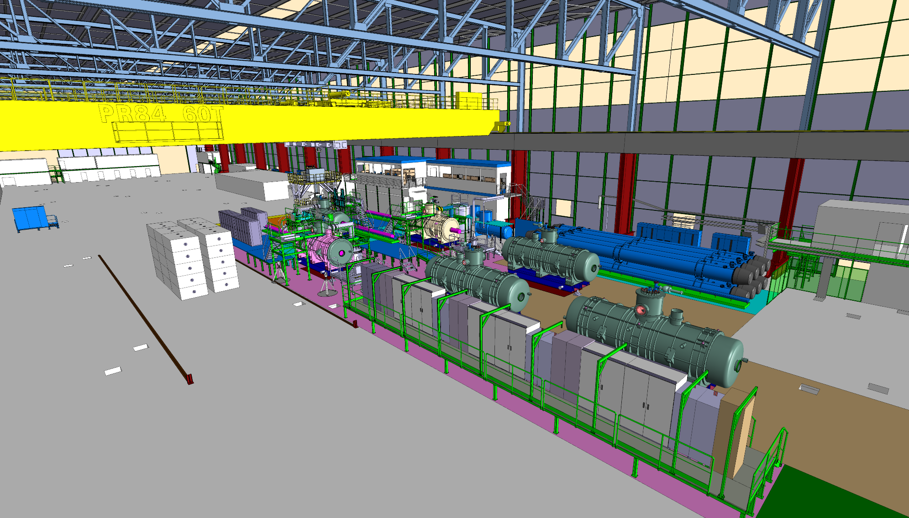
General view

Slide 15
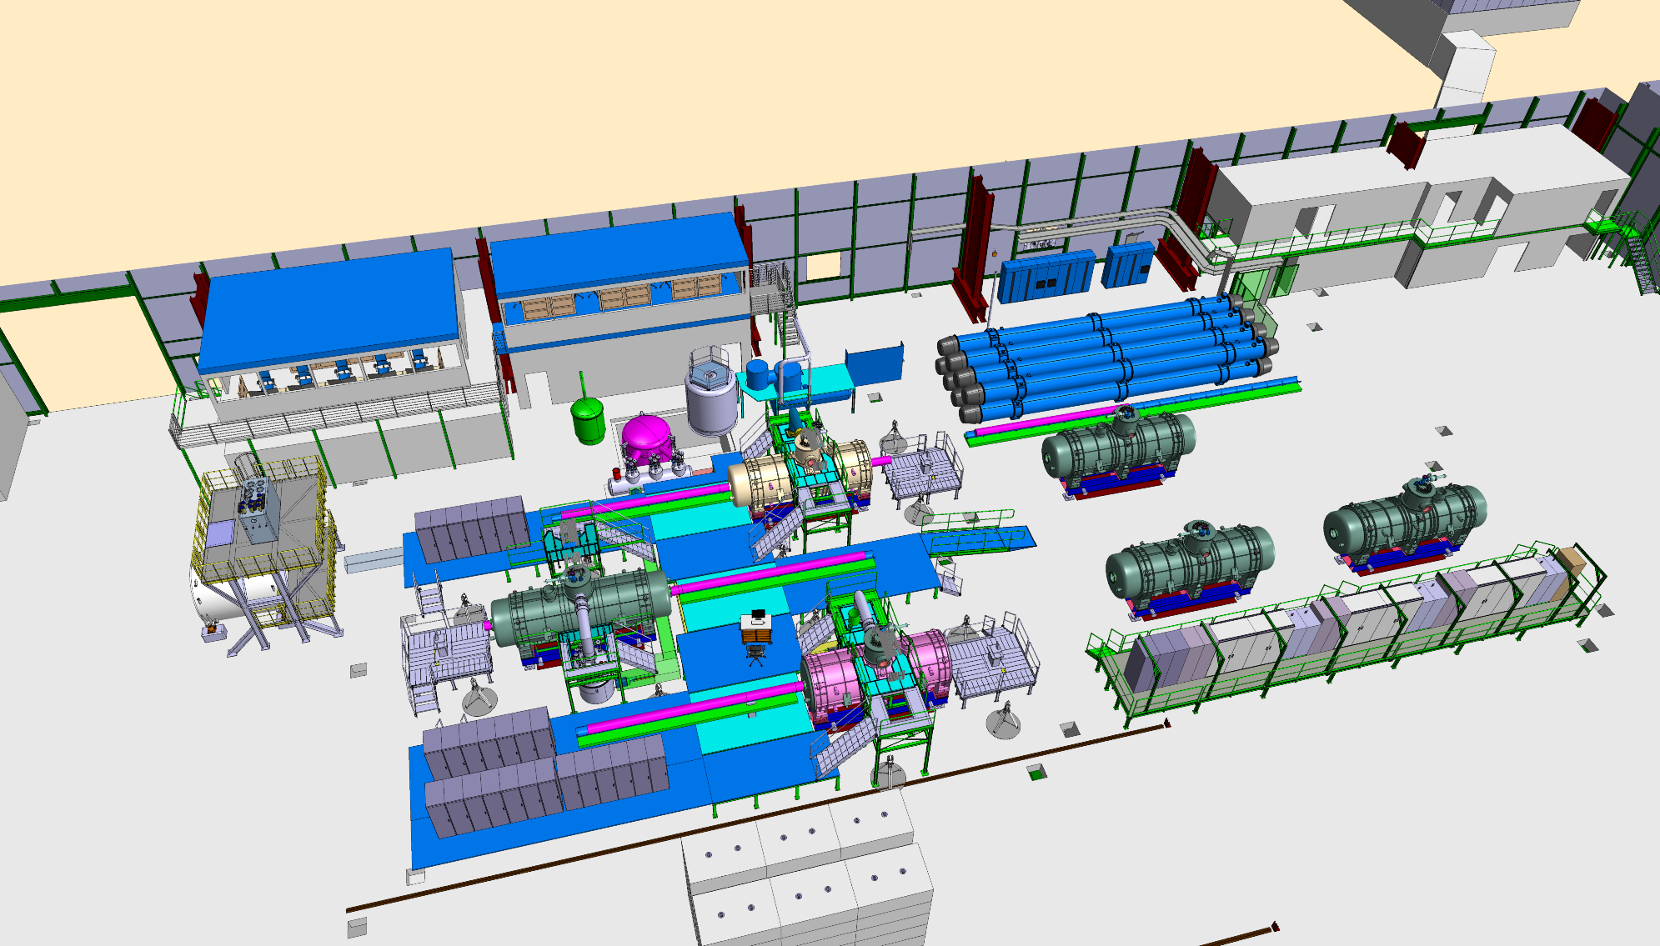
General view

Slide 16
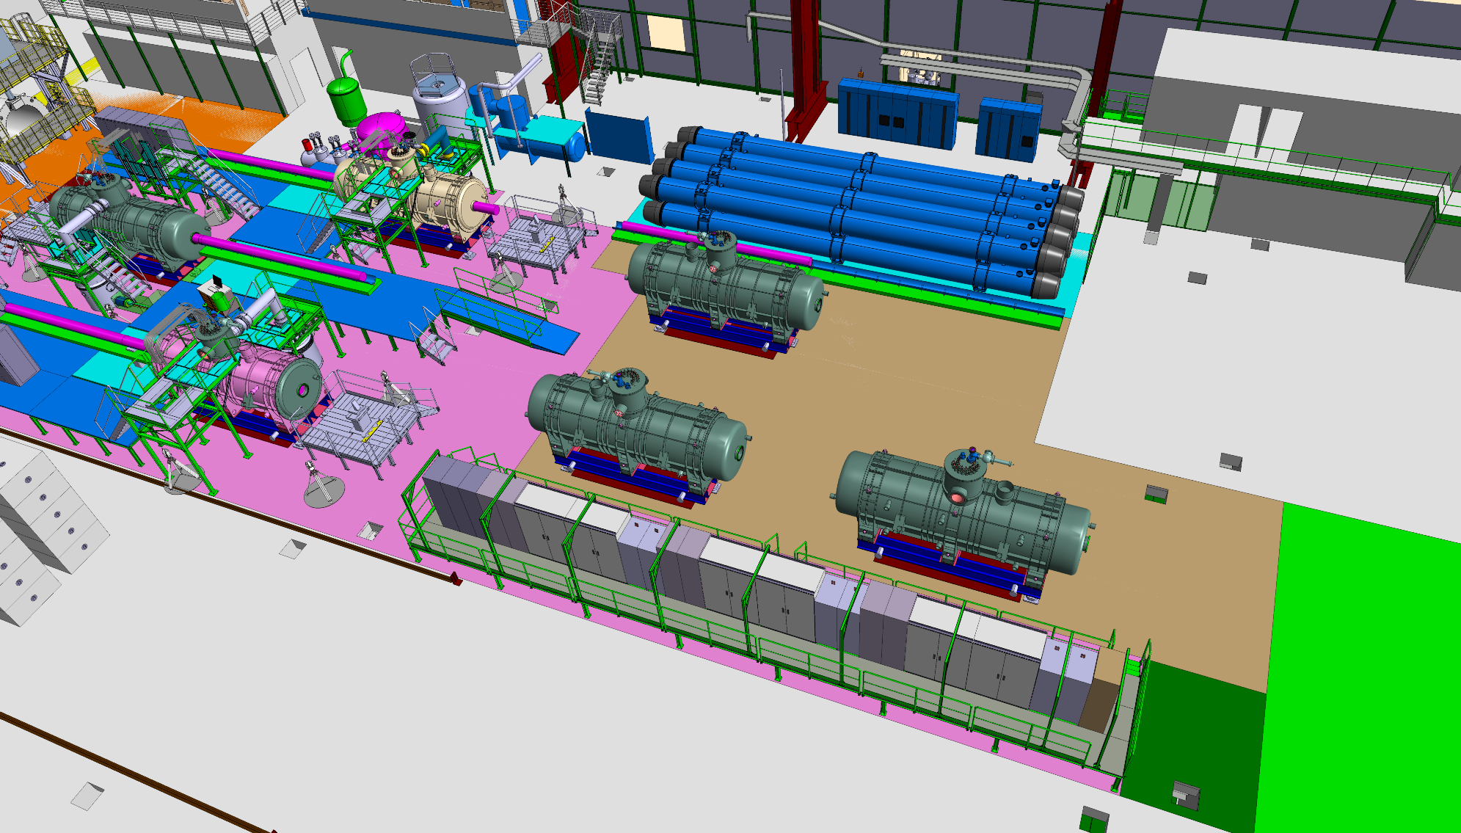
Cryo system
LHC dipoles
Test area
Detailed view
Preparation area
Power converters
Transport
Stockage
Measurements

Slide 17
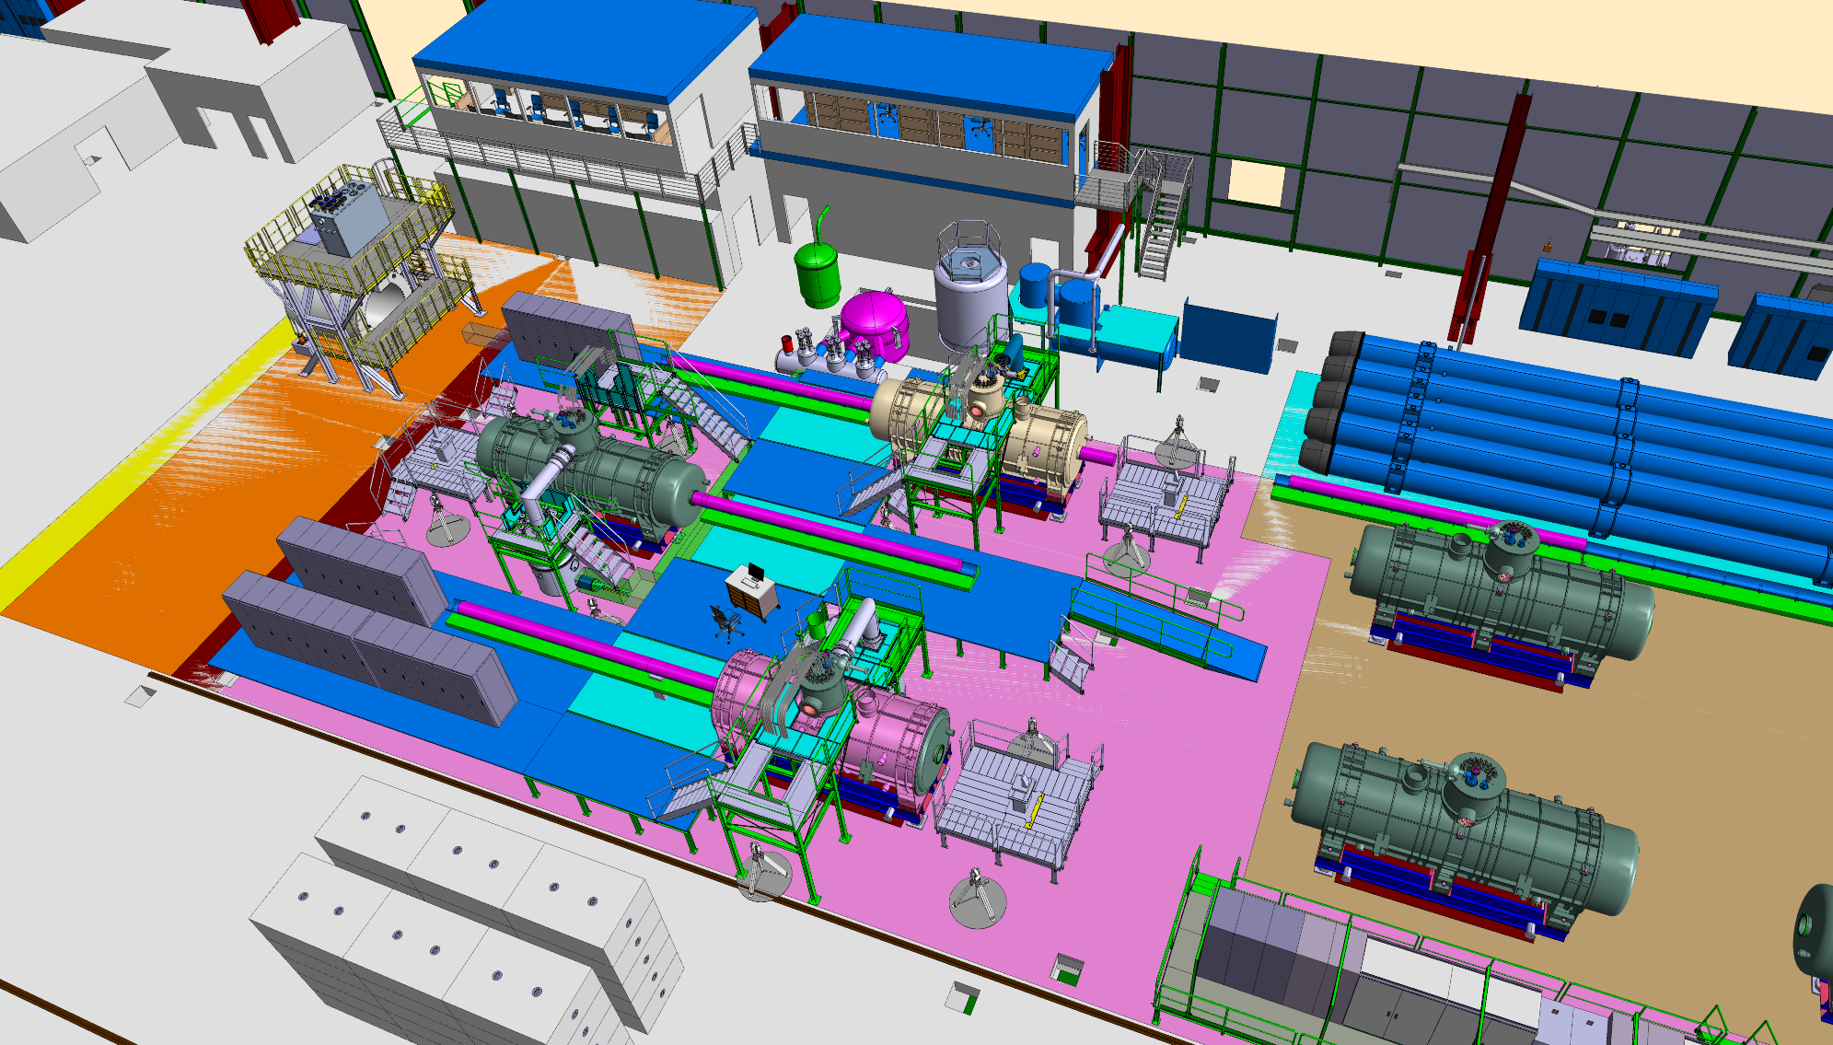
Control room
Offices
Atelier PH
Stockage PH
Cryo area
PANDA
Control racks
LHC dipoles
Detailed view
Test area
Control racks
Control racks
Magnetic measurement racks
Preparation area
Power converters

Slide 18
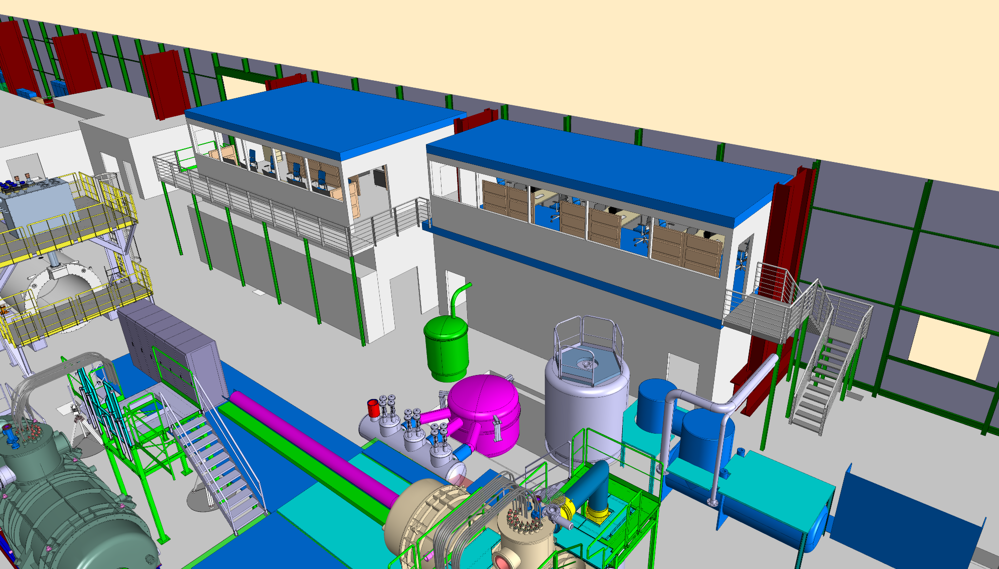
Control room
Offices
Walkway
Atelier PH
New control room & offices
New access
Stockage PH

Slide 19
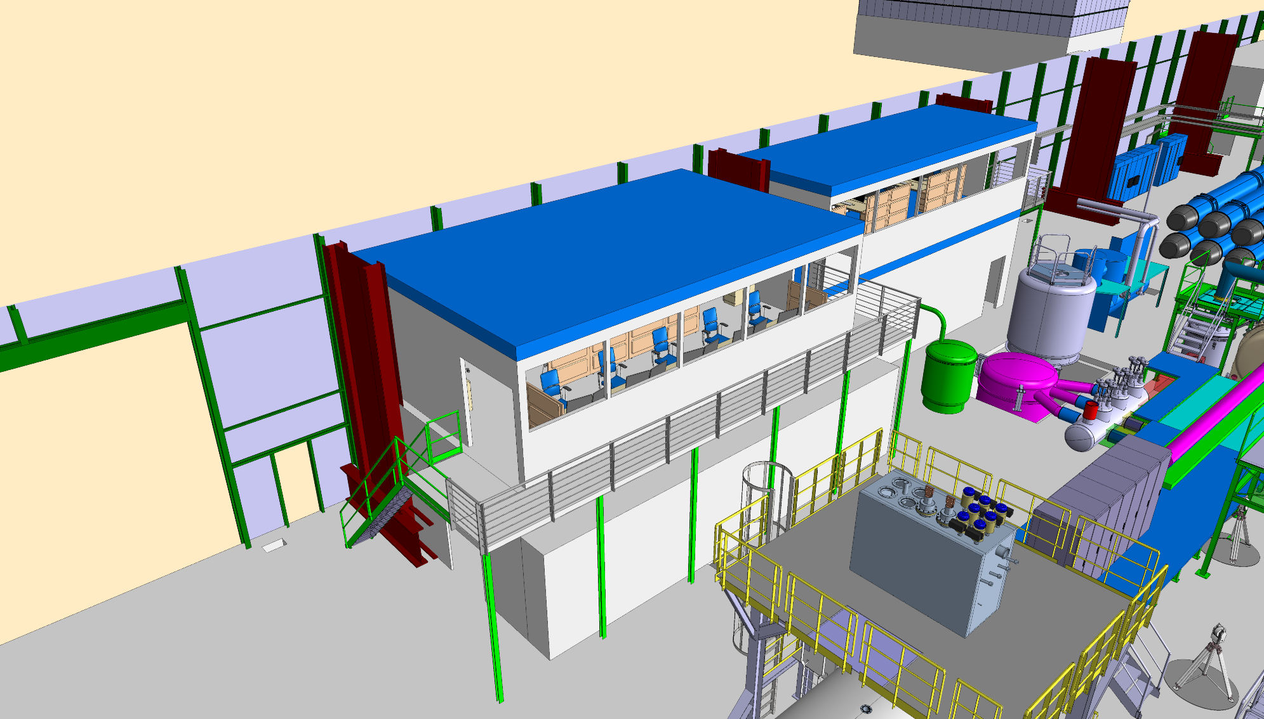
Offices
Control room
Stockage PH
New control room & offices
Old access
Atelier PH

Slide 20
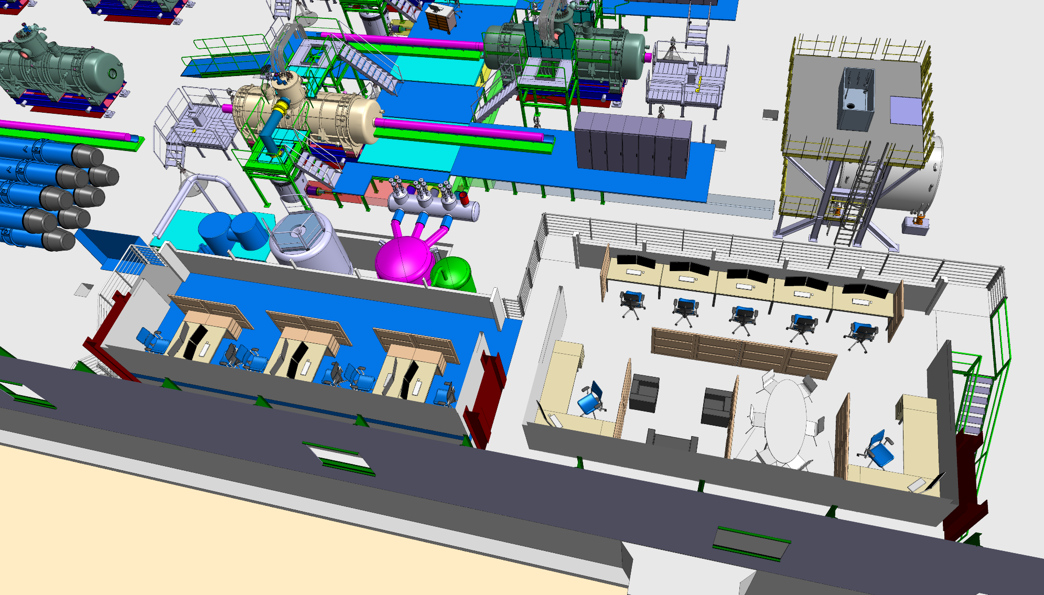
New control room & offices
Offices for 6 people
Control room 7 seats + meetings + coffee

Slide 21
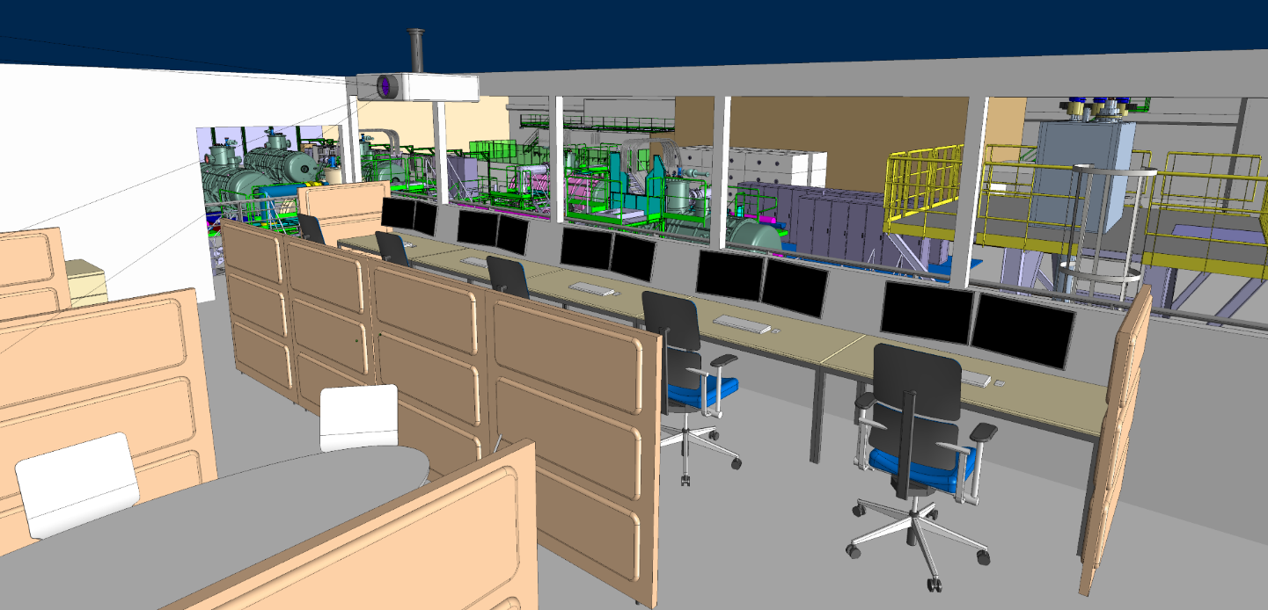
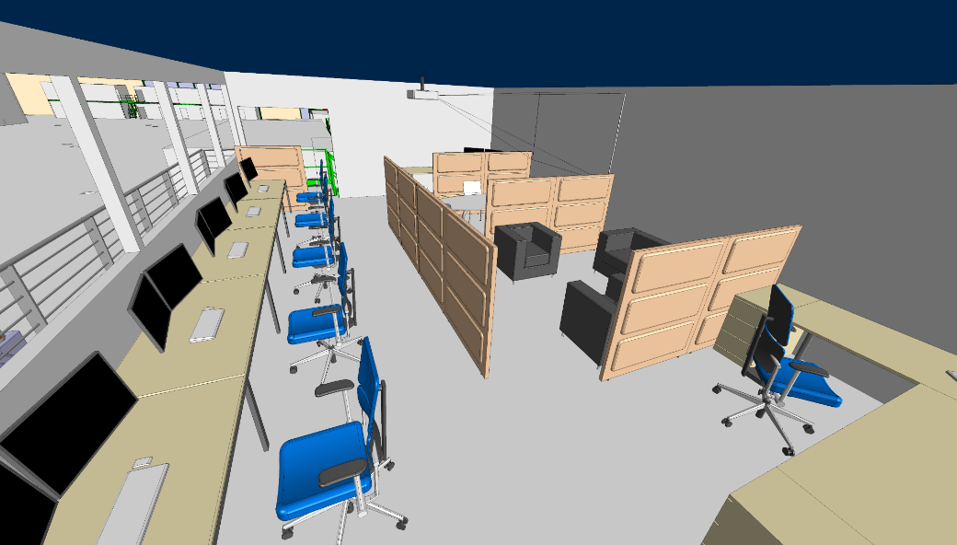
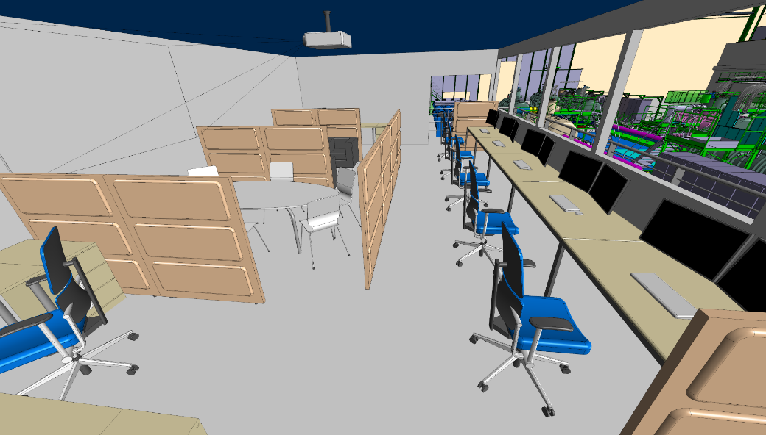
View from the control room

Slide 22
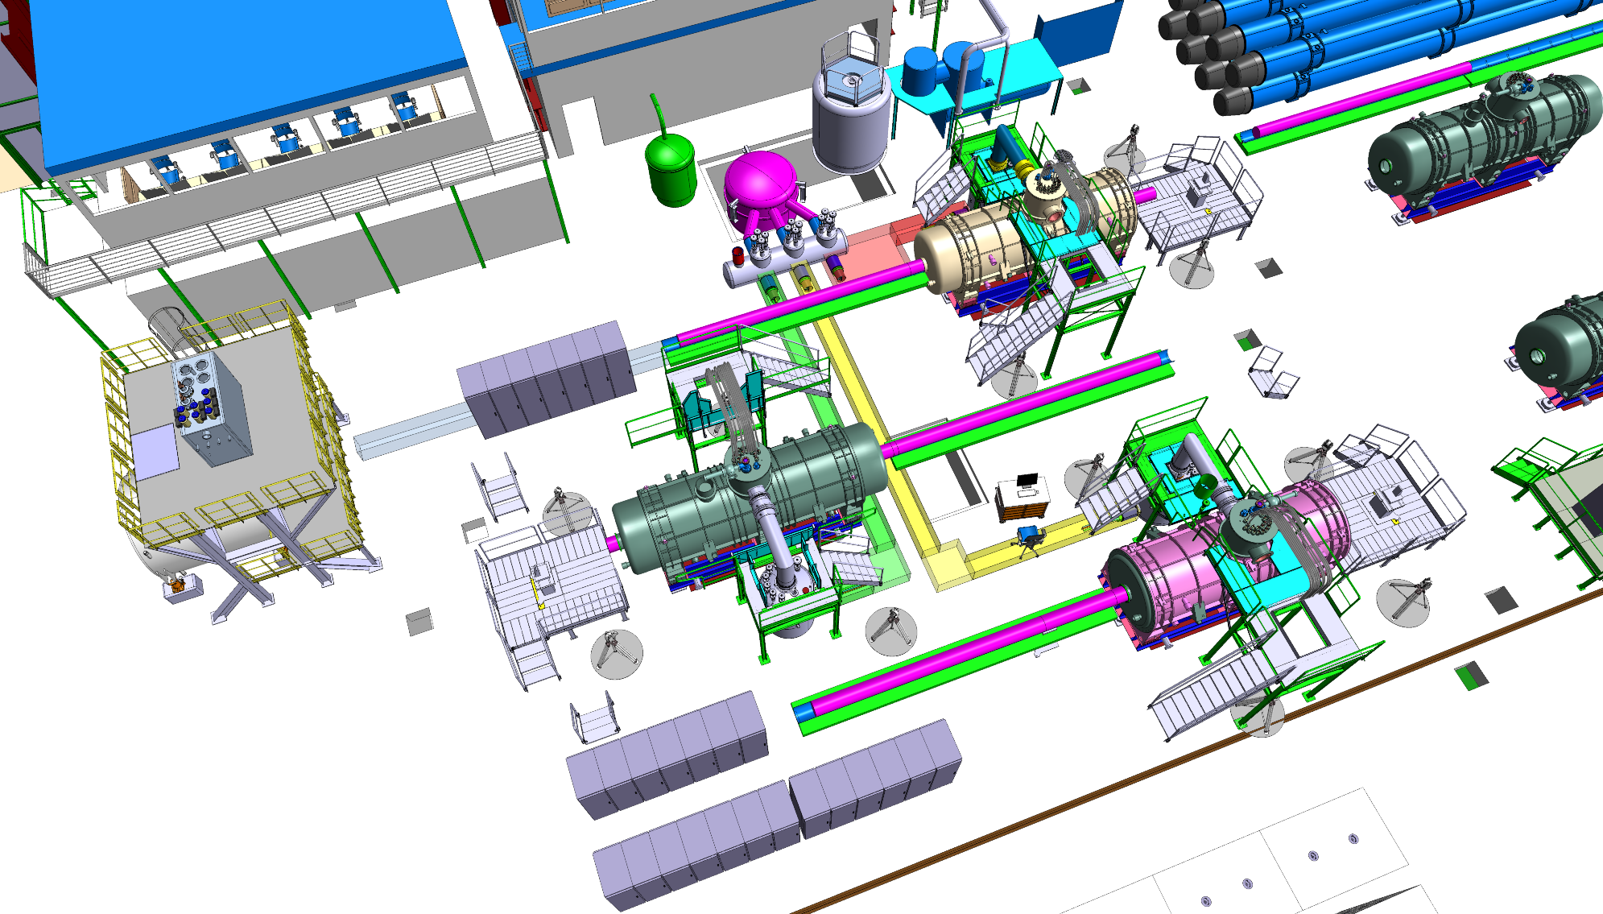
Control racks
Cryogenics
Control racks
Magnetic measurement racks
Control racks

Slide 23
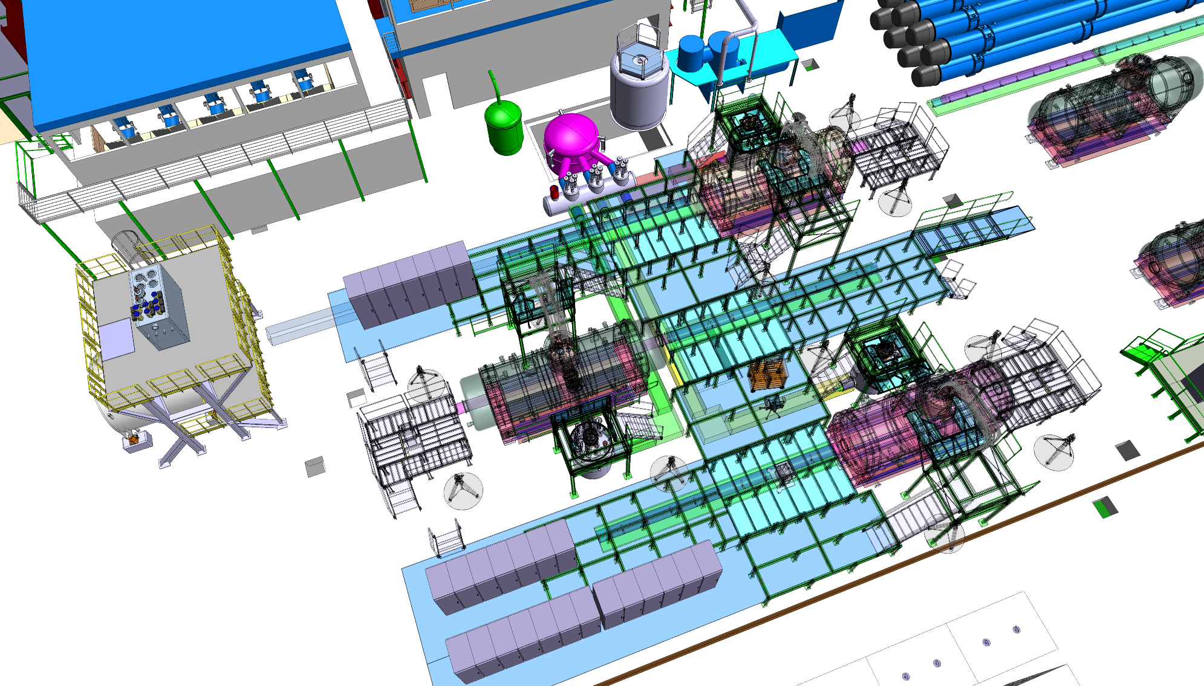
Cryogenics & metallic structures

Slide 24
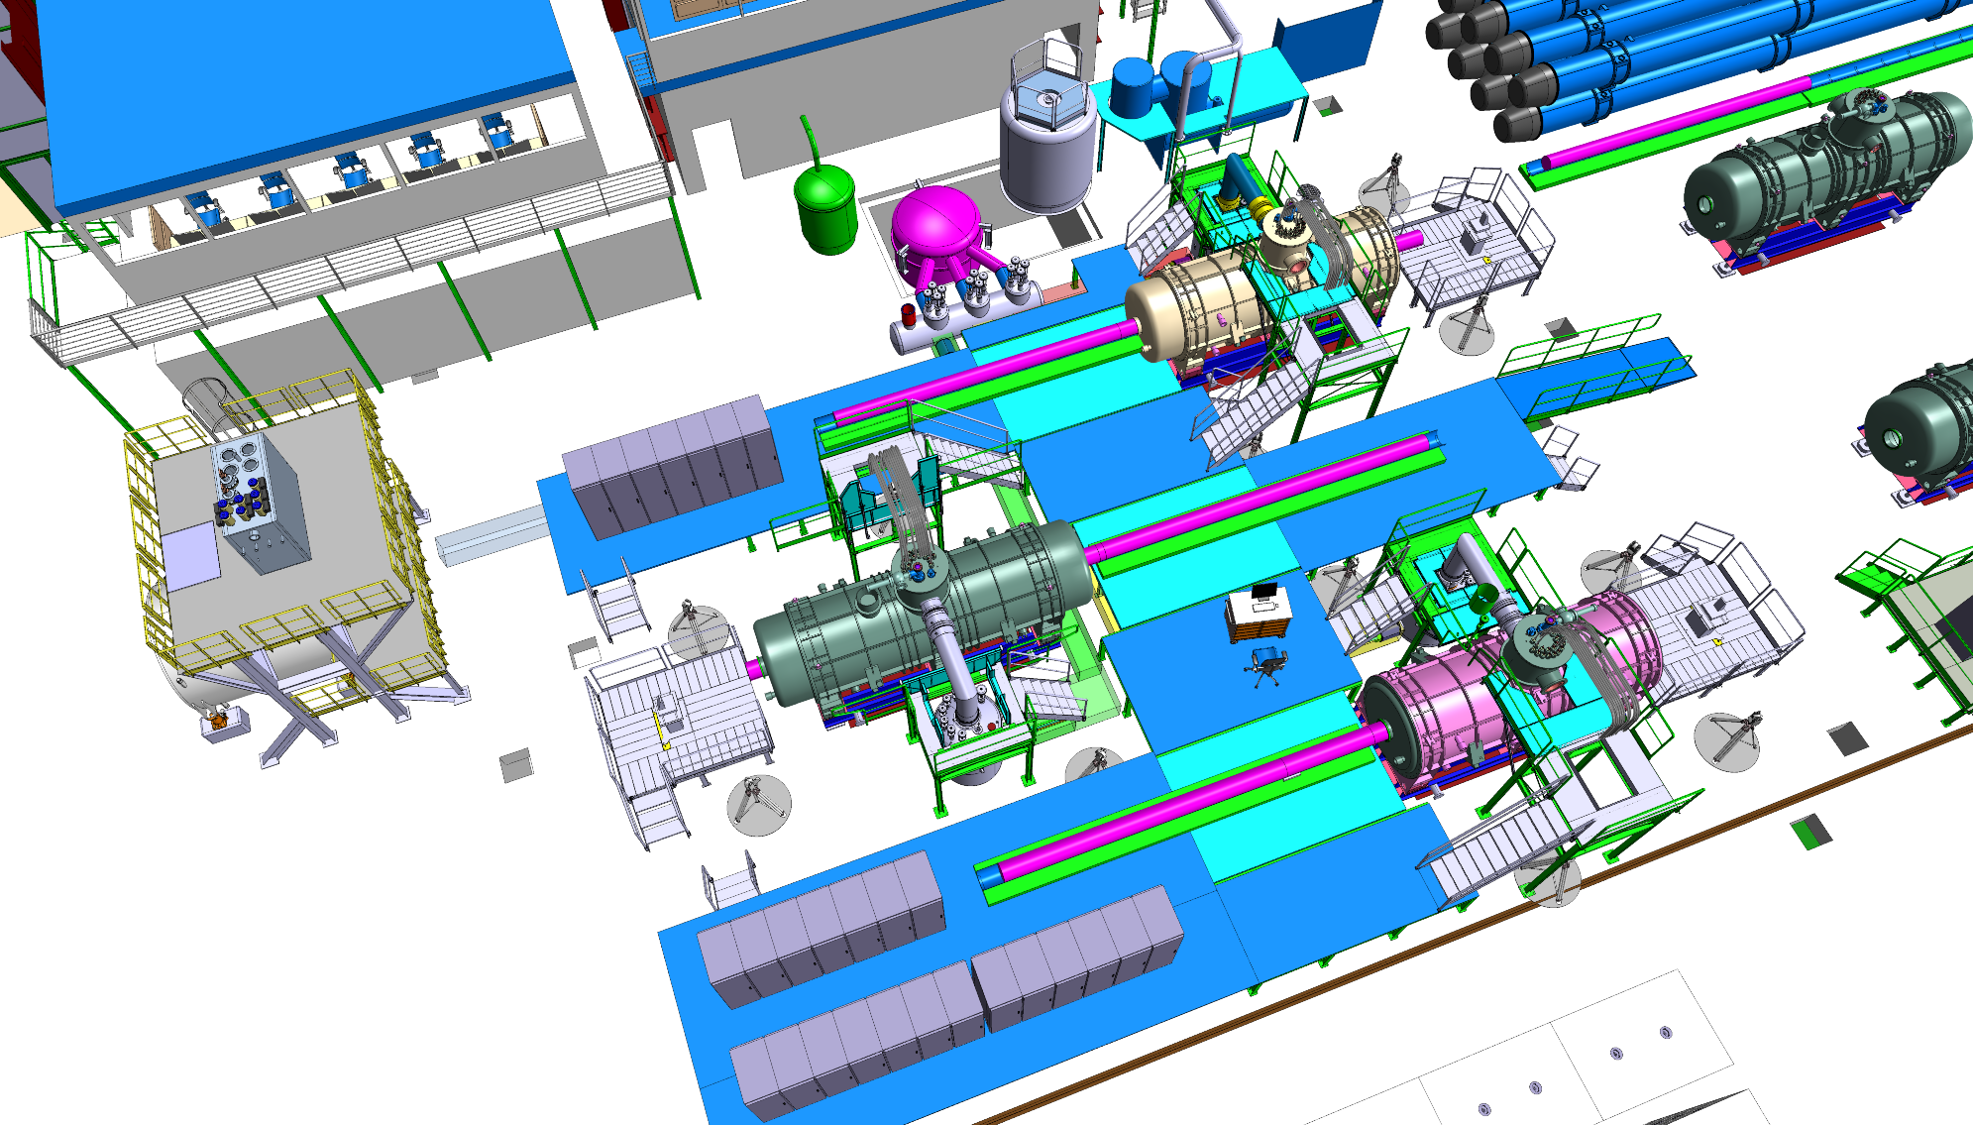
Cryogenics & metallic structures

Slide 25
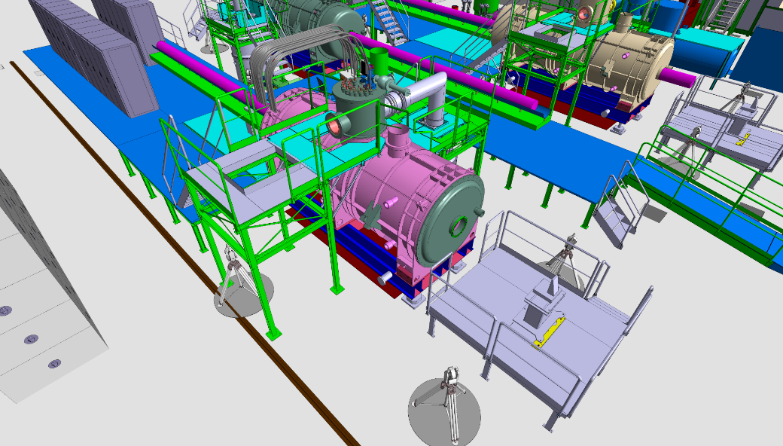
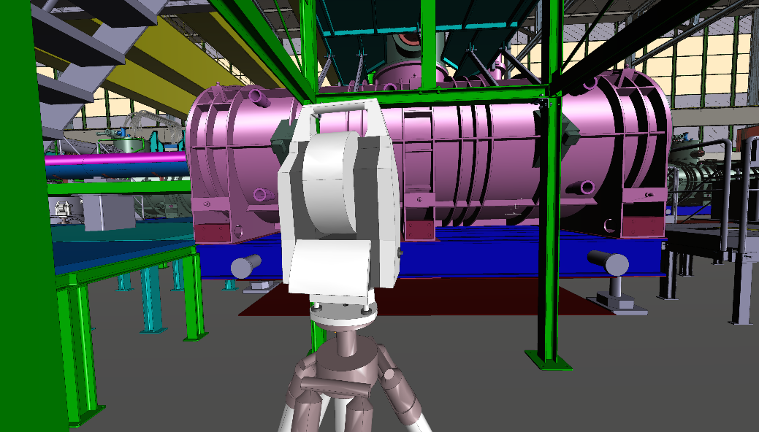
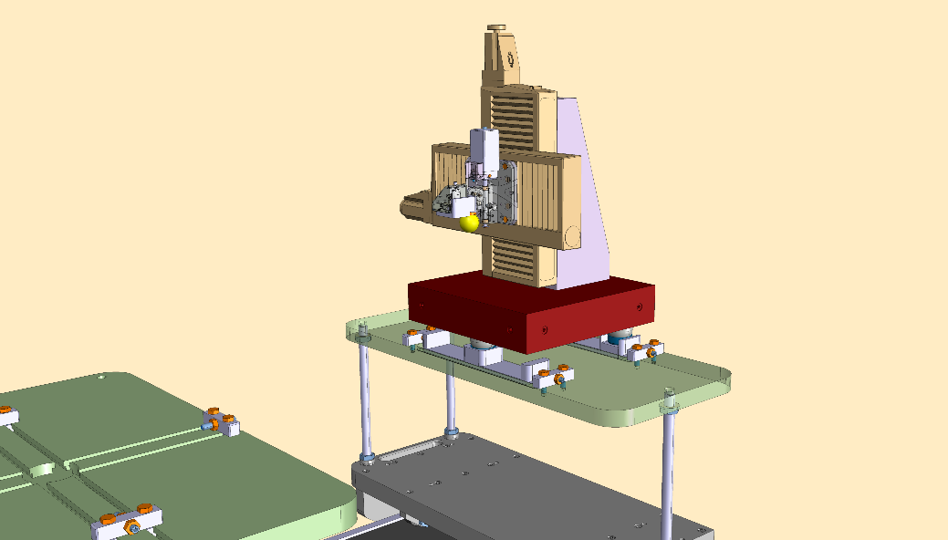
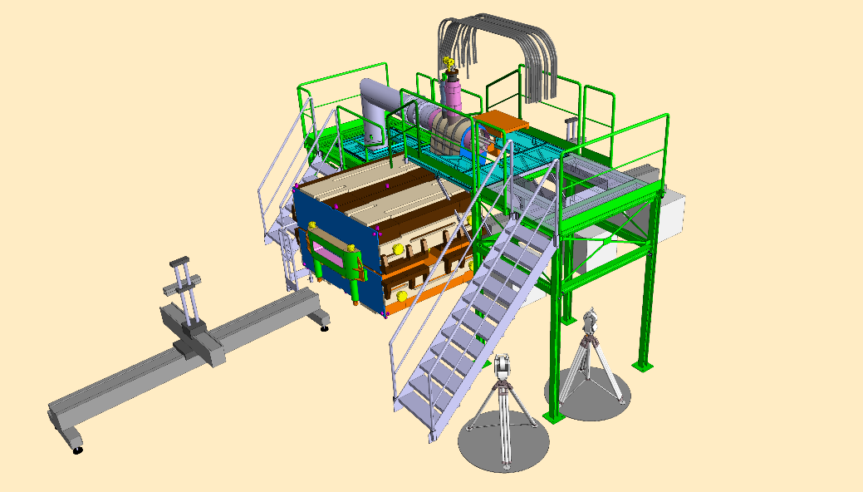
Magnetic & positionning measurements
Wire device on marbel table
Mapper

Slide 26
Approve the metallic structure layout:
  Position of the racks
  Height of the plateforms
  Position of the power converters
  Position of the cryo equipments
  Path of the cable trays
Layouts of the metallic structure
Construction
June 2015 ?
Left to do
August 2015 ?
Starts December 2015
Ends April 2015 ?
Thank you

