Slide 2
Project Management and Schedule
L. Serio

Slide 3
Outline
Introduction
Schedule overview
Cost overview
Threats and opportunities
Conclusions

Slide 4
Introduction 1/2
EVM, detailed schedule and cost profiling performed
  Review of the baseline after LLI procurement contract signed
  Test facility readiness in Autumn 2016 (potential delays not affecting the availability to test prototype magnets)
    All effort to complete the work in 2016 due to availability of personnel beyond this date
  Integration work to be completed soon and start of installation sequence review to schedule installation and commissioning activities
Several coordination meetings between CERN and GSI leading to the refinement and definition of the technical requirements
Several integration and coordination meetings among the involved interface to finalize the layout and required utilities
Preparation of the operation strategy and cost proposal

Slide 5
Introduction 2/2
Detailed design activities were started according to the maturity reached and the agreed schedule
  New layout to improve the preparation area and provide enhanced control and analysis infrastructures
  Electrical power distribution still needing final requirements
  Platforms significantly behind due to late finalizing of the layout / sequencing of installation
  Cryogenics slow start due to available resources, catching up
  Interface with floor, platforms, cranes and cryo distribution require final inputs from GSI
  Review to be done, once final layout completed, on the safety risks with the update of the safety launch sheet (electrical, mechanical, cryogenics, etc.)
Procurements have been launched for the main long lead items
  Cooling water system -> contract signed
  Cryogenic compressors - > call for tender

Slide 6
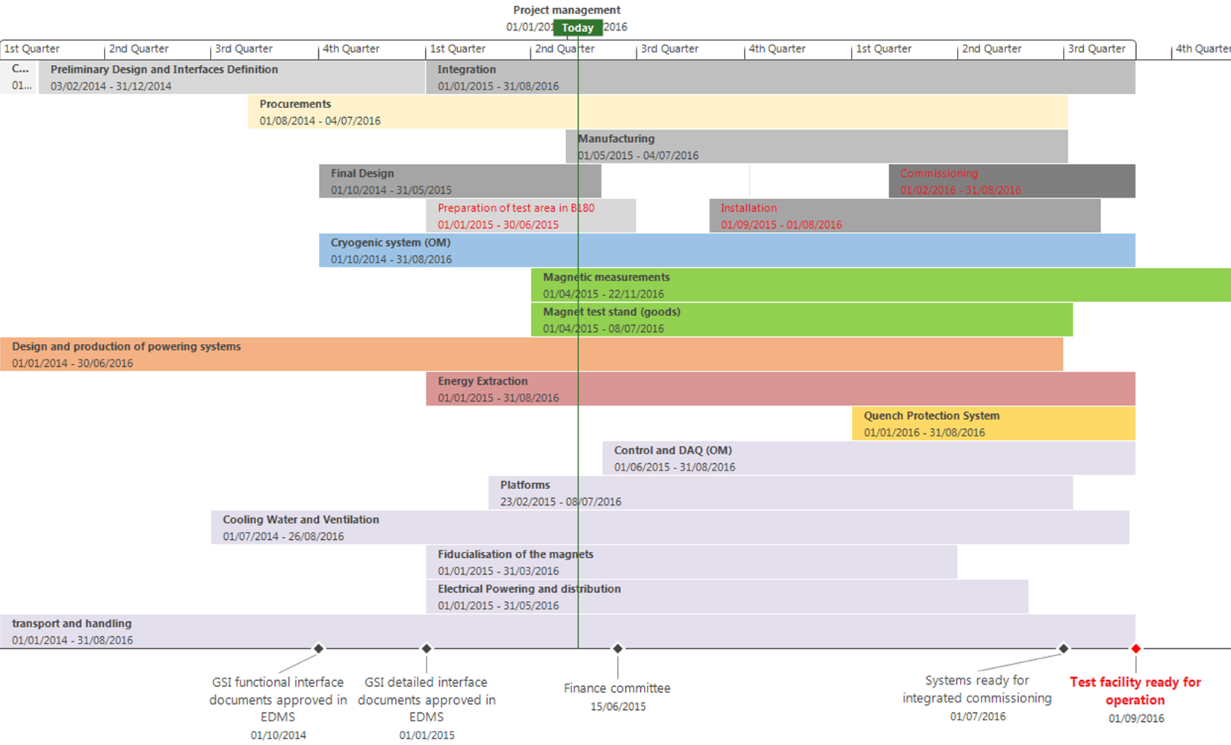
Schedule overview

Slide 7
EVM
Cost and profiling confirmed but requiring review due to delays in some major systems and adaptation to maturity of requirements and need date
  Global review and new baseline to be proposed at next coordination committee meeting
  Formality for better tracking and coordination
  The test station would be available anyway in Autumn 2016
No major cost increase expected
  Favorable CHF/EUR exchange rate
  Cryo compressor building consolidation pending review
  Control room and operation infrastracture to be covered by additional financing
Procurement lagging slightly behind (partly an artefact of EVM)
Importance of timely filling the report for correct assessment of the project status (please fill in your next report on the 1st of the month)

Slide 8
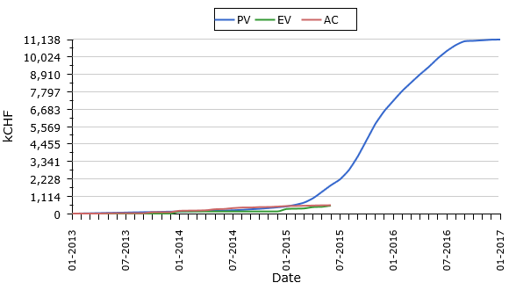
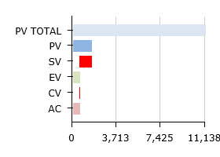
EVM
Actual metrics on the 30-Apr-2015 (reporting date)

Slide 9
Late deliverables
On critical path system
TF180-UPG 2 156738 :
Cryogenic system (OM) - A. Perin Refurbishment of DVB B180 (5%)
TF180-UPG 2 156739 :
Cryogenic system (Goods) - A. Perin Precooler 1 compression station refurbishment B279 (0%)
Not on critical path
TF180-UPG 3 156742 :
Platforms - M. Wilhelmsson Final design included contruction drawings (75%)
Other (non critical or not reported):
Powering, electrical distribution,survey, transport and handling

Slide 10
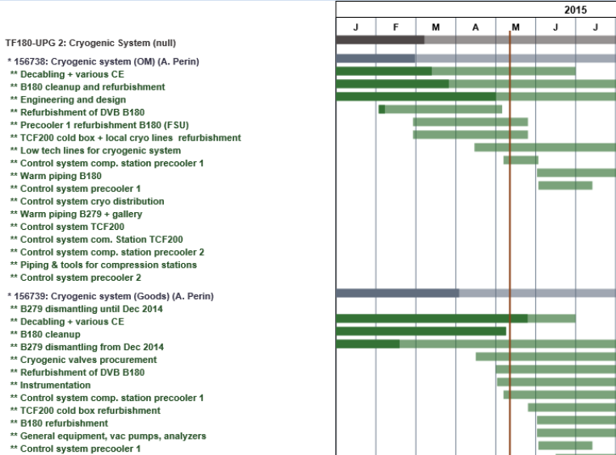
Cryogenics

Slide 11
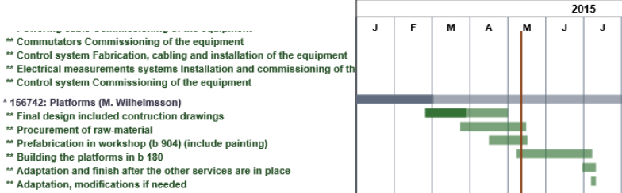
Platforms
2016

Slide 12
Threats and opportunities
Additional resources from CEA contribution to the testing of SFRS magnets at CERN to finance (directly or indirectly) the new control and data analysis infrastructure
Delay in finalizing the remaining interfaces with the magnets could impact the availability of CERN personnel to complete the facility and will impact cost
Environment and health requirements might impact the consolidation work for the compressor station building
New layout would ease the logistic and preparation area and provide additional opportunities for storage and testing purposes

Slide 13
Conclusions
Project slightly behind schedule but confirmed readiness for 2016 and well in time for first magnet testing
  Cryo LLI on critical path
Cost under control
  Consolidation of obsolete infrastructure and new control room to be reviewed carefully
Delay in providing requirements and specifications has an impact on the facility progress
  Resource availability to complete the work after 2016
  Need to take assumption and make compromise

