Slide 2
Cryogenic system for B180 for FAIR S-FRS magnet testing
CERN-GSI Technical Coordination Meeting
12th May 2015
A. Perin, H. Derking, L. Stewart, M. Chesi, B. D’Hulster, V. Inglese, K. Iakovidis, P. Chambouvet, G. Favre
Acknowledgements: all the B180 cryo and FAIR@CERN project team

Slide 3
Outline
  Project status overview and strategy
  Status of subsystems & interfaces
  Conclusions

Slide 4
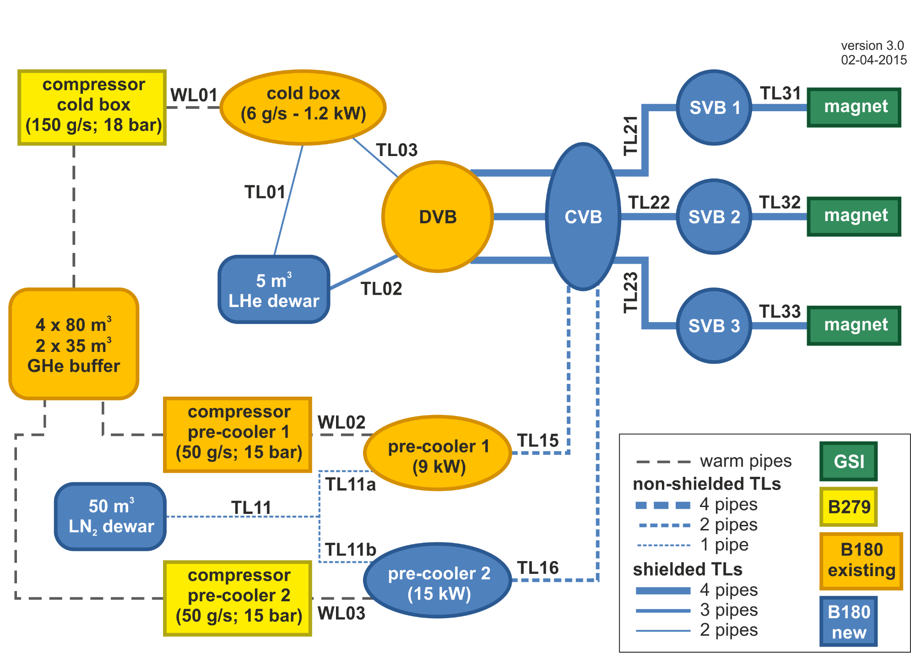
Layout of B180 test facility
Updated configuration

Slide 5
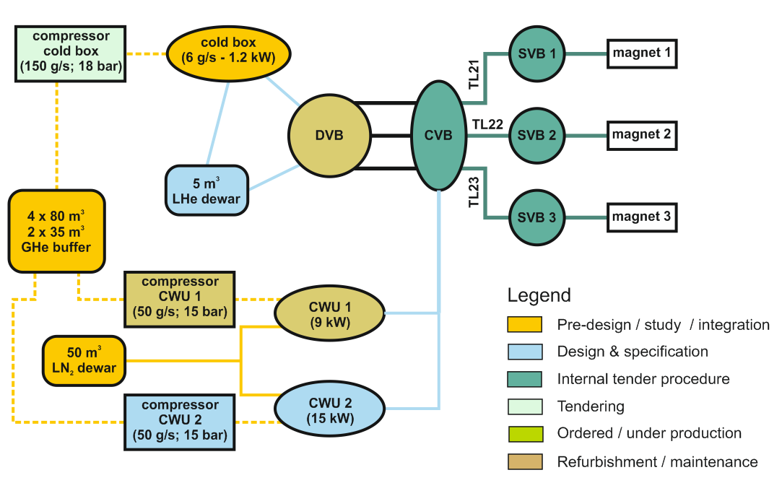
Status of the cryogenic system
For new equipment: specification and tendering
For existing equipment: refurbishment starting

Slide 6
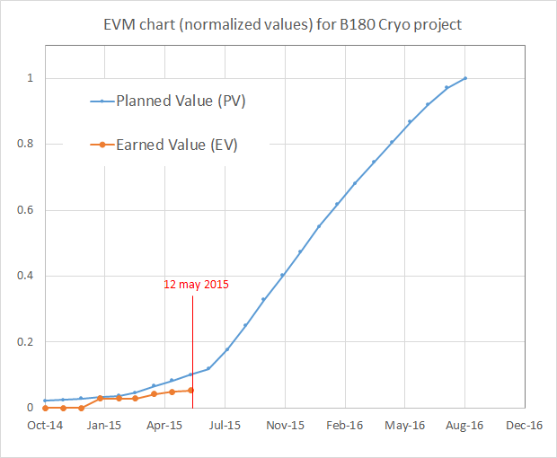
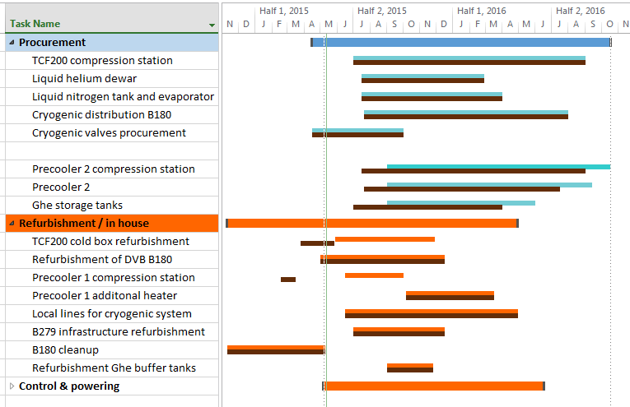
Schedule and Earned value (EVM)
✔
Essential procurement tasks are on track for summer 2016 operation with one pre-cooling system
Procurement of pre-cooler 2 shifted by 12 weeks.
Refurbishment & non ITs items work start has been delayed but is still compatible with baseline schedule. Starting in May.

Slide 7

Project overview 1/2
Global strategy
  Focus all resources on equipment that is needed to start testing in Autumn 2016.
  For prototype testing, pre-cooler 2 system is not needed and has to be be shifted by about 12 weeks.
    Phase 1: cryogenic system with 1 pre-cooler
    Phase 2: installation of pre-cooler 2 and its compression station
Design & integration
  All design parameters frozen. In particular design pressure of 20 bar and all mass flows.
  Layout and integration for main items finalized ✔
  Detailed specification design done for cryogenic distribution ✔
  Final P&ID not completed (80% done)
  Detailed design ongoing for warm piping
Procurement
  Cold box compression station: offers received 11th May. On track for Fc of June. ✔
  Cryogenic distribution: tech. Spec. in internal circulation, Spec. Comm. First week June. ✔
  Items that are not essential for prototype tests are put on hold (resources!).

Slide 8
Project overview 2/2
Refurbishment & non ITs items
  Work started later than planned due to unavailability of personnel.
  Still on track for Summer 2016.
Control system & powering
  Start of work has been shifted to second half of May (resources).
  Ok with baseline goals.
Infrastructure
  B180 cleanup completed. ✔
  B279 cleanup ongoing. Detailed plan being defined.

Slide 9
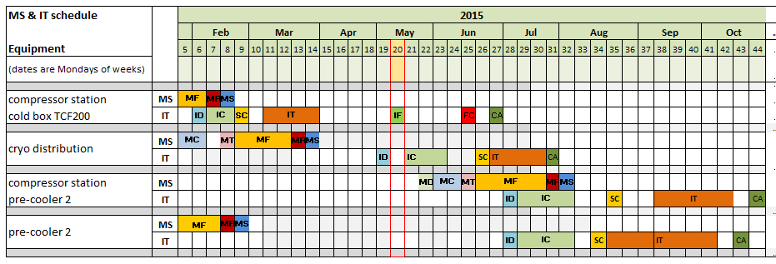
Procurement for main items: MS & IT schedule
MS & ITs for critical items for startup in summer 2016 are on time.
MS & ITs for pre-cooler 2 had to be shifted to secure tasks that are mandatory for startup in summer 2016.

Slide 10
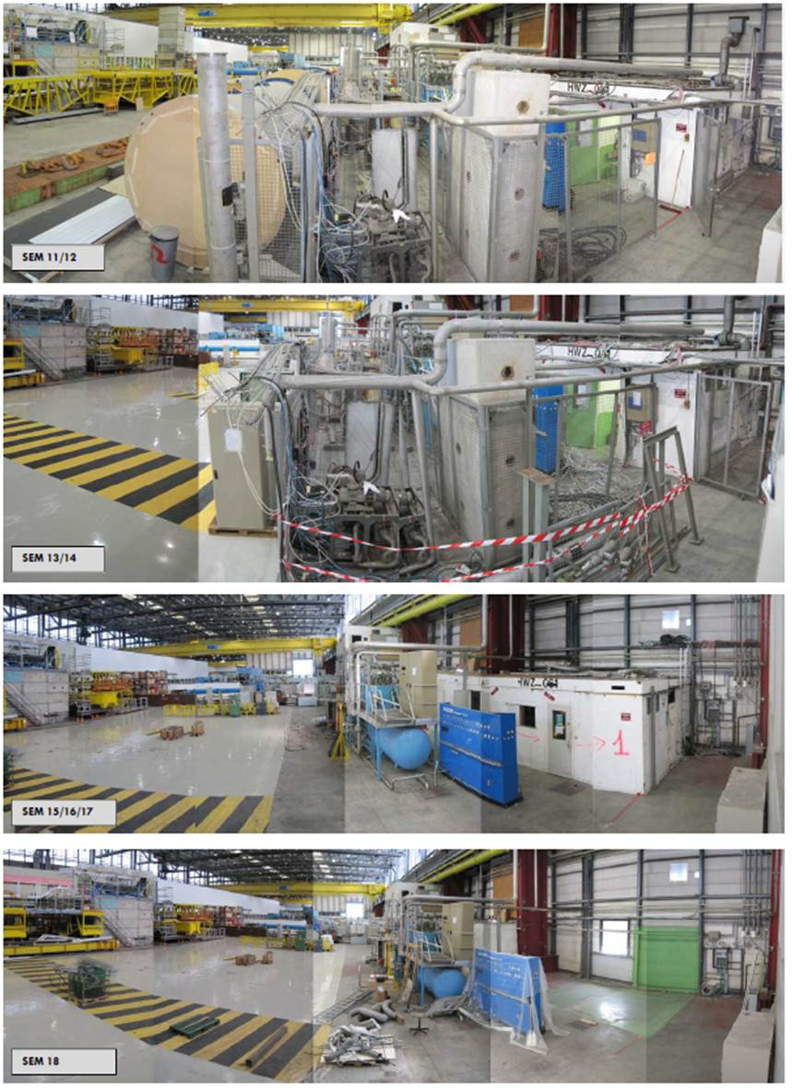
B180 Cleanup
Cryo equipment
  All non-necessary equipment was removed.
  De-cabling performed in preparation of refurbvishment activities completed.
Building
  Old barrack cleaned and removed to make space for new layout
  Work ongoing to prepare new layout.

Slide 11
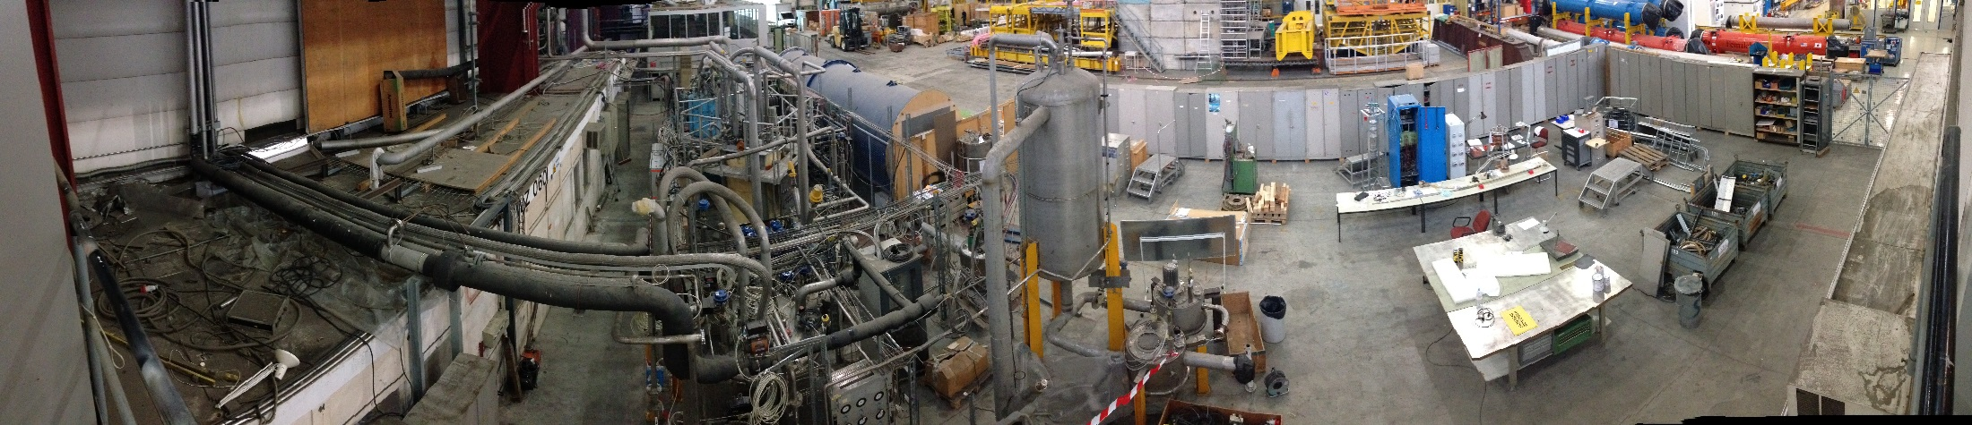
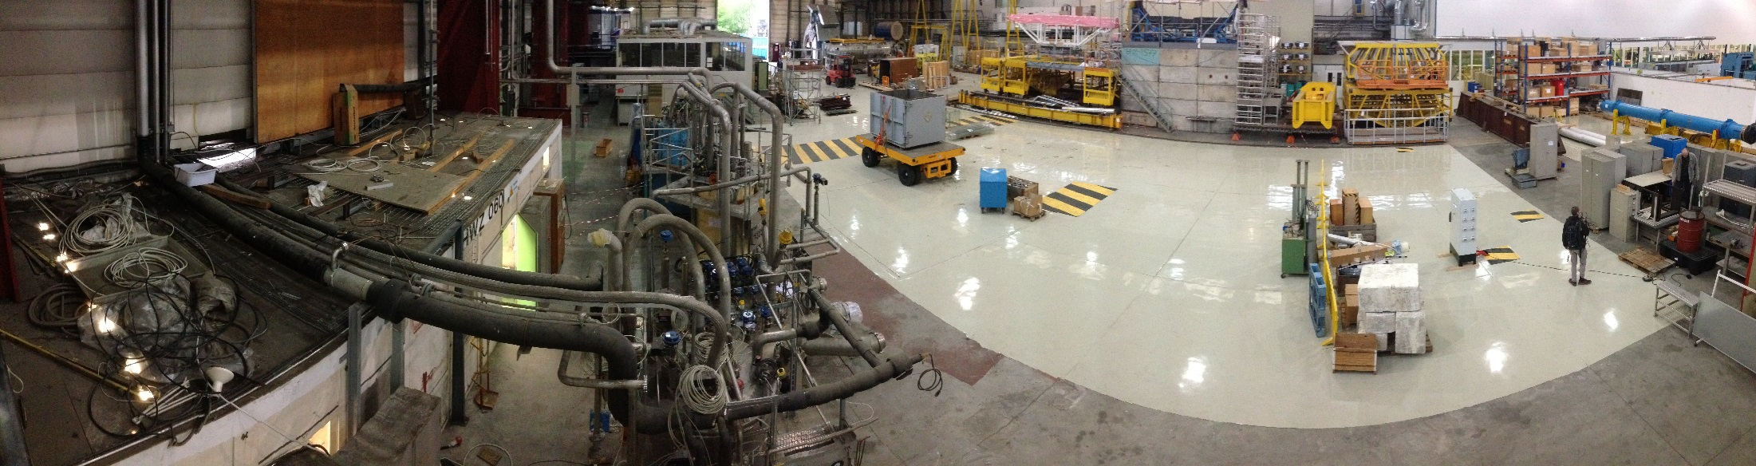
B180 cleanup
19th of January
5th of May
Area and cryogenic equipment are ready to start refurbishment and upgrade activities

Slide 12
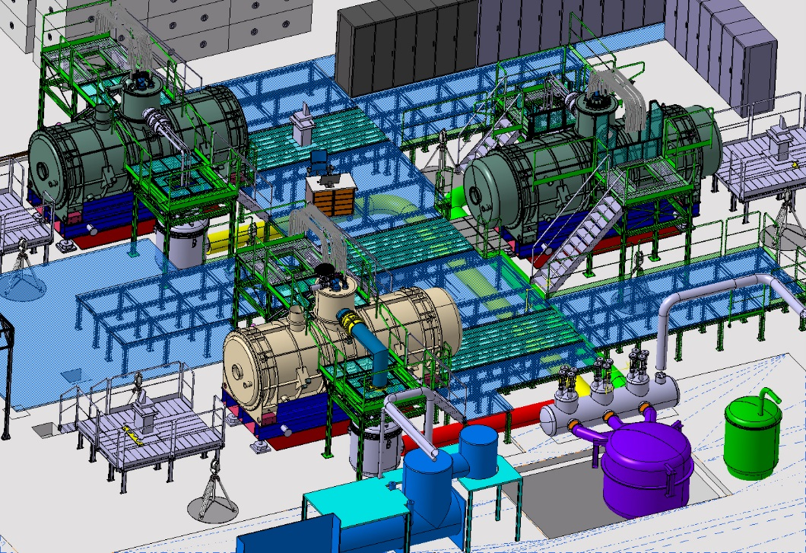
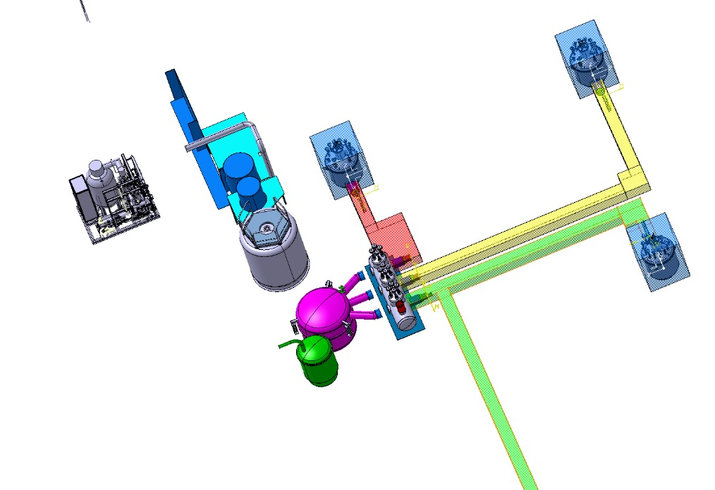
Layout and cryogenic distribution
SVB
Cold box
SVB
Dryer
Lhe dewar
DVB
SVB
CVB
DVB
Pre-cooler
Cold Box
Layout is finalized
Technical specification documents for procurement are being circulated.
Current strategy: jumper interface will be defined and procured later (see next slide)

Slide 13
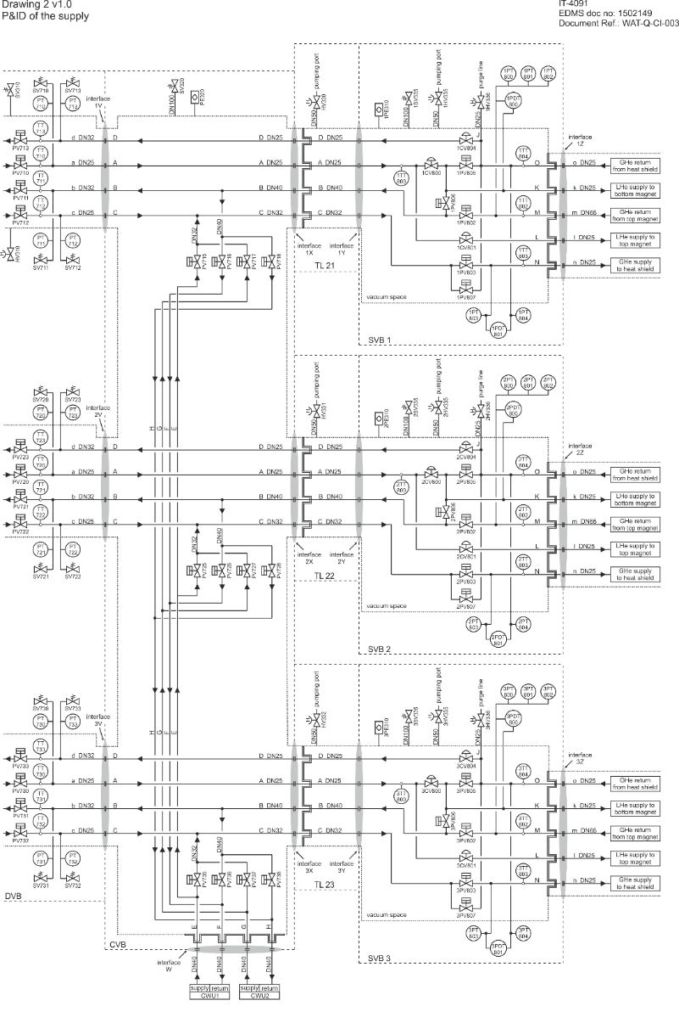
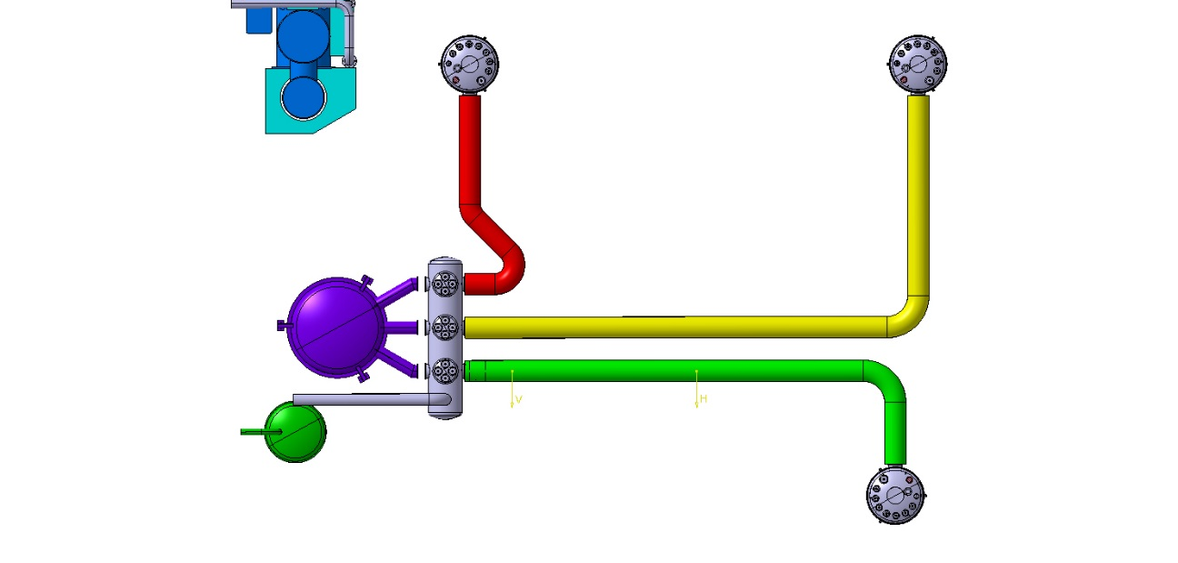
IT-4091 Cryogenic Distribution System
IT-4091:
MS finished, 9 firms interested
Design/integration finished
IT docs in circulation
Contract award planned for mid-July
DO-29235: Cryogenic valves
- Docs will go sent out in 2 weeks
SVB
SVB
DVB
CVB
SVB

Slide 14
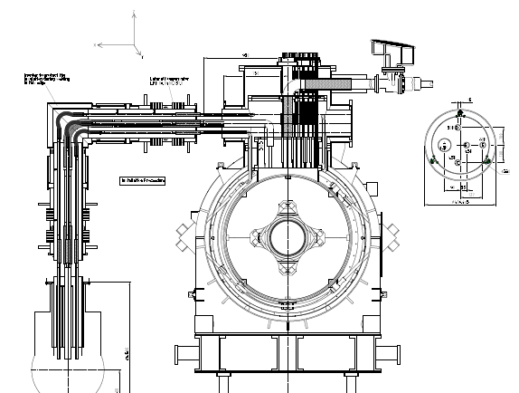
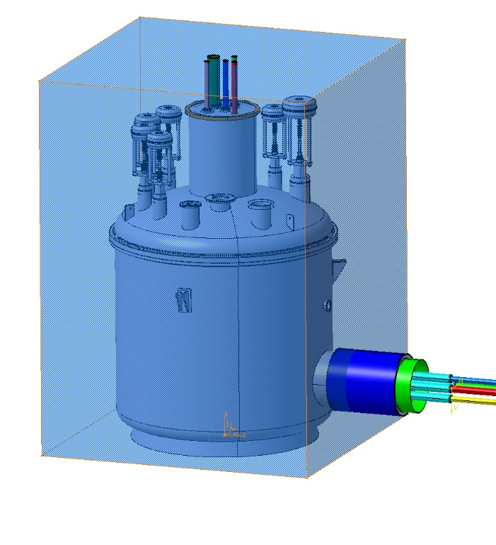
Satellite valve Box & cryo interface
Interface for procurement
GSI drawing
Procurement is proceeding with interface up to jumper. This allows to start the procurement and finalize the jumper and interfaces at a later time.
Jumper and connection technologies need to be finalized (see next slides).
Information received from FAIR last week, being analyzed.

Slide 15
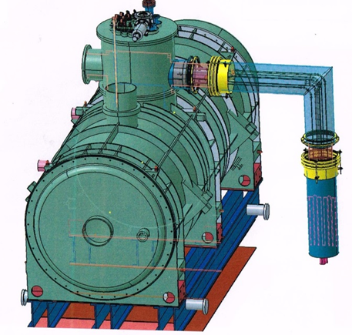
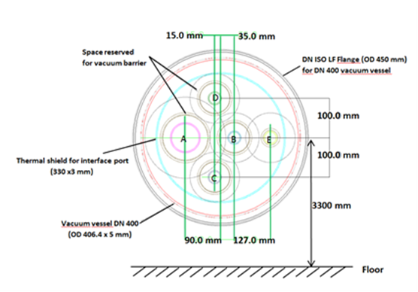
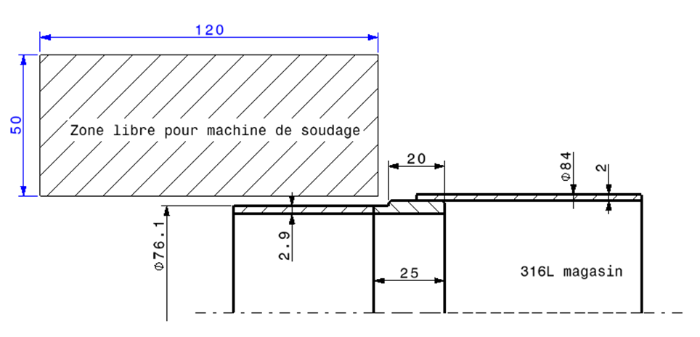
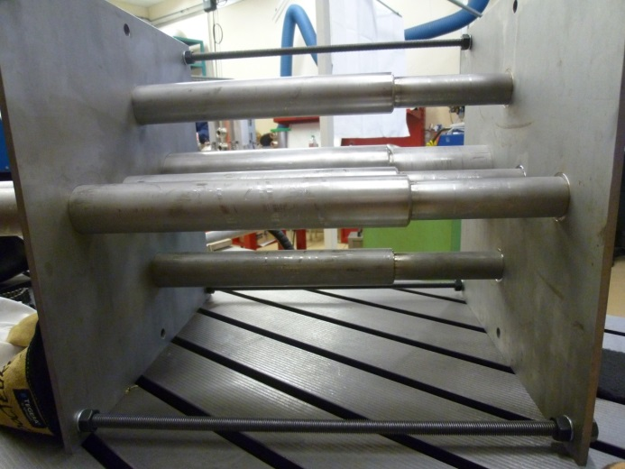
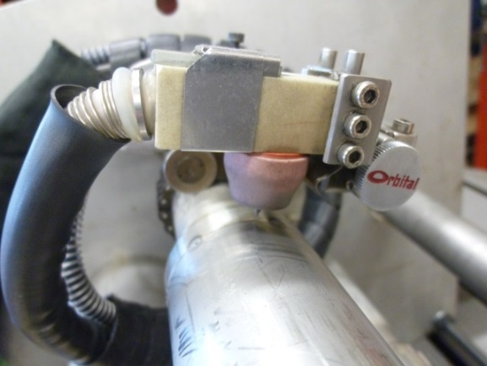
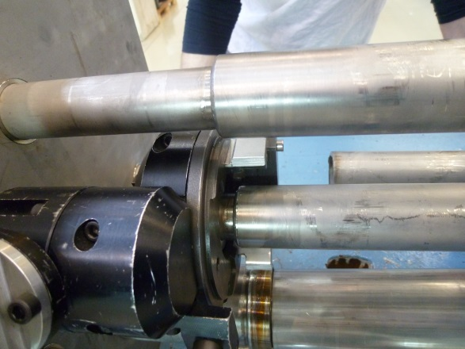
Cryo interface to magnets
Study to define and validate the configuration for welding and cutting being perfromed by EN-MME
Proposal of configuration. Realistic Mockup made.
Welding validated ✔, tooling validated ✔ , cutting validated ✔.
Pressure test qualification ongoing.
Proposed configuration
Mockup
Orbital welding
Cutting
G. Favre, EN-MME

Slide 16
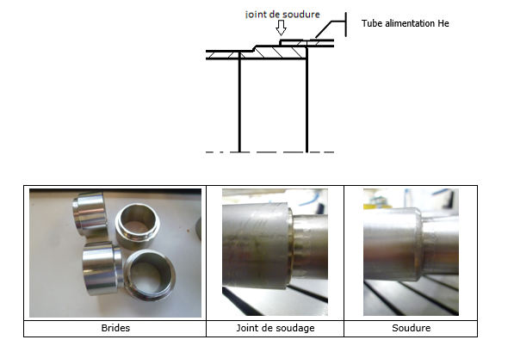
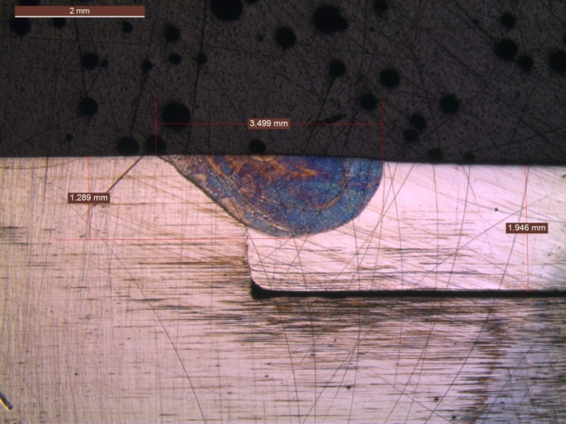
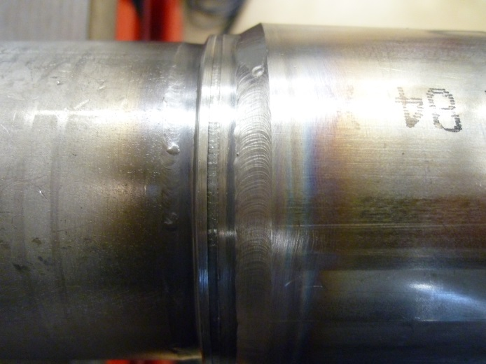
Welded cryo interface to magnets
Metallographic analysis of the welds
Weld
G. Favre, EN-MME

Slide 17
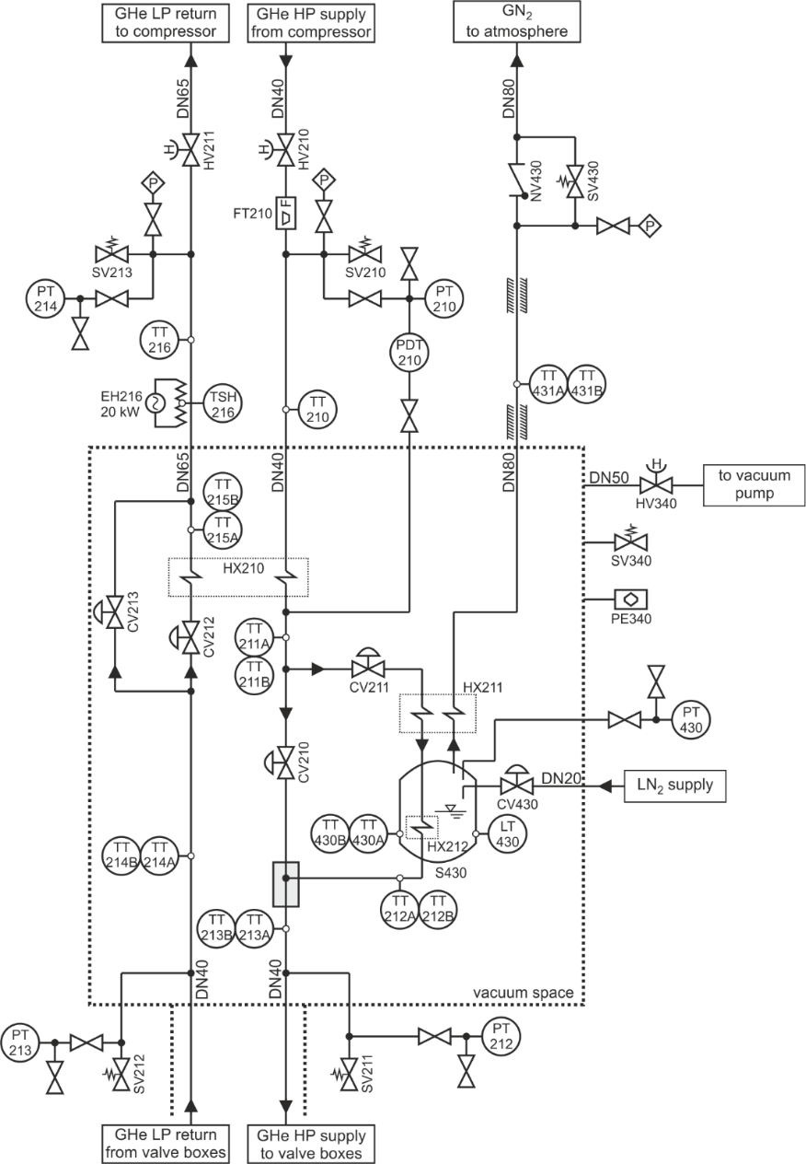
Precooler # 2 (CWU 2)
IT-4085:
MS finished, 7 firms interested
Design finished
IT postponed to after summer (resources)

Slide 18
Controls & powering
  Decabling in B180 according to planned schedule
  Personnel is now becoming available to start work on definition and refurbishment of equipment.
  Required CE man power for CB and Precooler1 available starting from mid-May thanks to the participation of 2 technical staff + 1 fellow + 1 student in order to readjust personnel allocation to other projects
  The control system architecture has been defined.
  Next step is the definition of interfaces and integration of magnet instrumention (see next slide).

Slide 19
Global cryogenic control architecture

Slide 20
Global cryogenic control architecture
GSI equipment

Slide 21
Control interface with GSI
GSI racks for magnet instrumentation must use a Profibus DP interface with the CERN cryogenic control system
  All signals shall be conditioned and calibrated, and exchanged with CERN in engineering units
  These signals will be stored through CERN’s archiving facilities (TIMBER) by means of filters set according to CERN policies
  Suitable naming complying with CERN standards shall be used for signal tags
For each test station, the following items are reserved for GSI:
  2 CERN standard racks
  5 kW / 400VAC (3.5 kW for current leads electrical heaters, 1.5 kW for remaining equipment)
  no UPS, no Ethernet
Objective: agree by end of July on interface specification document (CERN in charge of integrating document)

Slide 22
Conclusions
Strategy & priorities
  In order to secure the startup of the cryogenic system by summer 2016, the procurement of pre-cooler 2 had to be shifted by12 weeks.
  This has no impact on the magnet test schedule as only two prototypes are planned in 2016.
Schedule
  Procurement of critical items for phase 1 is on track for startup in summer 2016.
  Refurbishment and controls work has started with 12 weeks shift, but is still compatible for startup in summer 2016.
  Refurbishment of B279 on critical path. Study in progress.
Technical aspects and interfaces
  No show stoppers.
  Mechanical interfaces and control/instrumentation integration to be finalized by end of July 2015.

Slide 24
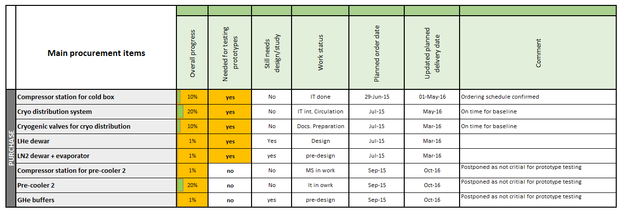
Detailed status: procurement
3 prototype tests are scheduled from November 2016 to September 2017.
series tests from Nov 2017 to May 2021
Test rate will be 2 magnets / mont

Slide 25
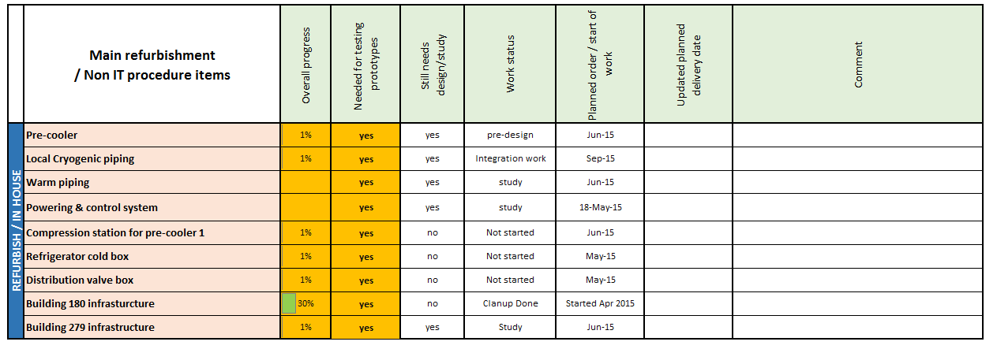
Detailed status: refurbishment & non Its items
3 prototype tests are scheduled from November 2016 to September 2017.
series tests from Nov 2017 to May 2021
Test rate will be 2 magnets / mont

Slide 26
CE Planning
Required CE man power for CB and Precooler1 available thanks to the participation of 2 technical staff + 1 fellow + 1 student in order to readjust personnel allocation to other projects

Slide 27
List of equipment
Existing equipment, all instrumentation to be refurbished
  Cold box 6 g/s of liquefaction capacity or 1'200 W @4.5K refrigeration
  Distribution Valve Box (DVB). To be modified.
  9 kW pre-cooler including 50 g/s compressor (maintenance required)
  GHe buffer, 5 x 80 m³ for 5 m³ of Lhe
New equipment required
  Compressor station for cold box, m=150 g/s at 18 bar
  Dryer
  10 kW pre-cooler including 15 kW heater inclusive of compressor station 50 g/s including buffer.
  Satellite 15 kW heater to implemented to the existing 10 (9) kW pre-cooler
  1 Connection valve box (CVB)
  3 satellite valve boxes (SVB) including instrumentation
  3 cryogenic lines between the distribution valve box and satellite valve boxes
  4 cryogenic lines between two pre-coolers and 3 satellite valve boxes (including 10 valves, 2+6+2, integrated in SVB)
  LHe dewar, V_{min} = 5 m³ of
  LN tank, 50 m³
  Cryogenic infrastructure

