Slide 1
FAIR platforms
Mats Wilhelmsson
Meeting 12 May 2015

Slide 2
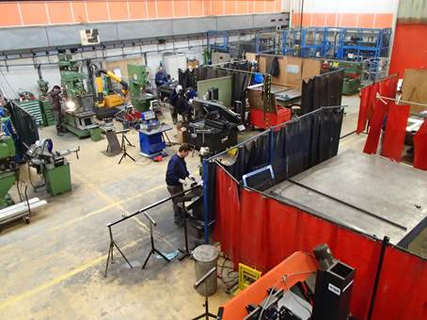
Design & building strategy
Since last year (end 2013), we have a mechanical building contract in place in EN/MEF which supports the Accelerators and the experimental areas with mechanical structures. (existed before in another group)
Workshop building 904

Slide 3
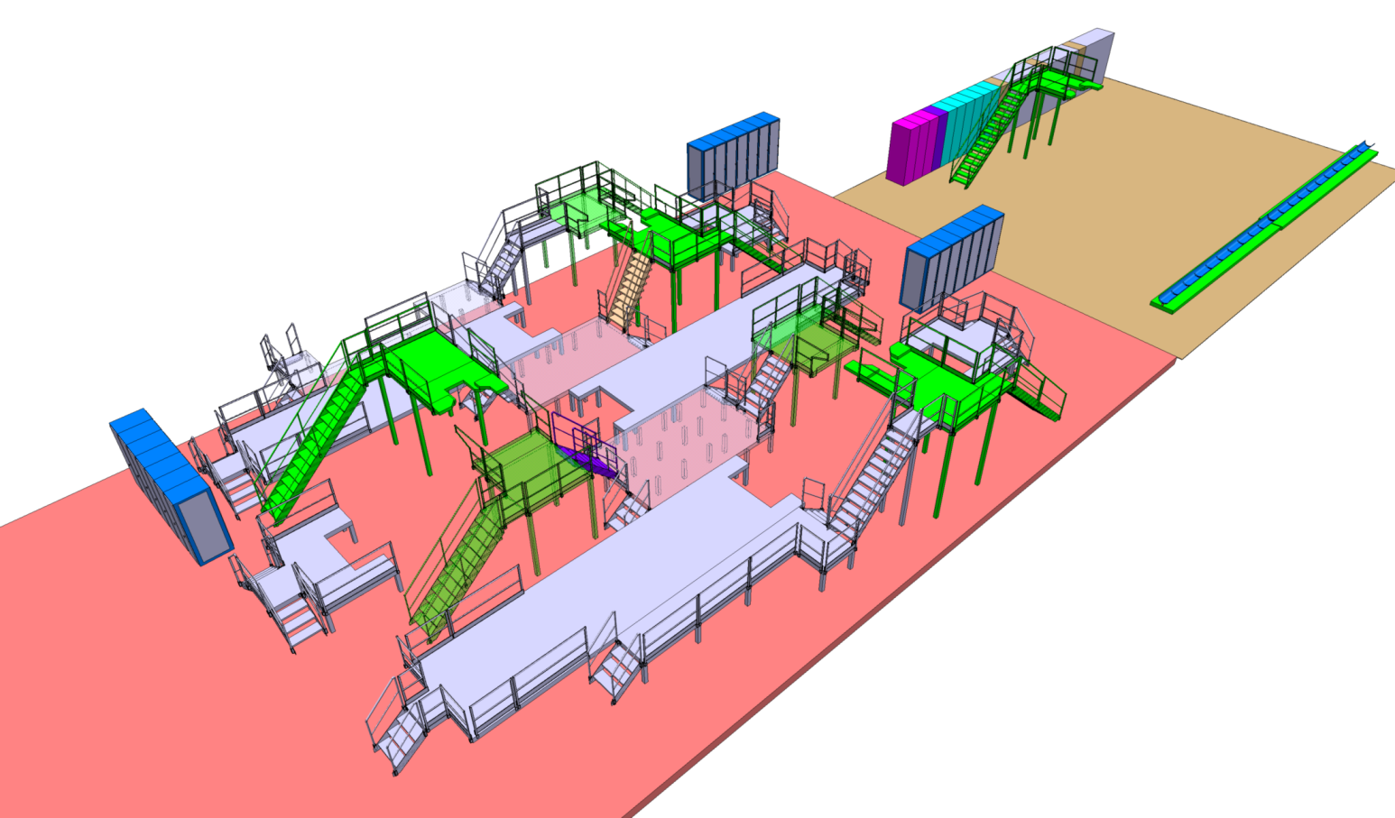
A cost estimate was produced by M Arnaud, the person in charge of this support activity, based on a preliminary layout:

Slide 4
FAIR / Types de structures
Structures fixes
Type | Nombre | Dimensions | Hauteur | Surface | Notes
1 | 1 | 6300x1000 | 800 | 7.4 m2
2 | 1 | 2950x4630 | 800 | 13.6m2
3 | 1 | 2450x4635 | 800 | 11.3m2
4 | 1 | 7000x1050 | 800 | 11.3m2
5 | 3 | 2350x2000 | 2300 | 4.7m2 | Certaines parties sont amovibles / Trappe Valvebox
6 | 4 | 3650x2000 | 3100 | 7.3m2 | Certaines parties sont amovibles
7 | 1 | 15000x900 | 500 | 13.5m2 | Chassis racks
8 | 3 | 4200x900 | 500 | 3.8m2 | Chassis racks
9 | 2 | 8000x800 | 900 | 6.4m2 | Support cannes de mesures au sol ou sur passerelle H=800mm
Structures mobiles
Type | Nombre | Dimensions | Hauteur | Surface | Notes
10 | 3 | 10000x2600 | 800 | 26m2 | Bouge de 4m / Trouver un système pour passer sur tuyaux cryo.
11 | 3 | 3000x2950 | 800 | 5.8m2 | Bouge de 4m / Trouver un système pour passer sur tuyaux cryo.
Escaliers
Type | Nombre | Hauteur | Notes
12 | 4 | 3100
13 | 6 | 2300 | Angles differents
14 | 3 | 1500 | Angles differents
15 | 19 | 800

Slide 5
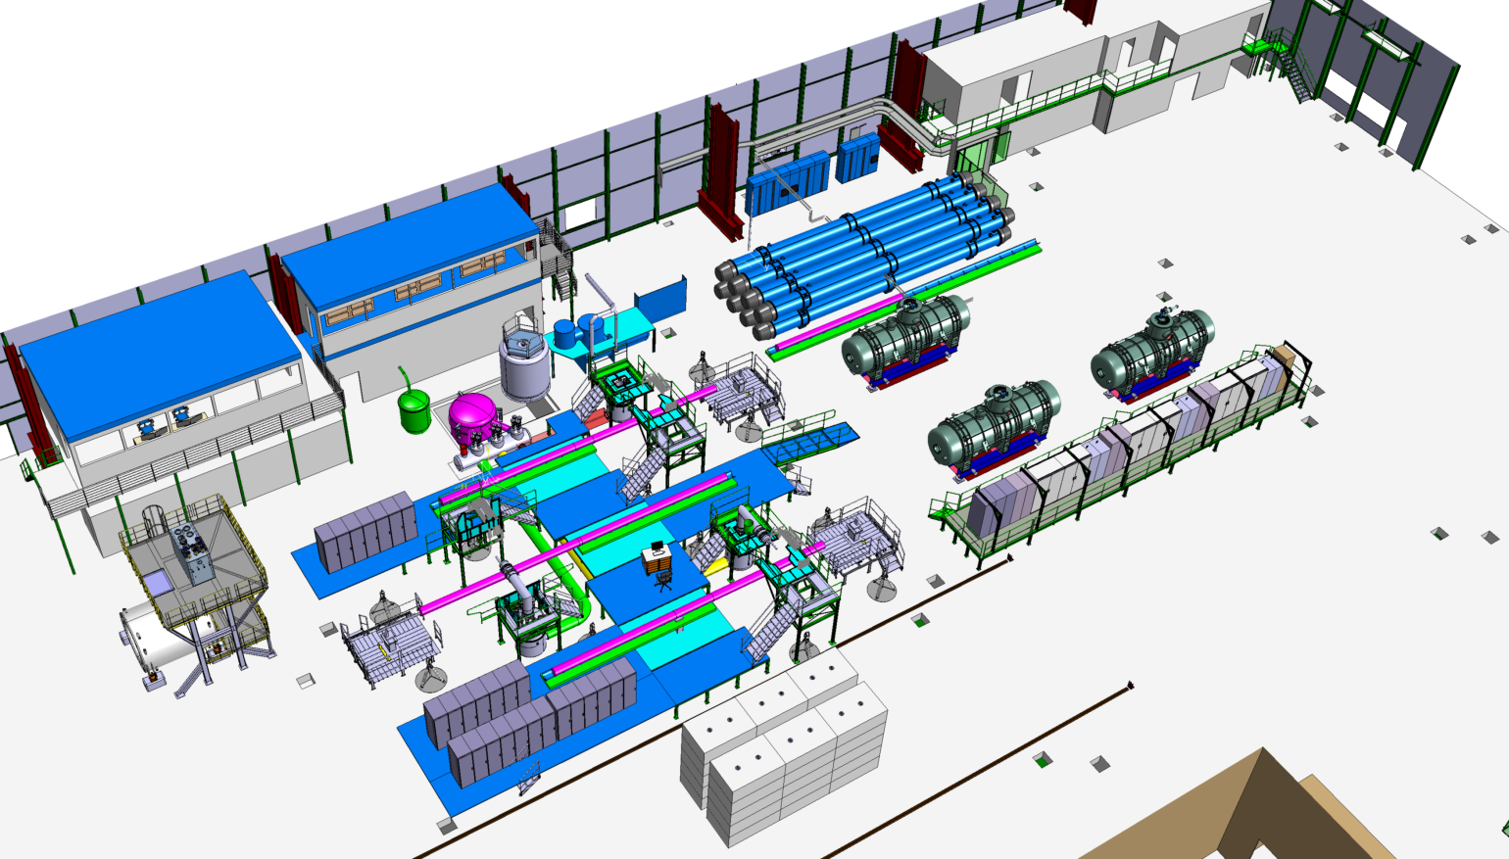
Development of the design

Slide 6
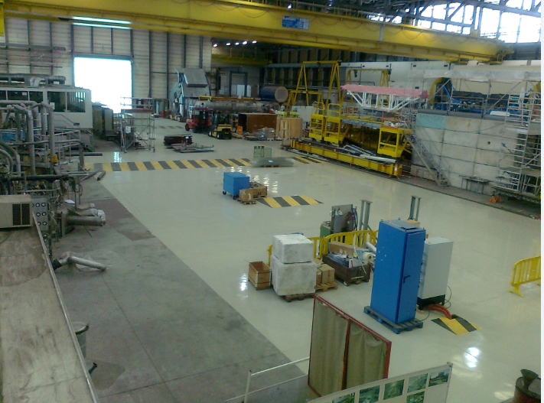

Slide 7
Next stages
When the integration models are freezed (when ?) the models will be transformed into
construction drawings
Approval of the construction file
Procurement of material
Pre-fabrication in our workshop (building 904)
Assembly in building 180.
Commissioning and adjustements

Slide 8
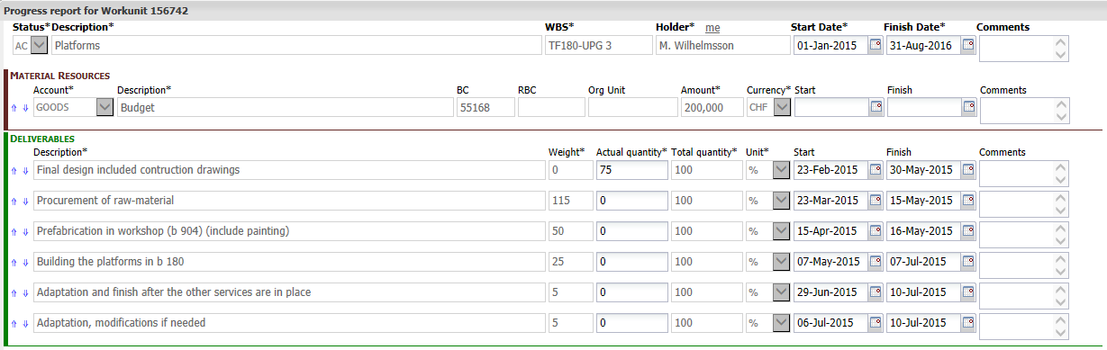
EVM

