Slide 1
The Building 180 Cryogenic infrastructure water cooling system
Status Update
Stefano Moccia, EN-CV
Coordination meeting 12/05/15

Slide 2
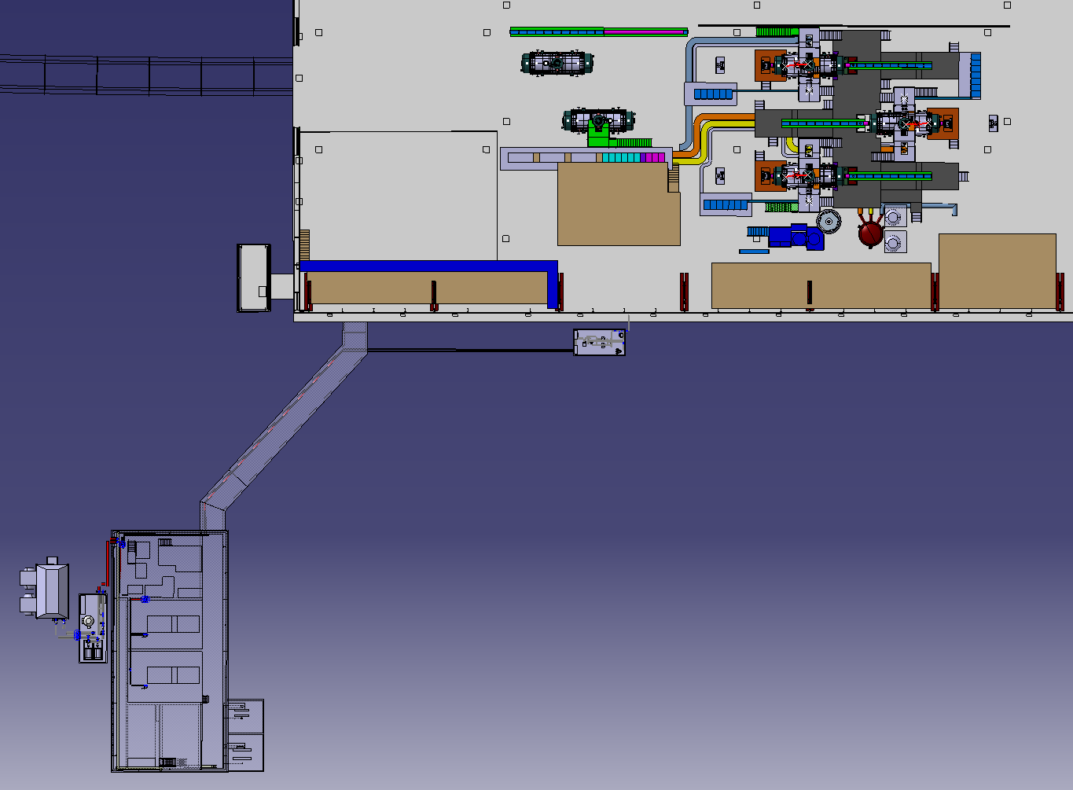
System Layout
Bat 180
Raw water
production
Demi water
distribution
Demi water
production
Raw water
distribution
Bat 279

Slide 3
Status Summary
The contract for the Raw water production/distribution and the demi water production has been awarded to Delta Ti (Italy).
Final input from Cryo needed in order to finalize the Raw water distribution layout inside Building 279. It would be desirable to have it by end of July 2015.
Integration effort to define the Demi water distribution inside Building 180 is ongoing.
The Demi water distribution will be done within the framework of EN-CV small jobs contract or via an amendment of the main contract.

Slide 4
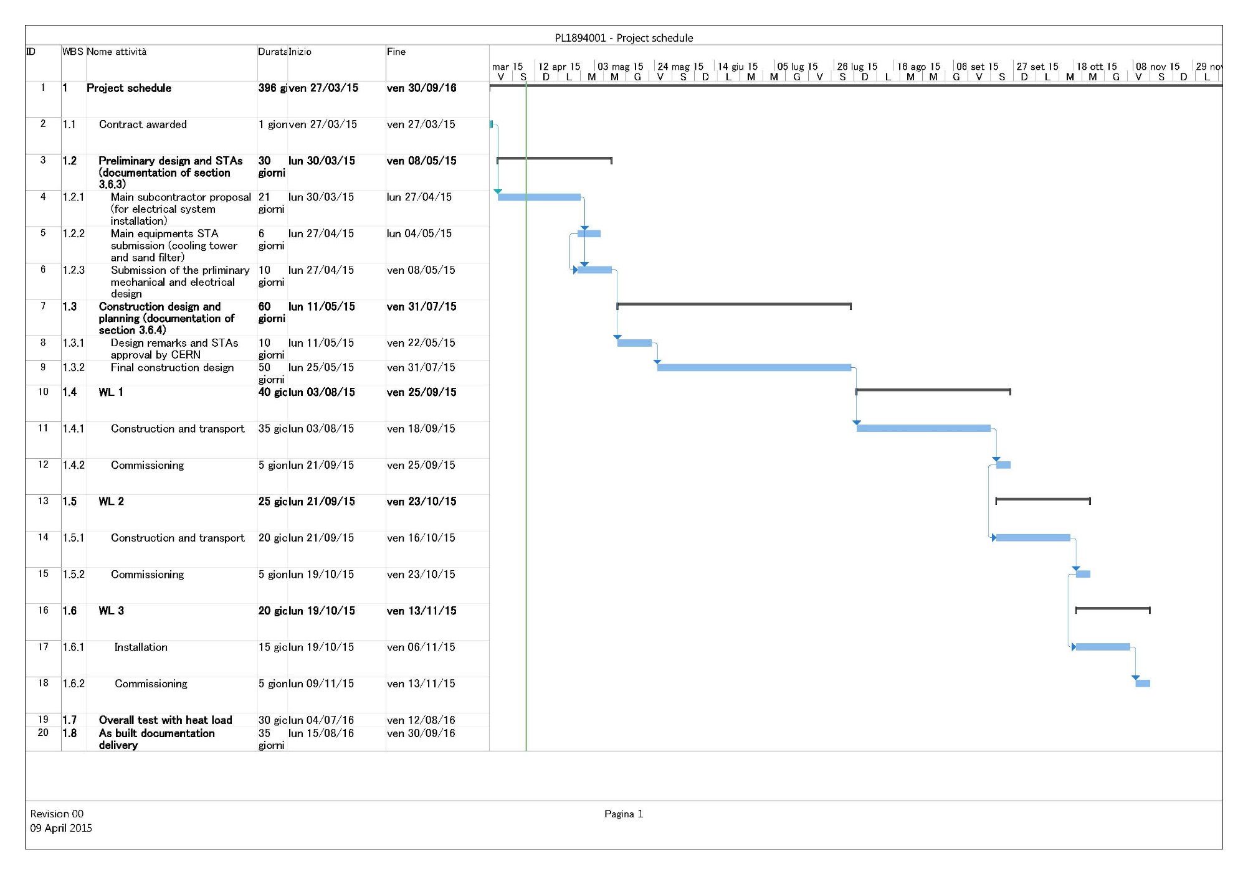
Planning
Design final
approval
End of procurement
(end July 2015)
Raw water production
Commissioning (end Sept. 2015)
CE works
(bike shed removal, slab,
trench excavation)
Demi water production
Commissioning (end Oct. 2015)
If Raw and Demi water distributions are defined, then
overall Commissioning (end Nov. 2015)
Overall heat load test to certify the cooling towers July- Aug. 2016

