Slide 1
Magnetic Measurements WP

Slide 2
Overview
Measurement requirements
  Dipoles
  Multiplets
Magnetic measurements proposal of the FAIR magnets
  Timeline
  Budget
  MM Systems
    For dipoles
    For multiplets
Test station bld. 180: environment influences on magnetic measurements

Slide 3
Magnetic measurement requirements
series tests
Dipoles
Measurement time |  | 10 days
Field Quality | Current levels | 5
 | Absolute integral field required accuracy | + 5*10⁻⁴
 | Integral field homogeneity required accuracy | + 5*10⁻⁵
 | Measurement planes | 3
 | Measurement longitudinal parts | 3
Magnet parameters
Central field at Inom (T) | 1.6
Integral field at Inom (Tm) | 3.403
Integral field at Imin (Tm) | 0.319
Magnetic length (mm) | 2127
total measurement length (mm) | 4000
Bending angle ° | 9.75
Curvature radius (mm) | 12.5
Aperture width (mm) | +460.85
Aperture height (mm) | +85
Good Field region width (mm) | +190
Good Field region height (mm) | +70
Acceptance criteria of field quality on the GFR boundary (Units of the integral field) | +3
Rise time to Inom (s) | 120
Open questions:
Which kind of measurement report? (passport with checklist ok/not ok, database with field homogeneity, etc.)
M2M reproducibility (thermal coefficient of the yoke?)
Assembly reproducibility tests required?
On line monitoring system required for operation?
How the measurement data will be treated?
Position of fiducials: where? And how are related w.r.t. the pole surface (mechanical measurement, absolute positioning w.r.t. lamination?)
Tolerances on the cryostat installation? (access to the pole surface)
Extended pre-series
Full map with hall probe at 3 currents and 3 planes of:
One dipole unit per type (2 + 1)
All dipoles with (straight) exit for beam (2 +[1])
Total number of dipoles: 24*
*Source SC_Magnet_Parameters_SuperFRS_2012_09_04.xlsx

Slide 4
Magnetic measurement requirements
Dipoles
measurement range [T] | >=0.16 and <=1.6
meas. Length [mm] | 4000* | *2120 mm on a curved path and 940 mm straight on each side
meas. longitudinal Radius [mm] | 12500
horizontal spatial resolution [mm] | 30
vertical spatial resolution [mm] | 70** | ** 35 mm for the prototypes
Excitation current | DC
current levels from Imin to Inom | 5*** | ***to be decided after pre-series if 3 are enough and extended to 16 for the pre-series
1 unit loss w.r.t to the integral at 2 m from the longitudinal pole centre
Open question:
Is it really needed to measure the homogeneity
along the hard edge model of parallel particle trajectories
(curved + 2 straight paths segments)?

Slide 5
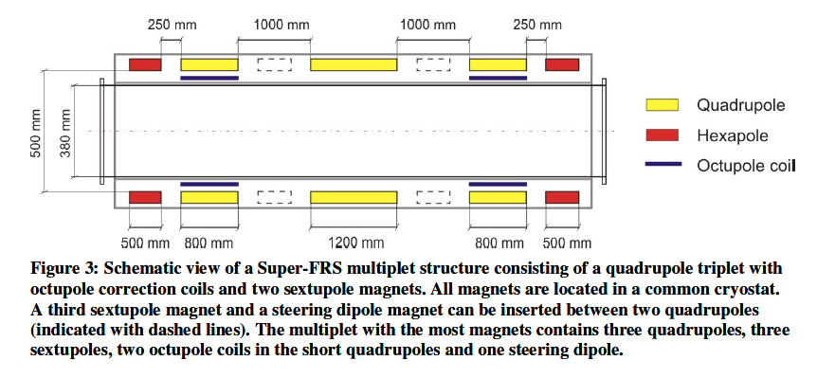
Magnetic measurement requirements
Multiplets
Short multiplets composed by: a Quad (plus octupole coils for some of them) and an hexapole (at left or right side of the quad)
Long Quadrupole parameters
Length of the measurements path | 2320 mm (short quads) 2720 mm (long quads)
Aperture radius (mm) | 190
Good Field region radius (mm) | 180
Position of magnet in the multiplet is fixed

Slide 6
Magnetic measurement requirements
Multiplets
Short multiplets composed by: a Quad (plus octupole coils for some of them) and an hexapole (at left or right side of the quad)
Multipoles: series tests
Measurement time |  |  | 10 days (full multiplet)
Field Quality | Quads | Current levels | 5
 |  | Integral field homogeneity | + 5*10⁻⁵
 | Multipoles | Absolute integral field accuracy | + 1*10⁻³
 |  | Integral field homogeneity | + 2*10⁻⁴
Fiducialization | Quads and multipoles | Angle (mrad) | <0.5
 |  | Axis (mm) except steerers | 0.2

Slide 7
Magnetic measurement requirements
Multipoles: extended pre-series tests
Full map with with a short coil at 10 mm steps of:
1 long quad
1 short quad
1 sextupole
Integral field, integral transfer function, hysteresis and Homogeneity at 16 current levels.
Cross-check measurements of the axis measurement performed with the SSW with another system (vibrating wire)
Cross-check of the field homogeneity with another system (a standard shaft at a smaller radius).
Open questions:
Will the local harmonics be used in particle tracking codes?
How is defined the polarity of the magnet w.r.t. the cryostat? (on the benches is possible to install the multiplet with different orientation)
If the magnets have different optical function in the machine are we measuring in the same configuration or in the final powering mode of the machine?

Slide 8
Magnetic Measurements WP
MM WP
Dipole measurements
Multiplet measurements
Electronic and control
Integral field
Homogeneity
Field map
Acquisition systems (integrators, DAQ,Racks)
Control system & actuators
Axis measurement
Field strength measurements
Homogeneity measurements
Translating fluxmeter
Translating fluxmeter
3D mapper
SSW
SSW
Rotating coil
5 systems to develop -> 5 sub WPs

Slide 9
Magnetic Measurements WP
Timeline

Slide 10
Magnetic Measurements WP
Budget
 |  | Budget [kCHF]
3 WBS Magnets test stand
 | 3.1 Stretched wire system | 110
 | 3.2 Rotating coils for multiplets | 100
 | 3.3 Hall probe mapper | 110
 | 3.4 sliding coils | 180
 | 3.5 Electronics | 150
 | 3.6 Installation | 30
680 KCHF total budget for:
design office (1 FTE)
material
systems commissioning

Slide 11
R&D
Risks
  Technical
    Even if the measurement methods are well known there is any practical experience for such large dimensions
    For the dipoles there are no other instrument at the moment that could fulfil all the time requirements and accuracy requirements simultaneously
    The 10 days cold tests do not allow any contingencies
…Solutions
    A metrological characterization of the systems (in particular the rotating coil) should be considered in another magnet (the development of the “air core” magnet should be considered not in the actual budget)
    “Sliding coils” can be a solution but the “curved wire” should be considered as backup solution (also for calibration and cross-validation issues)

Slide 12
MM-FAIR development overview
Design priorities
  MM system for dipoles (“sliding coils” or “curved SSW)
  Rotating coil for multiplets
  SSW system (parts for wire tensioning etc.)
  Mapper 3D (probe supports)
Electronics priorities
  Hall probe reading card
  FDIs (integrators) procurement

Slide 13

Magnetic measurements proposal of the FAIR magnets
Magnetic Measurements of Super-FRS dipoles: Translating coils
DC measurements
ΔB
A
B
Δs
ξ
A_{c} = 3.20 m² (25 mm width * 100 mm length and 1280 turns)
v = 200 mm/s
~ 1V peak when is passing through from the A(0) = 0 T to B(2 m) = 1.6 T
16 s full scan for each current level
First prototype of transport system for the “proof of principle” on a straight magnet under construction
Possible to move on a curved path
13

Slide 14
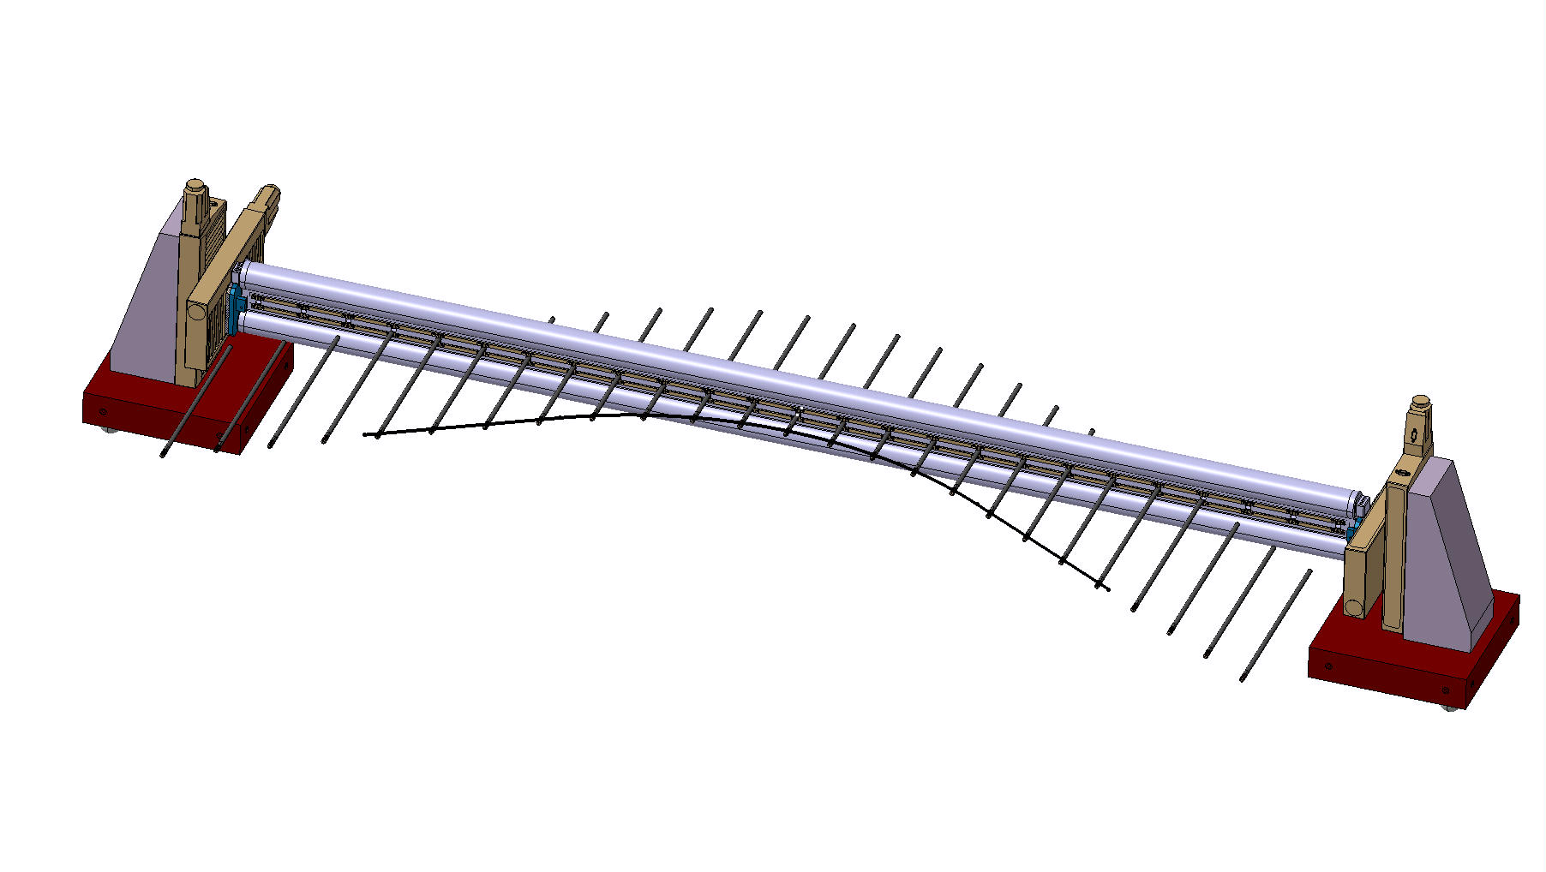
Magnetic measurements proposal of the FAIR magnets
As backup…
  “Curved pcb wires “ a pcb board with several tracks bent along the particle trajectory. Same principle of the stretched wire but “curved” (under development for SESAME curved dipoles)
    PRO:
      Lower cost
      No need of absolute calibration (as the SSW)
      Multiple tracks in series can increase the output voltage
      Uses the same stages and actuator of the SSW system
      Synergies with other CERN MM projects
    CONS:
      Longitudinal field distribution measurement requirements cannot be fulfilled (3 parts) (if strictly needed for all the series)
      New development (up to now any data about errors, vibrations etc.)
DC measurements
Courtesy of G. Villiger

Slide 15
Magnetic measurements proposal of the FAIR magnets
Magnetic Measurements of Super-FRS dipoles measurement: conclusions
The standard fluxmeter:
  Expensive and does not guarantee that the requirements can be satisfied. Anyhow it measure in AC not as the magnet will be operated.
A sliding coil array:
  Could be the solution to satisfy the measurement requirements but the performance are not yet evaluated
“curved wire”
  The only limitation is that the measurements can be only integral. As for the sliding coil no idea about performance but soon a prototype to the test the SESAME magnet will be ready.
15

Slide 16
Magnetic measurements proposal of the FAIR magnets
3D Mapper
  Cost 150 kchf (only translation system)
  (MM section contributes for the 50 %)
  3 x 1 x 1 m scanning volume
  Overall accuracy + 0.1 mm
Status
  stages
    Specification 60% ready
    Market survey done
  Electronics
    commercial 3D Hall probe
    Design of reading electronic ready for prototyping
Open points
  Probe calibration

Slide 17
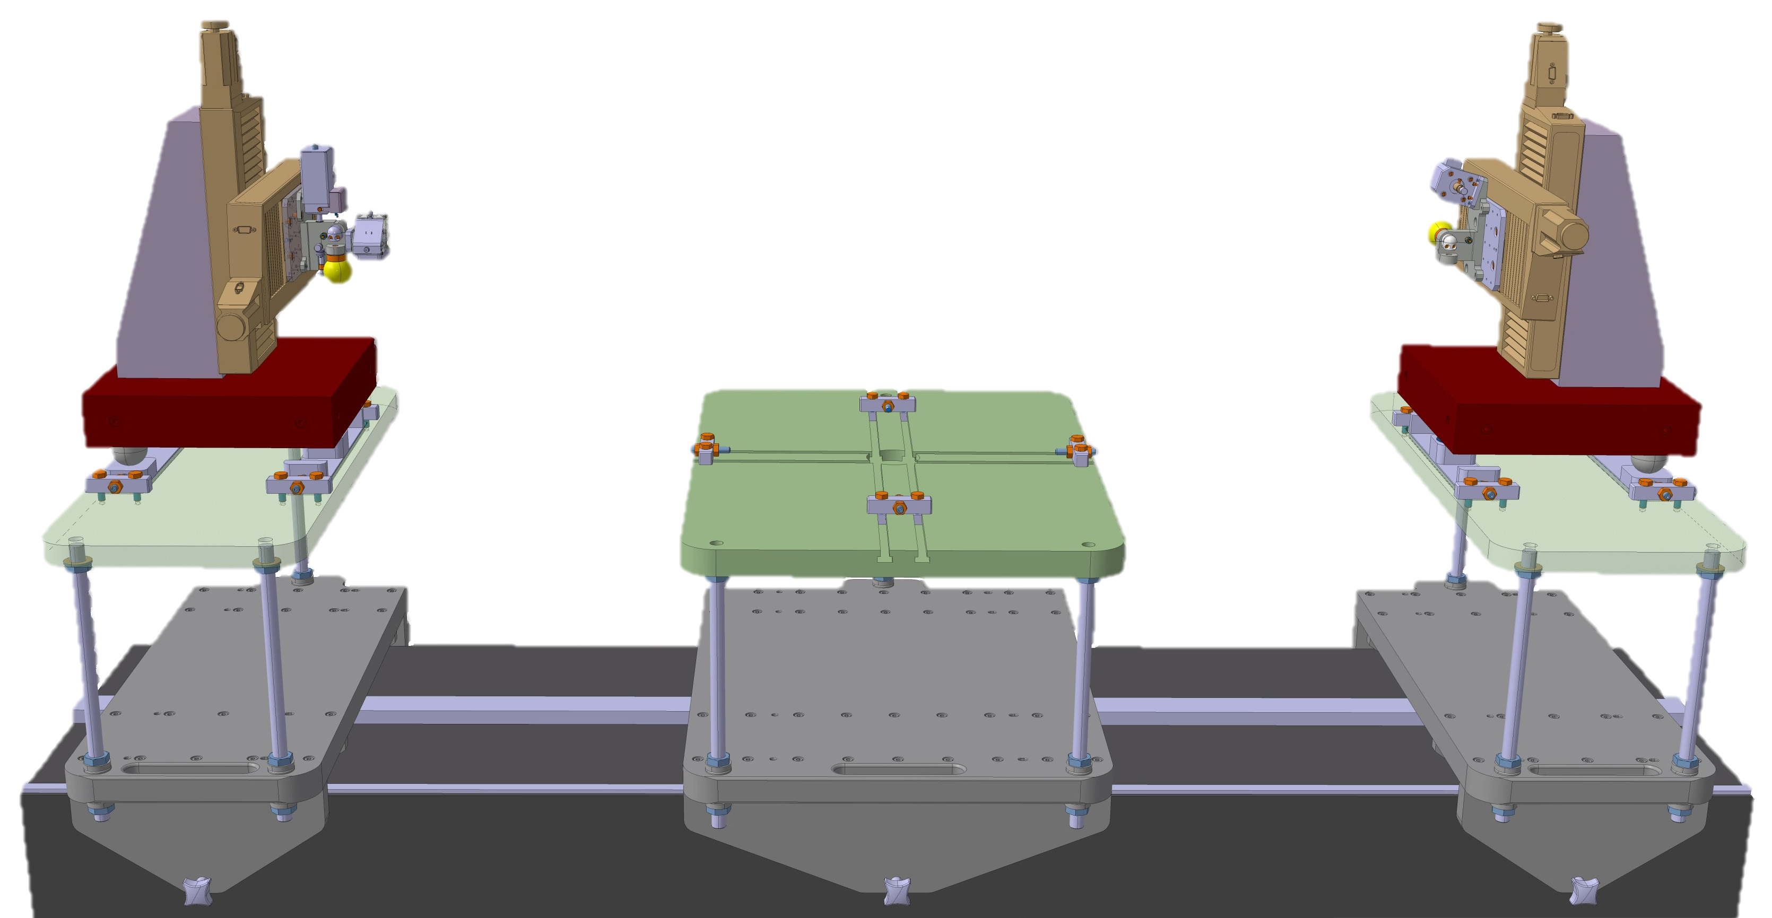
Magnetic measurements proposal of the FAIR magnets
SSW
  Stages + control system Cost 97 kchf
  400 mm stroke
  Overall accuracy + 5 μm
Status
  stages
    Specification ready
    Market survey done
  Electronics & mechanics
    Integrators shared with other systems
    Some design to adapt the wire tensioning is needed
Courtesy of G. Villiger

Slide 18
Magnetic measurements proposal of the FAIR magnets
Rotating coil
  Open questions
    Tangential or radial coil (kn calculation for the two geometries)
    Calibration / pcb coils?
    Lowest measurements radius
    MRU inside/outside magnet
    Coil length
  Reference radius 180 mm
  Maximum weight of the shaft 60 Kg
  Measurement integral length 3 m
Status
  Design
    Specification on-going
    Started pre design studies
    Started design modification to the MRU to fit in the aperture
3m
0.01 m
MRU far from stray field

Slide 19
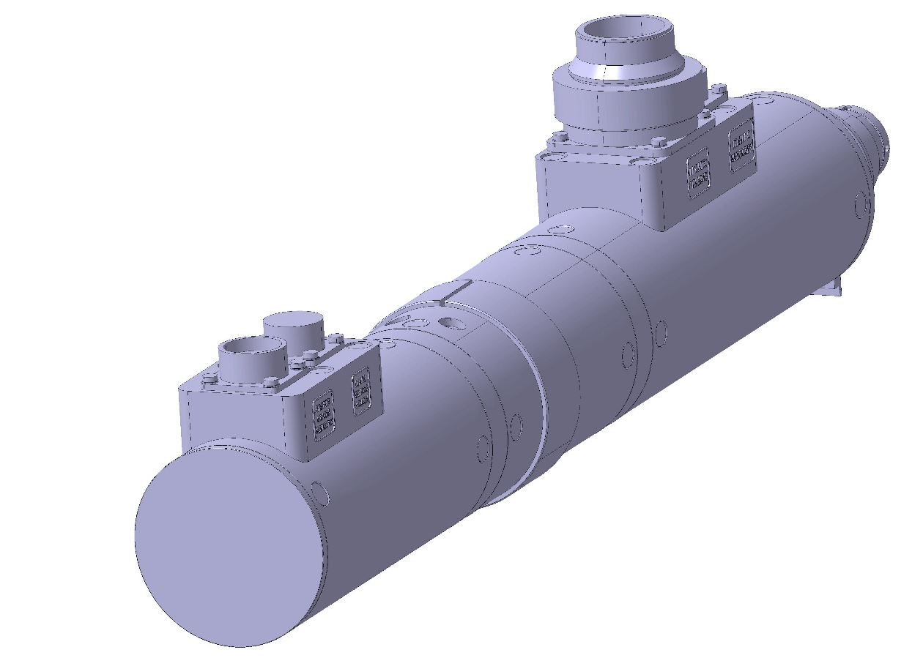
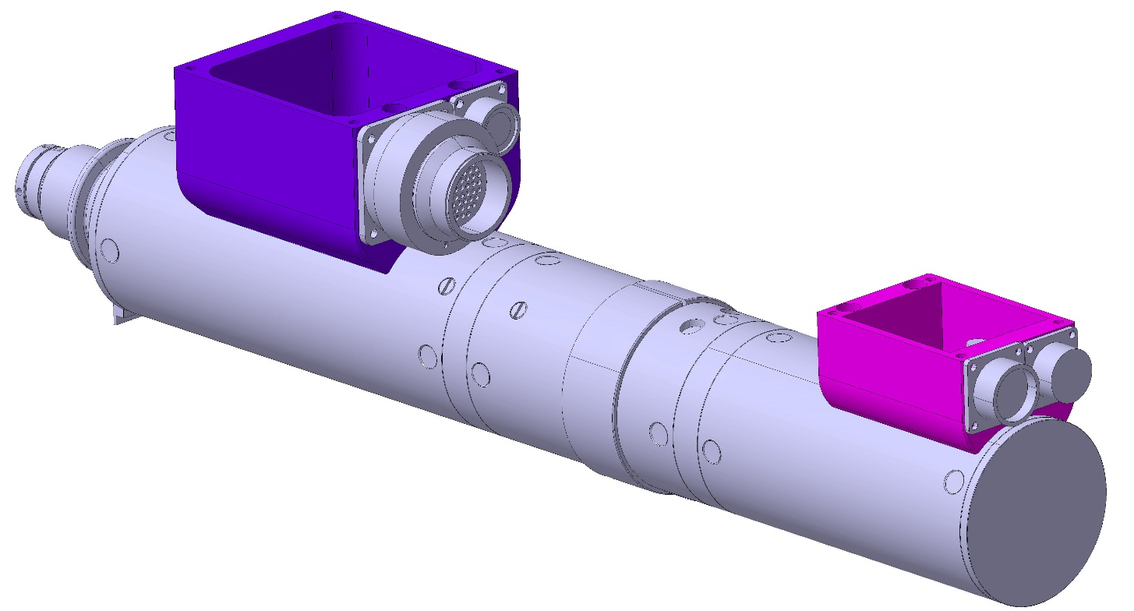
Magnetic measurements proposal of the FAIR magnets
Rotating coil
  Modification of the actual MRU to fit in the multiplets warm bore
220 mm diameter

Slide 20
Magnetic measurements proposal of the FAIR magnets
Rotating coil
  Measurement radius?
  N turns = 64
  Surface absolute coil = 3.64 m²
  L = 3 m
  Width = 38 mm
  (for the main quad) Output ~5 V @ 1Hz for the absolute at I_{nom}
  Coil sensitivity up to 15th order reduced by a third for a measurement radius of 175 mm
  the coil sensitivity is close to zero around the 50th harmonic
  Still possible to extrapolate the harmonics to R=180 mm

Slide 21
Magnetic measurements proposal of the FAIR magnets
Rotating coil
  Radial coil
  N = 128
  Surface absolute coil = 3.84 m²
  L = 3 m
  Width = 10 mm
  (for the main quad) Output ~5 V @ 1Hz for the absolute at I_{nom}
  Coil sensitivity up to 15th order reduced by a third for a measurement radius of 175 mm
  Still possible to extrapolate the harmonics to R=180 mm

Slide 22
Magnetic measurements proposal of the FAIR magnets
Rotating coil
  Radial coil (PCB)
  N = 60 (10 Turns * 6 Layers)
  Surface absolute coil = 1.26 m²
  L = 2* 1.5 m
  Width = 7 mm
  (for the main quad) Output ~1.5 V @ 1Hz for the absolute at I_{nom}
  measurement radius of 170 mm
  PRO
    No need for surface calibration
    Very good compensation (~ 5000)
    weight
  CONS
    Cost
    assembly
    Mechanical stability

Slide 23
Magnetic measurements proposal of the FAIR magnets
Magnetic Measurements of Super-FRS multiplets measurement options: conclusions
Shaft length
The option of 1 segment shaft or a long shaft does not have large impact on the time schedule.
The one segment shaft with a fix rallonge can be used for all the multiplets (included the not standard) and to scan the longitudinal multipoles.
3 m coils difficult winding
Using a shaft where we add the segments or a mole to move inside the bore could require an extra encoder and tilt angle at the end of the shaft (MRU only as actuator)
2 segments of ~ 1.5 m
PCB or standard coils both should be calibrated w.r.t the SSW anyway
One 1.5 m segment?
(meas. In 2 parts of the longest quad)
Coil sensitivity
Reduce the measurements radius to 175mm does not affect largely the coil sensitivity up to the 15th order
A radial coil could be more mechanically stable and with higher sensitivity to higher harmonics
23

Slide 24
Magnetic measurements proposal of the FAIR magnets
Electronic
ACQUISITIONS RACKS (Mobile) | 2 |  |  |  |  |  | piece number | spares
standard 19-inch |  |  |  |  |  |  | 1 | 1
- A blade PC (with accessories) |  |  |  |  |  |  | 1 | 1
- 17 FDI (12 FDI) à if we assume to use FDI V3 |  |  |  |  | FDI v5 to be checked |  | 12 | 8
- NI an acquisition card |  |  |  |  | NI-6289 |  | 1 | 1
- NI dispatch box |  |  |  |  | (coax connector) |  | 1 | 1
Encoder à 1 piece to produce |  |  |  |  | ( one piece in stock). |  | 2 | 1
- GPS (optional) card + splitter 1:3 à to buy. |  |  |  |  |  |  | 1 | 1
- PXI chassis |  |  |  |  |  |  | 2 | 1
- Mobile rack |  |  |  |  |  |  | 1
- LEMO interconnection cables (x12 min) to produce. |  |  |  |  |  |  | 18 | 18
- Encoder cable |  |  |  |  |  |  | 1 | 1
SSW control system |  |  |  |  |  |  | 1
VW current generator |  |  |  |  |  |  | 1
ACQUISITIONS RACKS (Mobile)

Slide 25
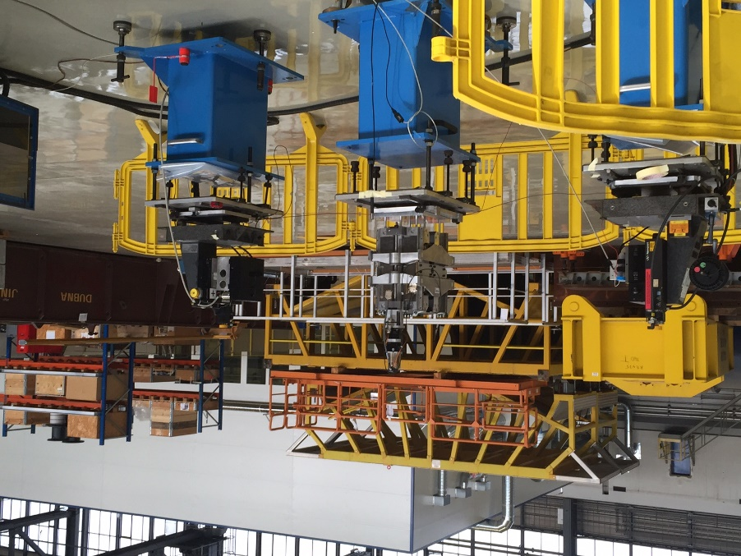
Test station bld. 180: environment influences on magnetic measurements
Setup:
  SSW system
  Hibrid Quad (iron pole with PMQ blocks)
  Wire length ~ 3.5 m
  L_{mag} = 180 mm
  GdL = 9.315 Tm/m (gradient at Inom of the FAIR quads ~ 10 Tm/m)
Procedure:
  Measurement of the magnet GdL along the horizontal axis
  Measurement repeated 5 times (~ 2 min)
  Monitoring of the environment temperature
  Measurement in this configuration in I8 (controlled environment)
  Moved the system in bld. 180 and installed with the same configuration
  Performed the same tests with controlled activities:
    Doors opened and closed
    Cranes operation
    Welding operations
  Performed the same test during standard activities in the hall

Slide 26
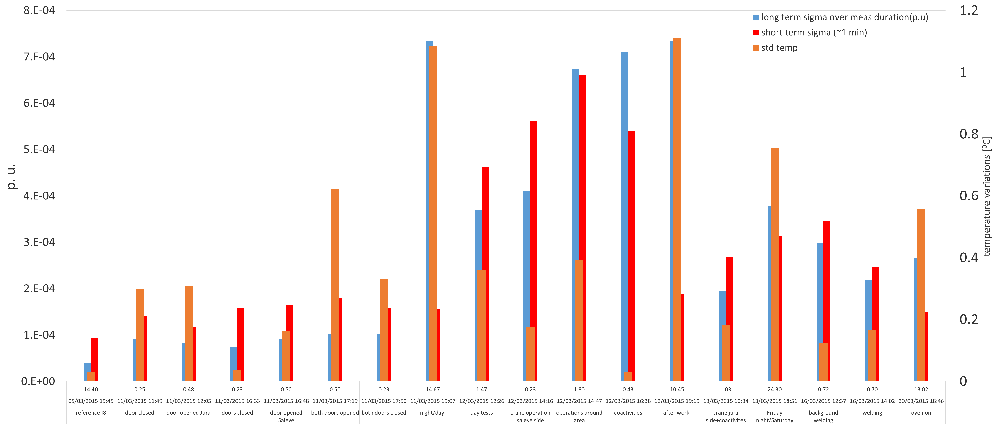
Test station bld. 180: environment influences on magnetic measurements
Thermal variation of Permanent blocks
  σ GdL over long period (long term σ) ~ 5 10⁻⁵
  Average variation on the short term (short term σ) ~1 10⁻⁴
Not controlled co-activities

Slide 27
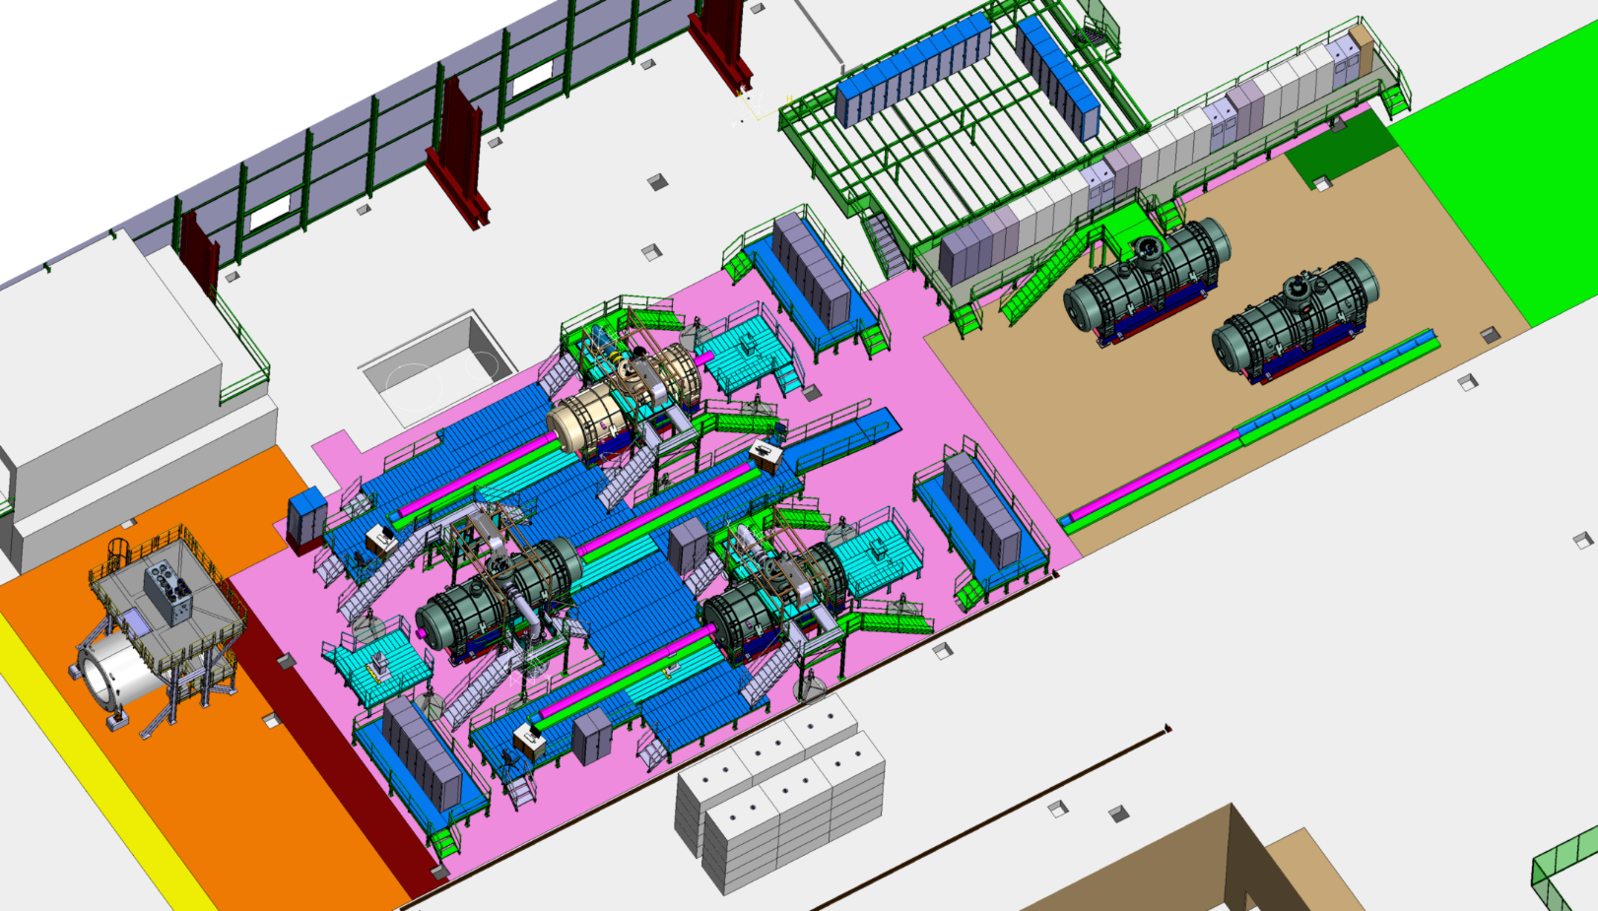
Test station bld. 180: environment influences on magnetic measurements
Not controlled co-activities during the measurements:
Fork lift trucks moving around
Large load charging/discharging
Crane
Measurement station

Slide 28
Test station bld. 180: environment influences on magnetic measurements
Conclusions:
Most relevant effect measured is the temperature variation between night and day (~ 5 °C worst case )
The measurement noise level incremented only during not standard operation in the close area
Standard co-activites (controlled) magnets lifting, welding, door opening for short time, do not have large impact on the measurement performance
Exceptional activities in the close area could affect the accuracy of the measurements
Considerations:
The multiplets are in the cryostat but the yoke of the dipoles do not (winter/summer variations)
The temperature must be reported in the measurements
The temperature of the yoke of the dipole should be monitored as well
The environmental temperature should be monitored and attached to the measurements
The axis measurements have a in the worst case + 3 µm variation so no problem to fiducialize
The GdL measurement with the SSW can be done:
  Is possible to measure trying to not overlap with trucks movements etc
  Is possible to measure the GdL periodically only to cross-check the coil calibration (use the rotating coil)
  Is possible to Insulate the stages from the floor

