Slide 1
Update WP3 – Magnet test stand
Gerard Willering
With input of Maryline Charrondiere
CERN, TE-MSC/TF
GSI plenary coordination meeting at CERN, 12 May 2015

Slide 2
Content
  Interlock
  Electrical measurement systems
  Database, post-mortem and analysis
  Cabling control system and instrumentation
  Powering cables
  Systems for commutators and connections
EVM
Global status
Challenges

Slide 3

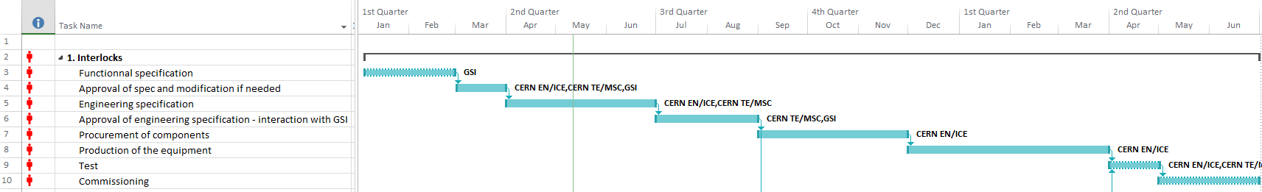
Interlocks
Functional specification draft is finished (H. Mueller and E.J. Cho)
For powering the magnets we need:
Cryo OK
QPS OK
PC and EE OK.
Load switch OK (correct bench selected)
All powering cables connected to the magnet or shorted (switch on magnet side)
Personal safety OK (no one on the platform)
For details of this functional specification, see presentation this afternoon of E. J. Cho.

Slide 4
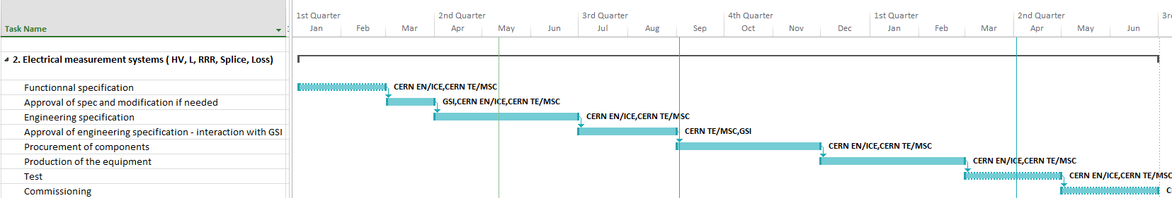
Electrical measurement systems
Stand alone measurement systems, based on existing systems in SM18, used for acceptance tests of LHC magnets.
2 full systems in mobile racks can serve the 3 test benches.
High Voltage
RRR
(Cu resistance during cooldown, low current)
Splice measurement
(Sc-Sc Splice, high current, 4.5 K)
AC loss
Inductance
T_{room}
Needed?
Megger
Multiplexer system
Up to 9 magnets, many combinations to tests
High precision PXI-DMM system
Frequency analyzer

Slide 5

Database and analysis
Temperatures Pressures
Levels
Magnetic measurements
Signals
Voltages
Current
CRYO
QPS
EPC
MSC-MM
See presentation Cryo
See presentation R. Denz
See presentation G. Gollucio
See presentation H. Thiesen
Low frequency
Logging database
Continuous
High Frequency
Post-Mortem database
Event based
Stand alone, treated seperately
Database
MSC-MM
Analysis
Data extraction, analysis, reporting
Data extraction, analysis, reporting
EN-ICE, MSC-TF
See presentation
E. Blanco
MSC-MM
Qualification
Comparison with criteria → Qualification stamp
MSC-TF

Slide 6
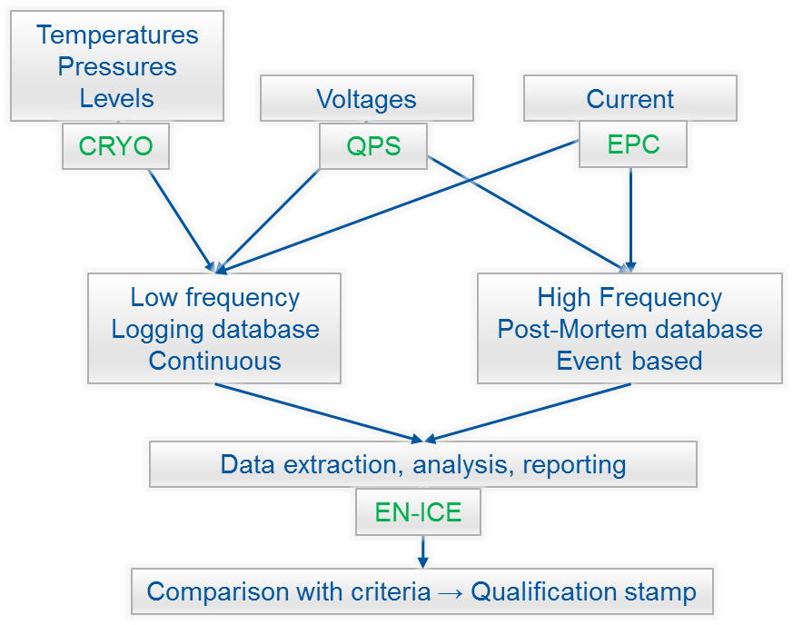
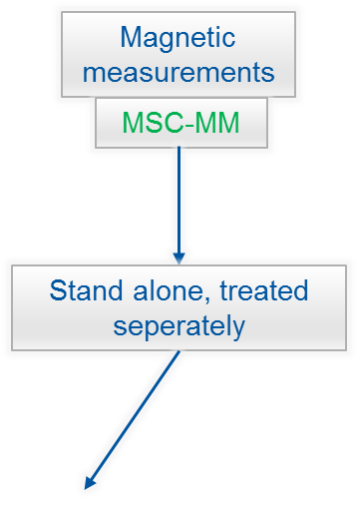
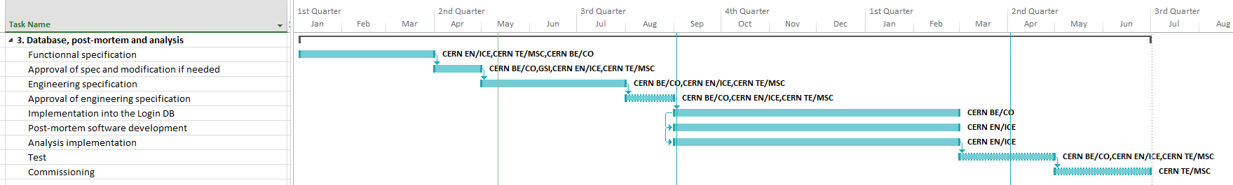
Database and analysis
The manpower is now defined and the functional specifications need to be written.

Slide 7

Powering cables
Functional specifications draft in EDMS 1510593, close to engineering specification.
1 long quadrupole circuit needs:
2 cables PC to EE unit (including EE-switch) up to 14 meter
2 cables through load switch of 1 meter
6 cables towards 3 benches of up to 50 meter
Circuit specifications
Maximum cable length about 120 meter per circuit
Cross-section 150 mm²
Maximum resistive voltage in the cables 5 V at 330 A
Amount of cable required
For 9 PC, 3 test benches, in total 78 cables are needed with a total lenght of about 2900 m.

Slide 8
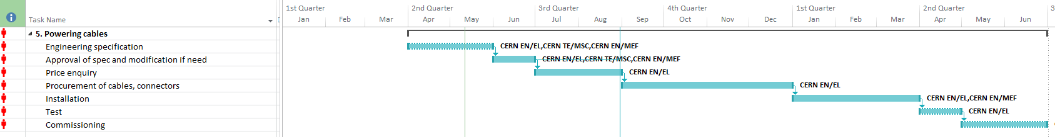
Powering cables
Draft document with all cable specifications already made by H. Thiessen.
Engineering specification only awaits the finalisation of the integration (cable lengths) and connector type.
Task well advanced.

Slide 9
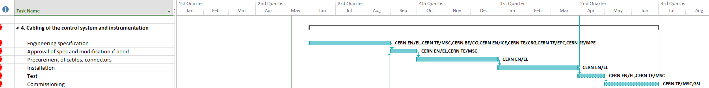
Cabling control system and instrumentation
Task due to start in June.
Strongly depends on the definition of the hardware and the integration design.

Slide 10
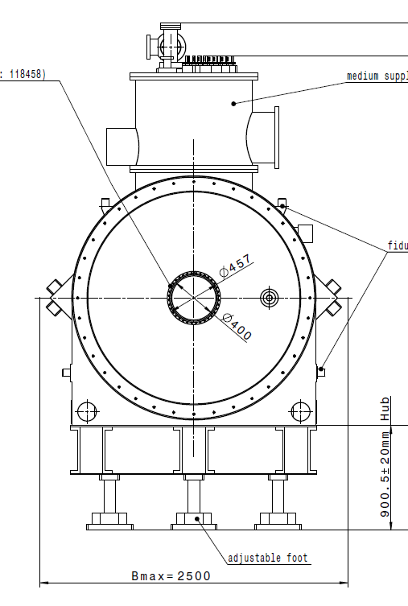
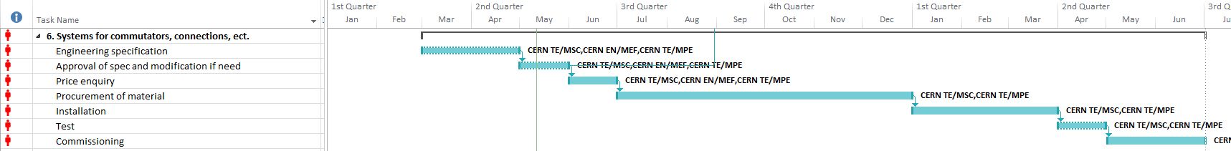
Commutors and connectors
Commutators (load switches) are included in the power converters, see presentation H. Thiesen and EDMS 1435672
Fast connection system to be designed per test station with
18 cables of about 1.5 kg/m, minimum bending radius 140 mm
Need for a pivoting point to be implemented to avoid additional commutators.

Slide 11
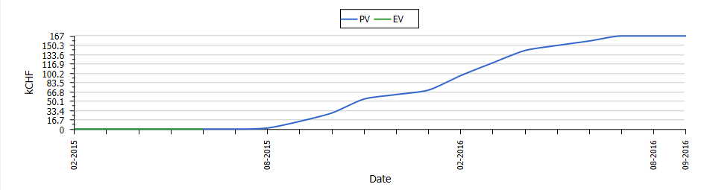
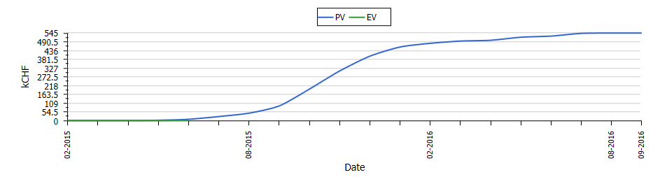
EVM
Two EVM work packages.
Expenses just started.

Slide 12
Global status and Open issues
The workload and responsabilities are clear.
Functional specifications and choice of systems are mostly completed.
Now it is time to finish the engineering specifications and hardware selection.
Backward approach may be useful:
Prepare a draft qualification report of one multiplet and one dipole with all necessary parameters and qualifications. This will help defining the needs for DAQ and Analysis.
Connector type on the magnet side need to be defined.
Cabling path not yet finalized: Integration studies and lengths to be defined.

