Slide 1

Update and status for the Work Unit ‘Energy Extraction’
- equipping the three test benches for series testing of Super-FRS Dipoles D2, D3, D4 and Quadrupoles Q3, Q4, Q5, Q6 in B180
TE/MPE-KDP _ 11.05.2015
TE/MPE/The Electrical Engineering section
K. Dahlerup-Petersen

Slide 2
Reminder:
Considerations of max. He_{gas} pressure during quenching lead to a demand for dissipation of stored magnetic any outside the cold-mass, hence energy extraction is required. This lead to a requested Rdump figure of 2.8 Ω
There was an obvious interest in using an extraction system which had already been developed for the LHC, with adaptations if required.
The LHC corrector circuit extraction systems appeared as a good candidate. 202 such systems are operated in the LHC since 2010.
FAIR will also profit from the upgrade of these LHC systems as applied during LS1 (Enhanced fixation of Holding Coil, overload protection by thermal interlock, preparation for on-line voltage drop measurements).
The systems feature: 3 series-connected breakers (A & B with operated together, Z only in case of A & B double-failure), each breaker with redundant release (one passive, one active) + Motordrive, optimized snubber caps for reduced contact loading and arc suppression, enhance current sharing trough equalizing resistors, LHC-type of controls (AMS fipset controller for WorldFip connection, integration into QPSexpert tool and Logging (Timber) possible.
Total breaker opening time: ~ 15 ms. All systems are qualified for 600 A continuous operation. They require no water-cooling.
Page 2

Slide 3
BUT: Arc voltage is limited to 450 V by the arc extinction process. 320 A operation with 2.8 Ω would exceed the limit by 100 %!
Solution: Insert 2 identical systems in each circuit (such as in the LHC Main Dipole circuits) - with Rdump 1.4 Ω per system.
Symmetrical insertion w.r.t. the Magnet Load and the Power Converter.
This topology has the advantage that the power converter will remain at ground potential during energy extraction, provided
that the system earth point is placed in the middle of the converter.
The maximum voltage to ground of the magnet during Energy Extraction will be divided by 2 ! Virtuel zero-voltage in the middle
of the tested magnet.
Six new 1.4 Ω energy absorption resistors are needed.
The two switch systems per test bench will be located in the same rack, such as for most of the cases of LHC corrector circuit systems.
The two associated dump resistors will be located in the adjacent 19-inch rack.
A fast, equipment stop panel will be added to each rack.
Page 3

Slide 4
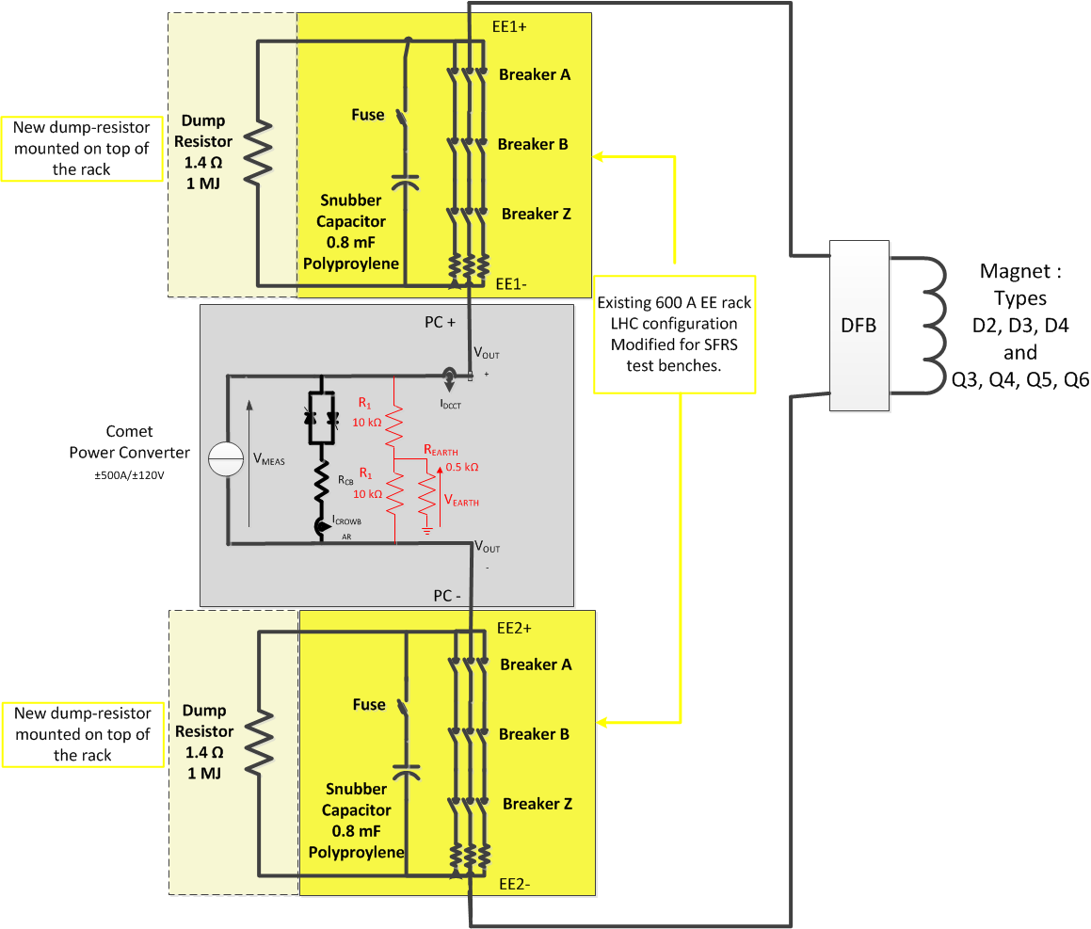
Circuit layout for one test bench.
Page 4

Slide 5
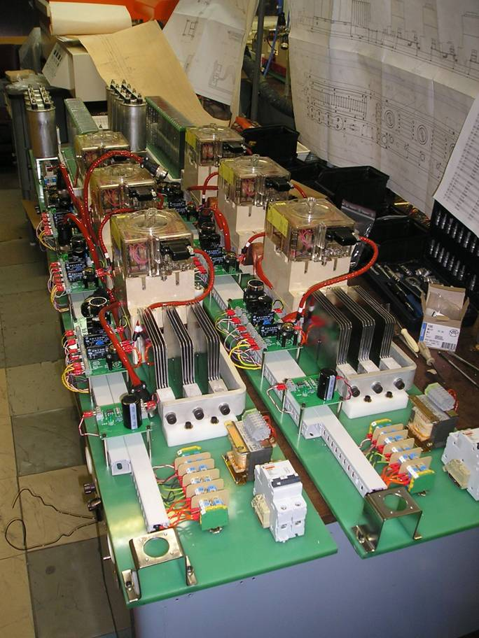
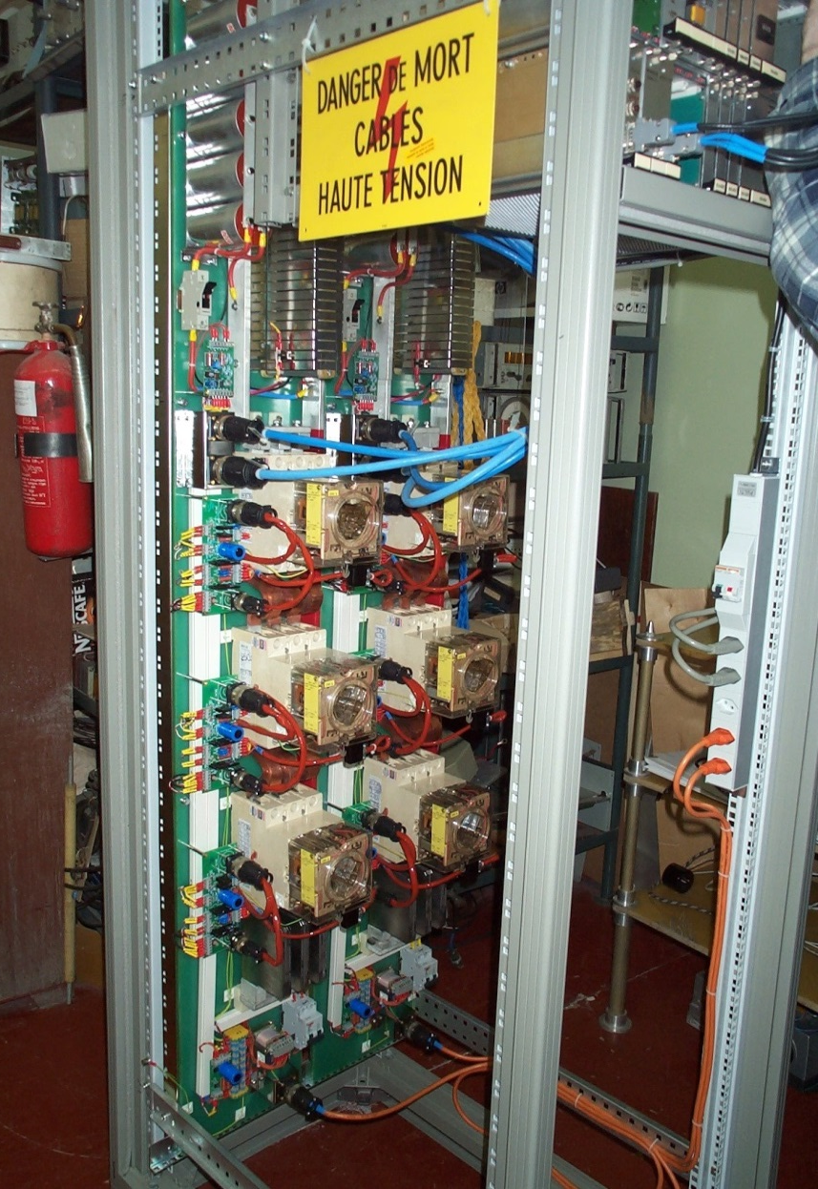
From the production in Novosibirsk (BINP Institute).
Seen from bottom-to-top: Current equalizing resistors, Breakers Z, B and A, snubber capacitors and extraction resistors.
Two, identical 600A systems mounted in the same rack – with controls electronics at the top.
Page 5

Slide 6
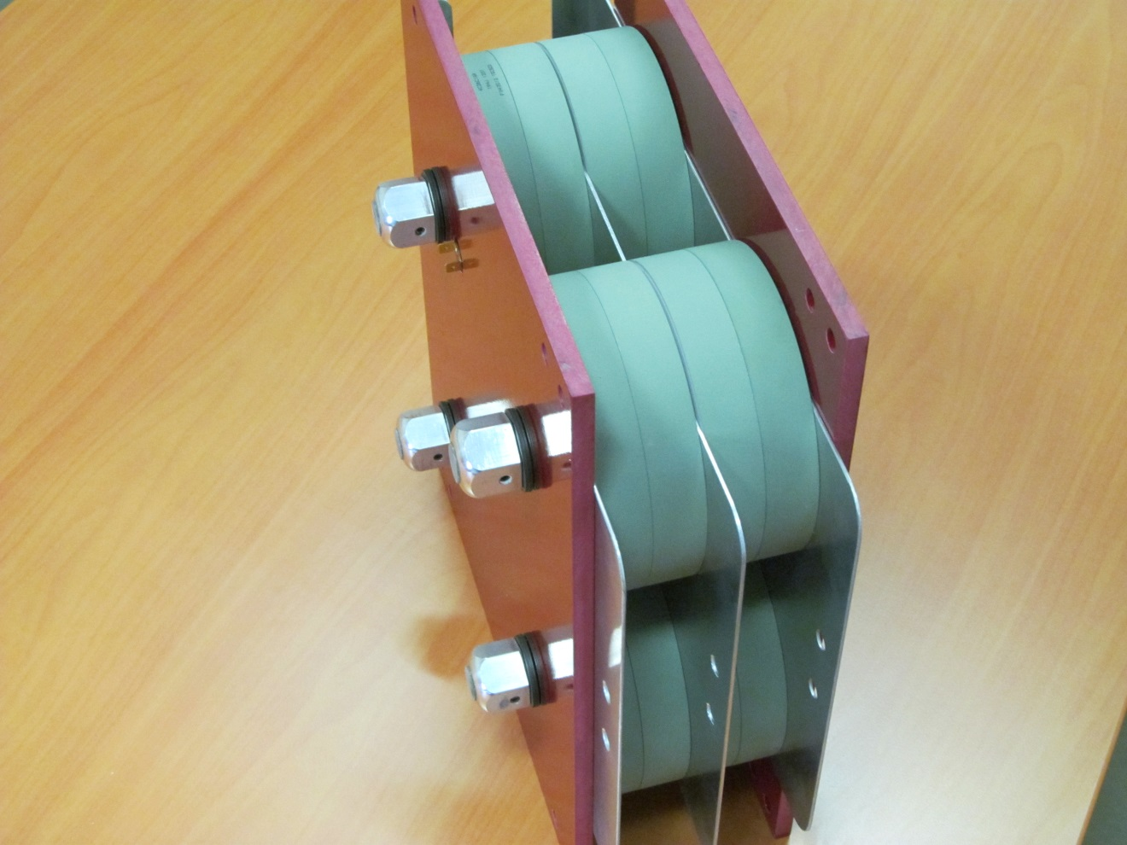
The new dump resistor (prototype): 1.4 Ω (16 discs of 5.6 Ω). Each disc is capable of absorbing 100 kJ.
Manufactured by ‘HVR International’, Newcastle.
For FAIR operation the carbon discs will typically attain a peak temperature of 100 ºC during an extraction (with 150 ºC admissible max). Cooling time by natural-air is not exceeding 1 hour.
Page 6

Slide 7
Two rows of eight, 600A EE systems in an LHC/UA gallery.
Systems under test: contact resistance measurements and opening time determination.
From the QPSexpert interface.
Page 7

Slide 8
The status of the project by 13 May 2015:
The 6 extraction systems for FAIR + the 2 spare systems were among the 16 facilities which were removed from LHC point 6 (UA67) for inspection and cleaning of pcb’s, following the incident with sprayed demin. water from the cooled cables above the racks.
The pcb cleaning process was performed on all systems using a stream of CO₂ pellets provided by a dedicated cryo cleaning machine. All traces from impurities, brought along with spraying water, were in this way efficiently removed by the carbon-dioxide jet.
6 + 2 complete EE systems were assembled, equipped with their control and supervision electronics and installed in the MPE 600A test facility in Bldg. 281.
At this moment the final power and signal cables are being connected in the test location.
The extended test program will begin end of May. It will be carried out with assistance from the MPE ‘on-call’ team of specialists.
The program will include:
- Individual System Tests (IST), i.e. functional checks and powering up to 600A – as a full
verification of the LHC required performance of these systems.
- HWC measurements of contact resistances and commutation characteristics.
- 8-hour heat runs of all systems.
- Endurance tests with 50 A for several weeks, with a certain duty cycle (regular commutations).
- FAIR configuration tests, in particular of the dump resistor (DQR) @ 1000 kJ (in P-Hall).
The complete test program will run through the summer, ending on 1st , 2015, after which the 6 systems will be ready for installation.
Page 8

Slide 9
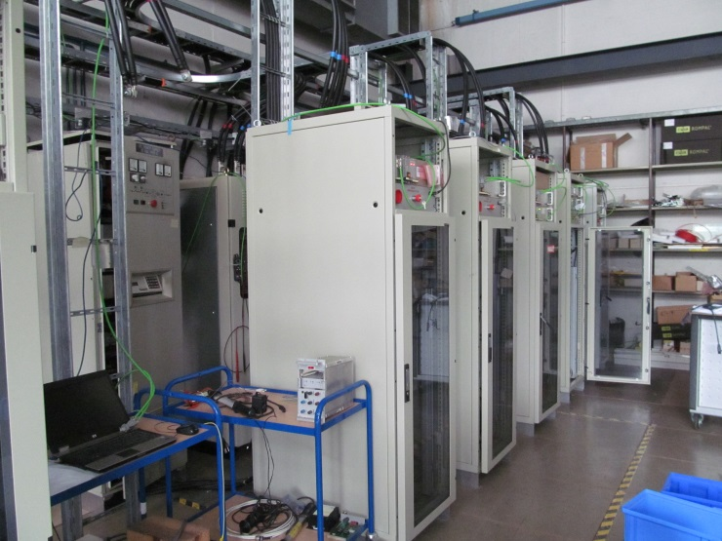
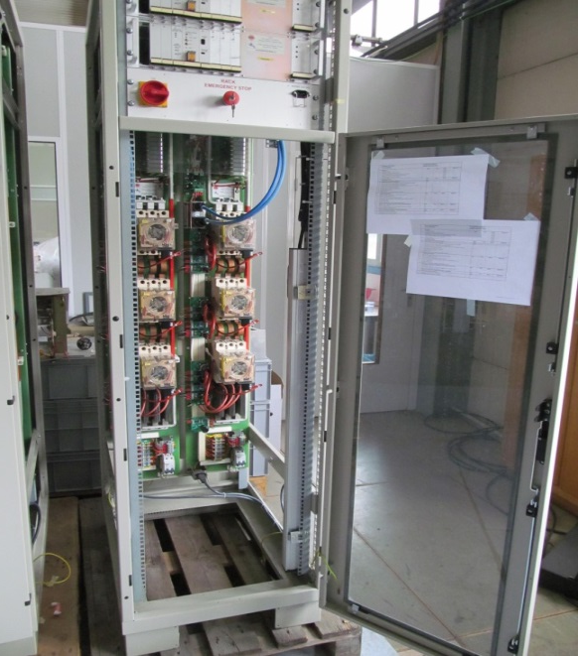
EE systems for FAIR test benches ready for testing in Bldg. 281 (ISR).
The 600 A powering circuit will comprise a 8 mH choke for stored energy.
The test program includes functional testing, endurance- and thermal tests with continuous operation at 600 A for an extended period of time (several weeks), commutation tests, precision resistance measurements and interlock verifications.
The test program will begin ultimo May, expected completion end-August 2015.
Page 9

Slide 10
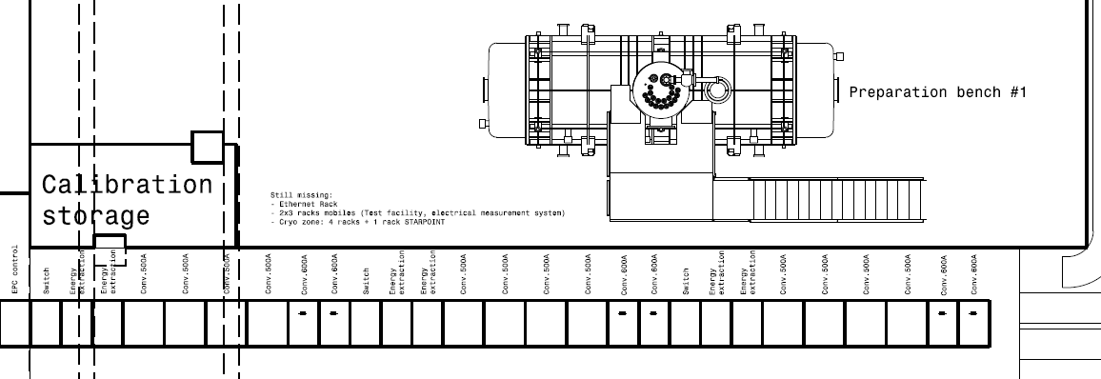
Page 10

Slide 11
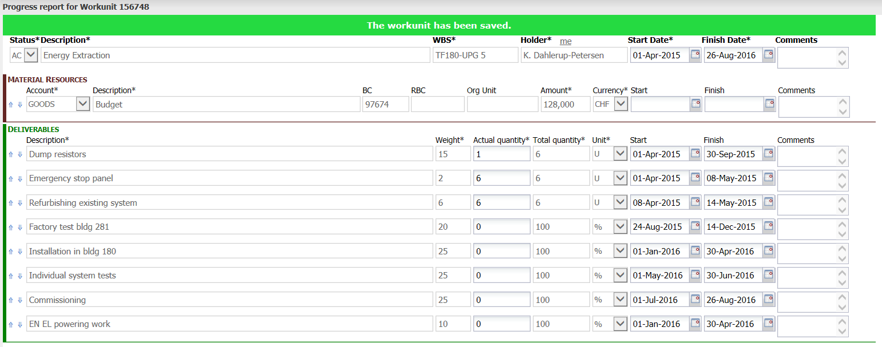
Page 11

