Slide 1
S-FRS Magnet Test Bench
SuperFRS Magnet Test Bench
Power Converter Status
H. Thiesen
13 May 2015

Slide 2
Powering work package
The powering work package concerns:
  Deliverables:
    6 power converters [±600A/±40V] (corrector magnets of the multiplet)
    3 power converters [±500A/±120V] (main magnets: D and Q)
    3 load switch racks (selection of the bench)
    1 control rack (gateways)
  Services
    Integration and Installation
    Commissioning
H. Thiesen – 13 May 2015

Slide 3
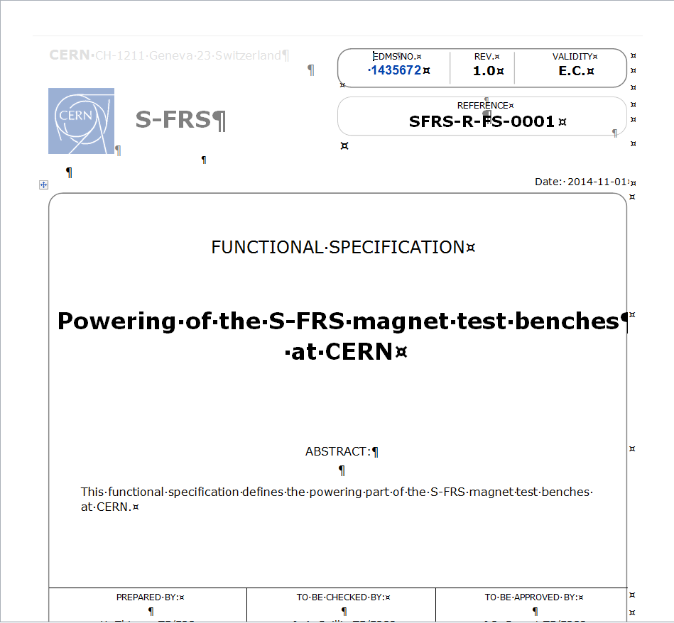
Powering work package
The powering work package concerns:
  Deliverables:
    6 power converters [±600A/±40V] (corrector magnets of the multiplet)
    3 power converters [±500A/±120V] (main magnets: D and Q)
    3 load switch racks (selection of the bench)
    1 control rack (gateways)
  Services
    Integration and Installation
    Commissioning
H. Thiesen – 13 May 2015

Slide 4
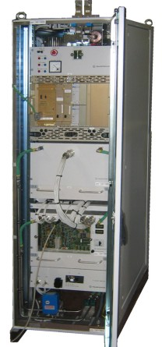
600 A Power Converters
The 6 [±600A/±40V] power converters has been delivered at CERN
The reception tests are on going
The 600A power converters will be ready for installation at the end of 2015
H. Thiesen – 13 May 2015

Slide 5
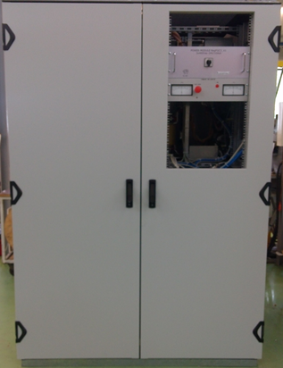
500 A Power Converters
The 3 standard [±500A/±120V] power converters must be delivered at CERN in June
The modification of the power converters must be started in the second semester of 2015
  Modification of the output crowbar
  Modification of the brake chopper
input
transformer
diode
rectifier
input
filter
break
chopper
IGBT
bridge
output
filter
output
crowbar
H. Thiesen – 13 May 2015

Slide 6
500 A Power Converters
The 500A power converters will be ready for installation at the end of March 2016
H. Thiesen – 13 May 2015

Slide 7
Load switch racks and control rack
The design of the 3 load switch racks and the control rack has not yet started
Actual planning
  Design: Q4 2015
  Production: Q4 2015 – Q1 2016
The load switch racks and the control rack will be ready for installation at the end of March 2016
H. Thiesen – 13 May 2015

Slide 8
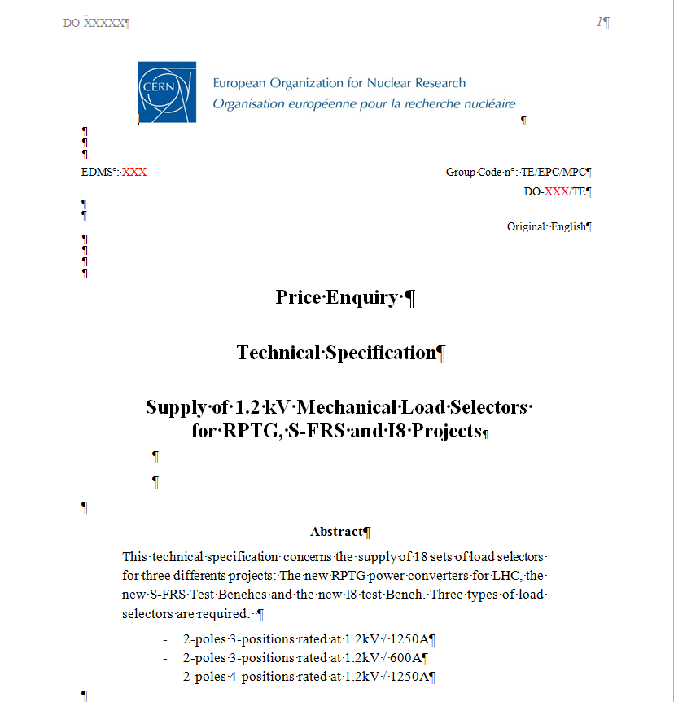
Load switch racks and control rack
The design of the 3 load switch racks and the control rack has not yet started
Actual planning
  Design: Q4 2015
  Production: Q4 2015 – Q1 2016
The load switch racks and the control rack will be ready for installation at the end of March 2016
H. Thiesen – 13 May 2015

Slide 9
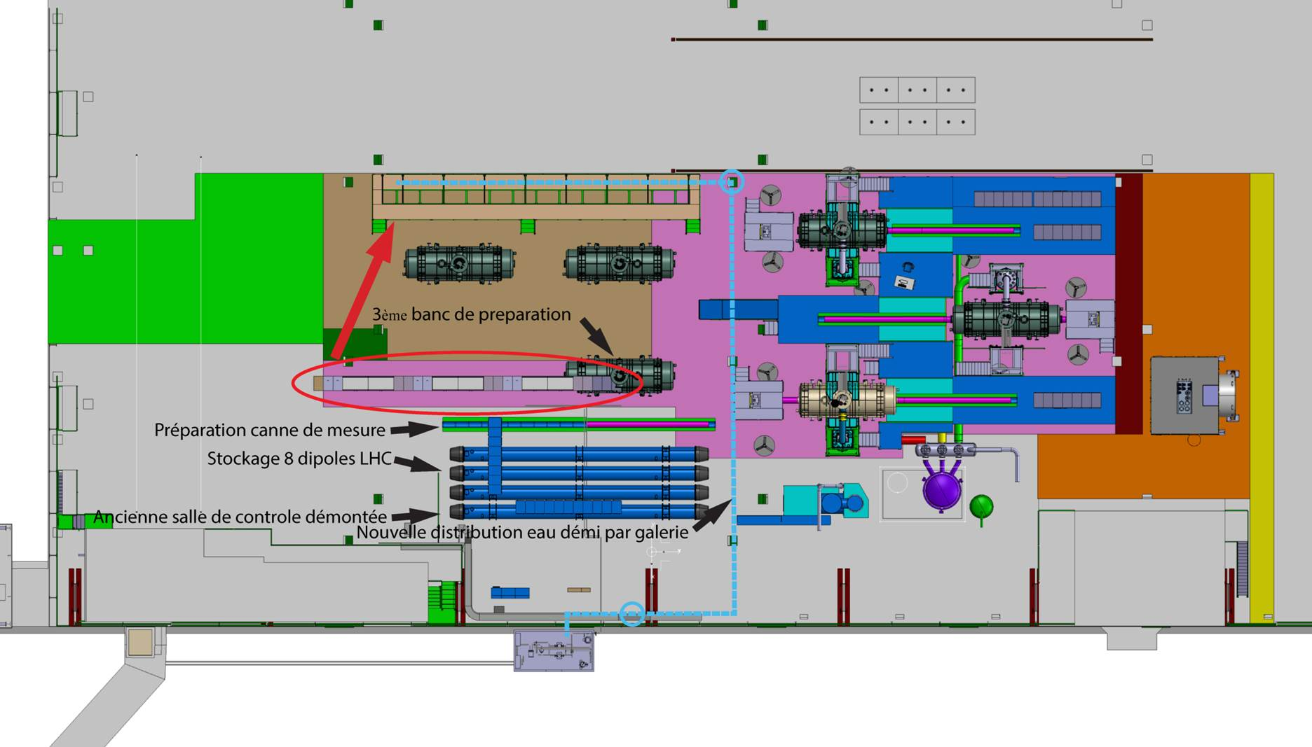

Integration and Installation
The integration of the powering area has just started. There are already significant changes.
The integration has to be finished in September 2015 to be ready to install the power converters in April 2016.
H. Thiesen – 13 May 2015

Slide 10
Integration and Installation
Must be clarified:
  AC distribution and interface
  Demineralized water distribution and interface
  DC cables
  Signal interface between power converters and
    EE systems
    Magnet protection systems (MPS)
    Control room
H. Thiesen – 13 May 2015

Slide 11
Summary
The project in on schedule to be ready for installation in April 2016
The 600A power converters have been delivered at CERN
The 500A power converters must be delivered in June
  Modification of the power converter is planned for Q4 2015 – Q1 2016
The design of the load switch racks and control rack has not yet started
  Design: Q4 2015
  Fabrication: Q1 2016
Integration of the powering area has just started
  Integration must be finished in September
  Installation is planned in April 2016
H. Thiesen – 13 May 2015

Slide 12
Summary
The different points must be clarified:
  Interface with CV
  DC cabling
  AC cabling
  Interface with EE systems
  Interface with MPS
  Interface with Control Room
No included in the project:
  Panda
Power converters have not be designed to work in magnetic environment
H. Thiesen – 13 May 2015

Slide 13
Integration and Installation
H. Thiesen – 13 May 2015

Slide 14
Integration and Installation
H. Thiesen – 13 May 2015

