Slide 1
FAIR magnets fiducialisation
WP 7.5
Dominique Missiaen

Slide 2
Agenda
Introduction to fiducialisation
Status

Slide 3
Fiducialisation
In order to align a magnet in a tunnel, some external references called «fiducials»
  have to be installed
  Measured w.r.t a reference axis
    Magnetic axis for the 33 cold multiplets
    Magnetic axis/yoke for the 24 warm dipoles
  The magnetic axis and roll angle is measured by the MSC group and transfered on some «references»

Slide 4
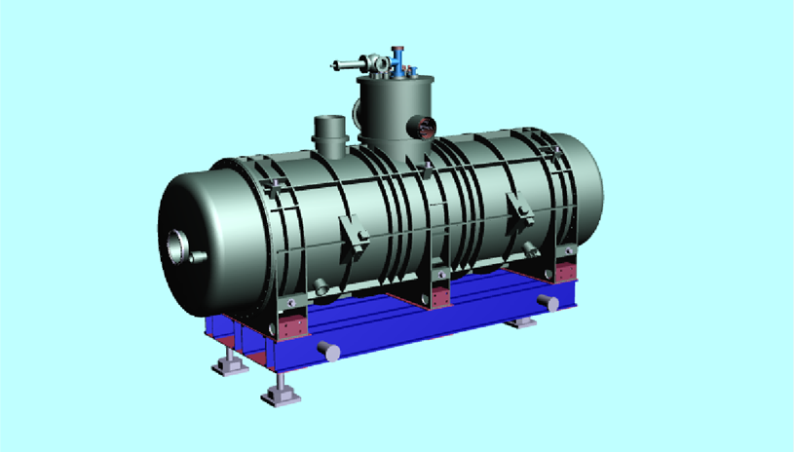
Fiducialisation set up

Slide 5
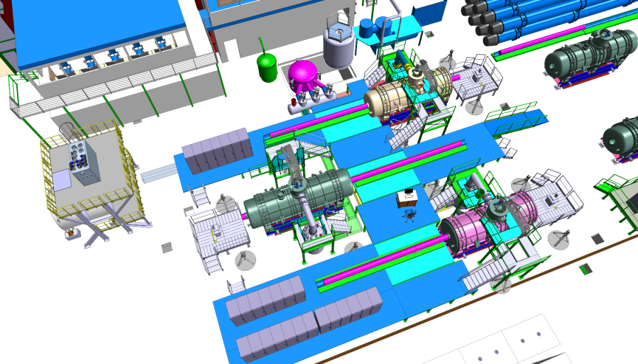
Fiducialisation setup
Courtesy Antoine Kosmicki

Slide 6
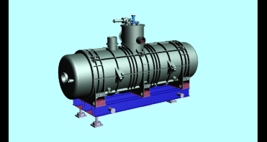
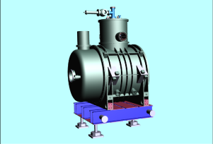
Fiducialisation
 | Number offiducials | Requested number | CERN | Requested accuracy (mm at 1s) | CERN (geometry) | Roll angle (mrad)
Long Multiplets | 12 | 4 | all | 0.2 | 0.08
Small multiplets | 8 | 4 | all | 0.2 | 0.08
dipoles |  |  | all | 0.5 | 0.08 | 0.5

Slide 7
Requirements
  4 positions per bench on a stable floor
  At least 6 network points per bench on a stable floor
  The supporting has to be realised exactly the same way for the fiducialisation as for the tunnel !!
    Who is taking care of the supporting/adjusting systems ?

Slide 8
Questions
  What will be the longitudinal reference
    Extremities of the cryostat ?
    Done during magnetic measurements ?

Slide 9
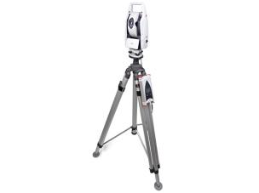
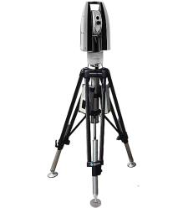
Status of the Wp
  Acquisition of an instrument
    AT402
    AT930/960
      real laser tracker
  Visit/demo of Hexagon/LEICA today at CERN
  Technical Specifications/Market survey/invitation to tender before summer

Slide 10
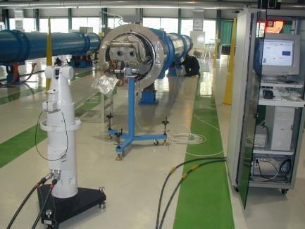
Status of the Wp
  Infrastructure
      Most of Network points available from LHC cryo-magnets fiducialisation in SMI2
  Software
    Automatisation of the measurement/data processing could be done using «Measurement Plan» from Spatial Analyzer

Slide 11
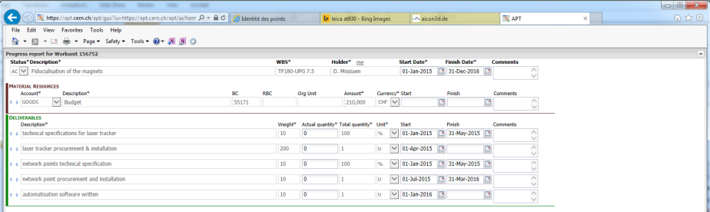
Status of the WP
  No progress entered in EVM

Slide 12
Questions ?

