Slide 1
S-FRS Test Bench
Work Package Protection QPS
R. Denz, TE-MPE-EP
Acknowledgements: D. Calcoen, J. Steckert

Slide 2
Quench Protection System for test benches - baseline
Standard quench detection system for magnet and leads according to specified protection requirements
  Digital, FPGA based, redundant detection systems
  Architecture and design will follow proven LHC concepts
QPS supervision
  LHC like solution delivering data for test bench operation (WinCC OA), logging database and post-mortem
  QPS supervision will treat all data acquired from voltage taps (also those not used for protection)
  QPS supervision will provide as well DAQ systems for EE (as in LHC)
TE-MPE-EP will take care of design, installation and commissioning of these systems
  Support for system operation and maintenance only during normal working hours
  Training & documentation for test bench operators will be provided

Slide 3
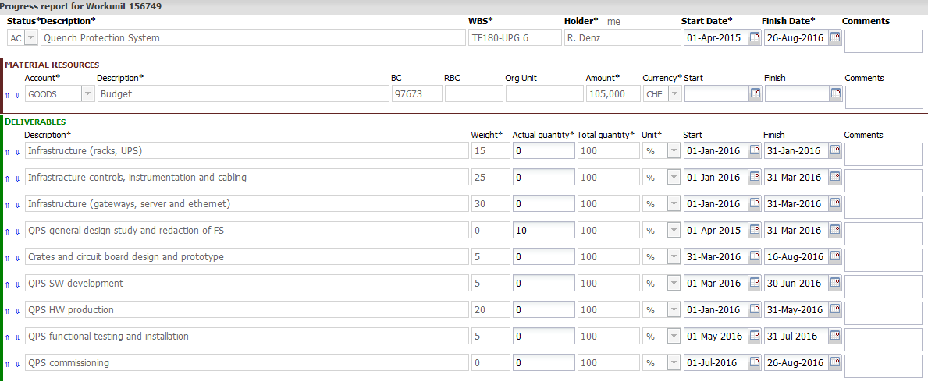
Quench Protection System for test benches - planning
In 2015:
  Infrastructure requests, general design studies and functional specification
In 2016:
  Final design and type testing, production, installation and commissioning
All items on schedule so far.

Slide 4
Quench Protection System for test benches - material cost estimate
Item | Price per unit | Quantity | Price
Multi purpose digital quench detection system | 10000 CHF | 3 + 1 x spare | 40000 CHF
Gateway | 10000 CHF | 1 | 10000 CHF
WINCCOA server + software licenses | 20000 CHF | 1 | probably paid by EN-ICE as shared with other users
Control cables (signals, interlocks, field-bus) | 20 CHF/m | To be defined ~500 m | 10000 CHF
Total |  |  | ~60000 CHF (100 kCHF max.)
Manpower | Qualification | Time | Comments
Design & production | D, E | 0.5 FTE | 2 persons (distributed over a period of one year)
Installation & commissioning | C, D, E | 0.5 FTE | 3 persons for ~2 month
Maintenance & operational support | C | 0.5 FTE/year

Slide 5
Quench Protection System for test benches – open issues
Infrastructure, cables etc.:
  Final specification for magnet instrumentation connector required to complete cabling requests
Supervision & interlocks:
  Test bench interlock system must be capable of handling software interlocks (QPS_OK) signal; hardwired abort loops must follow LHC specification
  Required data rates and resolution for all supervision signals still to be specified
Protection:
  Protection of current leads to be specified
  Required ramp rates to be confirmed (60 V issue …)
  Do you plan using the test bench as well for type testing/qualifying the FAIR QPS?
Operation:
  Further delays may interfere with LHC LS2 …

