Slide 1
WP: Control and DAQ
B180 (FAIR) Test Facility
Plenary Meeting, May 15 [INDICO event]
Enrique Blanco
Industrial controls (EN-ICE)
Acknowledgements: EN/ICE, M. Charrondiere, Gerard Willering

Slide 2
Control & DAQ*
EVM status
Current activities
Next actions & required inputs from GSI
* Voltage taps are treated by the QPS system

Slide 3
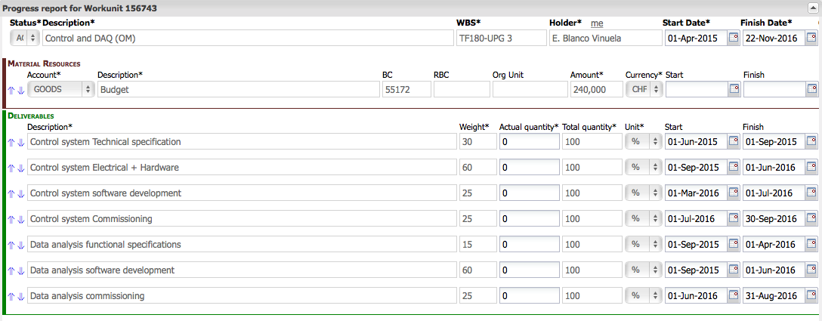
EVM status
First scheduled task starting in June 2015
Preliminary works started
Control system:
  Technical specification
  Electricity and hardware
  Software development
  Commissioning
Data Analysis
  Functional specifications
  Software development
  Comissioning

Slide 4
Current ACTIVITIES
  [1] Interlock (or safety) system
  [2] DAQ: Data Acquisition System
  [3] Controls Integration
  [4] Data & Post Mortem analysis
  In close collaboration with our colleagues from WP: test stand.

Slide 5
ACTIVITIES: [1] Interlock (safety)
    SM18 Test bench is our baseline
      Interlock system in SM18 is in a re-engineering phase
      Safety Instrumented System (SIS) instead of a conventional PLC interlock system
    Evaluating the solution and the applicability to the FAIR project.
    Cabling and cabinets dimension currently under specification. Estimated cabling : EDMS 1497694 (See G. Willering presentation)
    A first draft of specification from FAIR is available
    (v1) [09/April/2015]

Slide 6


ACTIVITIES: [1] Interlocks (safety)
QPS
(to INT) Lead voltages
(to INT) Feedback selectors
CRYOGENICS
Cryogenics PLC
(to INT) Lead temperatures
(to INT) Cryogenic phases
(to INT) Cryo OK
Cryo PLC
QPS
INTERLOCK
Power
Converters
QPS FEC
INT PLC(s)
PC FEC
DAQ Equipment
(to INT) DAQ ready
DAQ
Power Converters
(to INT) Current readings
(to INT) PC status
(to INT) Extraction status
(from INT) Power OK
Preliminary view based on
M. Charrondiere inputs and FAIR
DAQ Equipment

Slide 7






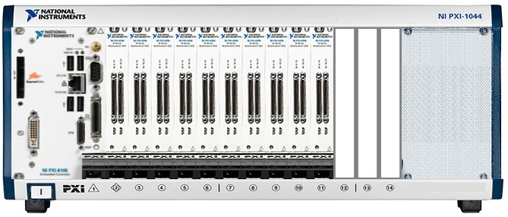
ACTIVITIES: [2] Data Acquisition System
  DAQ: Still under definition. The final design will likely depend on
    DAQ requirements (signals and sampling rates)
    Data analysis functionality requirements.
Virtual machine
For DIAdem
(IT)
Operator
Consoles
Data server
(CCR)
Ethernet
Quench DAQ
SM18 DAQ PXI-based
Courtesy of Adriaan Rijllart (CERN)

Slide 8
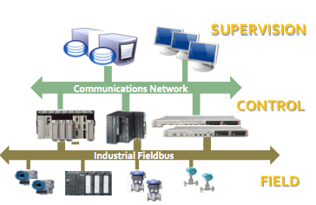
ACTIVITIES: [3] Controls Integration
    Our aim is full integration with standardized components
      Industrial controls based on the UNICOS* framework
      Industrial control architecture (3 layers: field / control / supervision)
* UNICOS: UNified Industrial COntrol System
http://www.cern.ch/unicos

Slide 9
ACTIVITIES: [3] Controls Integration
      Diverse control systems
      Individual operation of facilities (e.g. Cryogenics, Cooling & ventilation)
      Still easy integration of signals in the same HMI
Cryogenics
QPS
Cooling &
Ventilation
Interlocks
Supervision:
WinCC OA (UNICOS)
Control:
PLC Siemens (UNICOS)
Supervision:
WinCC OA (UNICOS)
Control:
FEC* (FESA)
Supervision:
WinCC OA (UNICOS)
Control:
PLC Siemens (UNICOS)
Supervision:
WinCC OA (UNICOS)
Control:
**PLC Siemens (UNICOS)
Power Converter
Supervision: Customized
Control:
FEC
* FEC: Front-End Computer
** Except for the safety PLC

Slide 10
ACTIVITIES: [3] Controls Integration
    Operation: Integration of all systems in a portal facility
        Control room with OWS: Operator workstations (Consoles)
        Possibility that all systems share an unique HMI (ease operation)
          Natively: Cryogenics (Vacuum), Cooling and Ventilation, QPS, Interlock.
          By communication: Power converters and additional DAQ channels
OWS(s)
(180 Control
Room)
Cryogenics
PORTAL
CV
Cryogenics
QPS
Controls (PORTAL)
Interlocks
CV
Data servers
(CERN
Control
Room)

Slide 11







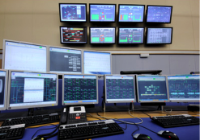

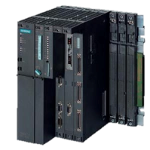
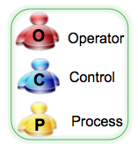
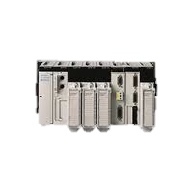
ACTIVITIES: [3] Controls Integration
Operation architecture
P
C
CERN
computers
WTS
P
C
Ethernet Corporate
EWS
SCADA Server(s)
WTS
OWS
B180
Control
Room
C
O
Ethernet Technical

Slide 12
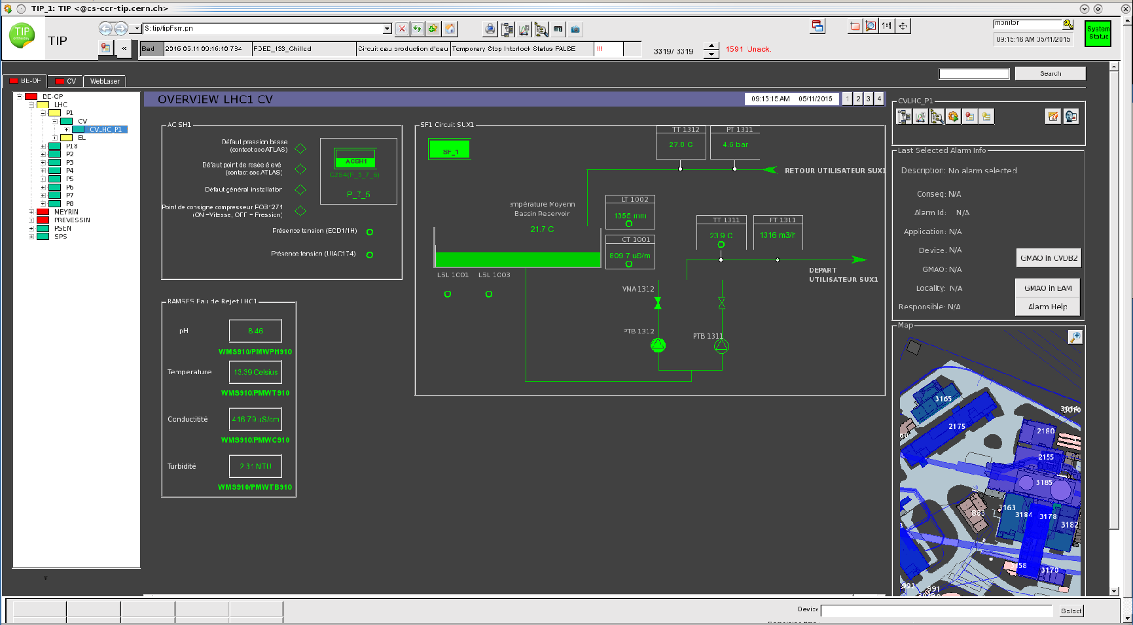
ACTIVITIES: [3] Controls Integration
  Operation HMI

Slide 13
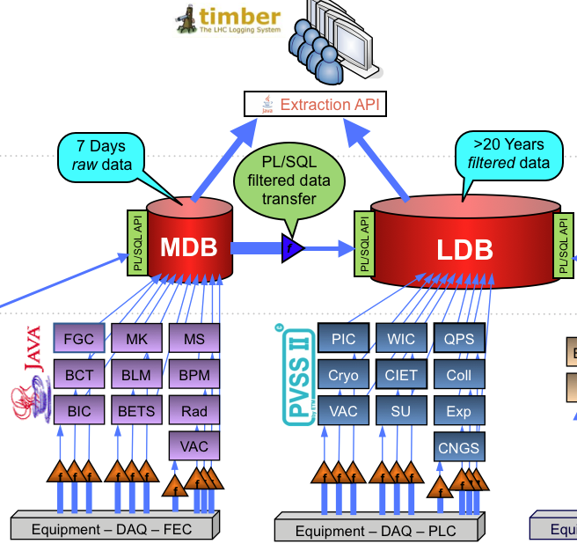

ACTIVITIES: [3] Controls Integration
Long term data availability (CERN)
Courtesy of Chris Roderick

Slide 14
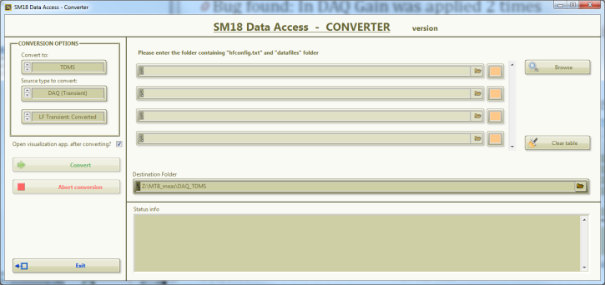
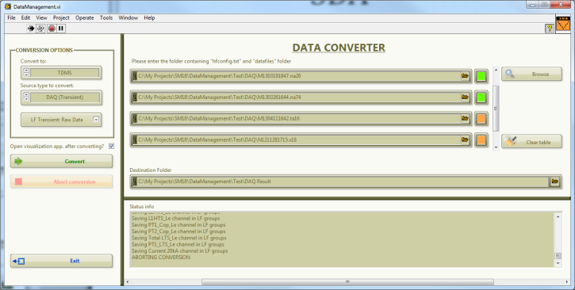
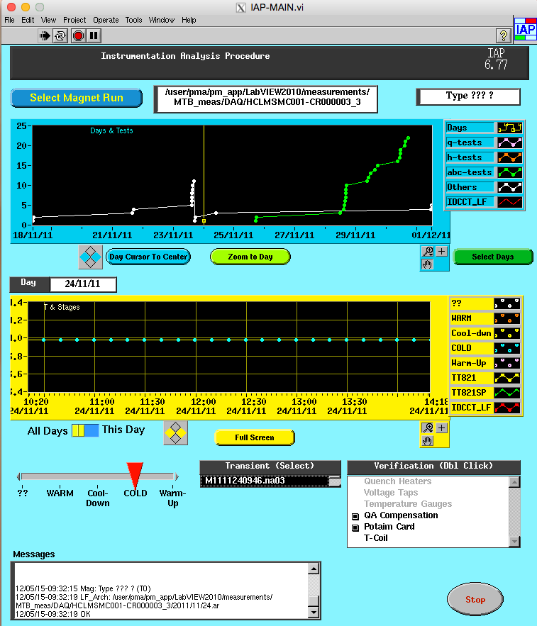
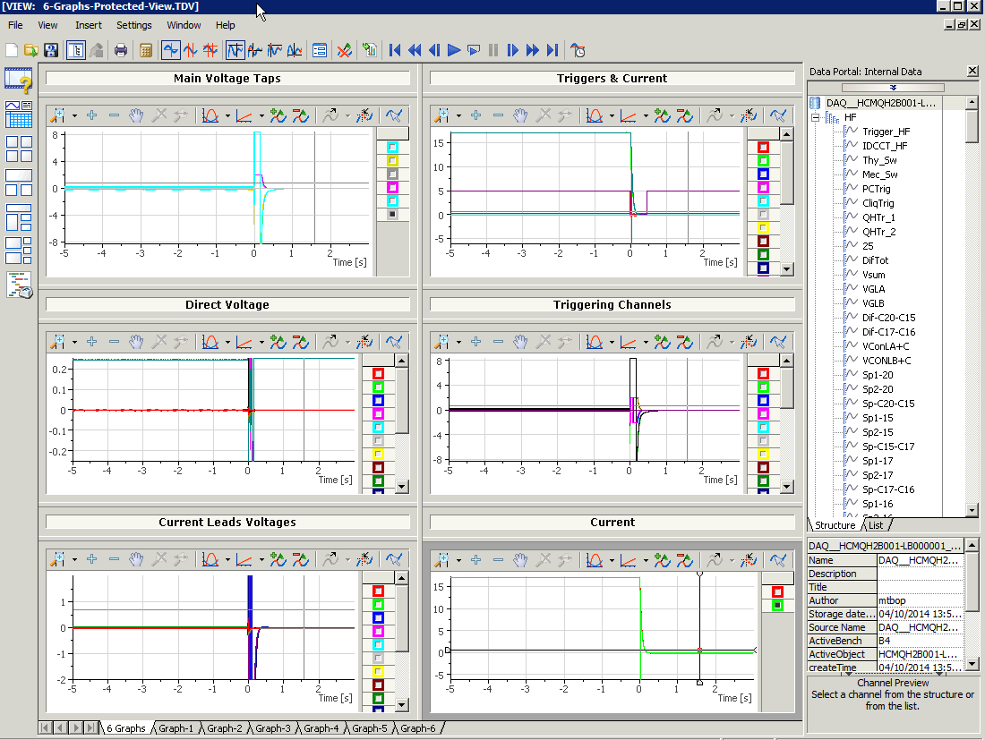
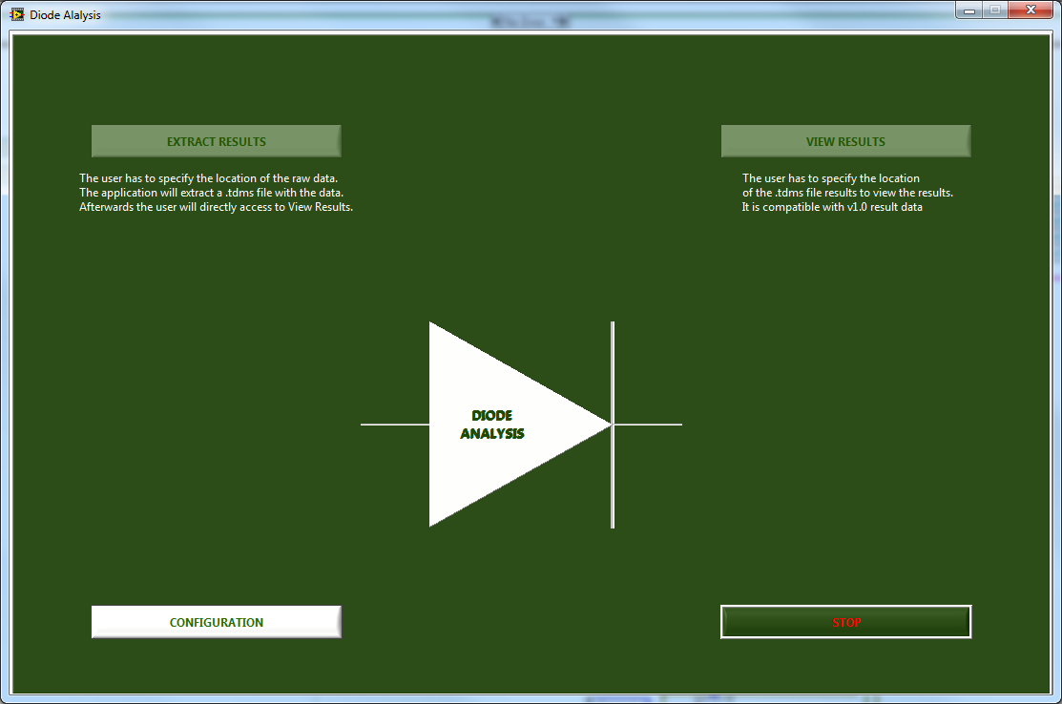
ACTIVITIES: [4] Data analysis
  A possible solution based on the SM18 installation: National Instruments)
SDA: Converter from several formats to TDMS*
IAP
Diadem
Diode
IAP – Instrumentation Analysis Procedure, check that the magnet instrumentation is ready, functional and available.
Diadem – Multi purpose analysis tool, can be configured to analyze any workflow
Diode – Specialized tool to analyze the diode characteristics (comes with a DIODE DAQ system not shown).
Courtesy of EN/ICE/MTA
* TDMS: NI file format
Notes:
SDA – Convert files from binary formats to TDMS
IAP – Instrumentation Analysis Procedure, used to check that the magnet instrumentation is ready, functional and available.
Diadem – Multi purpose analysis tool, can be configured to analyze any workflow
Diode – Specialized tool to analyze the diode characteristics (comes with a DIODE DAQ system not shown).

Slide 15
Next activities
Interlocks
  Feedback for the interlocks specs v1 to be done
    Mixed process interlocks with protection functionality. Need a common study with the cryogenics (end of May seems coherent with their WP activity)
  Identifying hazards
    Platform access & test bench human presence
    Risk analysis to complete (FMEA* as SM18) to be done
    Proper selection of the hardware in function of the results
    ODH: incorporated or standby systems as other installations at CERN
Data analysis
  Operational functionality to be defined by the operation crew
  Integration of the data analysis and the controls in the control room to be drafted
DAQ
  Technology decision
* FMEA: Failure Mode and Effects Analysis
** ODH: Oxygen Deficiency Hazard

Slide 16
Required inputs
Interlocks
  Finalize the interlocks specs [CERN, GSI] (June-Sept.15)
Controls & data analysis
  Data analysis: Functional specification to be done [GSI] (Sept.15)
DAQ
  Functional specification to be done [GSI]
    Measurements rate expected: sampling frequency requirements
    Physical measurement to be defined

Slide 17
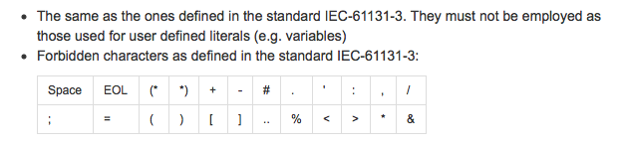
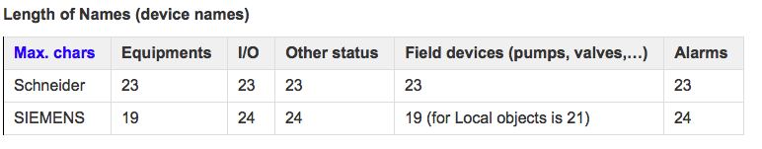
Appendix A: Control names
UNICOS reference: https://wikis.web.cern.ch/wikis/display/UCPC17/Project+Specifications
  At CERN we normally use the ISA conventions with a composition of three different entities [equipment, location, name] (e.g. QSDN_4_CV400). This is not a real constraint as you could use another standard (IEC-xxxx)
  The constraint comes from:
    Limitations on using PLCs (Programmable Logic Controllers)
    UNICOS (PLC based systems)
  Advice: Use your desired naming convention and use the expert names. Define control names for the PLC. Only the expert names will be known/seen in operation and long term data archiving.

Slide 18

Questions?

