Slide 1
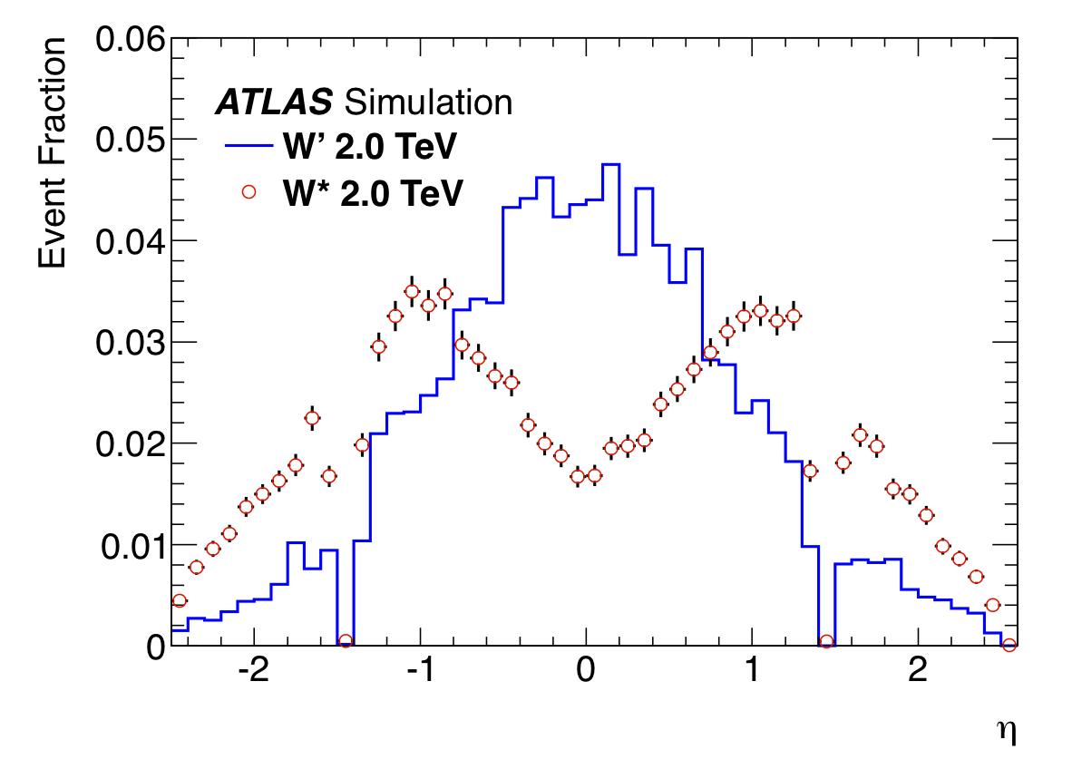
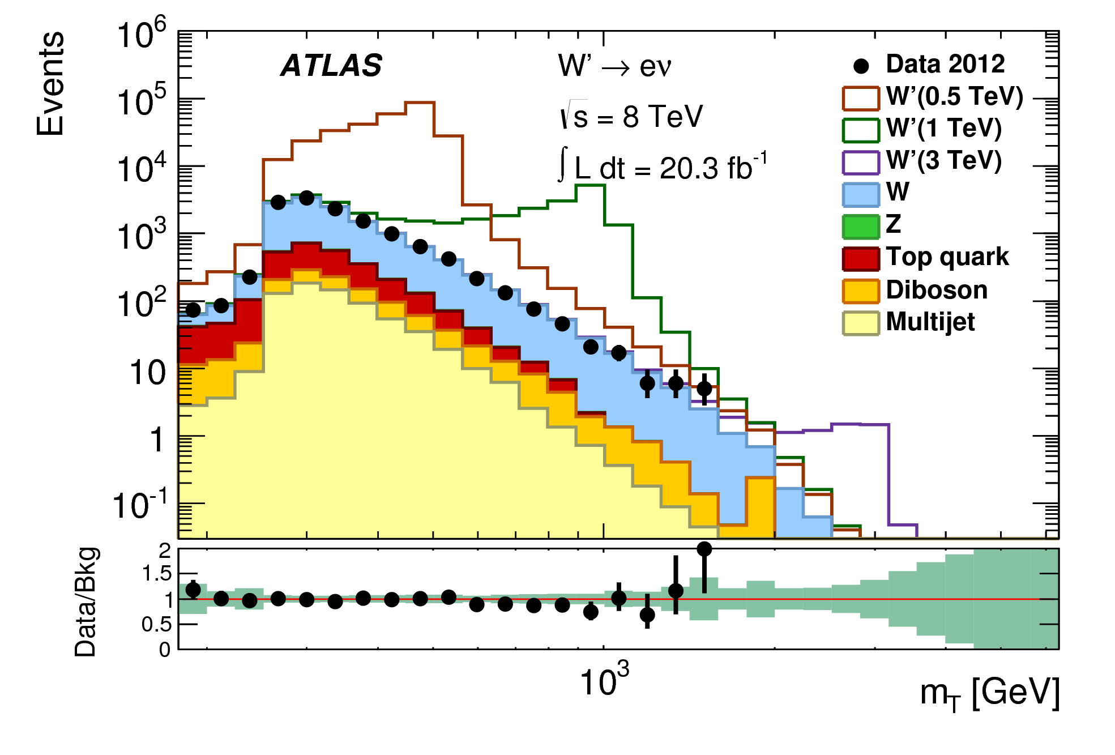
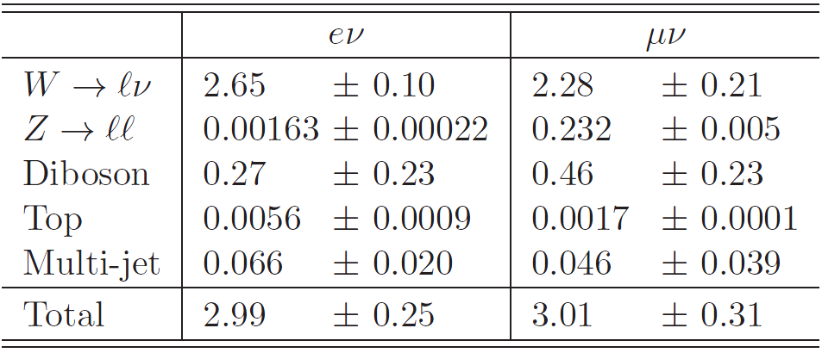
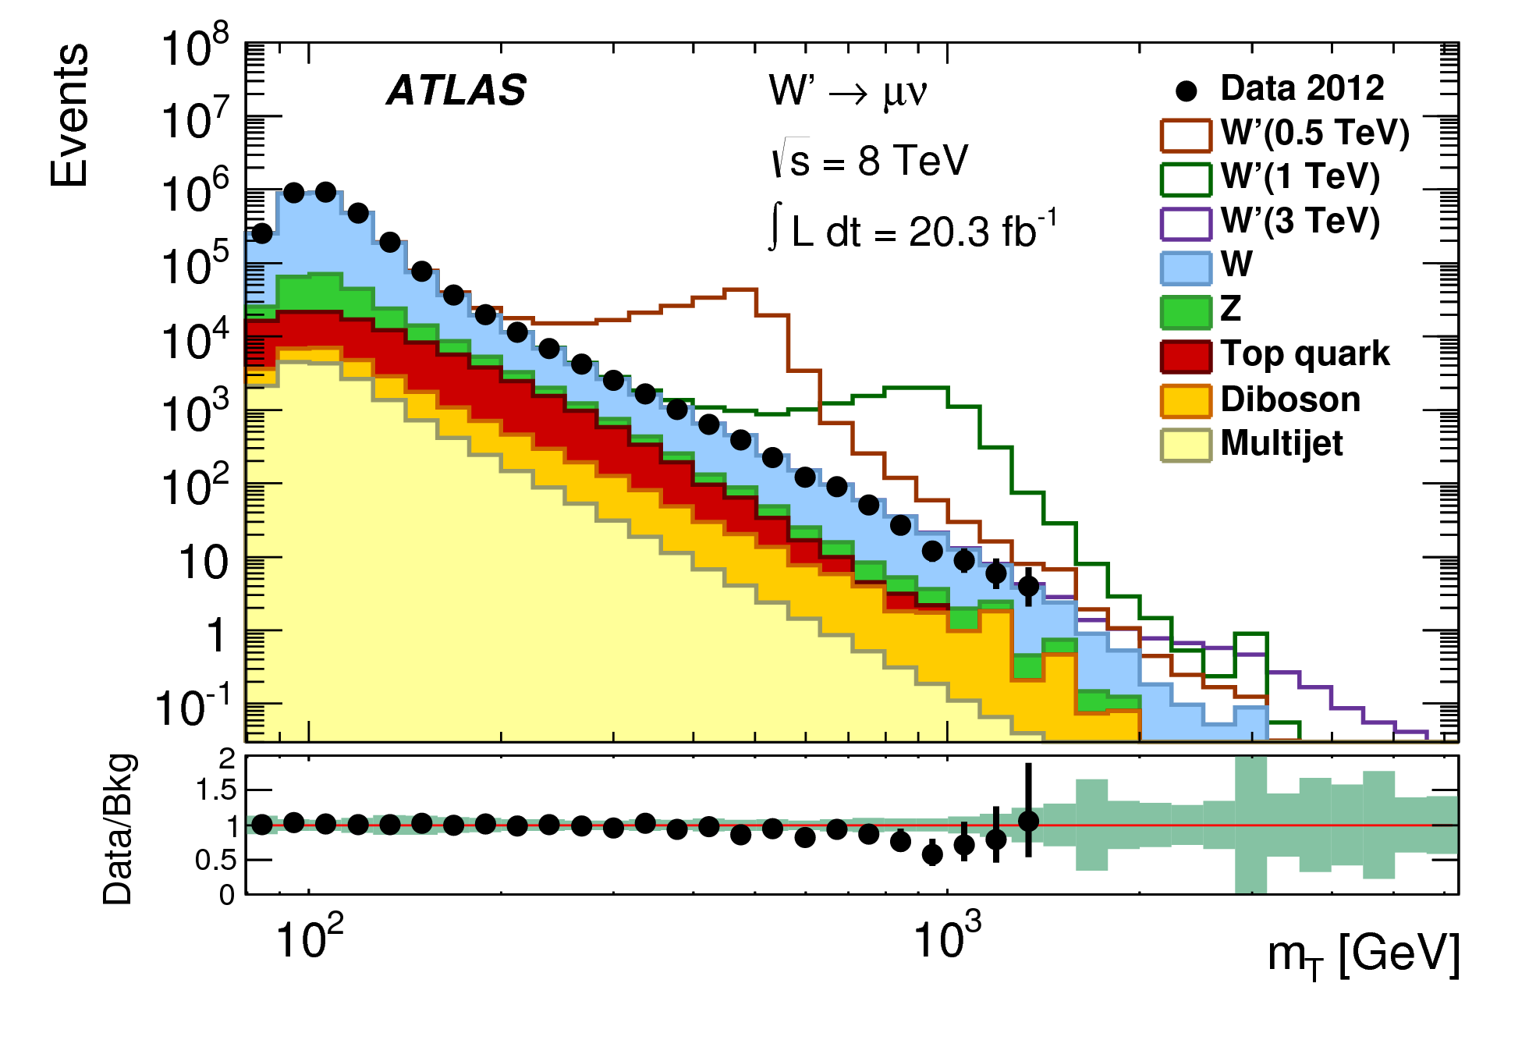
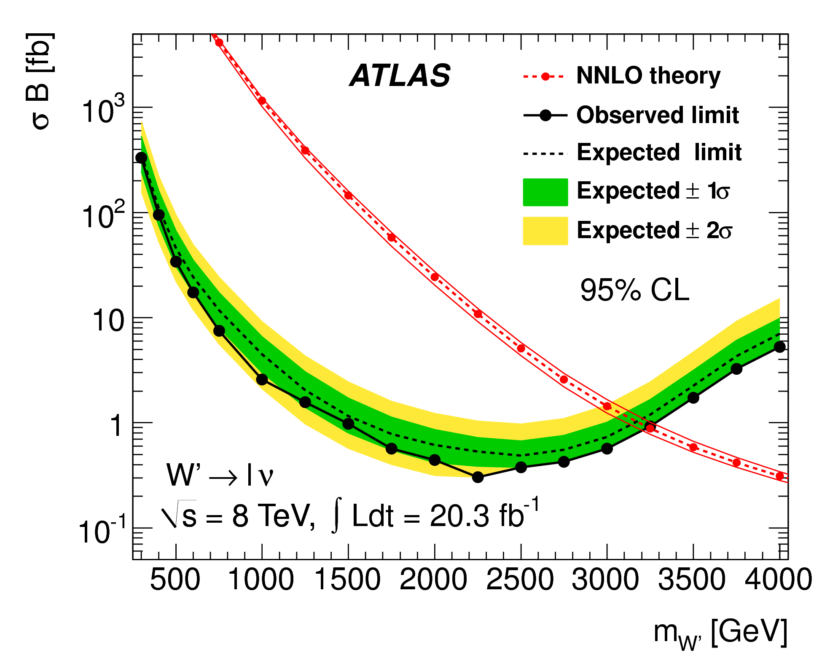
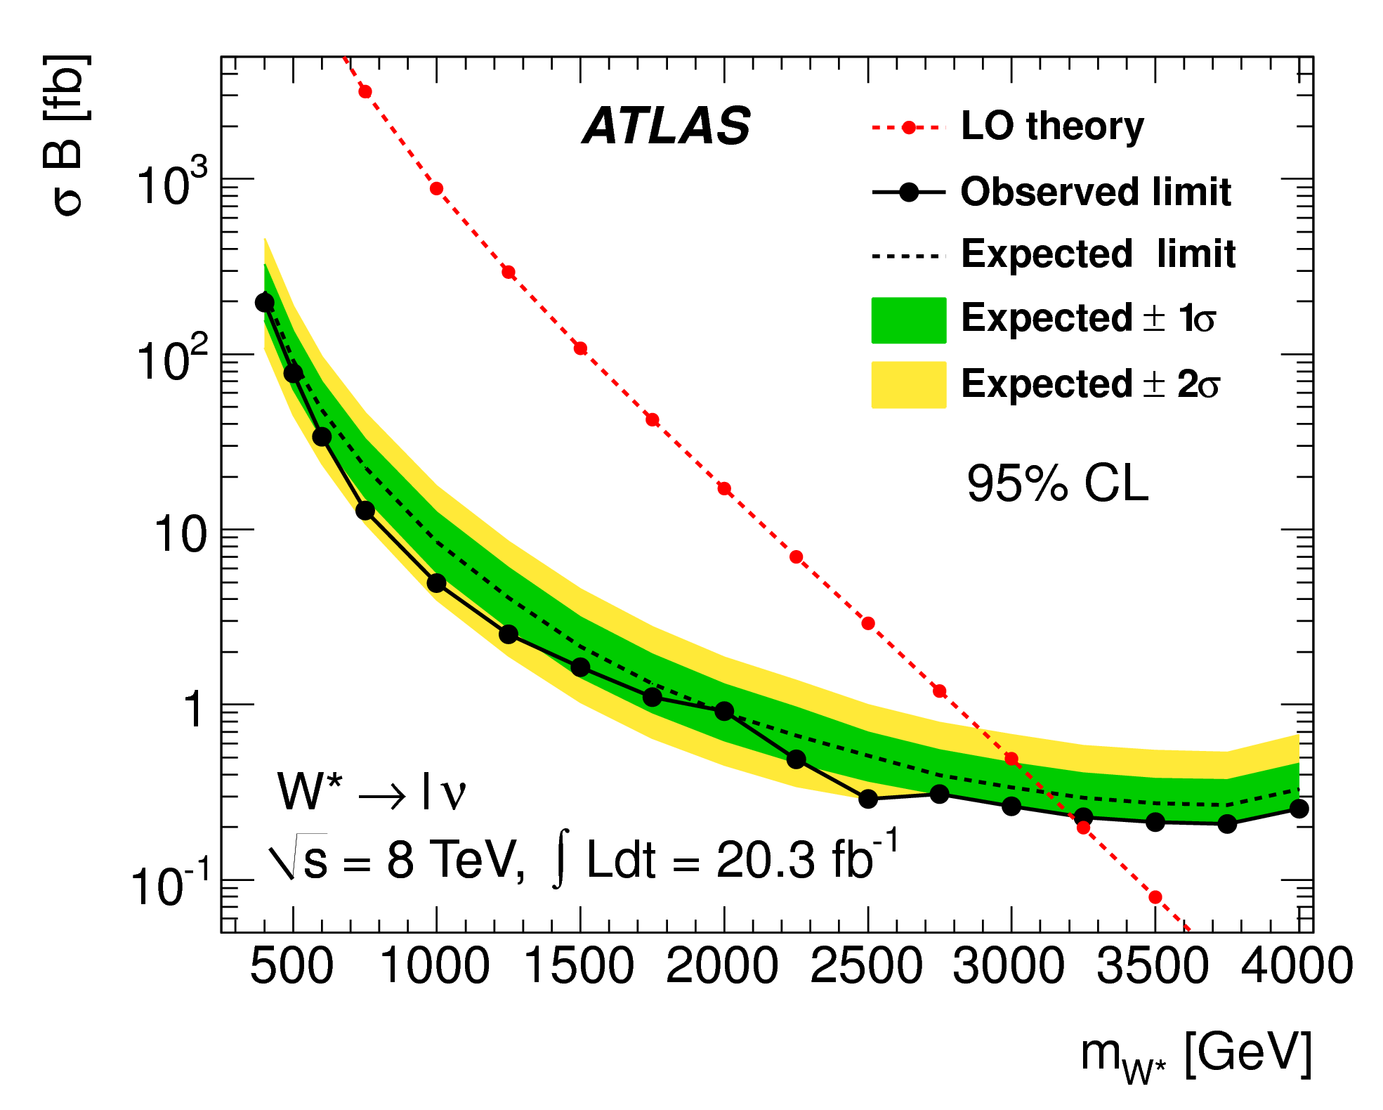
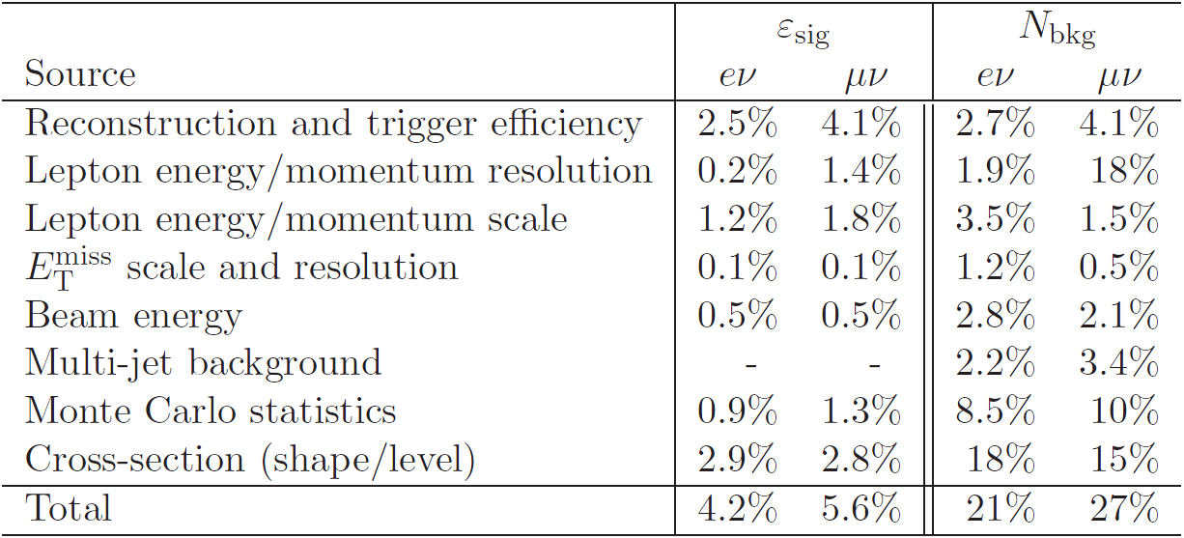
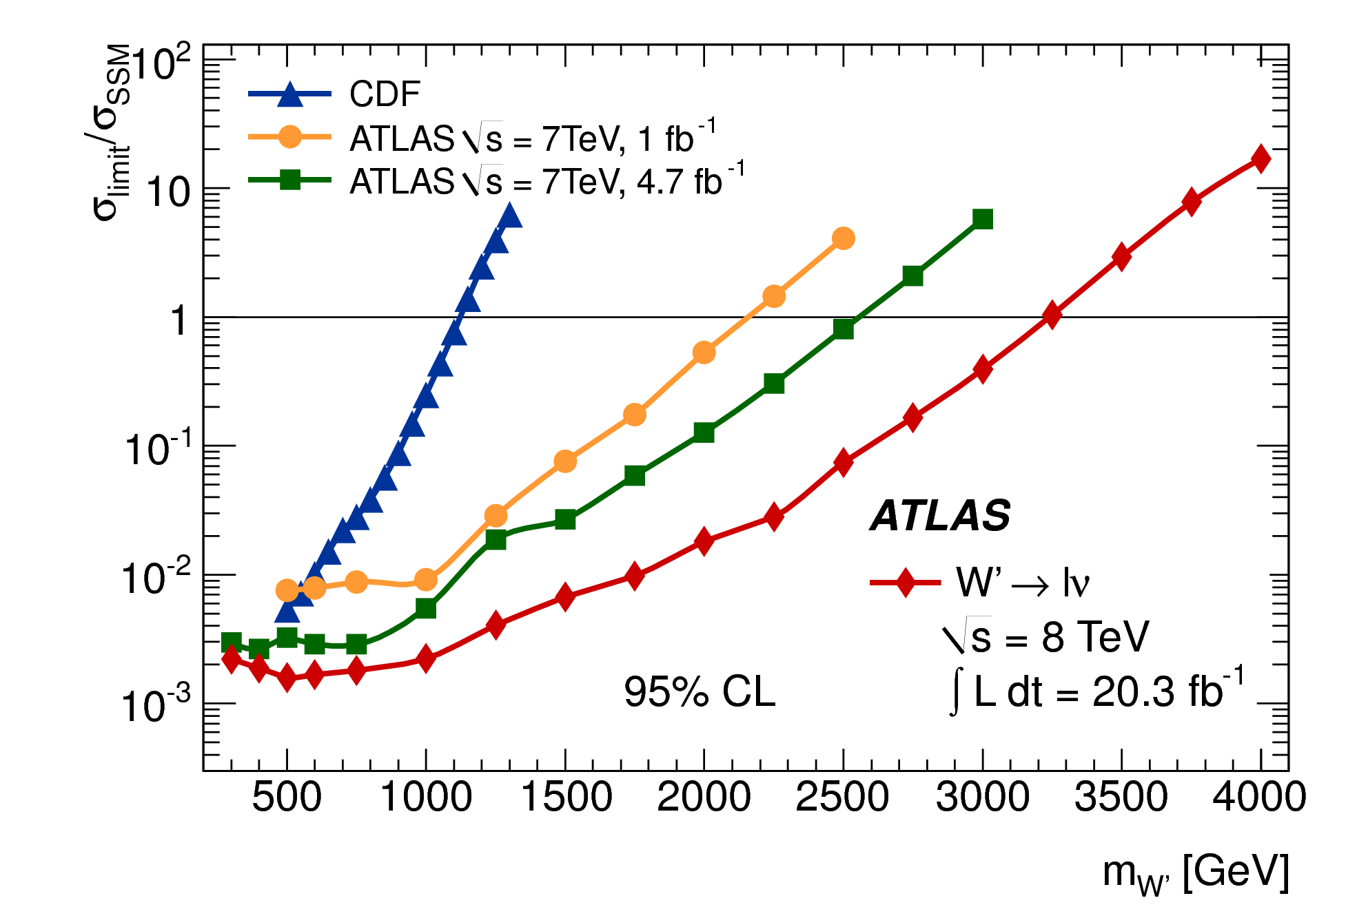
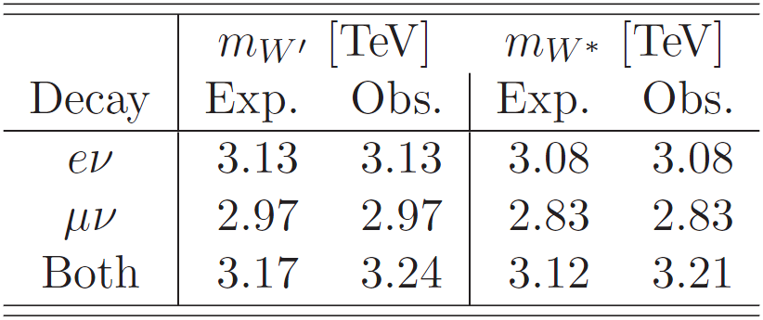
Search for heavy charged vector bosons decaying to a charged lepton and a neutrino with the ATLAS experiment
Victor Solovyev (PNPI), for the ATLAS Collaboration
Abstract
This poster presents a search [1] for new particles in events with one lepton (electron or muon) and missing transverse momentum using 20.3 fb⁻¹ of proton-proton collision data at √s = 8 TeV recorded by the ATLAS experiment at the LHC. W' and W* heavy charged vector bosons are considered as two new-physics scenarios. No significant excess beyond Standard Model (SM) expectations is observed. W' bosons with Sequential Standard Model couplings are excluded at the 95% confidence level (CL) for masses up to 3.24 TeV. W* bosons with equivalent coupling strengths are excluded at the 95% CL for masses up to 3.21 TeV. The search is also sensitive to direct production of weakly interacting candidate dark matter particles. This new-physics scenario is discussed in ref. [1] but not considered here since it goes beyond the subject of the poster.
Models
Search Strategy
Sequential Standard Model W' [2]:
Same couplings to fermions as
the SM W boson
Width increases linearly with the W' mass
Coupling of the W' to WZ is set to zero
Chiral Boson W* [3]:
Anomalous (magnetic-moment type)
coupling of the W* to fermions
Kinematic distributions significantly
different from those of the W'
The kinematic variable used to identify the signal is the transverse mass:
where is the lepton transverse momentum, is the magnitude of the missing
transverse momentum vector and is the angle between the and vectors
The distribution in data is examined for a significant excess above SM expectations
If no excess is found then limits are set on the cross-section times branching fraction (σB) using Bayesian approach
Reconstructed electron η distribution for W' → eν and W* → eν:
Event Selection
Signals and Backgrounds
Electron channel:
p_{T} > 125 GeV
|η| < 2.47 (excluding 1.37 < |η| <1.52)
ΣE_{T}^{Calo} < 0.007×p_{T} + 5 GeV (in a cone ΔR < 0.2† around the electron)
Missing E_{T} > 125 GeV
Veto events with additional electrons with p_{T} > 20 GeV
Transverse mass distributions of the selected events:
Signal processes:
  W' → lν and W* → lν (l = e,μ)
Background processes:
  W → lν (l = e,μ,τ)
  Z → ll (l = e,μ,τ)
  Top quark ( and single top)
  Dibosons (WW,WZ,ZZ)
  Multi-jet
Evaluated using simulated Monte Carlo samples (except multi-jet)
Normalized using the calculated cross-sections and the integrated luminosity of the data
Multi-jet background is estimated from data
Expected number of events in each channel for m_{T} > 1500 GeV:
Muon channel:
p_{T} > 45 GeV
|η| < 2.0 (excluding 1.0 < |η| <1.3)
Σp_{T}^{Track} < 0.05×p_{T} (in a cone ΔR < 0.3† around the muon)
Missing E_{T} > 45 GeV
Veto events with additional muon candidates with p_{T} > 20 GeV
Statistical Analysis and Systematic uncertainties
For each candidate mass the signal selection efficiency (ε_{sig}), the expected number of background events (N_{bkg}) and the number of observed events (N_{obs}) are determined above m_{Tmin} threshold. Values of m_{Tmin} are optimized for each candidate mass
Using Poisson statistics, the likelihood to observe N_{obs} events is:
where L_{int} is the integrated luminosity of the data sample
Uncertainties are included by introducing nuisance parameters (L_{int}, ε_{sig} and N_{bkg}) with log-normal PDFs and integrating the likelihood over nuisance parameters
Bayes’ theorem gives the posterior probability to have signal strength σB:
where N is a normalization factor, P_{prior} is a prior bribability chosen to be flat in σB
P_{post} is evaluated for each mass and decay channel and used to set a limit on σB
Inputs for the evaluation of P_{post} are L_{int}, ε_{sig}, N_{bkg}, N_{obs} and the uncertainties on the first three
Relative uncertainty on L_{int} is 2.8 %
As example, relative uncertainties on ε_{sig} and N_{bkg} for a W' with m = 2000 GeV used with m_{Tmin} = 1500 GeV are listed below:
†
Results
The numbers of observed and expected events are in good agreement
No evidence for the observation of either W' → lν or W* → lν
95% CL limits are set on σB for two decay channels and combined assuming the same branching fraction for each:
        Normalized limits σ_{limit}/σ_{SSM} can be compared to previous ATLAS [4,5] and CDF [6] searches:
        95% CL lower limits on W' and W* masses:
References
[1] ATLAS Collaboration, JHEP 09 (2014) 037, arXiv:1407.7494
[2] G. Altarelli, B. Mele and M. Ruiz-Altaba, Z. Phys. C 45 (1989) 109
[3] M. Chizhov and G. Dvali , Phys. Lett. B 703 (2011) 593-598, arXiv:0908.0924
[4] ATLAS Collaboration, Phys. Lett. B 705 (2011) 28–46, arXiv:1108.1316
[5] ATLAS Collaboration, Eur. Phys. J. C 72 (2012) 1–23, arXiv:1209.4446
[6] CDF Collaboration, Phys. Rev. D 83 (2011) 031102, arXiv:1012.5145
[7] https://atlas.web.cern.ch/Atlas/GROUPS/PHYSICS/PLOTS/EXOT-2015-002/
        The search is resumed in 2015 using pp collision data at √s = 13 TeV. First public plots based on 78 pb⁻¹ of the data are available in ref. [7]
LCHP 2015, August 31 – September 5, St. Petersburg, Russia

