Slide 1




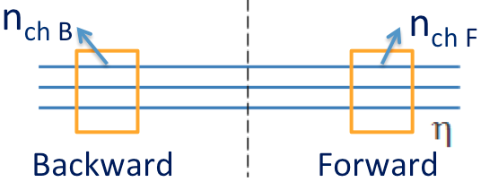
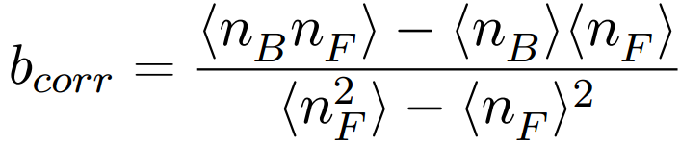
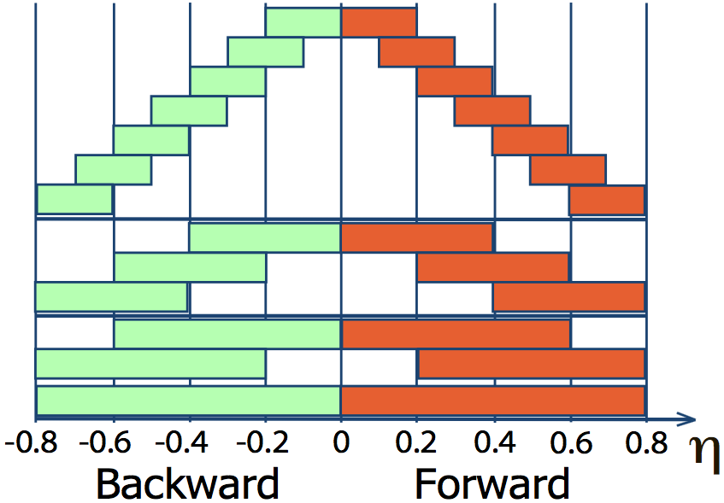
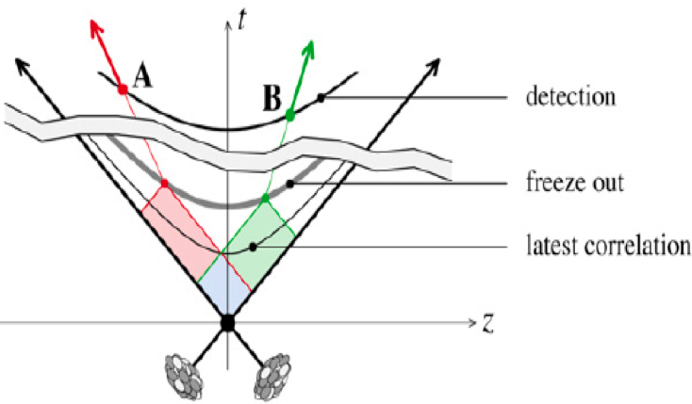
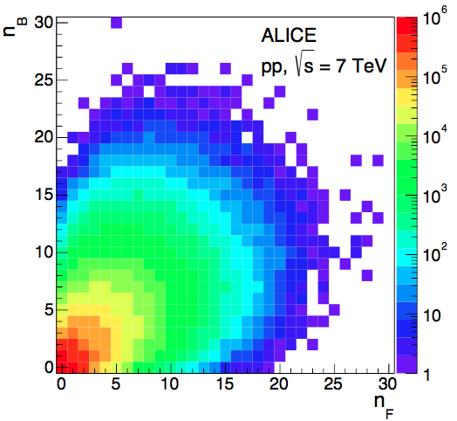
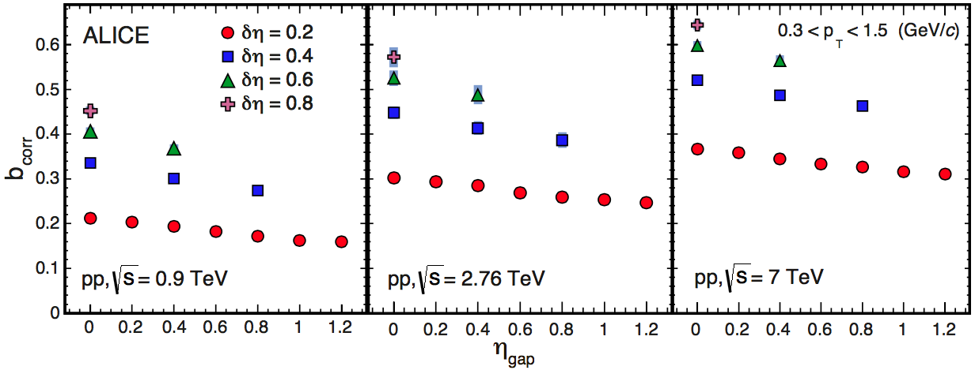
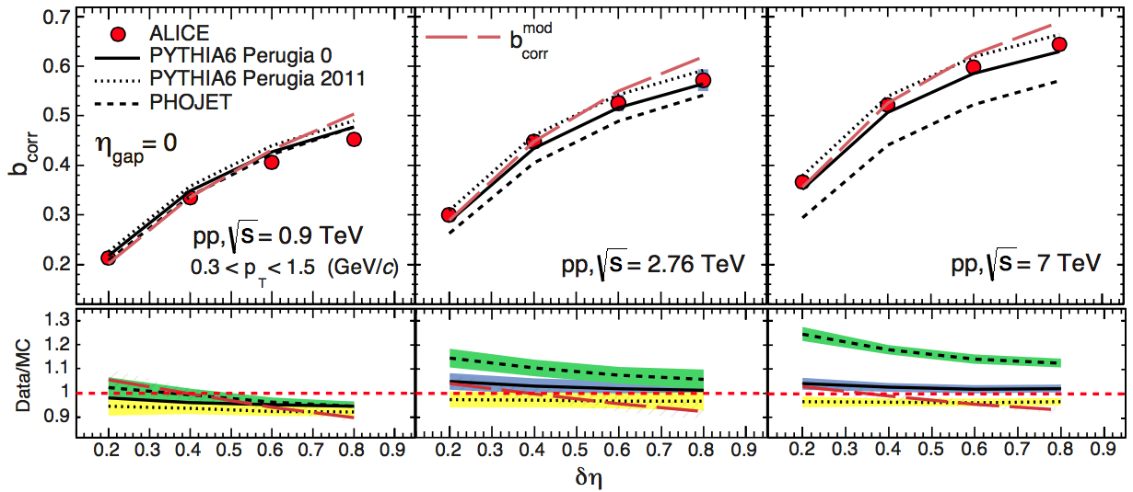
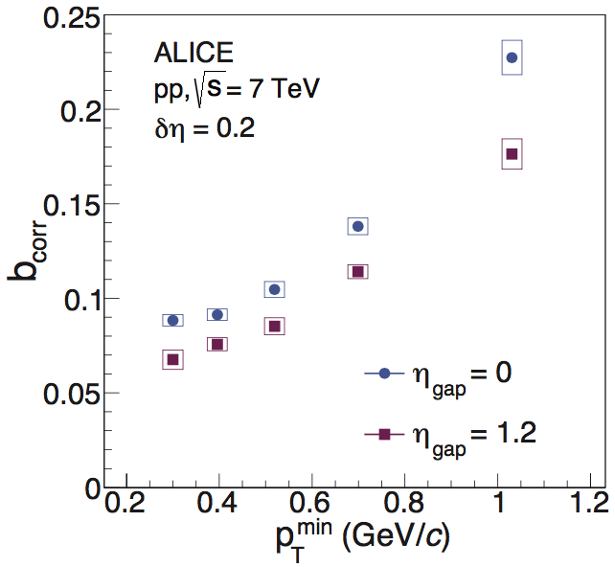
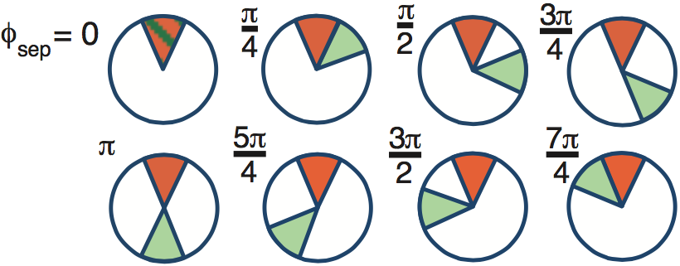
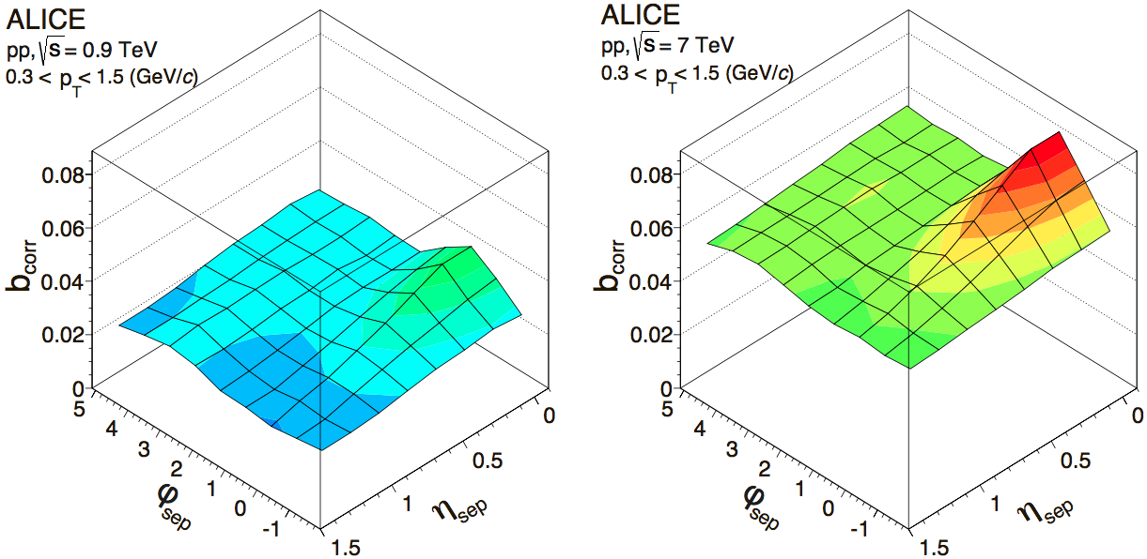
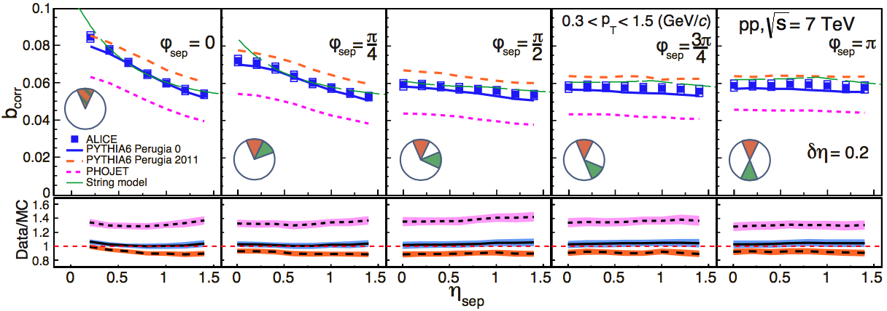







Short- and long-range multiplicity correlations in pp collisions with the ALICE detector
Grigory Feofilov (SPbSU), for the ALICE Collaboration
Abstract
The FB correlation strength b_{corr} is determined by:
Forward-backward (FB) multiplicity correlations are considered to be a powerful tool for the exploration of the initial conditions of hadronic interactions. The magnitude of these correlations is measured by the ALICE detector in proton-proton collisions at √s = 0.9, 2.76 and 7 TeV [1]. The measurement is performed in the central pseudorapidity region (|η| < 0.8) for the charged tracks with transverse momentum p_{T} > 0.3 GeV/c, in two separate pseudorapidity windows chosen symmetrically around η = 0. The correlation coefficient is also measured for multiplicities in different configurations of two azimuthal sectors selected within the η-windows. FB correlations are usually divided into short-range (SR) and long-range (LR) components. The energy dependence of bcorr is found to be weak for the SR component, while it is strong for the LR component. Results are compared to PYTHIA and PHOJET event generators and to a string-based phenomenological model. The observed dependencies of these correlations add new constraints on phenomenological models.
[1]ALICE Collaboration, JHEP(2015)097
1) linear regression:
2) correlator:
Determination of the FB multiplicity correlations
with the ALICE detector
η-window pairs used in ALICE are shown in the Figure.
Notations:
η_{gap} – distance between windows,
δη – windows width.
Initial conditions
Due to causality, the appearance of long-range correlations between particles detected in separated rapidity intervals in any type of collisions (pp, p-A, A-A) could happen only at the very early stages .
detection
freeze out
Particle reconstruction was performed using
Inner Tracker (ITS) and Time Projection Chamber (TPC).
Kinematic range is |η|<0.8, p_{T} range 0.3-1.5 GeV/c.
latest correlation
freeze out
A. Dumitru, F. Gelis, L. McLerran and R. Venugopalan, Nucl.Phys. A810 (2008) 91
[arXiv:0804.3858 [hep-ph]].
Correction factors for b_{corr} of the order of 5-10%, systematic uncertainties are of the order 2-5%.
Motivation:
Color string fusion phenomenon (SFM) (M.A.Braun and C.Pajares, Phys. Lett. B287 (1992) 154; Nucl. Phys. B390 (1993) 542, 549)
String percolation picture of pp collisions at LHC energies (P. Brogueira, J. Dias de Deus, and C. Pajares, Phys. Lett. B 675 (2009) 308)
CGC predictions for pp collisions at the LHC (E.Levin and Amir H. Rezaeia, "Gluon saturation and inclusive hadron production at LHC”, PRD82, 014022 (2010), arXiv:1005.0631)
"Twisted correlations" as a tool to tune color reconnection and MPI in PYTHIA (K. Wraight and P. Skands, Eur. Phys. J., C 71 (2011) 1628).
ALICE results for pp collisions
Fig.1: FB multiplicity correlation strength as a function of η_{gap} (gap between the windows), for different width (δη) of the windows.
Fig.2: FB multiplicity correlations as a function of width δη.
The comparison to the PYTHIA6 and PHOJET is shown.
Fig.3. FB correlations in p_{T}-intervals
with equal mean multiplicity
FB correlations in η-φ windows
φ-binning of the η-windows:
Azimuthal FB (or “twisted”) correlations reveal deeper insight into the dynamic changeof of b_{corr} with rapidity:
SR
LR
Fig. 5. 2D representation of b_{corr} at (a) √s=0.9 TeV and (b) at √s=7 TeV
for separated η-φ window pairs with δη =0.2 and δφ =π /4.
Fig.4. b_{corr} for separated η-φ window pairs at √s=7 TeV as function of η_{sep} (separation between centers).
Conclusions
The increase of b_{corr} with energy is still observed even if we choose window sizes such that the mean multiplicity stays constant:
Forward-backward multiplicity correlations were measured for charged particles with transverse momenta p_{T} ~0.3-1.5 GeV/c in minimum bias pp collisions
A considerable increase of the FB correlation strength b_{corr} with the growth of the collision energy is observed. It can be shown that the increase of b_{corr} with the energy can not be explained only by the increase of the mean multiplicity.
b_{corr} increases with the width of pseudorapidity windows (due to the main contribution of independent particle-emitting sources - strings) but decreases only slightly with the gap between the windows.
Analysis of b_{corr} for various configurations of azimuthal sectors enables to separate the short-range (SR) and long-range (LR) effects:
  the LR part arises due to event-by-event fluctuation of the number of emitters,
  the SR part is due to pair correlation between particles produced by the same emitter.
  A weak dependence on the collision energy is observed for the SR component, while the LR component has a strong dependence. The LR part reveals itself as a common pedestal increasing with the collision energy.
  FB correlation strength (b_{corr}) increases with the transverse momentum if p_{T}-intervals with the same mean multiplicity are chosen
PYTHIA and PHOJET MC event generators and the model based on the string picture of hadronic interactions indicate that the behavior of b_{corr} collisions in azimuth and rapidity is compatible with the multiparticle production by independent string emitters.
Table 1. Values of b_{corr} in pp collisions at √s=0.9, 2.76 and 7 TeV
in windows with equal mean multiplicity ⟨n_{F}⟩
FB multiplicity correlations in the parametric string model (results interpretation)
- acceptance of the forward and backward windows.
For windows with small acceptances in rapidity and azimuth situated in a mid rapidity region:
, where:
,
is the event-by-event scaled variance of the number of strings,
is the average rapidity density of the charged particles produced by one string,
REFERENCES
1) V.V. Vechernin, arXiv: 1305.0857, 2013
2) M.A. Braun, R.S. Kolevatov, C. Pajares,
V.V. Vechernin, Eur. Phys. J. C32, 535 (2004).
is the pair correlation function of a single string.
LHCP2015, The Third Annual Large Hadron Collider Physics Conference August 31 – September 5, 2015, Saint Petersburg, Russia

