Slide 1
Generalized solution for RS metric and LHC phenomenology
Alexander Kisselev
IHEP, NRC “Kurchatov Institute”, Protvino, Russia
The Third Annual Conference on Large Hadron
Collider Physics (LHCP2015)
St. Petersburg, Russia, September 2, 2015

Slide 2
Plan of the talk
Randall-Sundrum scenario with
two branes. Original RS solution
Generalization of RS solution
Solution with explicit orbifold symmetries
Role of constant term. Different physical schemes
Dilepton production at LHC in
RS-like scenario
Conclusions

Slide 3
Randall-Sundrum scenario
Background metric (y is extra coordinate)
warp factor
Periodicity: (x, y ± 2πr_{c}) = (x, y)
Z₂-symmetry: (x, y) = (x, –y)
orbifold S¹/Z₂
0 ≤ y ≤ πr_{c}
Two fixed points: y=0 and y= πr_{c}
two (1+3)-dimensional branes

Slide 4
5-dimensional action
(gravity term)
(brane terms)
Einstein-Hilbert’s equations:

Slide 5
Original Randall-Sundrum solution
(Randall & Sundrum, 1999)
The RS solution:
does not explicitly reproduce the jump
of derivative on TeV brane (at y=πr_{c})
is not symmetric with respect to both branes
(located at y=0 and y=πr_{c})
does not include a constant term

Slide 6
Generalization of RS solution
Two equivalent solutions related to different branes
σ(y)+ C
κπr_{c}
y
-πr_{c}
0
πr_{c}
2πr_{c}

Slide 7
Generalized solution
(0 ≤ C ≤ κπr_{c})
with fine tuning
1-st derivative of σ(y)
factor of 2 different
than that of RS
2-nd derivative of σ(y)

Slide 8
Explicit account of periodicity and Z₂-symmetry
Solution for the warp function in variable
(A.K., 2015)
Arccos(z) is principal value of inverse cosine
{
x - 2nπ, 2nπ ≤ x ≤ (2n+1)π
-x + 2(n+1)π, (2n+1)π ≤ x ≤ 2(n+1)π
Arccos(cos x) =
(see, for instance, Gradshteyn &Ryzhik)
In particular, σ(y) = κy for 0 ≤ y ≤ πr_{c}

Slide 9
Orbifold symmetries:
(periodicity)
(Z₂ symmetry)
1-st derivative of σ(y):
(y ≠ πnr_{c} , n = 0, ±1, ±2, …)
2-nd derivative of σ(y):

Slide 10
Hierarchy relation
Interaction Lagrangian
(massive gravitons only)
Masses of KK gravitons
(x_{n} are zeros of J₁(x))
Masses of KK gravitons m_{n} and coupling Λ_{π}
depend on C via M₅ and κ
Different values of C result in
quite diverse physical models

Slide 11
Different physical scenarios
I. C = 0
that requires
Masses of KK resonances
RS1 model
(Randall & Sundrum, 1999)
Graviton spectrum - heavy resonances,
with the lightest one above 1 TeV

Slide 12
II. C = κπr_{c}
Masses of KK resonances
RSSC model: scenario with small curvature
of 5-dimensional space-time
For small κ, graviton spectrum is
similar to that of the ADD model
(Giudice, 2005
Petrov & A.K., 2005)

Slide 13
III. C = κπr_{c} /2
“symmetric”
scheme
Masses of gravitons
Let
(A.K., 2015)
Almost continuous spectrum
of KK gravitons

Slide 14
Virtual Gravitons at the LHC
pp-collisions at LHC mediated by KK graviton exchange in s-channel
Processes:
Sub-processes:
h^{(n)}
KK gravitons
Σ
n≥1

Slide 15
Matrix element of sub-process
Tensor part of
graviton propagator
where
Energy-momentum tensors
and
(process independent)
Graviton widths

Slide 16
Dilepton production at LHC in
scenario with small curvature
Scenario II (C = κπr_{c})
Number of events with p_{t} > p_{t}^{cut}
Interference (SM-gravity) contribution is negligible
Statistical significance
16

Slide 17
No deviations from the CM
were seen at the LHC
LHC search limits on M₅
(p_{t}^{cut} = 200 GeV)
M₅ > 6.4 TeV
for 7 + 8 TeV,
L = 5 fb⁻¹ + 20 fb⁻¹
M₅ > 9.0 TeV
for 13 TeV,
L = 30 fb⁻¹
Week dependence of limits on parameter κ

Slide 18
Scenario III (C = κπr_{c} /2)
with
(relation of m_{n} with x_{n} was used)
For chosen values of parameters
TeV physics at LHC energies

Slide 19
Conclusions
Generalized solution for metric in RS-like scenario is derived
This solution σ(y):
- is symmetric with respect to the branes
- has the jumps of its derivative on both branes
- is consistent with the orbifold symmetries
- depends on constant C (0 ≤ C ≤ κπr_{c})
Different values of C result in quite diverse physical scenarios: RS1, RSSC, “symmetric” models

Slide 20
Conclusions (continued)
All these schemes lead to TeV physics at LHC, but with different experimental signatures
LHC limits on gravity scale M₅ are obtained in RS-like scheme with small curvature

Slide 21
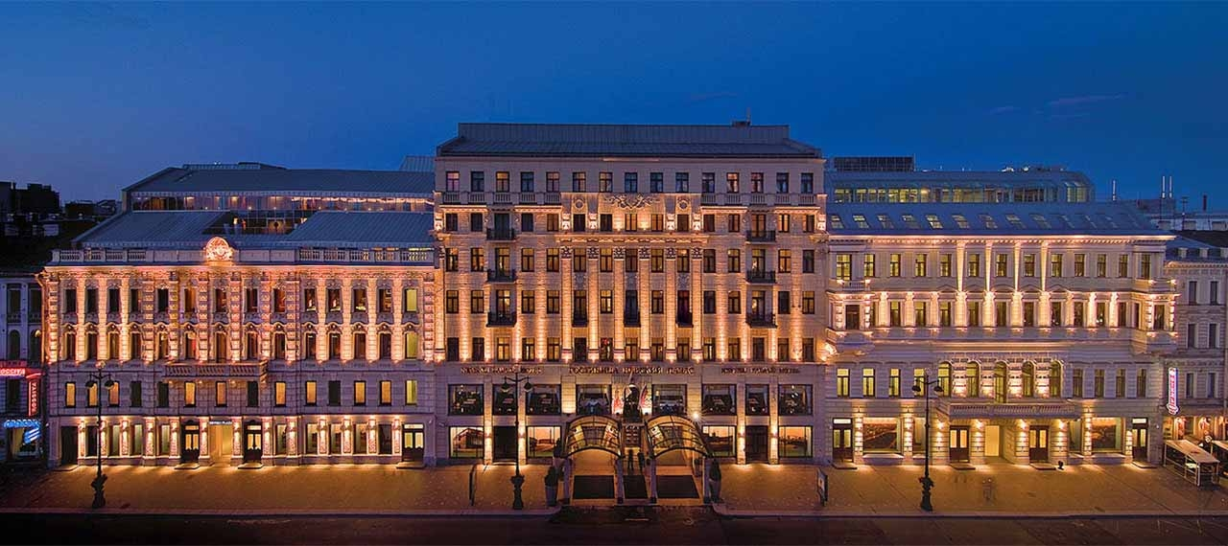
Thank you for your attention

Slide 22
Back-up slides

Slide 23
Extra dimensions: LHC limits
ADD model :
M_{D} > 4 TeV (for n_{ED} = 4)
real graviton production
(CMS, EPJC 75 (2015) 235)
M_{S} > 7 TeV (for n_{ED} = 4)
(HLZ convention)
virtual graviton exchange
(CMS, PLB 746 (2015) 79)
RS model :
m_{G*} > 2.7 TeV (for κ/M_{Pl} = 0.1 )
(ATLAS , PRD 90 (2014) 052005)

Slide 24
Dilepton production
Pseudorapidity cuts:
|η| ≤ 2.4 (muons)
|η| ≤ 1.44, 1.57 ≤ |η| ≤ 2.4 (electrons)
Efficiency: 85 %
K-factor:
1.5 for SM background
1.0 for signal

Slide 25
Uncertainties in search limit
(L = 30 fb⁻¹)
μ/2 →μ→2μ
PDF set (2.7%)
ΔL (3%)

Slide 26
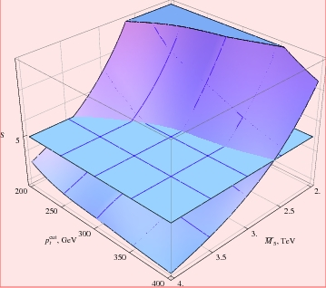
Statistical significance in RSSC for pp → e⁺e⁻ + X
as a function of 5-dimensional reduced Planck scale
M₅ and cut on electron transverse momentum p_{t}^{cut}
for 7 TeV (L=5 fb⁻¹) and 8 TeV (L=20 fb⁻¹)

Slide 27
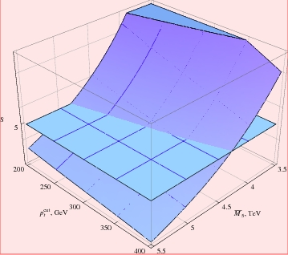
Statistical significance for the process pp → e⁺e⁻ + X
as a function of 5-dimensional reduced Planck scale
M₅ and cut on electron transverse momentum p_{t}^{cut}
for 13 TeV (L=30 fb⁻¹)

Slide 28
Graviton contributions in RSSC to the process
pp → μ+μ- + X (solid lines)
vs. SM contribution (dashed line) for 7 TeV

Slide 29
Graviton contributions in RSSC to the process
pp → μ+μ- + X (solid lines) vs. SM
contribution (dashed line) for 14 TeV

Slide 30
Weak logarithmic dependence
on energy comes from PDFs
(for fixed x┴)
dσ(grav): week dependence on curvature κ
30

Slide 31
dσ(pp→h^{(n)}→γγ) =
2 ∙ dσ(pp→h^{(n)}→l⁺l⁻)
universal for
all subprocesses
while in SM:

Slide 32
Effective gravity action
Shift
is equivalent to the change
Invariance of the action
rescaling of fields and masses:
Massive theory is not scale-invariant
From the point of view of 4- dimensional observer
these two theories are not physically equivalent

Slide 33
Randall-Sundrum solution
Does it mean that σ_{RS}(y) is a linear function for all y?
The answer is negative: one must use the periodicity condition first, and only then estimate absolute value |y|
In other words, extra coordinate y must be reduced to the interval -πr_{c} ≤ y ≤ πr_{c} (by using periodicity condition) before evaluating functions |x|, ε(x), …

Slide 34
Examples: definition of σ(y) outside interval |y| ≤ πr_{c}
Let y = πr_{c} + y₀ , where 0 < y₀ < πr_{c}
(that is, πr_{c} < y < 2πr_{c})
σ(y)+ C
κπr_{c}
κ(πr_{c} - y₀)
πr_{c}+ y₀
y
0
πr_{c}
2πr_{c}

Slide 35
RSSC model vs.ADD model
RSSC model is not equivalent to the ADD model with one ED of size R=(πκ)⁻¹ up to κ ≈10⁻²⁰ eV
Hierarchy relation for small κ
But the inequality
means that

Slide 36
(A.K, 2006)
where
36

Slide 37
37

