Slide 1

RD50 Status Report – June 2015
RD50
LHCC – 3.June 2015, CERN
Gianluigi Casse Michael Moll
University of Liverpool, UK CERN, Geneva, Switzerland
OUTLINE:
RD50 Collaboration
Scientific results
  Defect and Material Characterization
  Detector Characterization
  New Detector Structures
  Full Detector Systems
RD50 key results 2014/2015
RD50 Work Program 2015/2016
RD50 achievements

Slide 2
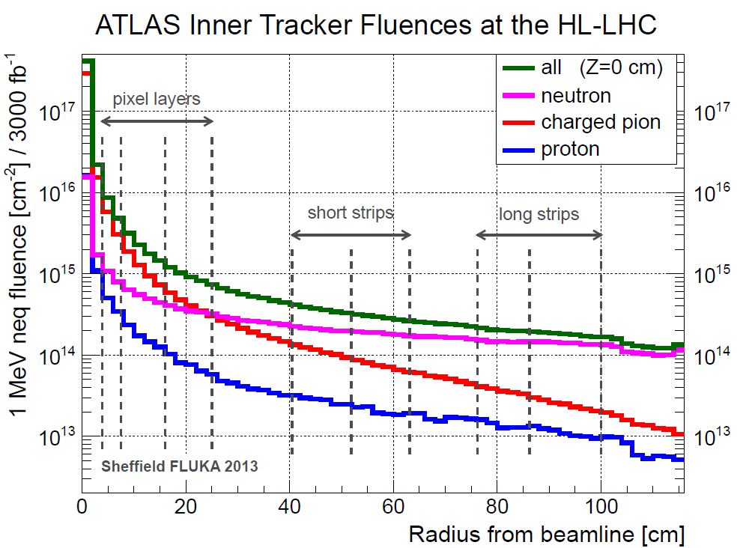
Motivation and Challenge
LHC upgrade (and beyond…. FCC)
  upgrade of the LHC to the High Luminosity LHC (HL-LHC) after LS3 (~2024)
  expected integrated luminosity: 3000 fb⁻¹ (x6 nominal)
[I. Dawson, P. S. Miyagawa, Sheffield University, Atlas Upgrade radiation background simulations]
Silicon detectors will be exposed to hadron fluences equivalent to more than 10¹⁶ n/cm²
➔ detectors used now at LHC cannot operate after such irradiation
  RD50 mission: development and characterization of silicon sensors for HL-LHC and beyond,
  analyze and understand radiation damage in silicon detectors
Notes:
HE: 16.5 TeV (CERN-ATS-2010-177)
Plot taken from Igor Mandic (Vienna 2013 presentation)

Slide 3
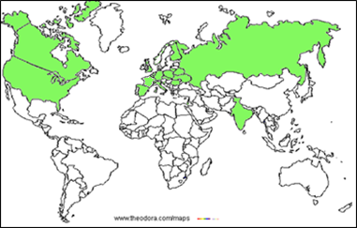
The RD50 Collaboration
RD50: 49 institutes and 275 members
41 European and Asian institutes
Belarus (Minsk), Belgium (Louvain), Czech Republic (Prague (3x)), Finland (Helsinki, Lappeenranta ), France (Paris, Orsay),
Germany (Dortmund, Erfurt, Freiburg, Hamburg (2x), Karlsruhe, Munich(2x)), Italy (Bari, Florence, Perugia, Pisa, Torino), Lithuania (Vilnius), Netherlands (NIKHEF), Poland (Krakow, Warsaw(2x)), Romania (Bucharest (2x)), Russia (Moscow, St.Petersburg), Slovenia (Ljubljana), Spain (Barcelona(2x), Santander, Valencia), Switzerland (CERN, PSI), Ukraine (Kiev),
United Kingdom (Glasgow, Liverpool)
6 North-American institutes
Canada (Montreal), USA (BNL, Fermilab, New Mexico, Santa Cruz, Syracuse)
1 Middle East institute
Israel (Tel Aviv)
1 Asian institute
India (Delhi)
No changes since last LHCC report in June 2014
Detailed member list: http://cern.ch/rd50

Slide 4
RD50 Organizational Structure
Co-Spokespersons
Gianluigi Casse and Michael Moll
(Liverpool University) (CERN PH-DT)
Defect / Material
Characterization
Mara Bruzzi
(INFN & Uni Florence)
Detector
Characterization
Eckhart Fretwurst
(Hamburg University)
New Structures
Giulio Pellegrini
(CNM Barcelona)
Full Detector
Systems
Gregor Kramberger
(Ljubljana University)
Characterization of
microscopic properties
of standard-, defect engineered and new materials pre- and post- irradiation
DLTS, TSC, ….
SIMS, SR, …
NIEL (calculations)
WODEAN: Workshop
on Defect Analysis in
Silicon Detectors
(G.Lindstroem & M.Bruzzi)
Characterization of test structures (IV, CV, CCE, TCT,.)
Development and testing of defect engineered silicon devices
EPI, MCZ and other materials
NIEL (experimental)
Device modeling
Operational conditions
Common irradiations
Wafer procurement (M.Moll)
Device Simulations (V.Eremin)
3D detectors
Thin detectors
Cost effective solutions
Other new structures
Detectors with internal gain
(avalanche detectors)
LGAD–Low Gain Avalance Det.
Slim Edges
HVCMOS
3D (R.Bates)
LGAD (V.Greco)
Slim Edges (V.Fadeyev)
LHC-like tests
Links to HEP
Links electronics R&D
Low rho strips
Sensor readout (Alibava)
Comparison:
- pad-mini-full detectors
- different producers
Radiation Damage in
HEP detectors
Test beams
(M.Bomben & G.Casse)
Collaboration Board Chair & Deputy: G.Kramberger (Ljubljana) & J.Vaitkus (Vilnius), Conference committee: U.Parzefall (Freiburg)
CERN contact: M.Moll (PH-DT), Secretary: V.Wedlake (PH-DT), Budget holder & GLIMOS: M.Glaser (PH-DT)

Slide 5
Defect & Material Characterization

Slide 6
Defect Characterization
space charge trapping leakage current
Aim of defect studies:
  Identify defects responsible for Trapping,
  Leakage Current, Change of N_{eff ,} Change of E-Field
  Understand if this knowledge can be used to mitigate
  radiation damage (e.g. defect engineering)
  Deliver input for device simulations to predict detector performance under various conditions
Method: Defect Analysis performed with various tools inside RD50:
    C-DLTS (Capacitance Deep Level Transient Spectroscopy)
    TSC (Thermally Stimulated Currents)
    PITS (Photo Induced Transient Spectroscopy)
    FTIR (Fourier Transform Infrared Spectroscopy)
    EPR (Electron Paramagnetic Resonance)
    TCT (Transient Current Technique)
    CV/IV (Capacitance/Current-Voltage Measurement)
    PC, RL, I-DLTS, TEM,… and simulation
  RD50: several hundred samples irradiated
  with protons, neutrons, electrons and ⁶⁰Co-γ
  … significant progress on identifying defects
  responsible for sensor degradation over last 5 years!
[R.Radu et al, JAP 117, 164503, 2015]
Example: TSC measurement on defects produced
by electron irradiation (1.5 to 27 MeV)

Slide 7
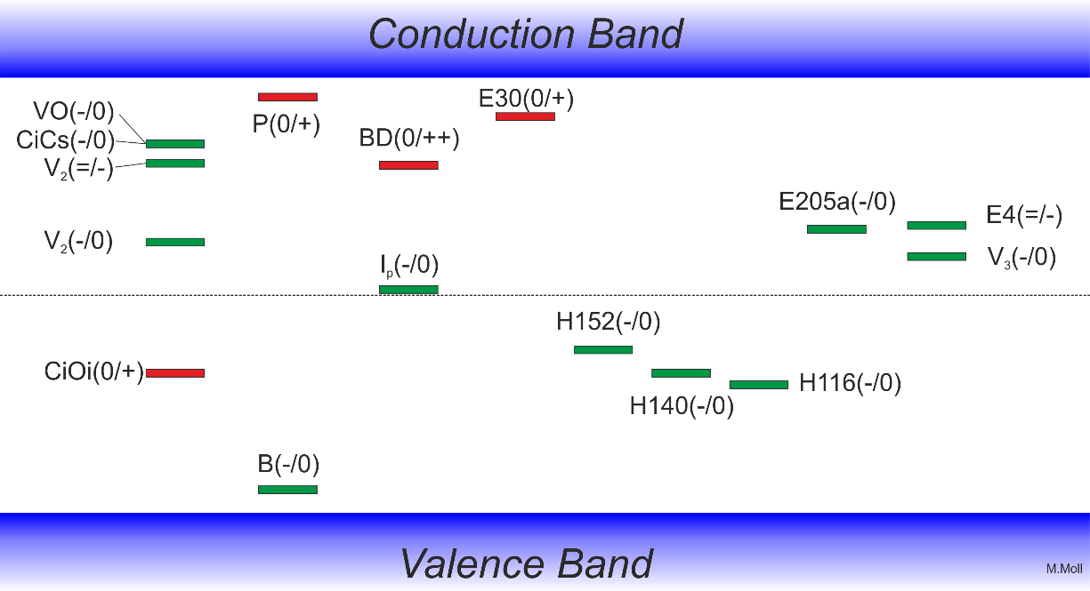
Summary on defects with strong impact on device performance after irradiation
Some identified defects
  Trapping: Indications that E205a and H152K are important (further work needed)
  Converging on consistent set of defects observed after p, π, n, γ and e irradiation.
  Defect introduction rates are depending on particle type and particle energy and (for some) on material!
positive charge (higher introduction after proton than after neutron irradiation, oxygen dependent)
positive charge (higher introduction after proton irradiation than after neutron irradiation)
Phosphorus: shallow dopant
(positive charge)
Leakage current: V₃
leakage current
& neg. charge
current after γ irrad,
V₂O (?)
Reverse annealing
(negative charge)
Boron: shallow dopant
(negative charge)
A table with levels and cross sections is given in the spare slides.

Slide 8
Electron Damage: Defects & NIEL
Study on defects concentrations and damage after electron irradiation (1.5 to 27 MeV)
  Aim: Understand defect generation as function of electron energy (“silicon recoil energy scan”)
  What is the threshold for defect cluster formation in terms of PKA (Primary Knock-on Atom) energy?
..type inversion during annealing
Example: 15 MeV e (2.2 x10¹⁴ e/cm²), STFZ
    Electrons above ≈ 3 MeV produce “cluster damage”
    Reverse annealing (N_{eff}) observed and matching the observed defect concentrations (H-defects)
Observation on the NIEL (Non Ionizing Energy Loss) for electrons below 30 MeV
  The leakage current damage factor (alpha) does not scale with the “classical NIEL”
  We had to use the “effective NIEL” as calculated by Molecular Dynamics (MD) calculations
  to describe the leakage current and the introduction of cluster related defects correctly
[Effective NIEL: Inguimbert et al., IEEE TNS 57 (2010)1915]
[more details: R.Radu et al, JAP 117, 164503, 2015]

Slide 9
Device Characterization & Simulation

Slide 10
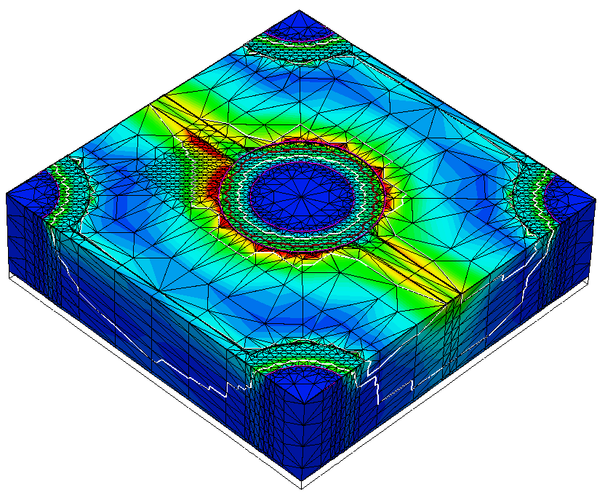
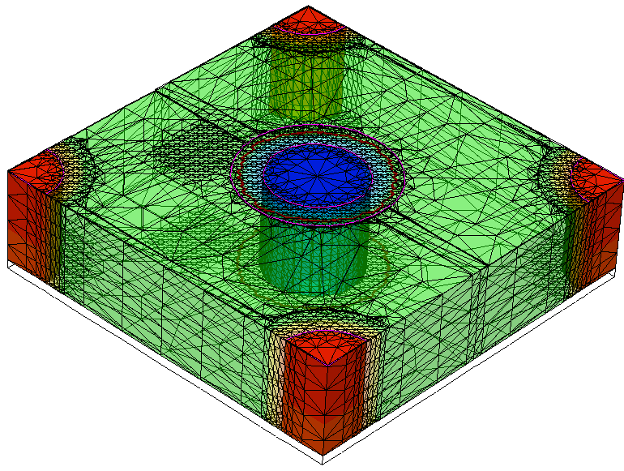

TCAD simulations
Why do we need TCAD simulations ?
  Complexity of the problem
    Coupled differential equations (semiconductor equations)
    Impact of defects depending on local charge densities, field-strength, … (“feedback loop”)
    Complex device geometry and complex signal formation in segmented devices ….
    Interplay of surface and bulk damage
    Example: 3D sensors
Electric field distribution in 3D detector (Al & oxide layer transparent for clarity)
Doping profiles
N_{p,n} = 5e18 cm⁻³
N_{bulk} = 1.7e12 cm⁻³
n⁺
LV
LV
LV
p⁺
V=0
Column depth =
bulk thickness
n⁺
Example of 3D sensor: T.Peltola (HIP, Helsinki): CMS & RD50
LV

Slide 11
RD50 Simulation working group
Aim: Develop simulations (TCAD input parameters) allowing to simulate performance of irradiated silicon sensors and performance predictions under various conditions (sensor design and material, irradiation fluence and particle, annealing,…).
  Close collaboration with CMS Tracker sensor simulation working group (A.Messineo)
  Example of results (simulation vs. measurement):
    Comparison between simulation results (Synopsis TCAD) and CMS test beam data (strip sensors)
    Surface damage included via interface charge layer.
[ T.Peltola, Vertex 2015– June 2015]
Simulations of irradiated devices in TCAD are getting predictive power!

Slide 12
Segmented Sensors with read-out at the n⁺ contact
(n-in-p or n-in-n)

Slide 13
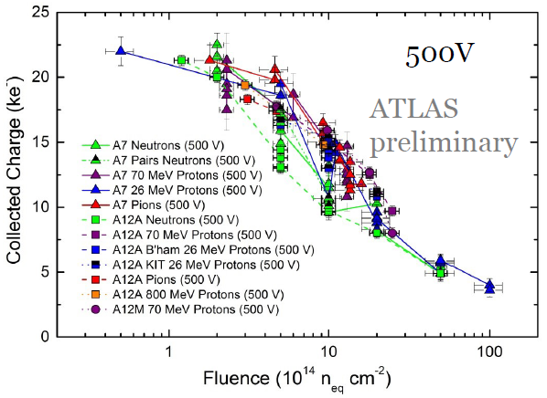
Reminder: Segmented sensors: n⁺ vs. p⁺ readout
p-type strip sensors with n⁺ readout (brought forward by RD50)
  are now the sensor choice for ATLAS and CMS Tracker upgrades
  n⁺-electrode readout (“natural in p-type silicon”):
    favorable combination of weighting and electric field in heavily irradiated detector
    electron collection, multiplication at segmented electrode
  Situation after high level of irradiation:
S. Wonsak, 25th RD50 Workshop Nov. 2014
p⁺ readout
n⁺ readout
[G. Kramberger, Vertex 2012]
p⁺
readout
n⁺
p⁺
n⁺
readout
holes
electrons

Slide 14
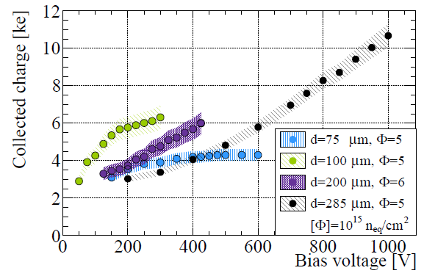
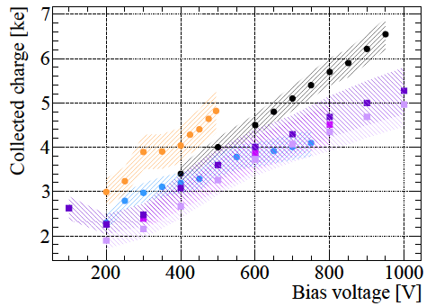
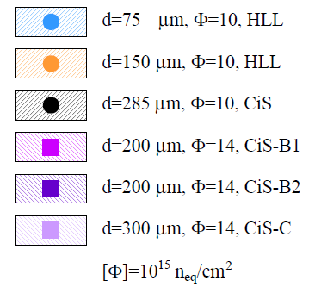
Thin p-type pixel sensors
Thin FZ p-type pixel sensors: 75 to 300 μm with 450 μm edge (MPI/CIS/VTT)
ATLAS FEI4, 25 MeV protons, 800 MeV protons, neutrons, data obtained with beta source
Detectors irradiated with 5 10¹⁵ n_{eq}/cm²
100μm thick sensors give more charge than 75μm thick sensors, both saturate with voltage
200 μm thick sensors give more charge
than 300 μm thick sensors at moderate voltage
Beam tests show 97-99% hit efficiency
(thickness tested 100 -200 μm, 500V)
Detectors irradiated
up to 1.4 10¹⁶ n_{eq}/cm²
Sensor modules
still functional (even
if in homogeneously
irradiated)
B. Paschen, 25th RD50 Workshop Nov. 2014
S. Terzo, 24th RD50 Workshop June 2014

Slide 15
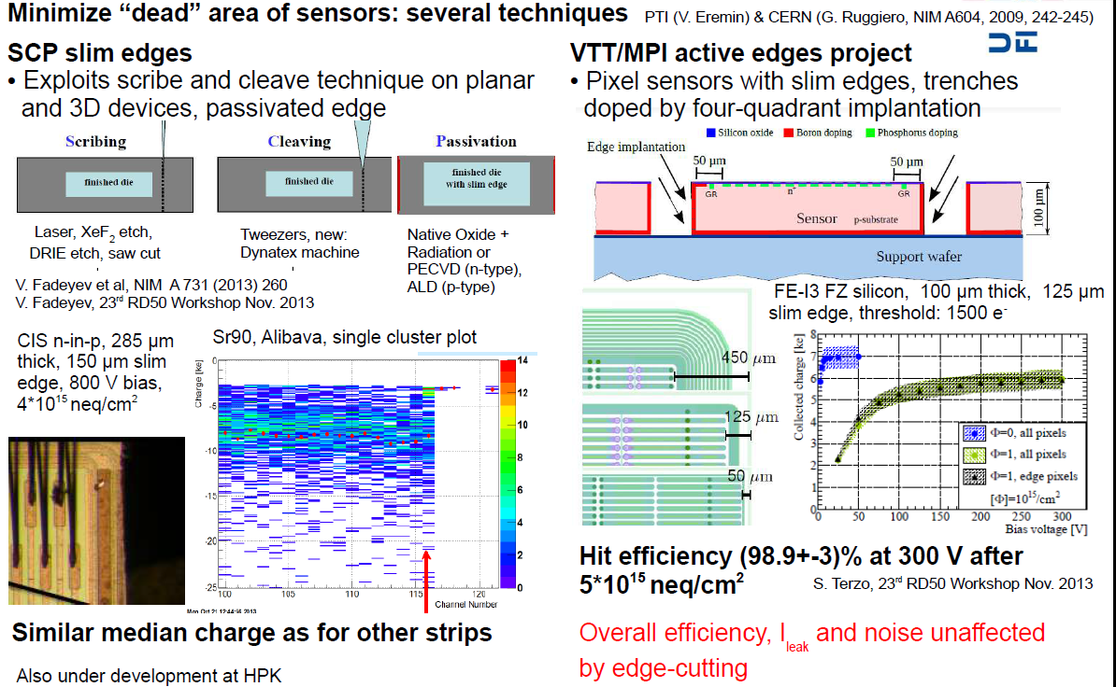
Slim Edges

Slide 16
New structures
Charge Multiplication
(Sensors with intrinsic gain)
HVCMOS
(towards monolithic sensors)

Slide 17
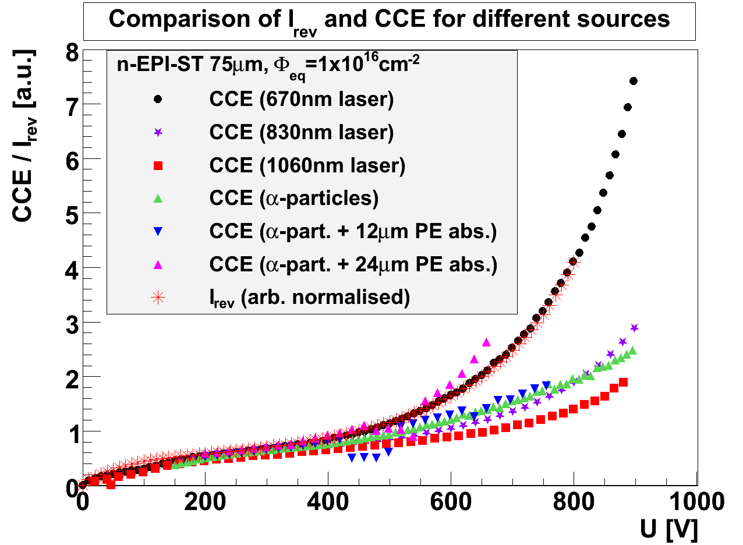
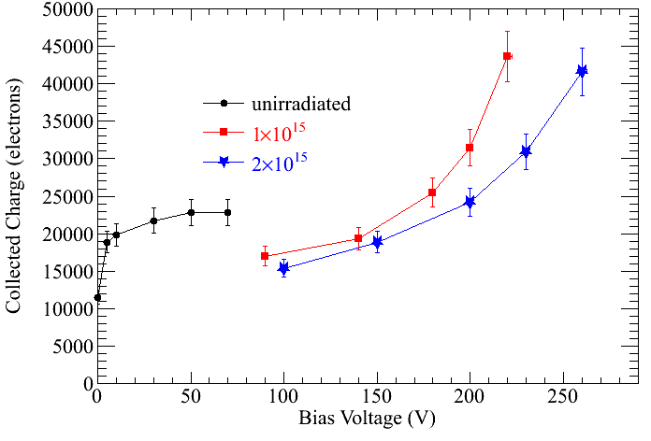
Reminder: Charge Multiplication
Charge Multiplication observed and characterized after high levels of irradiation
with different techniques and in several different types of devices
140 μm thick device
300 μm thick device
Diodes (Φ_{eq}=10¹⁶ cm⁻²)
Leakage Current & Charge Collection
Strip sensors (Φ_{eq}=5×10¹⁵ cm^{-2,} 26 MeV p)
Charge Collection (Beta source, Alibava)
Questions:
Can we simulate and predict charge multiplication ?
Can we better exploit charge multiplication?
3D sensors (Φ_{eq}=1-2×10¹⁵ cm⁻²)
Charge Collection (test beam)
Ref: Diode: J.Lange et al, 16th RD50 Workshop, Barcelona
Strip: G. Casse et al., NIMA 624, 2010, Pages 401-404
3D: M.Koehler et al., 16thRD50 Workshop, Barcelona

Slide 18
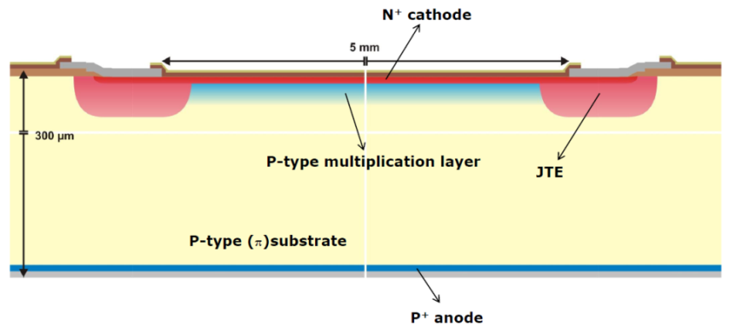
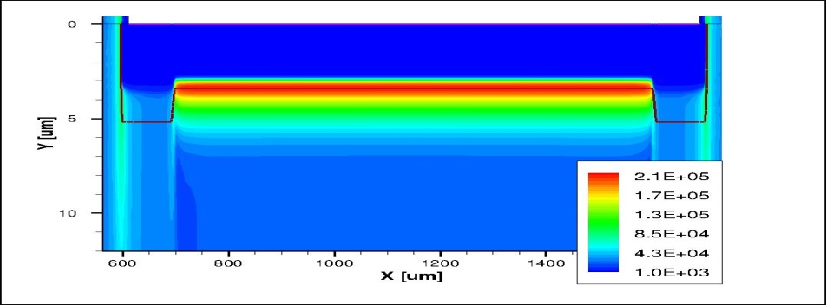
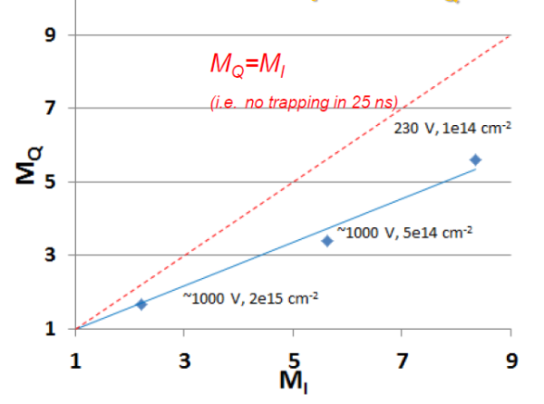
Low Gain Avalanche Detectors (LGAD)
[G.Pellegrini, 9th Hiroshima, 9/2013]
Diodes with implemented multiplication layer (deep p+ implant)
  APD concept [ n⁺⁺-p⁺-p-p⁺ structure] with JET (Junction Edge Termination)
  Gain of approx. 10-20 before irradiation : linear mode : spectra are Landau spectra (⁹⁰Sr)
Gain reduces with irradiation
  Dropping to about 1.5 after 2e15 n/cm²
    Why? Boron removal in p-type layer?
    Soon: Test of Gallium implants
  Charge (Sr-90) Multiplication
  versus Current Multiplication (Sr-90)
Further work ongoing (strip, pixel, …)
Test of timing capabilities (thin sensors)
  “Ultrafast sensors project”
N⁺⁺
N
P⁺
P
Simulation of E-Field [V/cm]
[G.Kramberger, RD50, June 2013]
[G.Kramberger, 22nd RD50 Workshop, Albuquerque, June 2013]

Slide 19
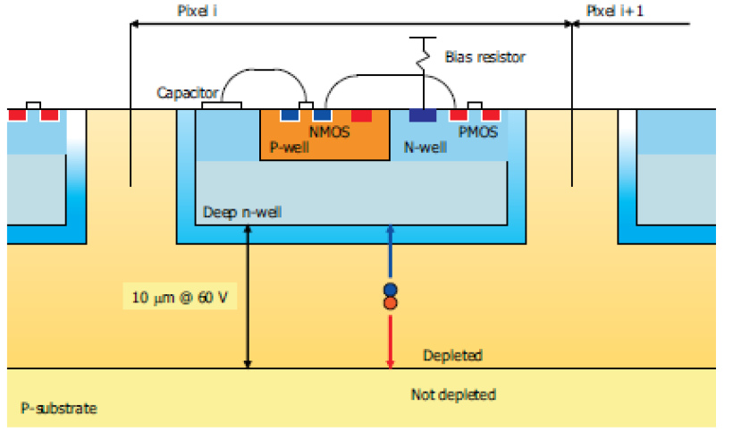
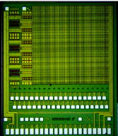
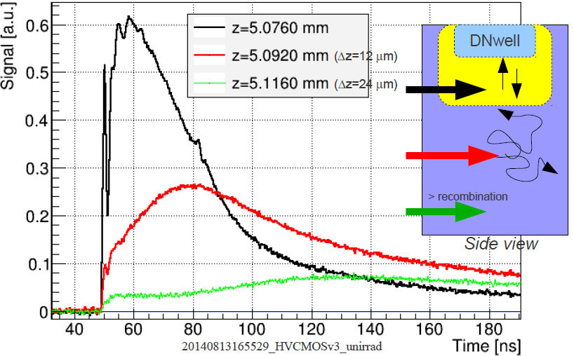
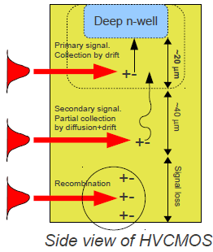
HVCMOS & monolithic devices
RD50 started to work on HVCMOS device characterization in 2014
  close collaboration with ATLAS HVCMOS group
  RD50 focus on characterizing radiation damage.
Typical HVCMOS device
  Depleted active pixel detectors implemented in CMOS process
  Sensor element is deep n-well in (usually) low resistivity (~10 Ωcm) p-type substrate
  Depletion with 60 V ~ 10 μm → charge collection via drift of ~1000 electrons
  Pixel and strip detectors possible
Edge-TCT measurements
HVCMOSv3
Edge-TCT
laser light
scan in y
fast readout amplifier
Drift and Diffusion component visible
M. Fernandez, 25th RD50 Workshop, Nov. 2014

Slide 20
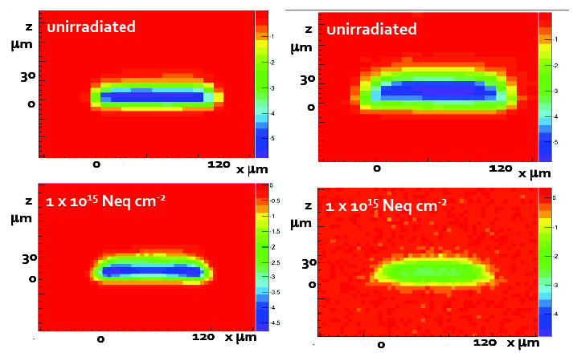
HVCMOS
Several HVCMOS devices tested after neutron irradiation up to 2x10¹⁶cm⁻²
  Example: HVCMOSv3; investigating 100 μm test structure
  Edge-TCT measurements
Signal: 3ns integration ; integration: 3-25ns
Total collected charge in 25ns
  For >80V the 10¹⁵ cm⁻² irradiated sample gives more charge than non irradiated
  After 2x10¹⁶ n_{eq}/cm² still ≈50% CCE !
Drift component t<3ns
contributing before and
after irradiation
Diffusion component
3ns < t <25ns
contributing before and
after irradiation
M. Fernandez and C.Weisser, 25th RD50 Workshop, Nov. 2014

Slide 21
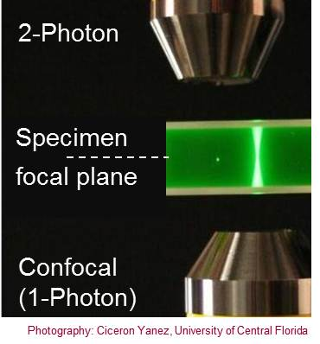
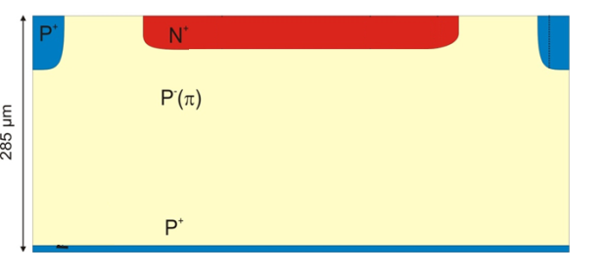
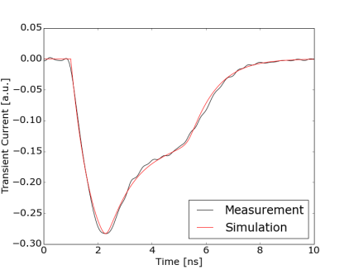
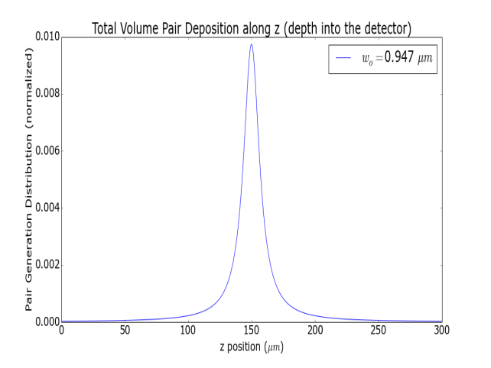
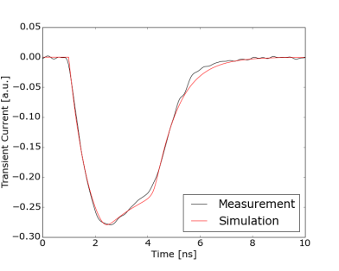
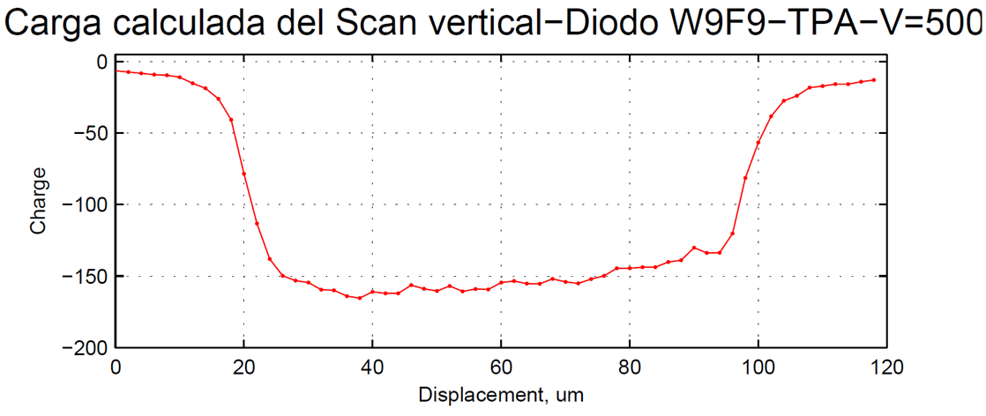
TPA – Two Photon Absorption
Two Photon absorption:
Investigation on a new technique
for sensor characterization (TPA – TCT)
  Deposition of charge at specific position in detector
  Laser: λ ∼ 1300 nm; P ∼ 50-100 pJ; ΔT ∼ 240 fs
  Proof of principle achieved:
Diode
Displacement
80 x n_{index_Si} ∼ 280 um
[I.Vila, 25th RD50 Workshop, CERN, November 2014]

Slide 22
Workplan for 2015/2016 (1/2)
Defect and Material Characterization (Convener: M.Bruzzi, INFN and University of Florence, Italy)
  Consolidate list of defects and their impact on sensor properties (Input to simulation group) including introduction rates & annealing for different type of irradiations and materials
  Extend work on p-type silicon including low resistivity material
    Understand boron removal in lower resistivity p-type silicon:
    Performance of MAPS, CMOS sensors, LGAD
  Review NIEL approach; Modeling and understanding role of clusters;
    Study of electron damage: Implement results into simulations
  Characterization of Nitrogen enriched silicon
Detector Characterization (Convener: E.Fretwurst, University of Hamburg, Germany)
  TCAD sensor simulations
    Cross-calibration of different simulation tools (ongoing)
    Refine defect parameters used for modeling (from effective to measured defects)
    Extend modeling on charge multiplication processes
  Extend experimental capacities on edge-TCT (implement set-up at more RD50 institutions)
    Parameterization of electric field (fluence, annealing time, etc.)
    Studies on charge multiplication processes
  Understand potential of Two Photon Absorption for sensor characterization
  Continue study on “mixed” irradiations
  Explore fluence range to10¹⁷cm⁻² (to prepare for future needs in forward physics)

Slide 23
Workplan for 2015/2016 (2/2)
New structures (Convener: Giulio Pellegrini, CNM Barcelona, Spain)
  Continue work on thin and 3D sensors (especially in combination with high fluence)
  Continue characterization of dedicated avalanche test structures (LGAD)
    Understand impact of implant shape and other geometrical parameters on avalanche processes
  Evaluate ‘low resistance strip’ sensors
  HVCMOS
    Continue characterization of existing devices (close collaboration with ATLAS HVCMOS working group)
    End of year: submission of first RD50 devise in an engineering run on AMS 35 process
Full detector systems (Convener: G.Kramberger, Ljubljana University, Slovenia)
  Further studies of thin (low mass) segmented silicon devices
  Study performance of thin and avalanche sensors in the time domain (Fast sensors!)
  Long term annealing of segmented sensors (parameterize temperature scaling)
  Continue study on “mixed” irradiations (segmented detectors)
  Continue RD50 program on slim edges, edge passivation and active edges
Links with LHC experiments and their upgrade working groups
  Continue collaboration on evaluation of radiation damage in LHC detectors
  Continue common projects with LHC experiments on detector developments

Slide 24
RD50 main achievements & links to LHC Experiments
Some important contributions of RD50 towards the LHC upgrade detectors:
p-type silicon (brought forward by RD50 community) is the base line option for the ATLAS and CMS Strip Tracker upgrades
n- MCZ (introduced by RD50 community) might improve performance in mixed fields due to compensation of neutron and proton damage: MCZ is under investigation in ATLAS, CMS and LHCb
Double column 3D detectors developed within RD50 with CNM and FBK. Development was picked up by ATLAS and further developed for ATLAS IBL needs.
RD50 results on very highly irradiated planar segmented sensors have shown that these devices are a feasible option for the LHC upgrade
RD50 data are essential input parameters for planning the running scenarios for LHC experiments and their upgrades (evolution of leakage current, CCE, power consumption, noise,….).
Charge multiplication effect observed for heavily irradiated sensors (diodes, 3D, pixels and strips). Dedicated R&D launched in RD50 to understand underlying multiplication mechanisms, simulate them and optimize the CCE performances. Evaluating possibility to produce fast segmented sensors?
Close links to the LHC Experiments:
  Many RD50 groups are involved in ATLAS, CMS and LHCb upgrade activities (natural close contact).
  Common projects with Experiments:
  Irradiation campaigns, test beams, wafer procurement and common sensor projects.
  Close collaboration with LHC Experiments on radiation damage issues of present detectors.

Slide 25
Recent key results
Progress in understanding microscopic defects
  Defects responsible for positive space charge in DOFZ, MCZ and EPI and defects provoking reverse annealing are characterized!
  Consistent list of defects produced covering electron, gamma, neutron and proton/pion damage
TCAD simulations : Good progress on simulations [Note: RD50 profiting from strong CMS simulation group]
  Commercial TCAD packages well understood and proved to be well adopted to our needs (defect description)
  Simulations can reproduce pulse shapes, depletion voltage, charge collection and leakage current. Getting predictive capabilities!
Systematic analysis of the Charge multiplication mechanism
  Noise issue particularly important for exploitation of this feature in Experiments
  New dedicated sensors produced to test avalanche effects, sensors working after irradiation
Consolidation of data obtained on p-type and thin segmented sensors
  Further results on radiation tolerance and further results on long term annealing
  Thin sensors seem to extend fluence reach of silicon detectors; Optimization: Optimum thickness depends on many parameters !
Slim and active edges
  Further progresses towards reduction of insensitive area (edges) of detectors
New structures based on mixed technologies
  Exploitation of DRIE etching: 3D-trench electrode, semi-3D sensors; planar strip with trenched electrodes, active edge planar pixel, ….….; Use of deep implantation for controlling avalanches.
Use of tools developed in framework of RD50: ALIBAVA & Edge-TCT & Beam telescope
  Edge-TCT and TCT systems are now produced centrally and can be procured by interested groups
  Use of the ALIBAVA readout system in many RD50 institutions

Slide 26
Spare Slides
Some spare slides
More details on http://www.cern.ch/rd50/
  Most results presented here have been shown on the last RD50 Workshop

Slide 27
Summary on defects with strong impact on device performance after irradiation
Most important defects [for details and references see JAP 117, 164503, 2015]

Slide 28

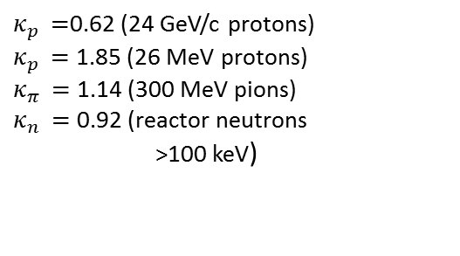
Reminder: NIEL – Non Ionizing Energy Loss
Displacement damage functions
1 MeV neutron equivalent damage
1
$Φ_{eq}=$ ${κ_{x }Φ}_{x}$
$κ_{p }=$0.62 (24 GeV/c protons)
$κ_{p }=$ 1.85 (26 MeV protons)
$κ_{π }=$ 1.14 (300 MeV pions)
$κ_{n }=$ 0.92 (reactor neutrons
>100 keV)
1 MeV
Hypothesis: Damage parameters scale with the NIEL
  Be careful, does not hold for all particles & damage parameters (see later)

Slide 29
NIEL for electron damage
Non Ionizing Energy Loss (NIEL)
  Used to calculate effective damage
  for different particles with different
  energy.
  Normalization usually to 1 MeV neutron
  equivalent damage
  Study on the validity of NIEL for electrons
  in the range of 1.5 MeV to 27 MeV
  Two approaches:
    a) Classical NIEL (our standard; based on two body elastic collisions between PKAs, 0K)
    b) Effective NIEL (Molecular Dynamics calculations taking into account many body interactions)
[Effective NIEL: Inguimbert et al., IEEE TNS 57 (2010)1915]
[R.Radu et al, JAP 117, 164503, 2015]

Slide 30
Ratio of cluster to point defects
[more details: R.Radu et al, JAP 117, 164503, 2015]

Slide 31
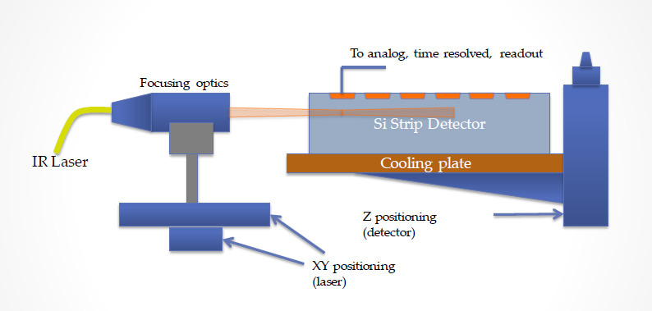
Edge-TCT to Study Fields
[Edge-TCT, G. Kramberger, IEEE TNS, VOL. 57, NO. 4, AUGUST 2010, 2294]
Study of Electric field inside silicon sensor very challenging problem
New tool (2010): Edge-TCT (Transient Charge Technique)
  Illuminate segmented
  sensor from the side with
  sub-ns infrared laser pulses
  Scan across the detector
  thickness
  Record current pulses
  as function of depth
  Extract rise time and
  collected total charge
  Reconstruct the electric field
Expectations
  Significant electric field only in depleted volume
  Charge generated in ‘undepleted’ part of detector is lost
[N.Pacifico, 20th RD50 Workshop, Bari, 2012]

Slide 32
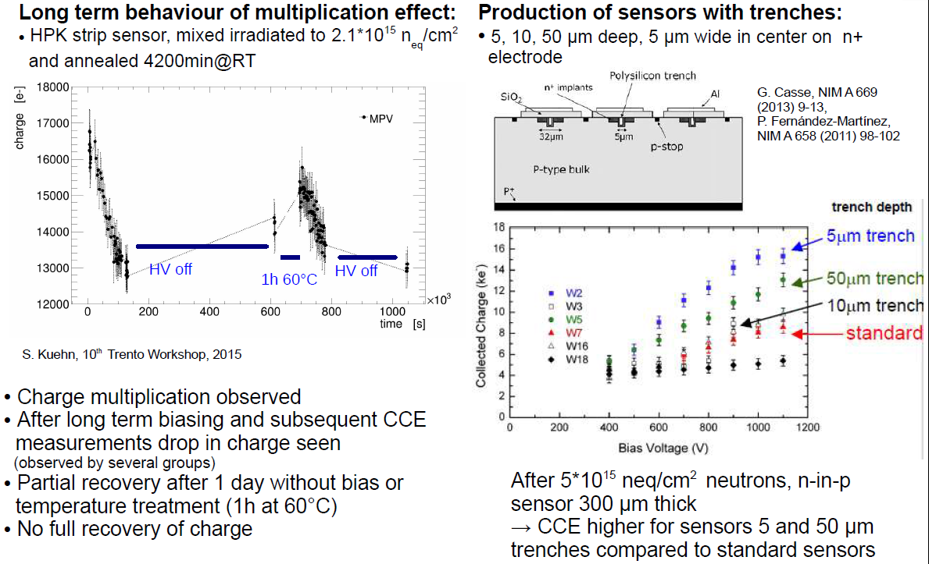
Charge Multiplication

Slide 33
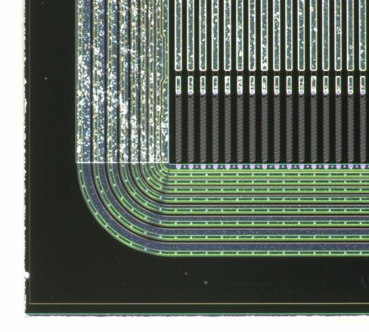
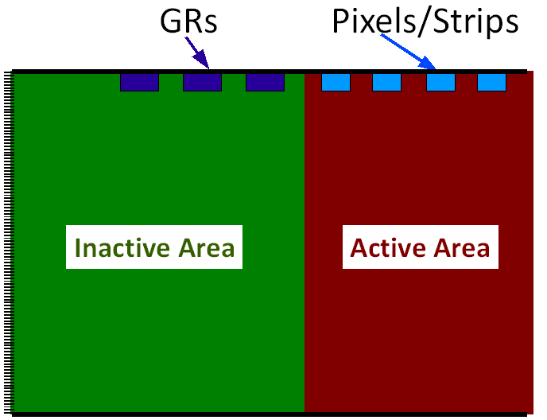
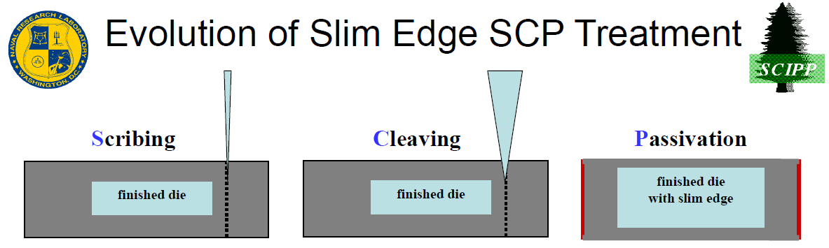
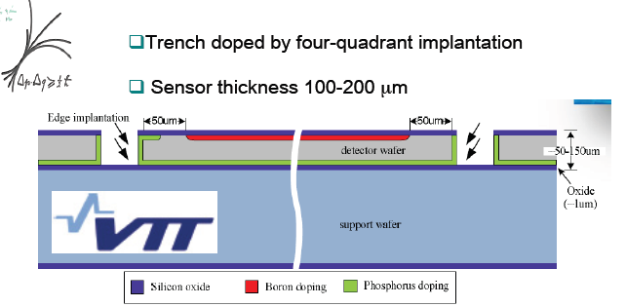
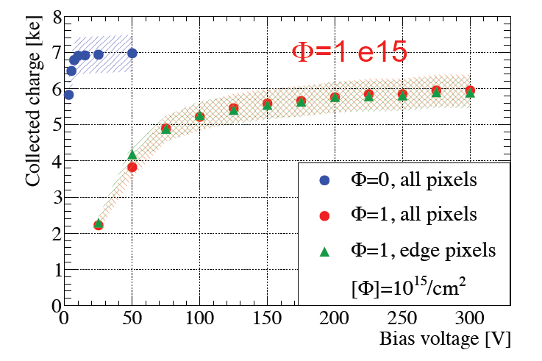
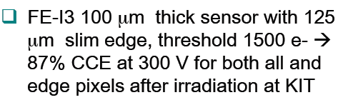
New structures: slim and active edges
RD50 slim edges project (reduce dead space around the active sensor)
active area
slim edge
  Scribe XeF₂ etch, diamond scribe, DRIE
  Cleave automated, manual
  Passivate nitride, oxide (n-type)
  alumina ALD (p-type)
inactive area
guard rings
[V. Fadeyev, 22nd RD50 Workshop, Albuquerque, June 2013]
… development picked up by HPK (see Hiroshima Symposium 9/2013)
Active edges (VTT & MPI Munich)
  Thin wafers with active edges produced at VTT [ A.Macchiolo, 22nd RD50, Albuquerque, June 2013]
10¹⁵ p/cm²
^{Testbeam:}
no difference between edge and other pixel!

Slide 34
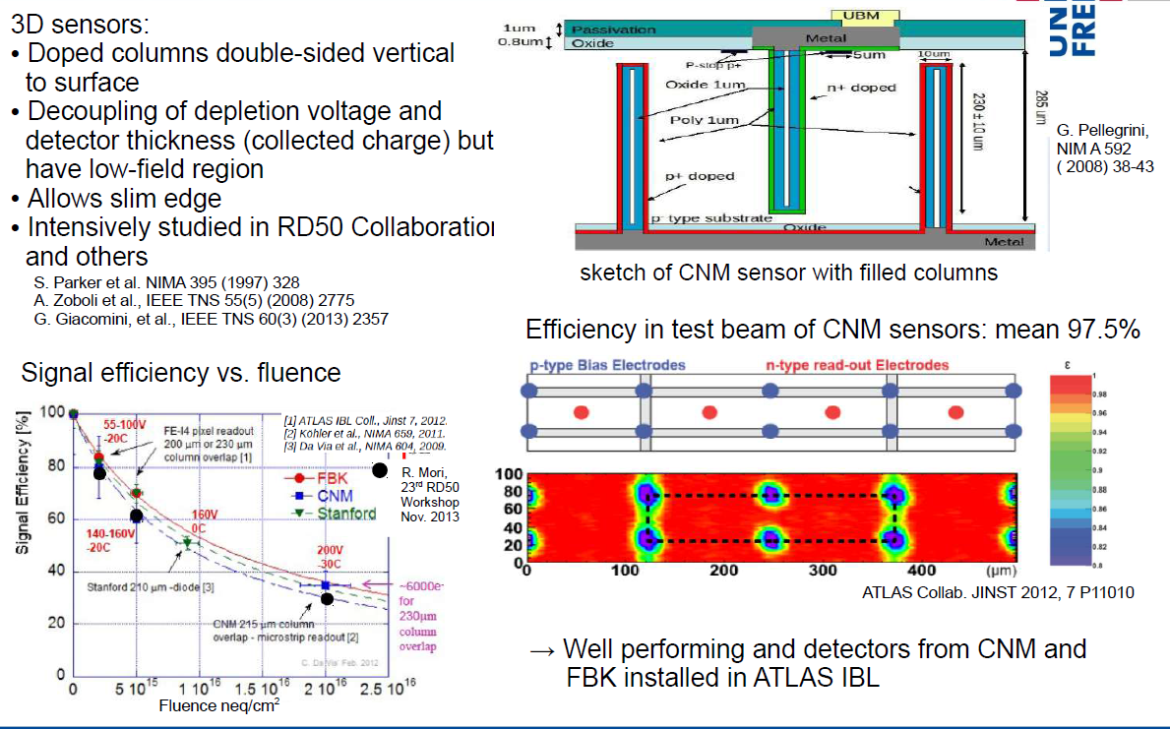
3D

