Slide 1
LHC BPM Timing Specs – 1st thoughts
Upgrade of the LHC BPM electronics (for HL-LHC):
  Keep existing infrastructure
    Beam pickups, cables, fibers, VME system, etc.
  Upgrade of analog, DAQ and trigger electronics
    Minimalistic analog front-end
      Preferable time-multiplexed single channel for 2 BPM electrodes
    Digital direct downconversion (DDC) technique
      Convolution integral or I/Q mixing?
    Internal ADC and FPGA clocks with ultra-low sub-ps jitter!
    External RF bucket tagging trigger!
Relaxed external timing requirements:
  RF bucket synchronous trigger signals in 2.5 ns increments
    Jitter & drift effects <<1 ns
    Needs to be supplied to each BPM DAQ electronics
      Of course separate trigger signals for B1 and B2

Slide 2
Conceptual Idea
convolution
based DDC
or
I/Q mixer
delay
line
BPF
filtering &
decimation
B
A
Att
LNA
ADC
CIC
CIC
FIR
FIR
Ctrl
single
or
dual (I/Q)
BPF response
waveform
or
NCO
analog signal conditioning
CLK & Timing
beam pickup
Brute-force digitalization
  E.g. TI ADC12J4000
    12-bit, 4 GSPS, SFDR ≈ 67 dBFS, SINAD ≈ 55 dBFS (@350MHz)
    Intergraded DDC, decimation by 4 or 8 (400MHz pass-band)
      SFDR ≈ 75 dBFS, SINAD ≈ 63 dBFS (@600MHz)
  Internal CLKs for ADC and FPGA
  External 40 MHz trigger (2.5ns steps) for bunch tagging (memory)
Single analog processing channel
  Based on delay-line networks and band-pass filters
digital direct downconversion:
- convolution integral
- I/Q mixing

Slide 3
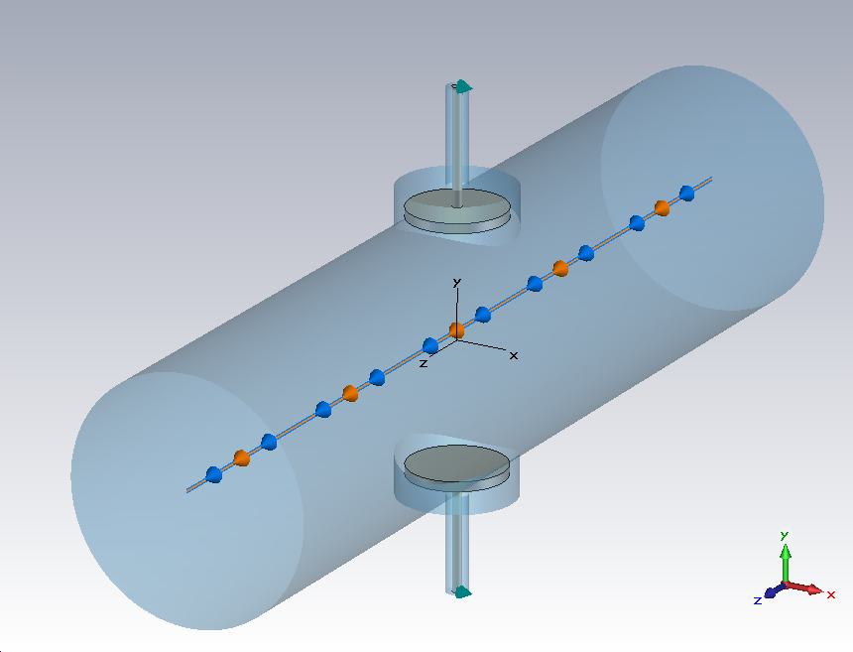
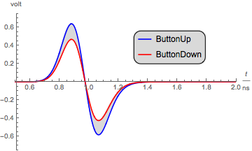
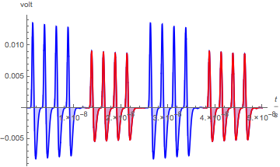
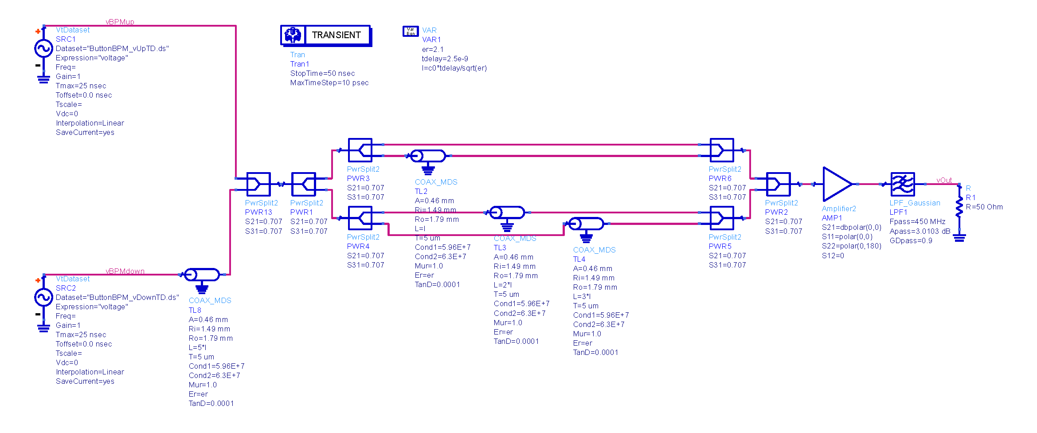
Analog Signals
d_{pipe}: 25 mm
d_{button}: 10 mm
beam pickup signal
Gaussian bunch:
  n=1E10, σ=25mm, v=c₀
  vertical offset=1mm
BPM sensitivity:
  e.g.: 2.7 dB / mm
conditioned analog signal
up
down
up
down
400 MHz delay-line filter network
12.5 ns delay-line
25 ns
25 ns

Slide 4
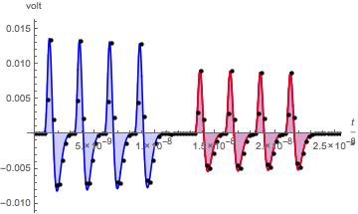
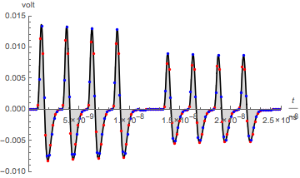
Waveform Sampling Options
4 GSPS = 250 ps sample spacing
  100 samples per 25 ns with single ADC
    50 samples per electrode signal, but only 20…24 samples ≠ 0
  200 samples per 25 ns with two interleaved ADC in I/Q operation
Requires low CLK jitter within 25 ns time interval
  E.g. t_{a} = 0.15 ps -> 68.5 dB@400 MHz
  (equivalent to EOB=11.1)

