Slide 1
Model for a
Azerbaijan Cloud Data Centre for Science
CERN April 24th 2015

Slide 2
Overview
Why Clouds for Scientific Computing
CERN’s Cloud infrastructure
Model for the evolution of a Cloud based data centre for science
Discussions

Slide 3
Why Clouds?
Clouds offer flexibility
  user workloads and system requirements are decoupled
  dynamic allocation of resources
  commercial and non-commercial providers
Based on established, open technology and protocols
  expertise is widely available
  products and tools evolve rapidly
  commercial and non-commercial users
Proven scalability
  small in-house systems to world wide distributed systems

Slide 4
CERN Cloud use-cases
Compute intensive physics computing
  More than 90% of our resources
  Linux VMs, managed LHC experiments
  Many identical machines
    “Cattle”, low SLA
Service nodes, personal VMs
  Webservers, development boxes, etc.
  Includes Windows VMs
  I/O intensive
  Huge variety of machines
    “Pets”, often requiring high uptime
Both require high level of automation

Slide 5
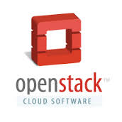
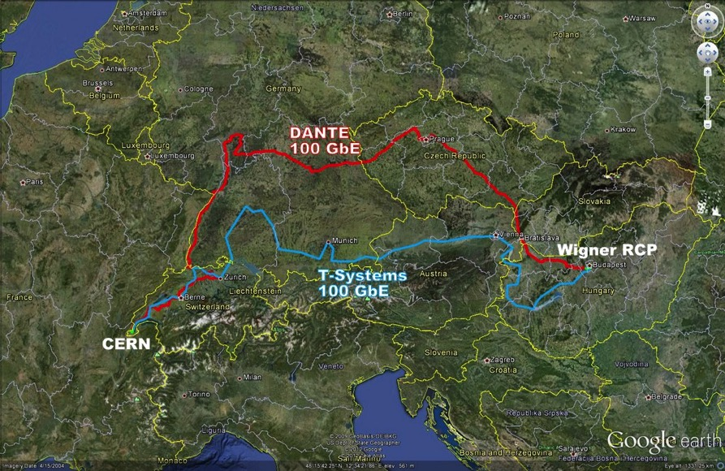
CERN Private Cloud - Numbers
Based on OpenStack Juno
Spans between 2 datacentres
5000 hypervisors
  120000 cores
11000 VMs
1500 users
1800 projects

Slide 6

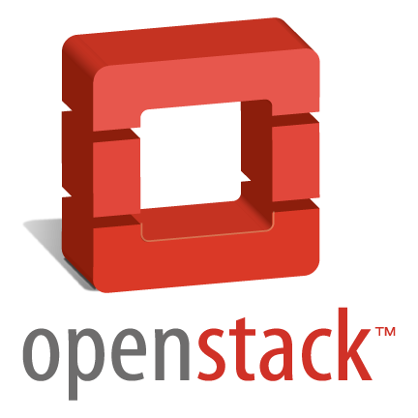
Block Storage
Ceph & NetApp
CERN Accounting
CERN Network Database
Ceilometer
Cinder
Account mgmt system
Network
Compute
Keystone
Scheduler
Microsoft Active Directory
Nova
Horizon
Glance
Database Services
Notes:
Account Management Automation
CERN legacy network database
No Neutron yet

Slide 7
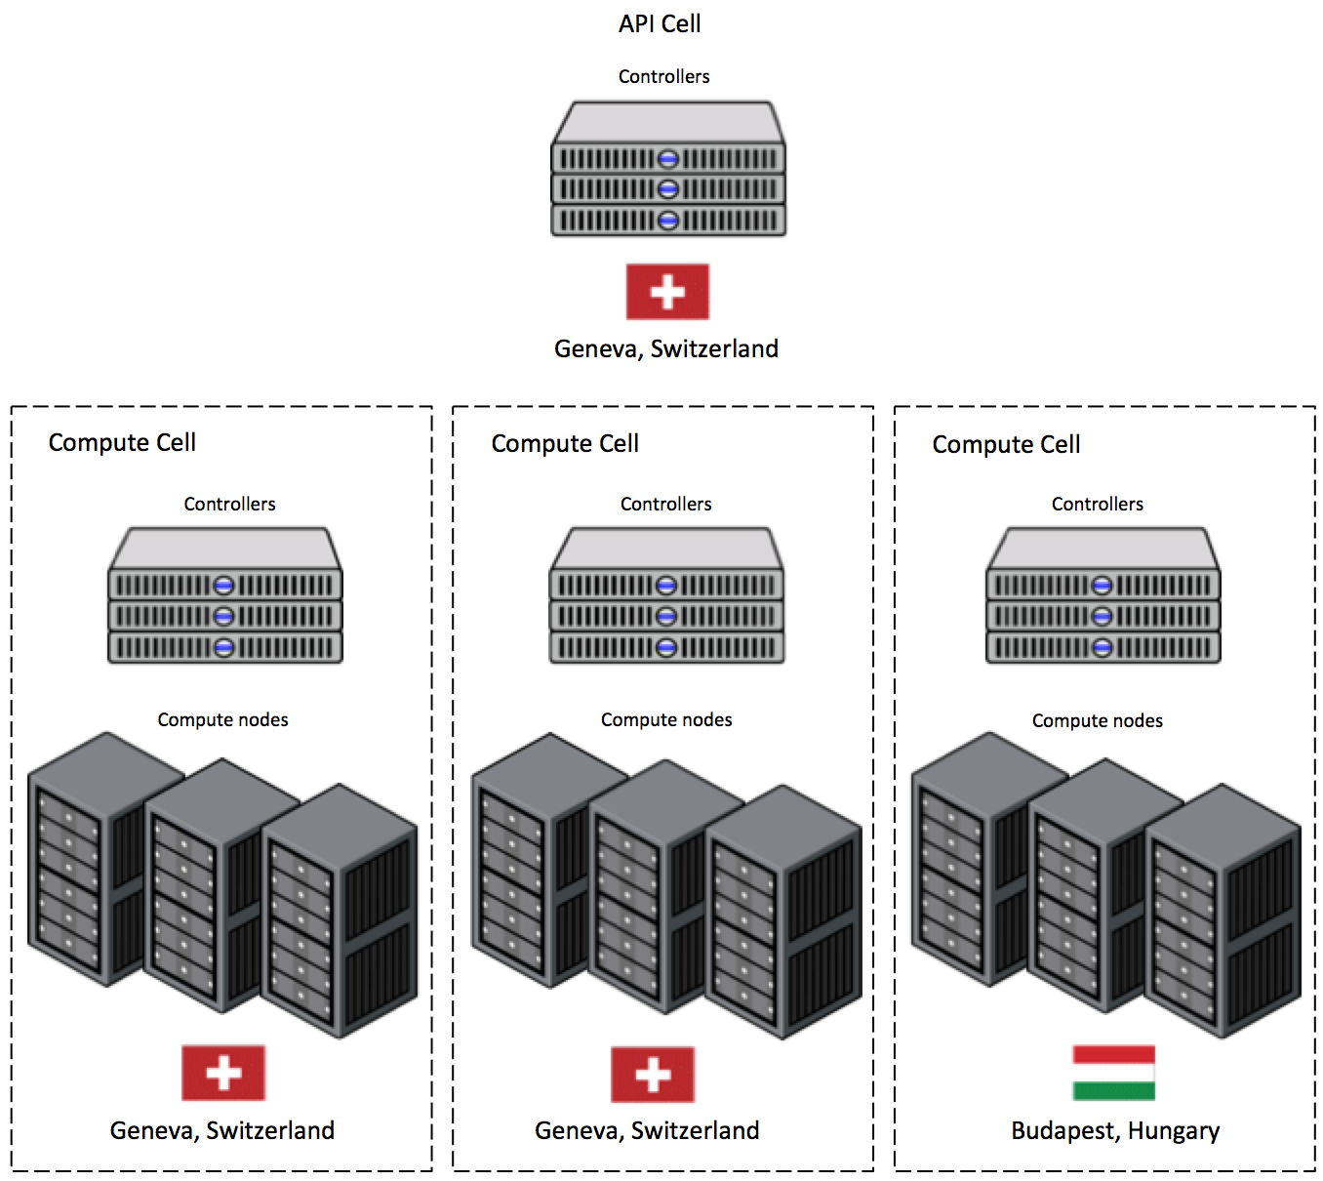
Scaling based on Nova Cells
Groups of 200 – 1000 hosts configured as a tree
Add cells to grow the deployment
CERN: 5000 servers in 15 cells

Slide 8
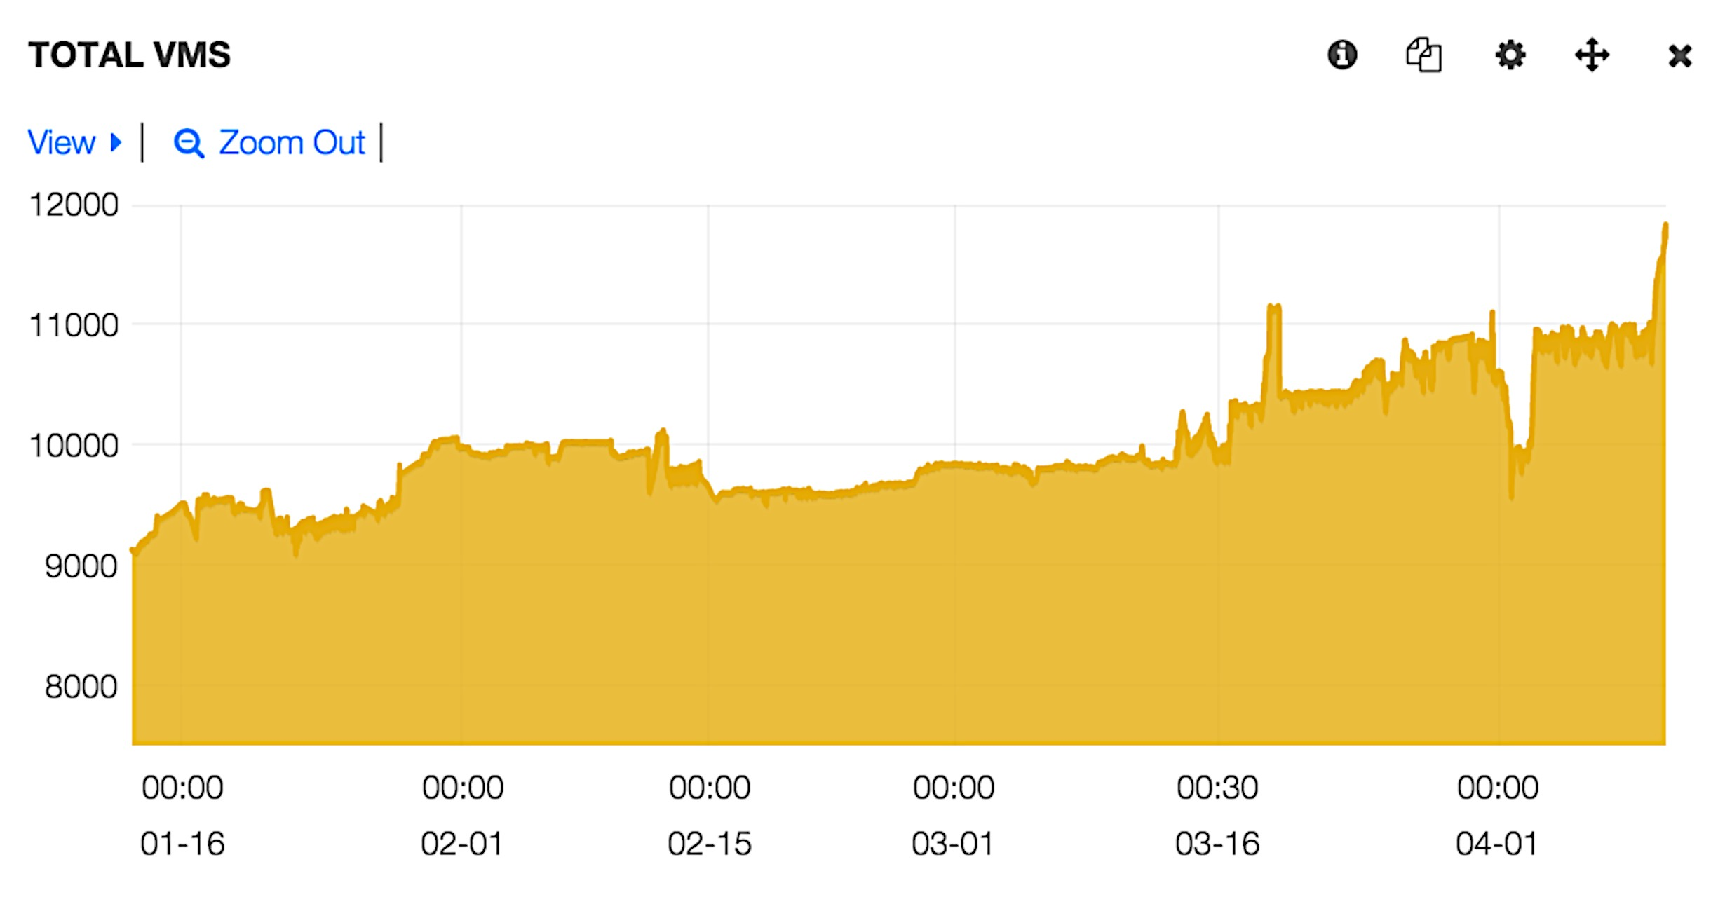
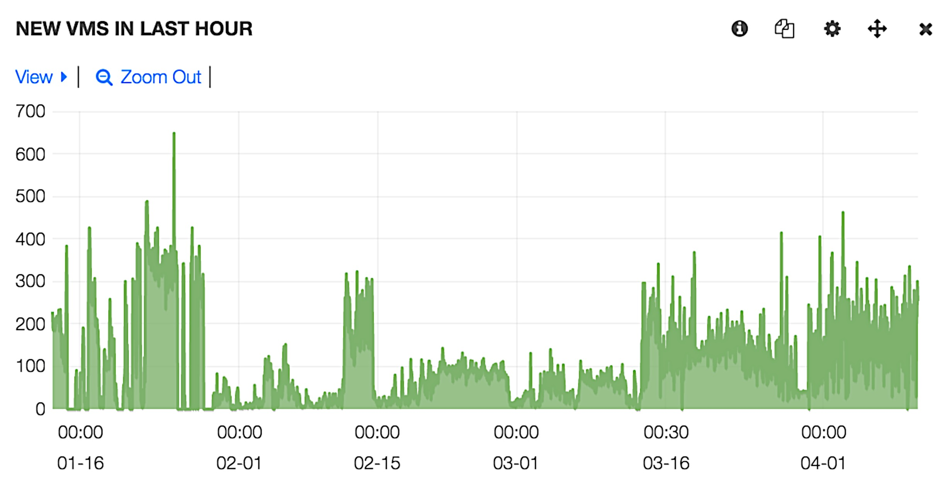
CERN Cloud usage figures
Number of VMs booted since July 2013
Notes:
- Creation (and deletion!) rates of 100s on VMs per hour
Booted more than 1M VMs in first 18 months
Number of running VMs now exceeds 10000

Slide 9



Storage for Science at CERN
Cloud based storage for cloud services
  OpenStack Cinder
    Ceph reliable backend
EOS for Physics research
  XROOTD and HTTP
    for high performance
  Kerberos and X509
    for Grid and local usage
  scalable to >>100PByte
CASTOR
  tape archive system
  >>100PByte
  forever

Slide 10
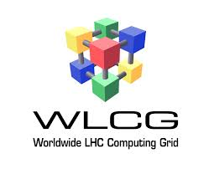
WLCG Experience
Avoid:
  “Everything has to work before anything works”
Computational resources are manageable
  everything is transient
  partial systems are already useful
  scaling/replacing is straight forward
Storage is difficult
  partial system is useless
  reliability&availability a must
  adding/replacing is complex
→ Multiphase deployment model works best

Slide 11



Possible deployment scenario: L1
Start with subset of OpenStack components
  Nova, Keystone, Glance, Neutron, Horizon, Ceilometer
Use modern fabric/config management tools
  kickstart, puppet, nagios etc.
Deploy using off-the-shelf components
  Commercial distributions exist
    incl. training and support
  CERN uses the RDO community distribution
    with Puppet modules
Integrate this into your operations infrastructure
  Server deployment, monitoring, maintenance

Slide 12
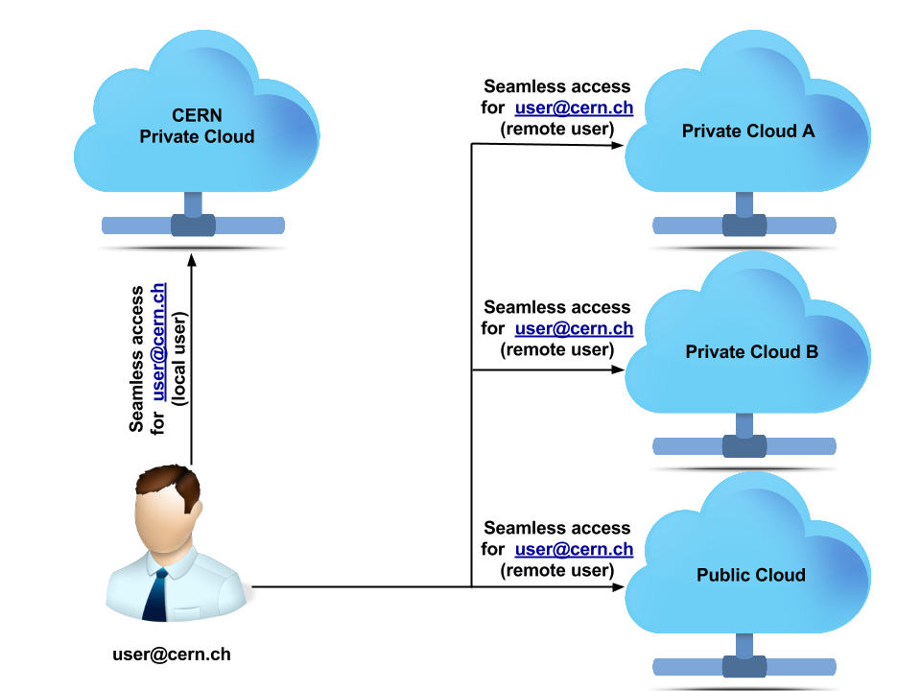




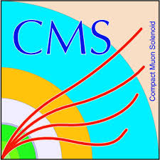
Configure OpenStack Federation
  l
  Federated access to resources in different clouds
local user

Slide 13
Azerbaijan Cloud Data Centre L1
Can be deployed gradually
  machines can be added as they get ready
Can be used by LHC users like CERN
  data and higher level services at CERN
  including accounting/crediting
Can provide computing resources to local users through cloud interfaces
Can be evolved without disruption

Slide 14


Azerbaijan Cloud Data Centre L2
Computing resources + local services
  improved efficiency (latency hiding)
Add OpenStack Cinder block storage
  with CEPH as a backend
  can be used by local (caching) services
    deployed in VMs (scalable)
    Squid, cvmFS.....
    staging services
Allows local users to deploy services

Slide 15
Azerbaijan Cloud Data Centre L3
Computing and Storage Cloud
Adding local storage
  CEPH backend can be scaled
  Can be offered to users via standard interfaces
    SWIFT, Cinder, S3, RADOS ...
Local users can use this directly
  Cloud object store or file system
WLCG users
  via VM based Grid Storage elements (EOS)
This can grow into a WLCG T2/T1 centre

Slide 16
What is needed ?
Expertise for setting up the system
  unix/linux sysadmins (2-3 for 2k nodes)
    training of OpenStack (commercially available)
  fabric knowledge
    racks, electrical system, cooling, cabling...
Estimated time line for L1(difficult prediction)
  “core servers” : few weeks + training
  Configuration of Federation: week
  Hypervisors and nodes can be added gradually

Slide 17
Discussion
contacts for technical discussions:
ian.bird@cern.ch
tim.bell@cern.ch
jan.van.eldik@cern.ch
markus.schulz@cern.ch

