Slide 1
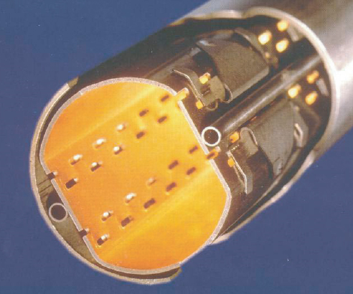
WP4
Cryogenic Beam Vacuum System Conception
Cryo Beam Vacuum
Work Distribution
Francis Perez

Slide 2
Team
Japan
KEK
Finland
TUT
CERN | IEIO
KIT | Germany
INFN | Italy
ALBA | Spain
CIEMAT | Spain
STFC | United Kingdom
United Kingdom
STFC, UNILIV, UOXF
Netherlands
UT
Germany
KIT, TUD
France
CEA, CNRS
CERN
Switzerland
EPFL, UNIGE
Italy
INFN
Spain
ALBA, CIEMAT

Slide 3
Tasks
^{Task} ^{4.1:} ^{Work Package Coordination}
^{Task} ^{4.2:} ^{Study beam} ^{induced vacuum effects}
^{Task 4.3: Mitigate beam} ^{induced vacuum effects}
Task 4.4: Study vacuum stability at cryogenic temperature
Task 4.5: Develop conceptual design for cryogenic beam vacuum system
Task 4.6: Measurements on cryogenic beam vacuum system prototype

Slide 4
Manpower

Slide 5
Francis Perez
CERN
Oleg
Reza
2x PhD Student
CERN
Manpower – WP4
Carles Collderam
Raquel Monge
1x PhD Student
CERN
Erhard Huttel
Roberto Cimino
1x Post Doc
CERN
Roberto Cimino
1x PhD Student
CERN
JM Perez
2 x Mech Eng
CERN

Slide 6
WP4 – Kickoff Meeting
WP4 - Kickoff meeting
Wednesday, June 3rd, 2015
Report by Task Leaders |  |  | Each task leader should expose:
 |  |  | - The objective of his task
 |  |  | - How it relates to the other tasks
 |  |  | - The execution plan
 |  |  | - The man power structure of his team & status new recruitment
14:00 | 14:15 |  | Welcome
14:15 | 14:30 | Task 4.1 | Coordination | Francis Perez | ALBA
14:30 | 15:00 | Task 4.2 | Study Beam Induced Vacuum Effects | Carles Collderam | ALBA
15:00 | 15:30 | Task 4.3 | Mitigate beam induced vacuum effects | Oleg Malyshev | STFC
15:30 | 16:00 |  | Coffee break
16:00 | 16:30 | Task 4.6 | Measurements of prototype | Erhard Huttel | KIT
16:30 | 17:00 | Task 4.4 | Study vacuum stability at cryogenic temperature | Roberto Cimino | INFN
17:00 | 17:15 | Task 4.5 | Develop design cryogenic beam vacuum system
17:15 | 17:45 |  | Mechanical stability of the beam screen during magnet quench | Cedric Garion | CERN
17:45 | 18:00 |  | Discussion | All
19:00 |  |  | Dinner WP4
Thursday, June 4th, 2015
09:00 | 10h30 |  | Joint session with WP2 - Arc Design
10:30 | 11:00 |  | Coffee break
11:00 | 12:30 |  | Joint session with WP5 - Magnets
12:30 | 14:00 |  | Lunch
14:00 | 15:30 |  | Summary and wrapup
15:30 | 16:00 |  | Coffee break
16:00 | 17:00 |  | Plenary discussion all WP

